Slide 1
Sprint 11 Show and Tell 10 January 2024
G Squad
Digital Team

Slide 2
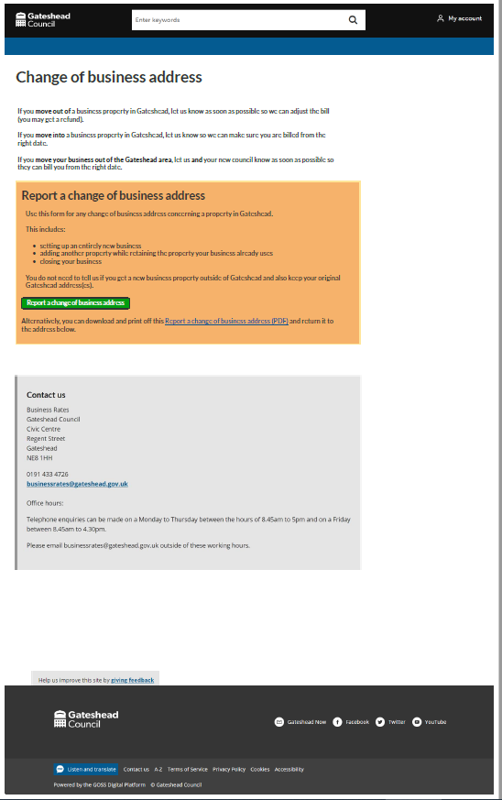
Sprint 11.
Business rates change of address - Discovery – Engage process (GW)
Wireframe / UX (KS)
Form dev progress (DC)

Slide 3
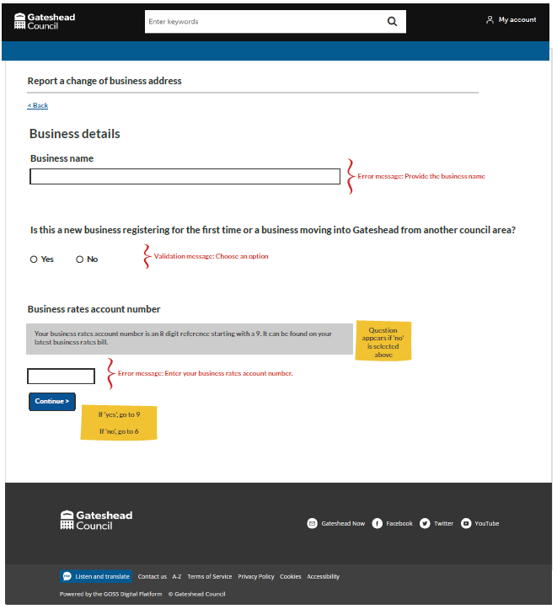
Sprint 11.
Business rates change of address

Slide 4
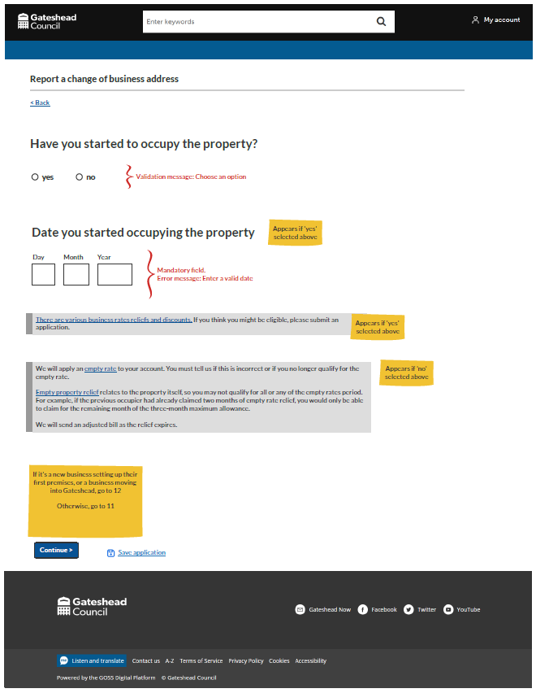
Sprint 11.
Business rates change of address

Slide 5
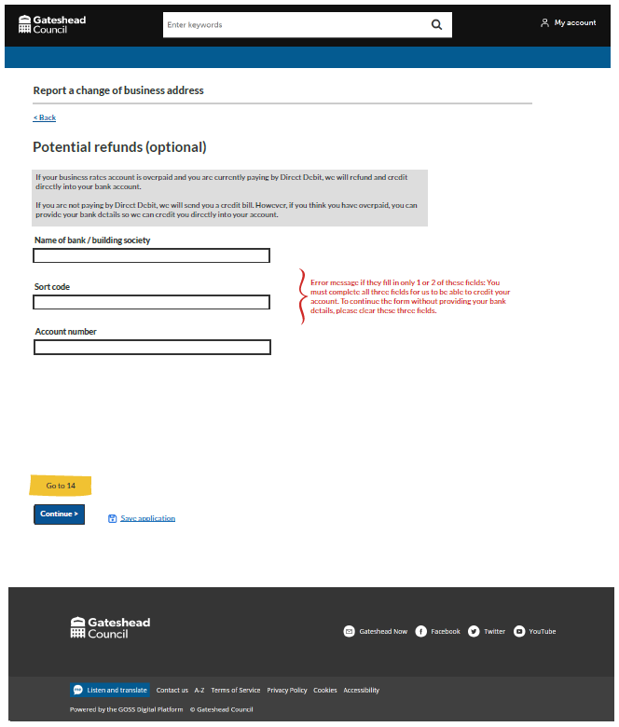
Sprint 11.
Business rates change of address

Slide 6
Sprint 11.
Business rates change of address
Form demo (DC)

Slide 7
Sprint 11.
Libraries
Overview of library events (LA)
Funding bid
Grant received from LibraryOn Arts Council platform had to be developed by Dec 23

Slide 8
Sprint 11.
Libraries

Slide 9
Sprint 11.
Libraries
Benefits:
Reduction in labour for the library team, no longer need to divide payments taken into cost codes
Increase revenue by moving over to GOSS platform as Eventbrite take a cut of ticket sales
Drives digital and physical footfall in the libraries all in one place no third party

Slide 10
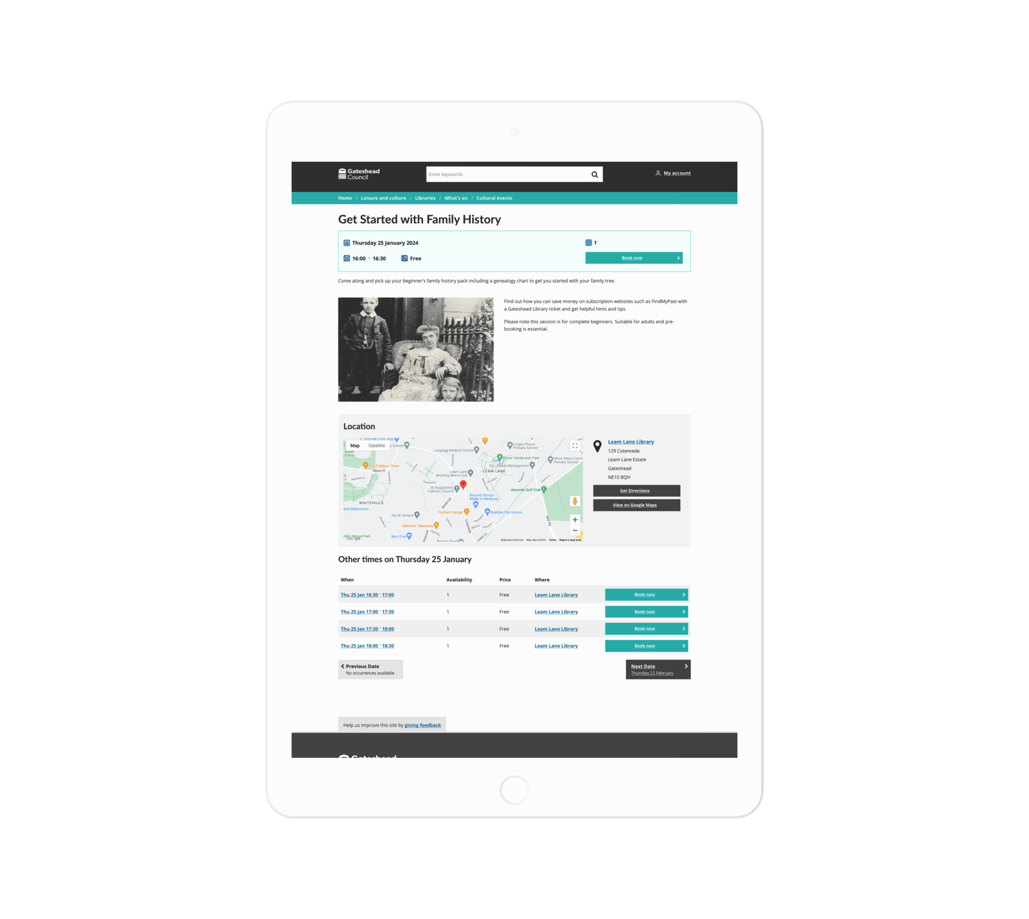
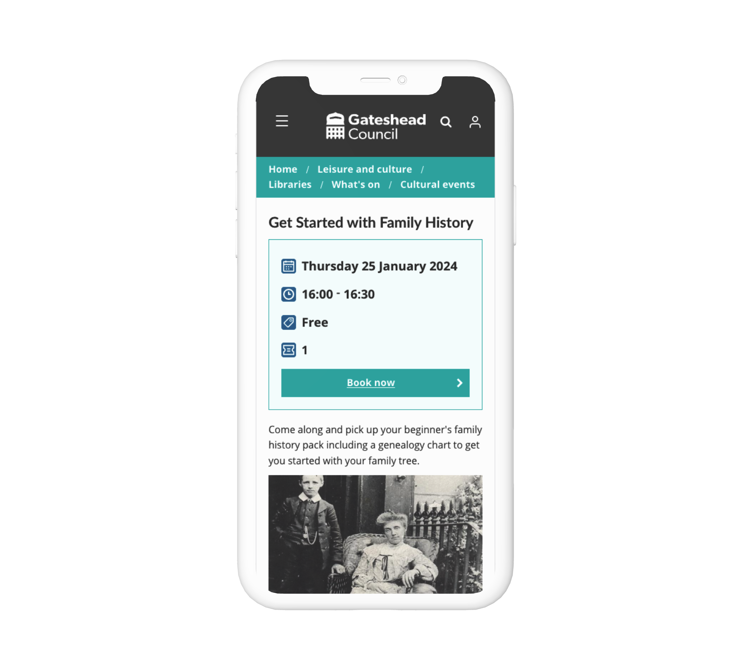
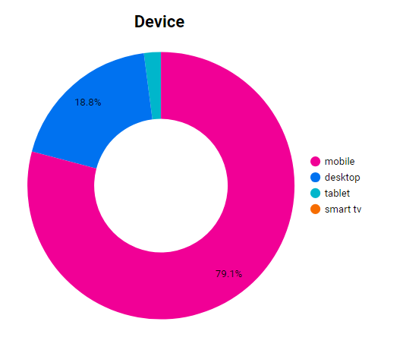
Sprint 11.
Libraries
Free events

Slide 11
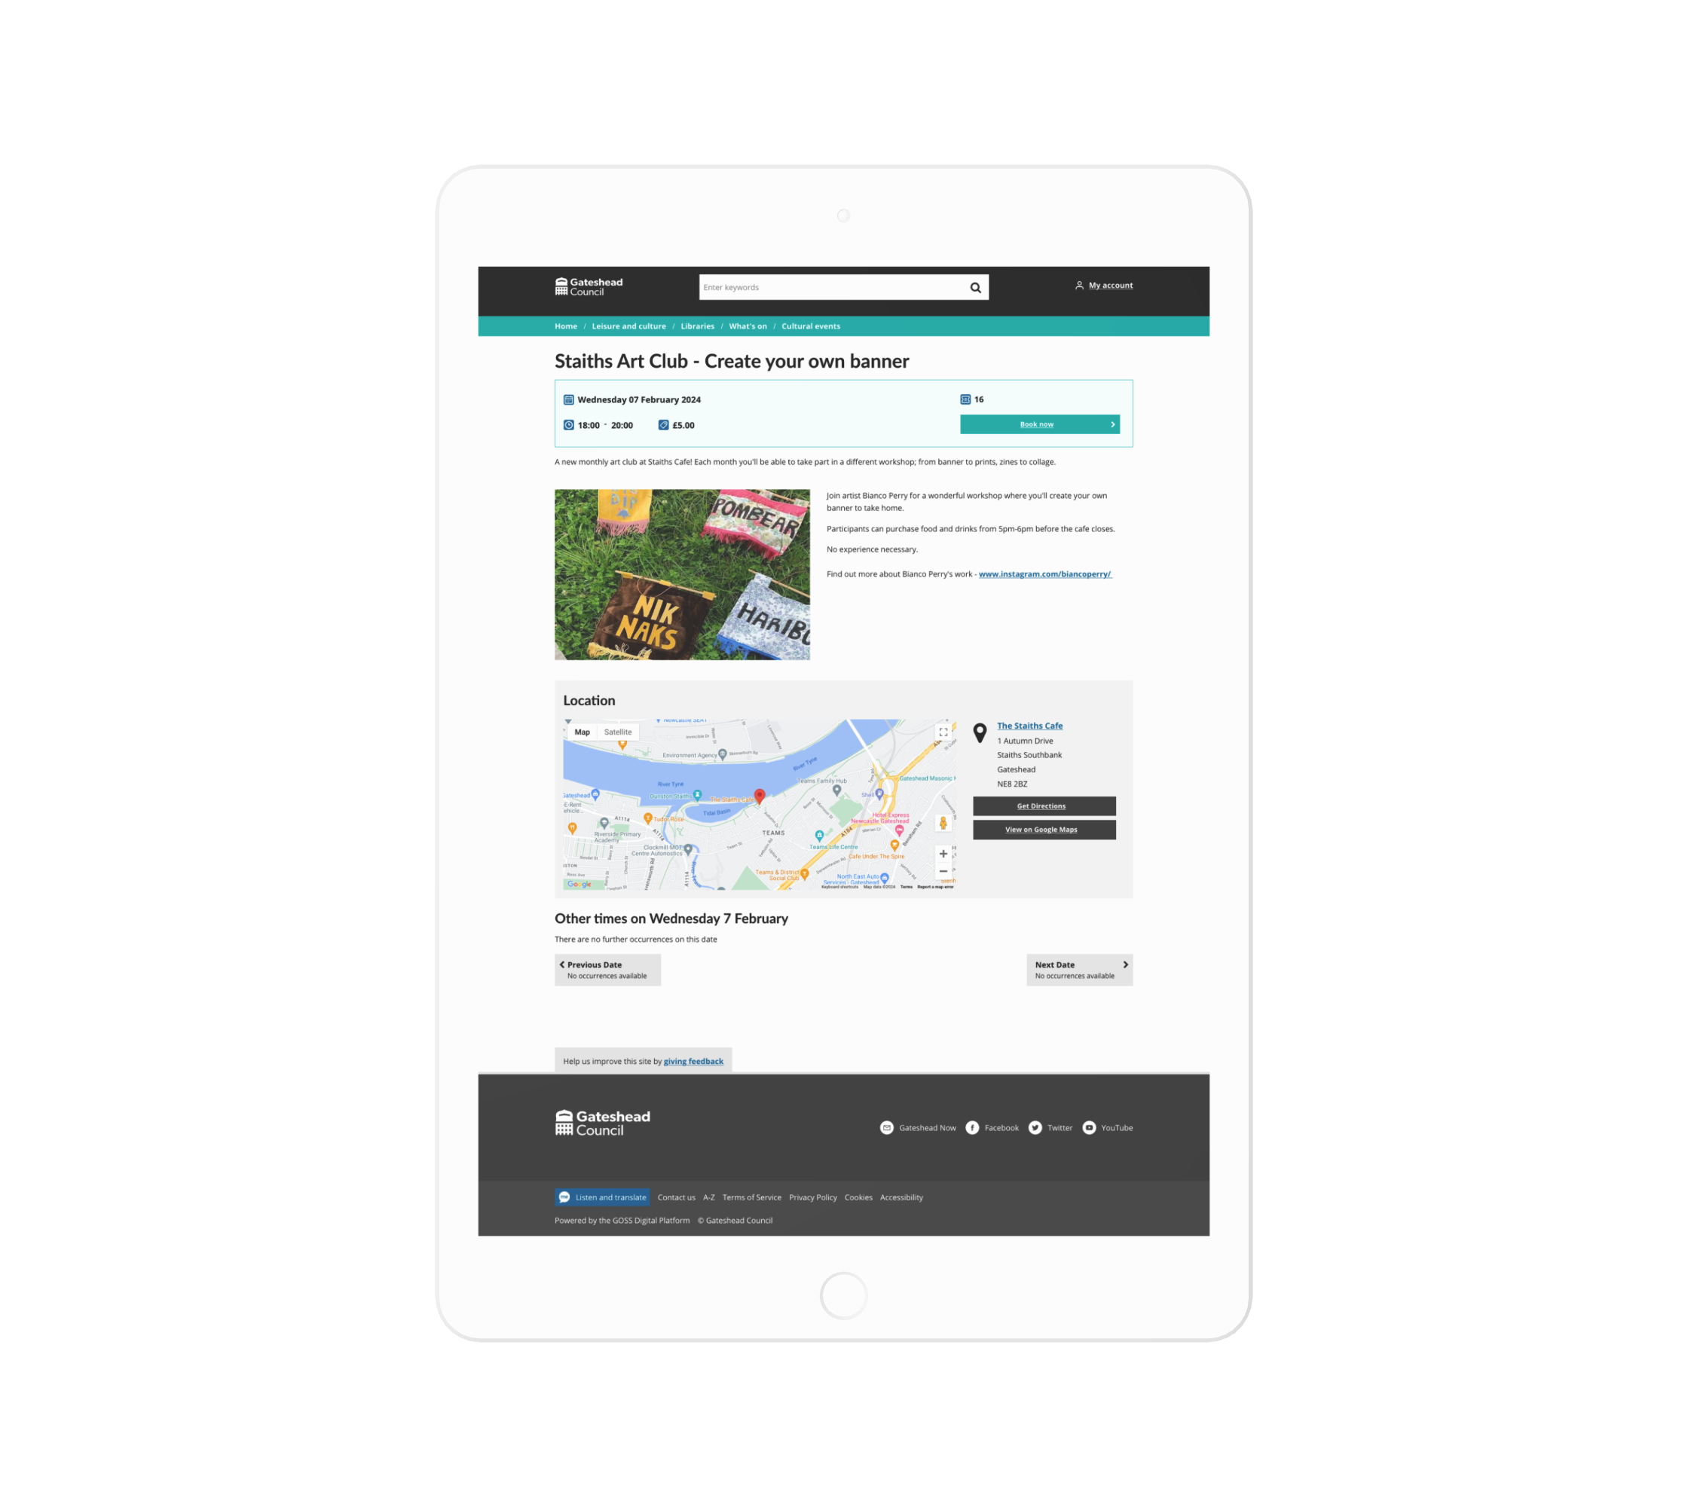
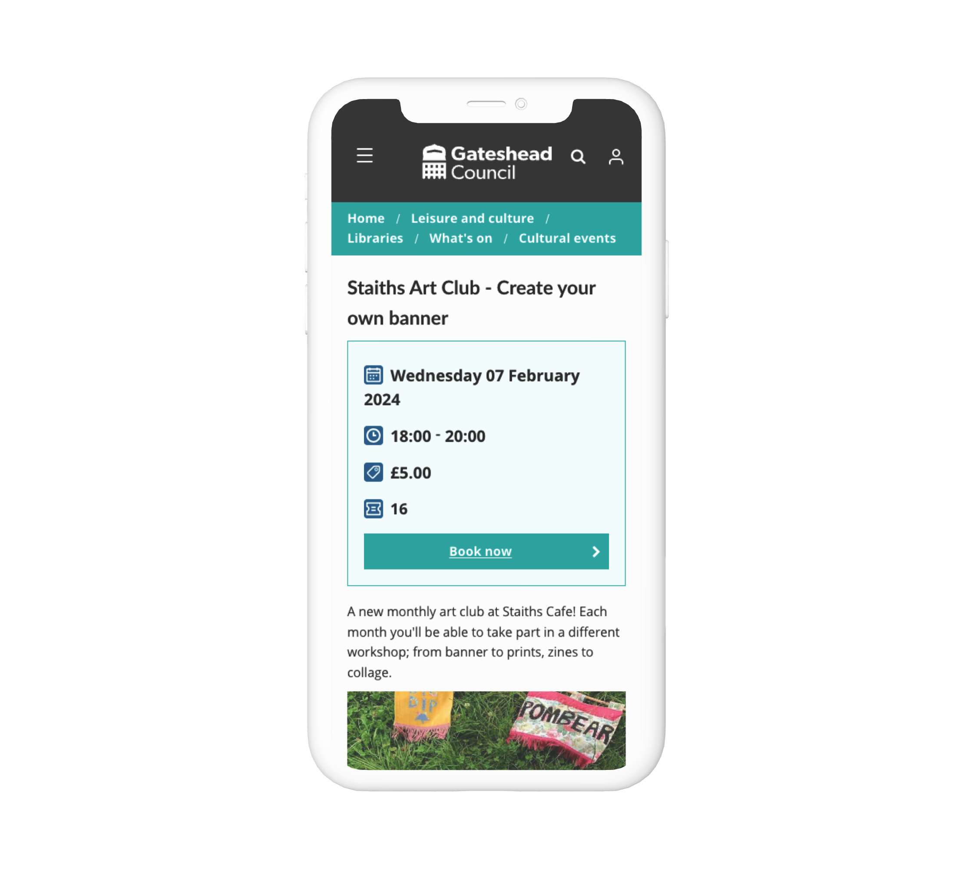
Sprint 11.
Libraries
Paid events

Slide 12
Sprint 11.
Libraries
Booking an event (GW)
Plug In (DC)

Slide 13
Sprint 11.
Libraries
Next steps:
Add plug in to each event – data collection for service
Go live – Monday 15th
Training for taking in person and telephone payments
Handover

Slide 14
Sprint 11.
Gateshead Energy Company
Website (KS)
Wireframes for 2x contact forms
Forms (LS)

Slide 15
Sprint 11.
Homelessness appeals process
Discovery and process map (KS)

Slide 16
Sprint 11.
Data
Christmas surprise: the limit on how many bulky was collection can be booked stopped working.
Resulted in bookings being oversubscribed by more than twice the expected limit.
Raised the need to have better oversight of bookings and the usage across different processes.
Aim to create a dashboard and a reliable data pipeline to that help us an overview of usage.

Slide 17
Sprint 11.
Data
Outstanding questions:
Are there other things we need to see about bookings?
Why are some days have more demand than others?
Is the allocation correct?
Next steps:
Add other bookings processes to this dashboard
Refactor some of the underlying data processing

Slide 18
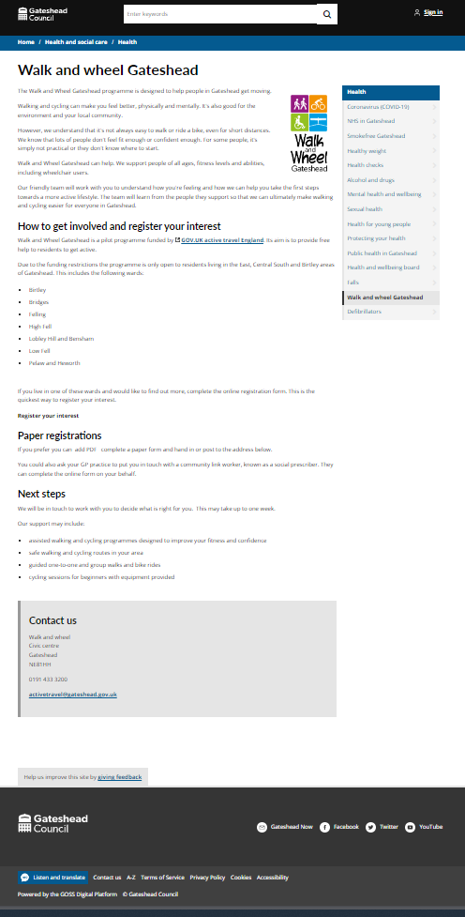
Sprint 11.
Content and wireframing
Walk and Wheel Gateshead content and wireframe

Slide 19
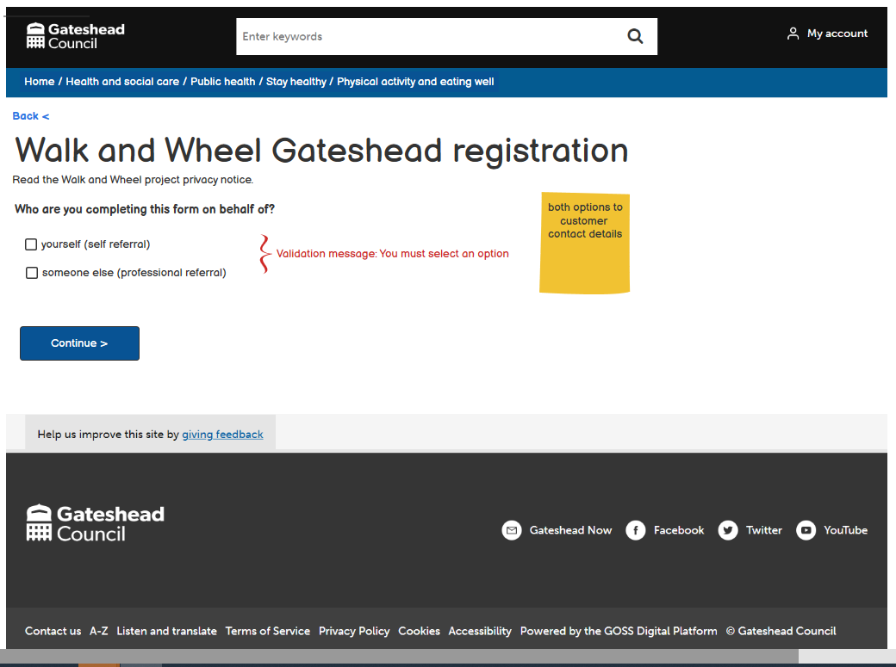
Sprint 11.
Content and wireframing
Walk and Wheel Gateshead content and wireframe

Slide 20
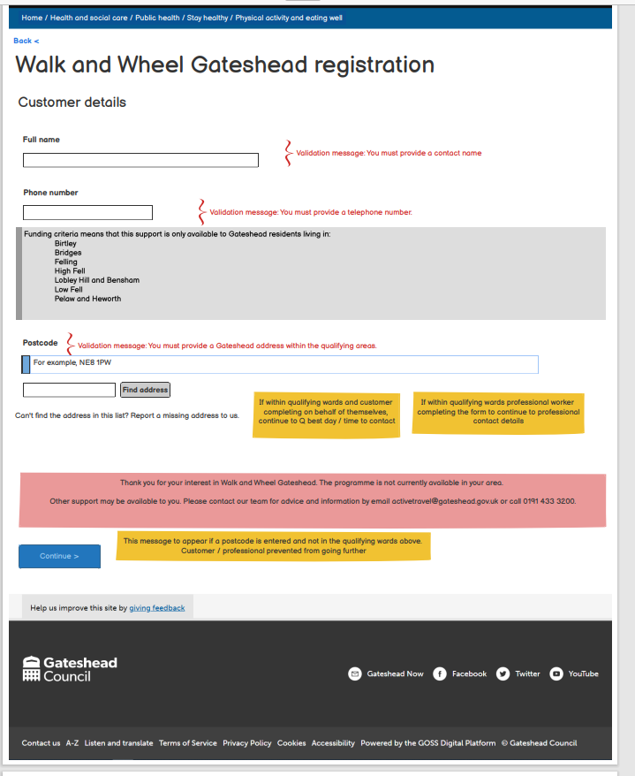
Sprint 11.
Content and wireframing
Walk and Wheel Gateshead content and wireframe

Slide 21
Sprint 11.
Content and wireframing
Public Health It's raining, it's pouring annual report 2020 transferred from a PDF to a document template

Slide 22
Sprint 11.
Content and wireframing
Public Health It's raining, it's pouring annual report 2020 transferred from a PDF to a document template

Slide 23
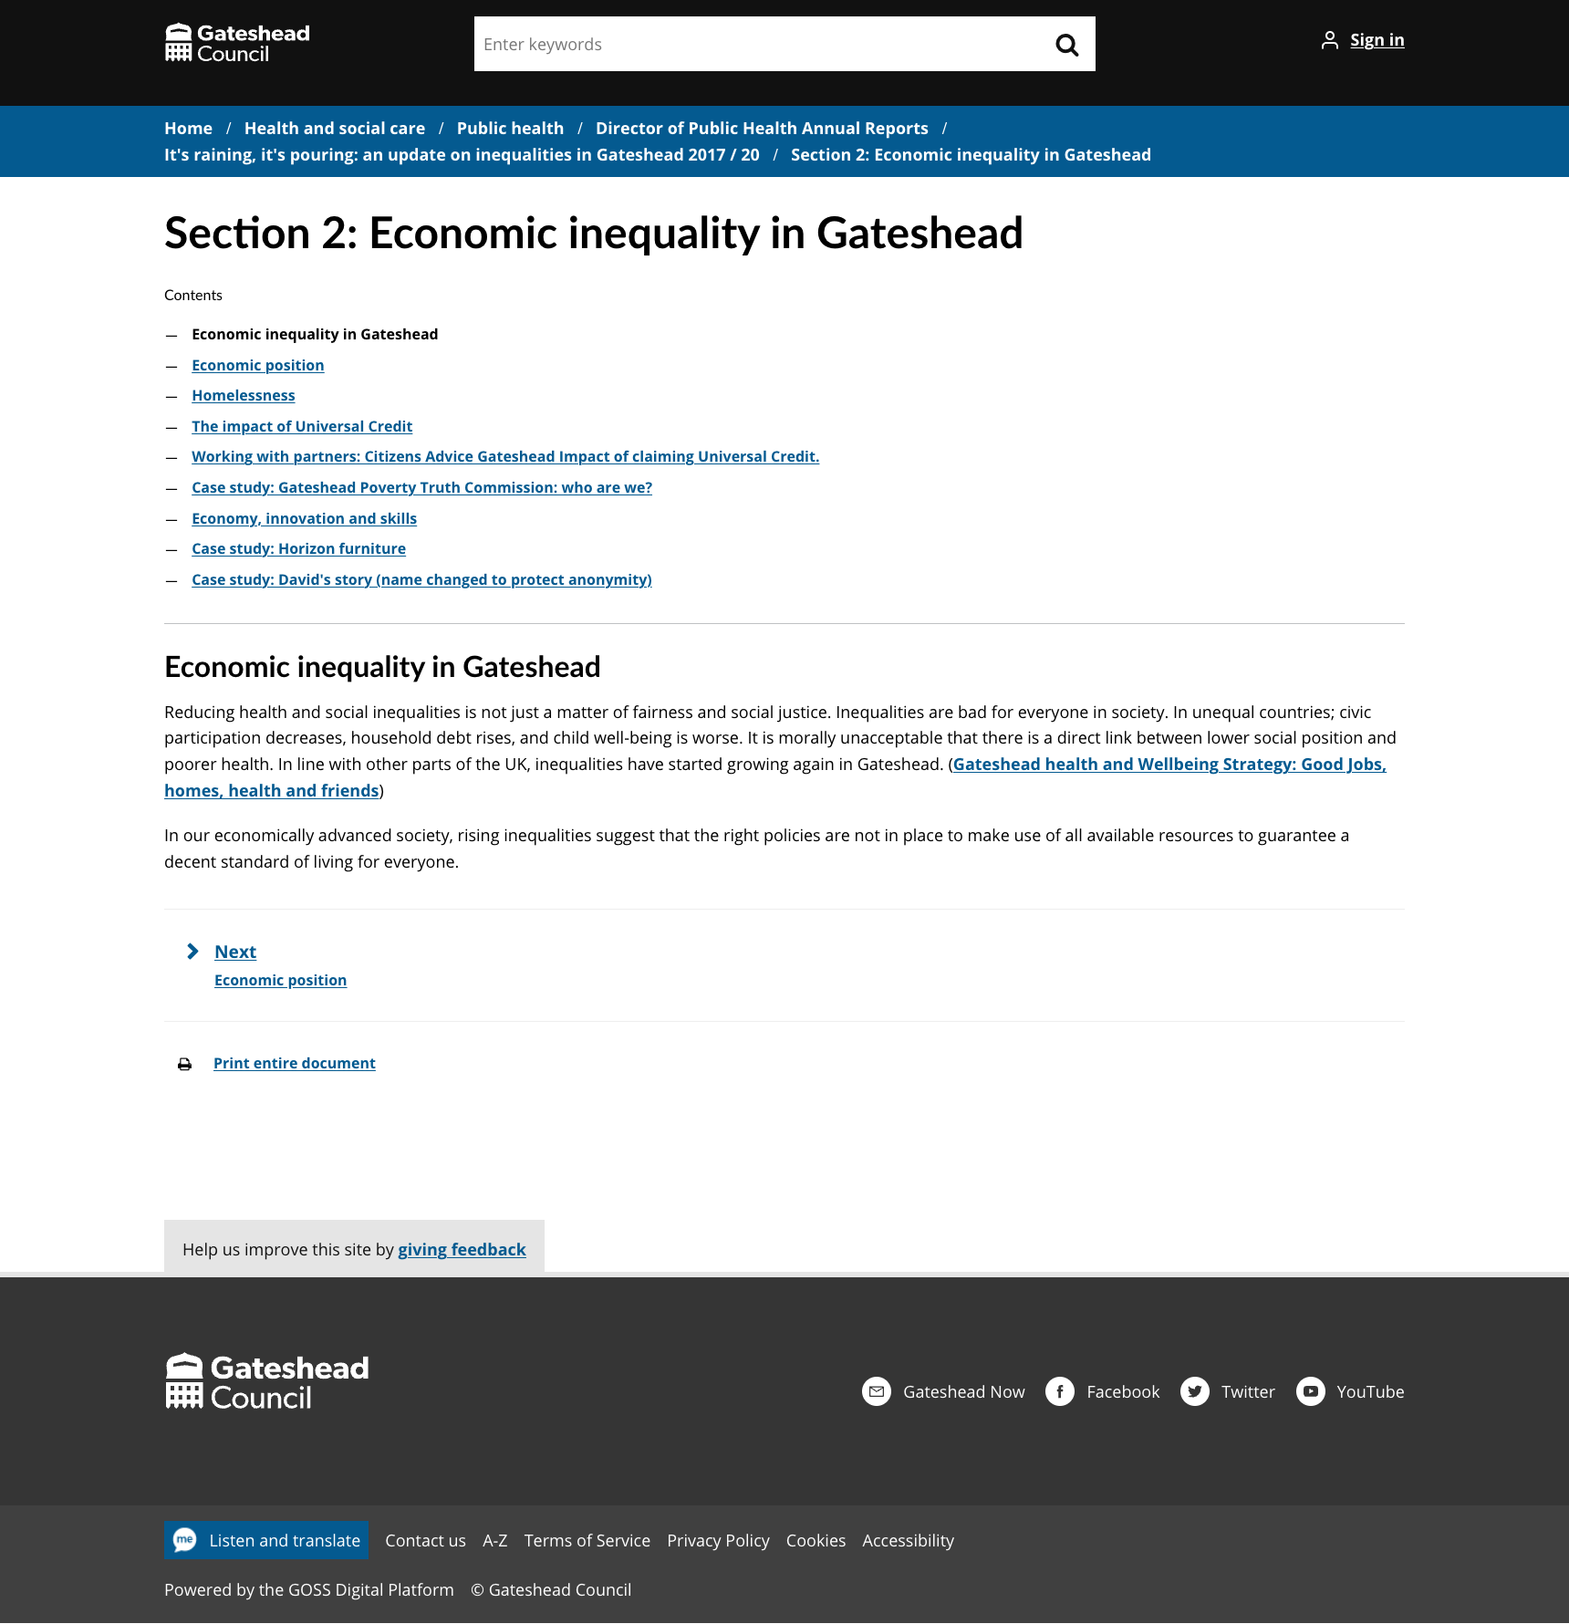
Sprint 11.
Content and wireframing
Public Health It's raining, it's pouring annual report 2020 transferred from a PDF to a document template

Slide 24
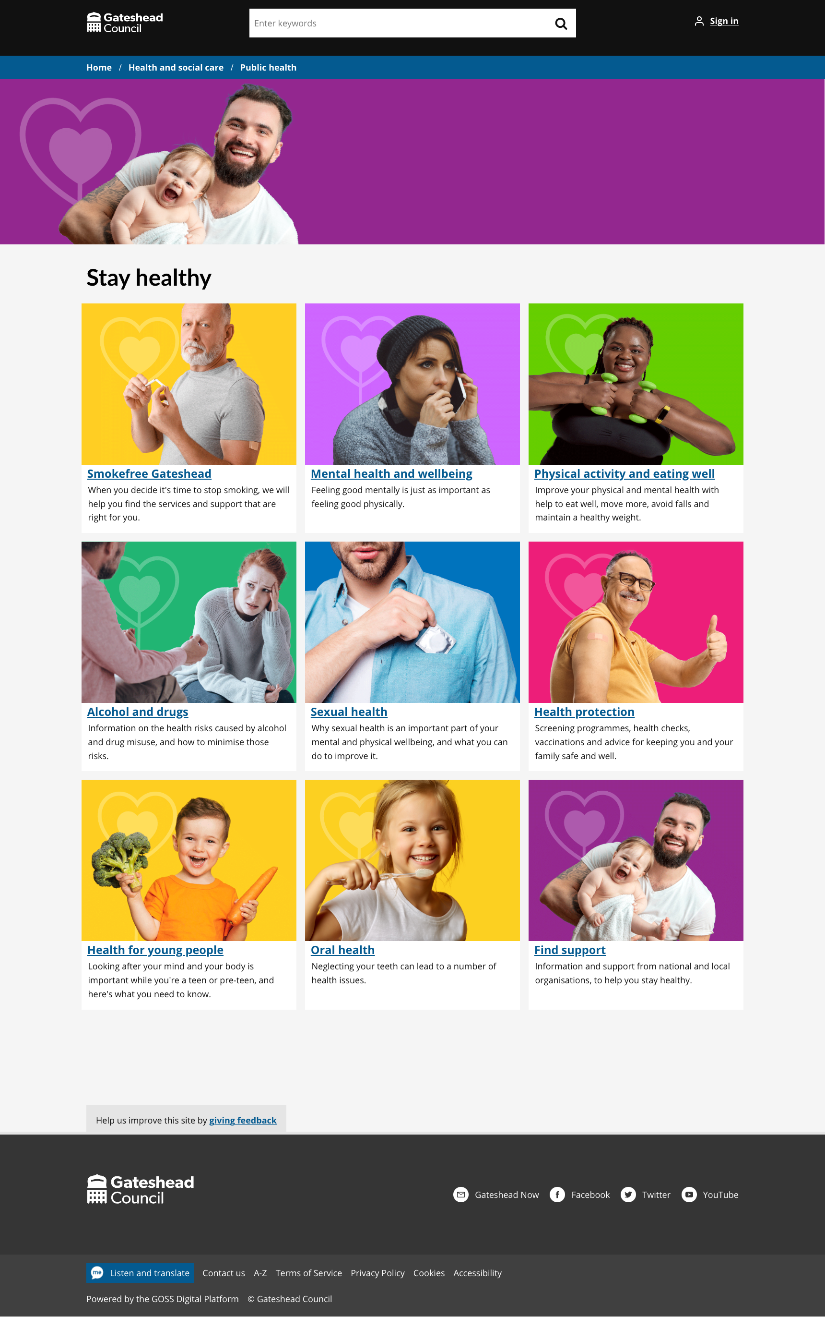
Sprint 11.
Content and wireframing
Public Health external links library

Slide 25
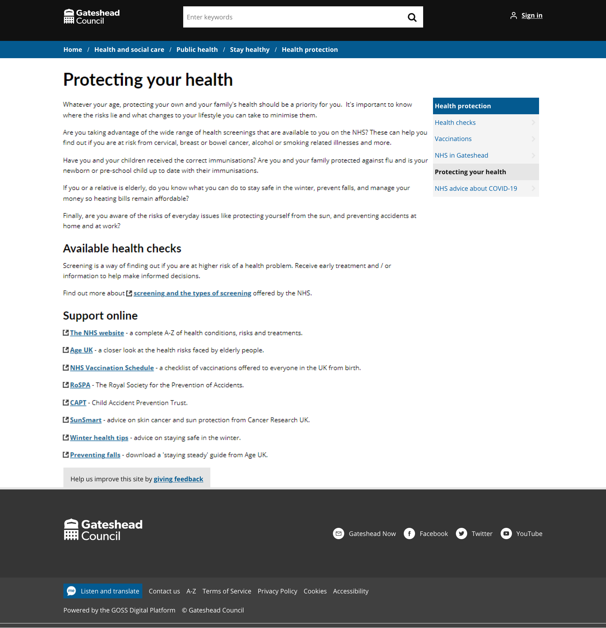
Sprint 11.
Content and wireframing
Public Health external links library

Slide 26
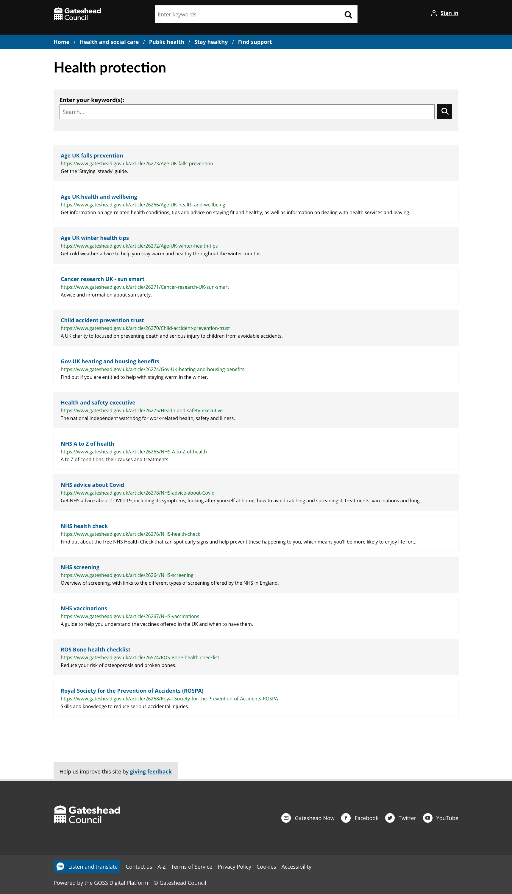
Sprint 11.
Content and wireframing
Public Health external links library

Slide 27
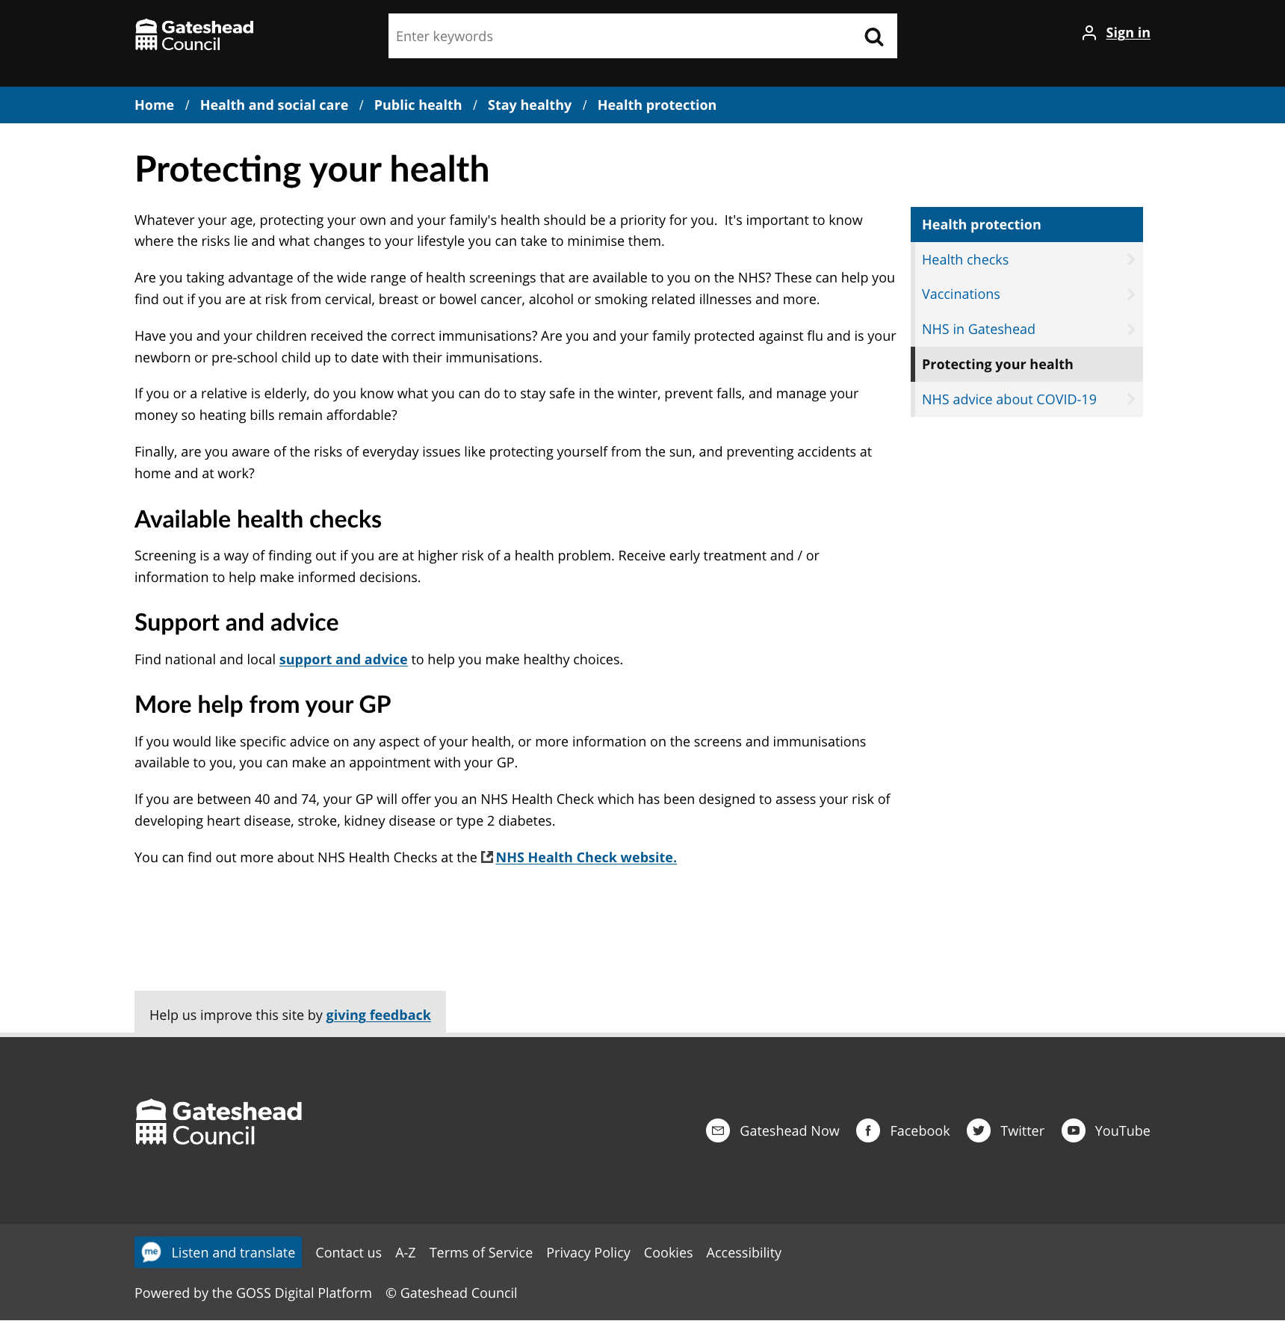
Sprint 11.
Content and wireframing
Public Health external links library

Slide 28
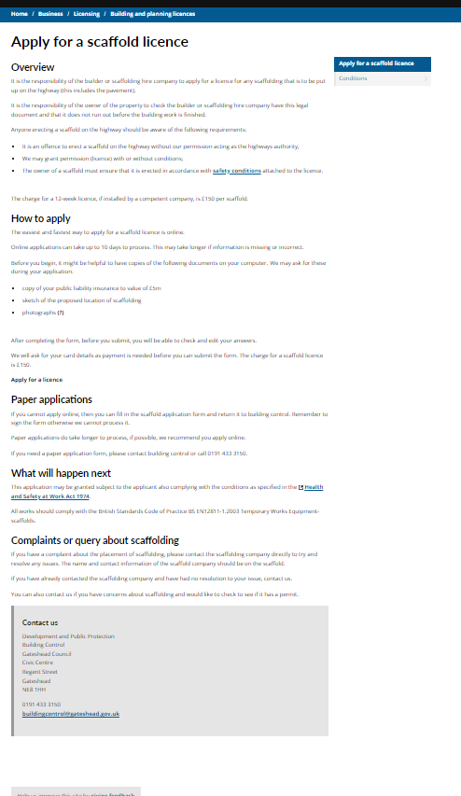
Sprint 11.
Content and wireframing
Scaffold licence content (and discovery)

Slide 29
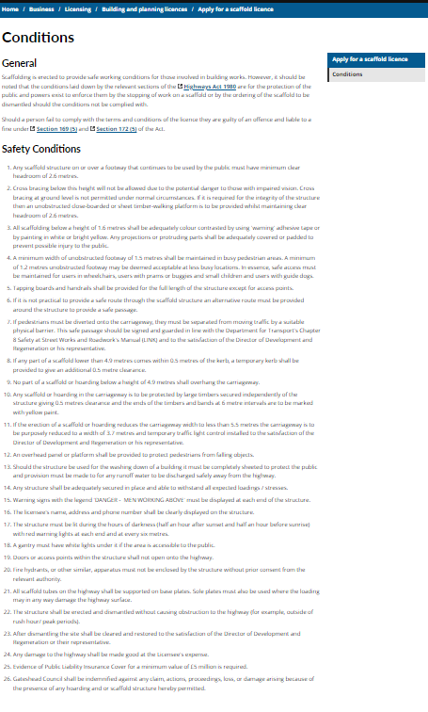
Sprint 11.
Content and wireframing
Scaffold licence content (and discovery)

Slide 30
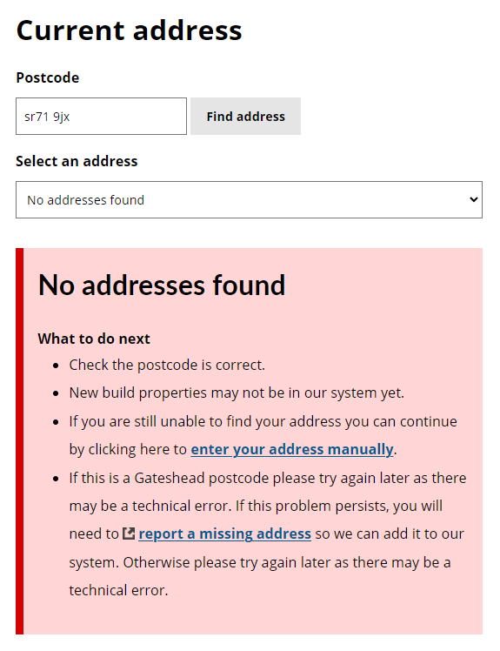
Sprint 11.
Address lookup development
Improved validation logic
Improves user guidance with dynamic tailored instructions
Reduces confusion and frustration
System alerts
During server errors a global alert can be enabled directly to address inputs with a configurable message
Falls back to manual input automatically if possible
Development improvements
Easy configuration for faster development
Global script handling
Global config to control text
Reduced risk of payment failures

Slide 31
Sprint 11.
Devel opment
Temporary Traffic Regulation Order (TTRO) changes
(Temporary restrictions or closures to the highway, to stop or limit vehicles or pedestrians on the highway.)
Online form, with pin on a map and upload options for evidence
Payment is taken before the form can be submitted
Automated acknowledgement page and email to customer
Case is held within case mgmt.
Case can be assigned between members of the team
Team can ask questions or request further info / evidence from the customer within case mgmt..
All GDPR compliant
Case history updates can be added
The signed TTRO can be uploaded

Slide 32
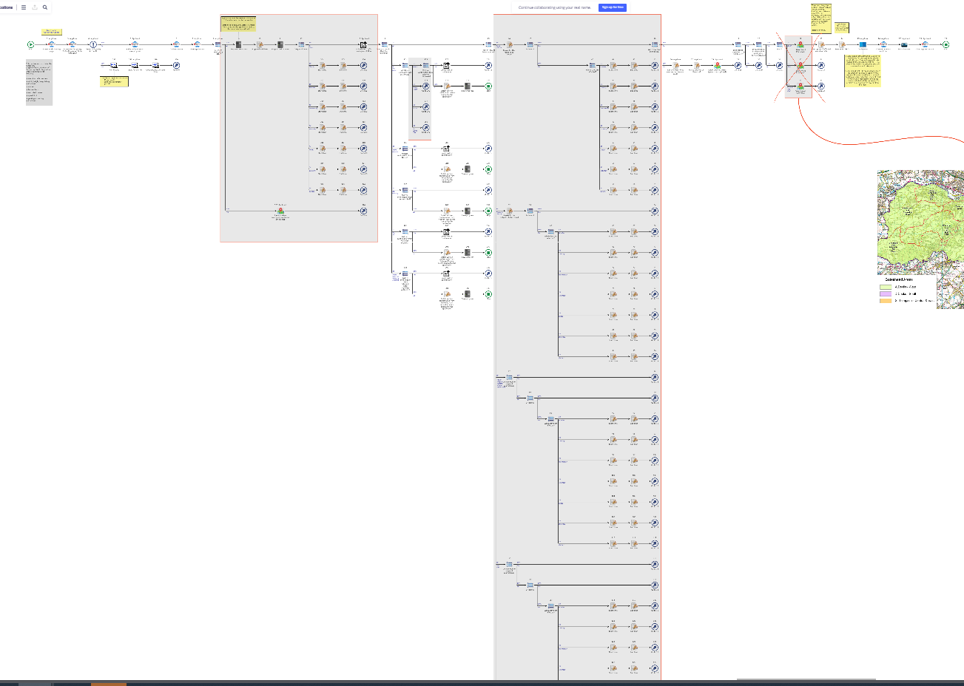
Sprint 11.
Devel opment
Temporary Traffic Regulation Order (TTRO) changes
Highlighted areas are revised sections of the process map

Slide 33
Sprint 11.
What's next?
Council Tax discovery workshop
Antisocial behaviour discovery
Homelessness digital process – wireframe and development
Scaffolding permits – wireframing and development

