Slide 1
Sprint 9 Show and Tell 13 December 2023
G Squad
Digital Team

Slide 2
Sprint 9.
Discovery
Engage process demo

Slide 3
Sprint 9.
Content and wireframing
Director of Public Health annual report: Behind the masks 2020/21
83 pages
12 chapters
Public health annual report - Behind the masks 2021 - Gateshead Council

Slide 4
Sprint 9.
Content and wireframing
A recent complaint highlighted the need for more users from the members' or mayors' offices.
Suggested by Tim Briton, Governance manager
Stage 1 group: Emma Reynard, Jennie Callaghan, Roddy Currie, Joanne Whitehead, Lynn Willis, Christine Thomas, Melvyn Mallam-Churchill and Emma Fagan (who will be starting January, not on the system just yet)
Stage 2 group: Roddy Currie, Joanne Whitehead and Lynn Willis
Training has been arranged for January 2024.

Slide 5
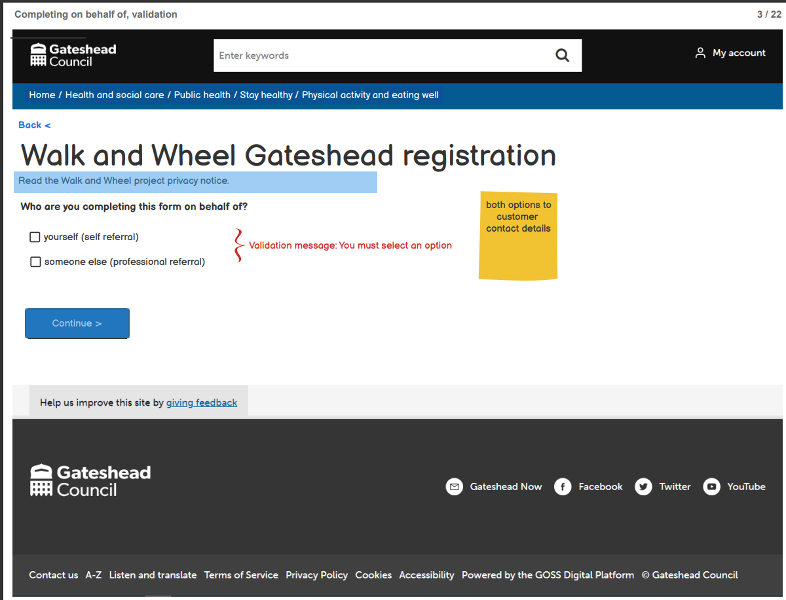
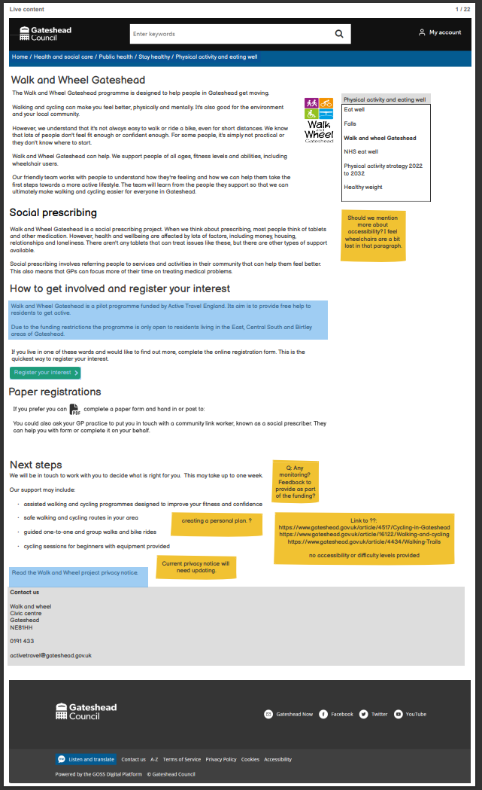
Sprint 9.
Content and wireframing
Wireframe for the walk and wheel registration form
Current situation
Proposed online form

Slide 6
Sprint 9.
Content and wireframing
Employee training
Adding locations for Libraries
Information gathering for Libraries and populating into spreadsheet which allows filtering

Slide 7
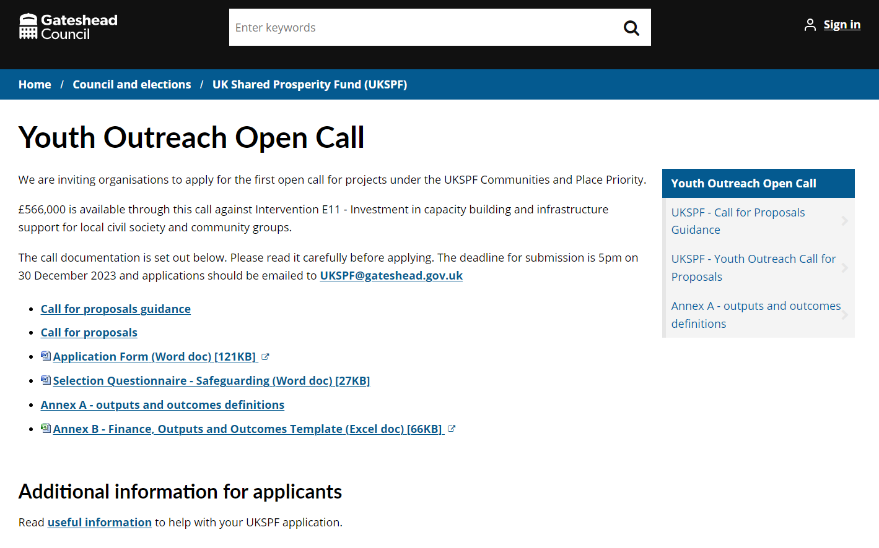
Sprint 9.
Content and wireframing
Content for UK Shared Prosperity Fund call for applications
Short-notice job
Involved converting 3 PDFs to html

Slide 8
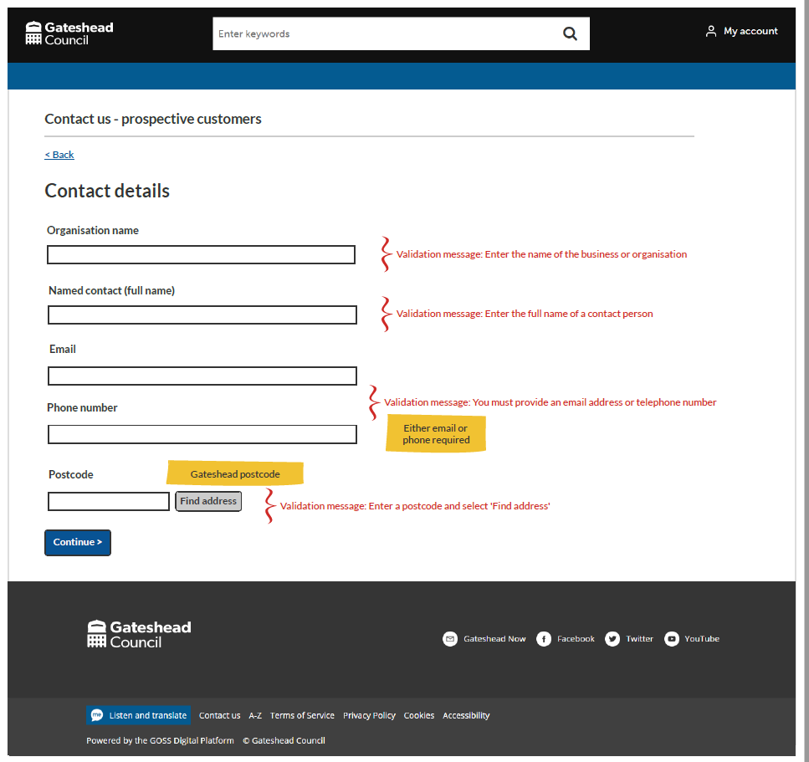
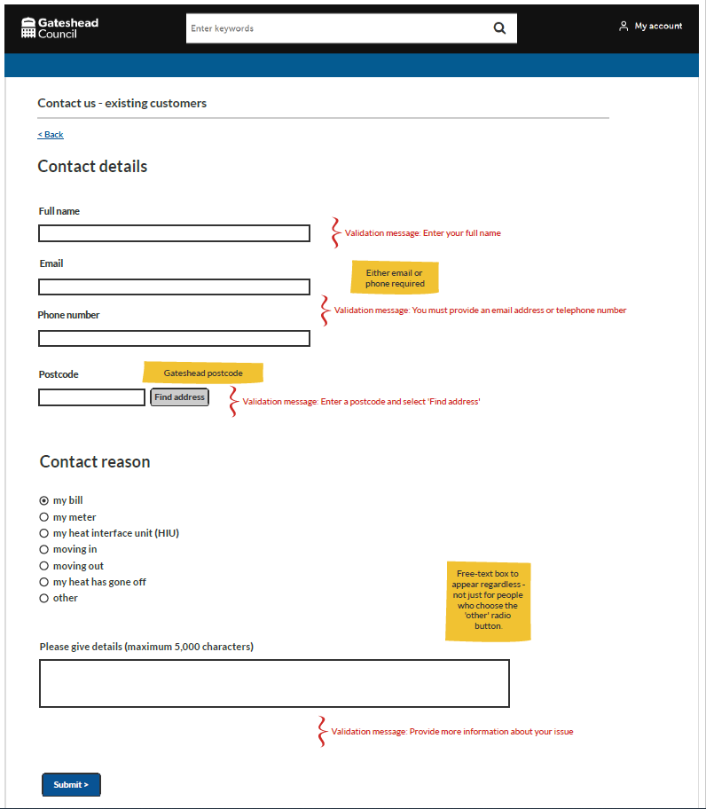
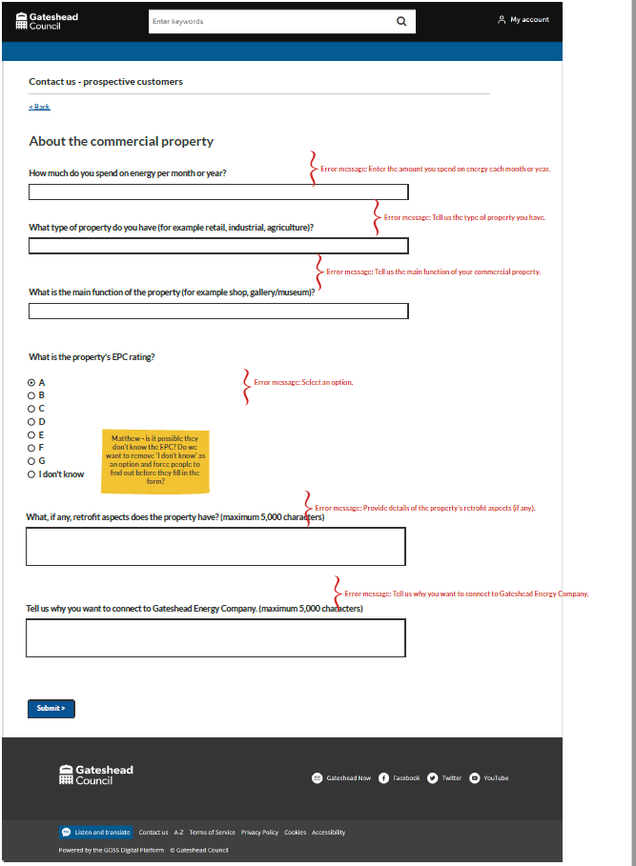
Sprint 9.
Content and wireframing
Wireframes for two customer contact forms for Gateshead Energy Company
Initially tried using one form for both sets of customers but realised that two forms would be much simpler.
Meeting with service 14/12/23 to run through; development of forms will go into Sprint 11.
Existing customers
Prospective customers

Slide 9
Sprint 9.
Content and wireframing
Antisocial behaviour – single point of reporting
Audit work:
identify all pages related to ASB
identify any existing online processes related to pages on our website
identify content information advertised
Next steps:
provide data for ASB related processes
create report-it process for "Neighbour disputes"
create report-it process for "Drug issues"
create report-it Process for "Youth disorder"
create report-it process to report "Vehicle nuisance"

Slide 10
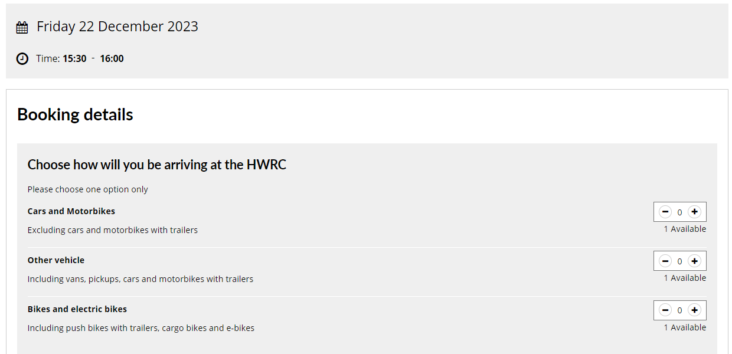
Sprint 9.
Development
Household waste and recycling centres
Bikes and electric bikes can now book an appointment to visit

Slide 11
Sprint 9.
Development
Business rates change of address demo

Slide 12
Sprint 9.
What's next?
Council Tax discovery
Libraries bookings
Blue Badge – add NFAR
Plug in for Libraries bookings
Gateshead Energy Company – Contact us form
Direct Debits Capita integration
Scaffolding permits

