Slide 1
Sprint 8 Show and Tell 6/12/2023
C Squad
Digital Team

Slide 2
Sprint 8
Discovery
Direct Payments
Meeting with Neil Blue
Research direct payments in other Local authorities
Waste Escalations
Initial meetings with CSU and Waste – workshop to follow later in the week.
Winter maintenance
Redesign salt request form
Case outcomes/confirmation emails/closure emails
Web content

Slide 3
Sprint 8
Design
Gateshead Has Your Back
Supply Intranet styling to Engage
Digital inclusion PowerPoint slides
Local Nature website testing
Design - Data
GA4 dashboard - Council tax section https://lookerstudio.google.com/s/no8Hby9MUHA

Slide 4
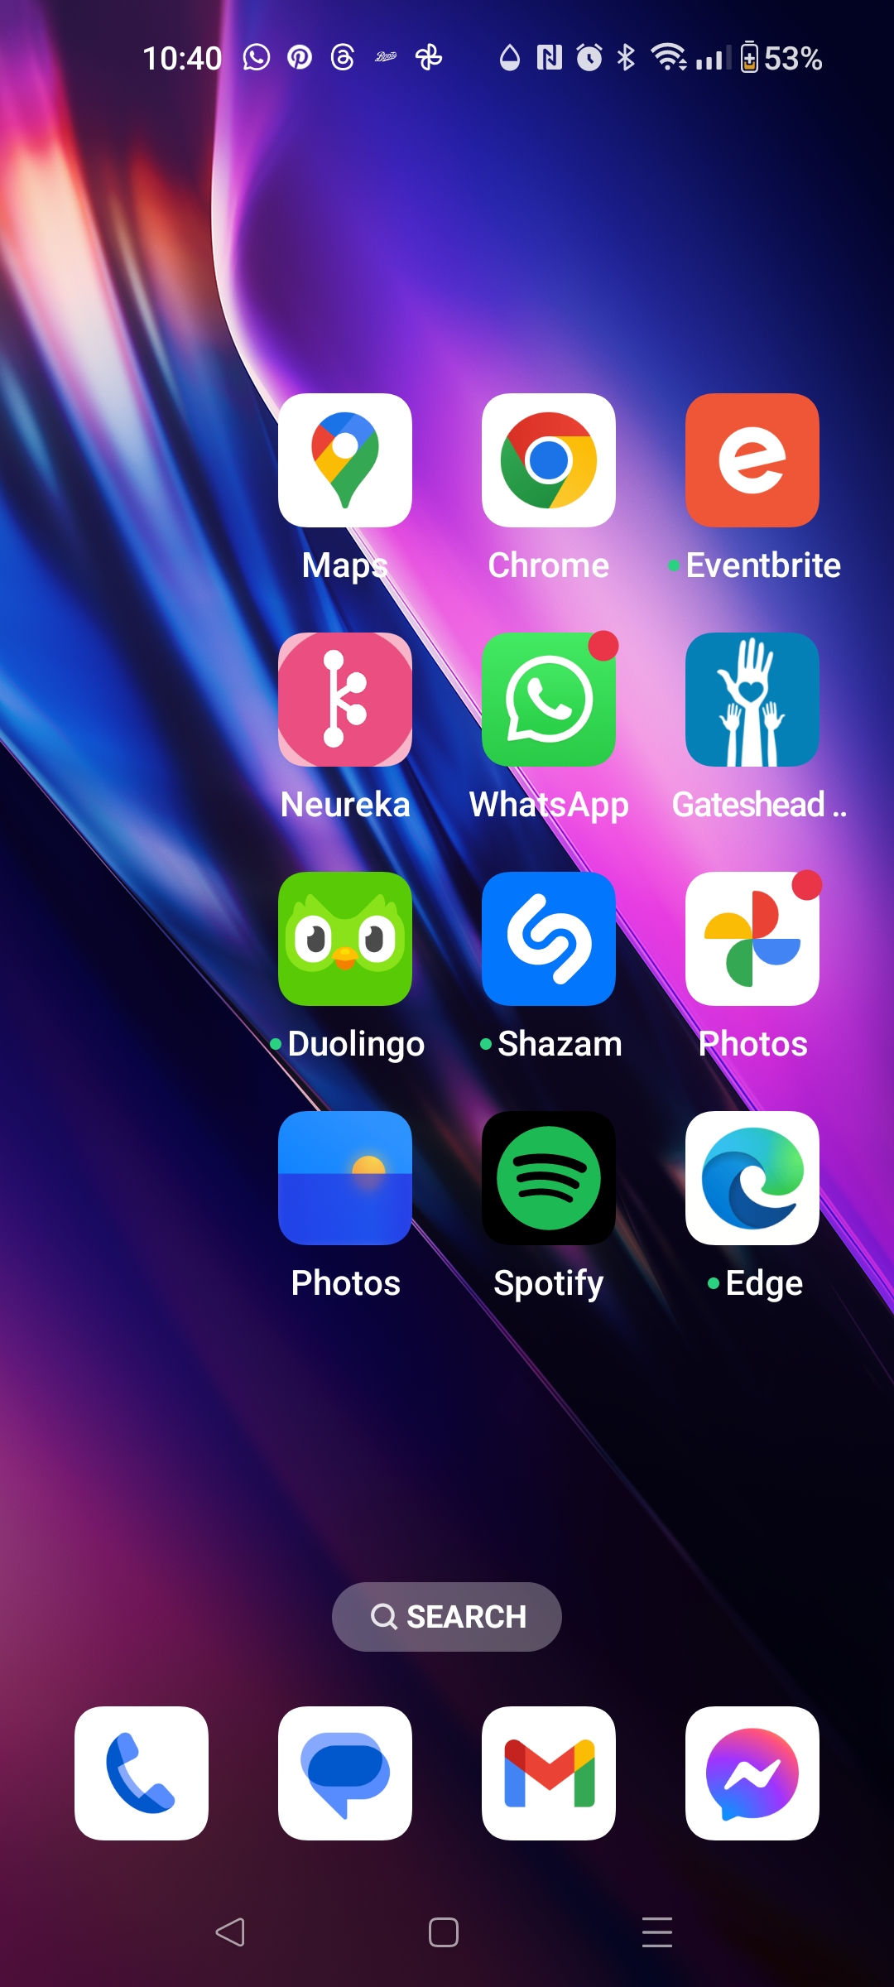
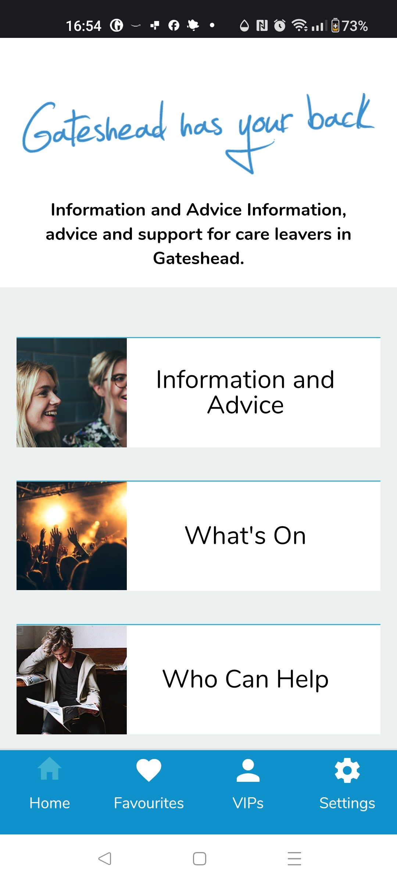
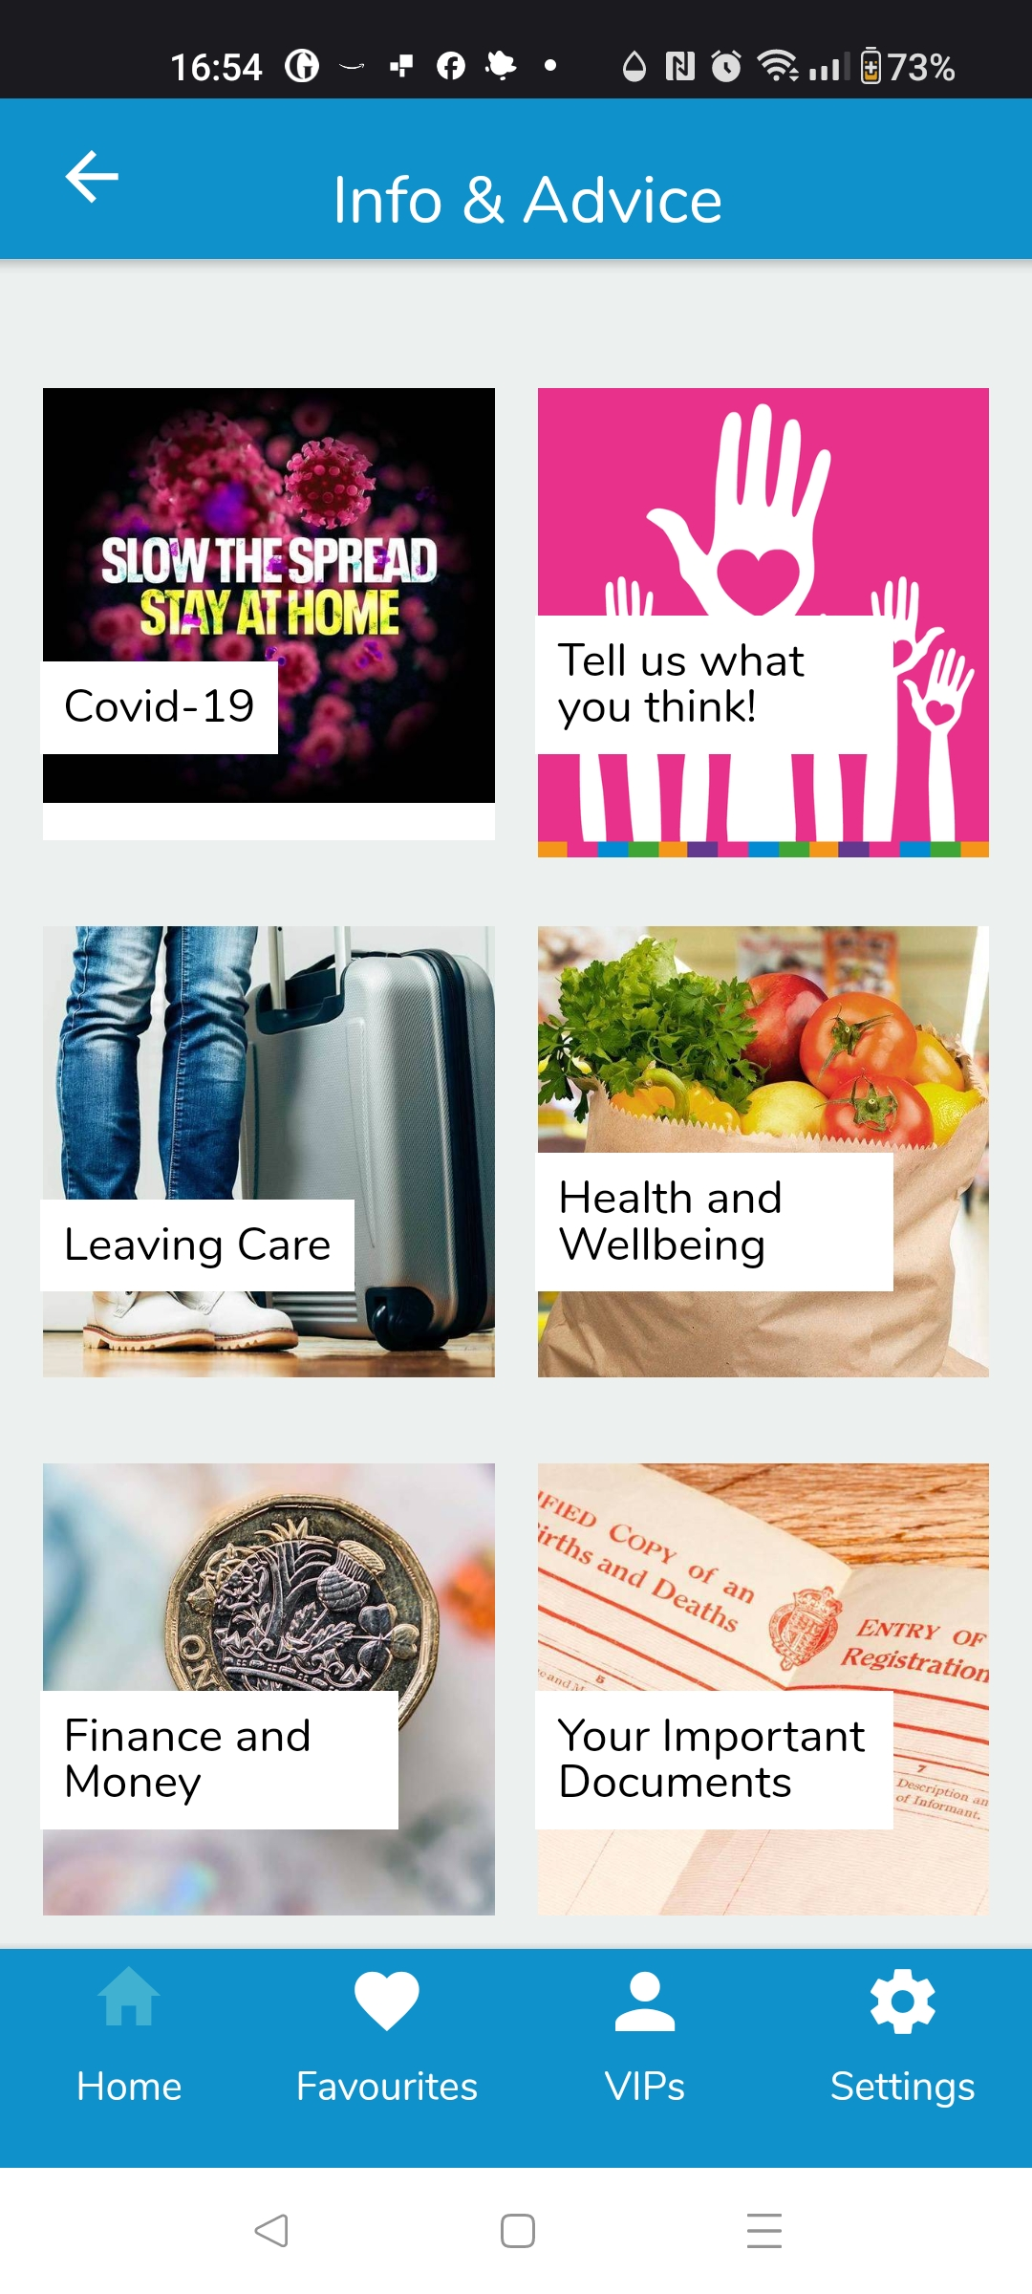
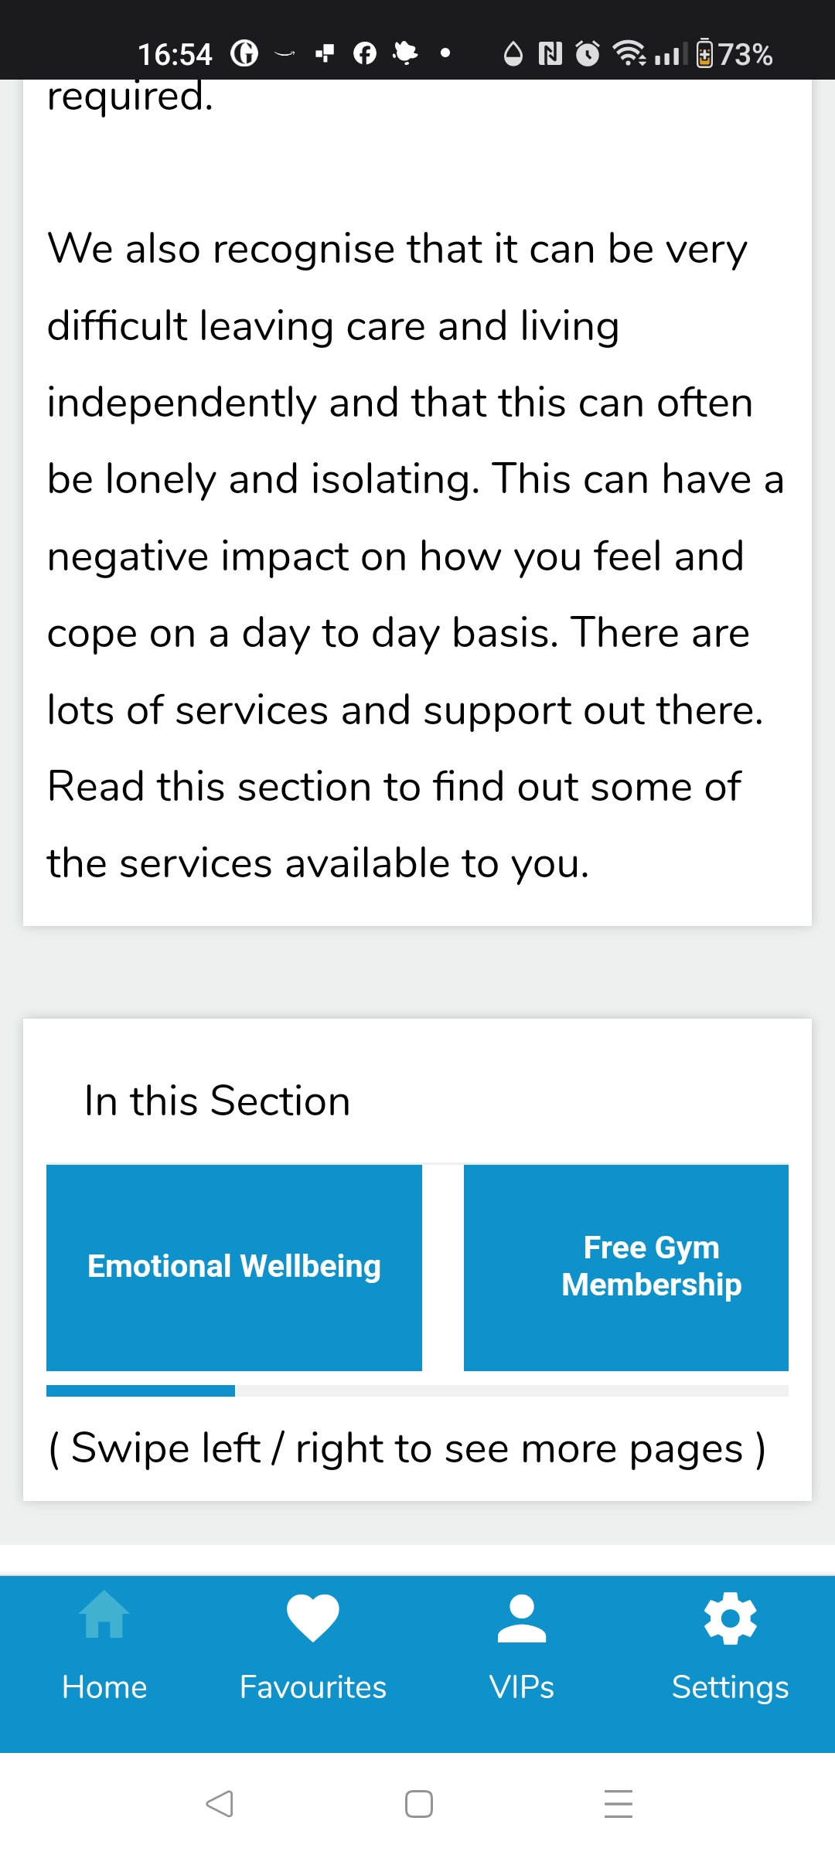
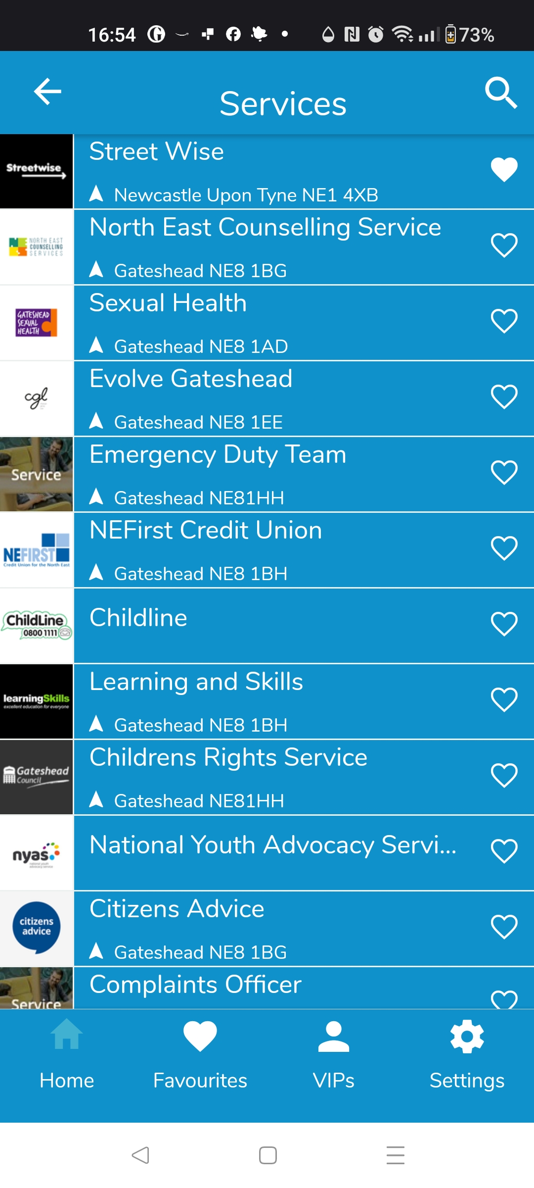
Sprint 8
Design - Gateshead Has Your Back Care Leavers app - before

Slide 5
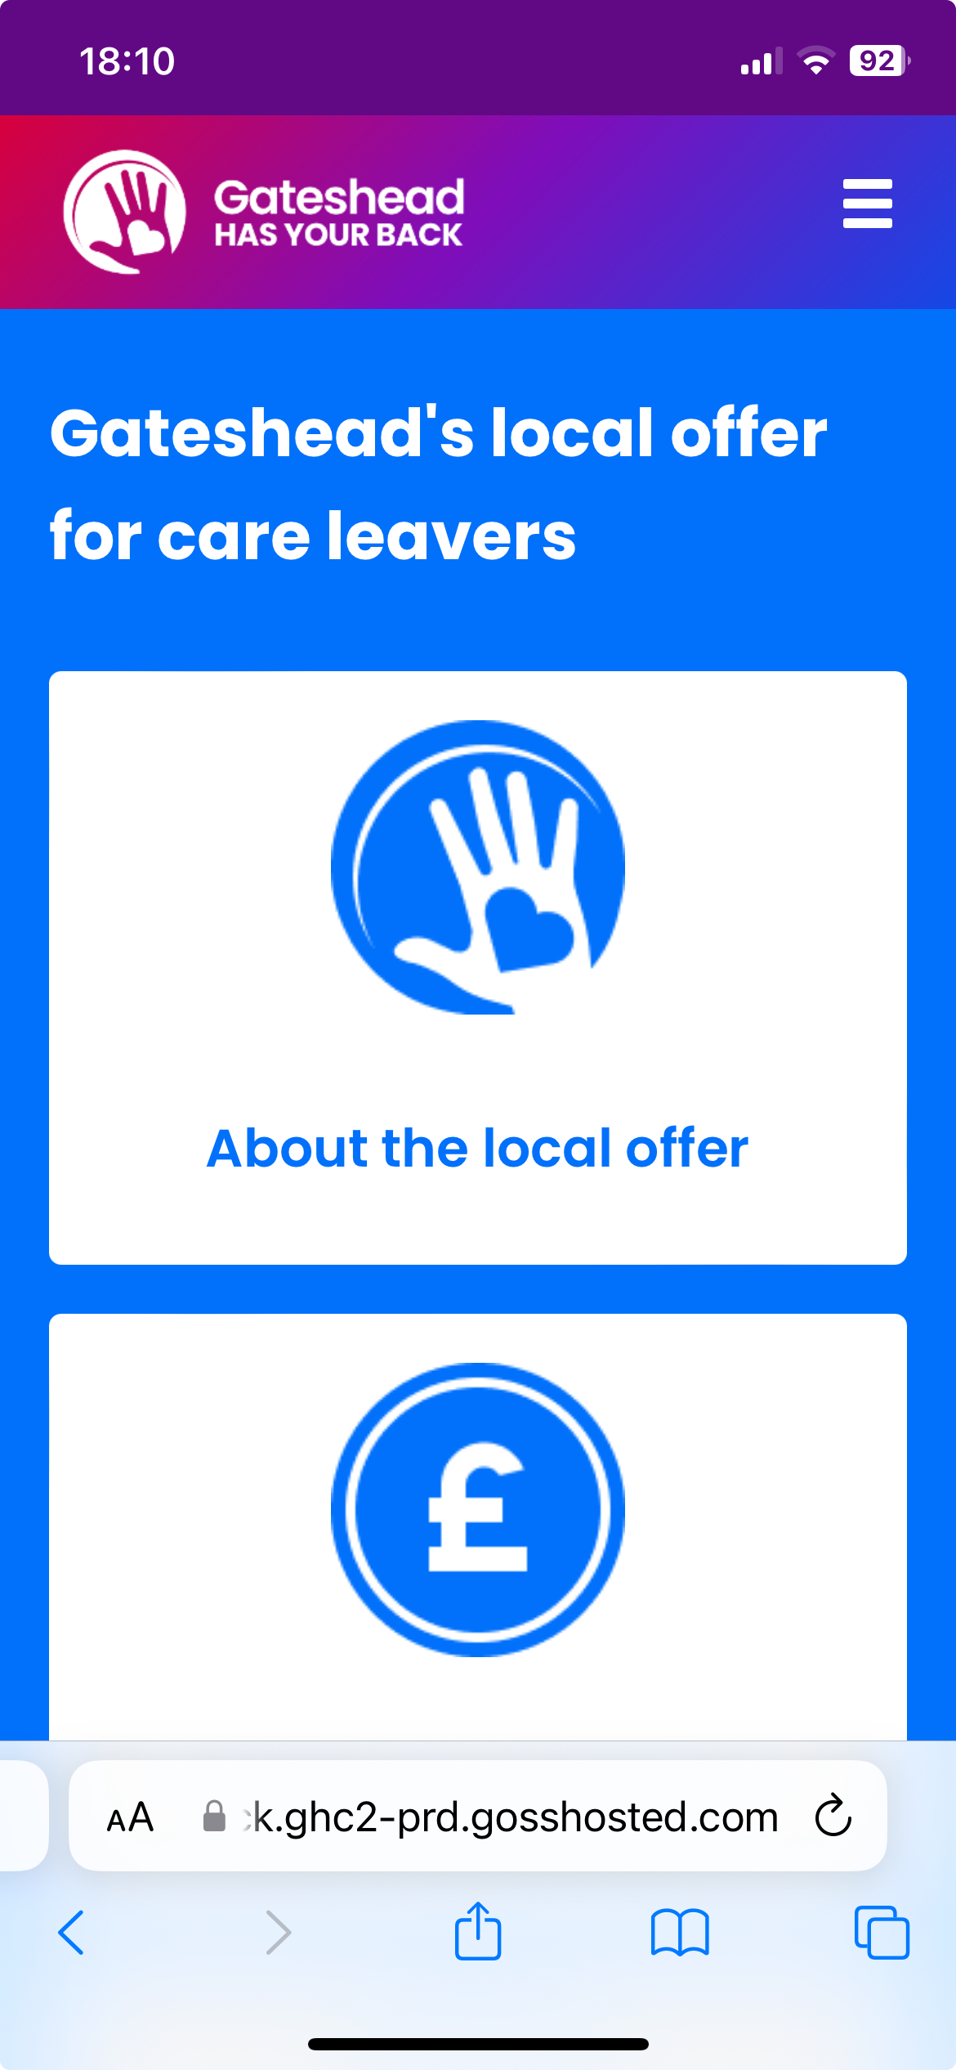
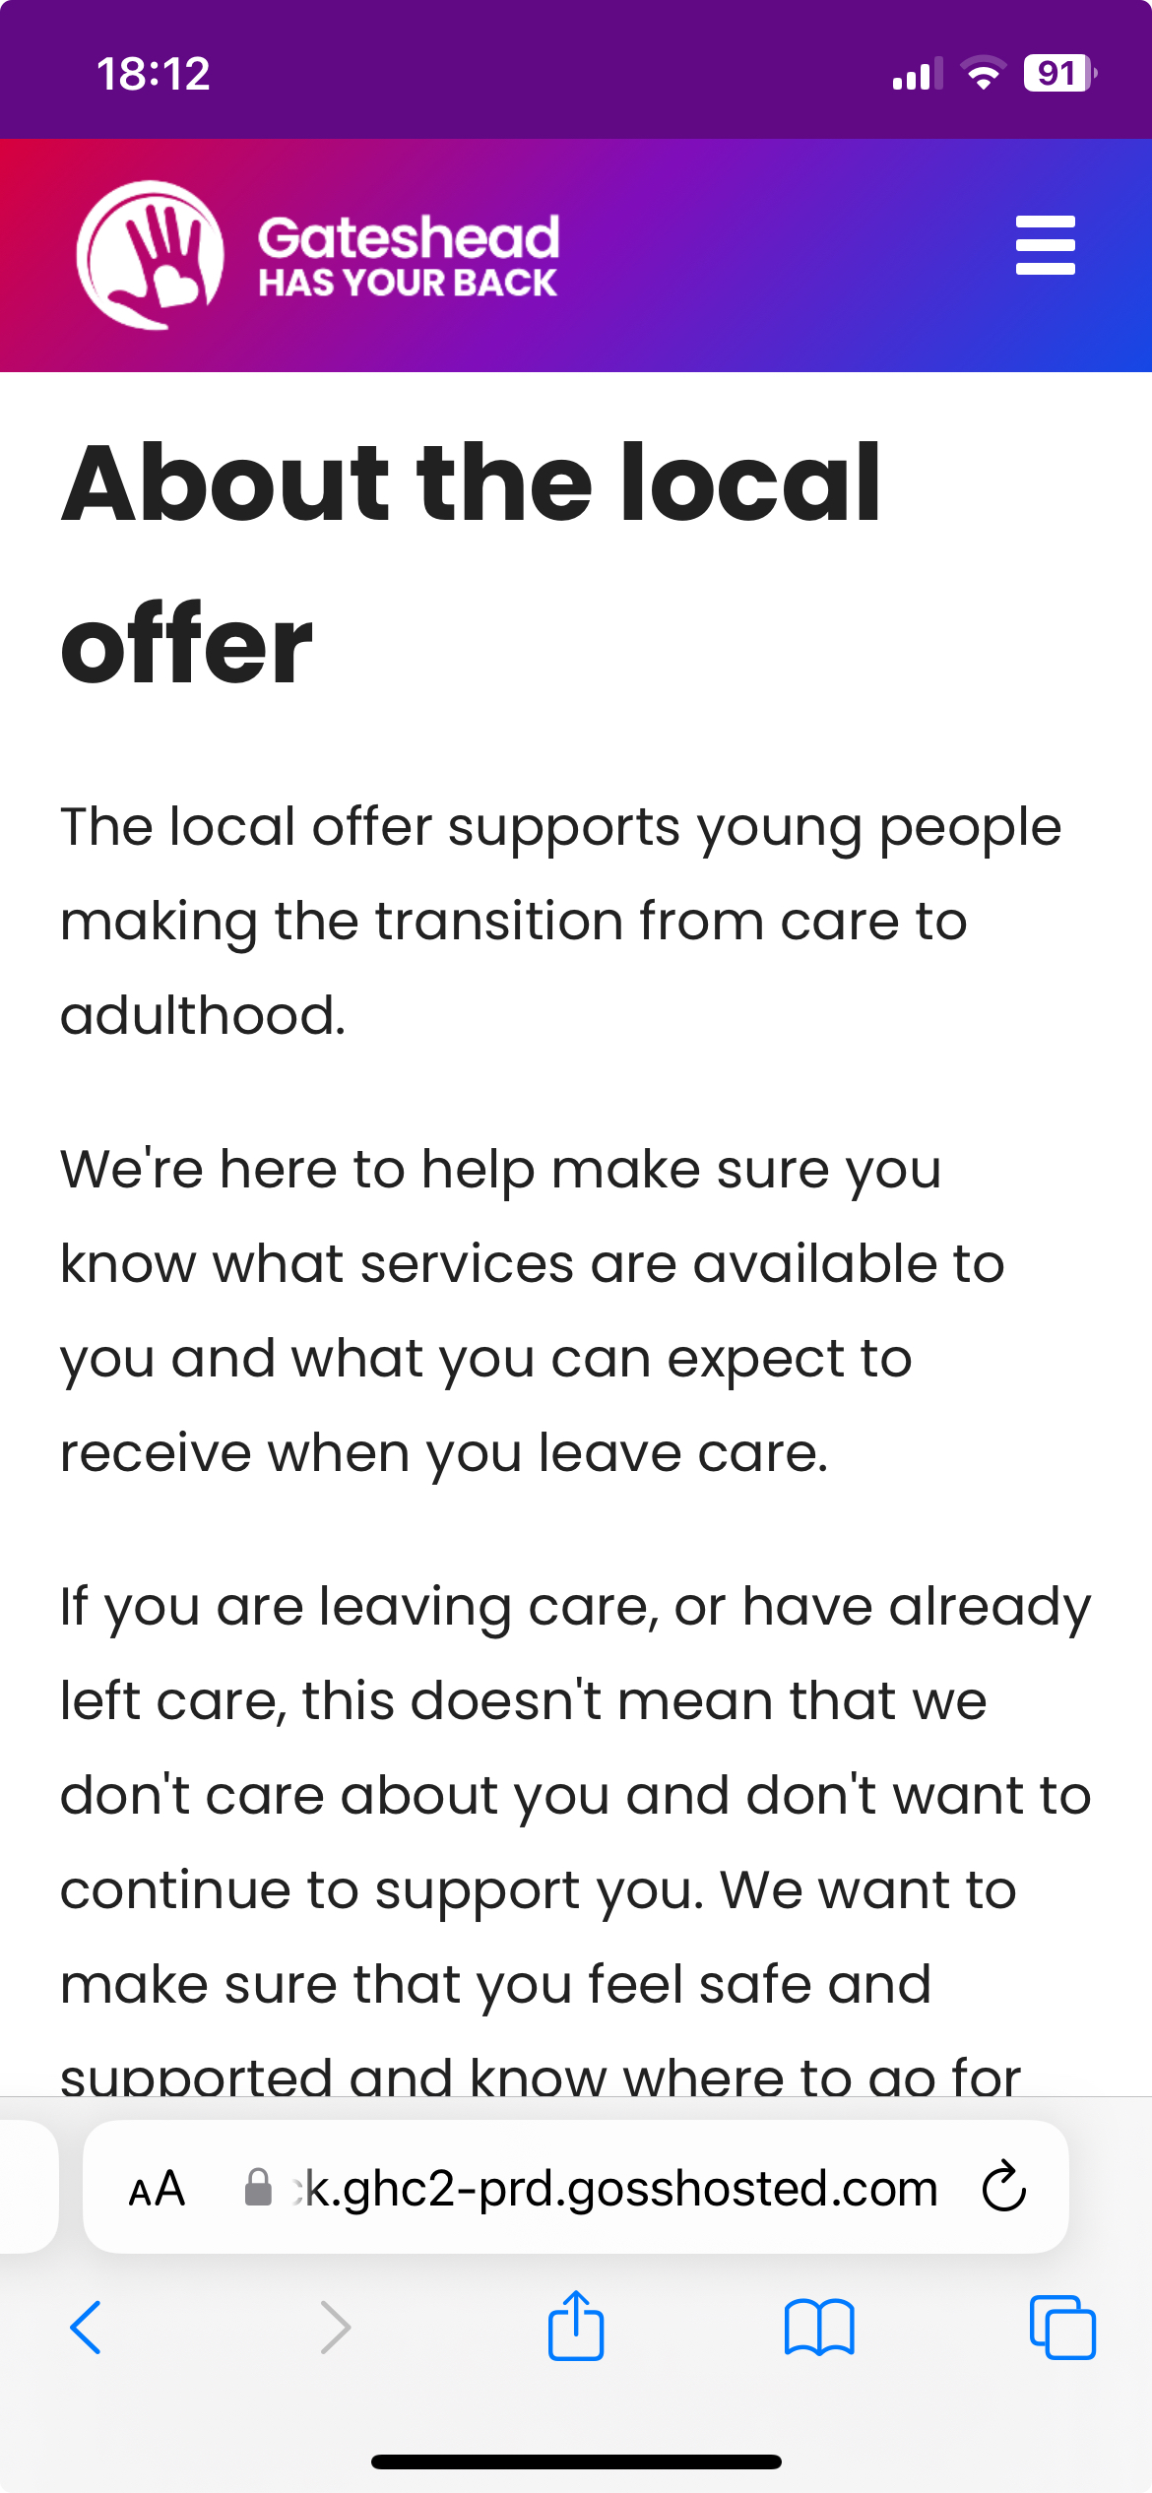
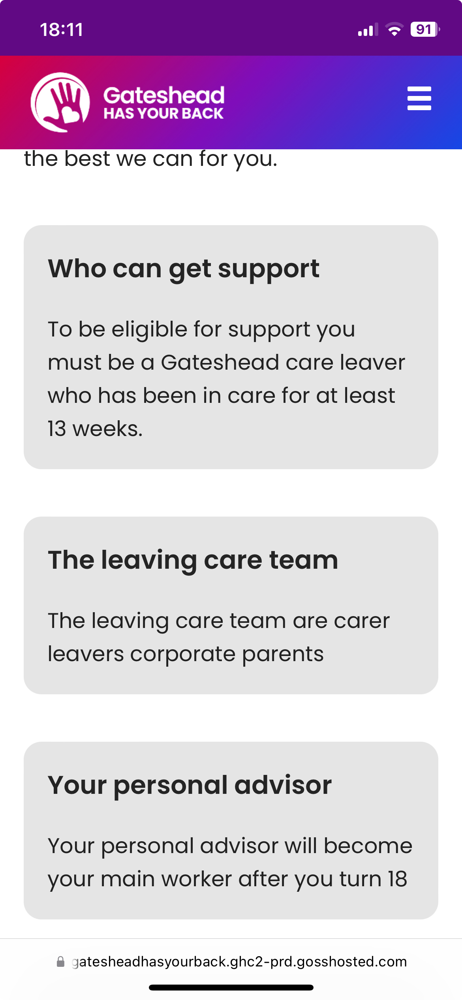
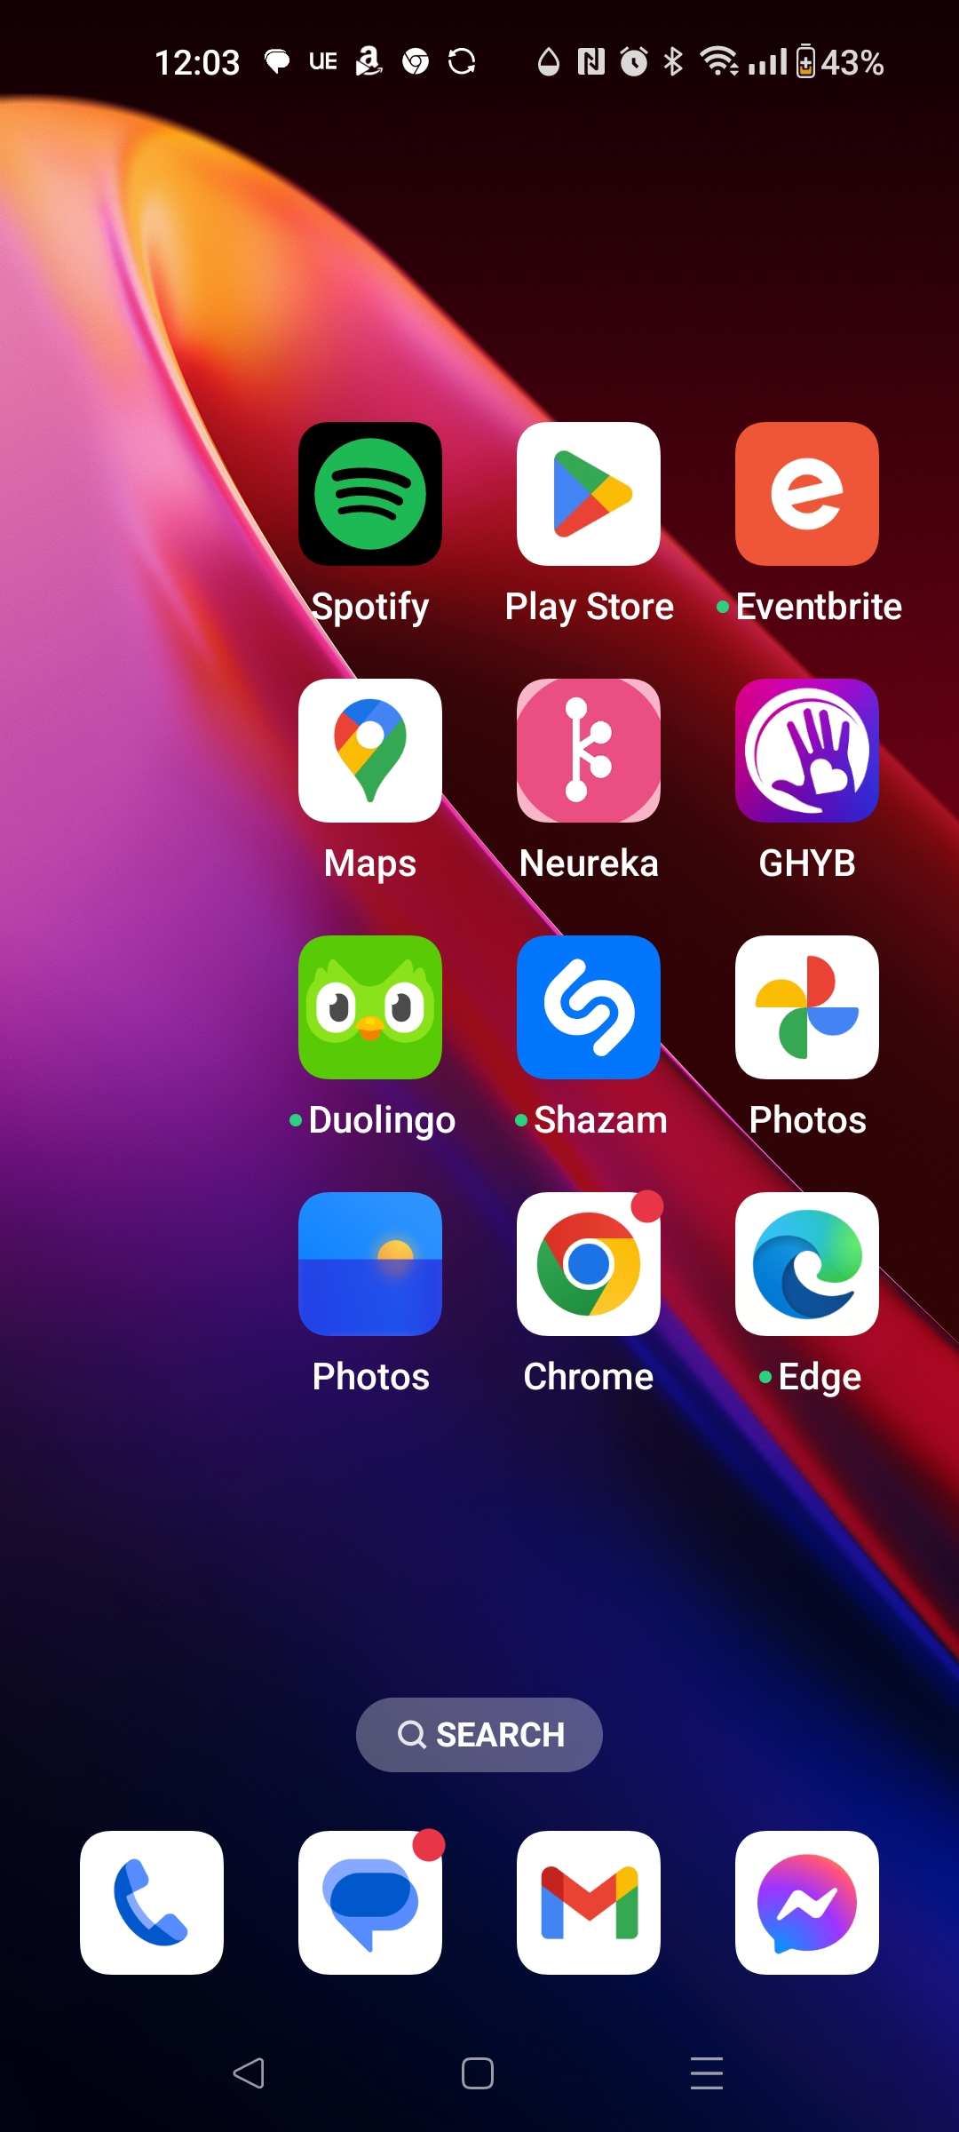
Sprint 8
Design - Gateshead Has Your Back Care Leavers app - after

Slide 6
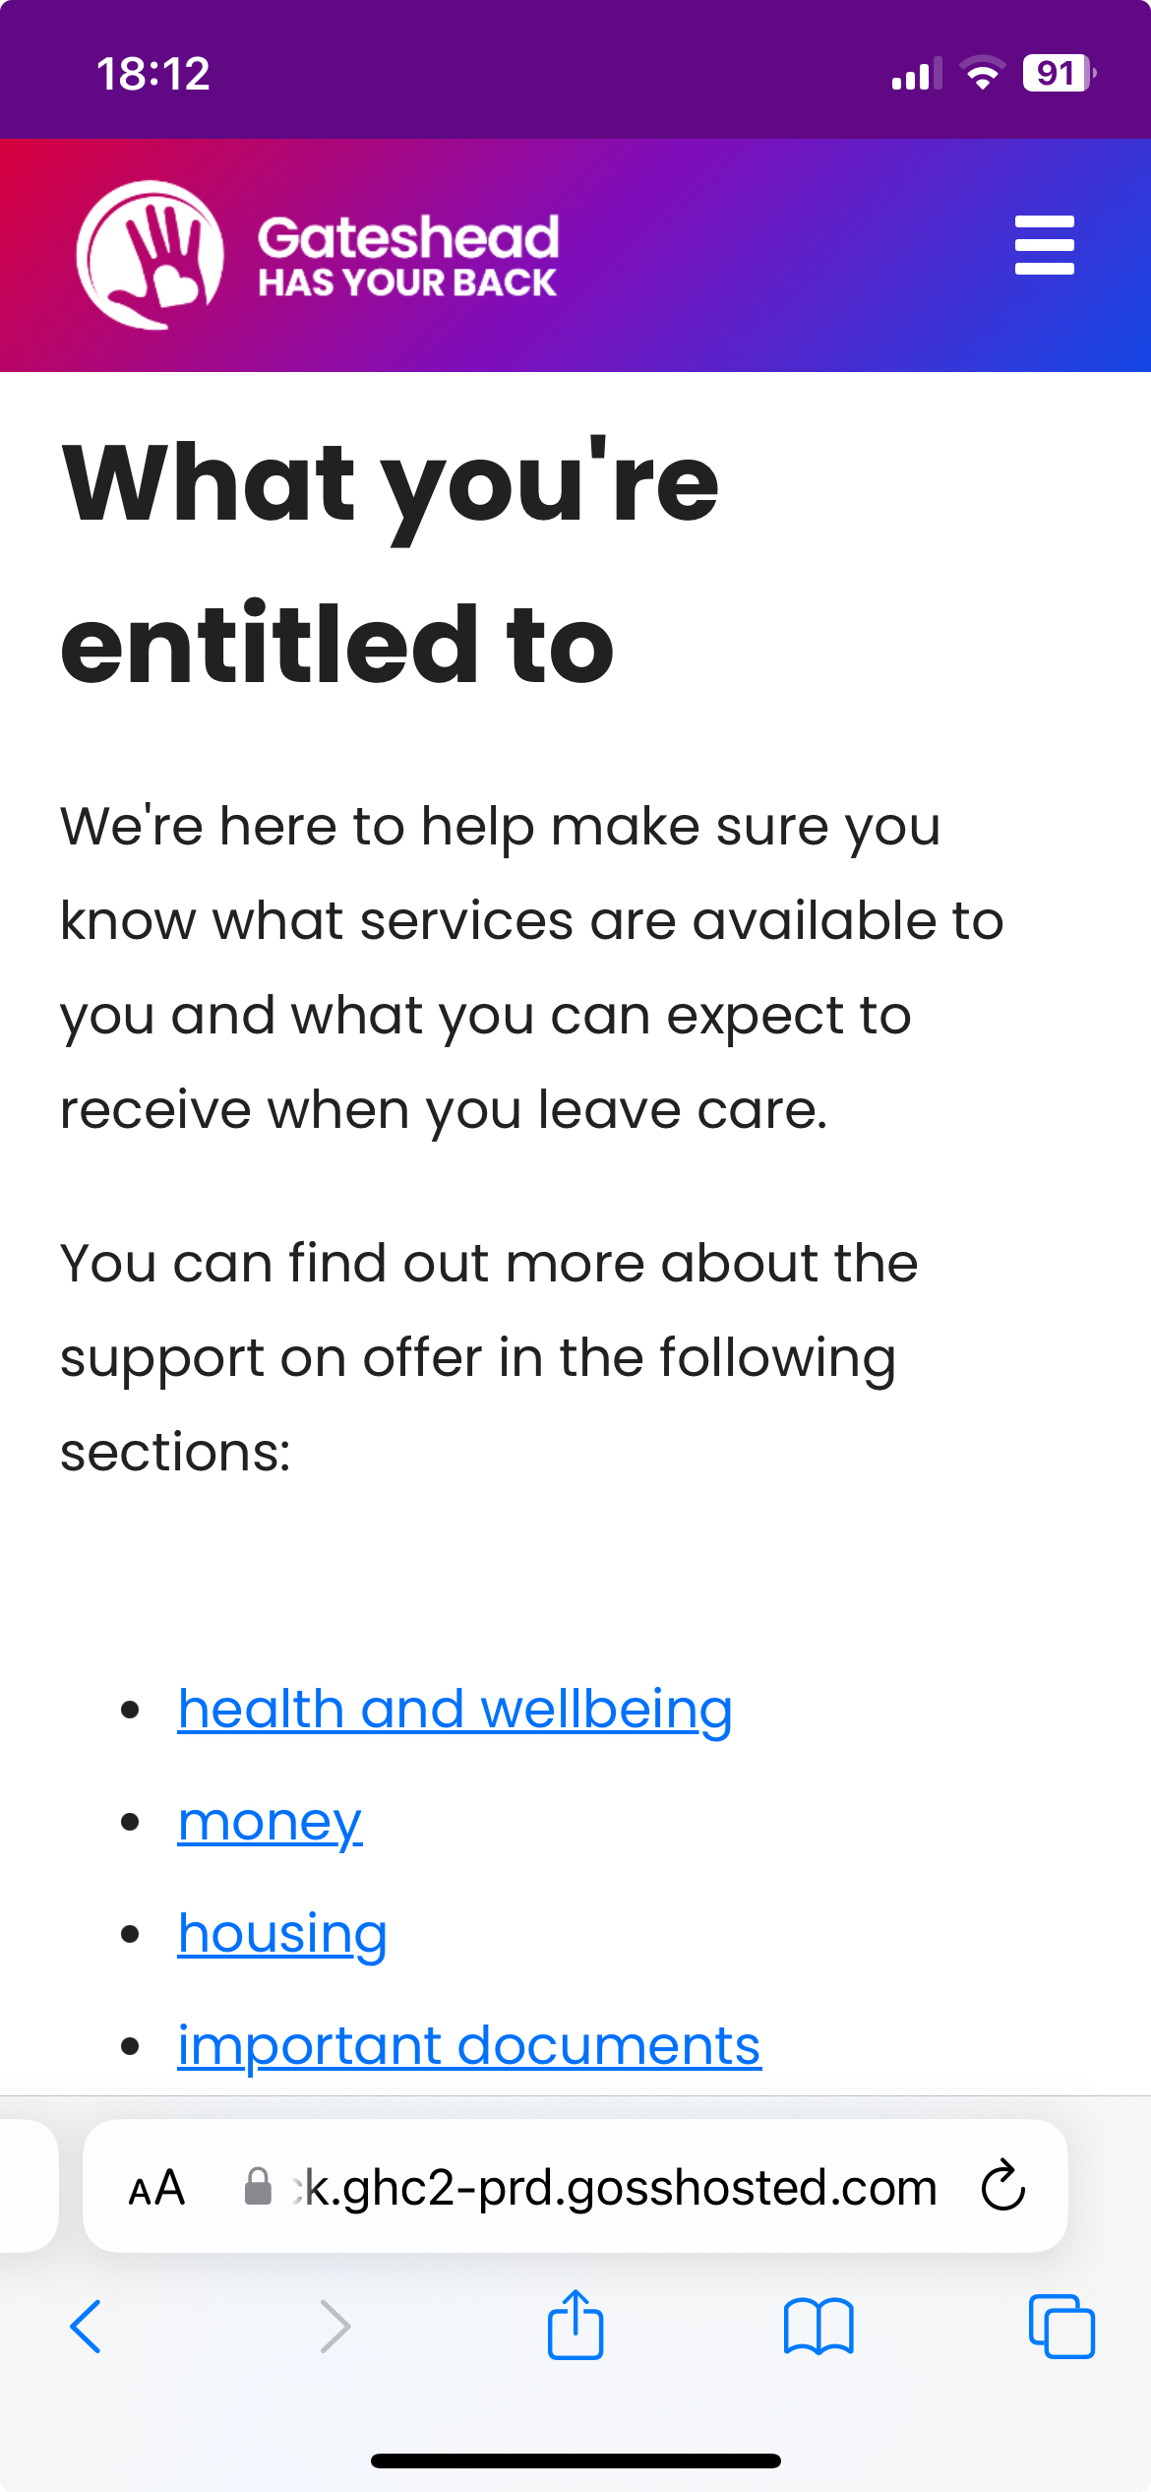
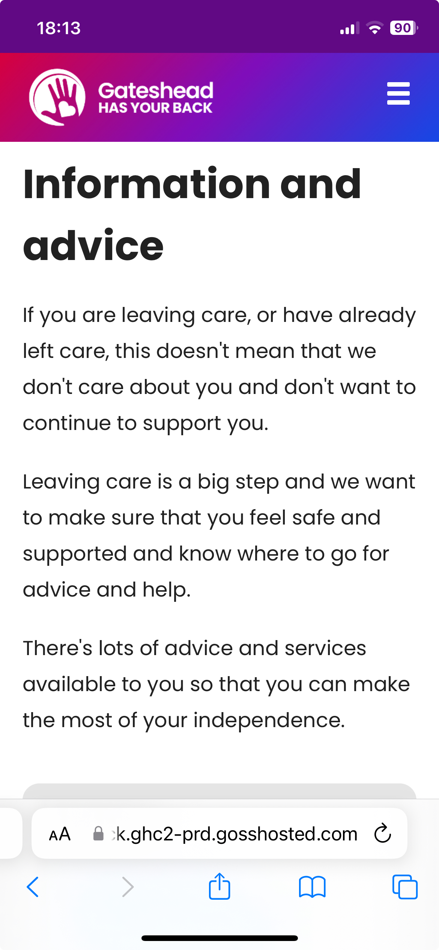
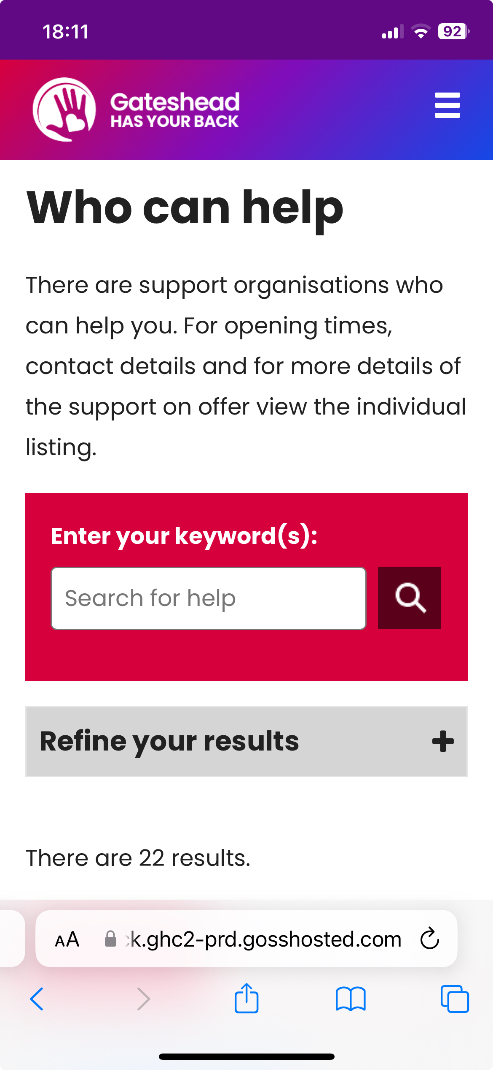
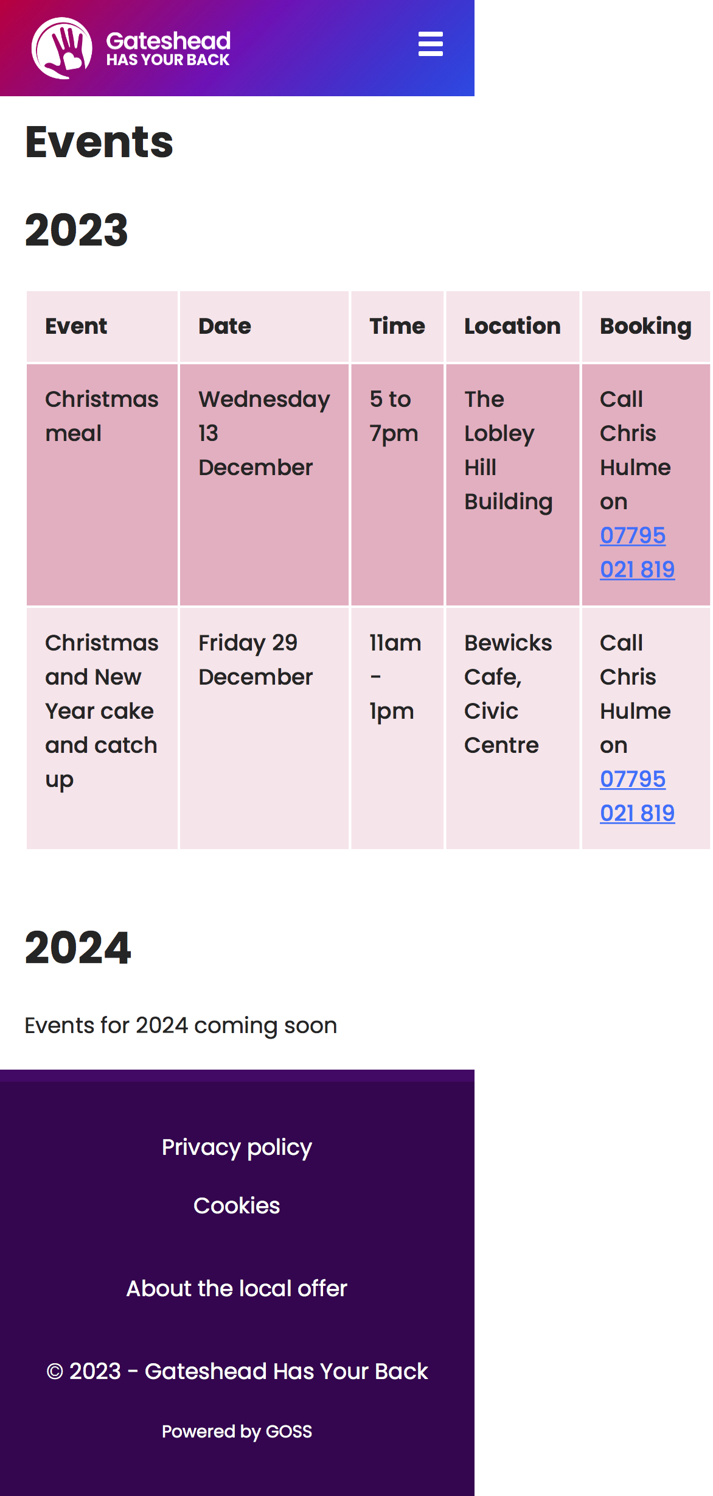
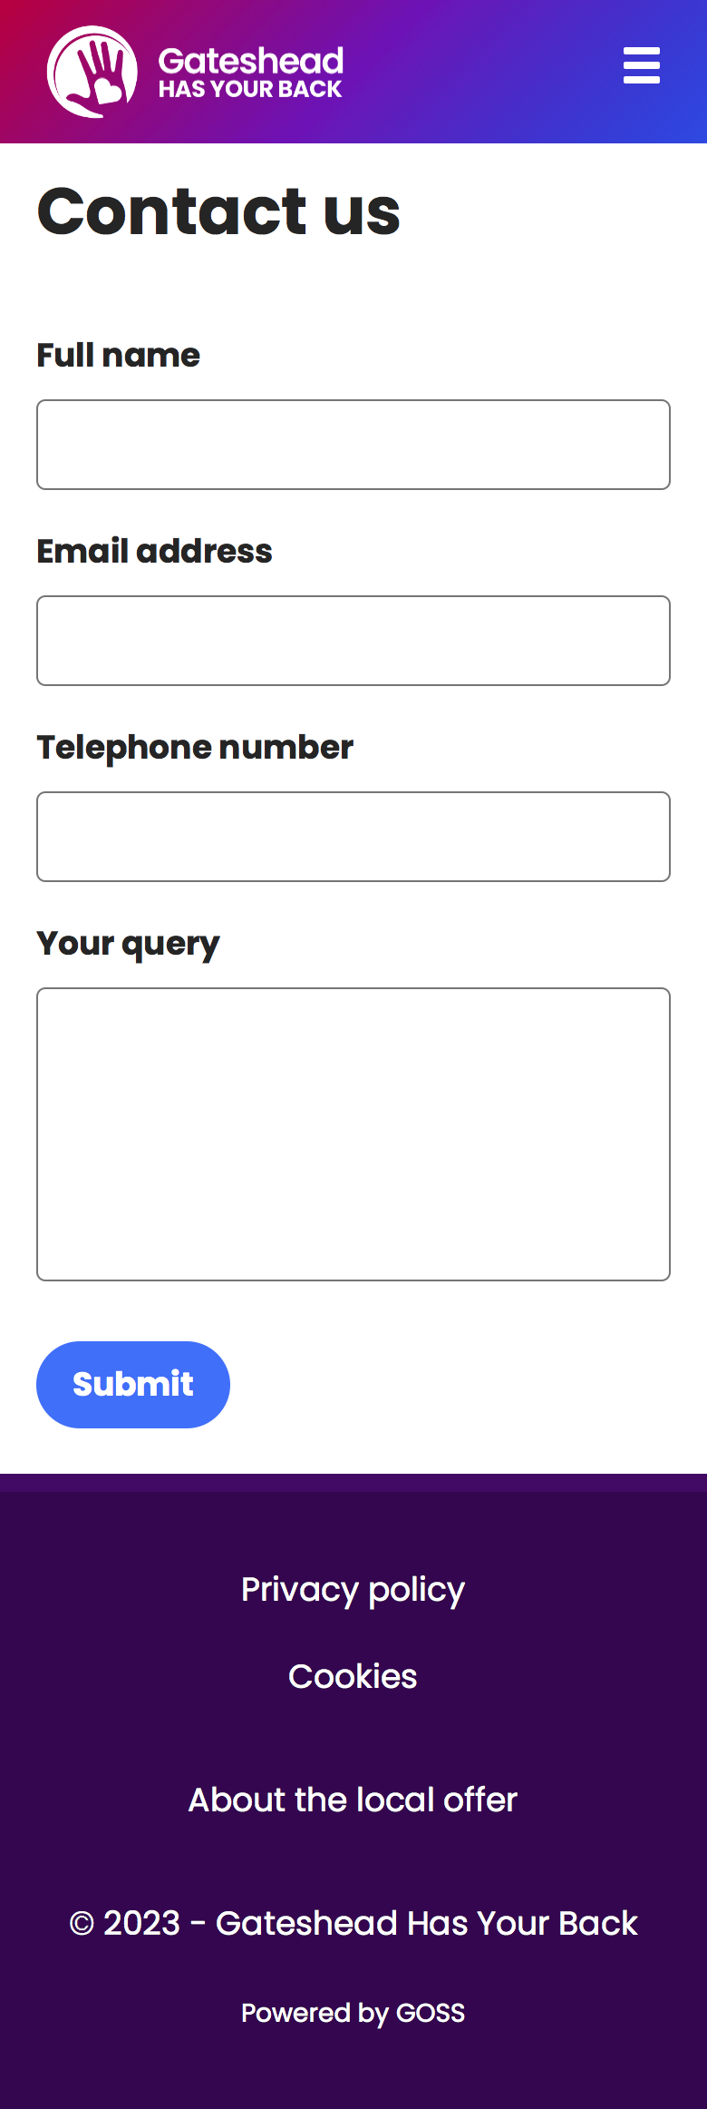
Sprint 8
Design - Gateshead Has Your Back Care Leavers app - after

Slide 7
Sprint 8
Design -
Supply Intranet styling to Engage

Slide 8
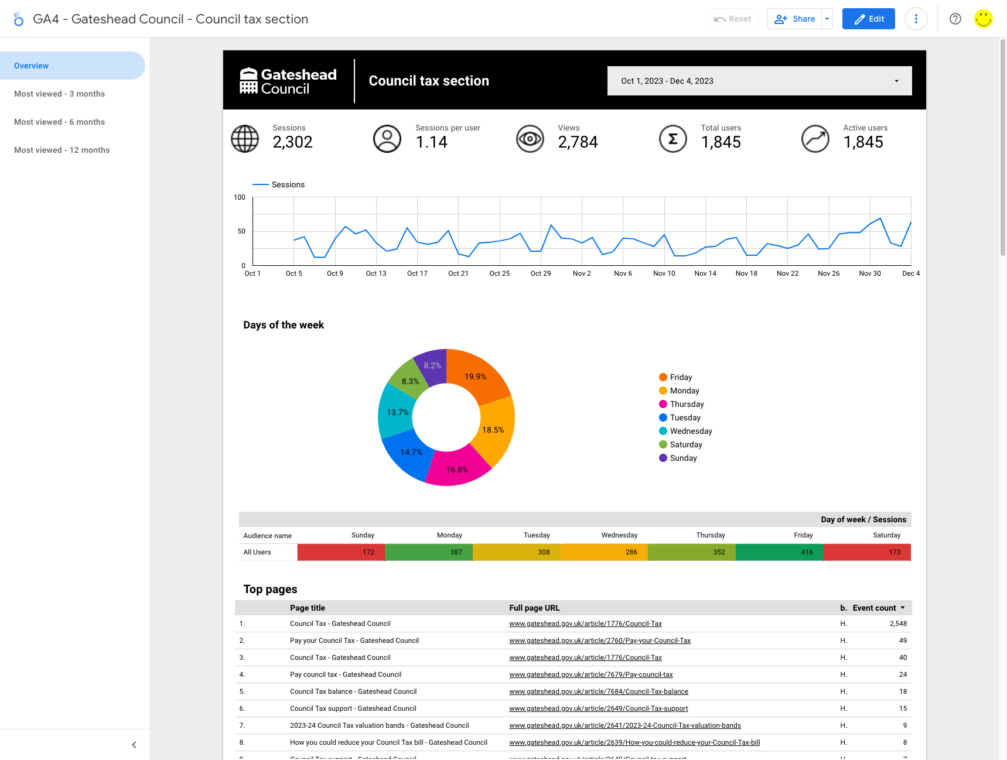
Sprint 8
Design - Data -
GA4 dashboard - Council tax section https://lookerstudio.google.com/s/no8Hby9MUHA

Slide 9
Sprint 8
Content and wireframing
Leader's blog – new area created for Leader's blog and blog for 23 November added
Gateshead Has Your Back care leavers app content
Making Gateshead Thrive new intranet content
Gateshead Now – 23 November and 6 December
Review IA survey on Optimal Workshop
Launch IA survey (Mailchimp campaign)
Updates to Common Assessment Framework page
Damp and mould reporting – wireframe new 'professional' referral route
In-year school transfers web content
Review of Family Hubs listings on Google Maps
Info Governance - Email retention policy content
Selective landlord licensing - Avenues Phase 1 Licensing Area - Midterm evaluation summary
Gateshead News – New edition upload and landing page creation

Slide 10
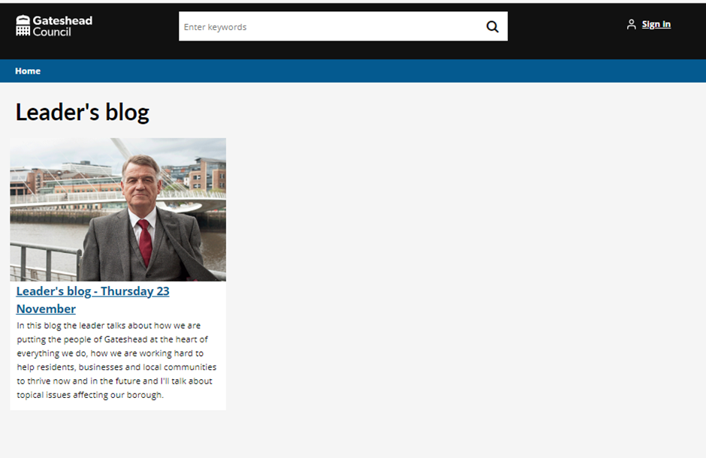
Leader's blog
New Leader's blog area of the website created.
Latest blog for 23 November added with video, links and transcript. Leader's blog home page to be developed as new blogs are added.

Slide 11
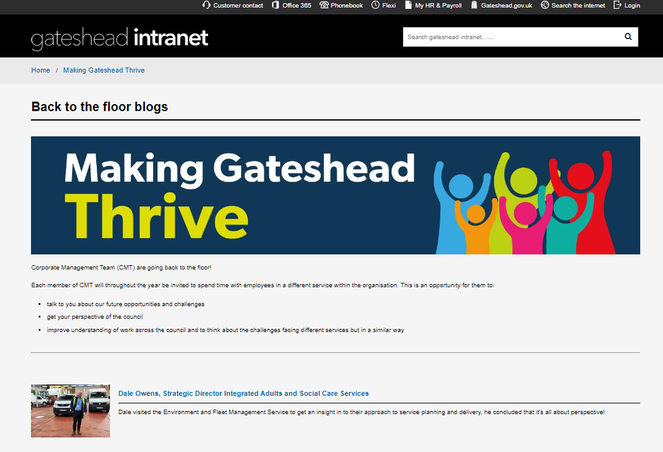
Making Gateshead Thrive intranet content
New Making Gateshead Thrive content added to the intranet
New sections included employee engagement and CMT back to the floor blogs

Slide 12
Gateshead Now – 23 November and 6 December

Slide 13
Review IA survey on Optimal Workshop and launch IA survey (Mailchimp campaign)
Optimal workshop survey: 50 cards to sort into 18 categories
Mailchimp campaign: Sent to our Digital Research panel (216 members)

Slide 14
Updates to Common Assessment Framework page
The CAF process has changed recently for professional referrals and is now an Early Help Assessment.
The service provided FAQs for the website which were re-written as web content.

Slide 15
Damp and mould reporting – wireframe for new professional referral route
The housing service want professionals (for example GPs) to be able to report damp and mould on behalf of a tenant.
This required extra questions to be added to the current form which would only be shown if that route was selected, and the form to skip questions that were only relevant if the tenant was reporting the problem.
We also added some extra questions for all routes through the form – for example details of medical conditions that are being directly affected by damp or mould, and whether there are vulnerable people living in the property.

Slide 16
In year school transfers web content
Review / rewrite the in-year school transfers web content ready for the new form going live.
Removed out of date content which referred to the paper version of the form
Restructured the content to make it more intuitive, as the current page is quite disjointed
Re-wrote the content in Plain English
Added contents list as the page is quite long

Slide 17
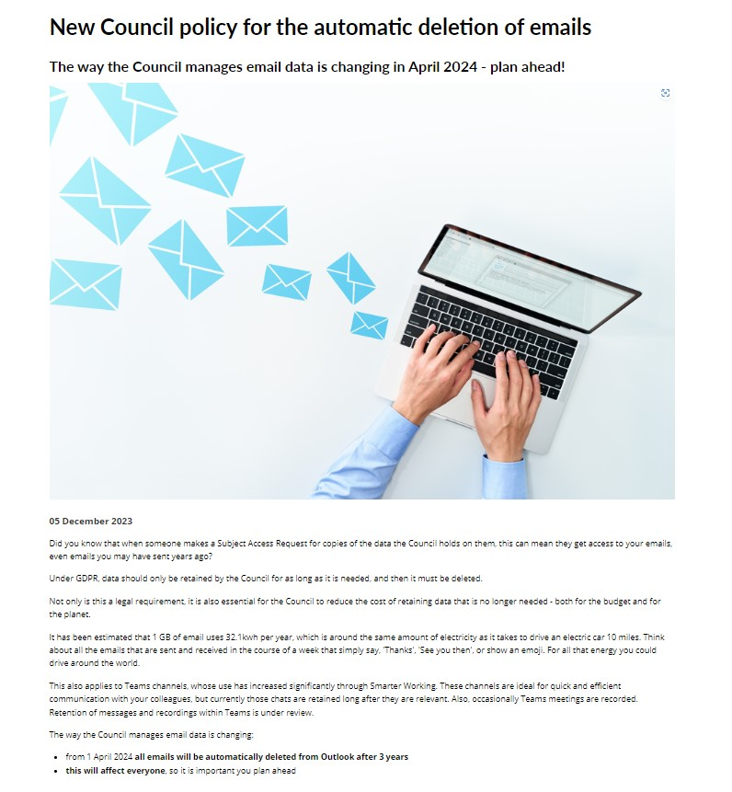
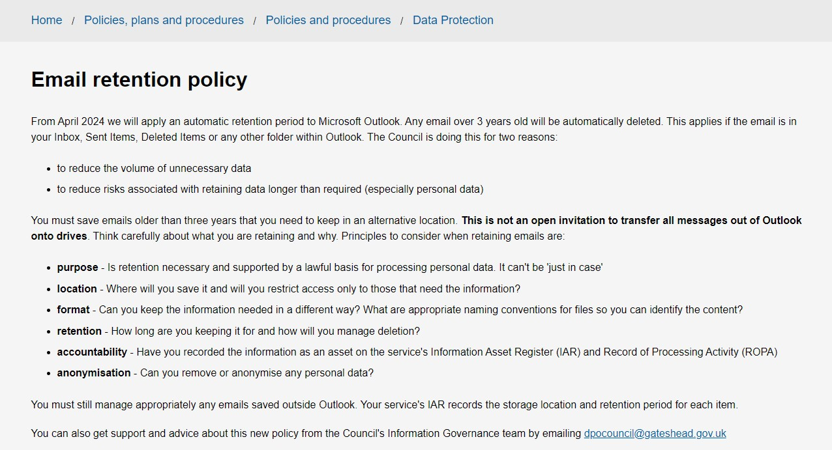
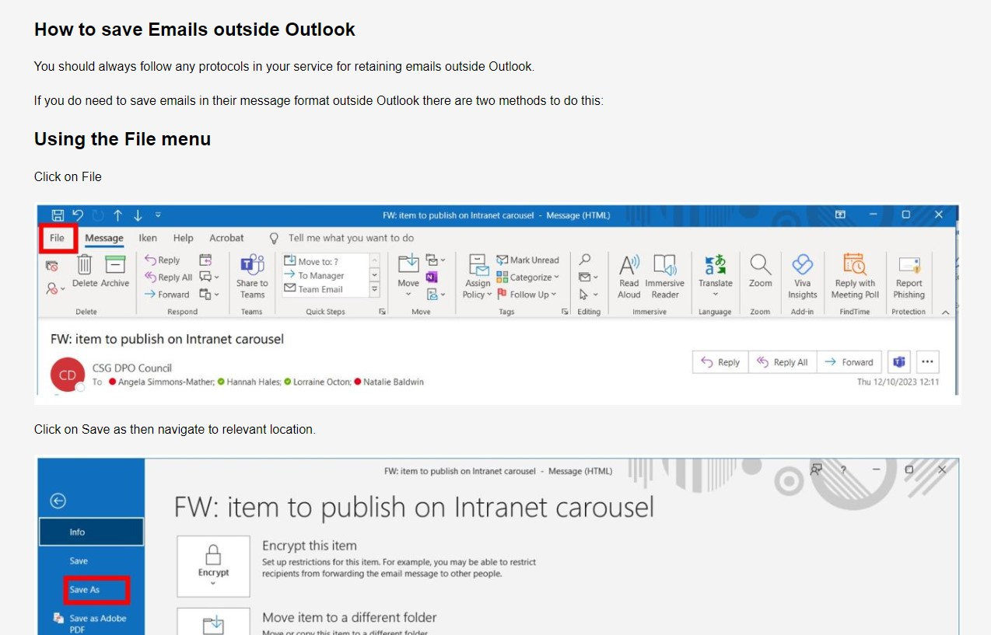
Info Governance - Email retention policy content
New intranet page with instructions added to Data Protection - Gateshead Intranet
Employee news item prepared
Agreed go live for w/c 11 December following service manager circular

Slide 18
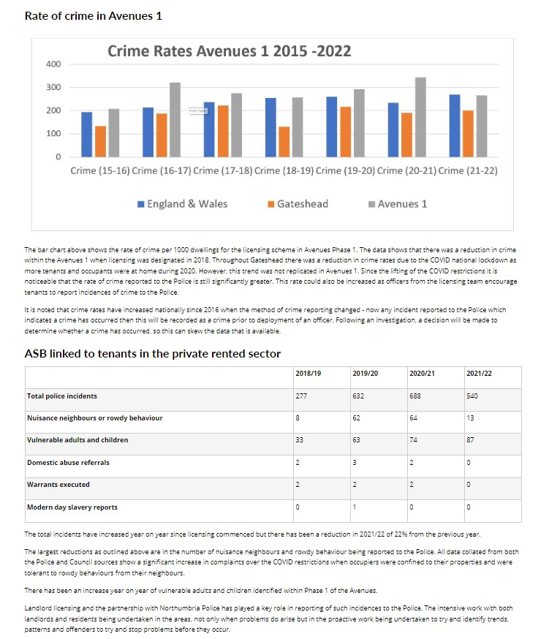
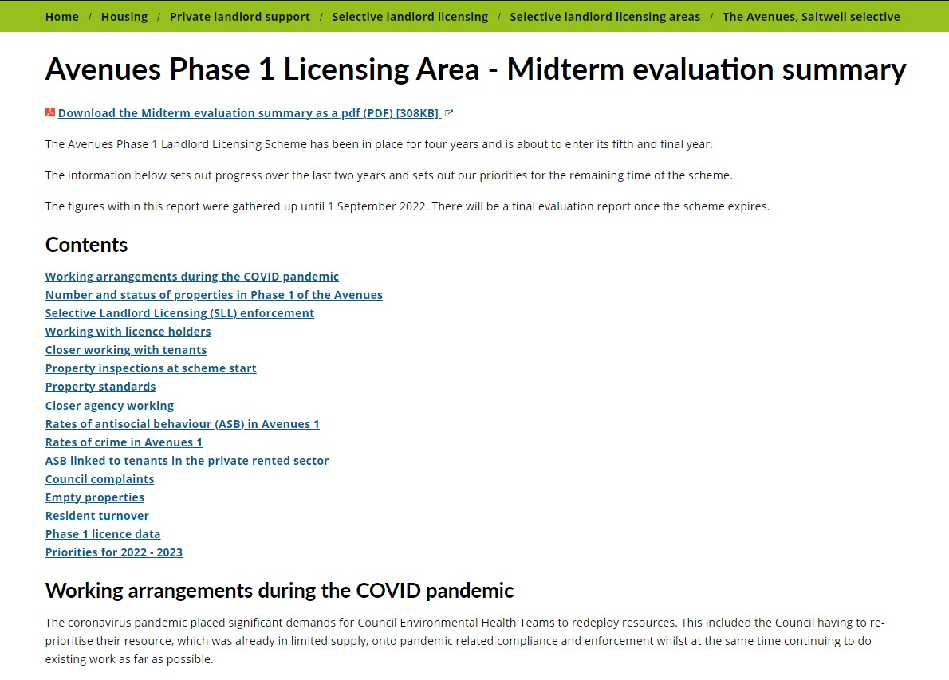
Selective landlord licensing - Avenues Phase 1 Licensing Area - Midterm evaluation summary
Conversion of pdf evaluation report
6K+ words in 16 chapters

Slide 19
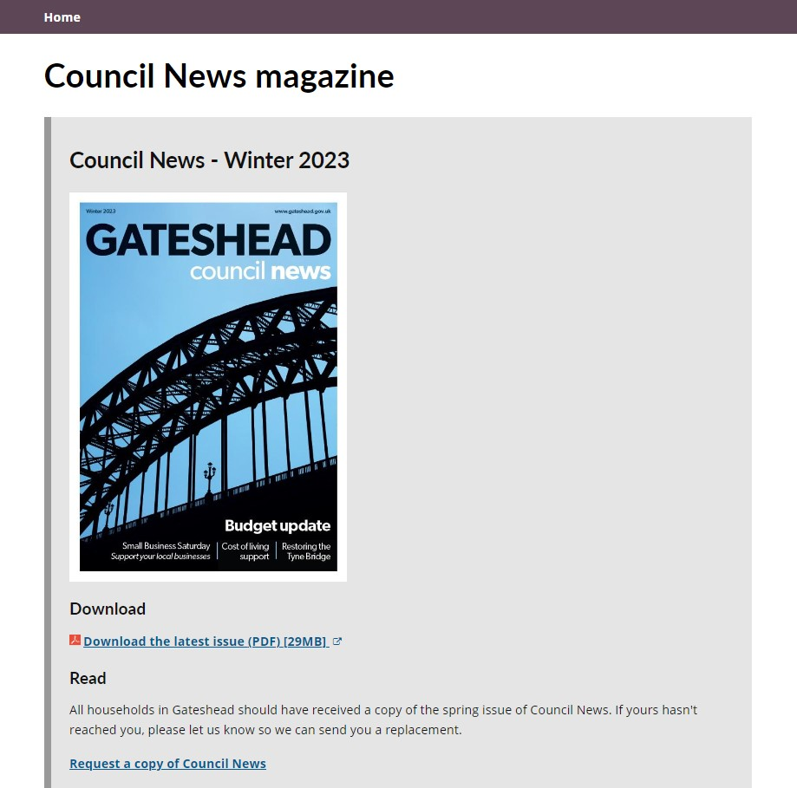
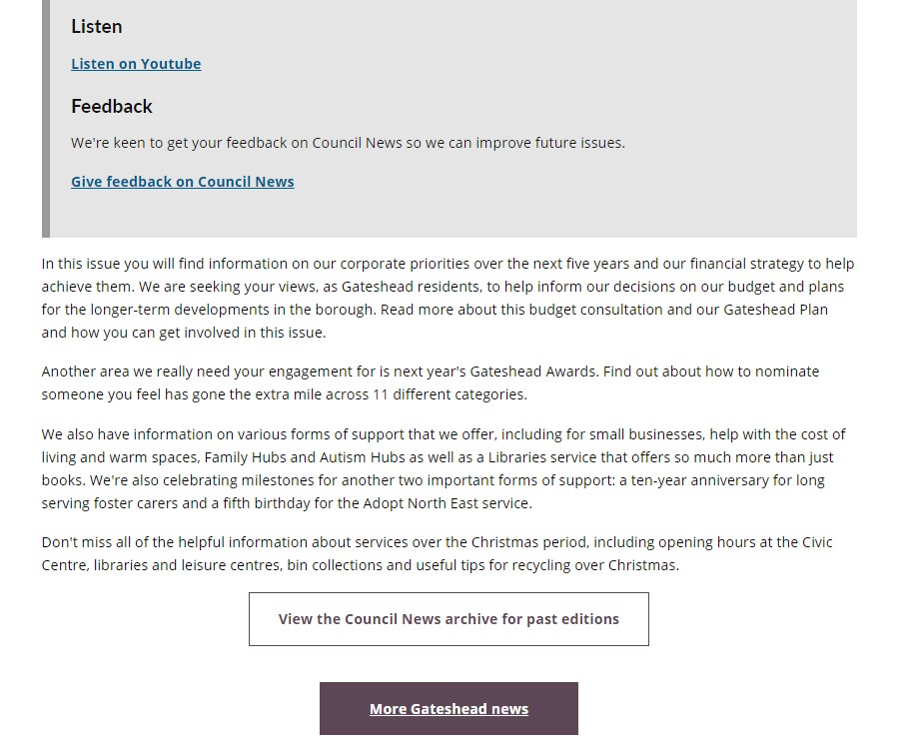
Gateshead News – Winter 2023 Upload and landing page
Drafted new summary text
Upload of audio version, cover image etc.

Slide 20
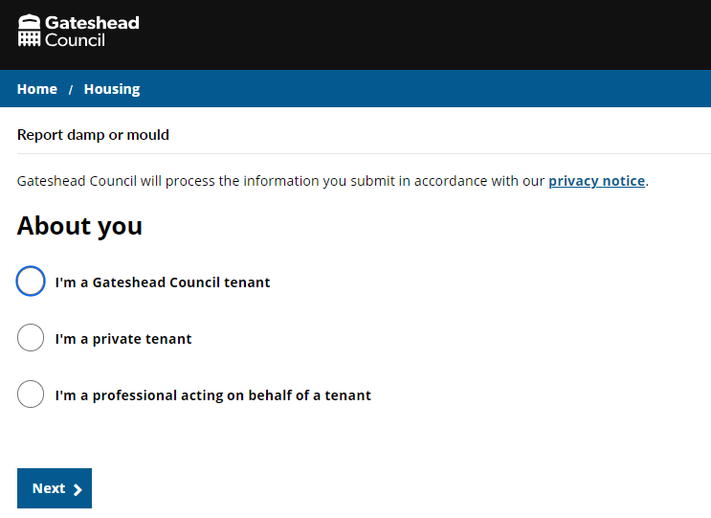
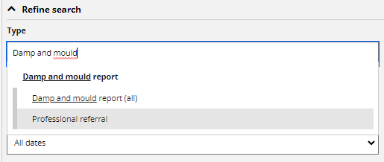
Sprint 8
Development
Development of the damp and mould reporting form allowing professionals to submit on behalf of a tenant.
The route for professionals is shorter and gathers sufficient information to allow the report to be handled.
Once submitted it creates a 'professional referral' case subtype to allow these cases to be separated out from reports from tenants.

Slide 21
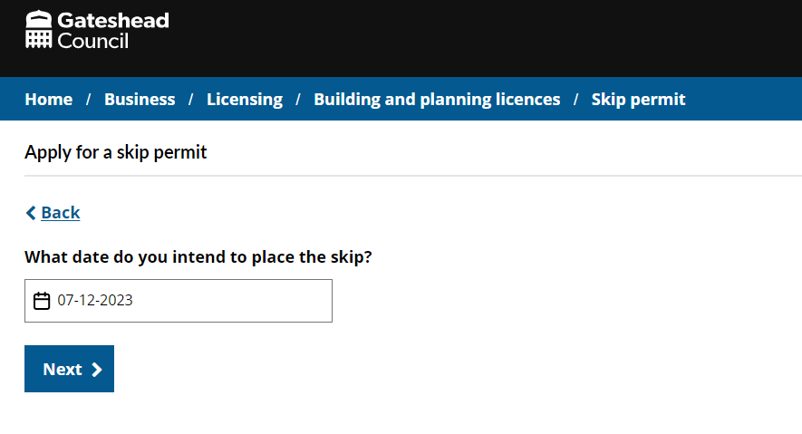
Sprint 8
Development
Skip permits (DCE-7974)- changes made in a previous sprint meant that the applicant wasn't charged the correct amount. This was picked and corrected immediately after deployment.

Slide 22
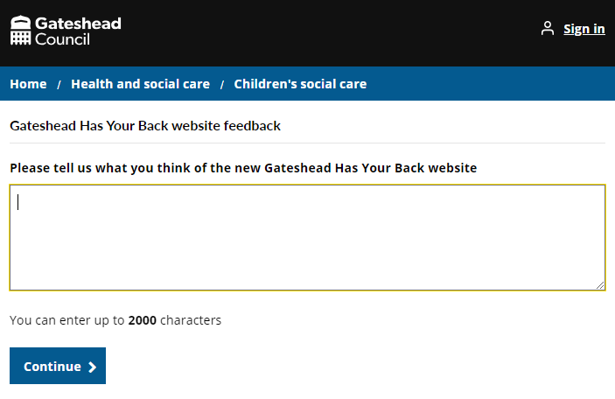
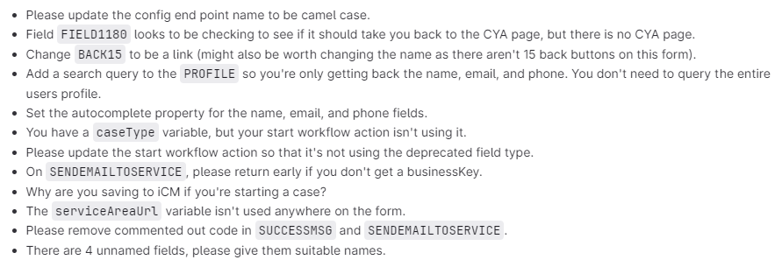
Sprint 8
Development
Code review amends for the Gateshead Has Your Back feedback form.
The changes made from this code review were also implemented in the development of the damp and mould reporting form.

Slide 23
Sprint 8
Testing
Pest control appointments – add case reference numbers
Planning bug on file uploads on householder pre app form
Bin replacement missing business key

Slide 24
Sprint 8
Go live

Slide 25
Sprint 8
BAU/ Other tasks
Engage BPM training
Demo by Helen and Sam

Slide 26
What's coming up in Sprint 10
Discovery
Direct Payments
Waste Escalations
Winter Maintenance
Damp and mould case management
Content
Safeguarding adults board information and guidance section of website
Business Gateshead events listings
Design
STAN case search results
Support from the digital service team form
Local nature recovery strategy website
Development
Payments bug fix and code tidy
Google ads for fostering service
Improvements to replace/repair a bin

Slide 27
Sprint 8
Deployment

