Slide 1
Sprint 7 Show and Tell 29/11/2023
G Squad
Digital Team

Slide 2
Sprint 7.
Data
[DCE-7656] Refactor the filtering for Channel Data dashboard - Jira (gossinteractive.com)
[DCE-7917] Fix timeouts on Power BI refresh for Garden Waste Data - Jira (gossinteractive.com)
Dashboard

Slide 3
Sprint 7.
Discovery
Business rates change of address discovery
Uptake of Financial Assessments digital process

Slide 4
Sprint 7.
Content and wireframing
SEO powerpoint for content team
Crib sheet for Libraries

Slide 5
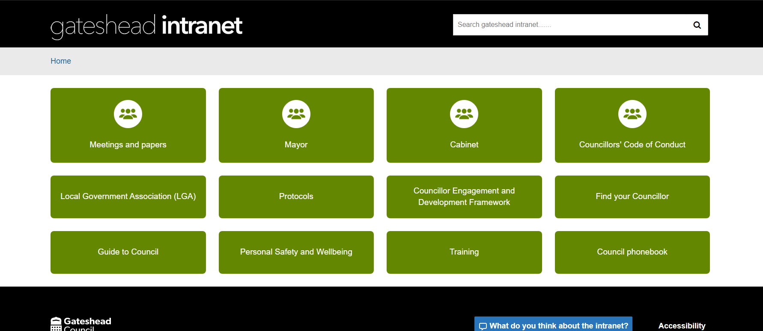
Further improvements to Councillors pages and Employee wellbeing pages on the Intranet live 28/11
Employee health and wellbeing - Gateshead Intranet
Councillors - Gateshead Intranet

Slide 6
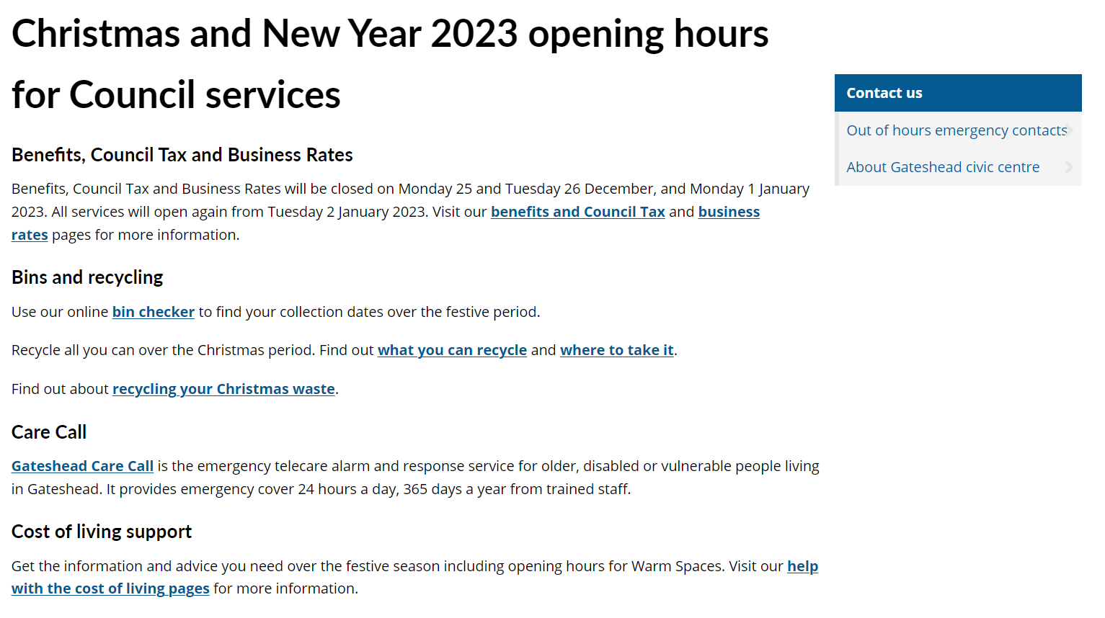
Sprint 7.
Content and wireframing

Slide 7
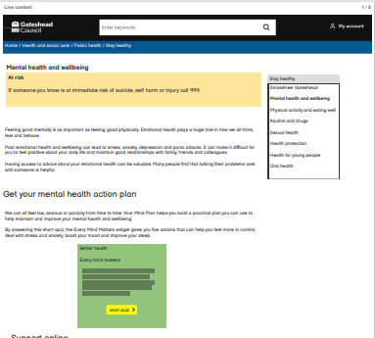
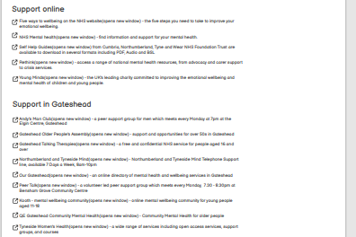
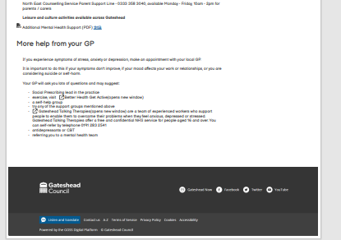
Sprint 7.
Content and wireframing
Public health, stay healthy, current health and wellbeing content

Slide 8
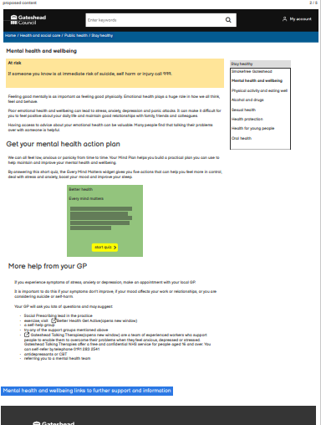
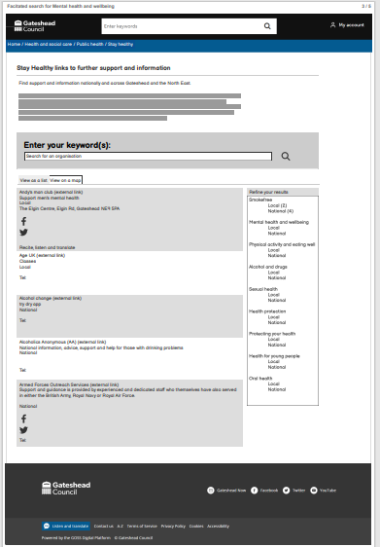
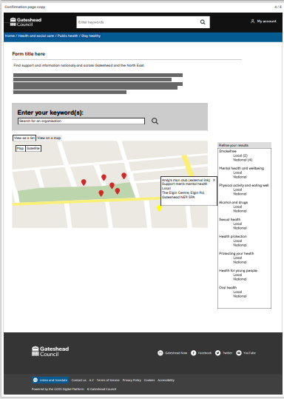
Sprint 7.
Content and wireframing
Streamlined content along with a faceted search list and map

Slide 9
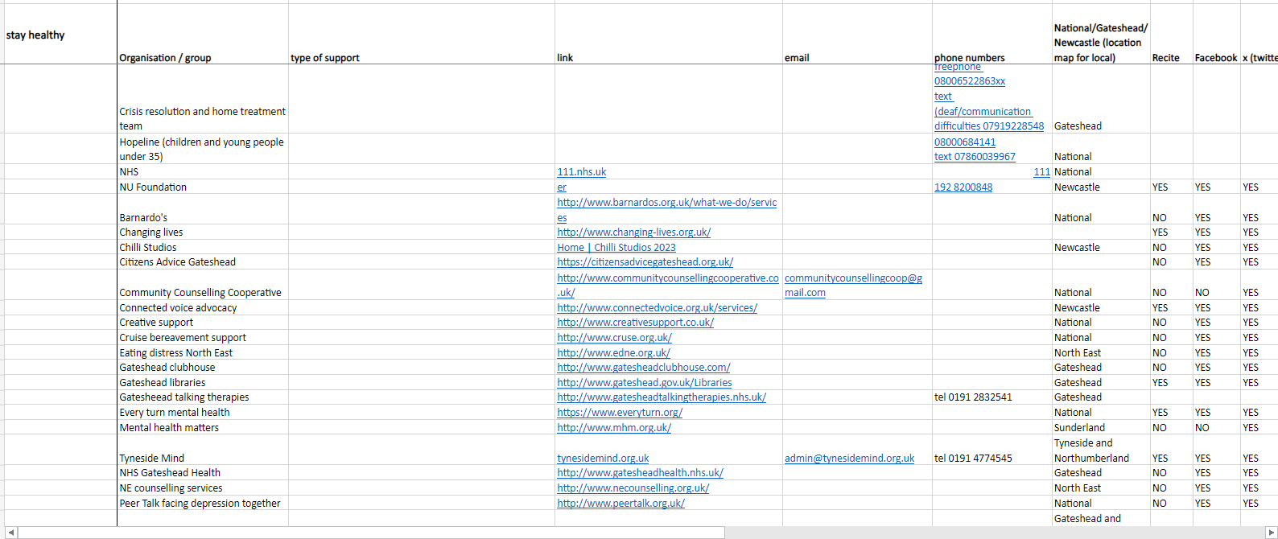
Sprint 7.
Content and wireframing
Organisations and groups listed on Stay healthy content

Slide 10
Sprint 7.
Content and wireframing
Public health annual report – Behind the masks 2021
83 pages
12 sections

Slide 11
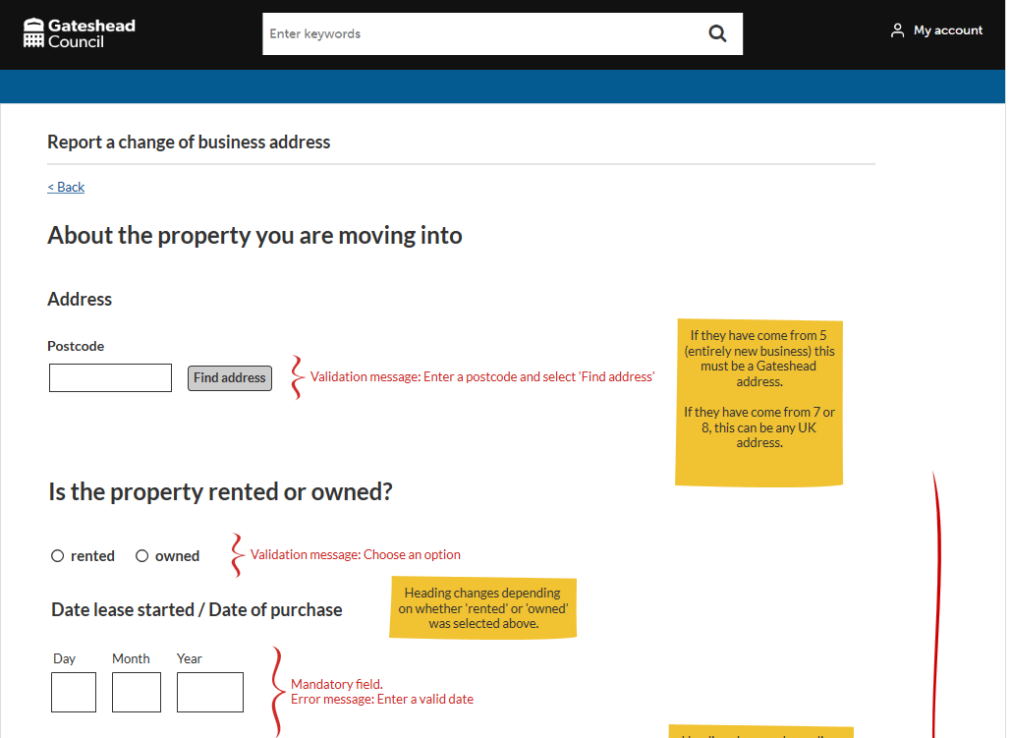
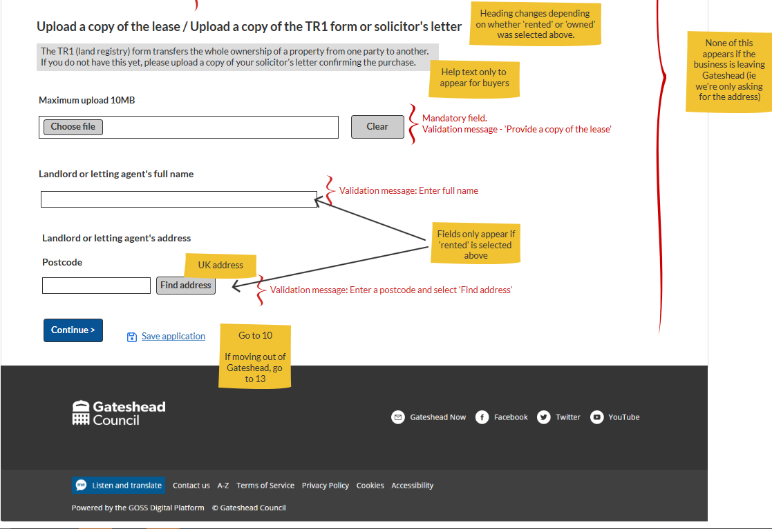
Sprint 7.
Content and wireframing
Business rates change of address form wireframe
Lot of logic; several possible customer journeys/scenarios:
New business/business moving into Gateshead
Business moving within Gateshead and keeping old property
Business moving within Gateshead and leaving old property
Business moving out of Gateshead
Business closing altogether
UAT checklist created for the service

Slide 12
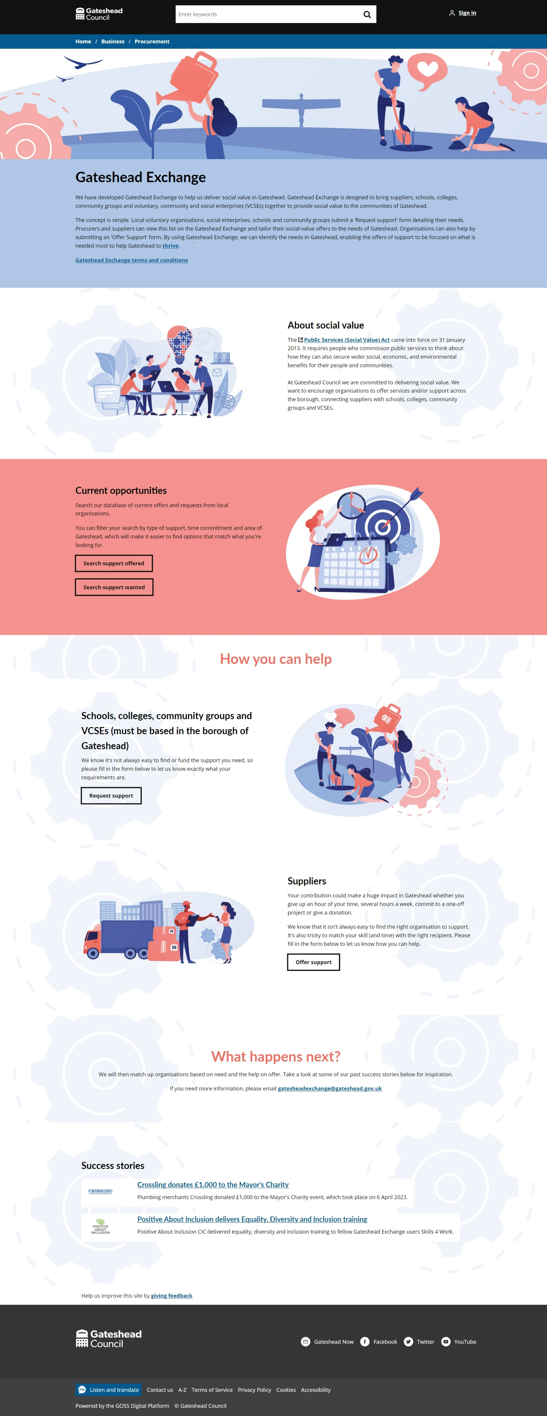
Sprint 7.
Content and wireframing
Added success story to Gateshead Exchange

Slide 13
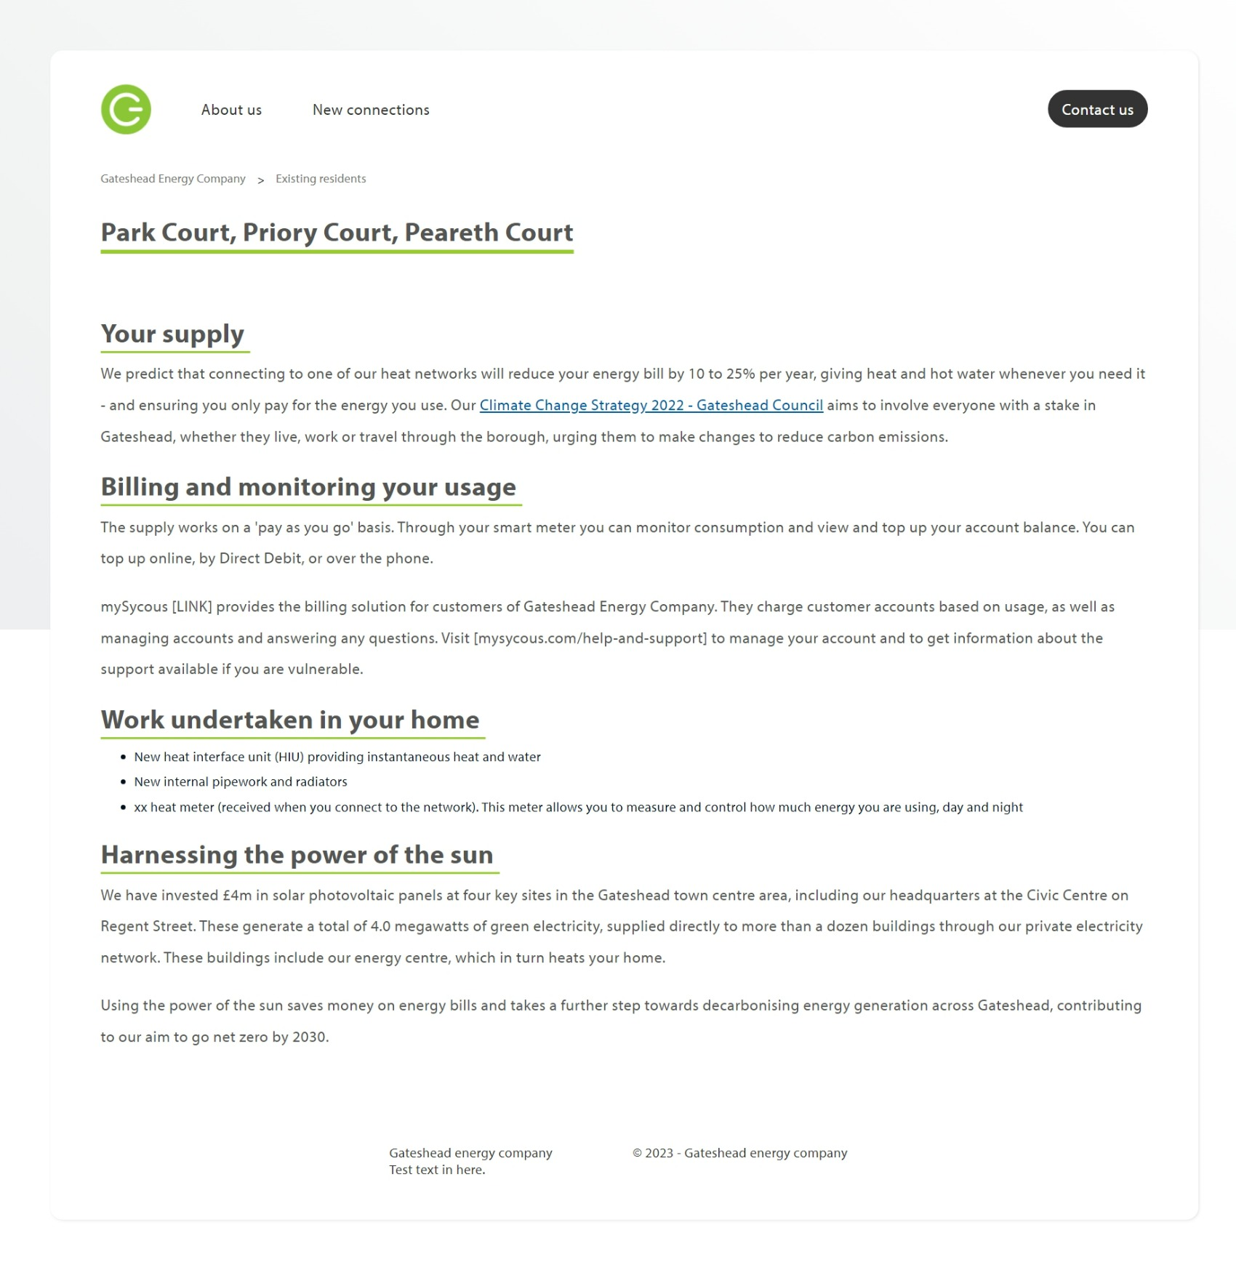
Sprint 7.
Content and wireframing
Gateshead Energy Company microsite Content (provided by service) edited and entered into iCM
Snippet of repeated content:

Slide 14
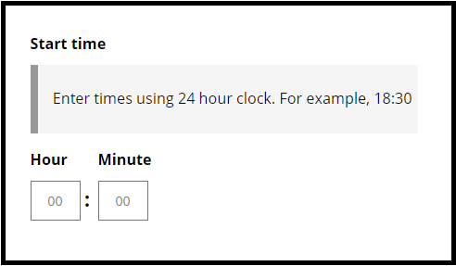
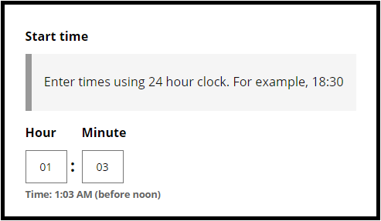
Sprint 7.
Time input R&D
Challenges:
Confusion in time inputs identified by GDS.
Issues include 24-hour vs. 12-hour confusion, Midnight/Noon ambiguity, AM/PM uncertainty, and suboptimal mobile experience for type=time inputs.
Solution:
Clearly define format with example.
Clear labels and specified input format using placeholders.
Autofill leading zeros if omitted.
Display inputted time in 12-hour format, indicating before or after noon.
Validate non-digit characters; limit 2 characters per input.
Improve accessibility with ARIA tags for reading 12-hour format.
Outcome:
Significantly enhances user experience through clear guidelines, auto-filling, 12-hour display, explicit indications, and stricter validation.

Slide 15
Sprint 7.
Development
Update payment reconciliation endpoint to handle file uploads
Waste Permits. Text change in the form
Indoor Bulky Waste collections - Unnecessary bullet point
Garden Tidy Service form – remove reference to Keelman Homes
Housing complaints form - remove reference to Keelman Homes
Change wording on replace a bin form so bin and bins are used consistently
Pest control appointments - add case reference numbers and View Case button
Skip membership expiry date prompt
Ongoing development of Temporary Traffic Regulation Order process to improve information around closure types, and automatic inclusion of ward, as well as some minor text and logic changes.

Slide 16
Sprint 7.
What's next?
Council Tax discovery
Scaffolding permits discovery
Business rate change of address form build
Payments - bug fixes and code tidy
Walk and wheel referral form
Libraries bookings

