Slide 1
Sprint 6 Show and Tell 22/11/2023
C Squad
Digital Team

Slide 2
Sprint 6
Discovery
Damp and mould reporting form
Redesign of current form
Direct Payments
Data analysis
Review discovery with Revs and Bens
Waste Escalations
Analysis of waste escalation data
Winter Maintenance Review
Process mapping

Slide 3
Sprint 6
Design
Site not displaying correctly on Galaxy S23 Ultra
My Gateshead account - HWRC field not showing in mobile view
Late school applications – styling
Intranet - Use news hub to display the news on the Gateshead Intranet
Hint text is overlapping the question in forms
STAN site testing - Call to action buttons
STAN site testing – List styling
8x8 icon for customer contact navigation
Gateshead Has Your Back site styling

Slide 4
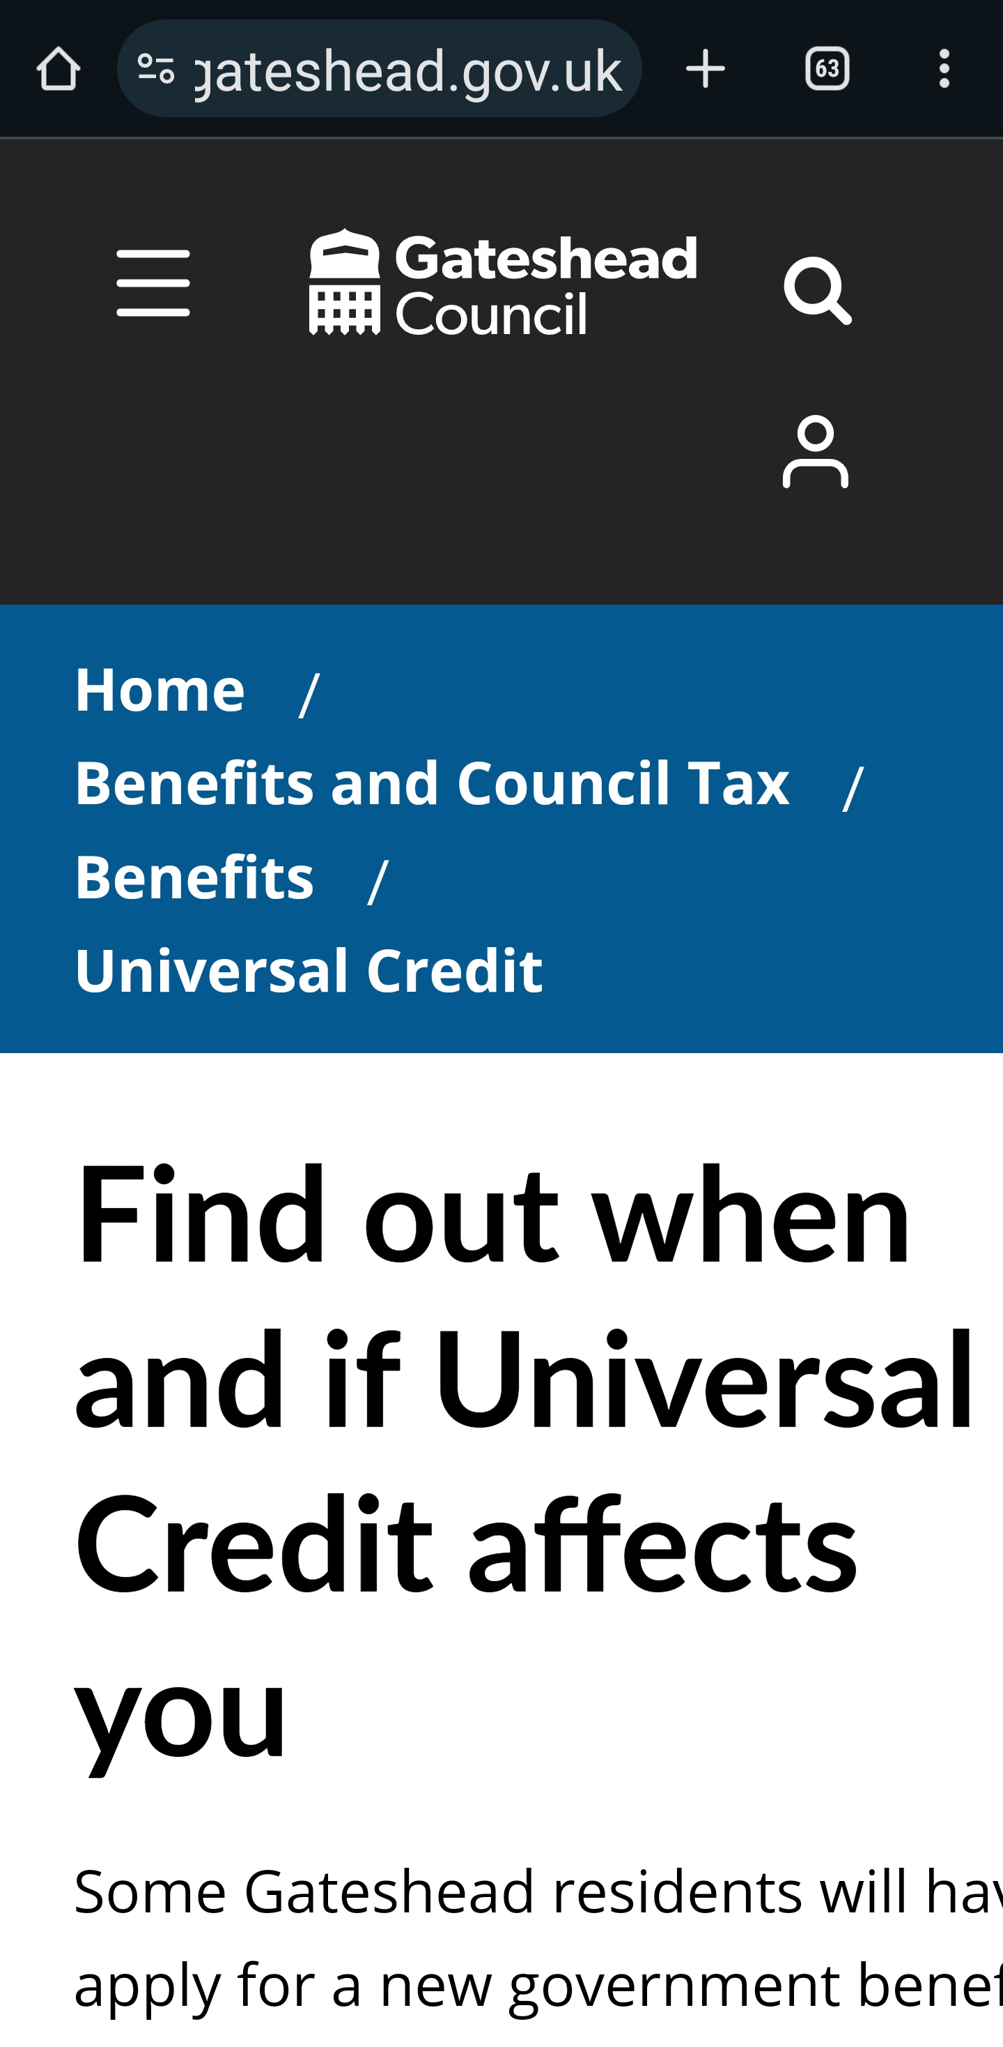
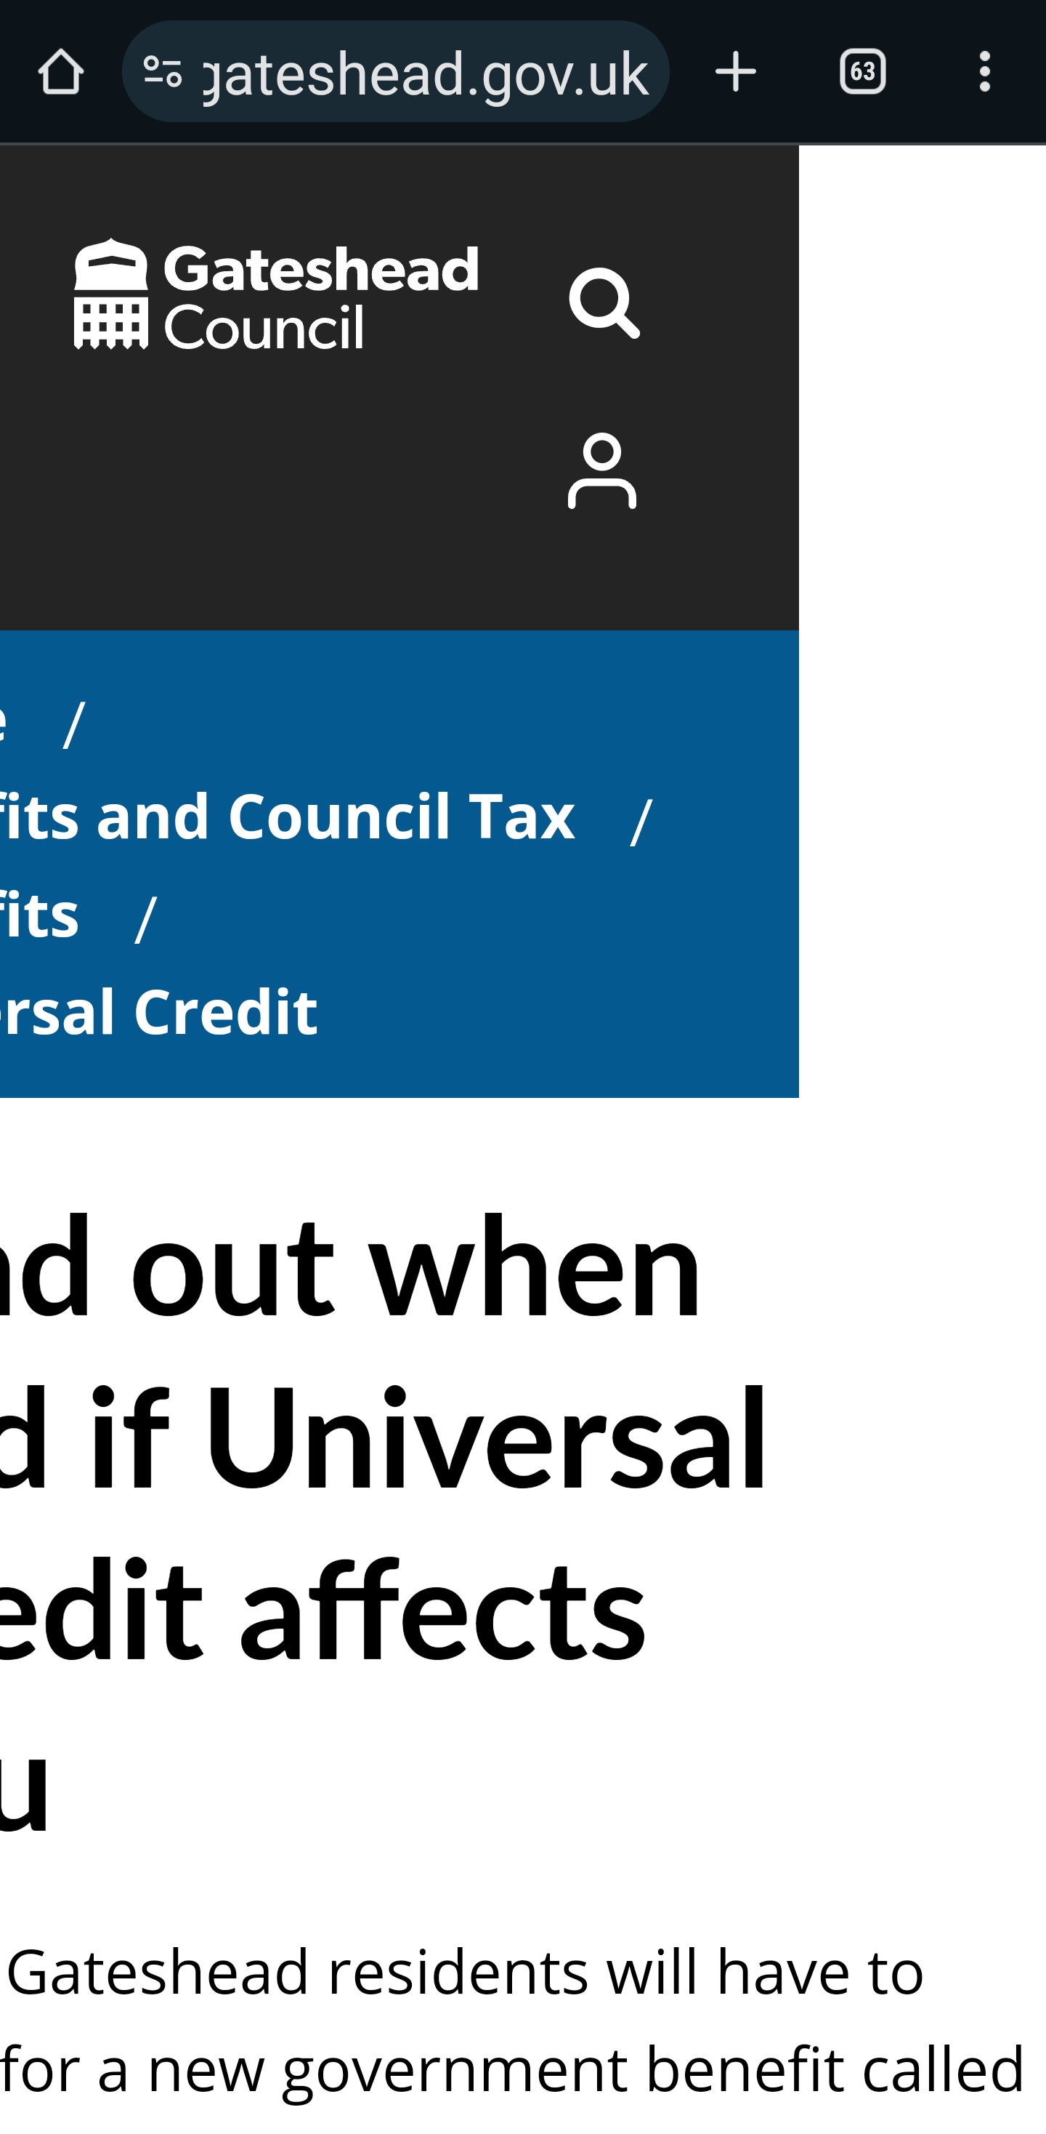
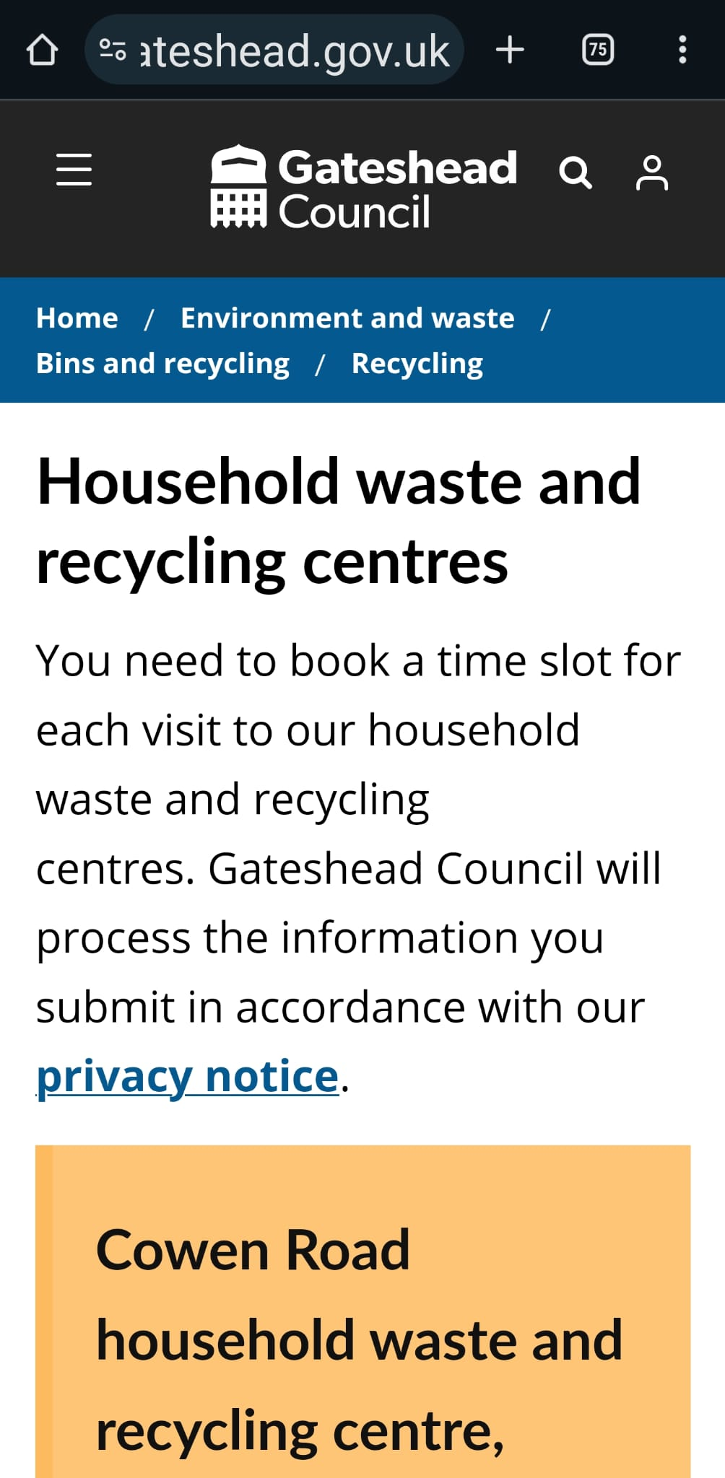
Sprint 6
Design - Site not displaying correctly on Galaxy S23 Ultra

Slide 5
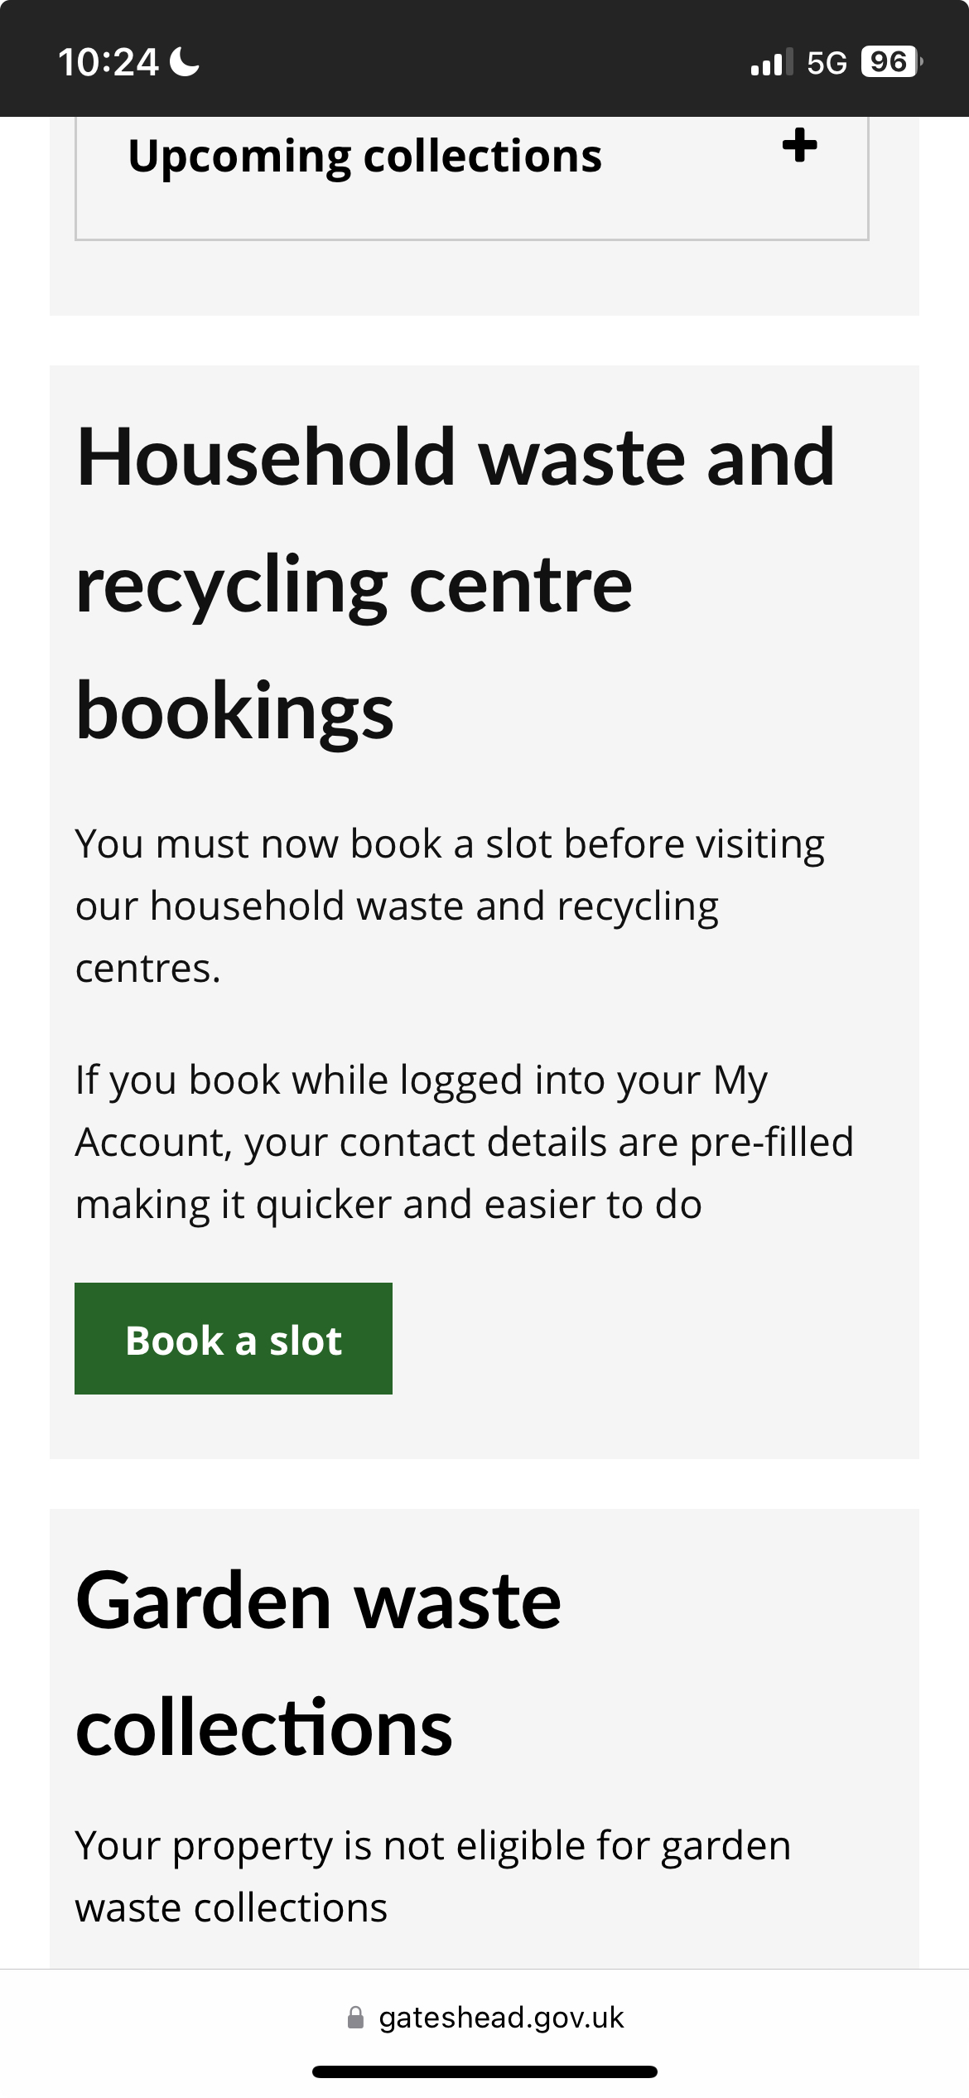
Sprint 6
Design - My Gateshead account - HWRC field not showing in mobile view

Slide 6
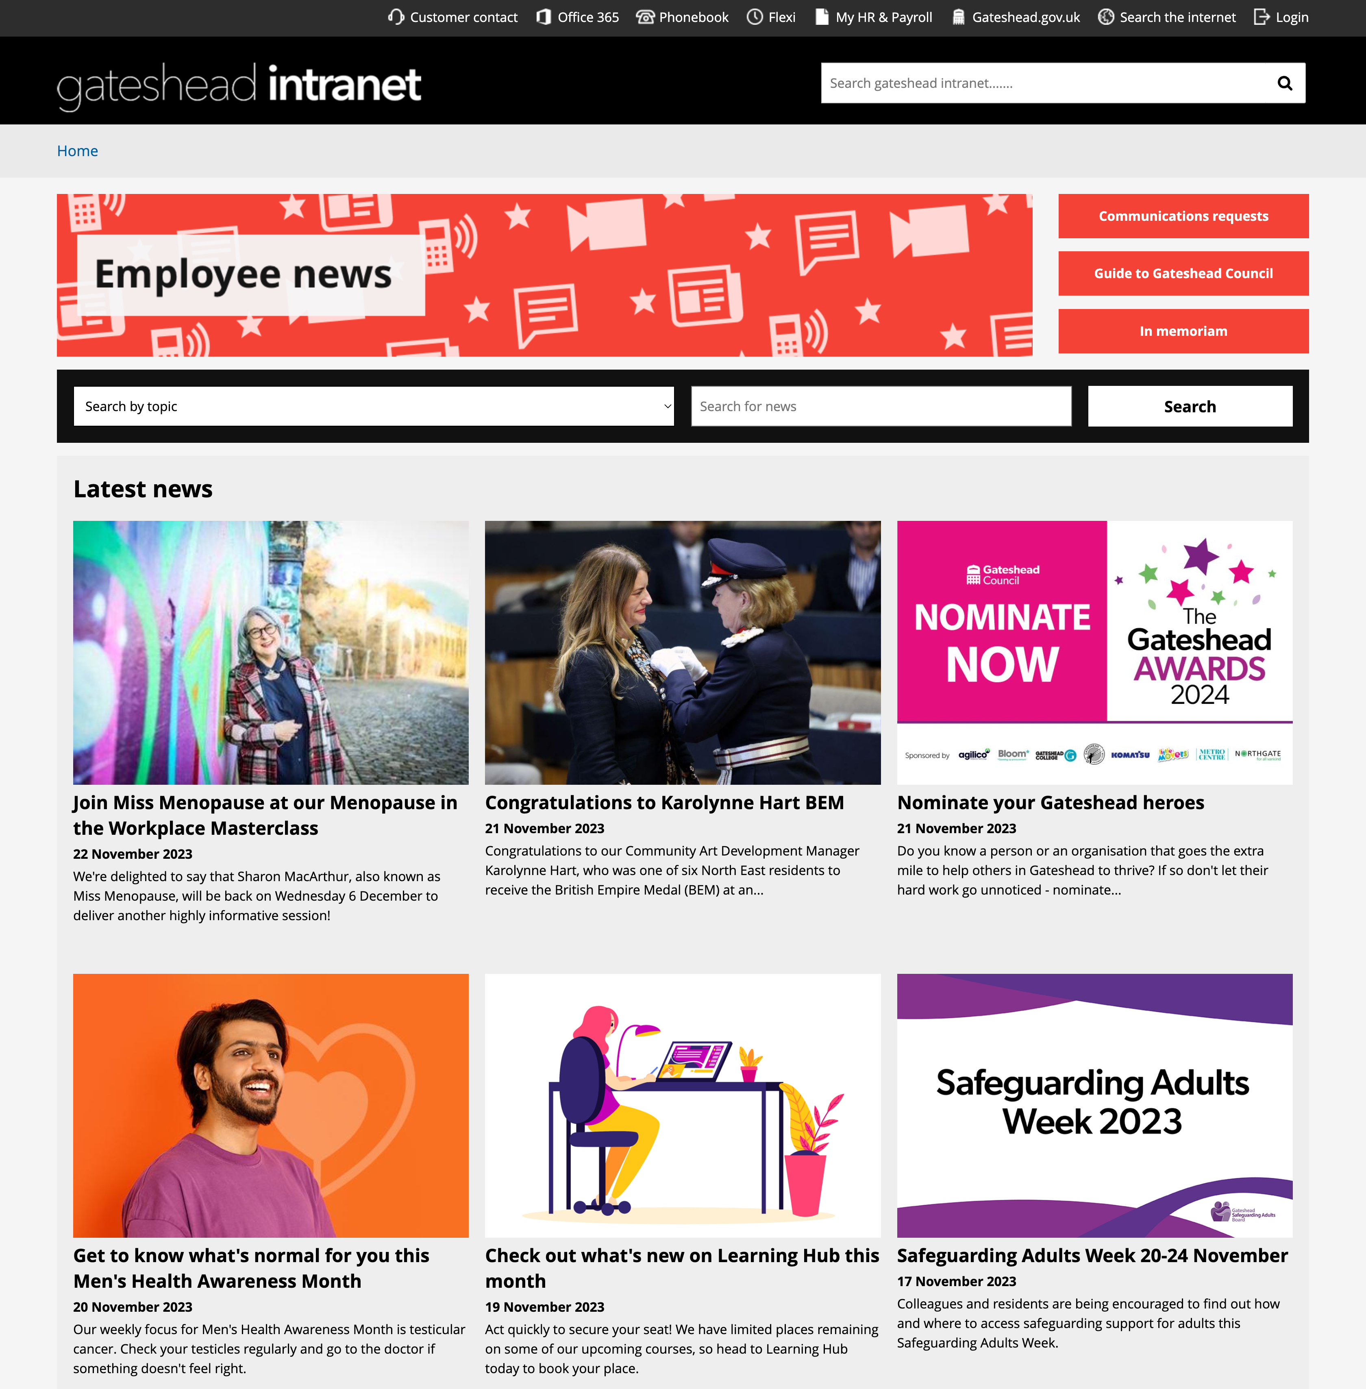
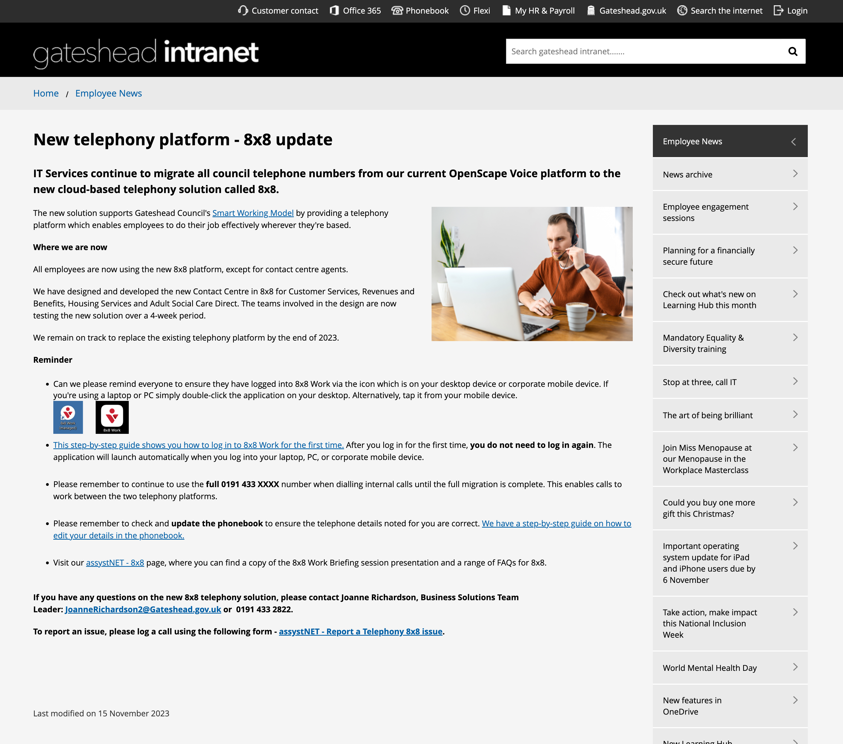
Sprint 6
Design Intranet - Use news hub to display the news on the Gateshead Intranet

Slide 7
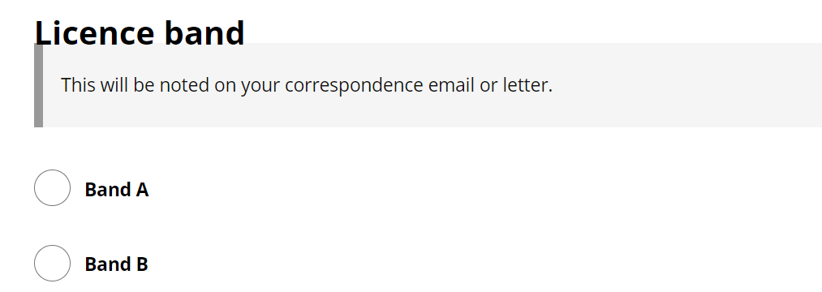
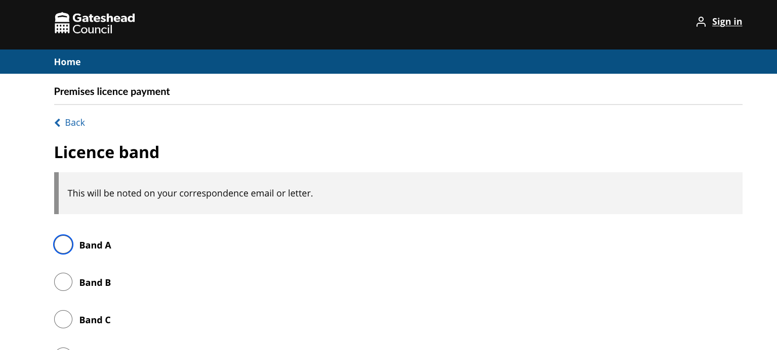
Sprint 6
Design - Hint text is overlapping the question in forms

Slide 8
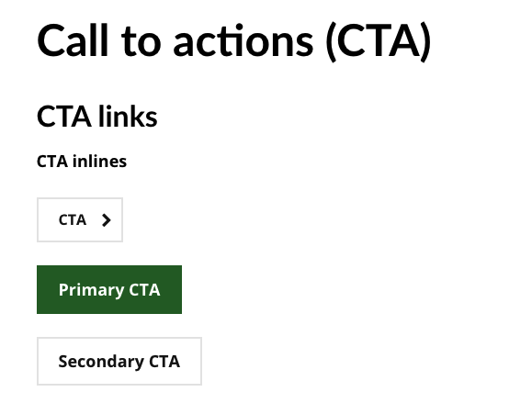
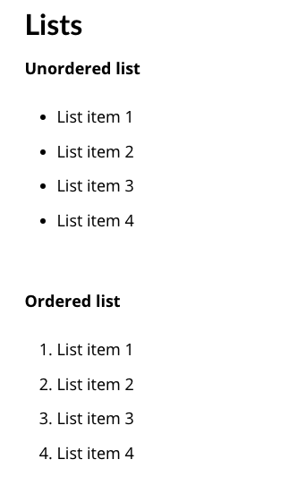
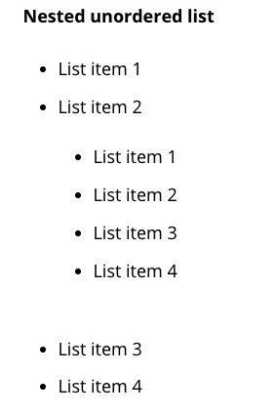
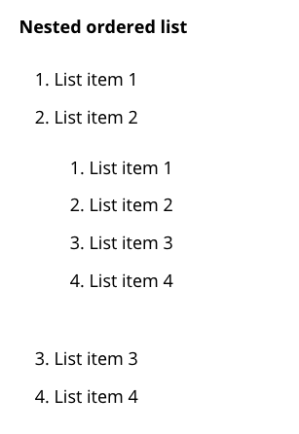
Sprint 6
Design - STAN site testing - Call to action buttons and List styling

Slide 9
Sprint 6
Design - 8x8 icon for customer contact navigation

Slide 10
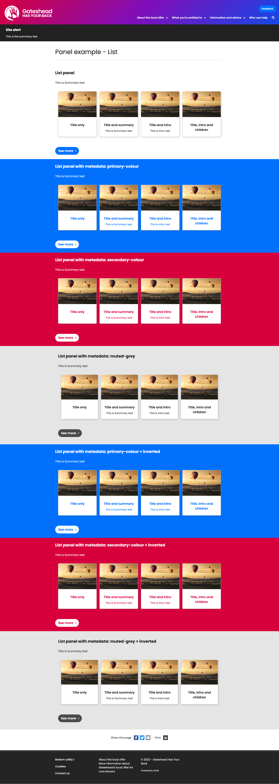
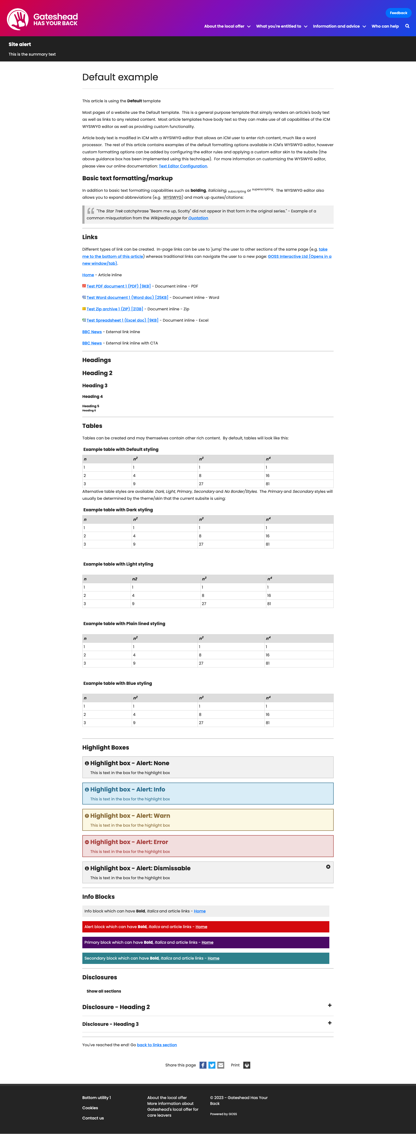
Sprint 6
Design - Gateshead Has Your Back site styling

Slide 11
Sprint 6
Content and wireframing
Brighten the Day Christmas holiday activities
Activities added to hidden part of the website
Mailchimp email created for free school meals families
Go Gateshead BtD activities added to booking system and web content created
Updated Thrive/Corporate Plan
Gateshead Now sent out on Thursday 16 November
Local Nature recovery Strategy website – build content structure
Late school applications – web content and form go-live
Set up dashboards and search article in Customer Contact for late school applications
Street lighting web content update
Gateshead Awards – set up nomination details and form, sponsors details page and make page live for 2025 awards
Budget consultation – main web page and proposals page
New page and links for Waste and Recycling Visitor and Education Centre
New page content for DPH Sexual Health Survey 2023
GTC New Enterprise Allowance Scheme Phase 2 Privacy notice
Draft email types for Libraries events platform

Slide 12
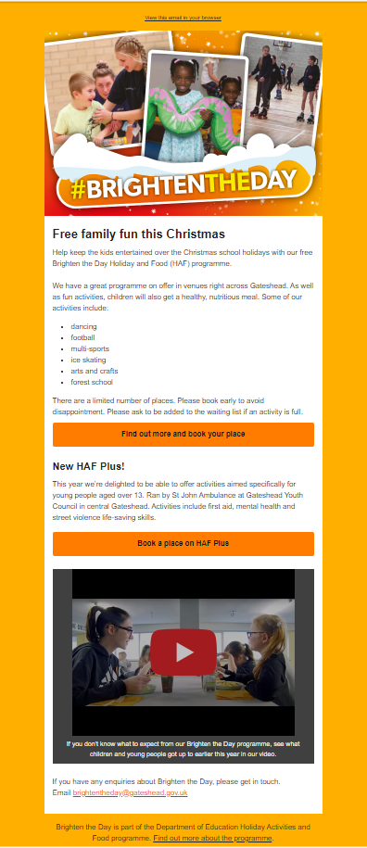
Brighten the Day Christmas holiday activities
38 activities added to hidden part of the website, searchable by location, age and date
Mailchimp email created to be sent to free school meals families on Monday 27 November.
Go Gateshead holiday activities added to bookings platform

Slide 13
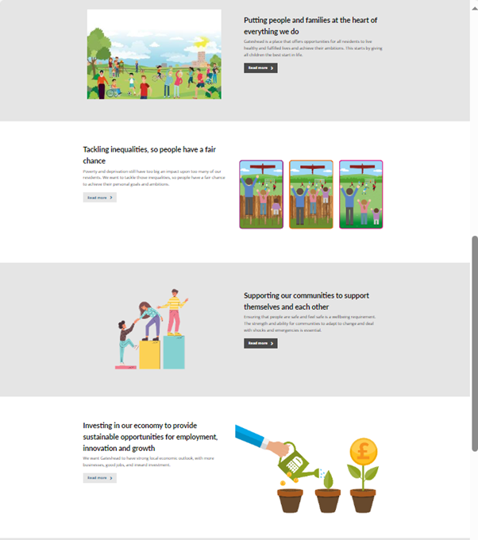
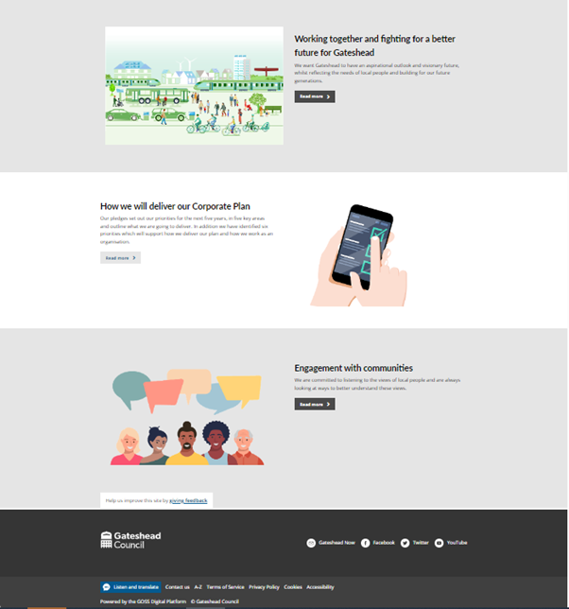
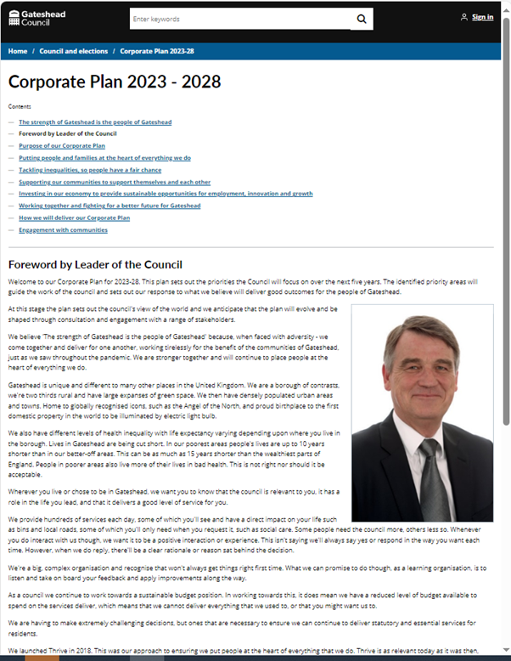
Update to Thrive/Corporate Plan for 2023-28
New Corporate Plan set up in panel template
Corporate Plan itself added in the document template rather than a pdf
Go live after council on Thursday 23 November

Slide 14
Other content
Gateshead Now – 16 November
Go Gateshead Christmas sport activity bookings

Slide 15
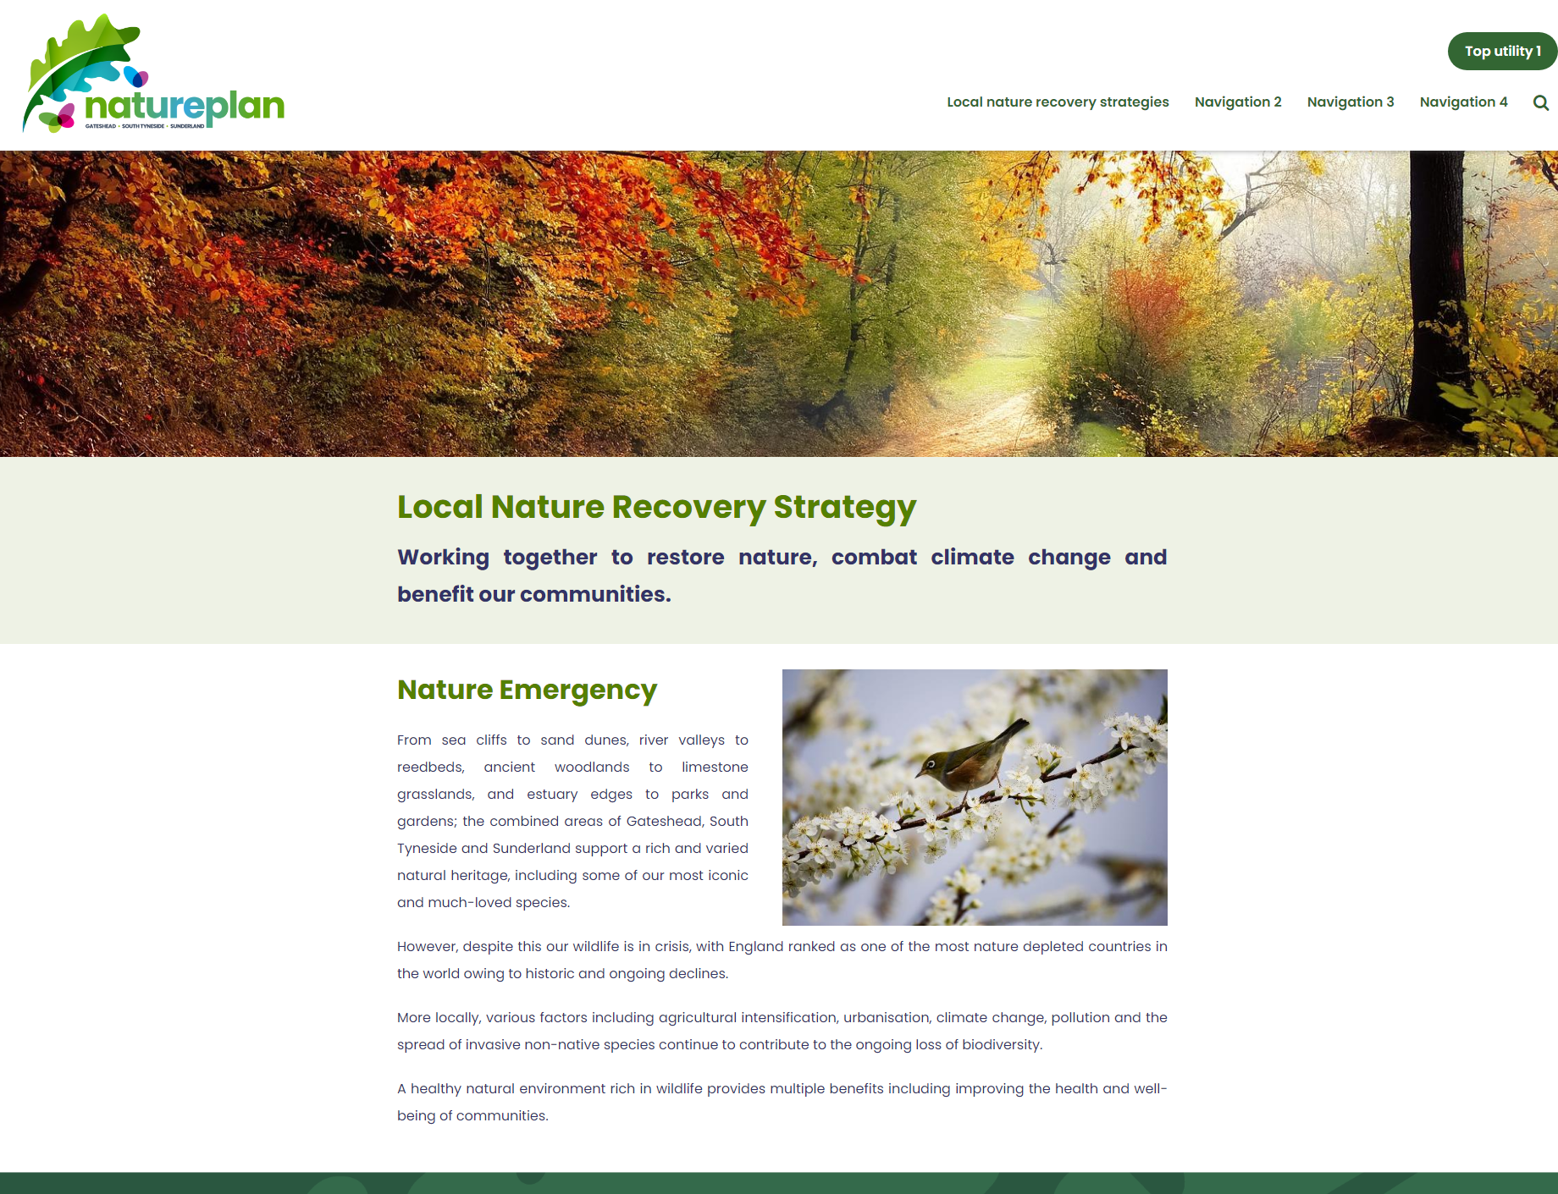
Local Nature Recovery Plan website
Build content structure

Slide 16
Late school applications
Add content to website and link to new form

Slide 17
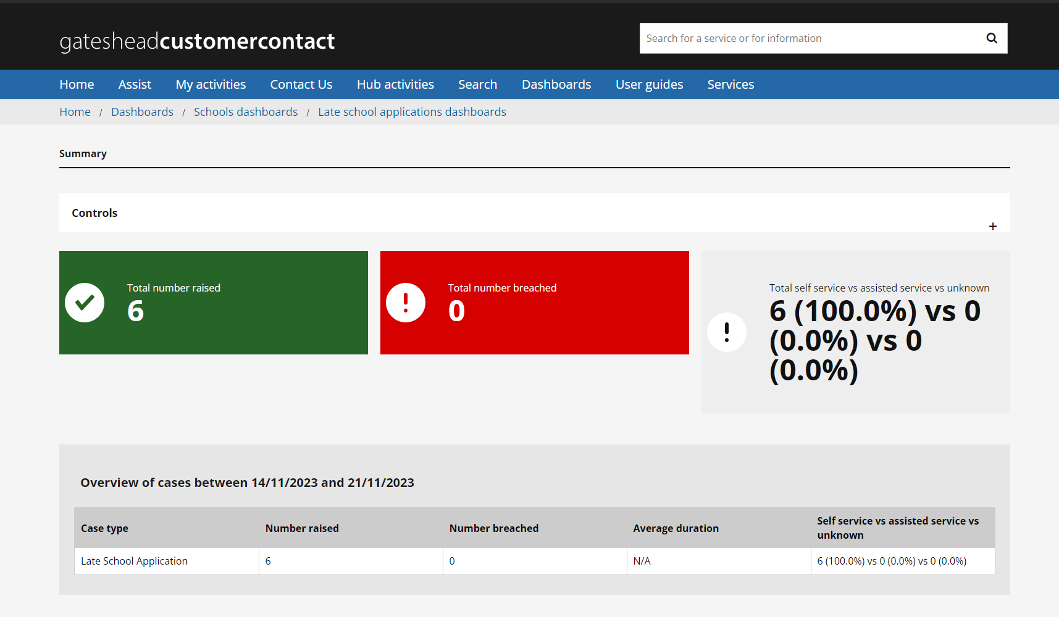
Late school applications
Set up search article and dashboards in Customer Contact

Slide 18
Street lighting
https://www.gateshead.gov.uk/article/17139/Street-lighting
Customers were using the incorrect form to report an issue with a streetlight
Added text to clearly show what issues can be reported using the 'Problem with a street light' form
Updated the order of the sections on the page so that 'Report a problem' is nearer the top
Moved the 'Contact us' section to the bottom of the page
Changed the text on this section so that the types of enquiry the contact form should be used for are front loaded in the text
Made sure the general street light enquiry form was excluded from the site search and Google

Slide 19
Gateshead Awards
www.gateshead.gov.uk/gatesheadawards
Updated page for 2024 awards
Added nomination category information
Added nomination form
Added award sponsors information page

Slide 20
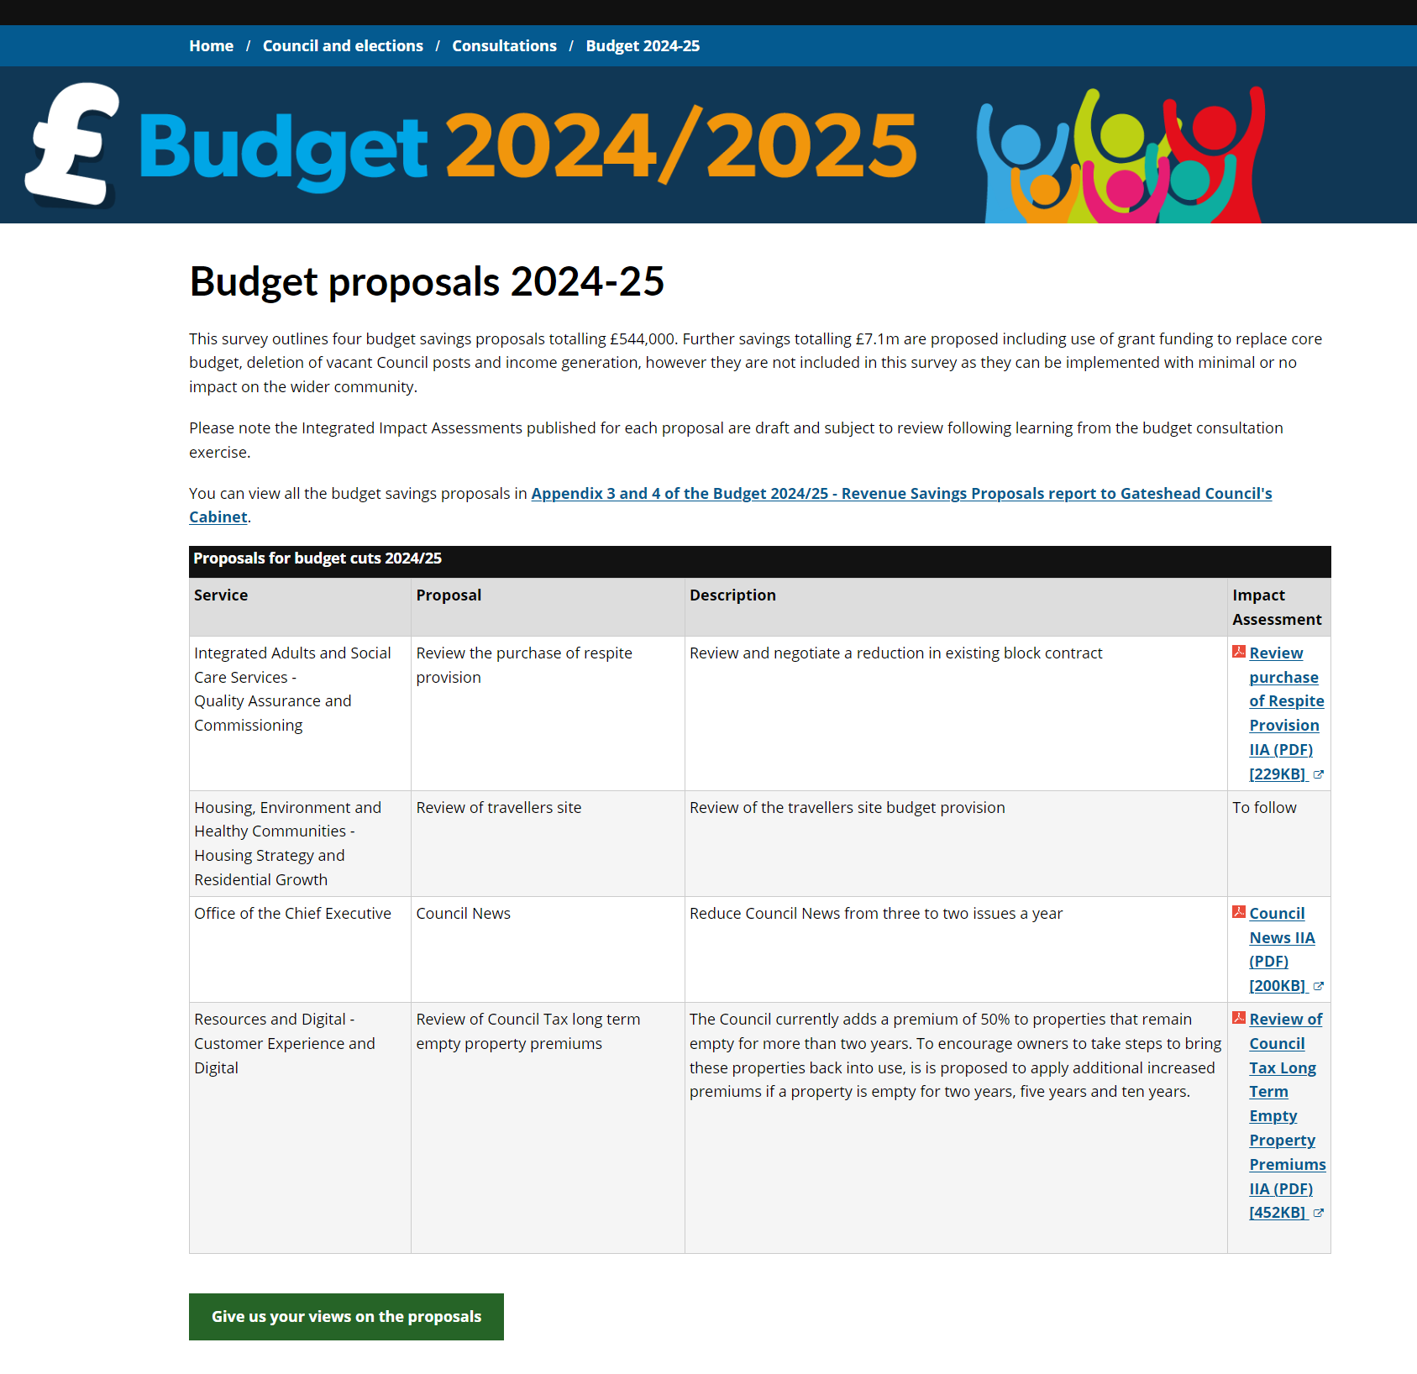
Budget consultation 2024/25
New pages for 2024/25 consultation went live 21 November 2023
www.gateshead.gov.uk/budget

Slide 21
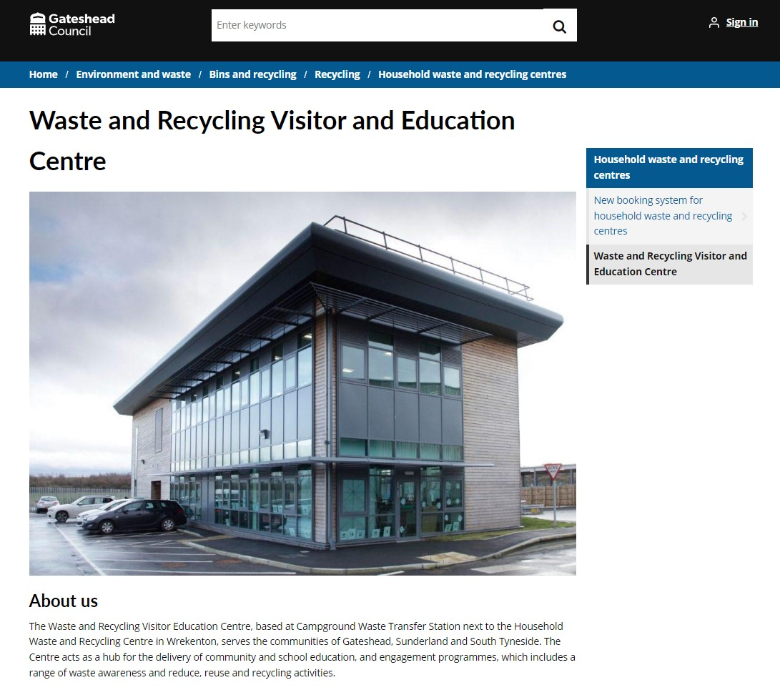
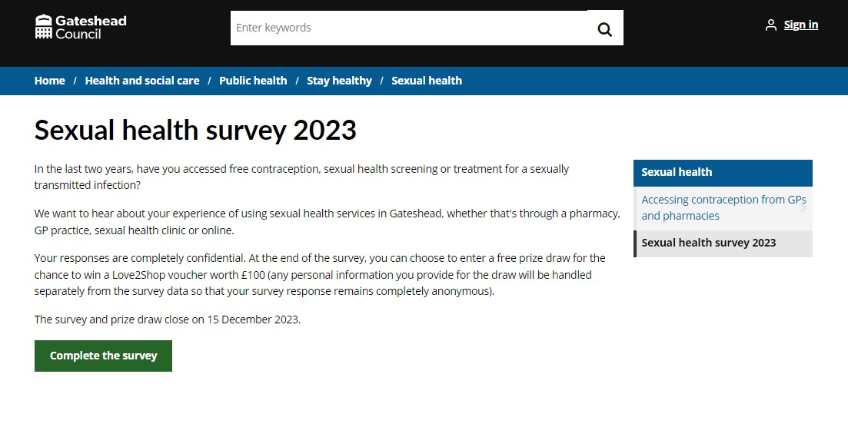
New HWRC and DPH pages
New pages for Waste and Recycling Visitor and Education Centre and DPH Sexual health survey went live 16 November
www.gateshead.gov.uk/article/25705/Waste-and-Recycling-Visitor-and-Education-Centre
Sexual health survey 2023 - Gateshead Council

Slide 22
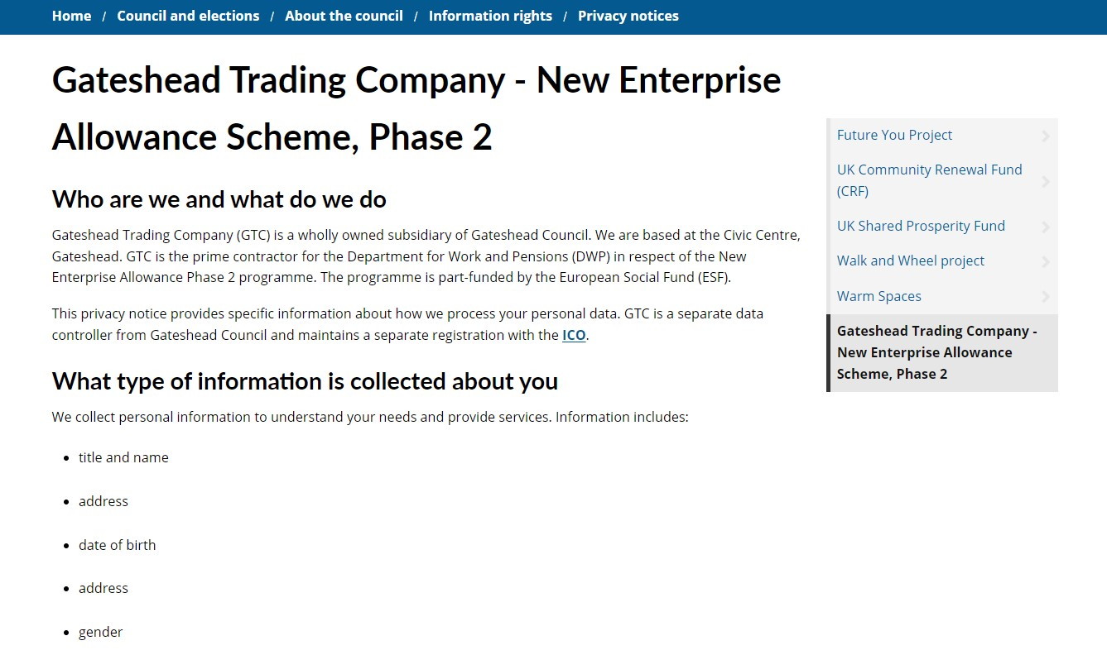
New privacy notice
GTC New Enterprise Allowance Scheme Phase 2 Privacy notice
Gateshead Trading Company - New Enterprise Allowance Scheme, Phase 2 - Gateshead Council

Slide 23
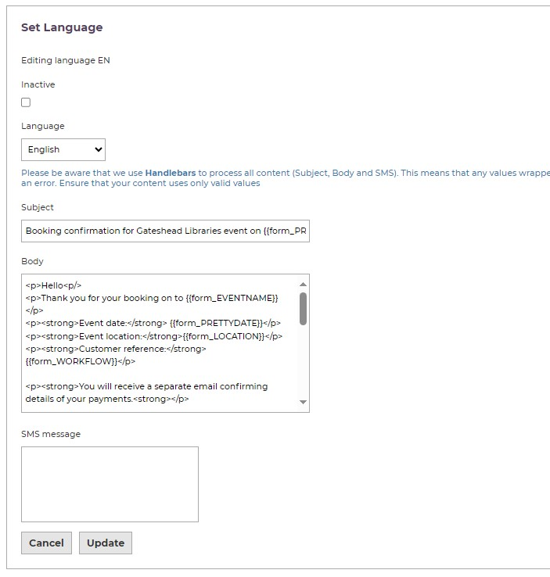
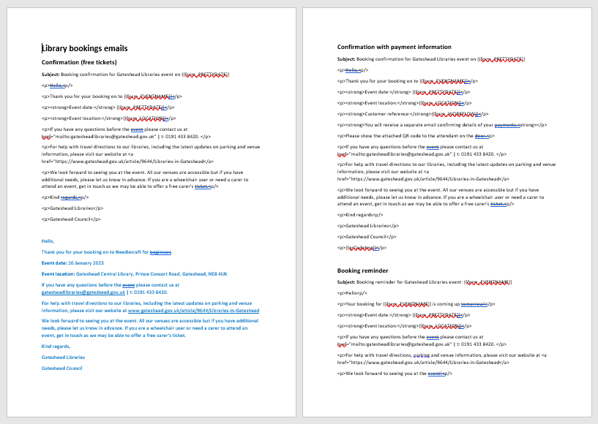
Comms templates for Libraries bookings platform
Draft different email types for Library service events process in ICM: free and paid, booking reminder, booking moved, booking cancelled, payment successful

Slide 24
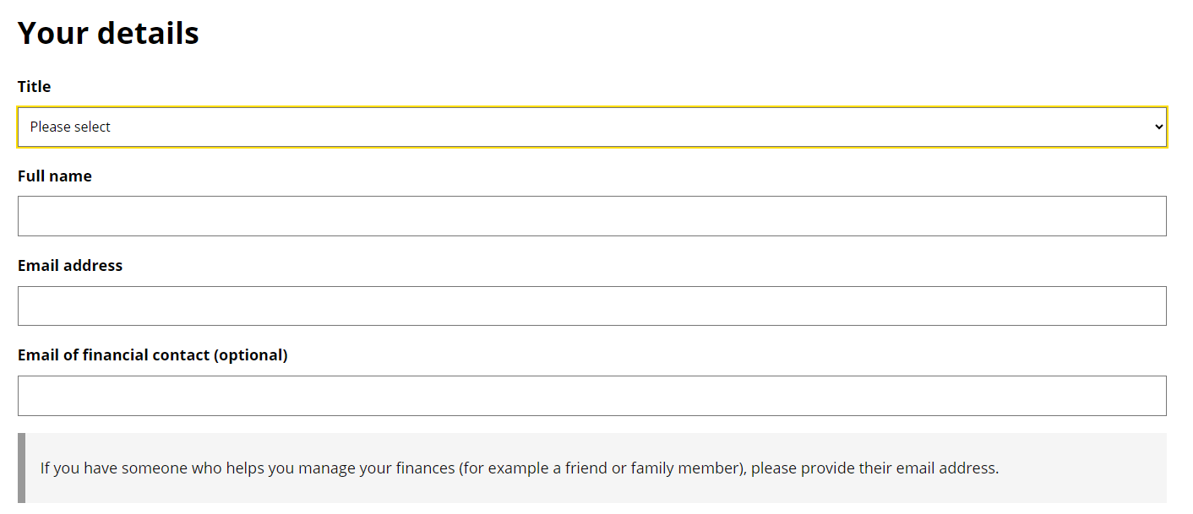
Sprint 6
Development
ASCD Initial care assessment form
Addition of email field. Needed in case someone helps with finances.

Slide 25
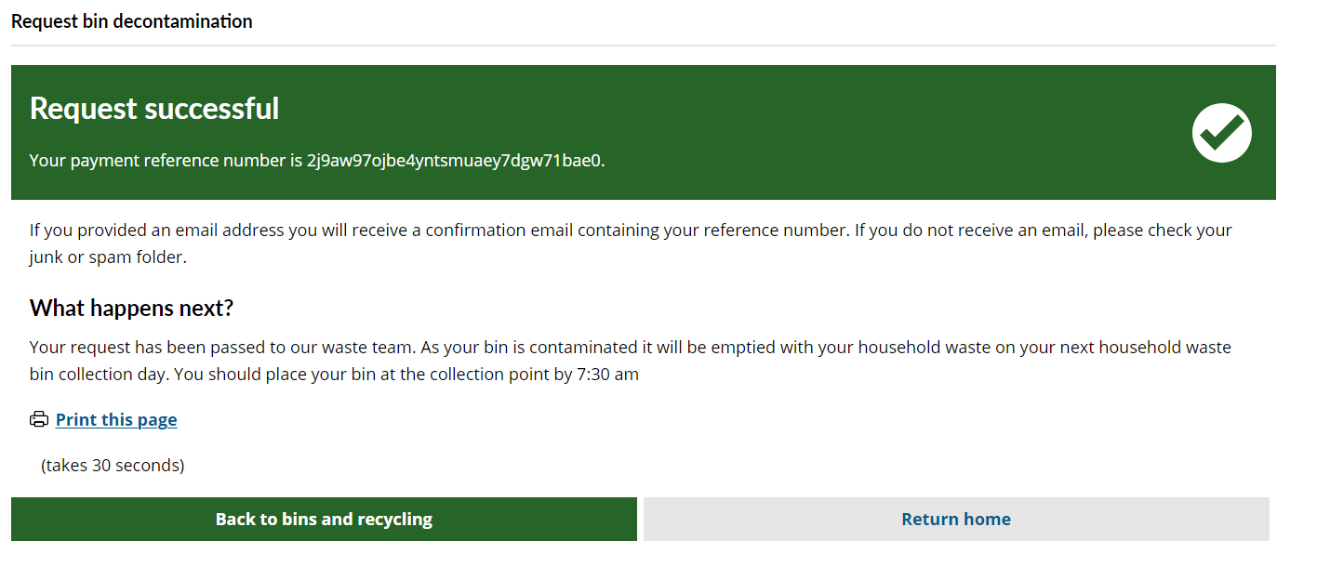
Sprint 6
Development
Bin decontamination process
Confirmation page updates and case config changes to allow staff to view case details.

Slide 26
Sprint 6
Development
Update to all Mayrise case types
Reallocation groups updated with Street Scene Technical Officer and Digital Team.
Email action and validation updates to all Mayrise case types.
Previously an email was sent to the customer when 'Cancel' was selected by the service. Mandatory fields had to be populated when cancelling too, this validation has been removed.

Slide 27
Sprint 6
Development
Missed bins
Update to confirmation text to inform customers that the bin may not be collected the next working day

Slide 28
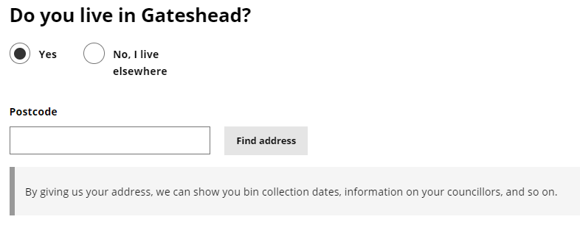
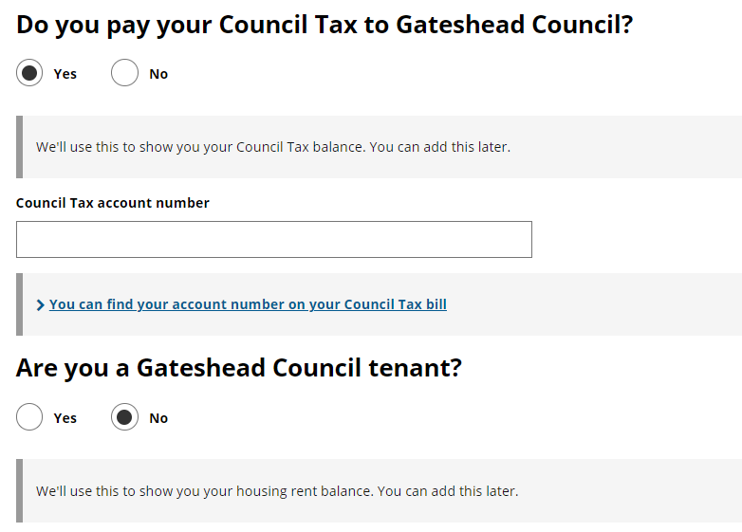
Sprint 6
Development
Text changes to various pages within the My Account area
User registration form
Update your details form

Slide 29
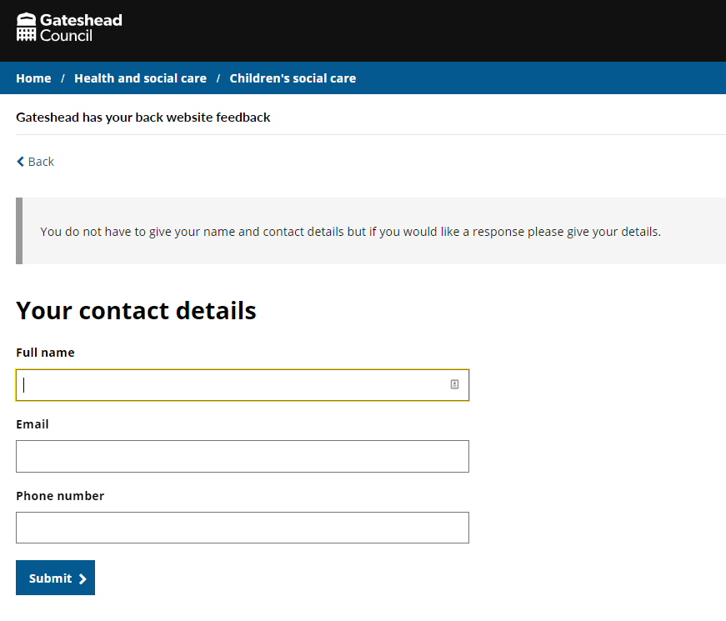
Sprint 6
Development
Development of the Gateshead Has Your Back feedback form (link)

Slide 30
Sprint 6
Development
Premises licence payment Premises licence payment - Gateshead Council (gosshosted.com)
Service search in Customer Contact Premises licence payment search - Customer Contact (gosshosted.com)

Slide 31
Sprint 6
Testing
Standard site testing
Changes to Late Applications
Add title to form
Emmanuel college detection
Ensure surname is provided
Completed form details to be emailed as PDF attachment
Changes to In Year School Transfers
Apply cosmetic label adjustments to the RESIDENCE and ARRIVED pages in response to feedback.
Update corresponding labels on the CYA page and the configuration templates to align with the cosmetic changes.
Implement the addition of a TITLE field on the CONTACT page in the first-stage form.
Develop calculations and logic for the CHILDDOB field on the CHILDDETAILS page, including creating a function to calculate the child's age.
Incorporate logic to determine if the child is currently in the term for year 11 or beyond.
Configure the system to halt progression if the child surpasses the specified cutoff date.
Display an alert in such cases and hide the remaining fields on the form.

Slide 32
Sprint 6
Go live
Late school applications
Intranet employee news
Standard site

Slide 33
Sprint 6
BAU/ Other tasks
Service engagement sessions
Agile training
Content
Service support
Inbox/complaints

Slide 34
What's coming up in Sprint 8
Discovery
Direct Payments – meeting with Adult Social Care and further research
Waste escalations – continue with data analysis and start on form for Return a Bin
Content
Safeguarding Adults Board information and guidance content review ahead of website design revamp
Gateshead Now budget special to go out on 23 November
Design
Gateshead Has Your Back care leavers local offer website to go live (soft launch)
Supply Intranet styling to Engage
Development
Update to all payment forms
Remove message when moving a registrars appointment

