Slide 1
Sprint 5 Show and Tell 15/11/2023
G Squad
Digital Team

Slide 2
Sprint 5.
Data
Blue Badges
[DCE-7671] Blue Badges: Applications where the badge was ordered on 9.10.23 - Jira (gossinteractive.com)
[DCE-7691] Refresh for latest case status - Jira (gossinteractive.com)
Fly-tipping
[DCE-7682] Create fly-tipping export and prototype locations based view - Jira (gossinteractive.com)

Slide 3
Sprint 5.
Data: Blue Badges
This sprint
[DCE-7671] Blue Badges: Applications where the badge was ordered on 9.10.23 - Jira (gossinteractive.com)
[DCE-7691] Refresh for latest case status - Jira (gossinteractive.com)
[DCE-7772] Blue badges - Export - list of cases where a payment has been attempted and failed - Jira (gossinteractive.com)
Future Sprints
[DCE-7773] Blue badges data - time taken to process each application - Jira (gossinteractive.com)

Slide 4
Sprint 5.
Data: Fly-tipping
Dashboard
Emily Goldsmith – GIS and Integrations Officer

Slide 5
Sprint 5.
Bonus Data Science: Fly-tipping hot spots

Slide 6
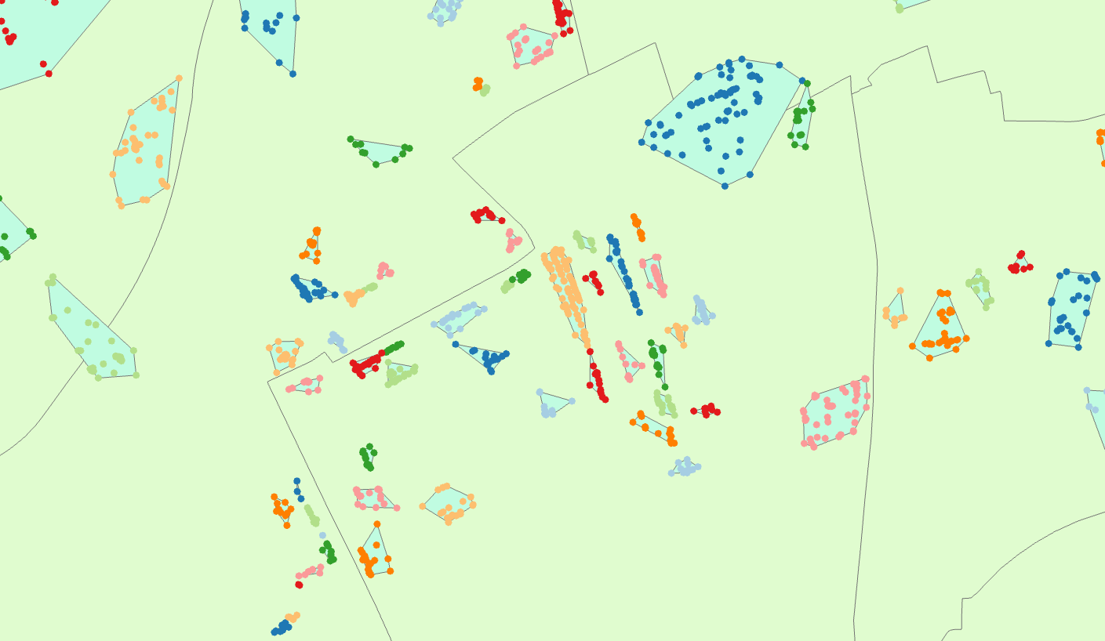
Sprint 5.
Bonus Data Science: Fly-tipping hot spots

Slide 7
Sprint 5.
Bonus Data Science: Fly-tipping hot spots
Are there any common features about the locations of hotspots?
Can that help us predict potential future hotspots?
Can it help inform how we approach the problem of fly-tipping in different areas?

Slide 8
Sprint 5.
Discovery
[DCE-7689] Scope the current state of ASB Reporting - Jira (gossinteractive.com)

Slide 9
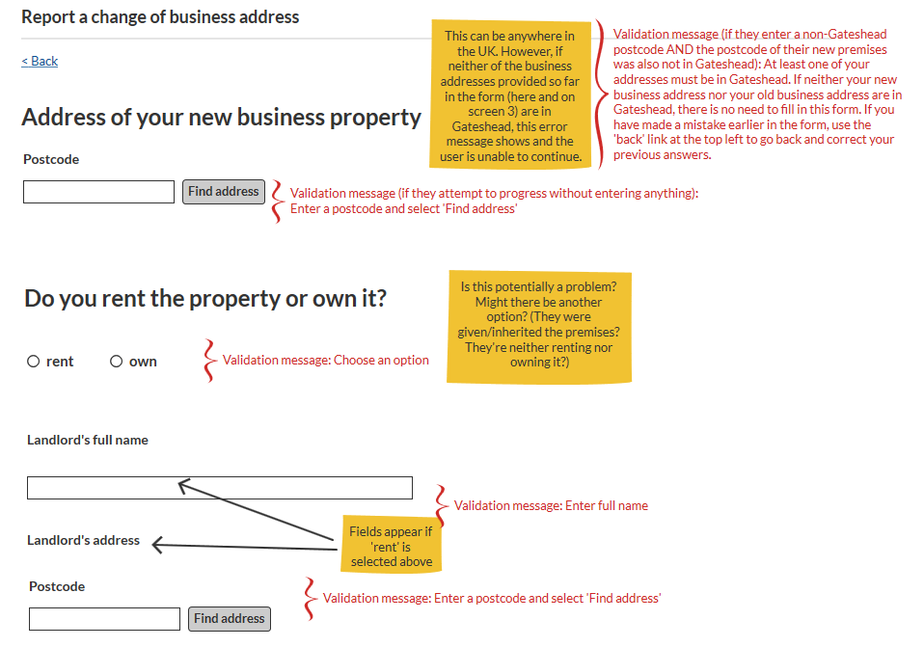
Sprint 5.
Content and wireframing
Created wireframe for Business rates change of business address
Needs to go to service for UAT

Slide 10
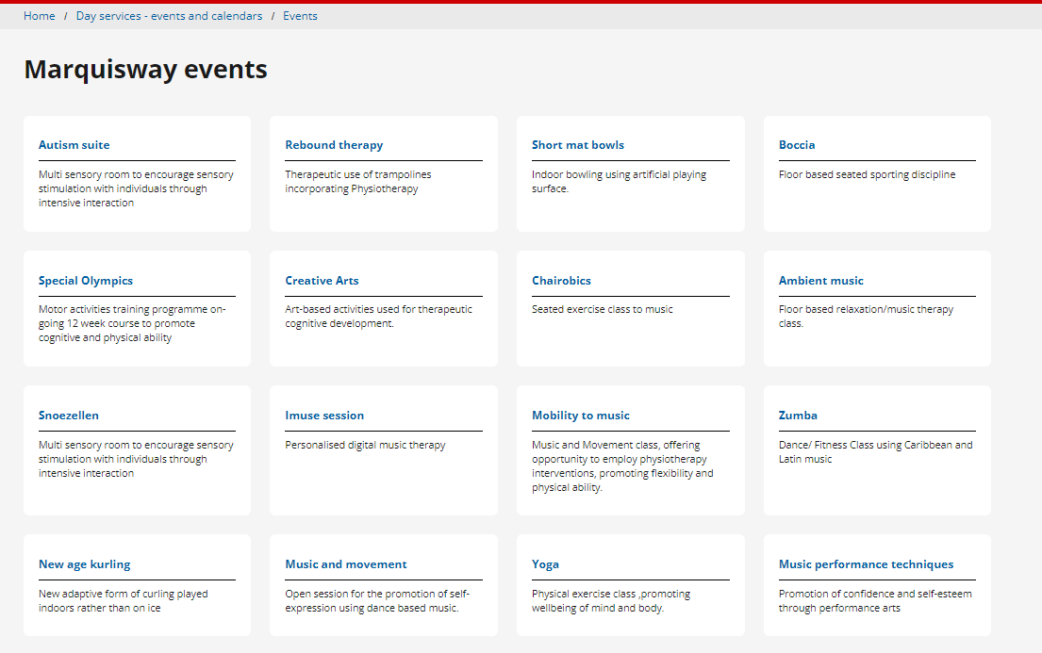
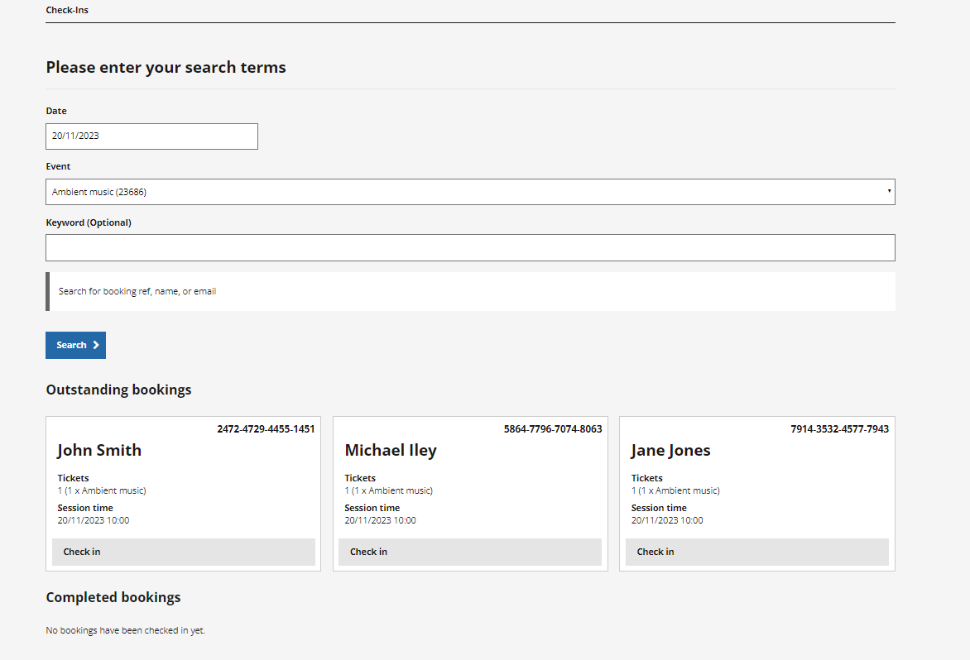
Sprint 5.
Content and wireframing
Day Services bookings
All Marquisway events and occurrences set up

Slide 11
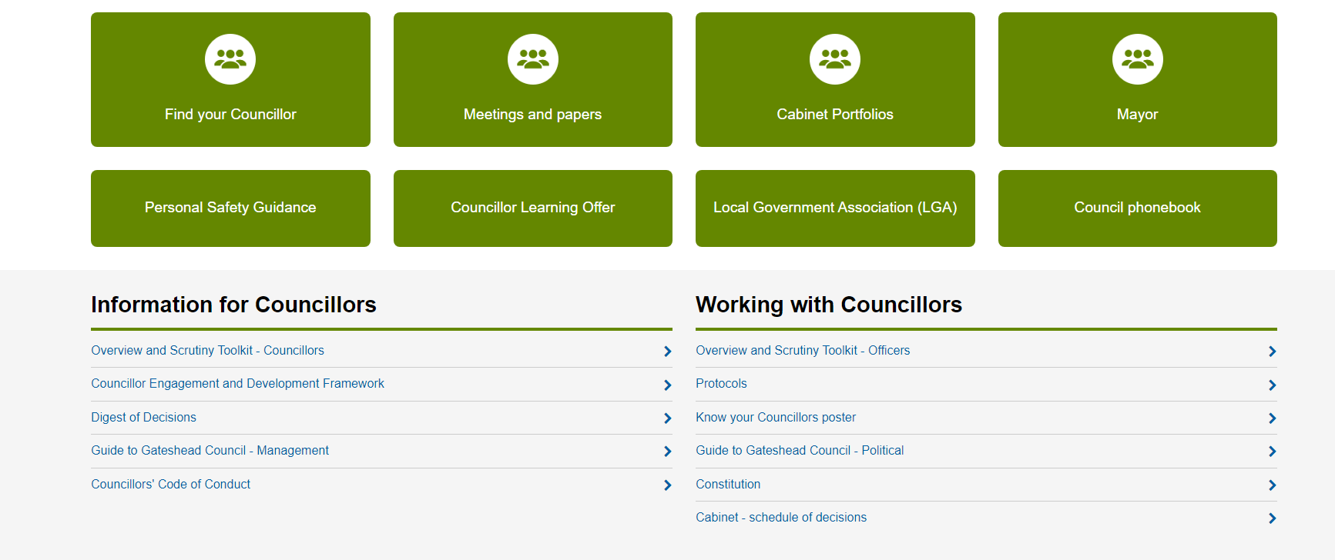
Sprint 5.
Content and wireframing
Improvements made to Councillors information on the Intranet

Slide 12
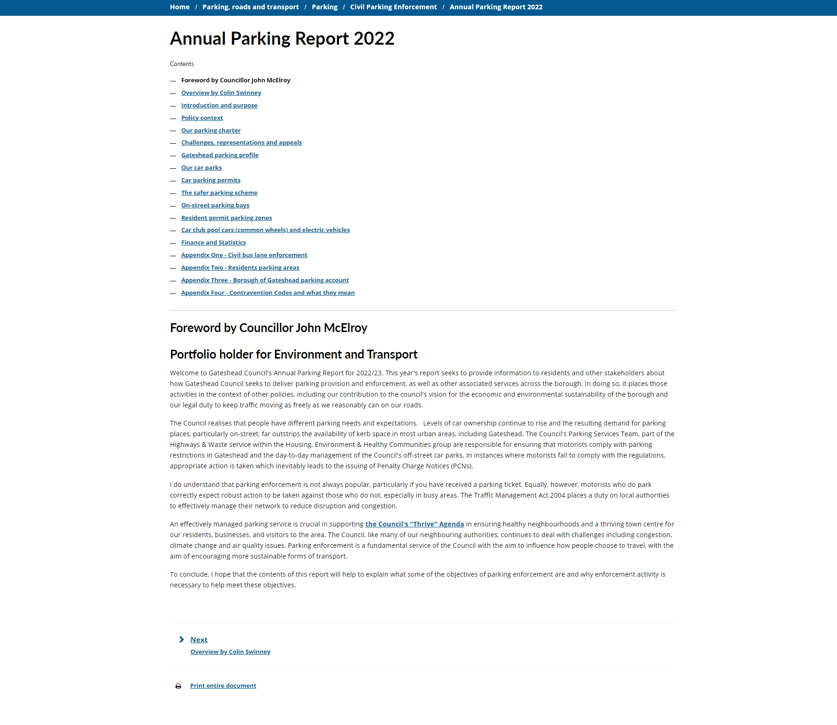
Sprint 5.
Content and wireframing
Annual Parking Report
Converted the report into HTML content on Gateshead.gov.uk

Slide 13
Sprint 5.
Content and wireframing

Slide 14
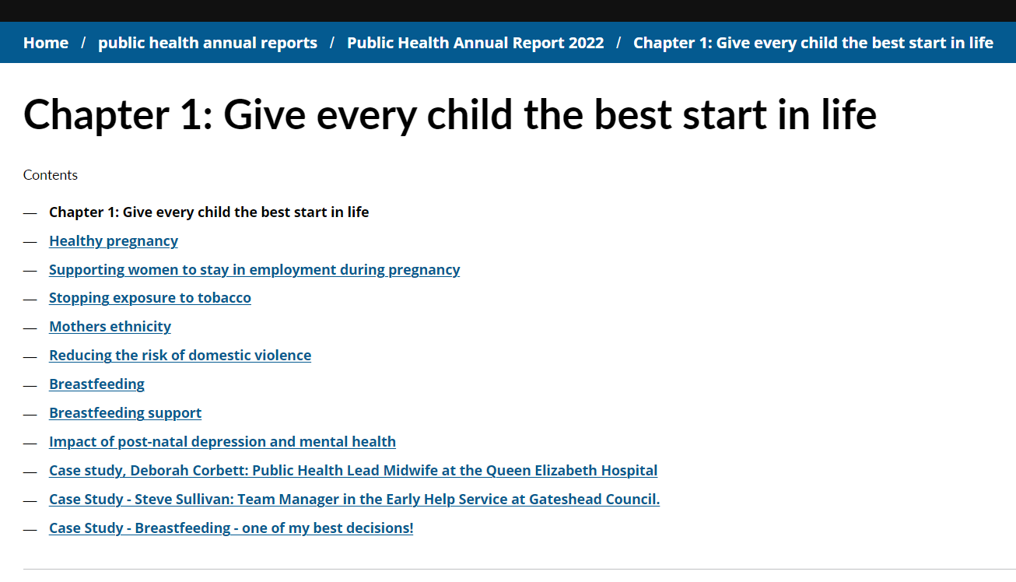
Sprint 5.
Content and wireframing
Public Health Annual Report 2022
92 page document
6 chapters plus recommendations
Many sections within each chapter
Images to convert to content

Slide 15
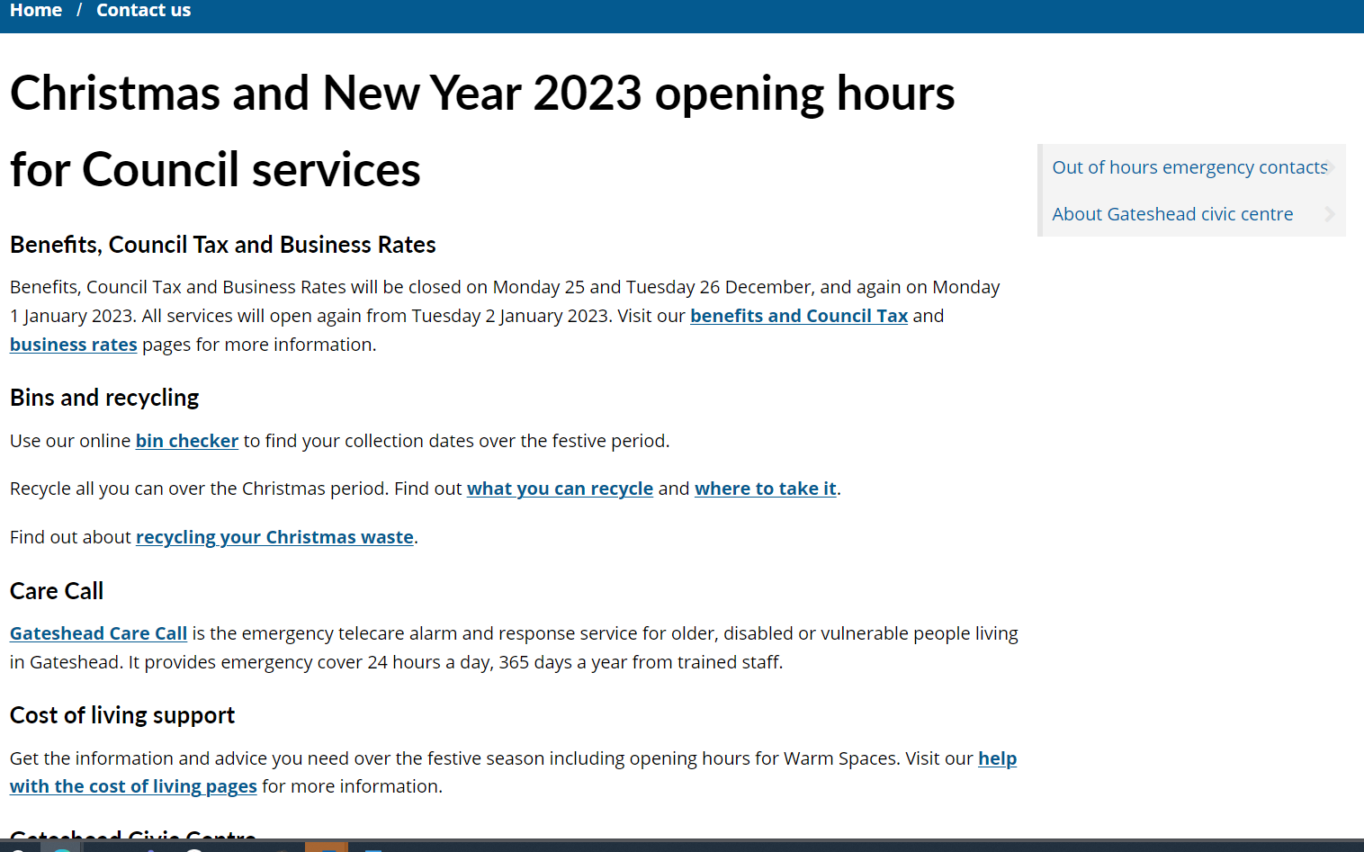
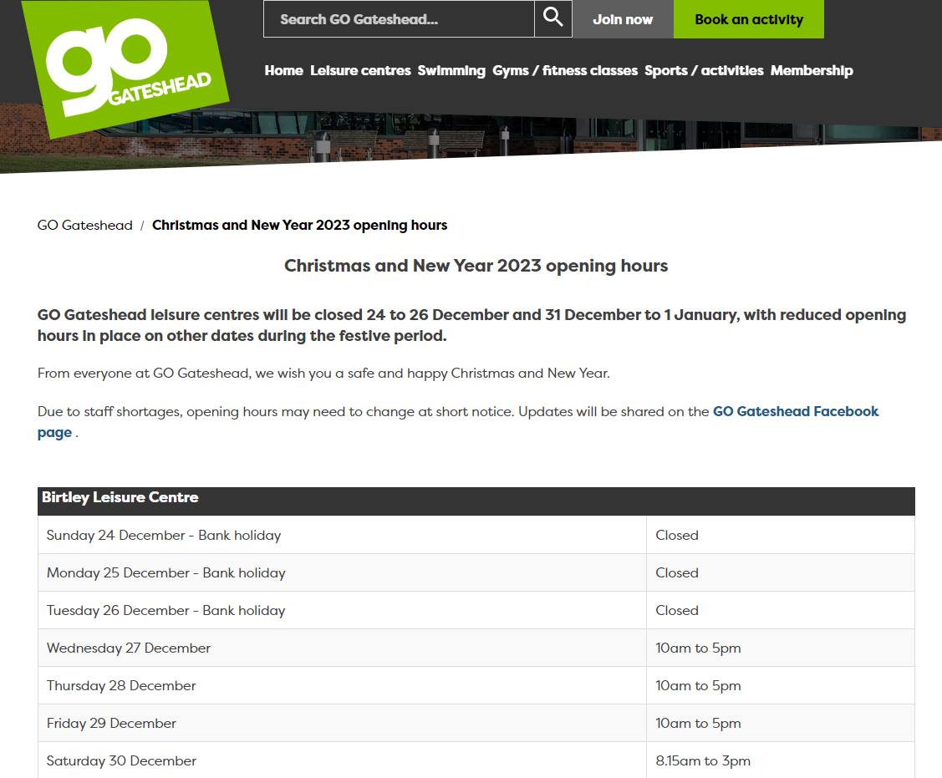
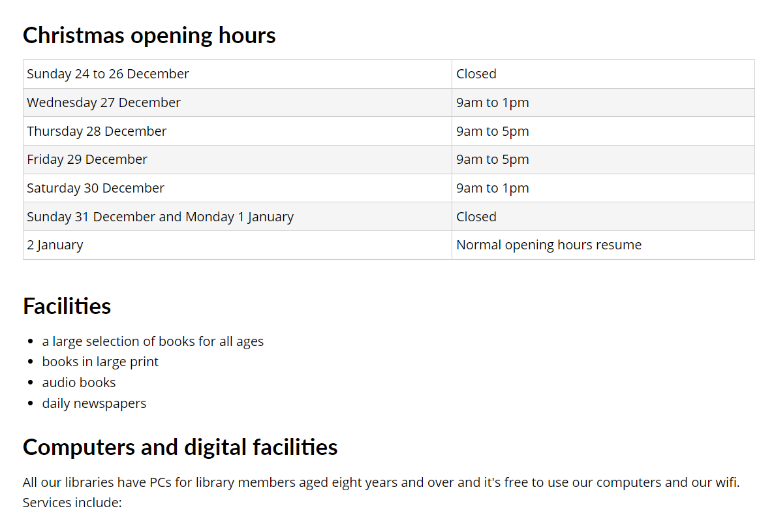
Sprint 5.
Content and wireframing
Christmas opening hours 2023
Updates to GO Gateshead and seven libraries now live Contact us content – waiting for confirmation from Register Office and Saltwell Towers

Slide 16
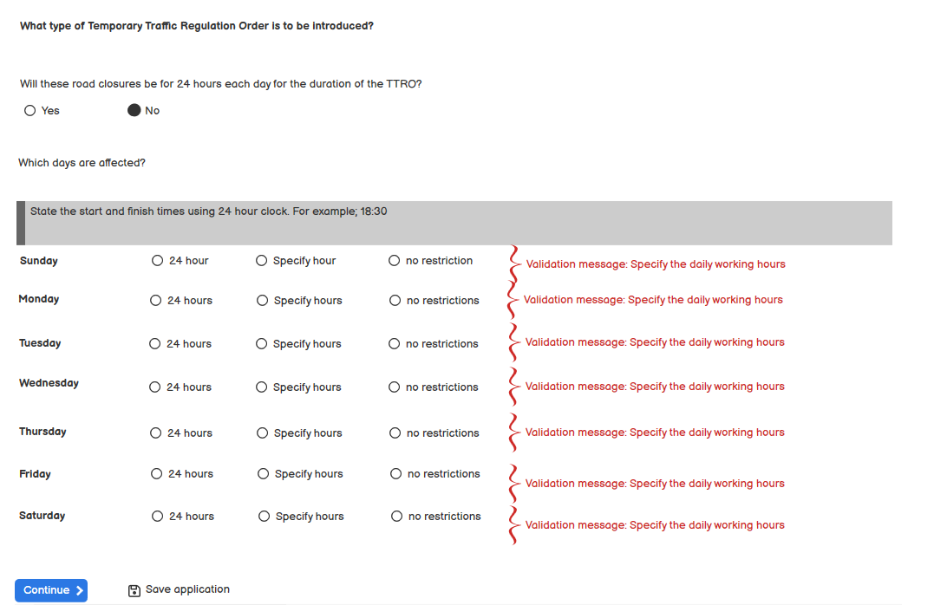
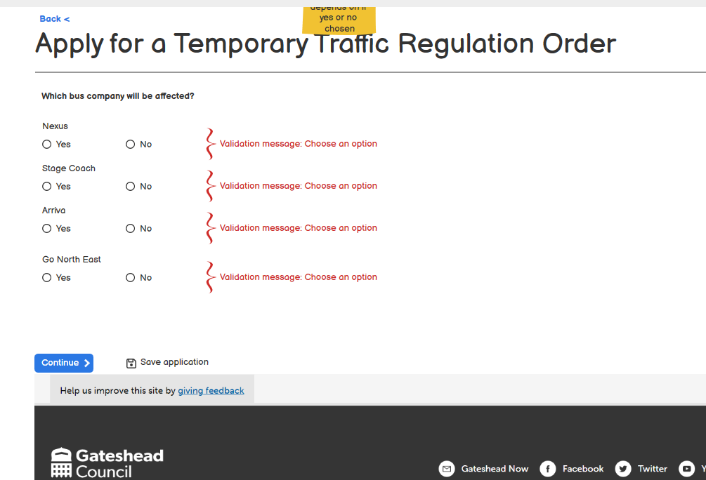
Sprint 5.
Content and wireframing
Temporary Traffic Regulation Order (TTRO) revised wireframe

Slide 17
Sprint 5.
Development
Mayrise – Lit road signs. Make use of Mayrise data (DCE - 6884)
Mayrise - addition of attachments to Mayrise cases (DCE – 7693)
Mayrise – Emails being sent when cancel is selected (DCE – 6612)
Improvement to Bartec endpoints (DCE – 5437)

Slide 18
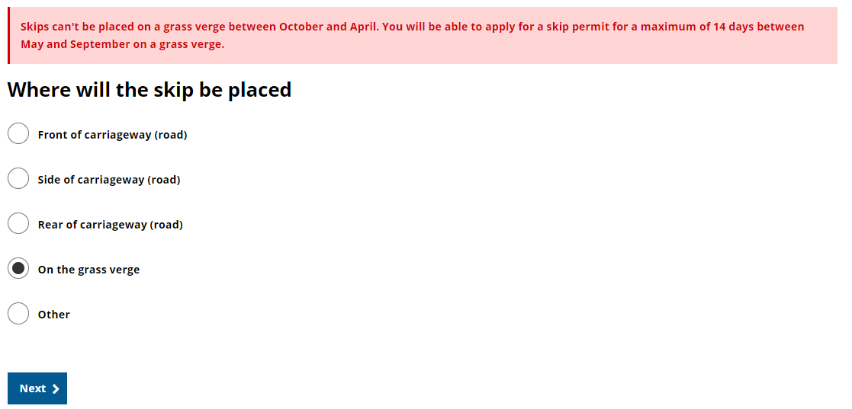
Sprint 5.
Development
Skip permits (DCE-7615)
A change to the ordering of some of pages and a correction to the logic which checks if a skip can be placed on a grass verge.
Previously, the form just took into account the date the application was made rather than the actual date that the skip was to be placed.
(Applicants can now order skips in winter for Spring and place them on a grass verge)

Slide 19
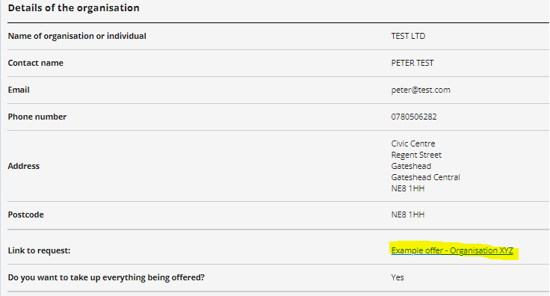
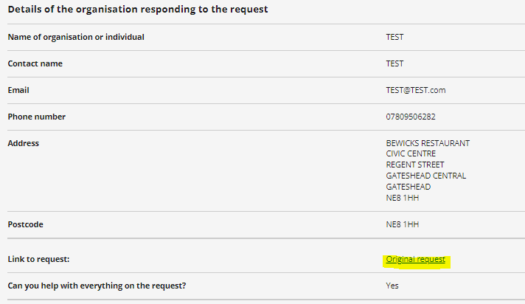
Sprint 5.
Development
Gateshead Exchange (DCE-7687)
Further development to the Gateshead exchange forms, following testing on preprod. If the endpoint isn't able to retrieve the title of original request or the offer being responded to then it will display a more readable link (rather than 'Unknown')
Pushed endpoints, configs and forms to prod.

Slide 20
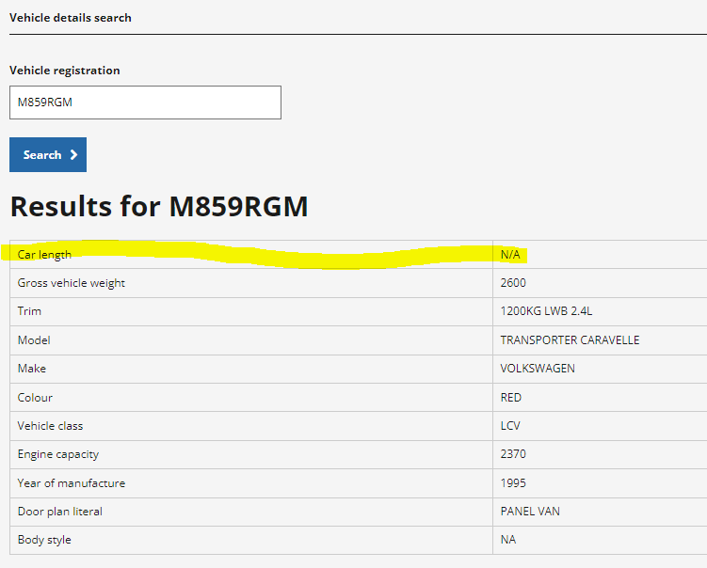
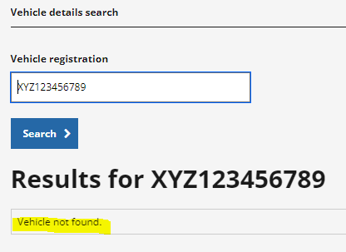
Sprint 5.
Development
Waste permits, vehicle details search (DCE-7635)
As requested from the service we made an improvement to the vehicle details search page to always show the length of the vehicle even if the value isn't known.
DC made a further improvement to display a 'Vehicle not found' message if no vehicle is returned.

Slide 21
Sprint 5.
Development
Blue Badges, organisational request payment task (DCE-7152)
Addition of a 'request payment' task to organisational Blue Badges. Added new statuses, updated task titles and routines for this case type so that it works similar to standard Blue Badges making it easier for the team to process these applications.

Slide 22
Sprint 5.
Development
Blue Badges, HIDDEN eligibility code (DCE-XXXX)
Addition of HIDDEN as an eligibility code to the Blue Badge ordering form and to the short form to allow Blue Badge officers to use this eligibility code when ordering a Blue Badge.
DC has updated the endpoint to allow badges to be ordered with this eligibility code and any other available codes that we might add into the forms at a later stage

Slide 23
Sprint 5.
Development
Gateshead Energy Company

Slide 24
Sprint 5.
What's next?
Council Tax discovery
Complaints process review and assessment
Prepare HWRC prod bookings to allow bikes
Business rates change of address
Temporary Traffic Regulation Orders – updates to process
Gateshead exchange
Public Health – faceted search

