Slide 1
Sprint 4 Show and Tell
C Squad
Digital Team

Slide 2
Sprint 4
Discovery
Direct payments
Review existing current state process maps
DP01 Direct Payments Process.pdf
Winter Maintenance
Discovery workshop
Taxi Vehicle Testing
Write up user stories and requirements
Taxi vehicle testing requirements.xlsx
Street light requests
Analysis of reports

Slide 3
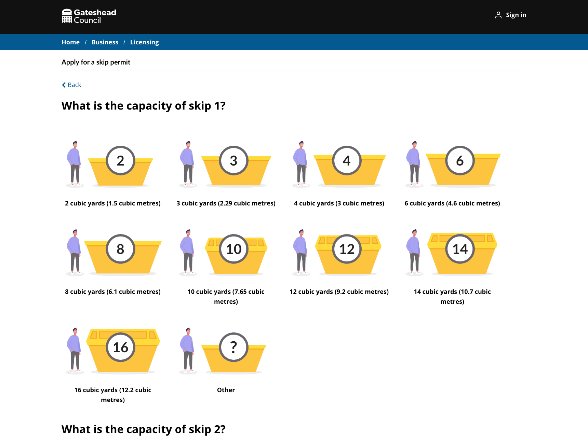
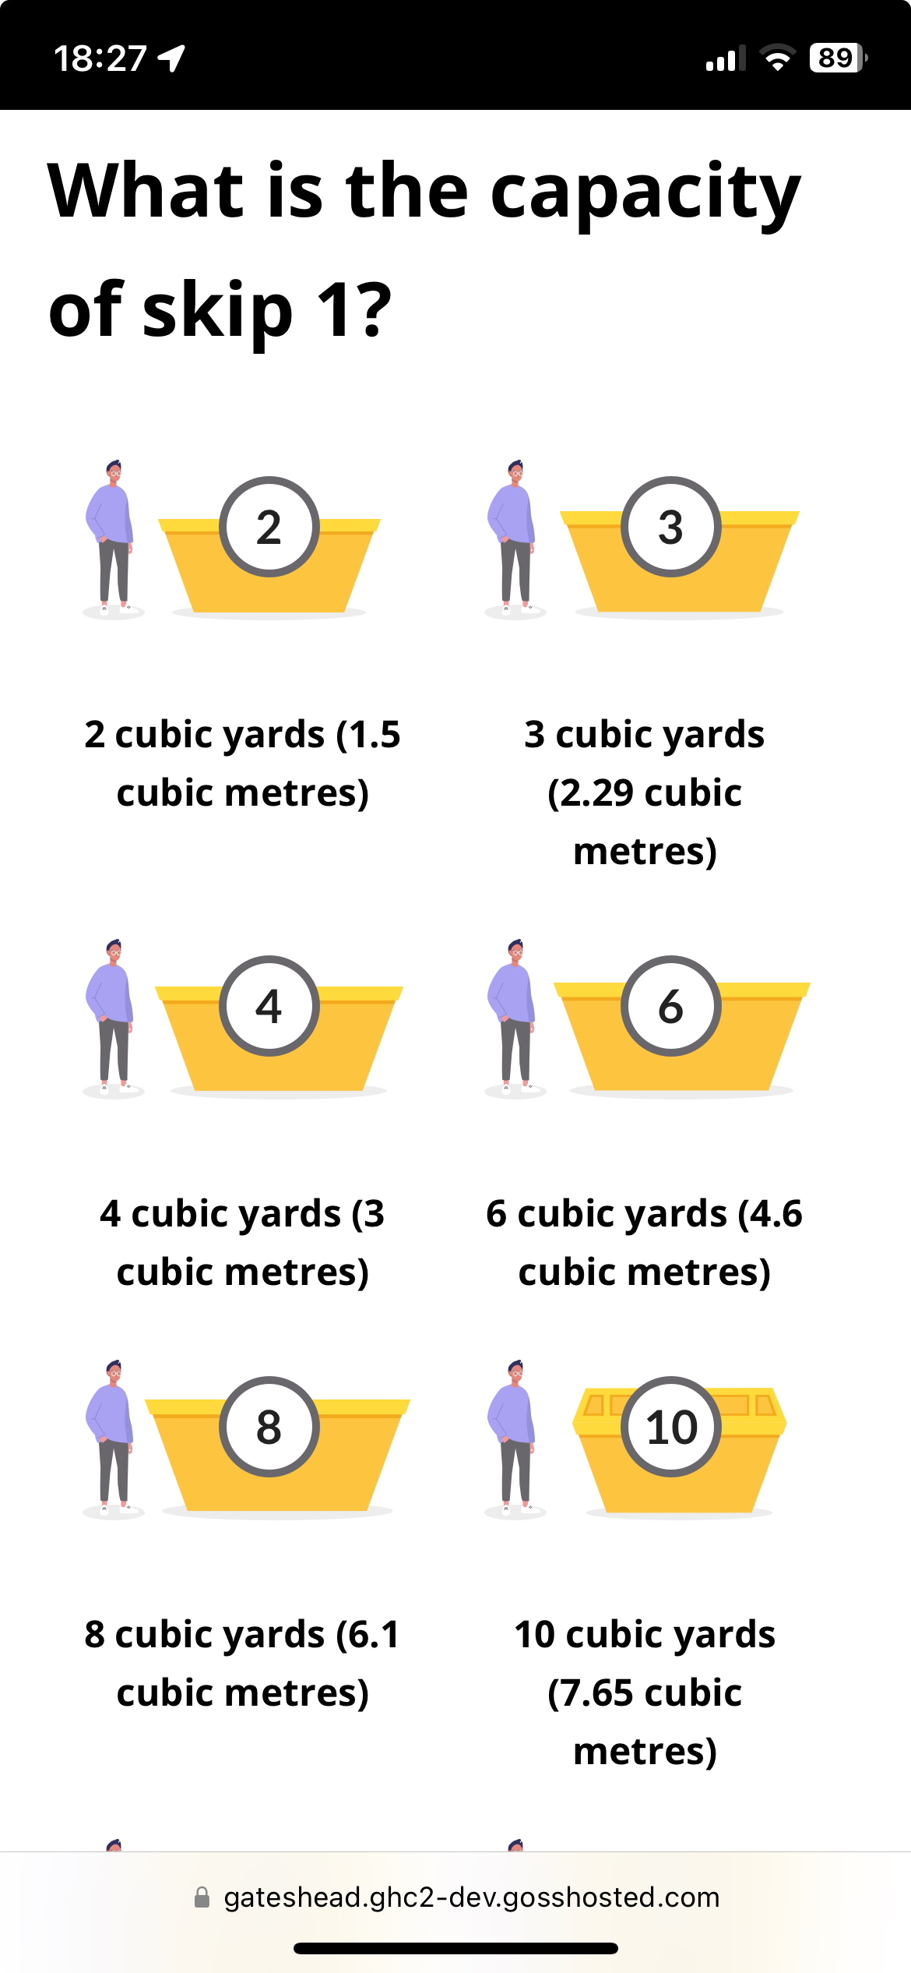
Sprint 4
Design
Skips – what size skip imagery

Slide 4
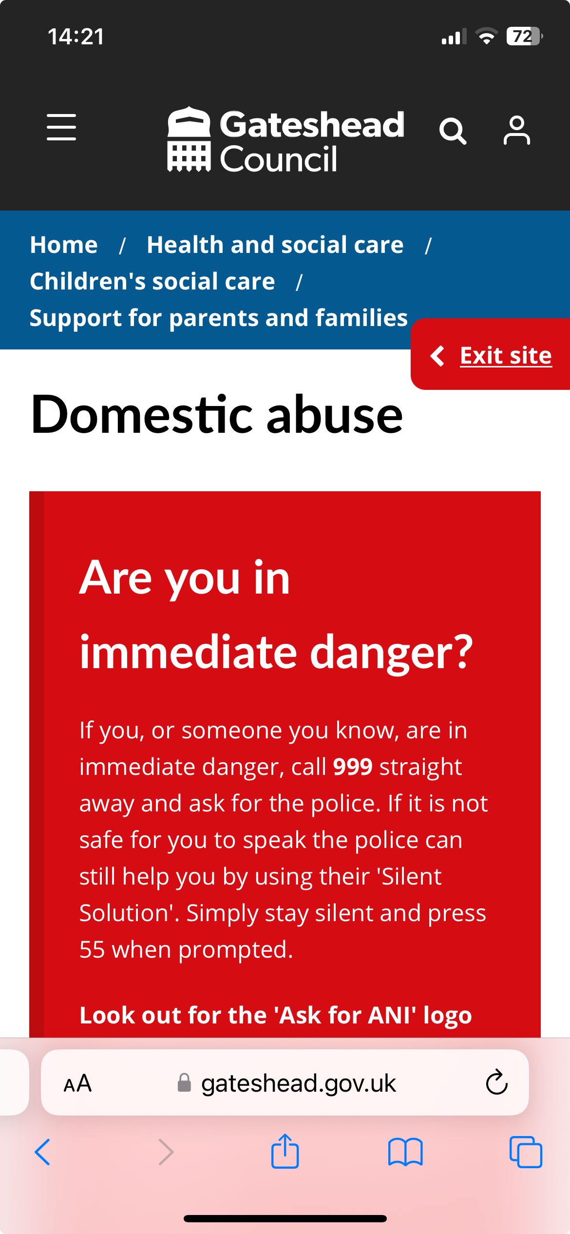
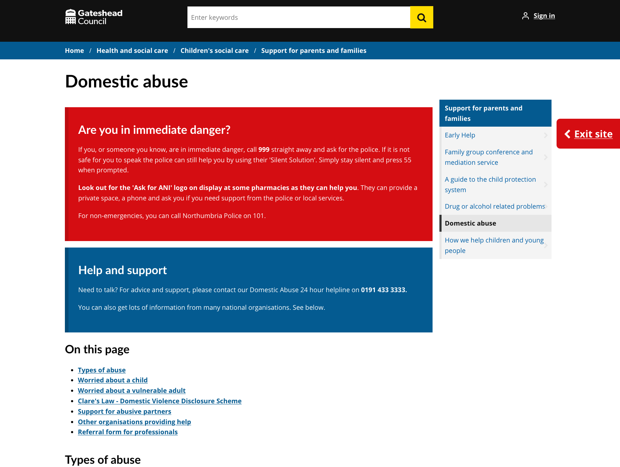
Sprint 4
Design
Exit button on domestic abuse page not in right place

Slide 5
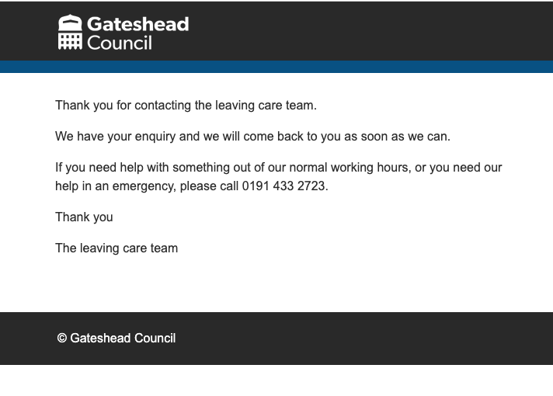
Sprint 4
Design
Gateshead's got your back app subsite
Created contact us form
Added example templates ready for styling with brand colours and logo (tbc)

Slide 6
Sprint 4
Development
Site decommission
SSL certificate for Gateshead.gov.uk
ADFS renewal
Change text on Digital Panel sign up on confirmation pages

Slide 7
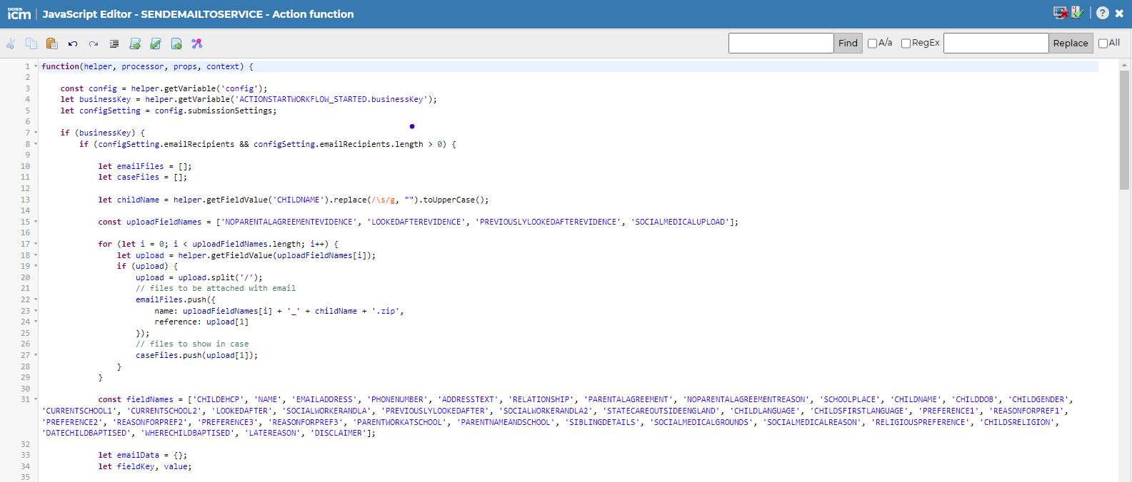
Late School Applications – code review amendments
Improve code to make it faster, simpler to update, and easier for other developers to maintain.

Slide 8
Sprint 4
Content and wireframing
Replacement bins
Update email following a rebooking – reference to payment removed and additional advice about access
Create page for cabinet appendices
Adult Social Care - resource centres
Digital style guide - Digital service standards - Intranet - Gateshead Intranet
How we work
About the digital team/how we can help you
Past and current digital projects
Content accessibility
Accessible pdfs

Slide 9
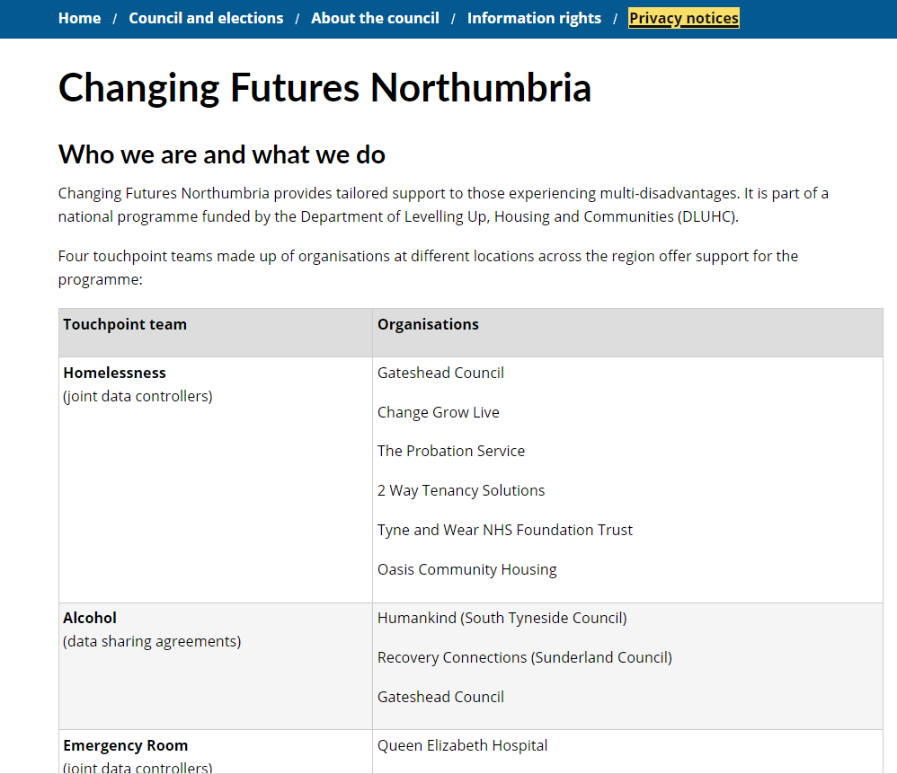
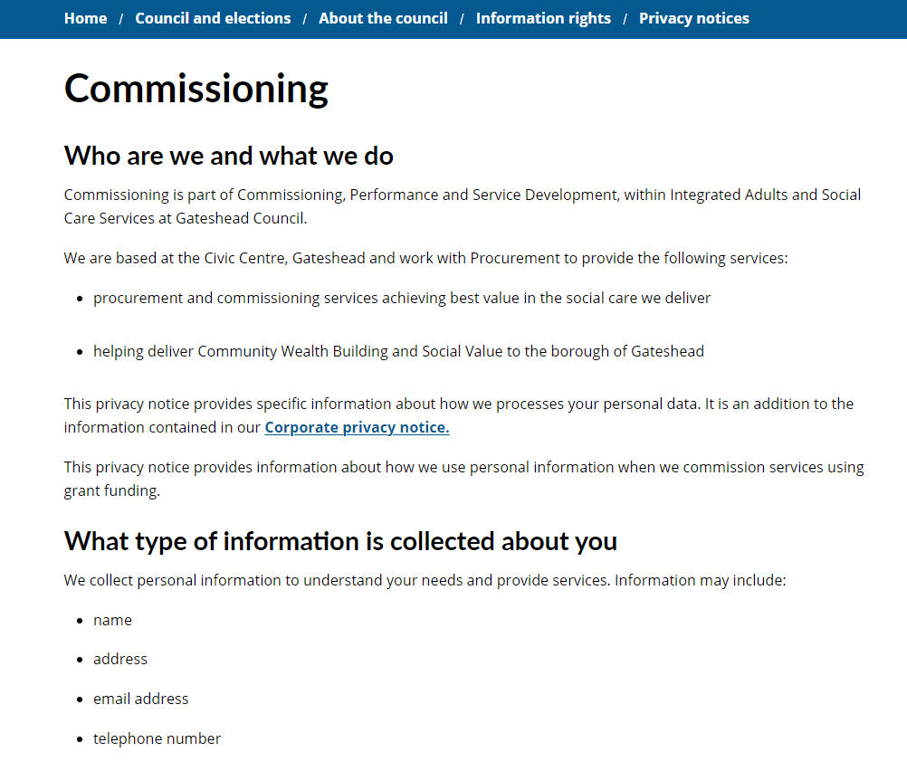
Editorial checks and publication of three new privacy notices
Registration service
Changing Futures Northumbria
Commissioning

Slide 10
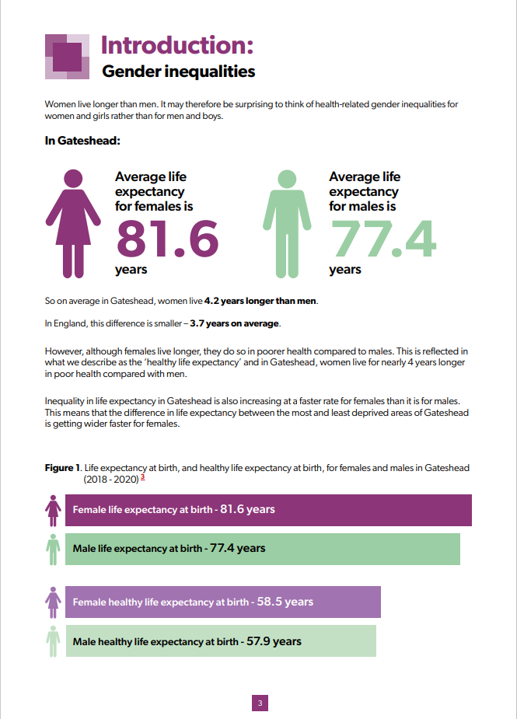
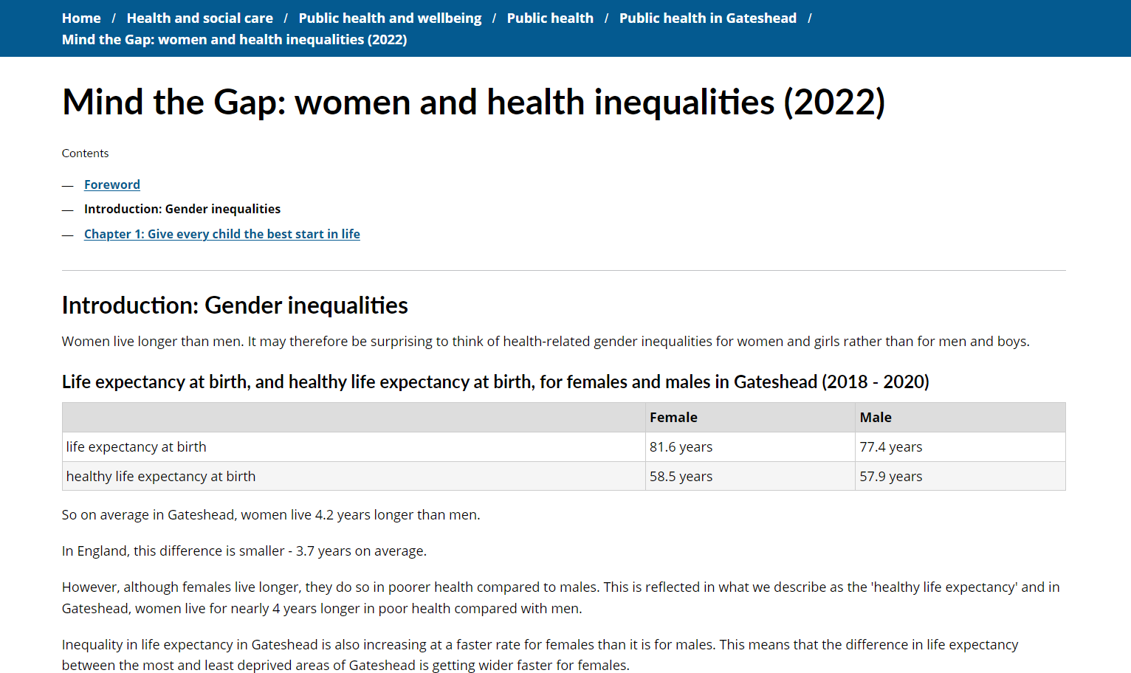
Preparatory work for planned DPH Annual report 2024
Conversion of first 3 sections of 2022 DPH annual report
Demonstration to Comms and Public Health team of planned approach to conversion of forthcoming 2023/4 report
Full report approx 100 page pdf document.
Working closely with service and Comms team on new edition (full text due 20 November)

Slide 11
Review Information Architecture survey in Optimal Workshop
We will ask participants from our digital user research panel to sort subject areas into the groups that make sense to them, to help us determine the best information architecture (site structure) for gateshead.gov.uk

Slide 12
Change text on Digital Panel sign up on confirmation pages
Text added to:
Report fly-tipping
Garden waste subscriptions
Bulky waste collections
HWRC bookings

Slide 13
Improvements to planning permission pages for householders
Before
Planning application process not clear
Householders directed to apply for planning permission rather than to seek pre-application advice
Information on how to pay is included which is no longer needed

Slide 14
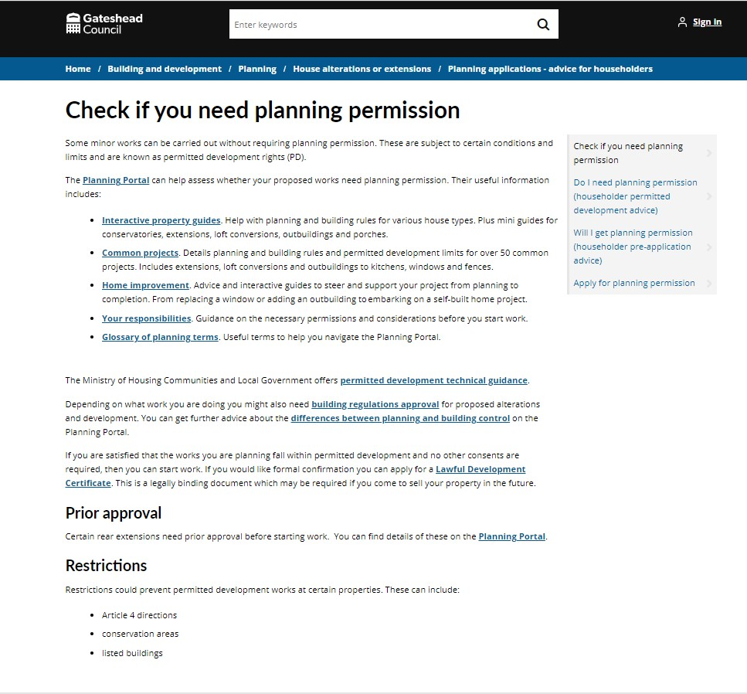
Improvements to planning permission pages for householders
After
New advice for householders page with planning application process laid out clearly on one page
New check if you need planning permission page
Apply for planning permission page updated so now aligned with existing improvements to pre-app content

Slide 15
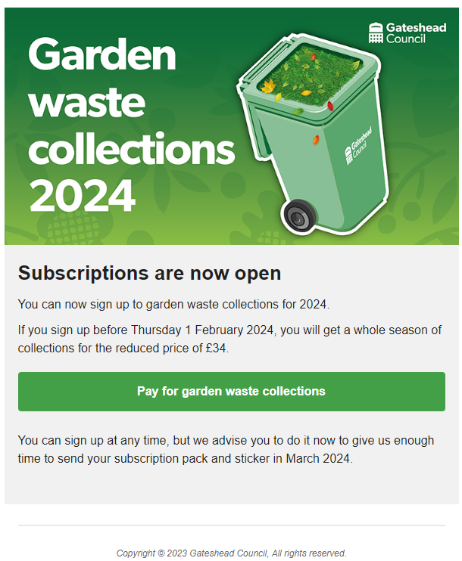
Garden Waste collections 2024 - emails
Send GW email to early adopters
Send GW email to all past subscribers
Early adopters email
All past subscribers email

Slide 16
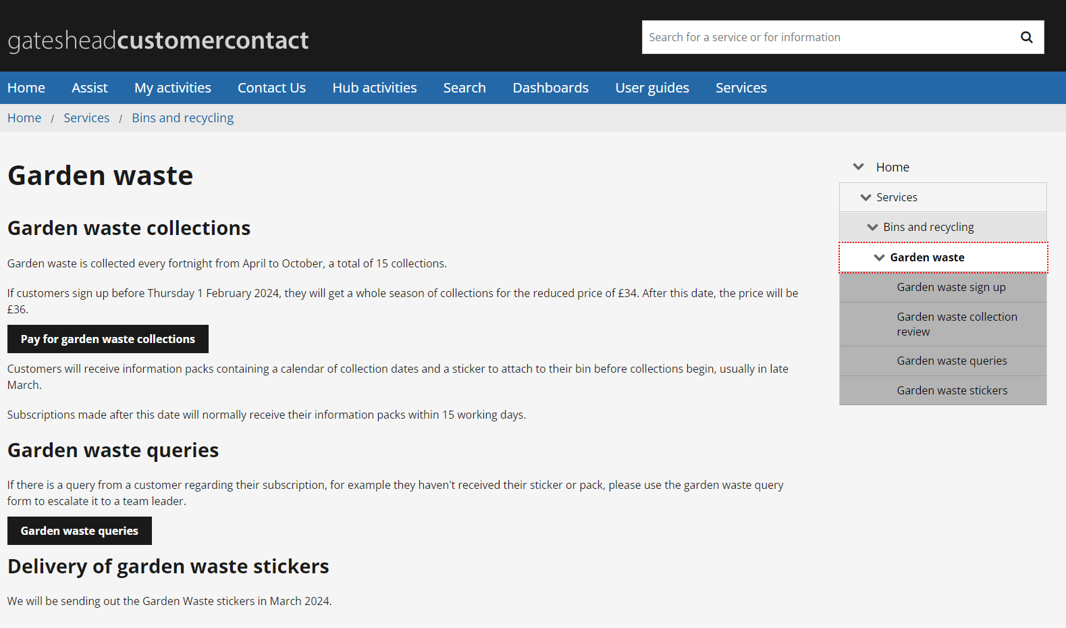
Reinstate Garden Waste subscriptions on website and Customer Contact
Website www.gateshead.gov.uk/gardenwaste
Customer Contact

Slide 17
Create a separate queue for complaints cases in Customer Contact
A manager had an issue with missing complaints cases coming in due to having so many different case types coming through in their 'My Activities' queue. I created a separate queue for complaints cases, and a new user group for this. Now any other staff member having the same issue can be added to this group and gain access to the separate queue, making their complaints cases much easier to access and keep track of.

Slide 18
Sprint 4
Testing
Testing standard site on PRP server
Test text change on Digital panel sign up on confirmation page
Late School Application – code review amendment re-testing

Slide 19
Sprint 4
Go live
Garden waste collections 2024 – launch
Gateshead Now – 02 November

Slide 20
Sprint 4
BAU/ Other tasks
Data training
E-learning modules
Create a separate queue for complaints in Customer Contact

Slide 21
What's coming up in Sprint 6
Discovery
Direct payments
Winter maintenance
Content
Brighten the day activities
Further privacy notices
Library bookings
Design
Gateshead has your back PWA
Late school applications
Development
Bin decontamination improvements
Financial assessment improvement
Email action – update multiple processes

