Slide 1
Sprint 3 Show and Tell
G Squad
Digital Team

Slide 2
Sprint 3.
Data
Telephony Data
Processing OpenScape Data reliably
Prototype dashboard:
Channel Data Dashboard
Verifying the data
Dashboard:
Discovery
Business rates change of address – to be process complete

Slide 3
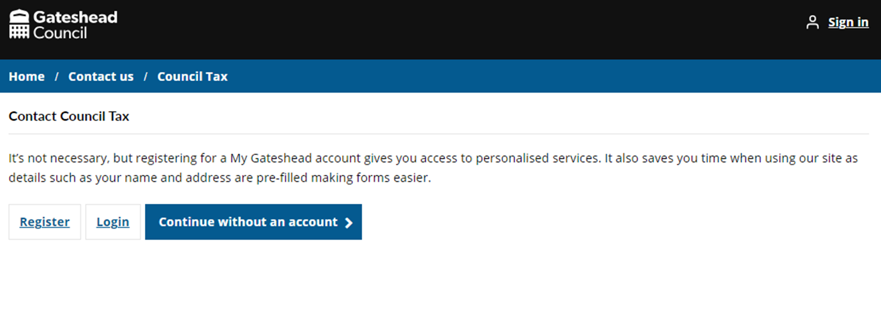
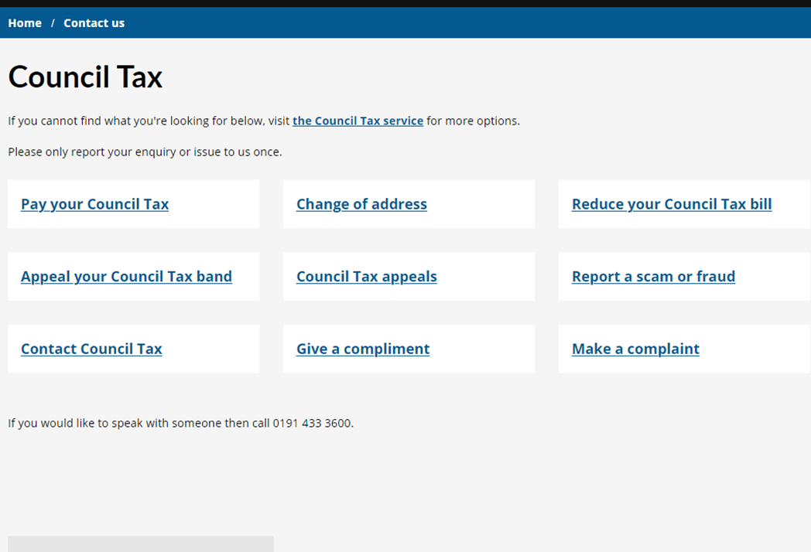
Sprint 3.
Content and wireframing
Council Tax removal of email address, embedded contact us form CTA button
Short url
20 submissions since go live 3 days ago

Slide 4
Sprint 3.
Content and wireframing
Privacy notices
– Domestic abuse - IT school support - Home to school transport - Catering and cleaning - Gateshead Channel - Community safety - OH (traded service) - HR (traded service)
Privacy notices - Gateshead Council
3 remaining, then forms will be updated across the site with correct PN
Annual parking report – awaiting graphics completion of PDF before go live.

Slide 5
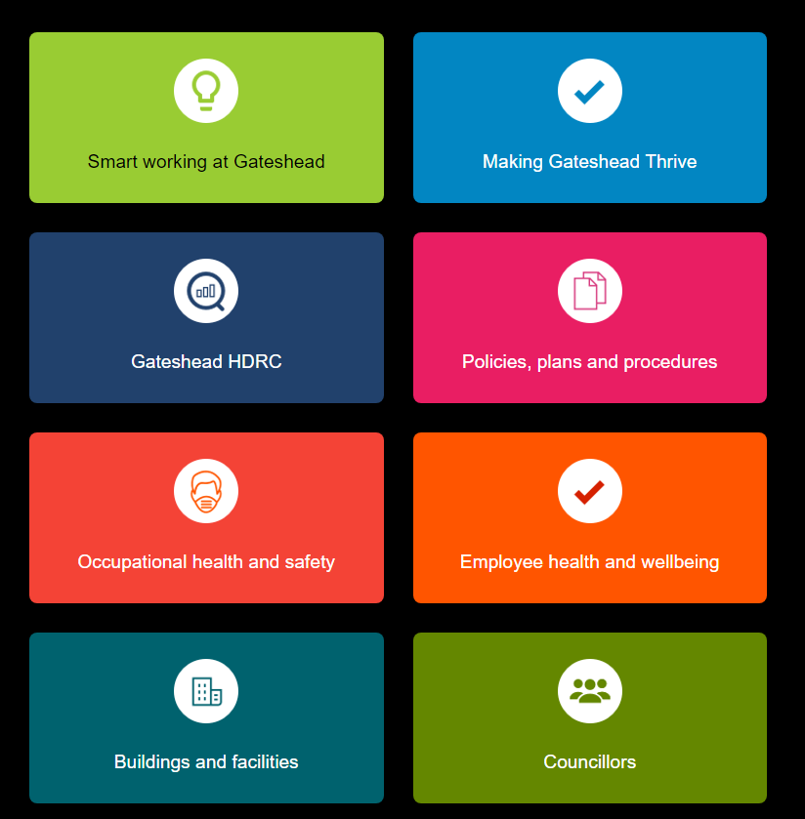
Sprint 3.
Content and wireframing
Intranet modifications of Employee health and Wellbeing, Occupational health and Councillor resources
Working with Emma Raynard and Emma Wales.
Additional improvements to follow to Councillors section, Employee health and wellbeing new proposed areas to be populated.

Slide 6
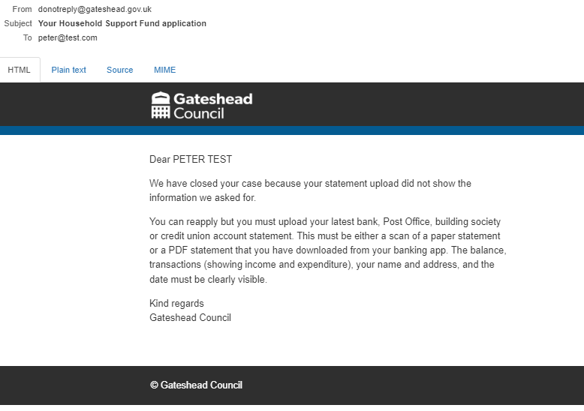
Sprint 3.
Content and wireframing
Grounds maintenance – contextual info was missing in Customer Contact ('we've already had reports in this area...')
Grounds maintenance – new text for confirmation message (was referencing street lights)
Bonfire removal content – checking if any updates needed and informing CSU
Amended wireframes x2 for Gateshead Exchange
Improvement for HSF – additional closure reason and confirmation email (see pic):

Slide 7
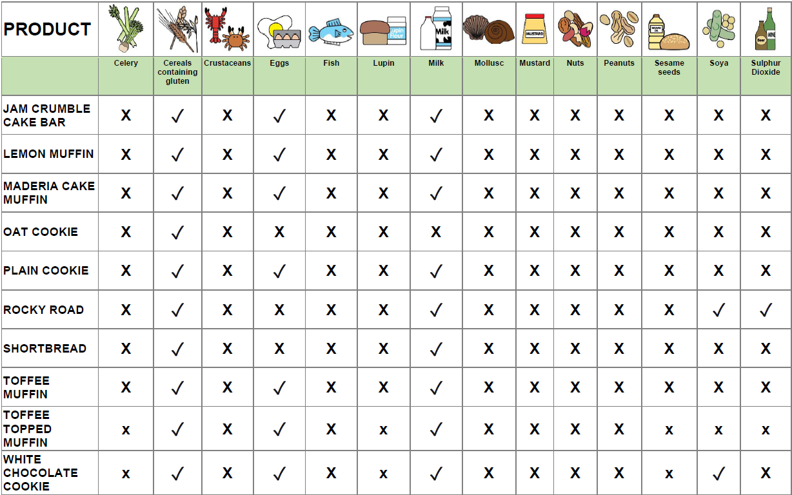
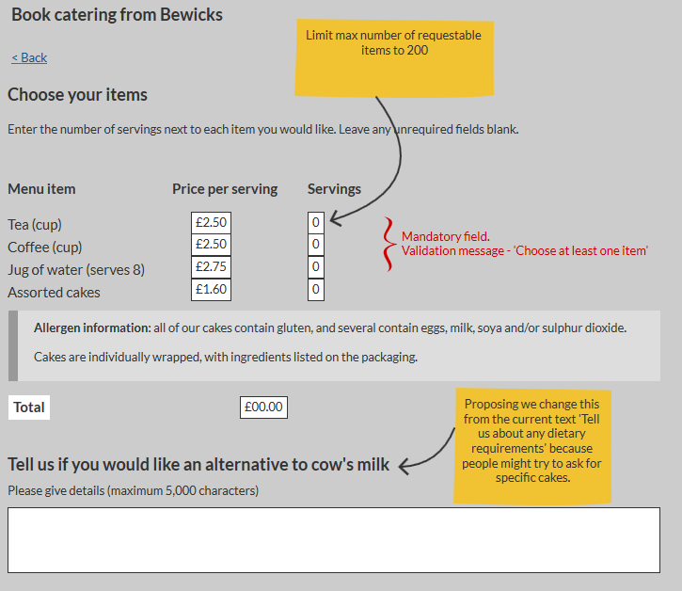
Sprint 3.
Content and wireframing
Bewicks catering for meetings now offering 'assorted cakes'.
Lots of back and forth regarding whether people can choose the cakes they get, allergen info, ingredient listing, wrapping...
Content changes on the right – currently with the service for feedback.

Slide 8
Sprint 3.
Development
Early draft of Gateshead Energy Company microsite homepage. (desktop on left; mobile on right) Still awaiting official graphics.

Slide 9
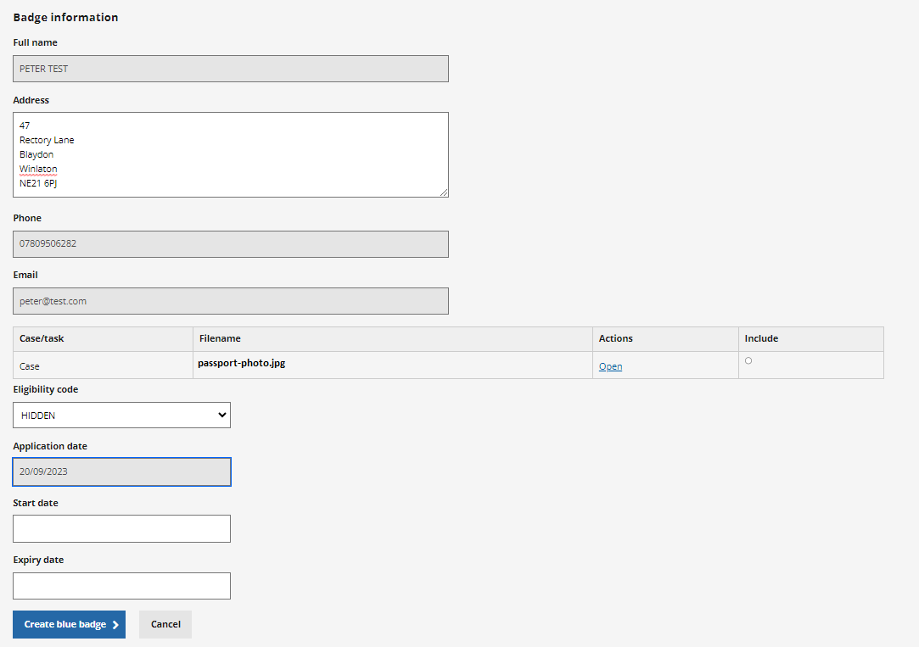
Sprint 3.
Development
Blue Badges
Ability to select 'HIDDEN' as the eligibility code when ordering a Blue Badge
Ability to edit the address when ordering a badge

Slide 10
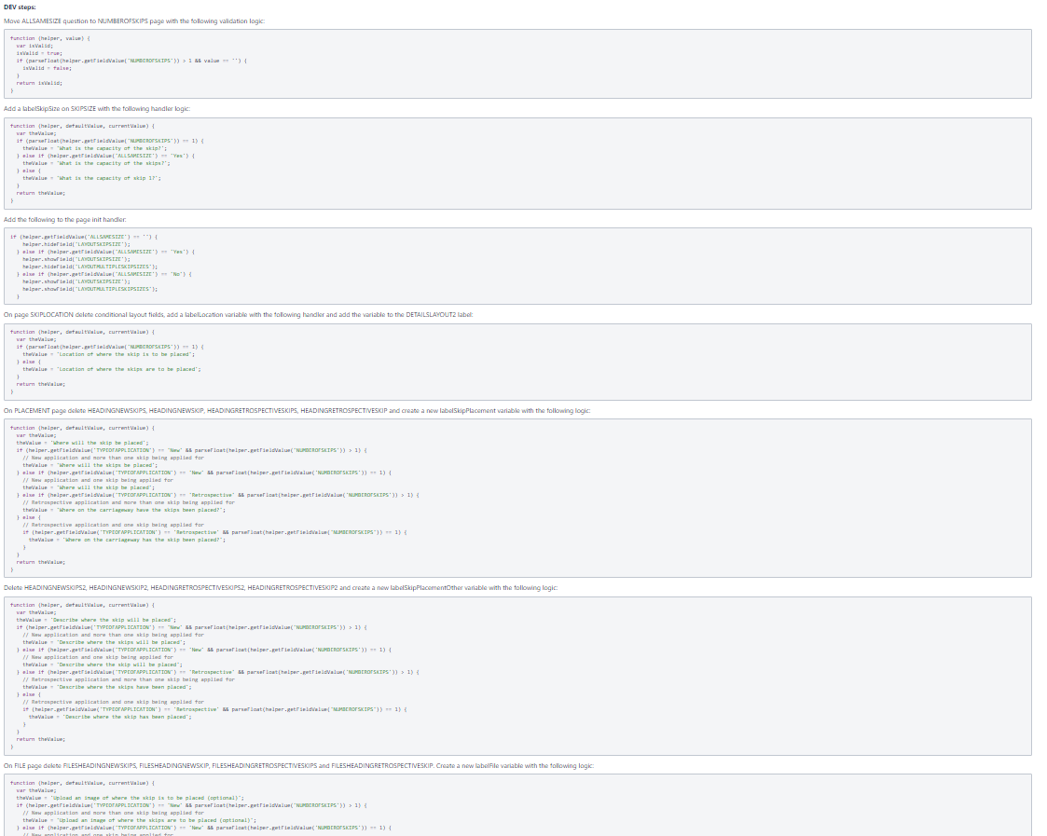
Sprint 3.
Development
Skip permits Actions from code review. Making the code more efficient, easier to maintain, easier to update, resulting in a more accessible form for users.

Slide 11
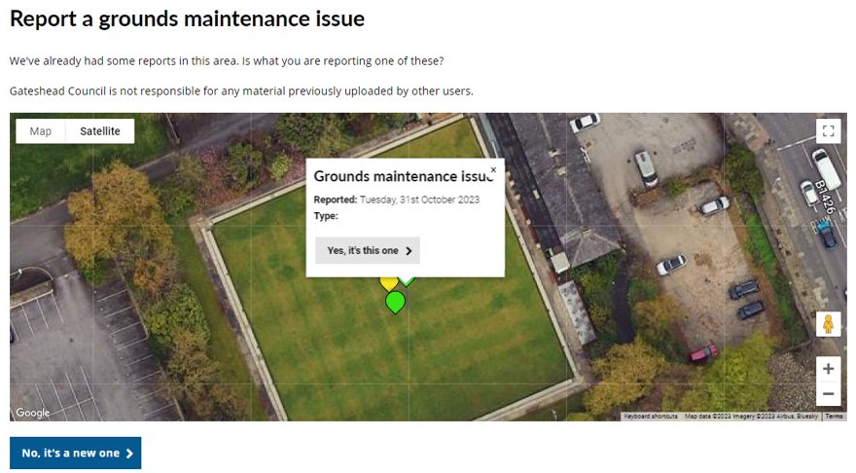
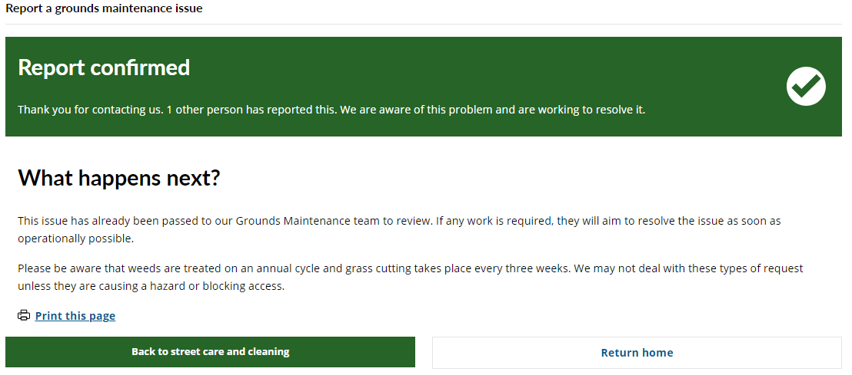
Sprint 3.
Development
Grounds maintenance
Allow the form to show previously reported issues
Correct the existing report confirmation page
Correct the new report confirmation page (survey links and return URLs)

Slide 12
Sprint 3.
Development
New or replacement bins (DCE-7187)
Picked up from Sprint 2
Allow the form to change the wording of the question and guidance based on the answers selected.

Slide 13
Sprint 3.
Development
Gateshead Exchange forms
https://gateshead.ghc2-dev.gosshosted.com/article/13258

