Slide 1
Sprint 29 Show and Tell 15 May 2024
G Squad
Digital Team

Slide 2
Sprint 29.
Sprint goals
Council Tax change of address to be process mapping.
Council Tax single person discount form build (apply and cancel).
Council Tax student discount wireframe.
Council Tax e-billing user research.
Council Tax website content audit.
Homelessness appeals form build testing.

Slide 3
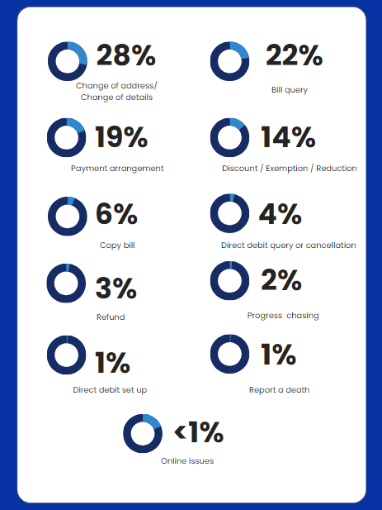
Sprint 29.
Council Tax contact form – demand analysis
Over 50 percent of customers entered an account number – speeding up indexing
Around 50 percent of enquiries will be able to be reported online
Copy bill – opportunity to automate that process
Change of address – can already be reported online. User research to understand why this online process isn’t being used

Slide 4
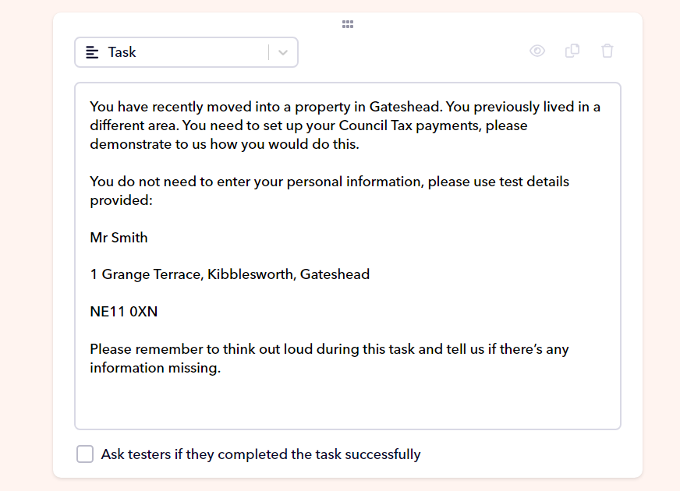
Sprint 29.
Council Tax user testing – user brain
Areas to monitor:
Evaluate our success in search engine
Analyse end-to-end user experience from initial enquiry to outcome
Review initial perceptions of content and navigation
Suggested topics:
Paying Council Tax
Moving into the area (notifying Council and setting up payment)
Review eligibility for discount or exemption

Slide 5
Sprint 29.
Council Tax – content audit
Pages with the most views in the last 6 month:
How you could reduce your Council Tax bill (5,900)
Student Council Tax discount and exemptions (5,800)
Single person discount (5,100)
Next steps:
Reduce number of tables
Possibility of combining PDF forms into one form
Aim to improve each page content

Slide 6
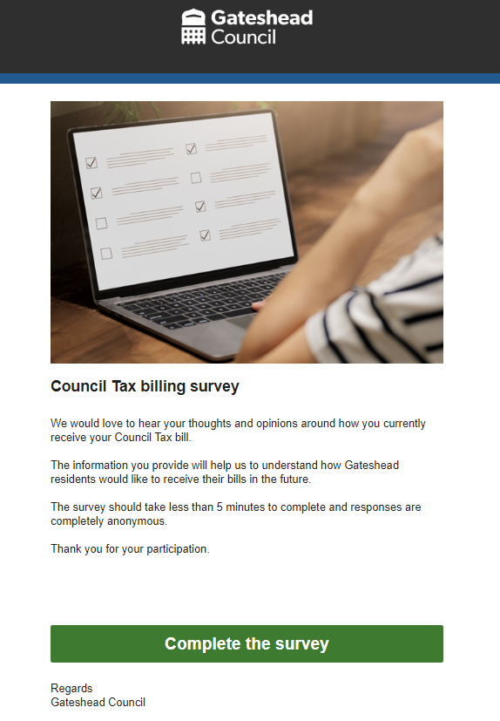
Sprint 29.
Council Tax user research – billing survey
Met with service to discuss survey placement on website and email addresses to use to mail out survey
Tested and iterated survey
Chose survey format (Microsoft Forms vs Optimal Workshop)
Help from David and Emma to set up Mailchimp
Contact with Matt Liddle around the consultation panel
Next steps:
Survey go live

Slide 7
Sprint 29.
Debt Data Project – Next Phase
Data Matching | Building an Evidence Base | Automate Existing Reporting
Automate data extraction and processing. Automate the algorithm performing the matches. Develop evaluation criteria to measure the effectiveness of the model, and repeated runs. Test matching with Services contributing data and Legal. | Rerun the Can’t Pay/Won’t Pay analysis. Validate the types of payers. Review payment history identify patterns based on groups. Investigate how arrears accumulates. Cost / Benefit Analysis of Recovery Action | Making it easier to generate regular reports. Make the data available to a wider audience. Enrich current reporting with other data available across the council (LIoN, GIS etc) to provide additional value to quickly.

Slide 8
Sprint 29.
Debt Recovery Process

Slide 9
Sprint 29.
Debt Recovery Data Model

Slide 10
Sprint 29.
Debt Recovery Data Model

Slide 11
Sprint 29.
Council Tax Base Dashboard

Slide 12
Sprint 29.
Modelling Impact: Developing a baseline
Exploring the data available in Capita, 8x8 and Civica: does it provide a baseline for the improvement work we have started?
Month | No. of Calls | Time Spent - Hours | FTE | Estimated Cost | Cost per interaction - £
January | 6218 | 565 | 3.81 | £ 11,765.43 | 1.89
February | 5237 | 637 | 4.3 | £ 13,266.46 | 2.53
March | 7490 | 777 | 5.25 | £ 16,197.54 | 2.16
April | 5878 | 722 | 4.88 | £ 15,056.31 | 2.56
May | 1958 | 223 | 1.51 | £ 4,646.18 | 2.37

Slide 13
Sprint 29.
Council Tax -Change of address process mapping
Engage process map demo

Slide 14
Sprint 29.
Council Tax, single person discount (SPD)
Apply and cancel proposed web content
Demo of both apply and cancel

Slide 15
Sprint 29.
Form demo of single person discount process

Slide 16
Sprint 29.
Council Tax, student discounts and exemptions wireframe (prototype) proposed web content

Slide 17
Sprint 29.
Council Tax, student discounts and exemptions
DOB under or over 20 years old

Slide 18
Sprint 29.
Council Tax, student discounts and exemptions
Foreign language assistant

Slide 19
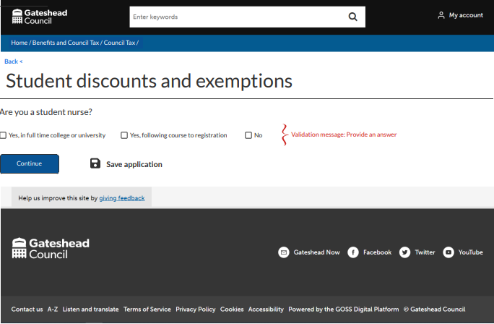
Sprint 29.
Council Tax, student discounts and exemptions
Are you a student nurse?

Slide 20
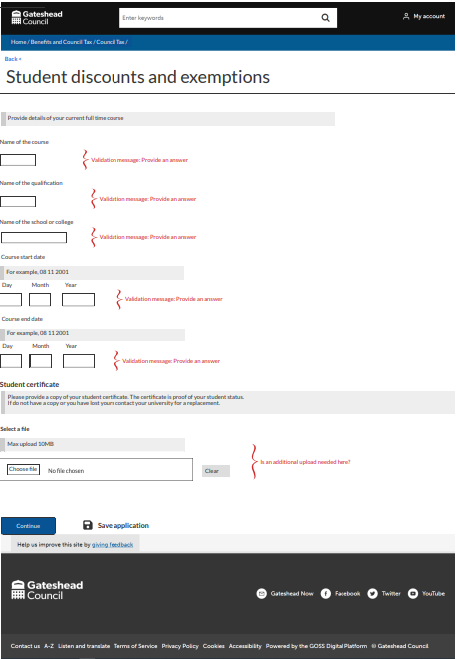
Sprint 29.
Council Tax, student discounts and exemptions
Student

Slide 21
Sprint 29.
Council Tax, student discounts and exemptions
Any occupants over 16 years old

Slide 22
Sprint 29.
Council Tax, student discounts and exemptions
Details of occupants over 16 years old

Slide 23
Sprint 29.
Housing – Homelessness appeals
Form demo
Case management demo

Slide 24
Sprint 29.
Housing – Homelessness appeals. Case management
Appeals received will drop into a work queue
Cases an officer is working on appear in assigned tasks

Slide 25
Sprint 29.
Housing – Homelessness appeals. Case management
Status is marked Open

Slide 26
Sprint 29.
Housing – Homelessness appeals. Case management
Click to view case details

Slide 27
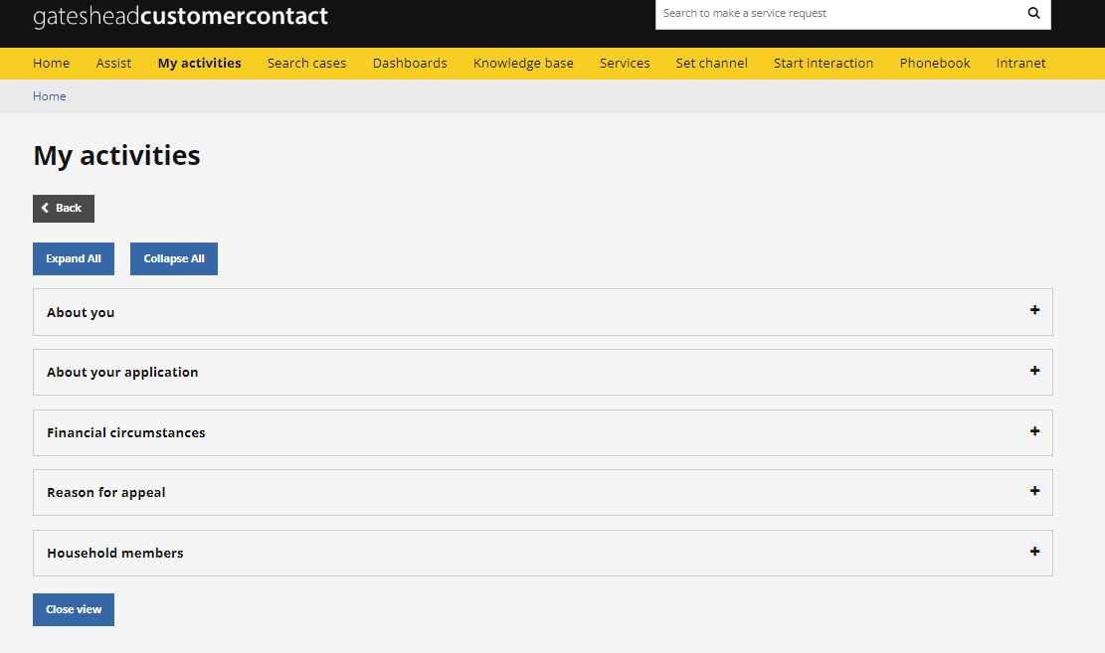
Sprint 29.
Housing – Homelessness appeals. Case management
Content of form contained in different sections

Slide 28
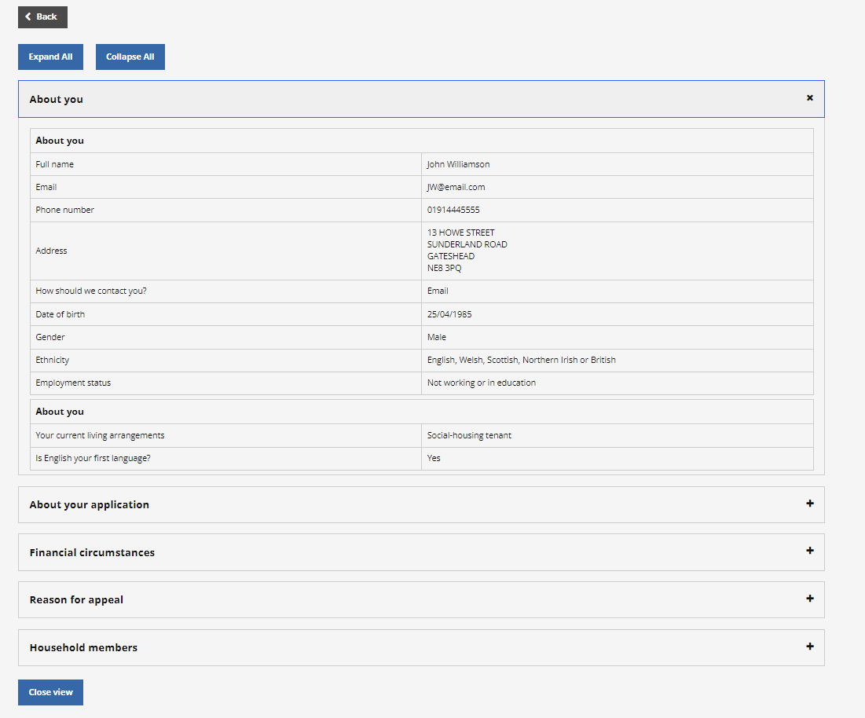
Sprint 29.
Housing – Homelessness appeals. Case management
Content of form contained in different sections

Slide 29
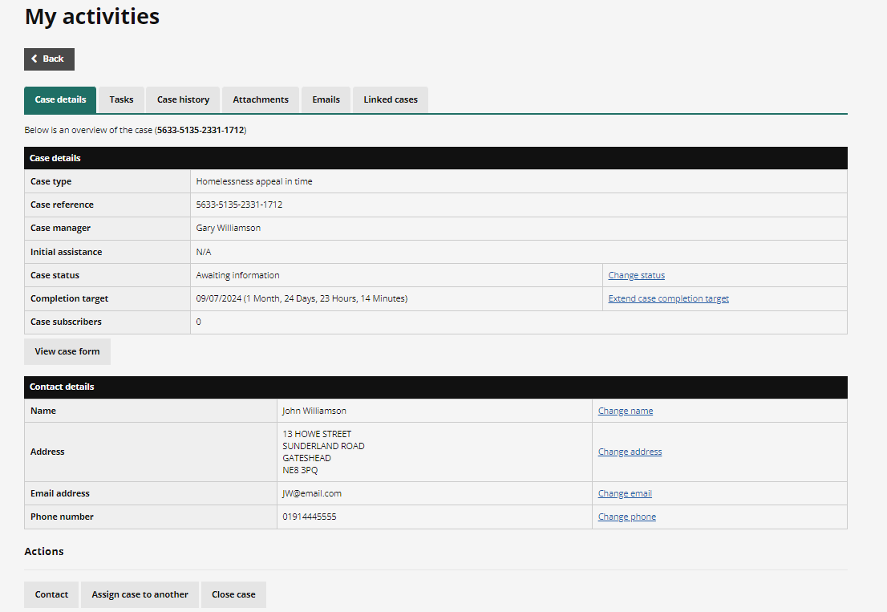
Sprint 29.
Housing – Homelessness appeals. Case management
Status of the case changed to reflect the stage the case is at

Slide 30
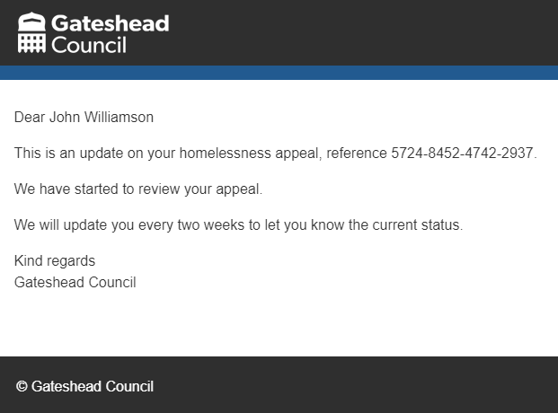
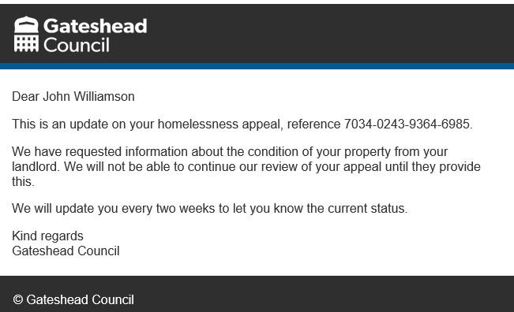
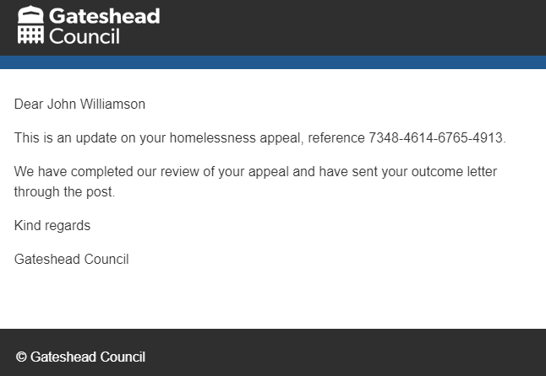
Sprint 29.
Housing – Homelessness appeals. Case management
Customer kept up to date by email at every status change – reducing avoidable contact

Slide 31
Sprint 29.
What's next?
Household Support Fund changes
Council Tax - Change of address build
Council Tax – discount
Integrating contact form with NEC?
Planning content audit

