Slide 1
Sprint 28 Show and Tell 24/04/2024
C Squad
Digital Team

Slide 2
Sprint 28 goals
Start implementing new IA and plan how to roll this out
Progress taxi vehicle testing

Slide 3
Sprint 28 - Discovery
Council Tax e-billing user research – Miro board
Finishing survey draft
Agreeing next steps with service
Planning for launch on website and via Notify service
Direct payments
Met with colleagues from Revs & Bens and ASC to agree next steps
Reviewed service design plan (process mapping, customer journey mapping, user research) with presentation
Agreed on next dates for process mapping sessions
Gateshead District Energy Company – Miro board
Met colleagues for process mapping session
Winter maintenance - dashboard
Reviewing salt request data for Winter period '23/24
Adult Social Care – analysis of Contact us data
760 submissions via contact us form
Approx. 1/3 of data analysed so far
Link to data

Slide 4
Sprint 28
Design
Tyne Derwent Way – Post go live snagging
Digital Service Standards
Homelessness appeals form styling
Library events metadata
HWRC availability display in Customer Contact
Kinship care – Panel template set up and styling
Reciteme – Move Listen and translate to the header

Slide 5
Tyne Derwent Way
Post go live snagging
Fixed various styling issues and bugs with the website after going live.
www.tynederwentway.co.uk

Slide 6
Digital Service Standards
Continued development
Reviewed the address form examples
Reduced the number of panels to streamline the home page
Concentrated on the intranet version which includes the Digital Request form
https://intranet.gateshead.gov.uk/article/24880/Digital-service-standards

Slide 7
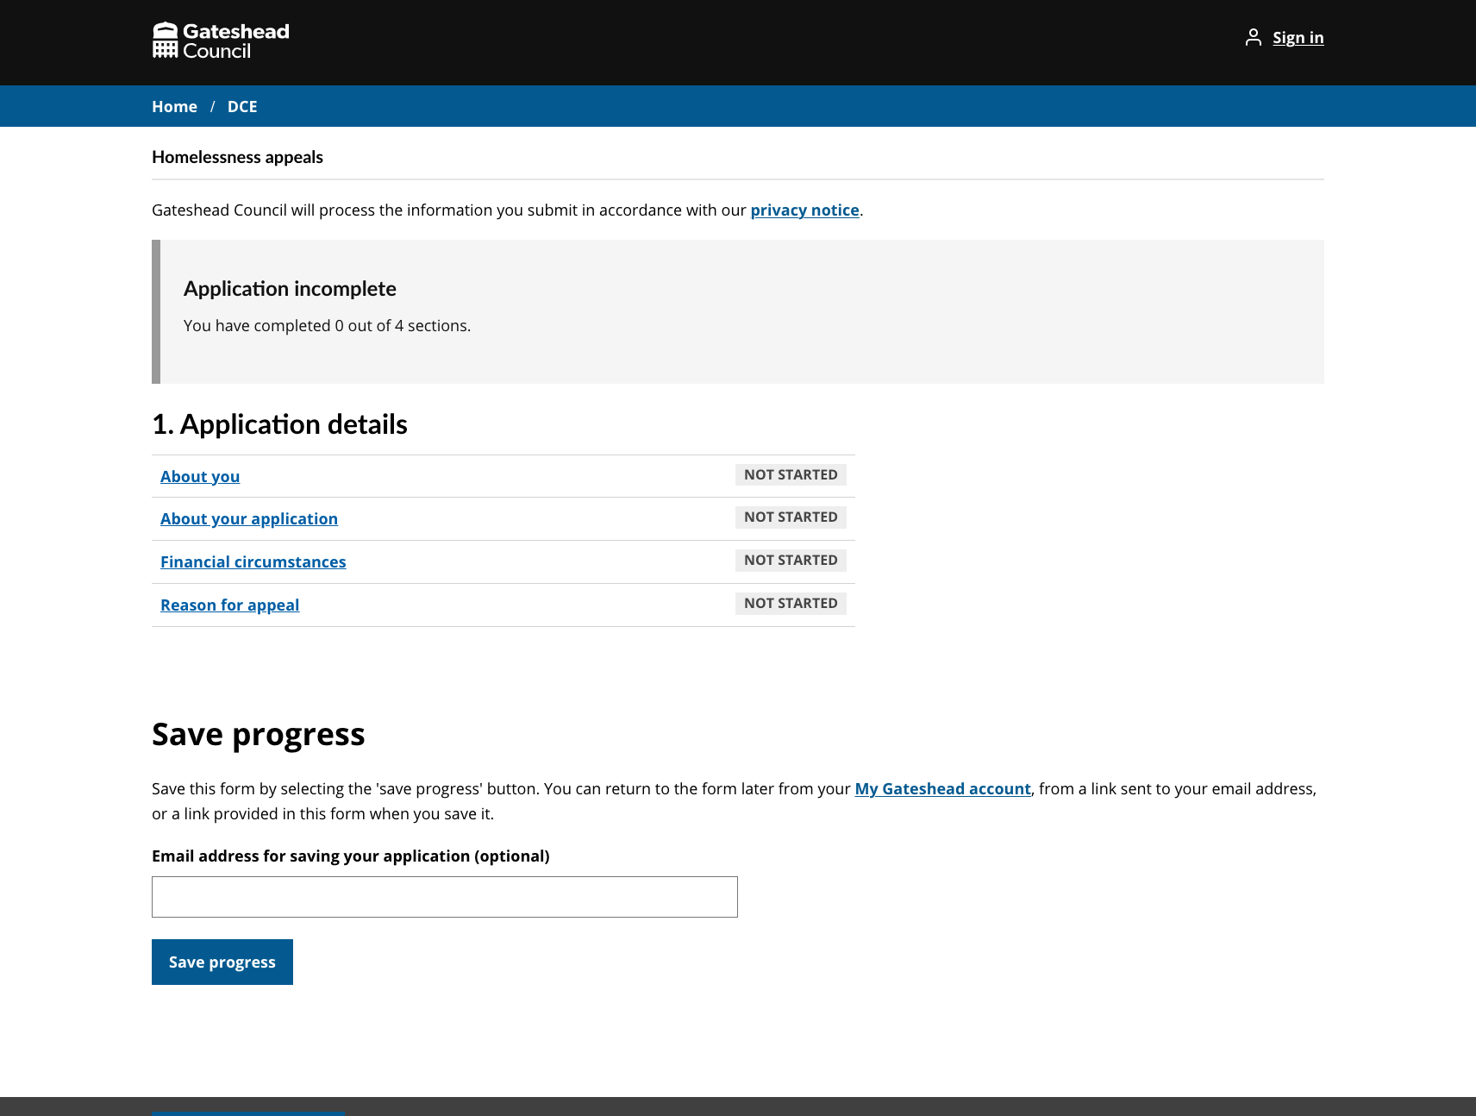
Homelessness appeals form
Styled form
Updated task list (hub and spoke) styling to work with the Gateshead Theme
Styled the application progress and save progress sections to be more prominent
Various other styling improvements
https://gateshead.ghc2-dev.gosshosted.com/article/13611/Homelessness-appeals

Slide 8
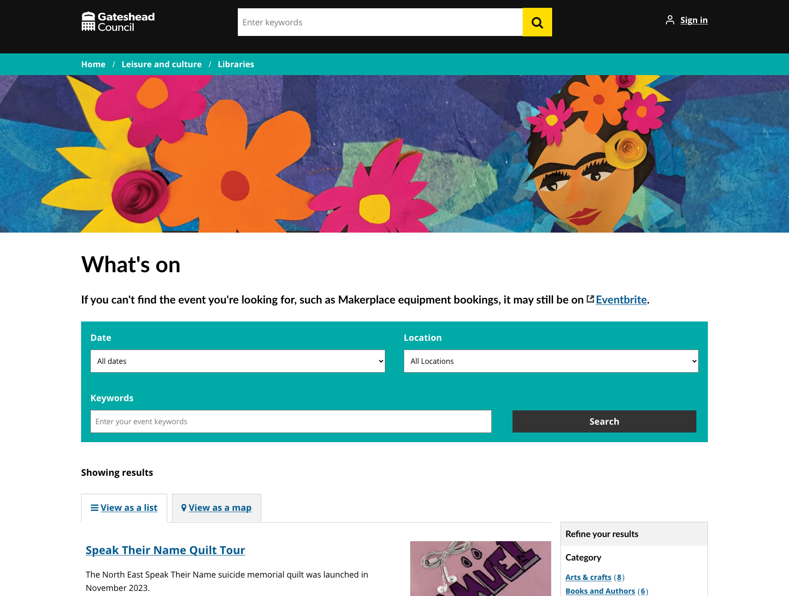
Library events
Pay on the day events
Added metadata and styling to hide the payment amount when the user is booking the event
https://www.gateshead.gov.uk/article/9646/What-s-on

Slide 9
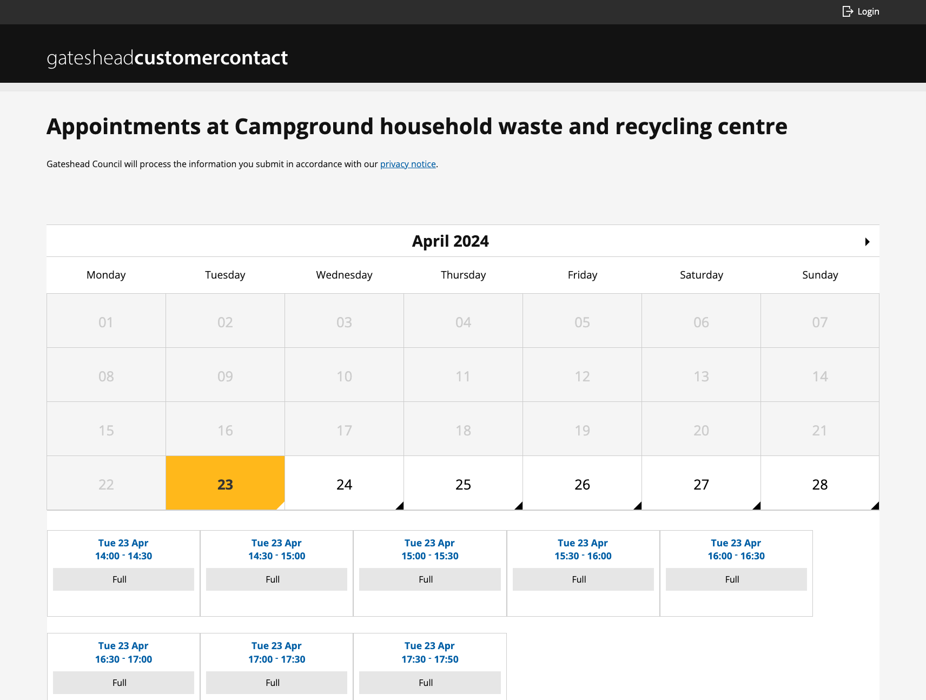
HWRC availability in Customer Contact
Pay on the day events
Once a slot is full, hide the text "Full spaces available"
https://customercontact.gateshead.gov.uk/article/19828/Appointments-at-Campground-household-waste-and-recycling-centre

Slide 10
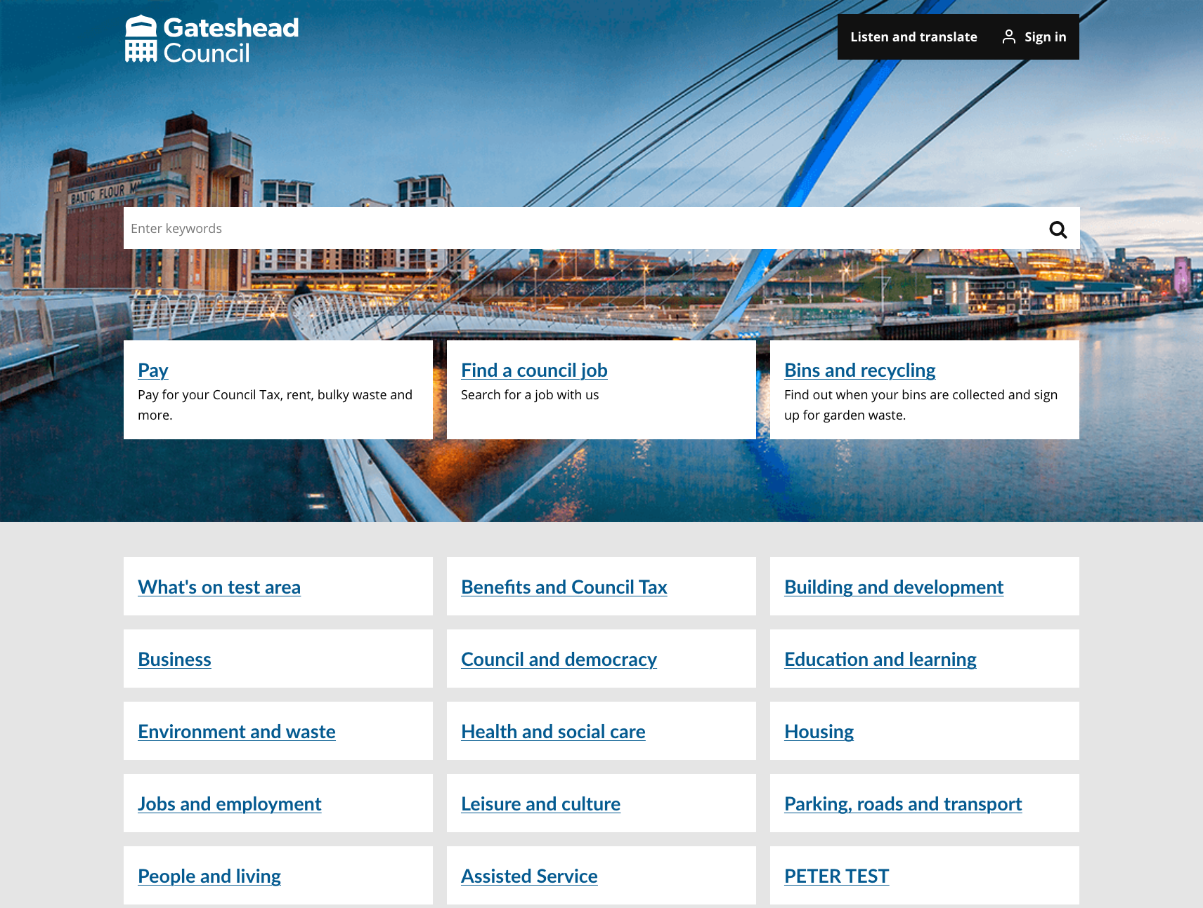
Recite me – Listen and translate
Move to the header
Remove the link from the footer
Add to header
Style the link
Test everything works when a user is logged in / out
Ongoing task to be carried over to next sprint
https://gateshead.ghc2-dev.gosshosted.com/

Slide 11
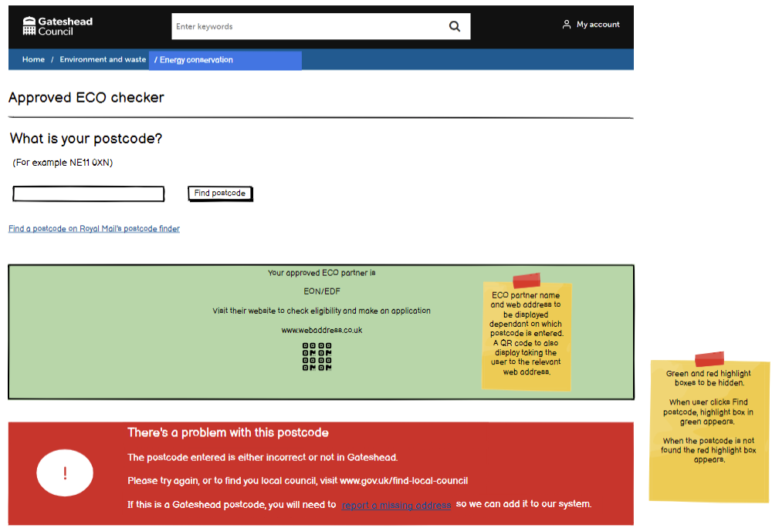
Sprint 28

Slide 12
Sprint 28
Content
Regent Funeral Service updates
Commissioning approach and priorities documents added as web copy
Kinship carers landing page refresh
Issued Kinship carers marketing newsletter
Changes to bulky waste collection confirmation email
Support to libraries to add next batch of what’s on events – images resizing and QA
New Devolution intranet pages for Councillors
Create new site IA in test
Taxi vehicle testing wireframe – licensing team and inspectors

Slide 13
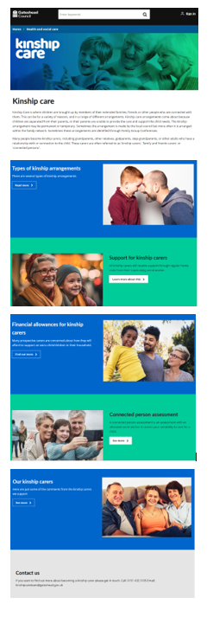
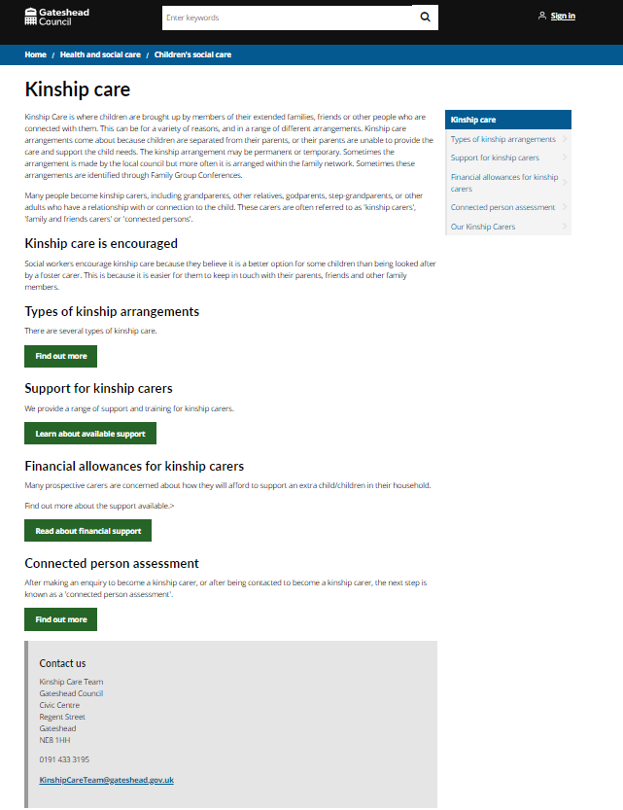
Kinship carers
Content and Design
The fostering team wanted to refresh the kinship carers web pages to align them more with fostering where images and branding are used.
Landing page changed to panel template
Metadata added
Added styling to colour the panels
Images added to landing page. Main content pages remain the same.
New pages with the service for checking/ approval before being put live.

Slide 14
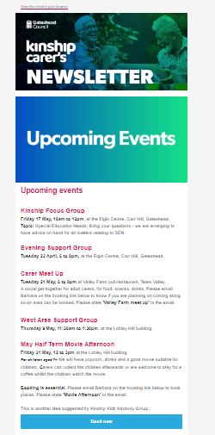
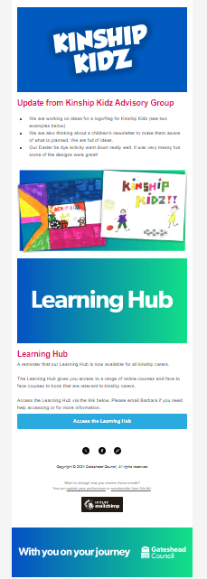
Kinship carers newsletter
Kinship carers monthly newsletter checked and issued through Mailchimp

Slide 15
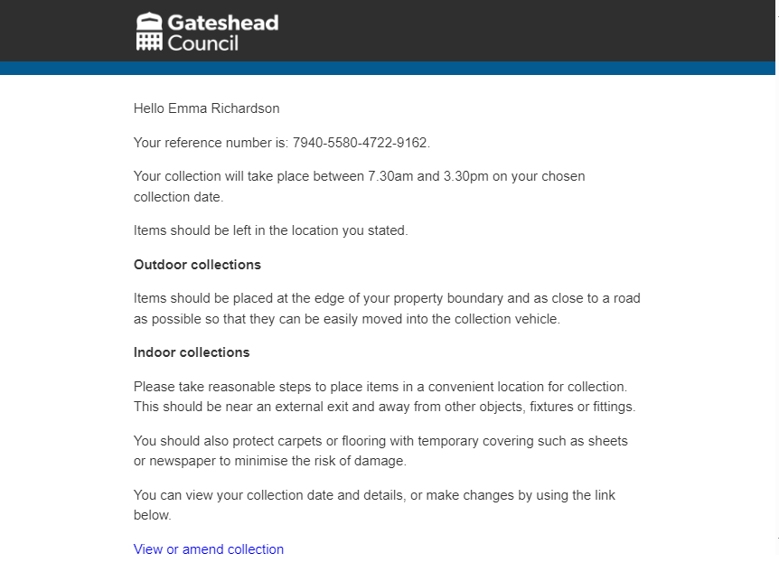
Bulky waste email
Request from CSU to amend bulky waste confirmation email to include information for both indoor and outdoor collections.
Previously the email just detailed what to do if the customer booked an outdoor collection so was confusing for those who’d booked an indoor collection.

Slide 16
New Devolution intranet pages for Councillors
https://intranet.gateshead.gov.uk/article/27680/North-East-Devolution
​
​

Slide 17
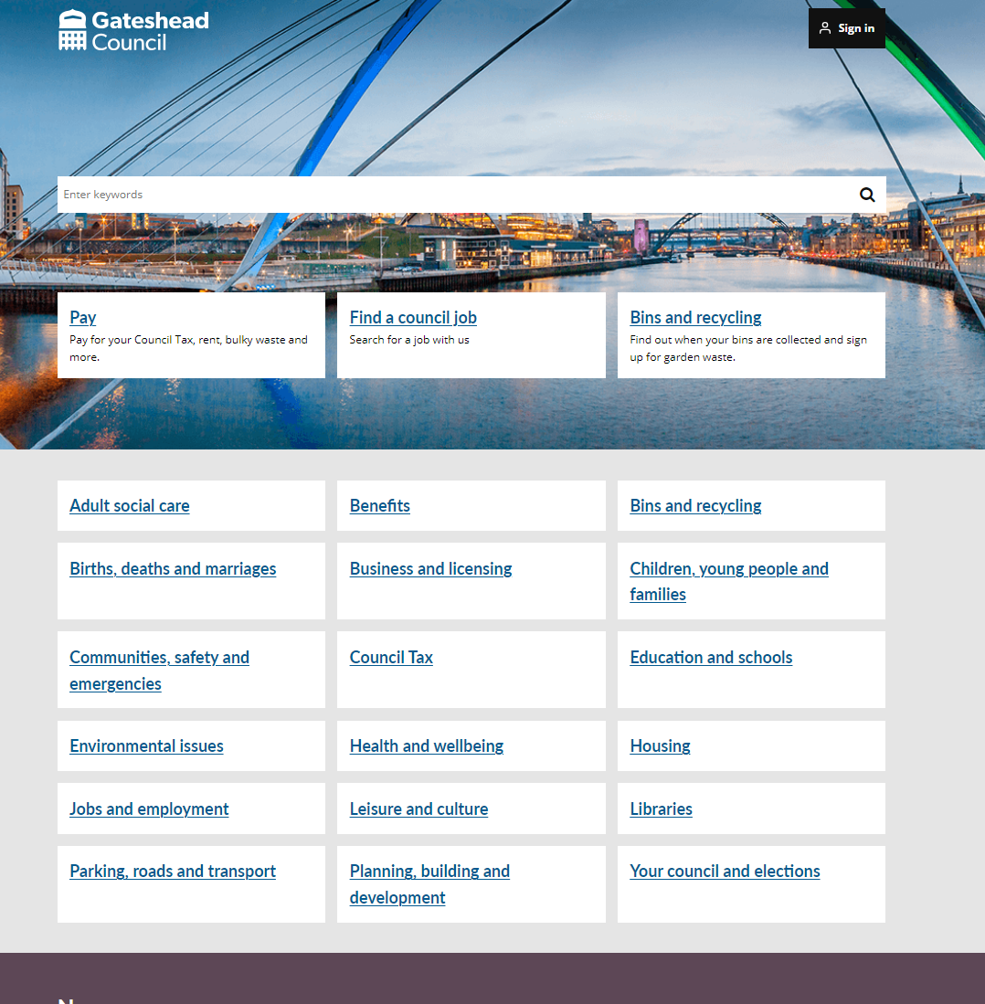
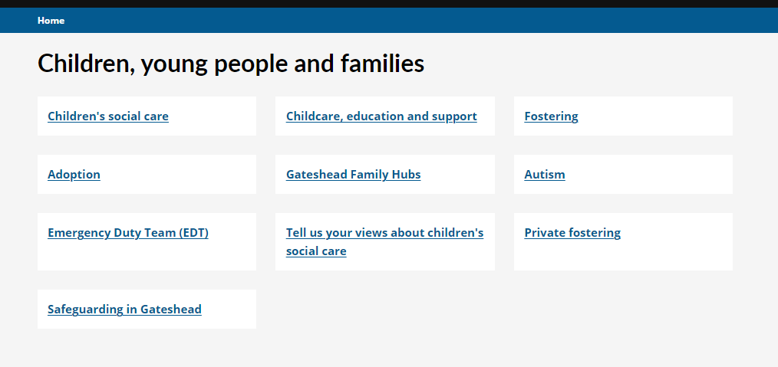
Create new site IA in test
https://gateshead.ghc2-tst.gosshosted.com/
​

Slide 18
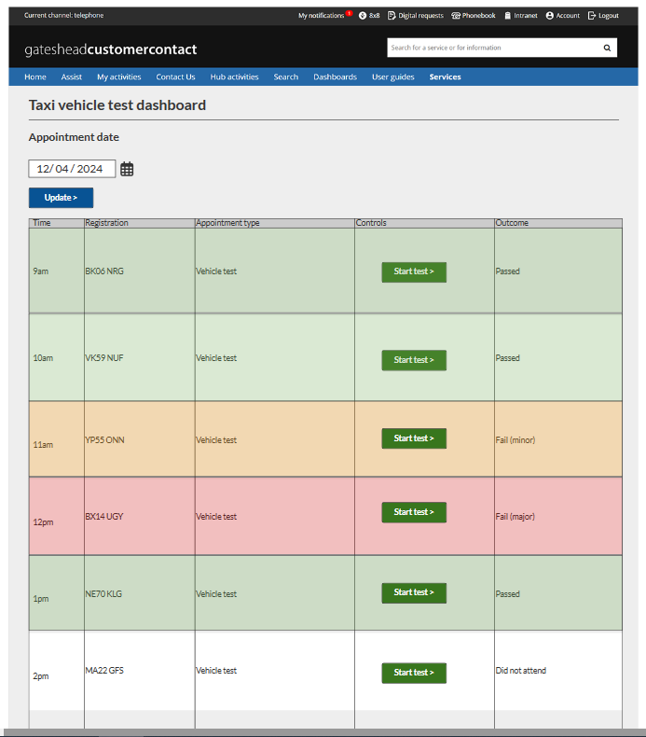
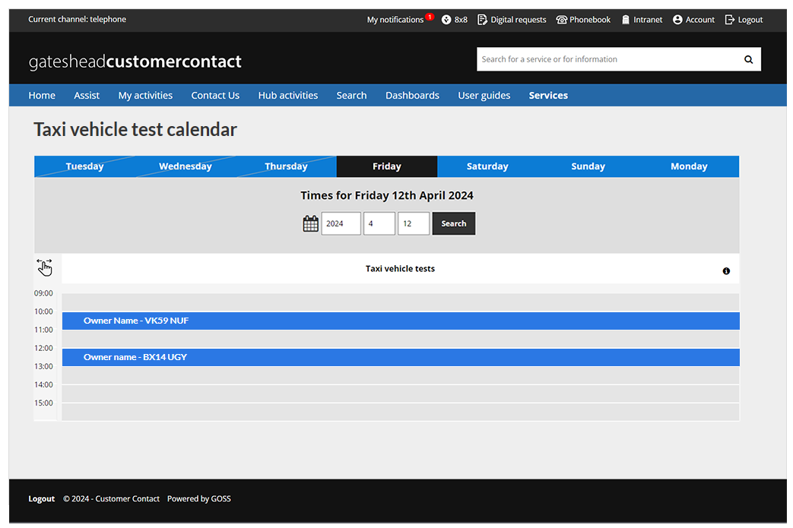
Taxi vehicle testing wireframe – for licensing team and inspectors
​

Slide 19
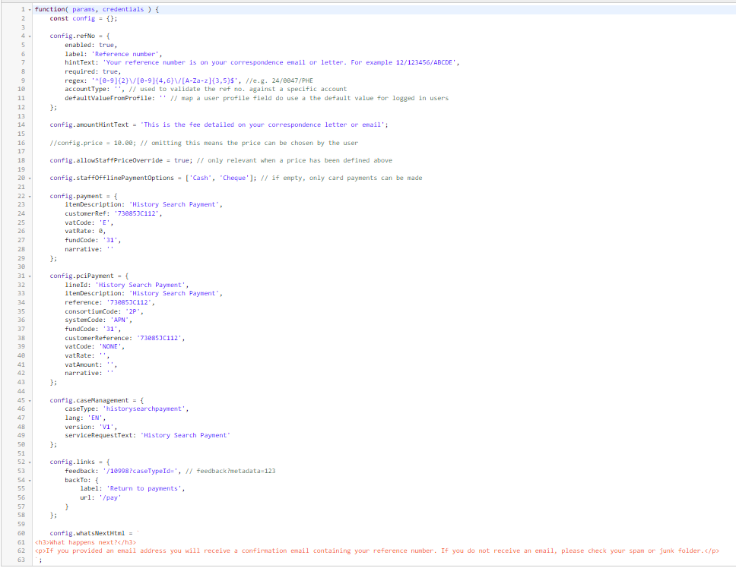
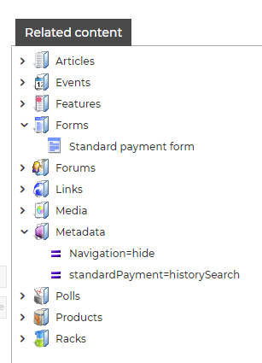
Sprint 28
Development
History search payment form
Food hygiene re-rating payment

Slide 20
Development – Code improvements
Environmental health enforcement advice payment form
Safer Food Better Business (SFBB) pack
Forms now read prices from config and have been updated to use the latest standards.

Slide 21
Development
Update to Report a damaged or dangerous structure – map page

Slide 22
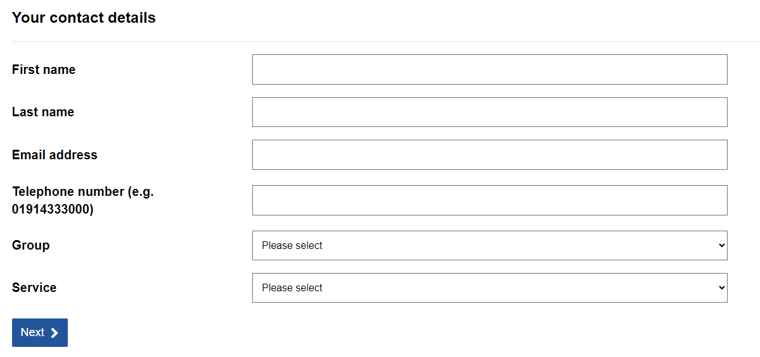
Development
Update Intranet book a room booking form – updated groups and services.

Slide 23
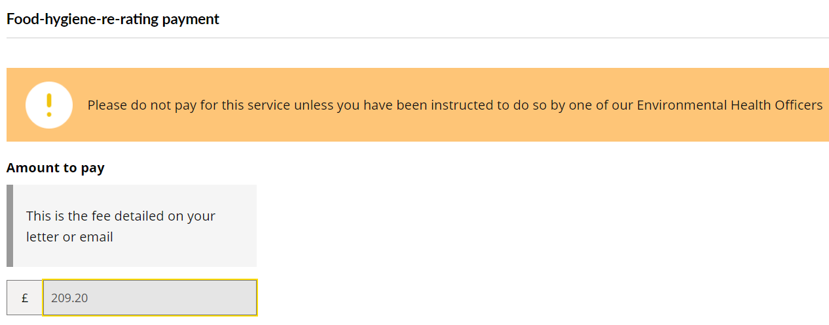
Development
Skin piercing registration payment form: https://gateshead.ghc2-dev.gosshosted.com/article/12386
Brighten the day (providers area) exports
Update to alert text on standard payment form

Slide 24
What's coming up in Sprint 30
Develop ECO flex postcode tool
Direct Payments mapping
Progress care cost calculator
Taxi vehicle testing, wireframe for examiners
New Mailchimp campaign set up for HDRC (Health detriments research collaboration.
Updates to Tyne Derwent Way website
Improvements to householder planning content
Alternate provision register
Continue work on IA

Slide 25
Sprint 28
Deployment

