Slide 1
Sprint 14 Show and Tell 17/01/2024
C Squad
Digital Team

Slide 2
Sprint 14
Discovery
Highways licensing process
Initial meeting, scoping and research
Miro board
Definition of ready
Brainstorming and Service Design Team workshop
Miro board
Direct payments
Project meeting to re-establish scope
Reviewing papers
Waste Escalations
Miro Board

Slide 3
Sprint 14
Design
Gateshead Theme – Change Twitter icon to X
Business Gateshead – Update logos in footer
Design improvements to Libraries events
Parking PCN templates
STAN site – Fix case search modal
GO Gateshead styling
GA4 – Add tracking for page load times on gateshead.gov.uk

Slide 4
Sprint 14
Design - Gateshead Theme – Change Twitter icon to X

Slide 5
Sprint 14
Design - Gateshead Theme – Change Twitter icon to X

Slide 6
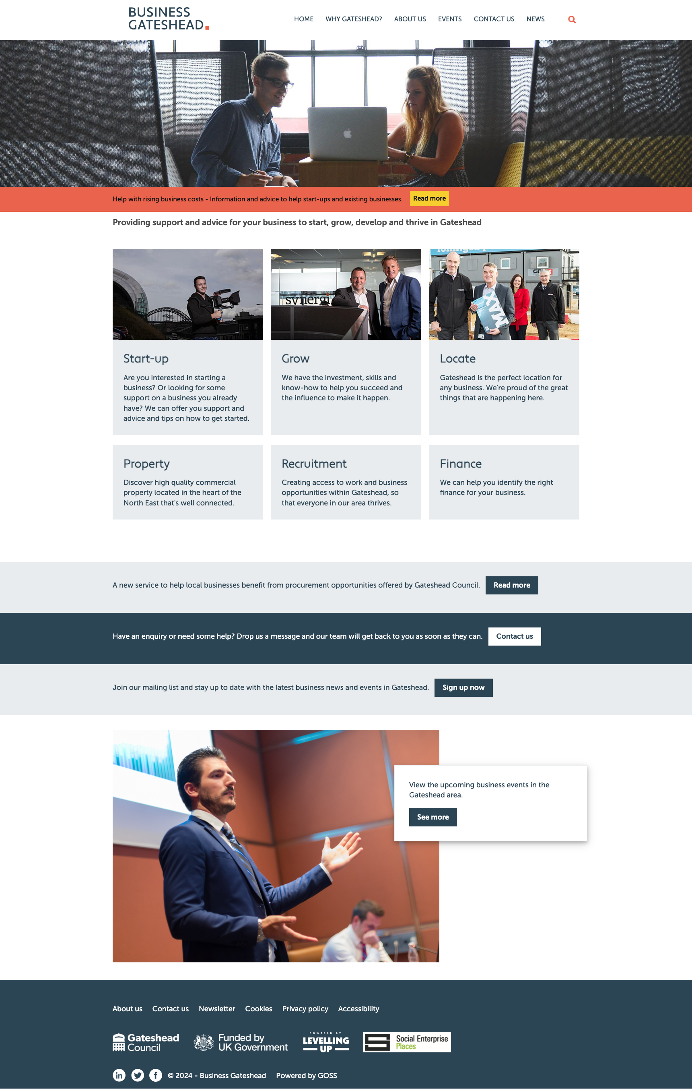
Sprint 14
Design - Business Gateshead – Update logos in footer

Slide 7
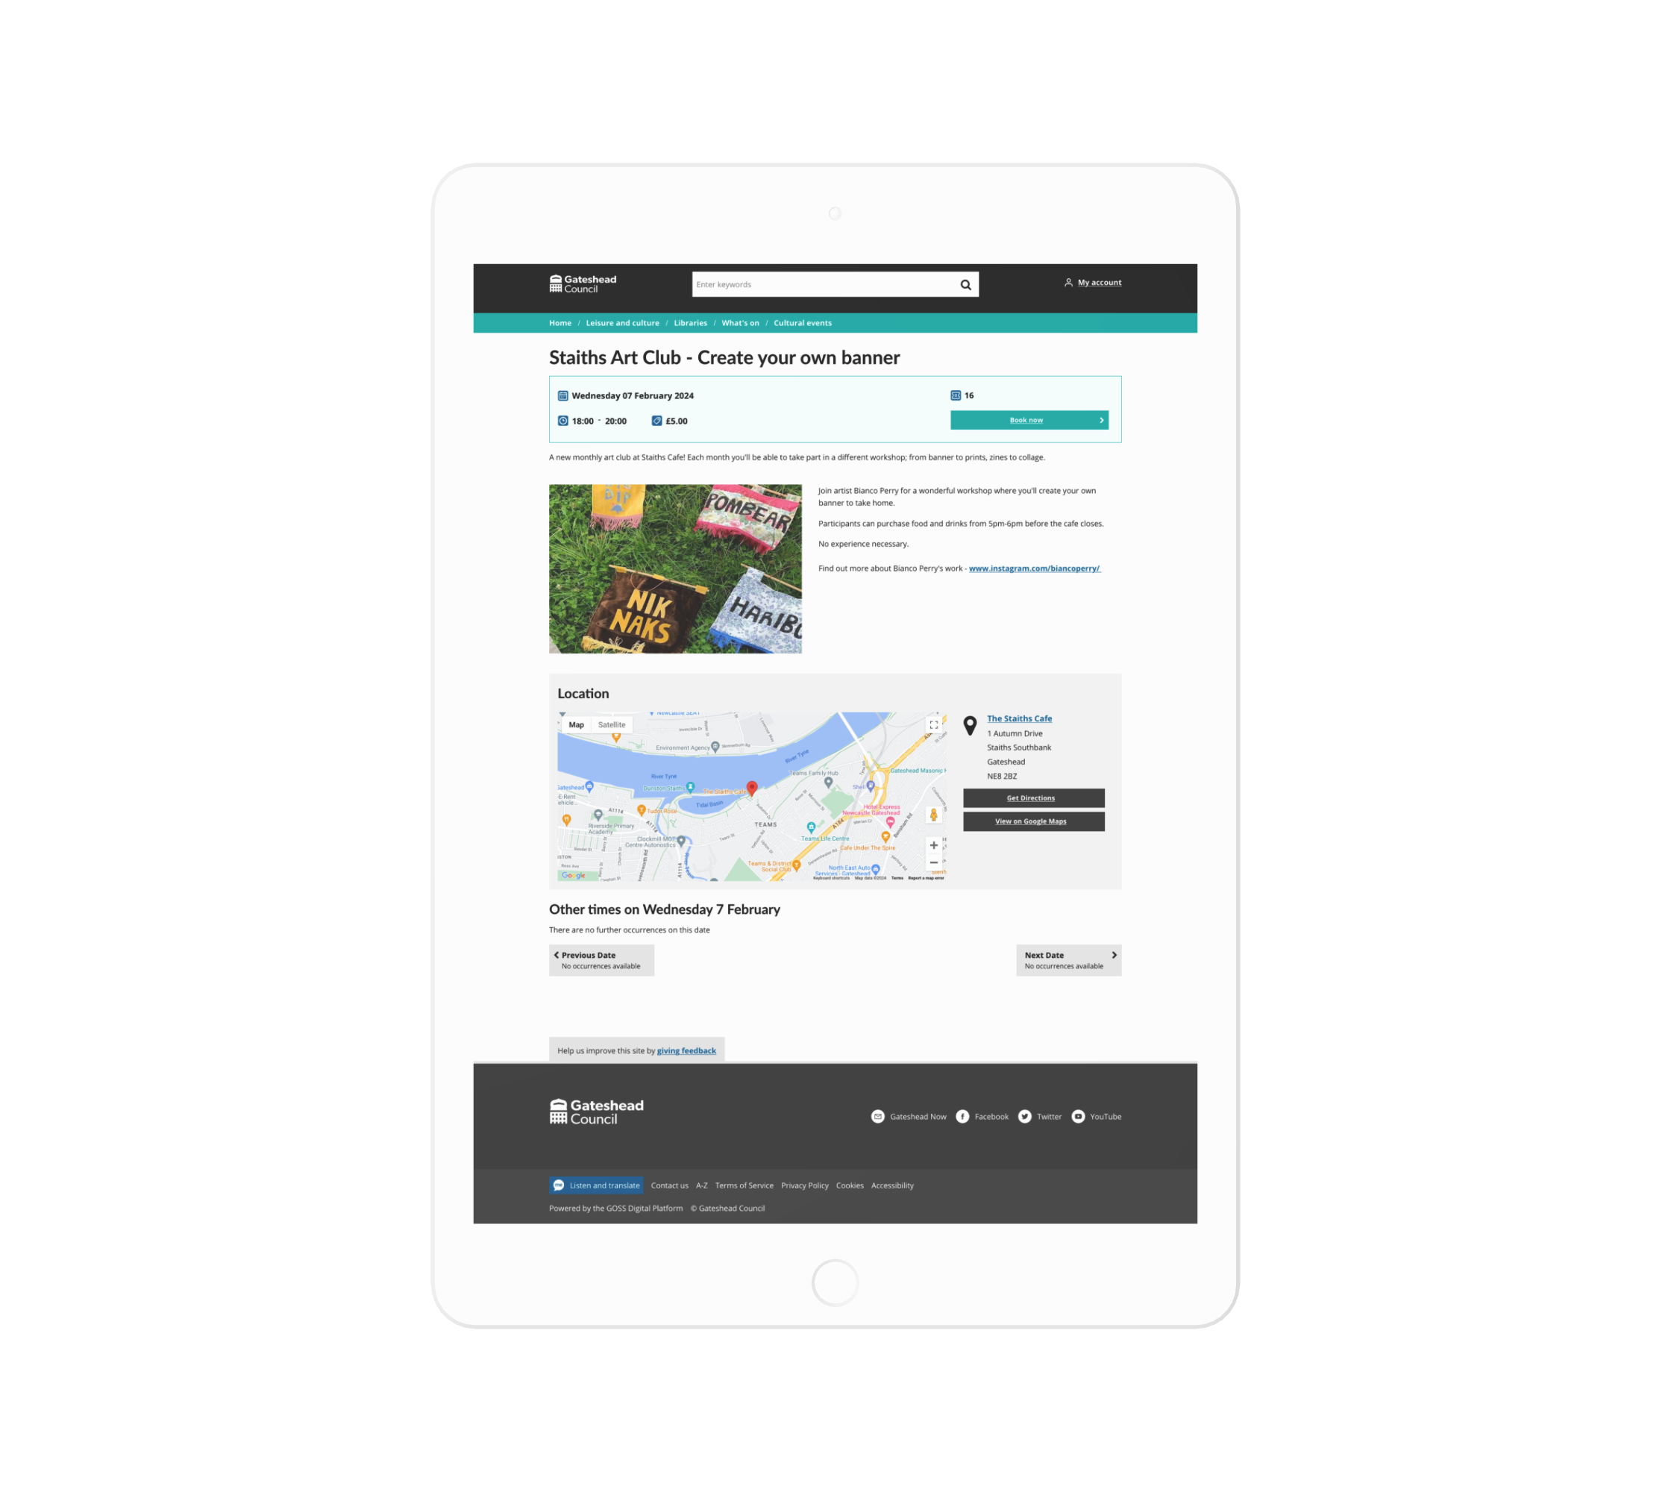
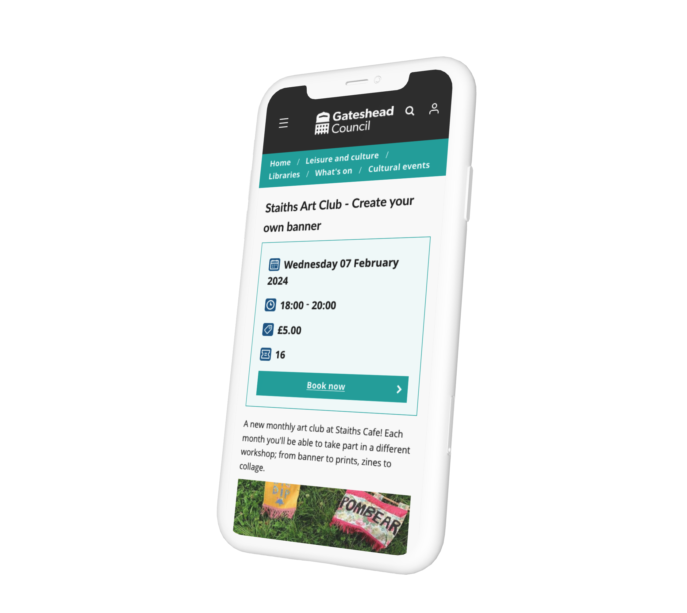
Sprint 14
Design - Design improvements to Libraries events

Slide 8
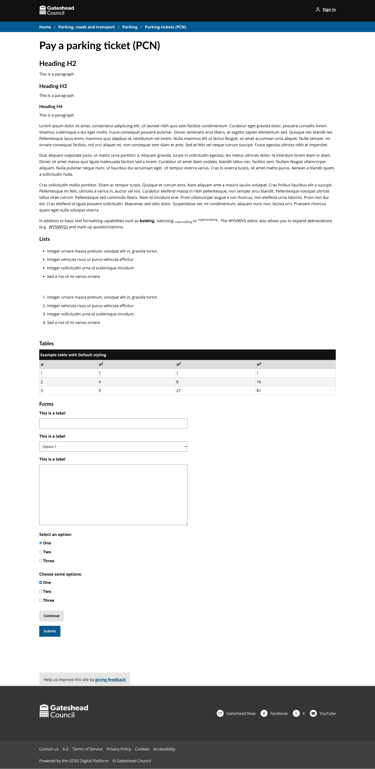
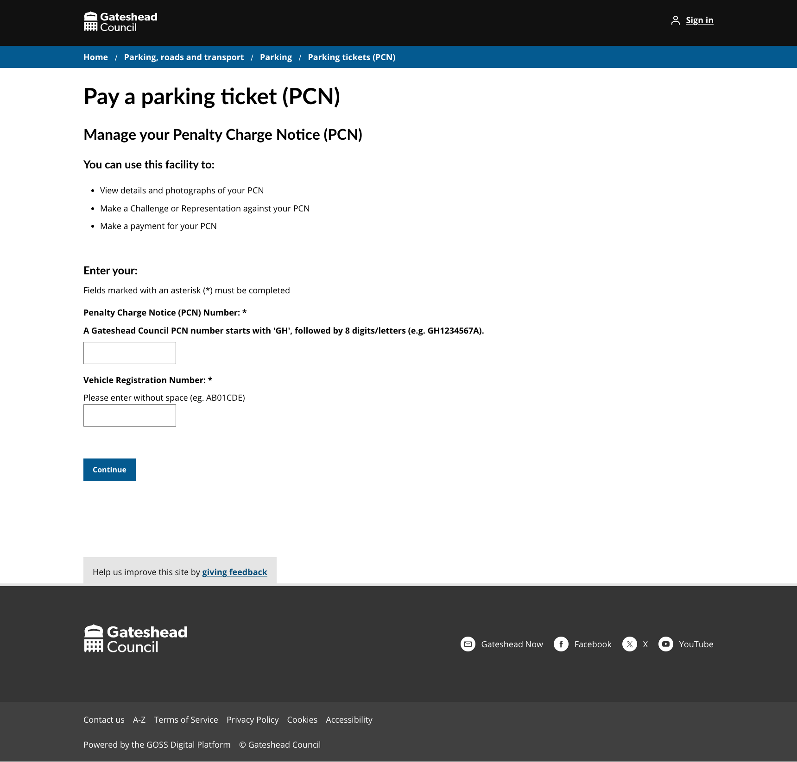
Sprint 14
Design - Parking PCN templates

Slide 9
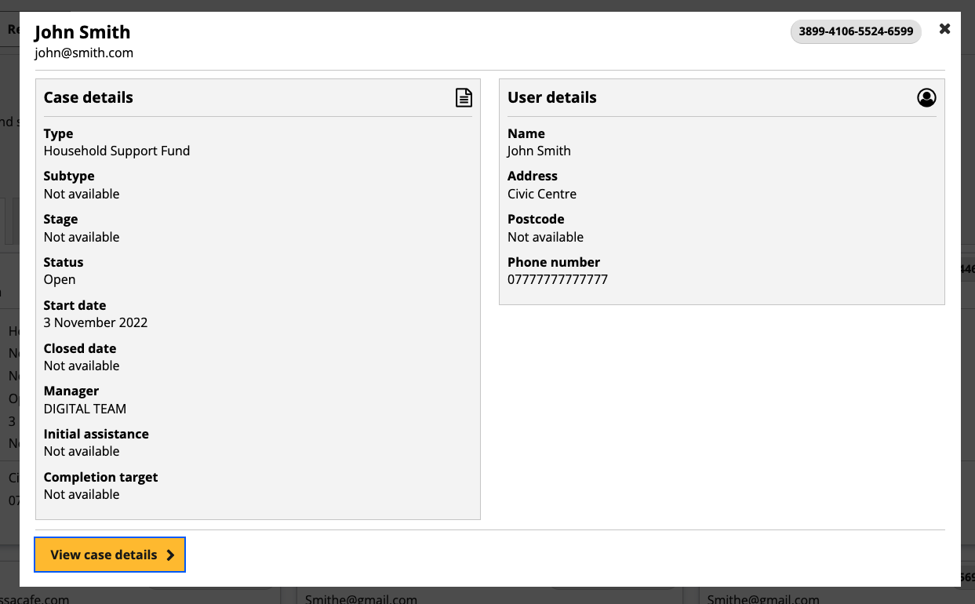
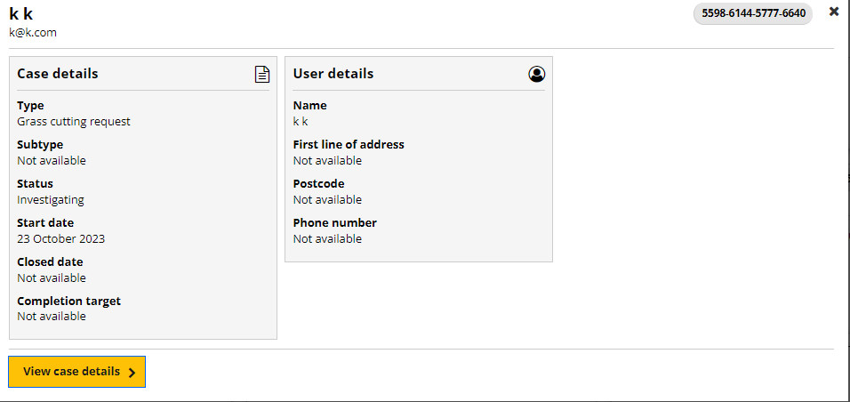
Sprint 14
Design - STAN site – Fix case search modal

Slide 10
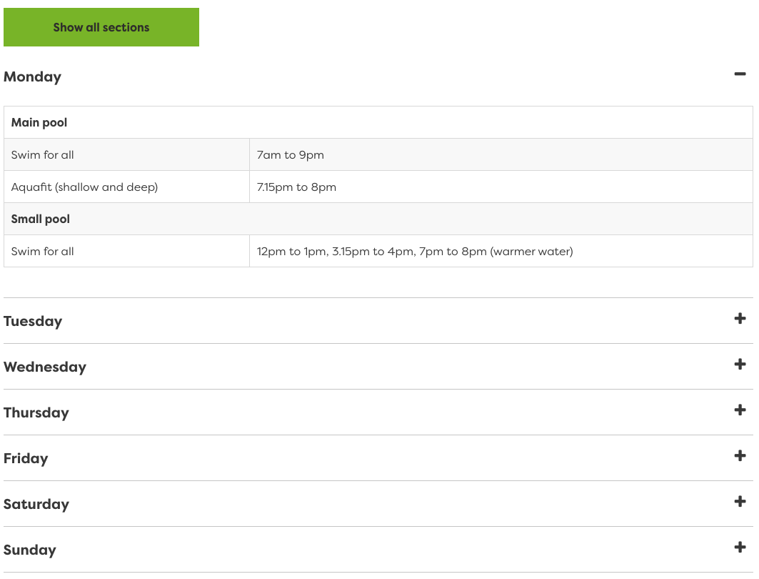
Sprint 14
Design - GO Gateshead styling

Slide 11
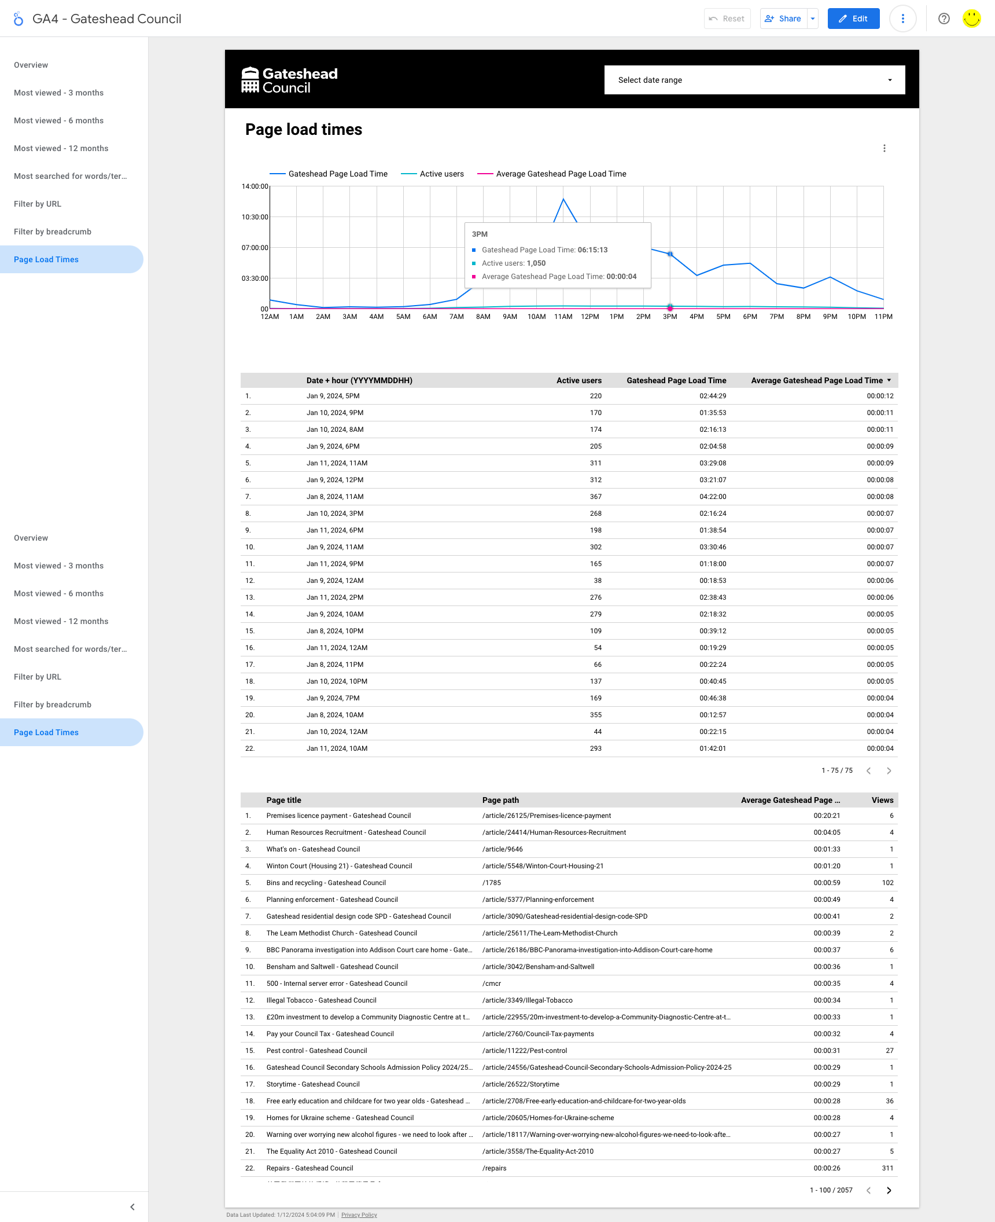
Sprint 14
GA4 – Add tracking for page load
times on gateshead.gov.uk
https://lookerstudio.google.com/s/j2R1eKWNtQo

Slide 12
Sprint 14
Content
213 libraries events added to What's on (team effort with G squad)
Family Voice - new section on Family Hubs
Gateshead Now – 10 January
Understanding Safeguarding added to Safeguarding website

Slide 13
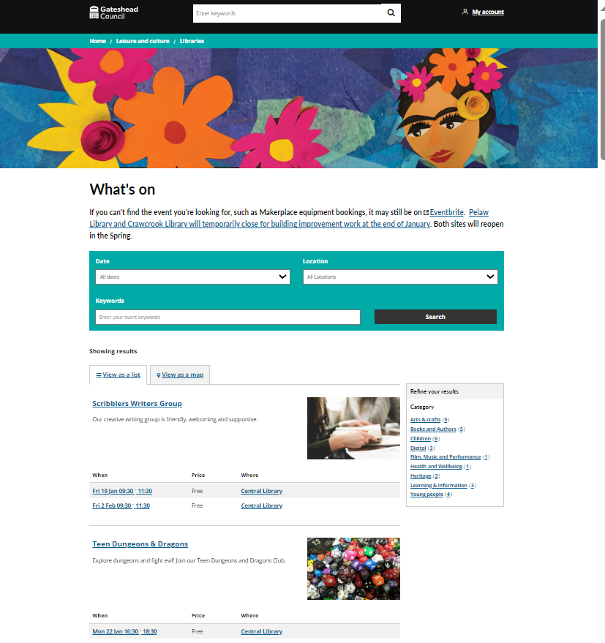
Libraries what's on
213 libraries events added to new What's on – 213 events,
18 venues, 39 regular monthly events
Images sourced and added
Basket added, postcode and MakerPlace plug in added
Bookings tested using plug ins and basket feature

Slide 14
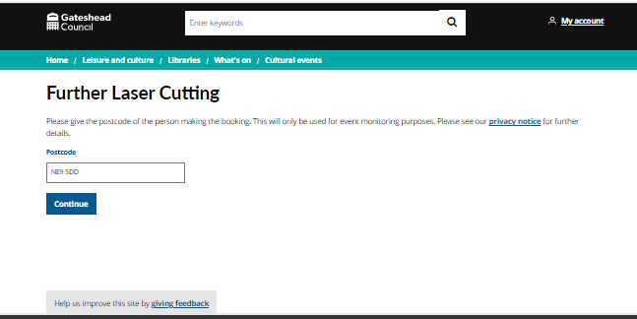
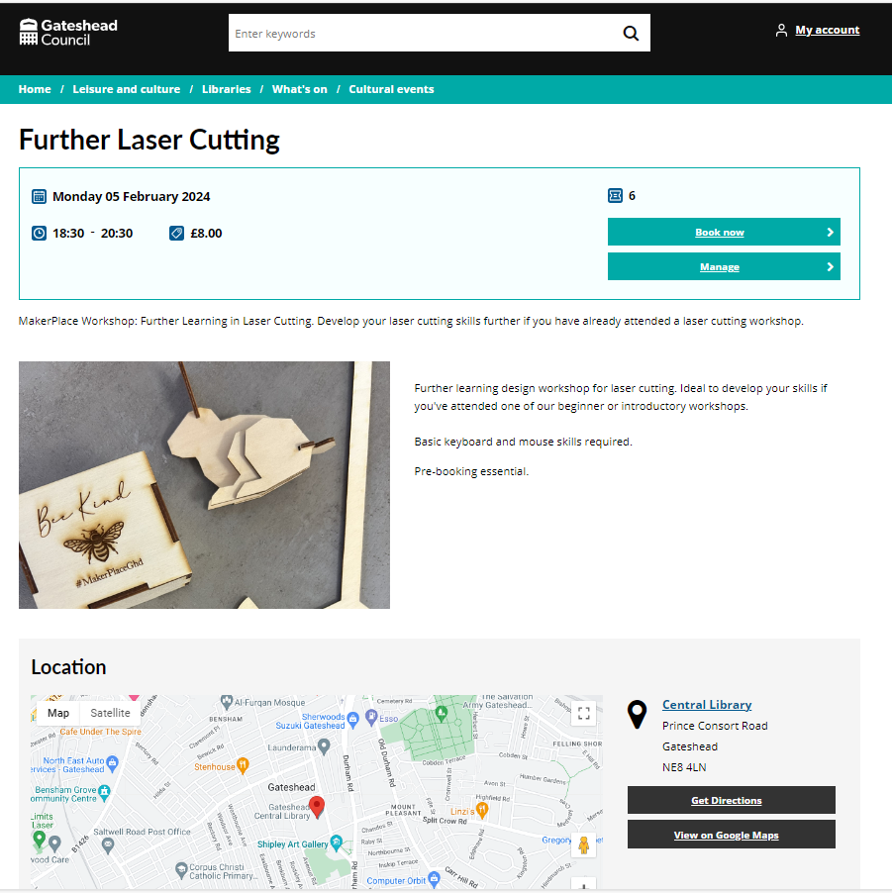
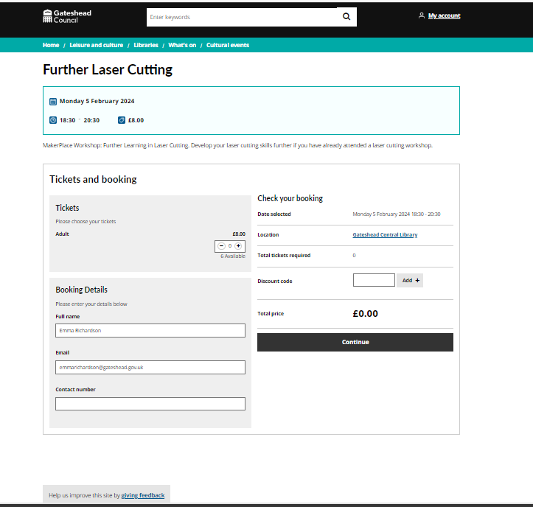
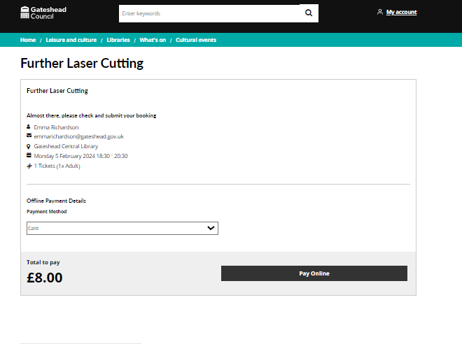
Libraries what's on

Slide 15
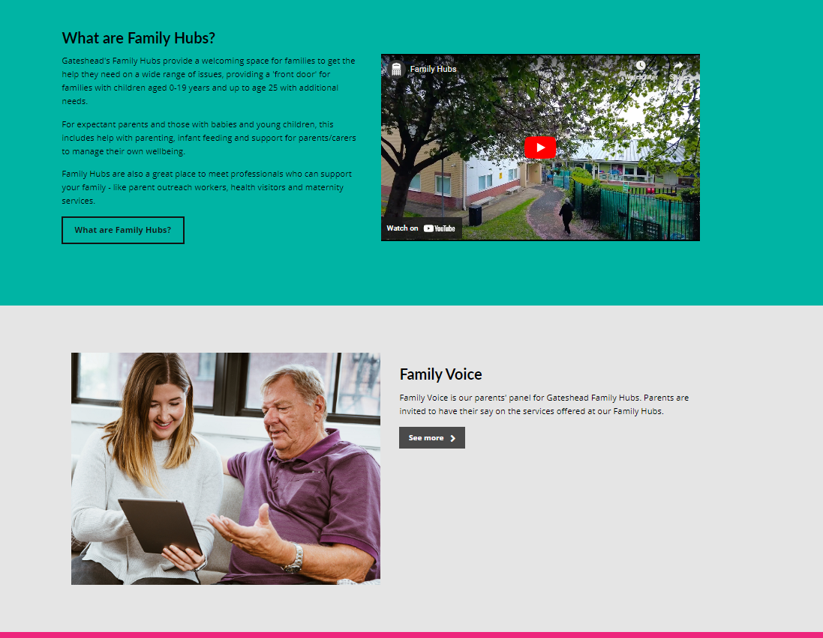
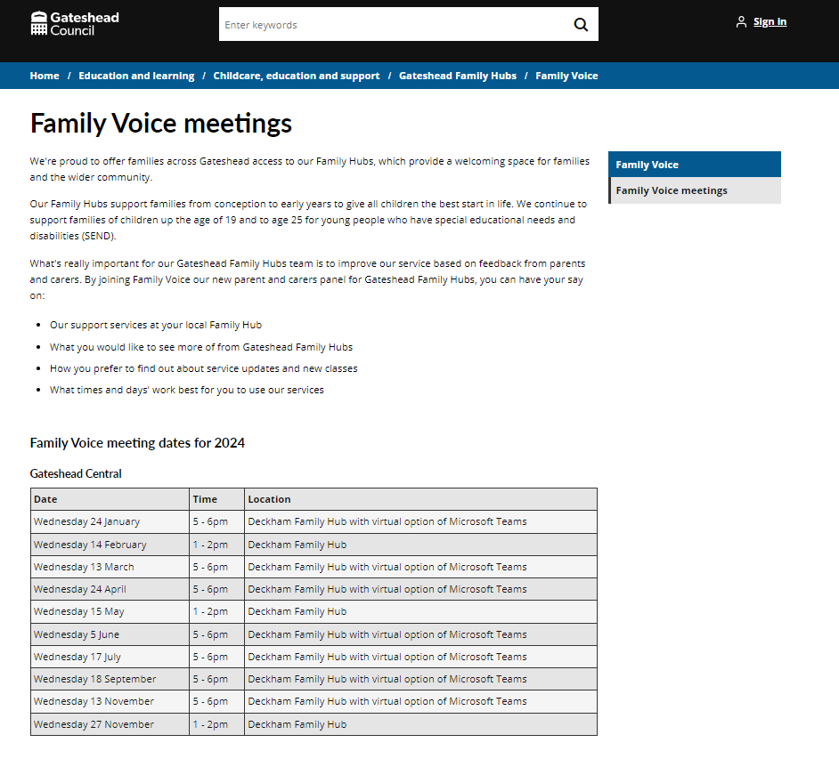
Family Voice new web content
New section on Family Hubs for family engagement sessions called Family Voice with meeting dates for the year

Slide 16
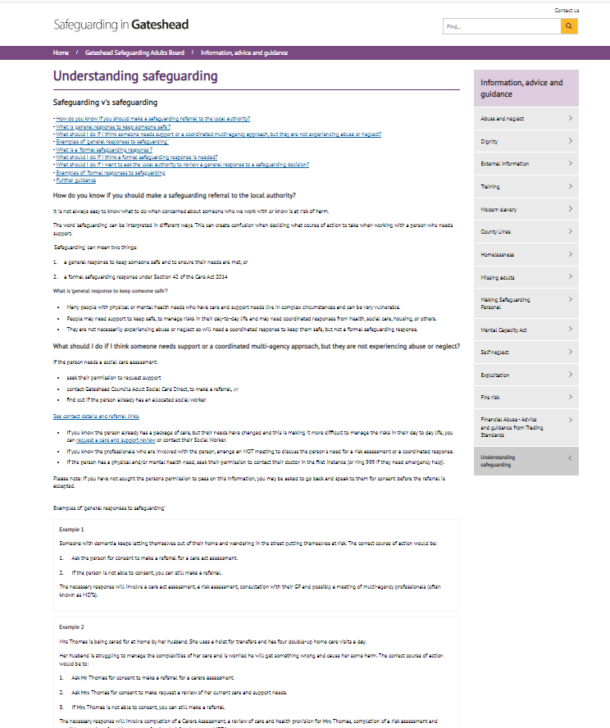
Other content
Gateshead Now (10 January) Understanding safeguarding

Slide 17
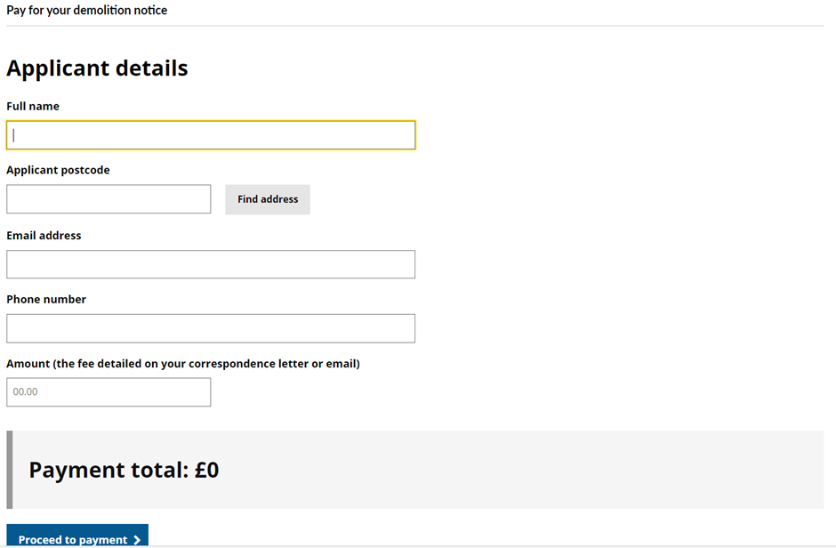
Sprint 14
Development
Payment process (spike)

Slide 18
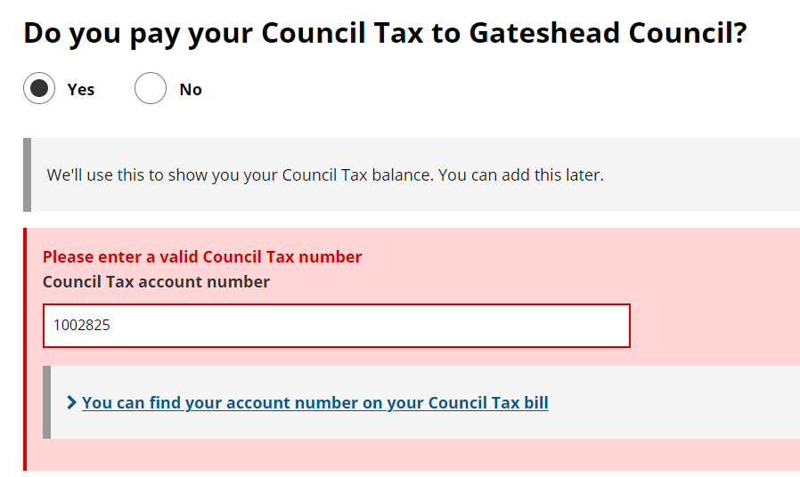
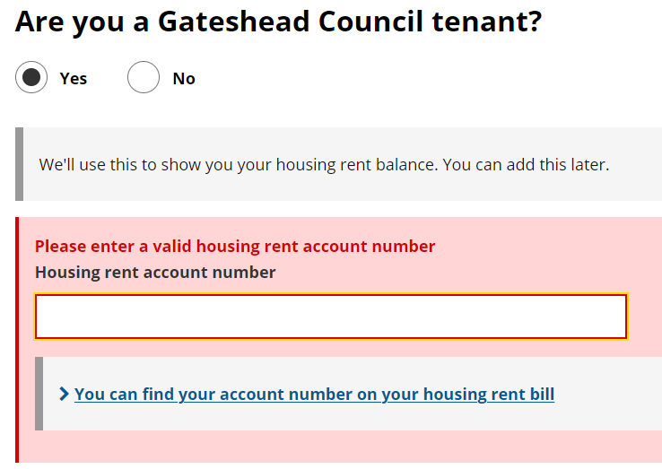
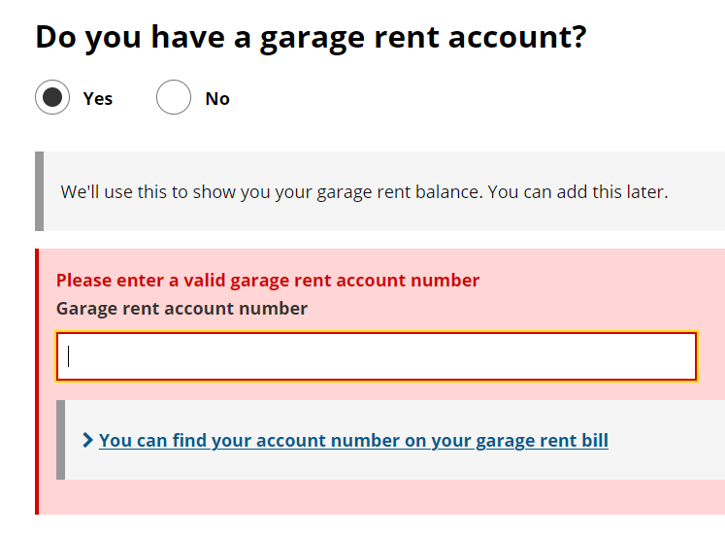
Amends to update your details (my Gateshead account)

Slide 19
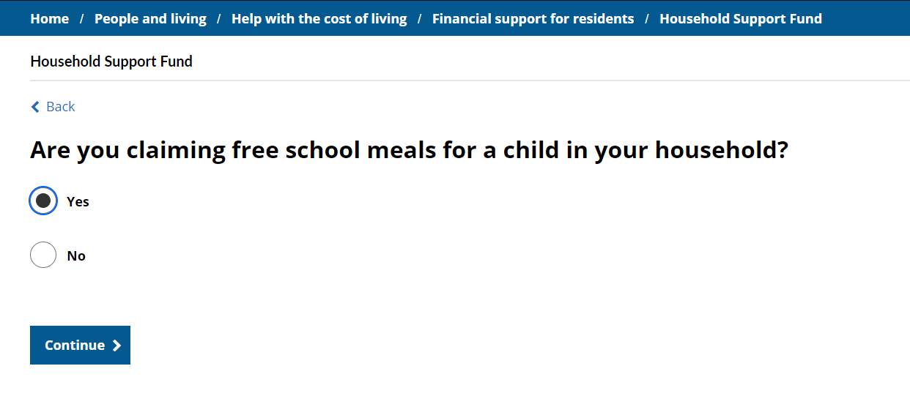
Amends to Household Support Form

Slide 20
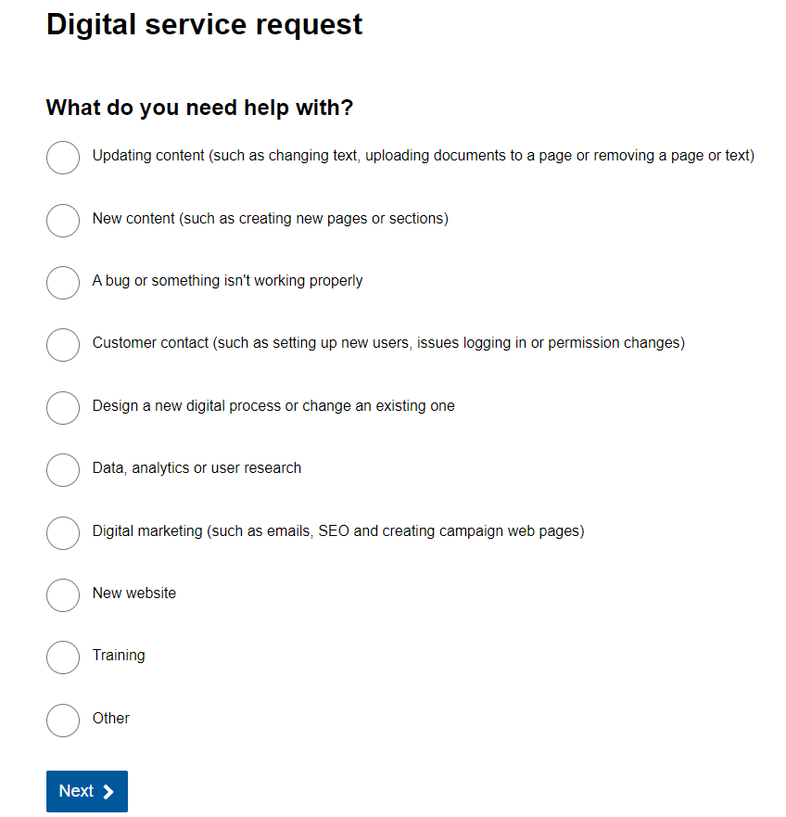
Care call self-referral form
https://gateshead.ghc2-tst.gosshosted.com/article/14752/Care-Call-request
Updates to digital team request
Cases are assigned to 3 groups now
More closure reasons in config

Slide 21
Sprint 14
Testing​

Slide 22
Sprint 14
Go live
Libraries what's on

Slide 23
Sprint 14
BAU/ Other tasks

Slide 24
What's coming up in Sprint 16
Discovery
Content
Design
Development

Slide 25
Sprint 14
Deployment

