Slide 1
Sprint 12 Show and Tell 03/01/2024
C Squad
Digital Team

Slide 2
Sprint 12
Discovery
Direct payments discovery with adult services

Slide 3
Sprint 12
Design
Libraries – Icons and general styling
Housing icons and social media link styling
GHYB – Email – Set up verified email address
Digital support requests – Success page styling

Slide 4
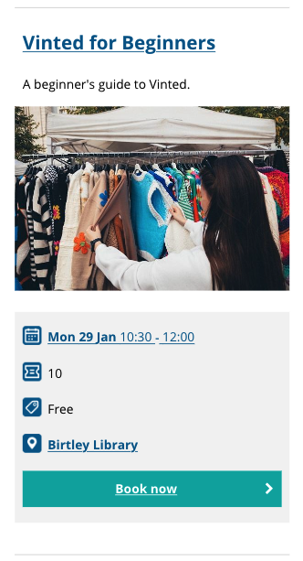
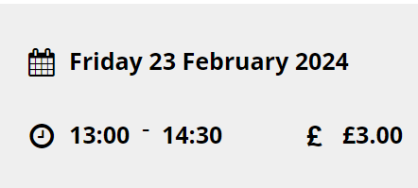
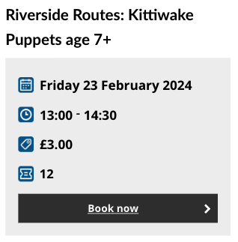
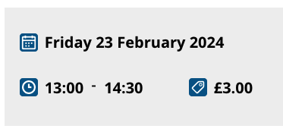
Sprint 12
Design – Libraries – General styling and icons

Slide 5
Sprint 12
Design – Housing – Icons and social media links

Slide 6
Sprint 12
Design – Housing – Icons and social media links

Slide 7
Sprint 12
Content
Library bookings - What's on - Gateshead Council

Slide 8
Sprint 12
Development
Winter maintenance
Damp and mould

Slide 9
Sprint 12
Testing​

Slide 10
Sprint 12
Go live

Slide 11
Sprint 12
BAU/ Other tasks

Slide 12
What's coming up in Sprint 14
Discovery
Waste escalations
Content
More libraries
Design
Parking
Development
Care call self-referral
Update to text on report it maps
Payments bug fix and code tidy

Slide 13
Sprint 12
Deployment

