Slide 1
Sprint 12 Show and Tell 20/12/2023
C Squad
Digital Team

Slide 2
Sprint 10
Discovery
Direct payments:
Review 2015/16 DP support business case and presentation
Review ASCOF performance framework for DP’s
Link to Miro board.
Waste Escalations:
Meeting with BCO’s at Park Road
Link to Miro board
Winter maintenance:
Meeting with service and CSU. Agreed form redesign, web content, case types, outcomes and associated emails
Link to Miro board

Slide 3
Sprint 10
Design
Gateshead Has Your Back
Design improvements
Add favicons, apple touch icons
Add Reciteme (Listen and translate)
Contact us email branding
Add GA4 tracking
Library events and general event design improvements
Local Nature Recovery Strategy website – Test and suggest design changes
Capita payment page – Check and supply new CSS
Design/Data - GA4 dashboard – Adult Social Care

Slide 4
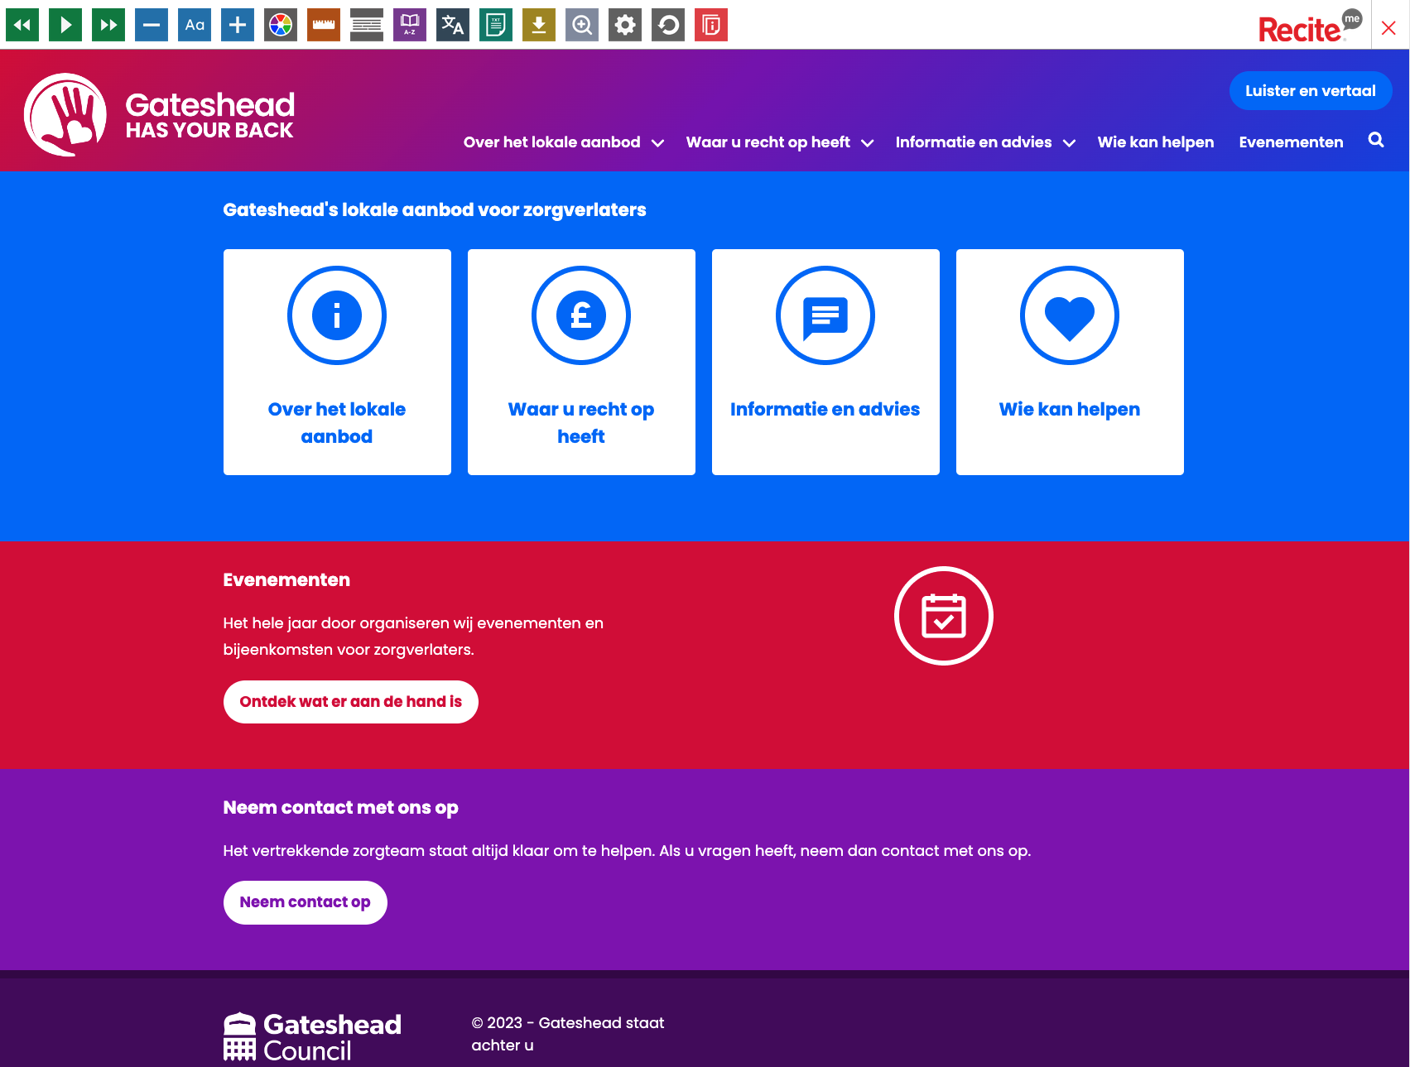
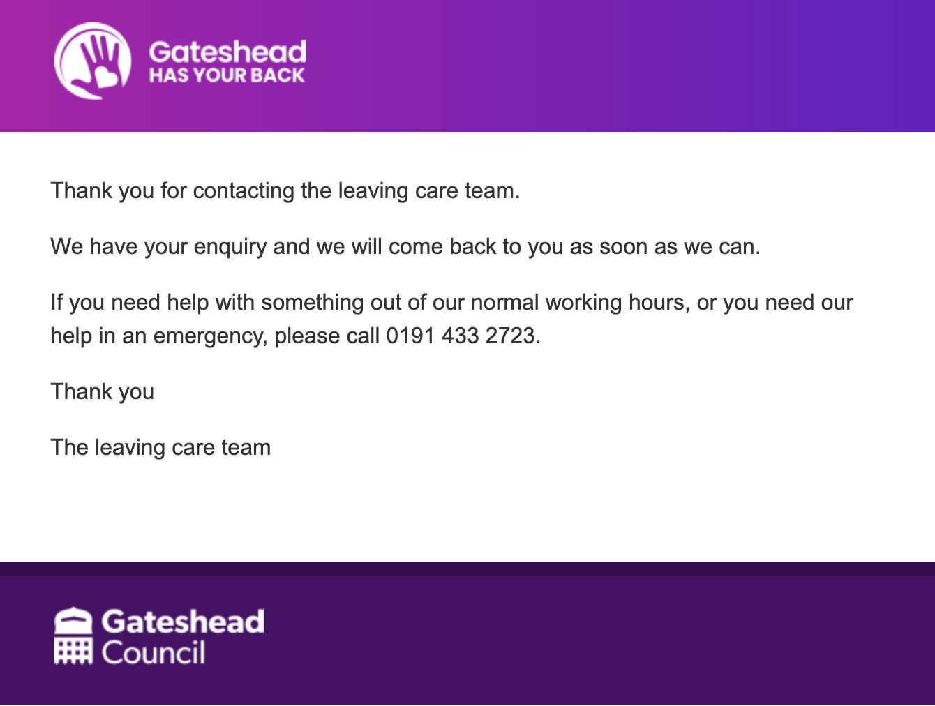
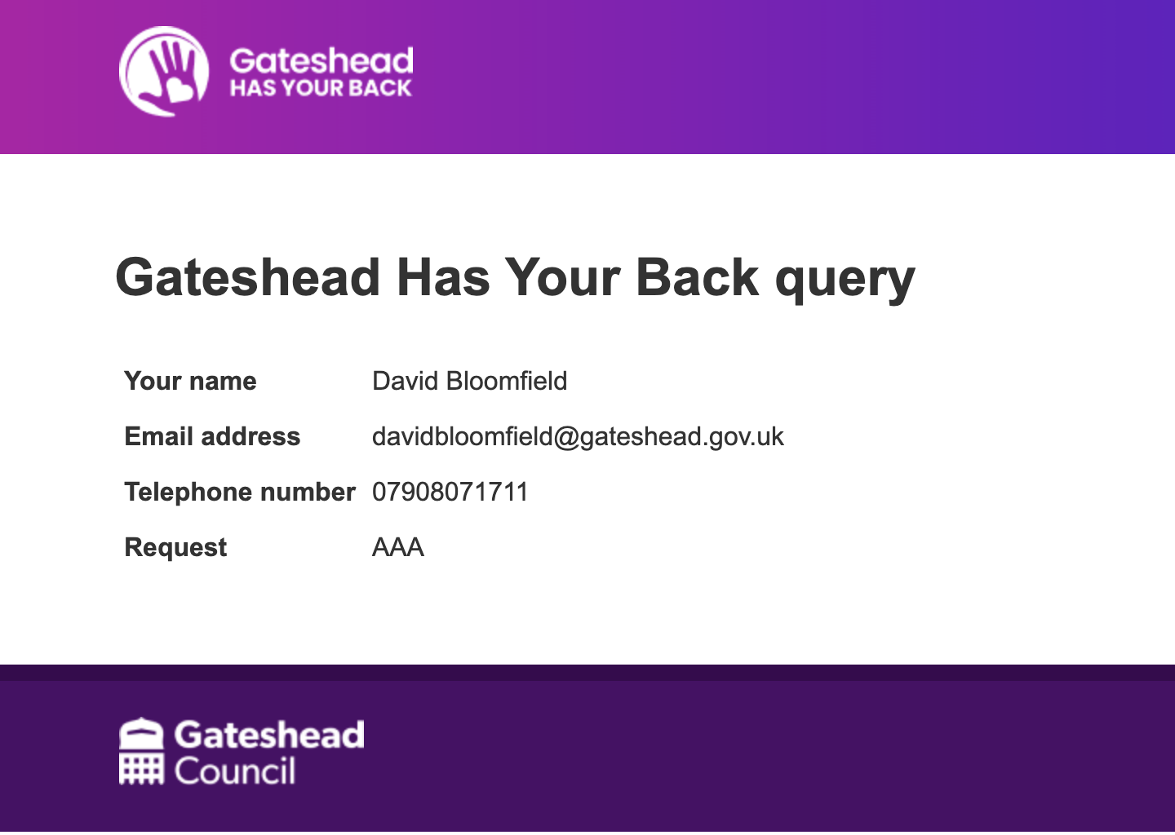
Gateshead Has Your Back
Design improvements
Add favicons, apple touch icons
Add Reciteme (Listen and translate)
Contact us email branding
Add GA4 tracking

Slide 5
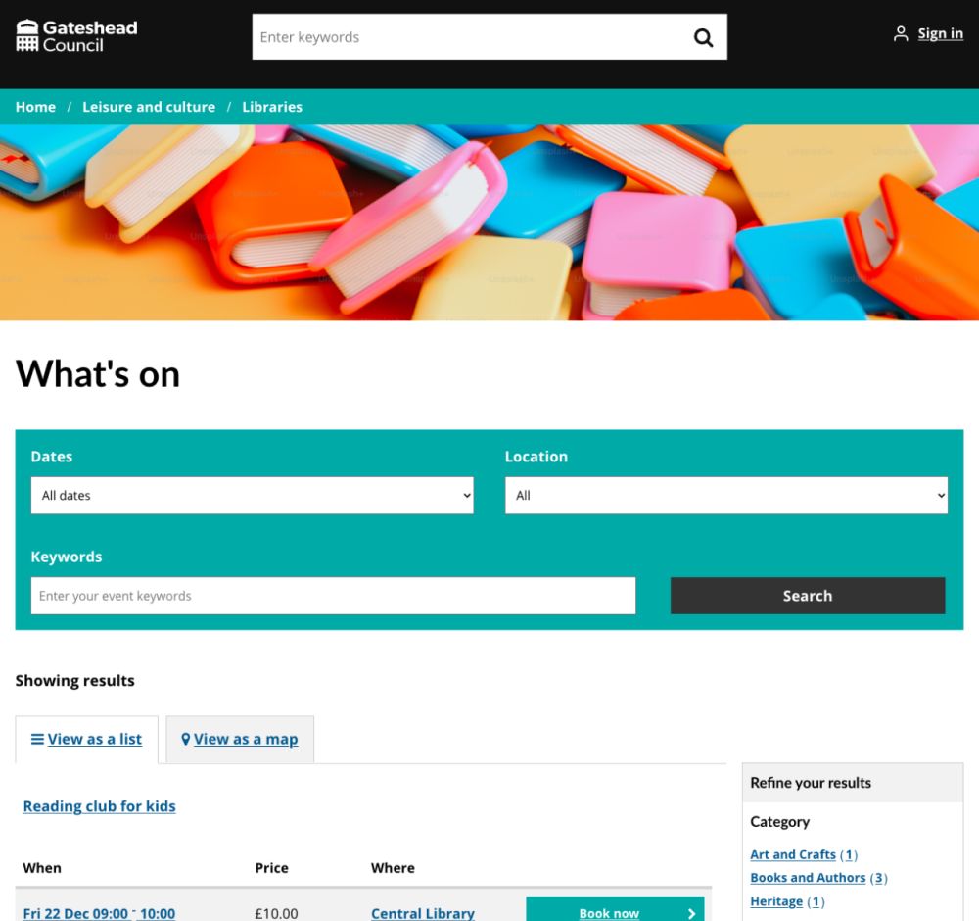
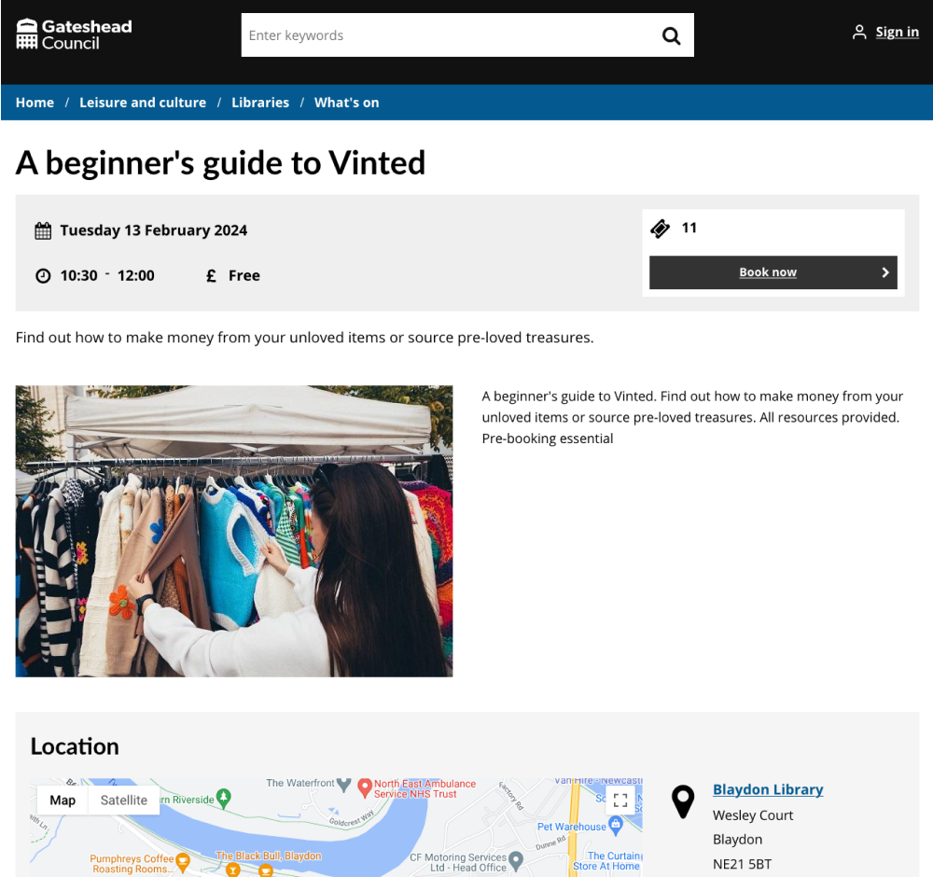
Library events and general event design improvements

Slide 6
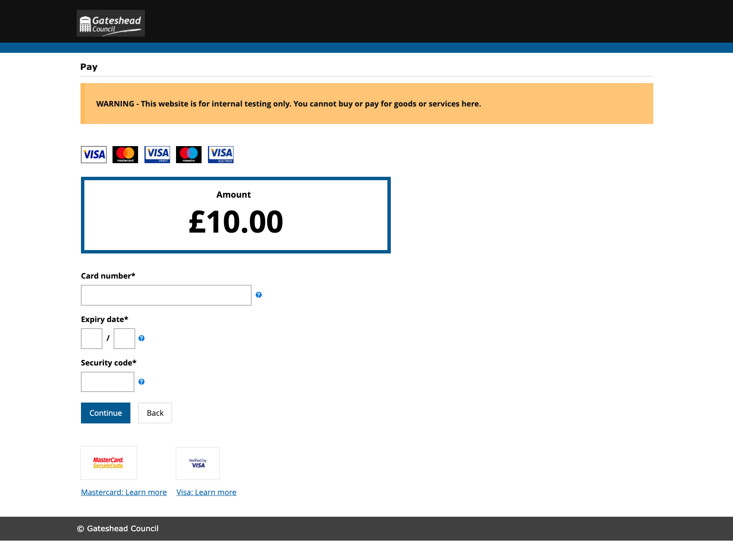
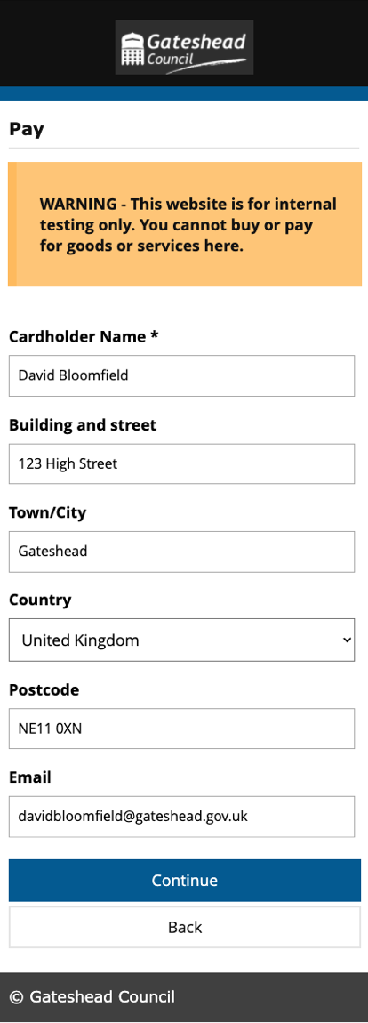
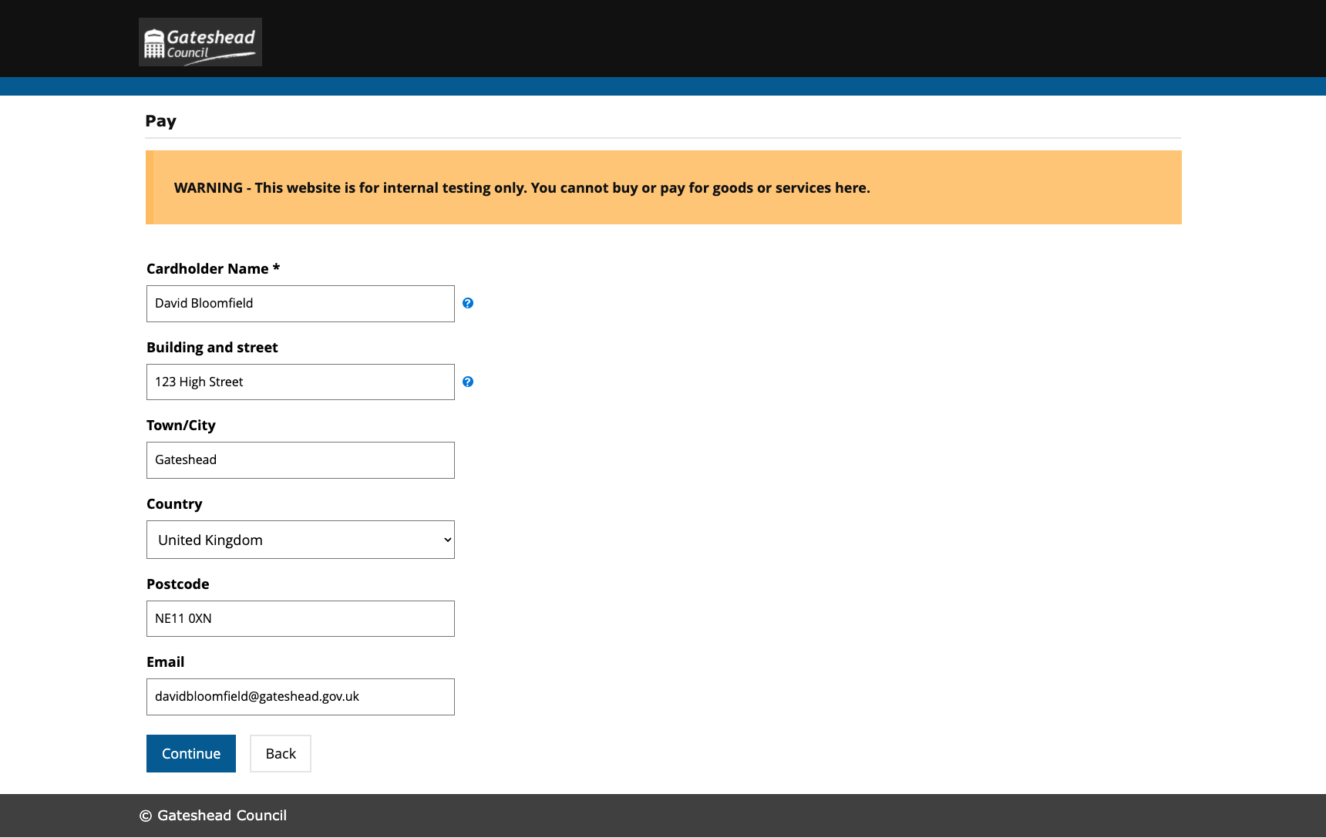
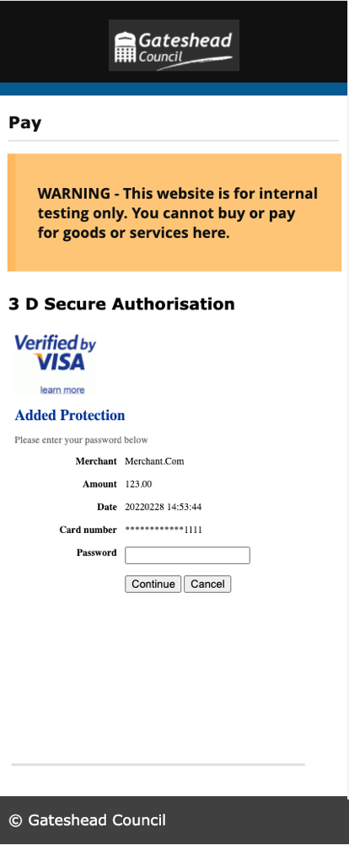
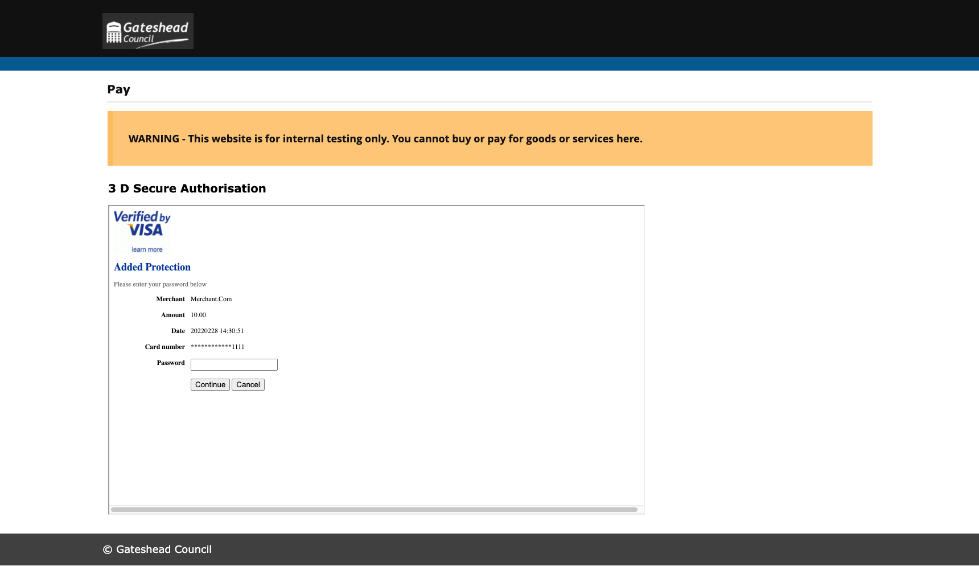
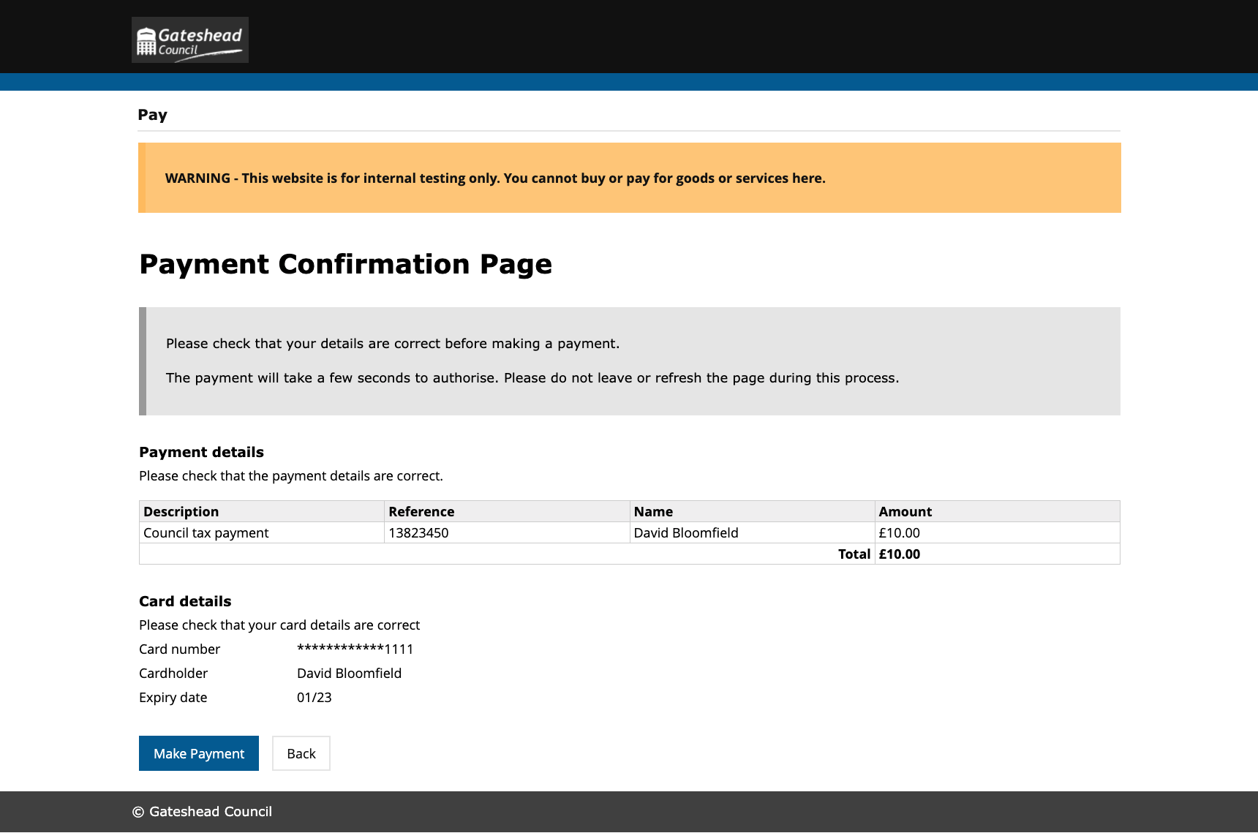
Capita payment pages

Slide 7
Sprint 10
Content and wireframing
3 email marketing campaigns - 2 for Go Gateshead and Gateshead Now
Intranet updates - new page showing benefits, financial support and welfare ward profiles, pay scales updated
Wireframe for bookings to make it easier for us and libraries to add and amend bookings
Libraries event bookings
Gritting and salt bins web content
Wireframe revised salt requests form
Wireframe Care Call request form
Add Christmas bin collection day changes notice to website
Leader's Christmas messages

Slide 8
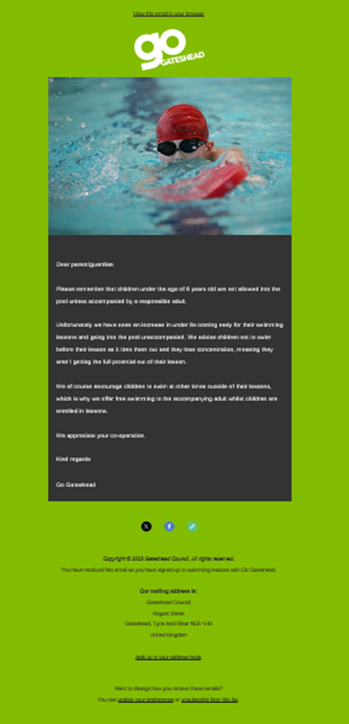
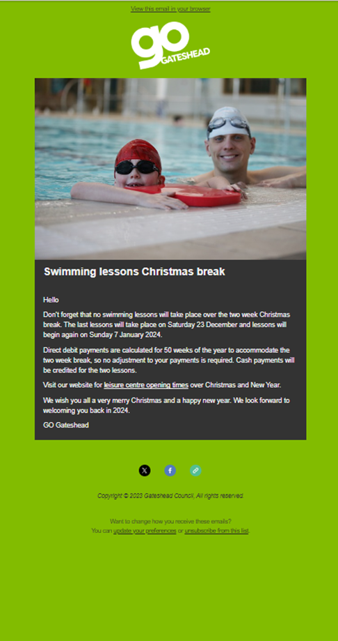
Email marketing campaigns
Gateshead Now – 19 December
Sent to swimming lesson customers warning them that under 8s should not be unaccompanied in the pool
Sent to swimming lesson customers with Christmas opening hours

Slide 9
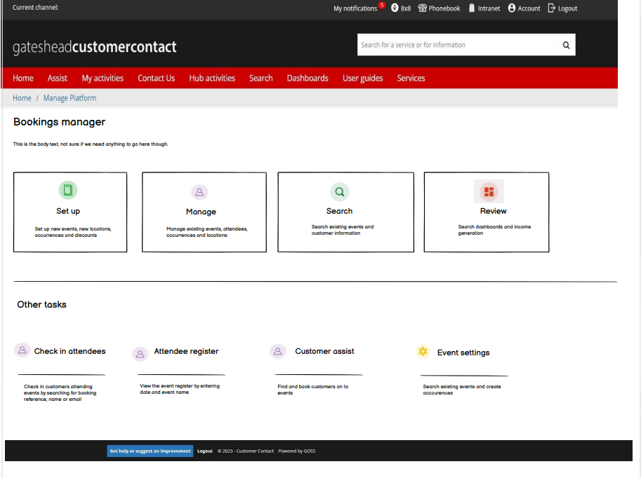
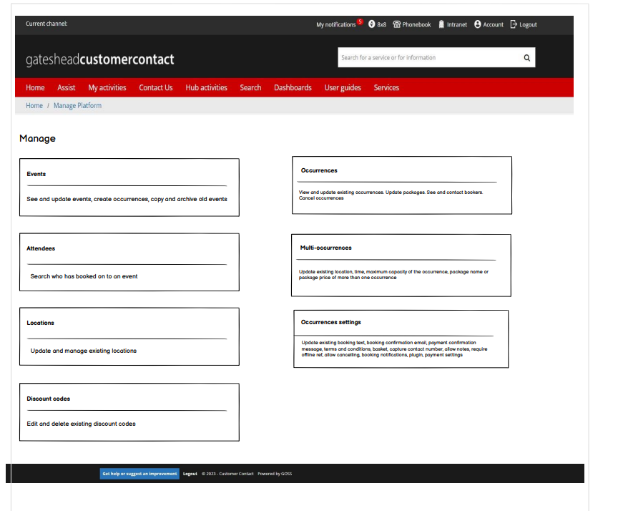
Bookings wireframe
Improvements to bookings Manage Platform to make it easier for us and libraries to know how to add content
New tiles with Set up, Manage, Search and Review with additional support text for each section

Slide 10
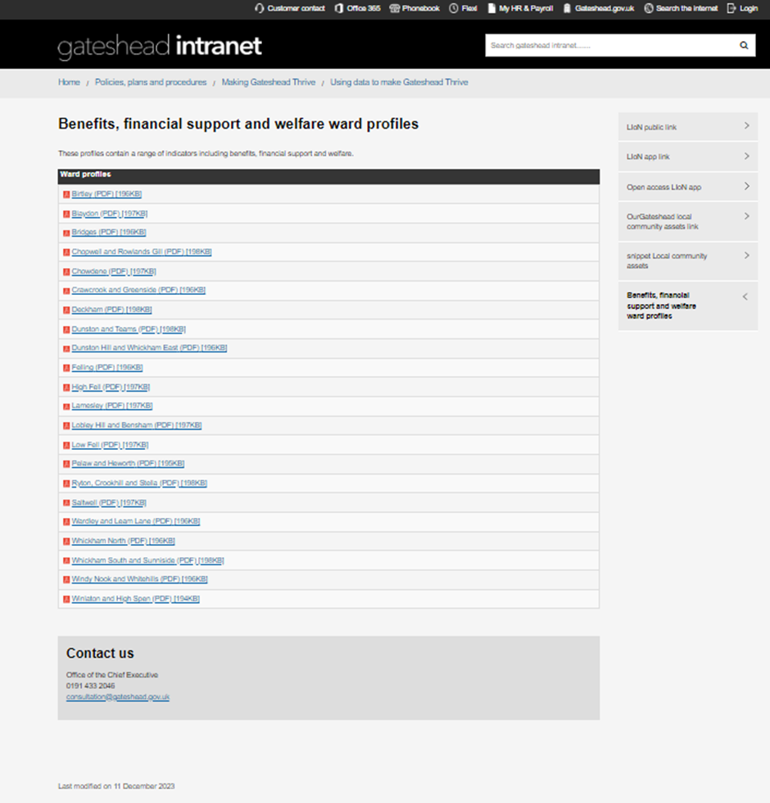
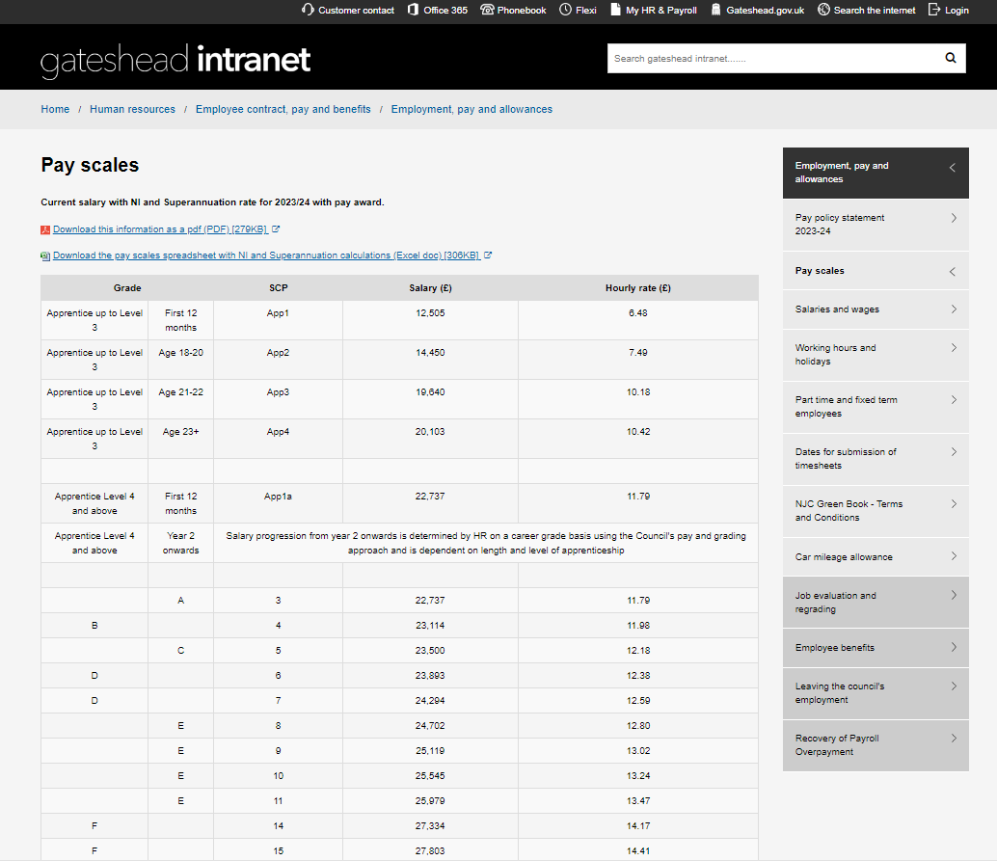
Intranet updates
New page showing benefits, financial support and welfare for each of the ward areas
Pay scales for 2023/24 updated

Slide 11
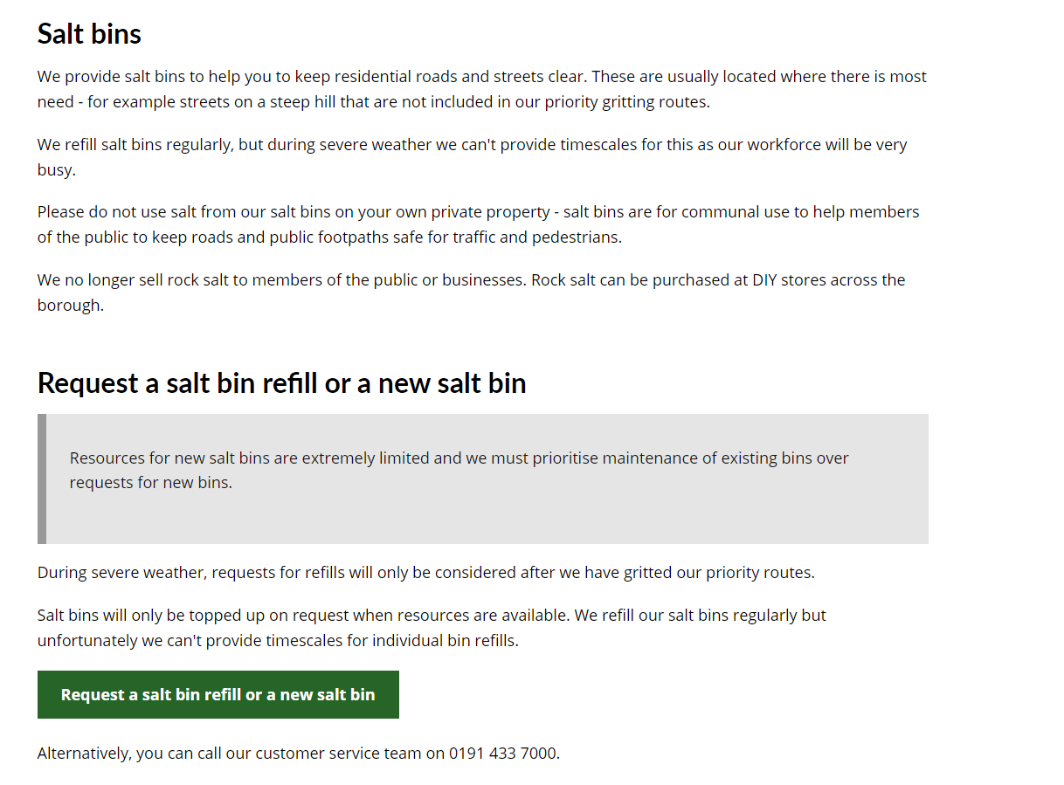
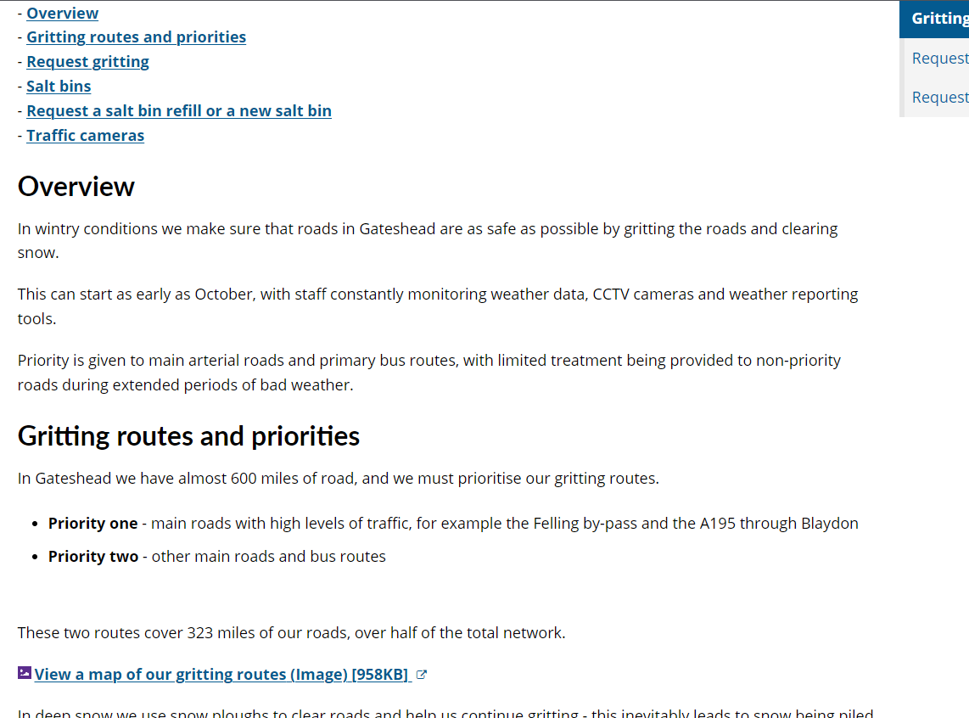
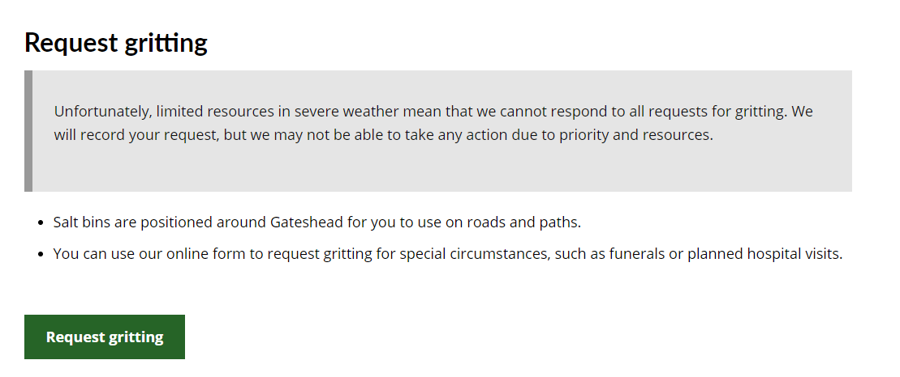
Gritting and salt bins web content
Updated text to make it clearer what we can and can't do
Removed references to salt heaps

Slide 12
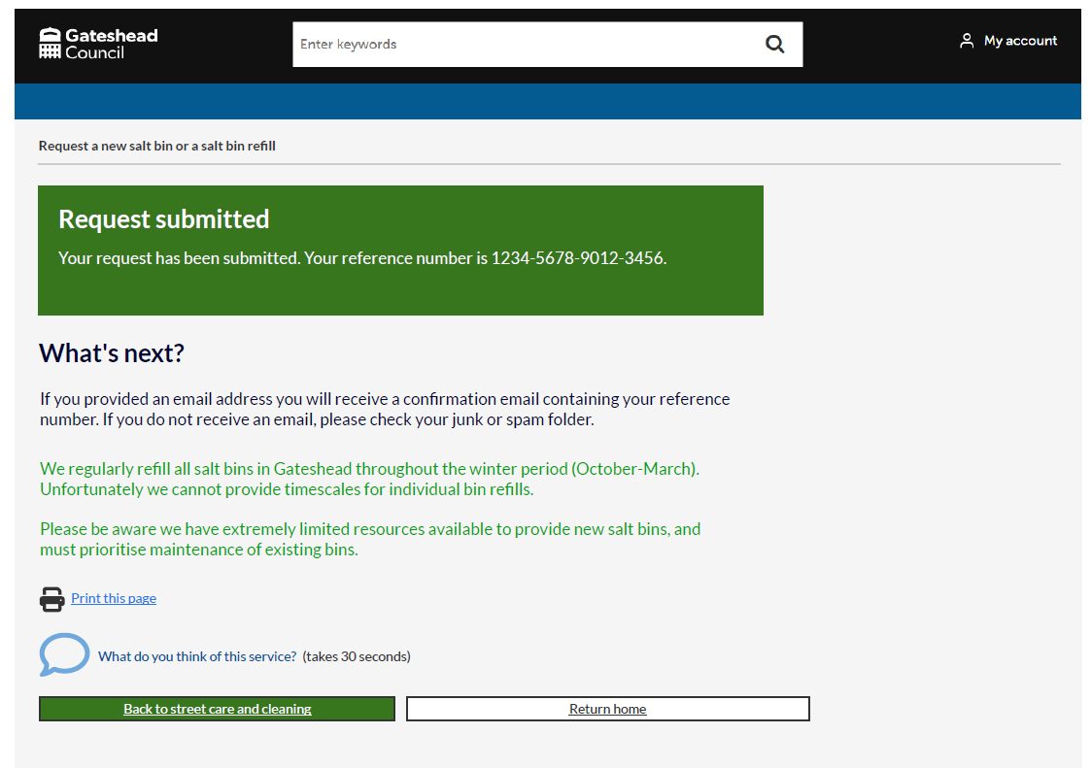
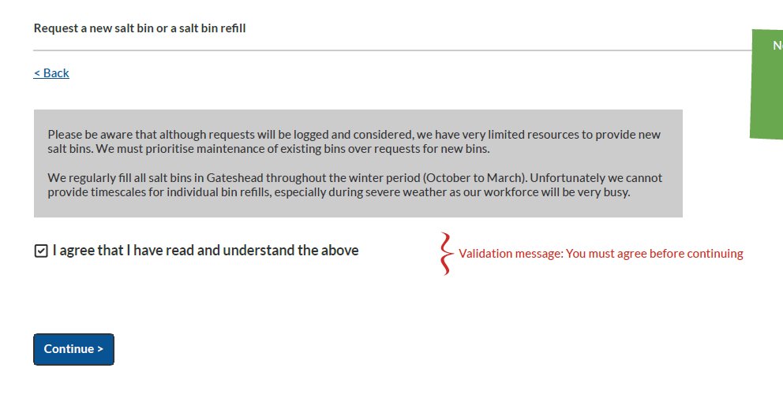
Salt bins wireframe
Added disclaimer to first page
Removal of 'request salt heap' option
Improved confirmation page with message to manage expectation

Slide 13
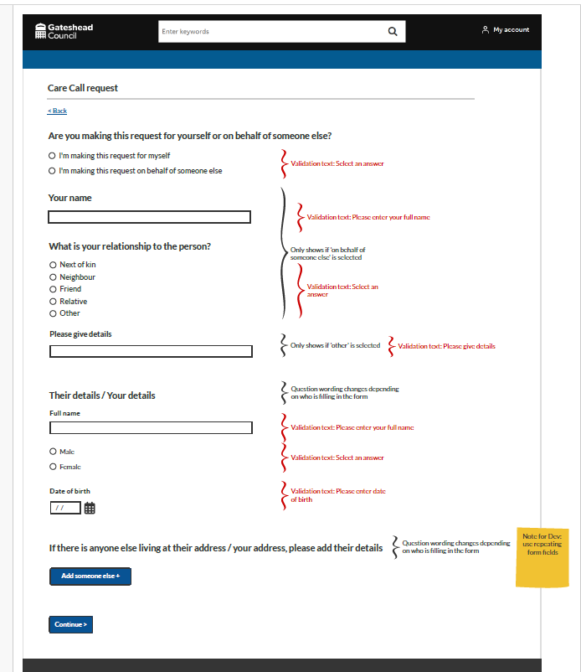
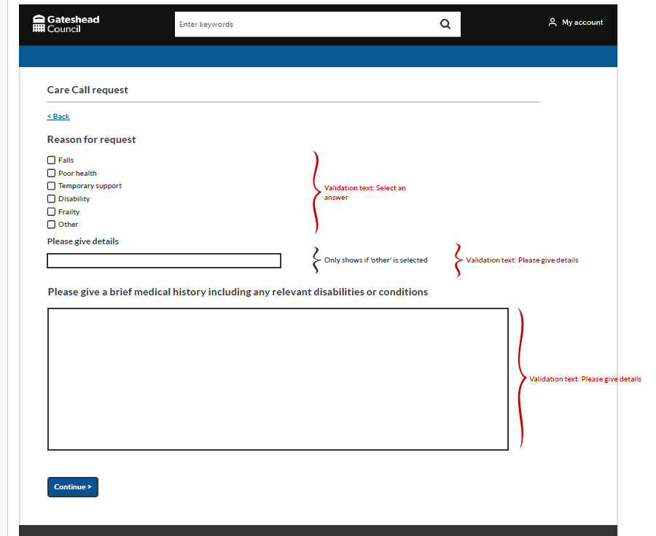
Care Call request wireframe
New form for self-referrals
Currently only a word document

Slide 14
Add Christmas bin collection day changes notice to gateshead.gov.uk
Bin days are changing over the festive period
Notice added to pages in bins and recycling, not a site alert as we can't link to a different page

Slide 15
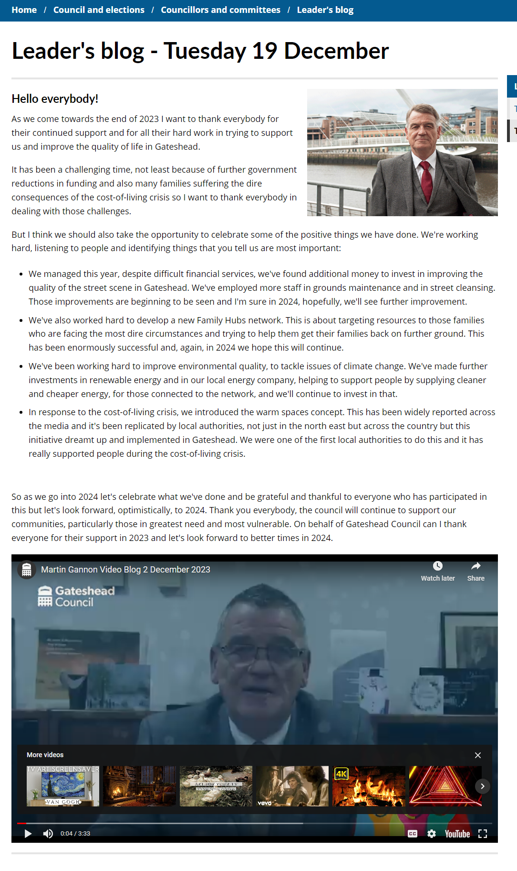
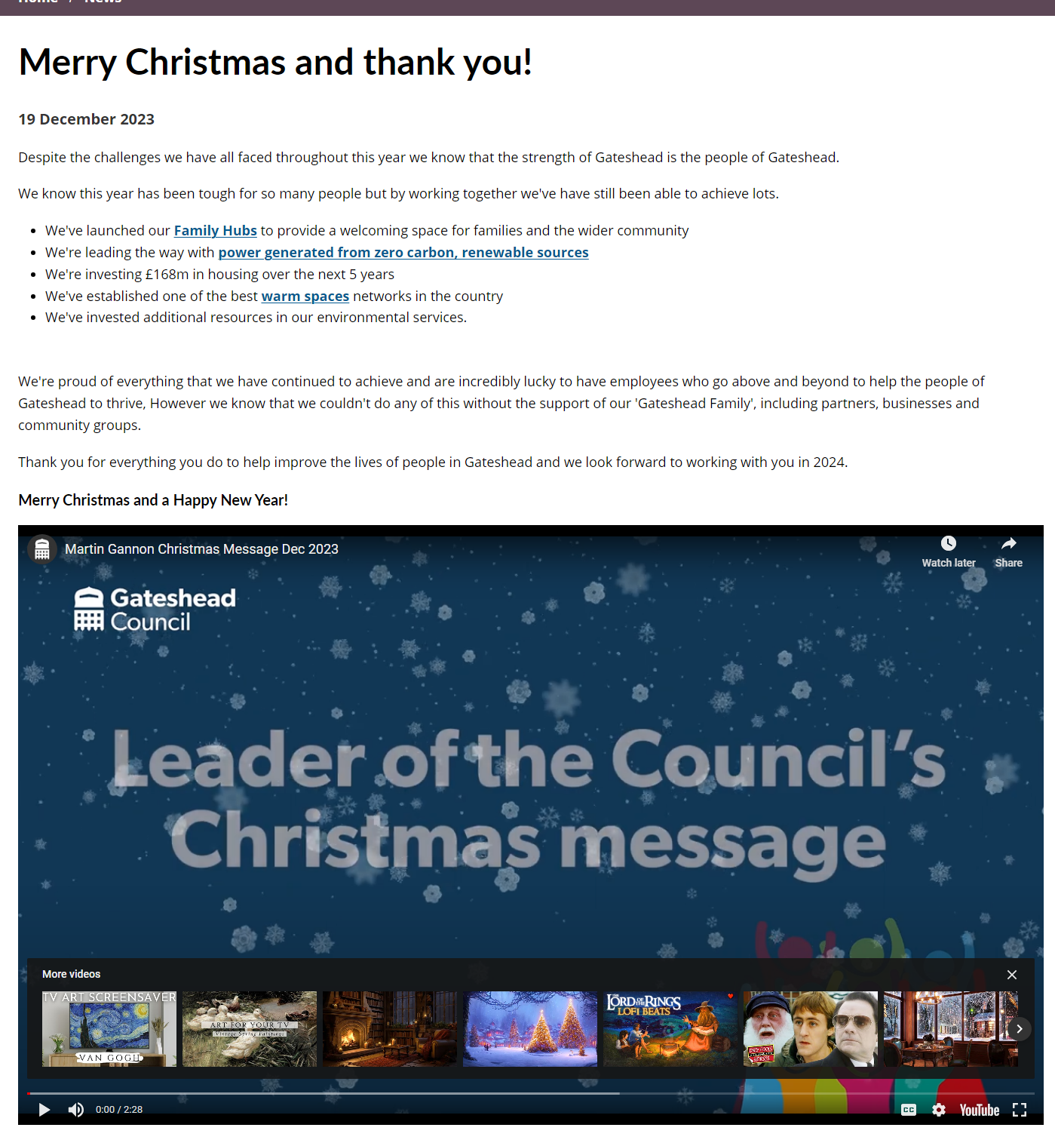
Leader's Christmas messages
Leader's blog added to website
Leader's message for staff added to intranet
Leader's Christmas message added to news item

Slide 16
Sprint 10
Development
Pest control - bug fix and code tidy
Rebooking bin delivery Change the Back to Case link button to Back to My Activities for CSU

Slide 17
Sprint 10
Development
GHYB - Google maps API
Update text on council tax forms
Change text from
If you have any queries regarding your account, please email counciltax@gateshead.gov.uk or call 0191 433 3600
To
If you have any queries regarding your account, please contact the Council Tax team or call 0191 433 3600

Slide 18
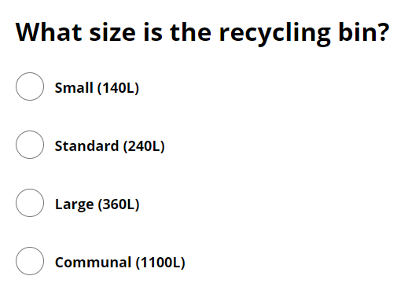
Sprint 10
Development
Decontamination form - update to text

Slide 19
Sprint 10
Development
Map screen wording for Pot hole reporting
Current text reads:
'Please select the location of the pothole on the map below. You can use the search box to find a specific area, then drag the pin to the required location.'
Please update text to read:
'Please select the location of the pothole on the map below. Double click on the map to place a pin or use the search box to find a specific area, then drag the pin to the required location.'

Slide 20
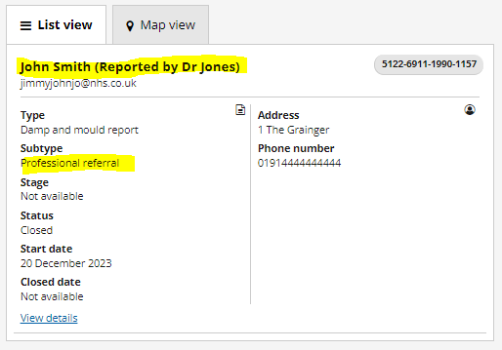
Sprint 10
Development
Damp and mould reporting improvements
Ability for professionals to submit damp or mould reports on behalf of clients.
Changes made to the process ahead of the service using case management.

Slide 21
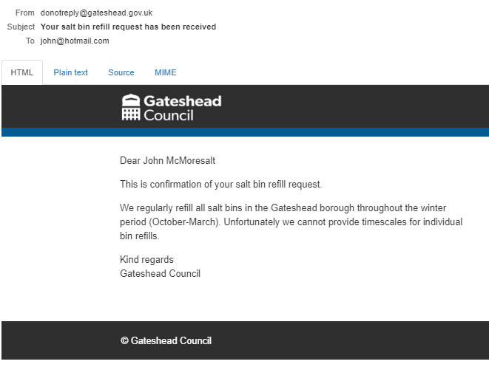
Sprint 10
Development
Changes to salt bin requests.
Salt heaps are no longer an option.
Salt bin refill requests raise a new subtype and are automatically closed.
Closure reasons changed from 8 to 3
Emails sent by the process updated and improved

Slide 22
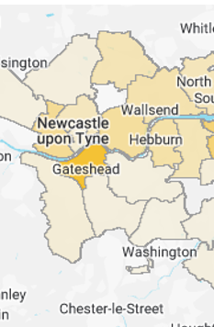
Sprint 10
Development
Google Ads for fostering
Met with the service last week to discuss the possibility of running ads on Google.
Provided a summary of the campaigns which had run in the past.
Service to review and come back to us with how they would like to proceed.

Slide 23
Sprint 10
Development
Complaints – new groups added to handle cases and tasks (governance)
Blue Badges – Updated with new API details, implemented a process to have these requested each year before they expire.
Registrars – remove warning message to user when an appointment is rescheduled
Gateshead Has Your Back – changes to feedback form from code review
Household Support Fund – processing of daily applications (775 applications received)

Slide 24
Sprint 10
Testing​
Updated salt bins form
Updated damp and mould form

Slide 25
Sprint 10
Go live
In Year School Transfers form
Premises Payments
Gateshead has your back care leavers website

Slide 26
Sprint 10
BAU/ Other tasks

Slide 27
What's coming up in Sprint 12
Discovery
Content
Libraries bookings
Design
Development
Christmas Holidays!

Slide 28
Sprint 8
Deployment

