Slide 1
Sprint 2 Show and Tell
C Squad
Digital Team

Slide 2
Sprint 2
Discovery
Direct payments uptake rate
Initial discovery meeting
Bin delivery rebooking review
Initial meetings with Waste Service and CSU
Taxi vehicle testing
As is mapping
To be mapping
My account survey
Build first iteration of feedback dashboard
Pest control service review
Initial discovery meeting

Slide 3
Sprint 2
Data
Family hub analytics
Design
Digital requests – success page styling

Slide 4
Sprint 2
Development
Adult Social Care - Addition of a question and file upload field in ASCD forms - Adult social care enquiry - Gateshead Council (gosshosted.com)
Multiple payments - Update address field on multi-payments basket
Replacement bins - Bin replacement/ repair form amends
Holiday activities form plug in amends
Digital panel - Add link to Digital Panel sign up to confirmation pages and emails on most frequently used processes
Late School applications – case config
Bin operations
Payment alert
Additional confirmation text
Digital request form
Request support form – updates, content requests, form name

Slide 5
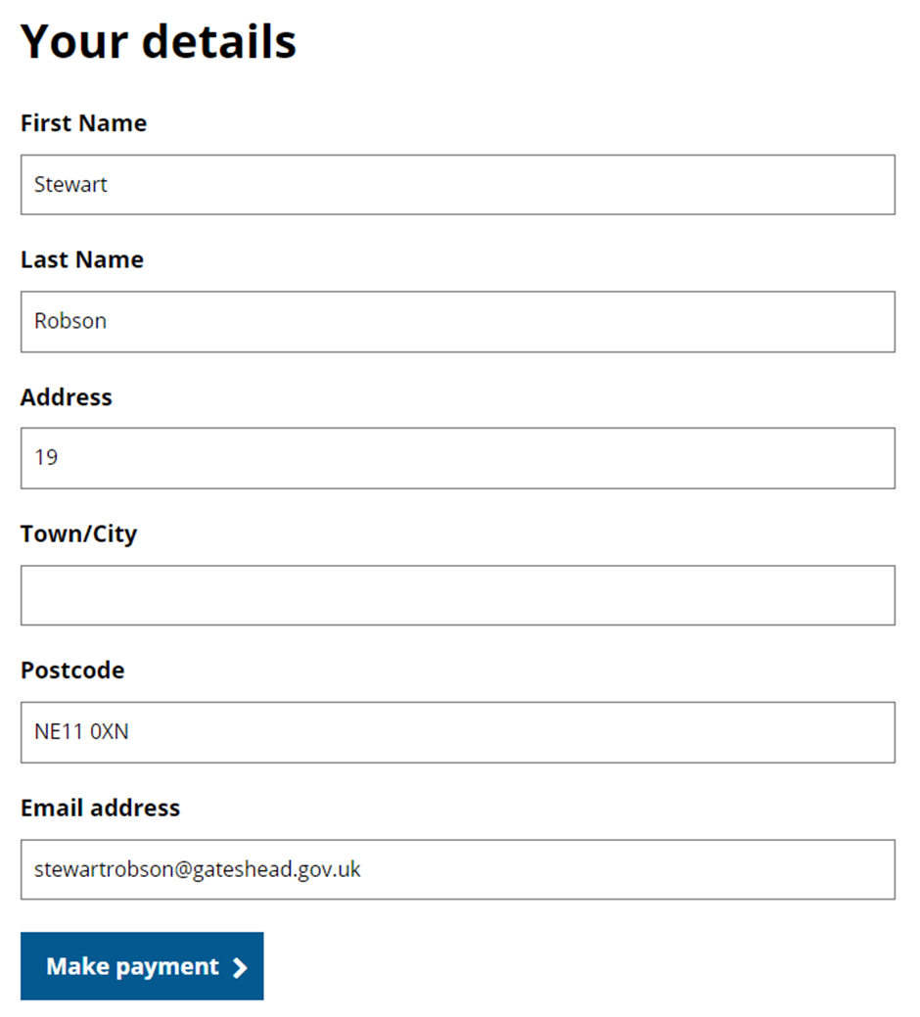
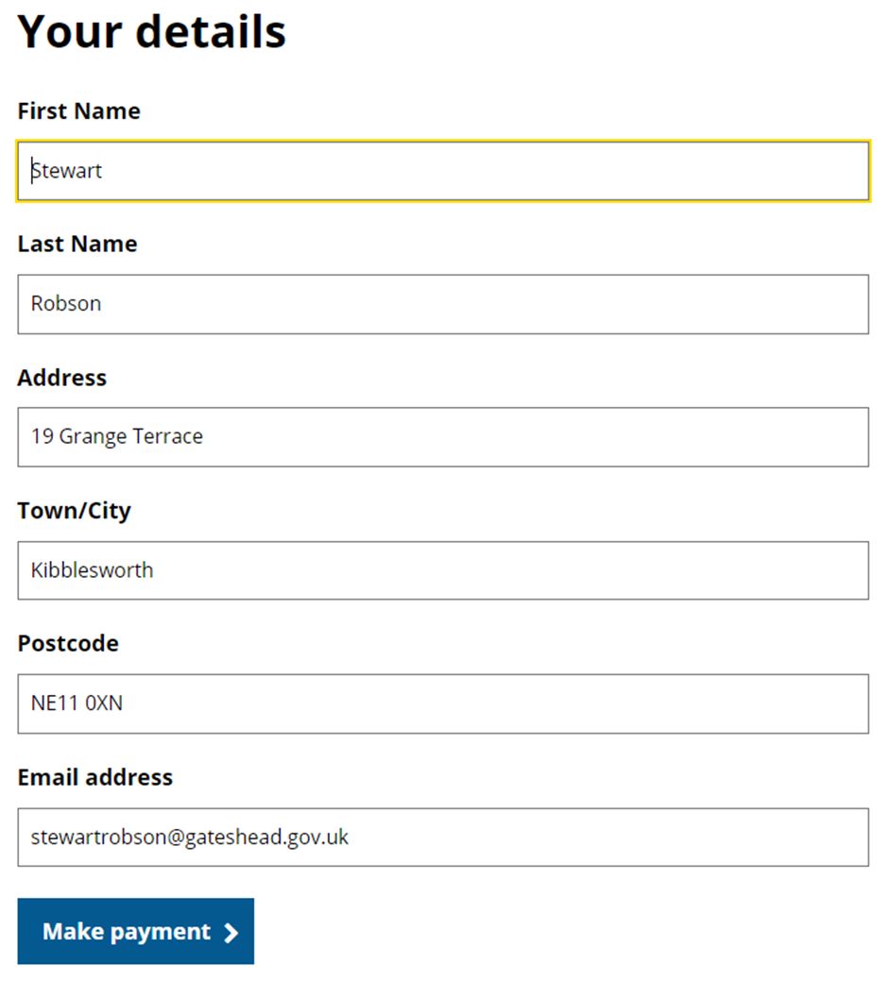
Sprint 2
Development

Slide 6
Sprint 2
Development

Slide 7
Sprint 2
Content and wireframing
Improve structure/split 'information for early years providers with SLA' page​
Garden waste collections 2024 – create email campaigns for early adopters and past subscribers
Upload of Houses in multiple occupation (HMO) register to Landlord support​
Libraries – Draft email types for new library events process
Update pest control calendars for winter working hours (reduced availability)
Late school applications – content
Shared lives – updates to shared lives and section structure
Gateshead Now – 19 November
Holiday activities – family fun day 3rd November
Group volunteering form and content
Adult Social Care
Safeguarding adults website who are we
Safeguarding adults website – improve news article content
Commissioning – add introduction and remove out of date content
Create 'About ASC' intro page
Safeguarding annual report 2023 web content

Slide 8
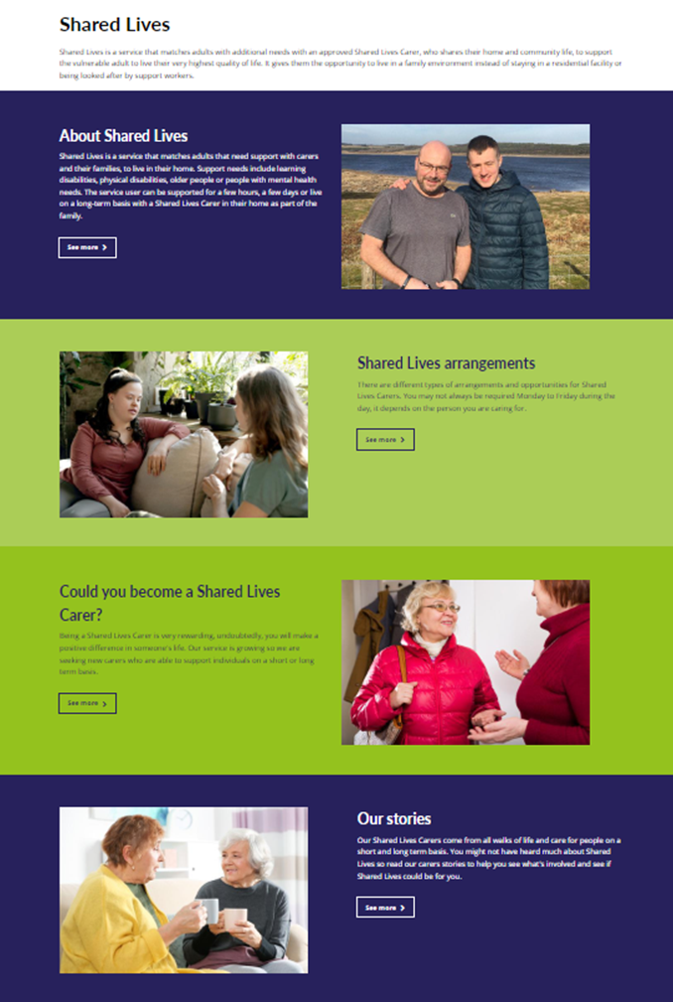
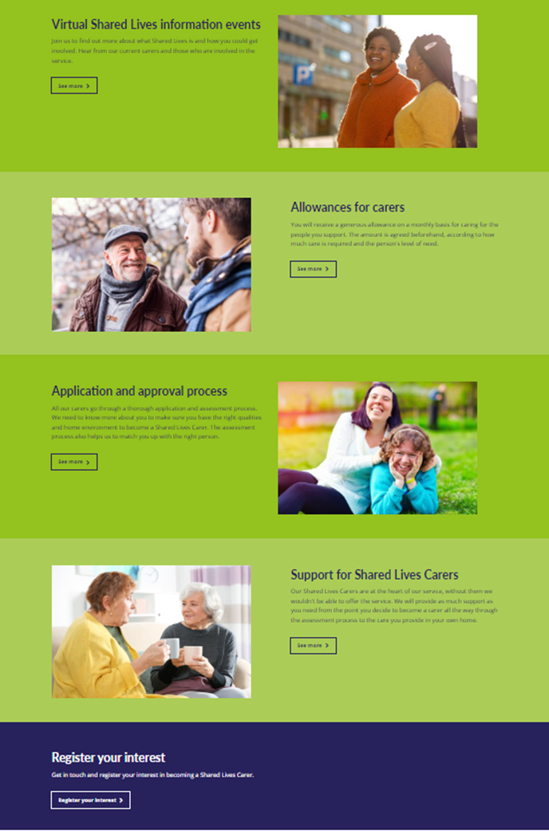
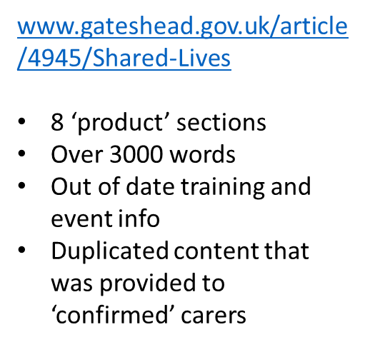
Sprint 2
Content and wireframing

Slide 9
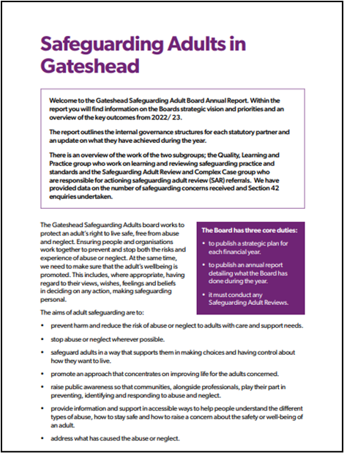
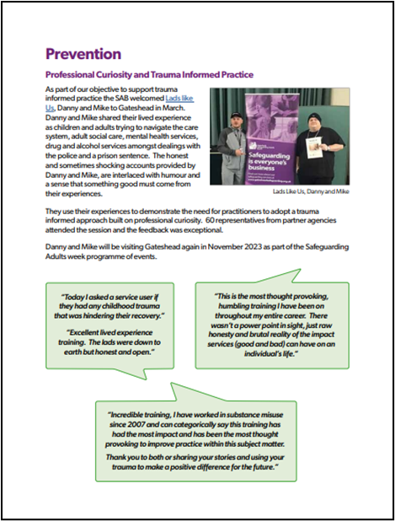
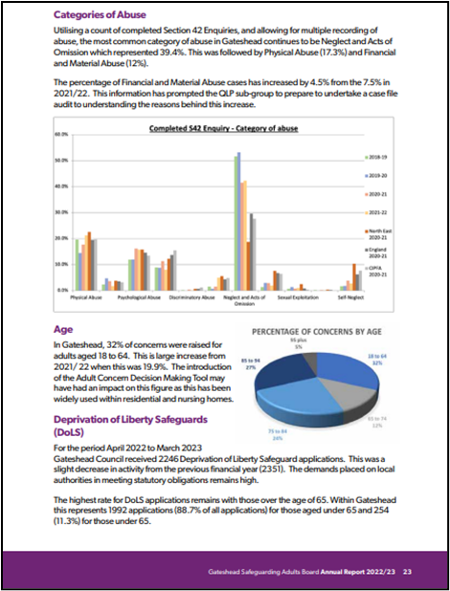
Sprint 2

Slide 10
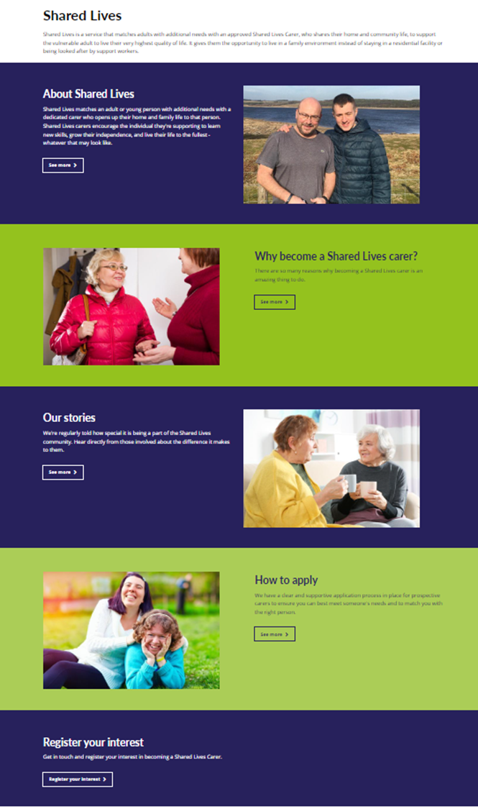
Sprint 2
Content and wireframing

Slide 11
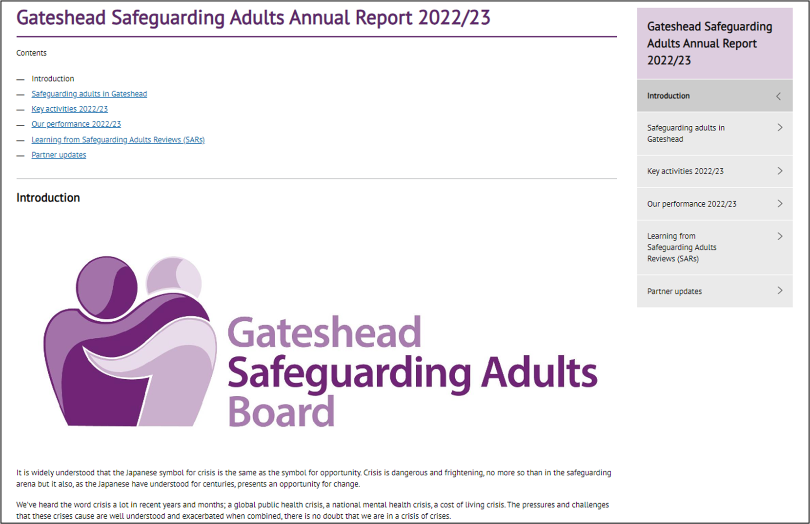
Sprint 2

Slide 12
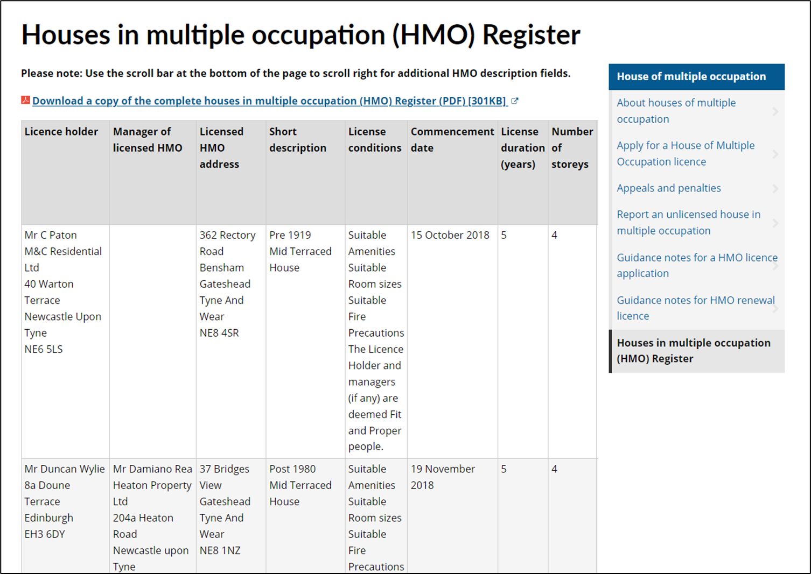
Sprint 2

Slide 13
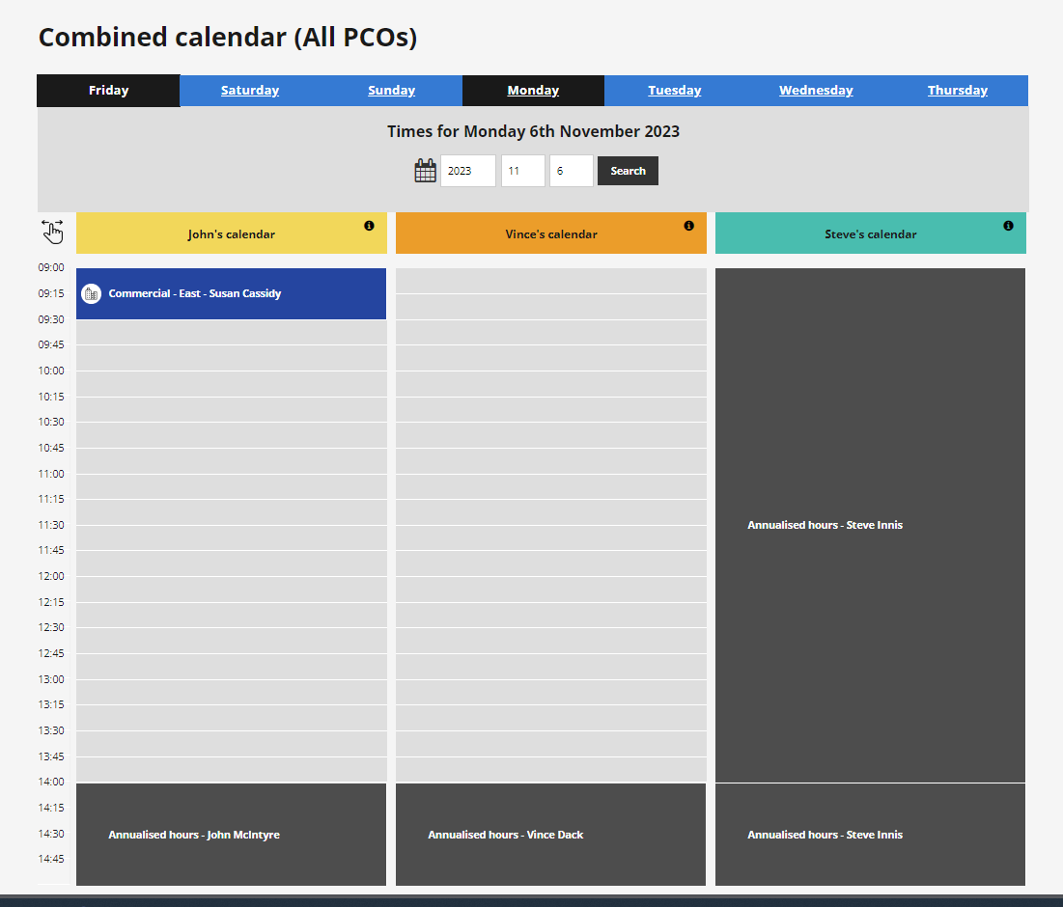
Sprint 2

Slide 14
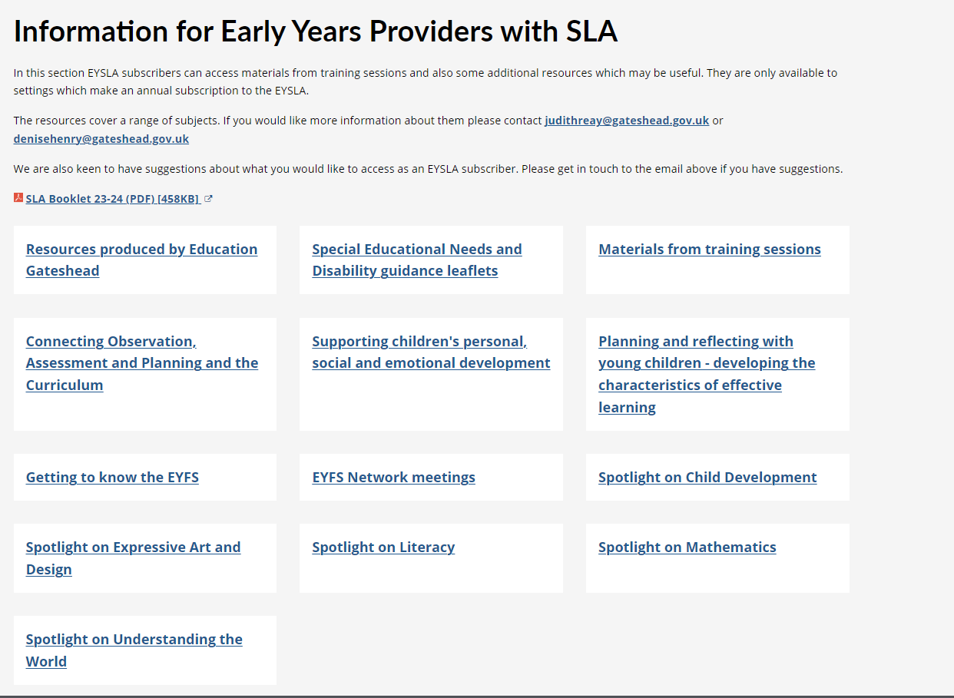
Sprint 2

Slide 15
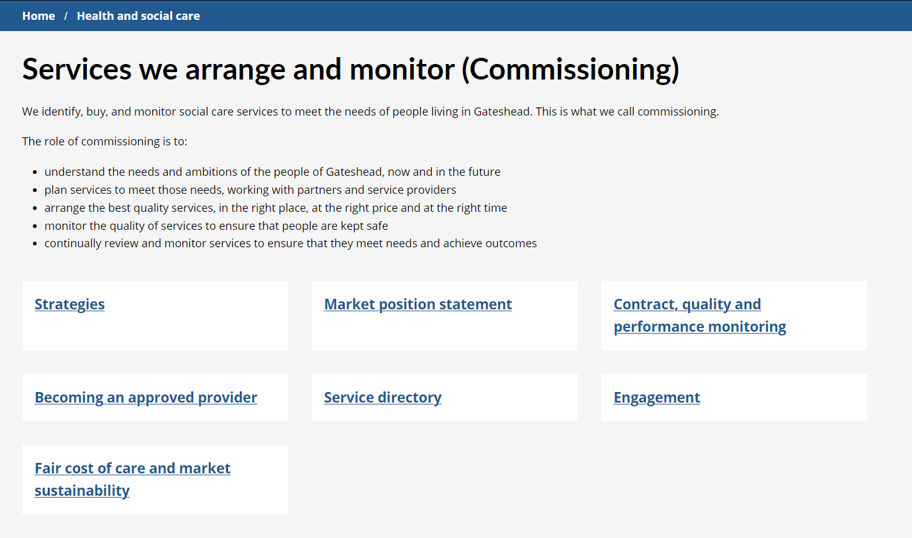
Sprint 2

Slide 16
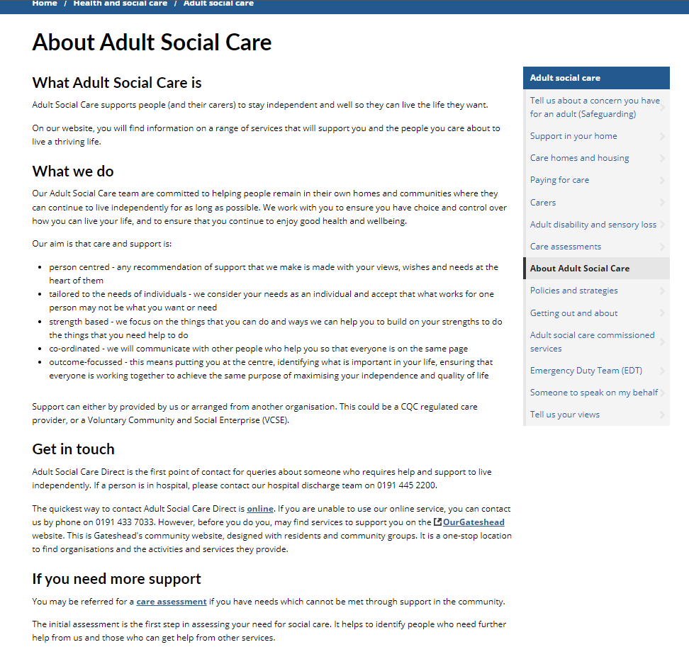
Sprint 2

Slide 17
Sprint 2

Slide 18
Sprint 2
Testing
In year school transfers form.
Late school application form
Access form
Enter child/ parent details
Enter school preferences
Enter sibling details
Enter supporting info
Enter religion
Enter reason for late application
Complete declaration
Receive completed forms
Digital request form
Bin replacements

Slide 19
Sprint 2
Go live
Gateshead now – 19 October 2023
November 3rd family fun day
Group volunteering form and content

