Slide 1
Sprint 19 Show and Tell 21 February 2024
G Squad
Digital Team

Slide 2
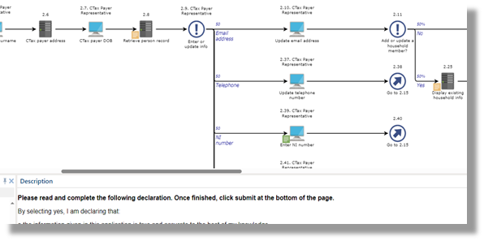
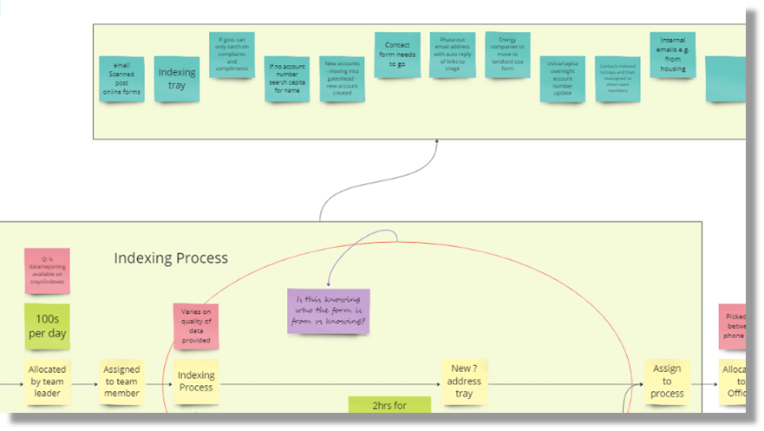
Sprint 19.
Discovery
Progress on Council Tax discounts and exemptions processes
Finding out how indexing in Civica works and what it looks like

Slide 3
Sprint 19.
Data
Arboriculture case extract, notable because of the approach to documentation.
Audit of Waste and Environemtal Services data things

Slide 4
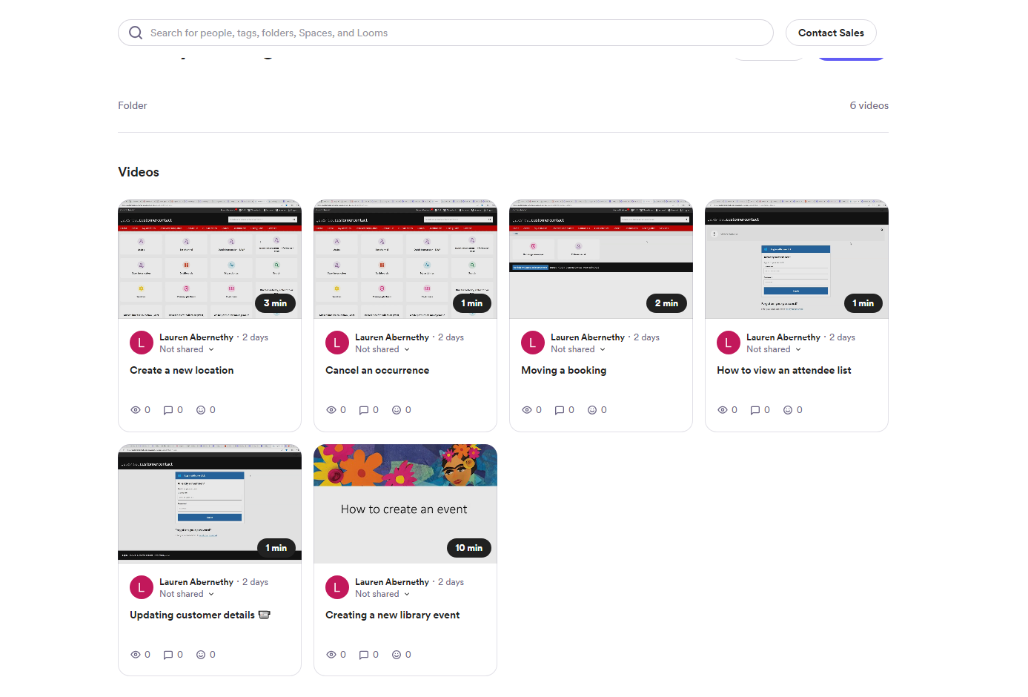
Sprint 19.
Loom videos

Slide 5
Sprint 19.
Libraries powerpoint – Step by Step

Slide 6
Sprint 19.
Crib sheet

Slide 7
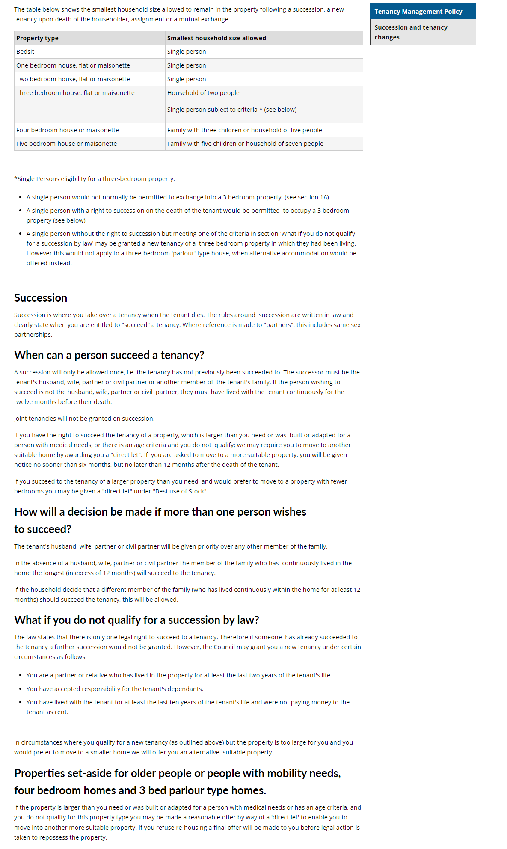
Sprint 19.
Tenancy Management Policy

Slide 8
Sprint 19.
Election CC pages

Slide 9
Consider Care Roadshow

Slide 10
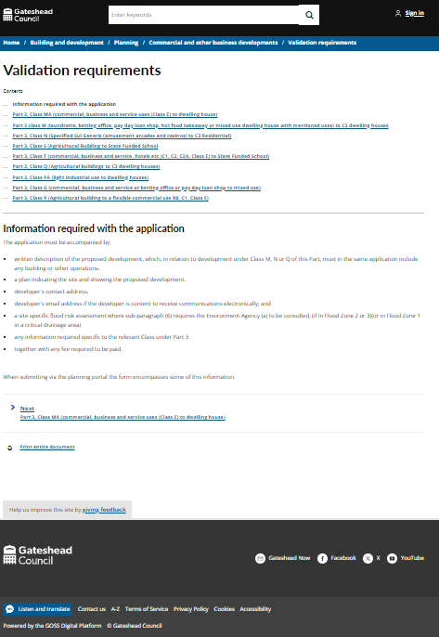
Sprint 19.
Content
Planning prior approval validation requirements

Slide 11
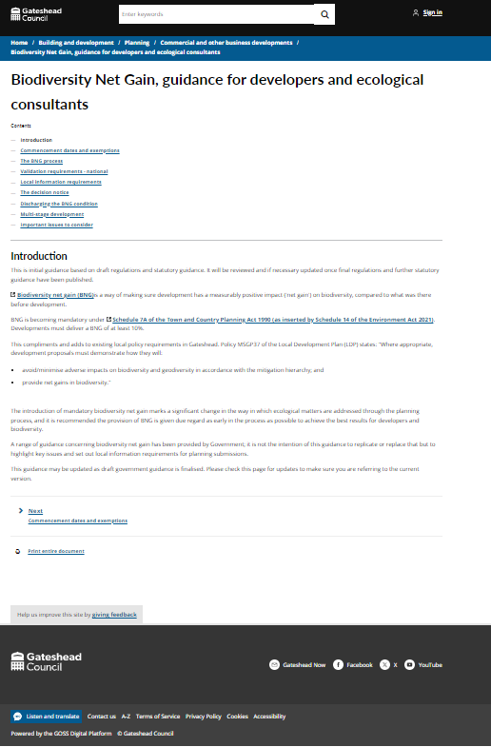
Sprint 19.
Content
Planning prior approval - Biodiversity Net Gain guidance

Slide 12
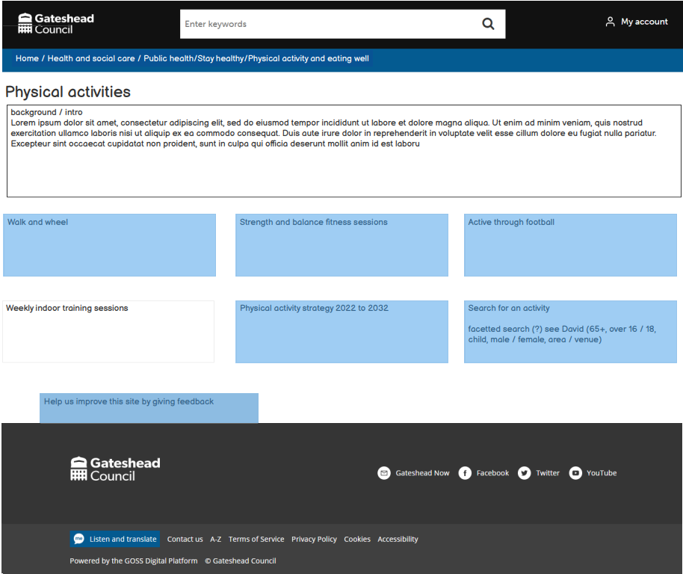
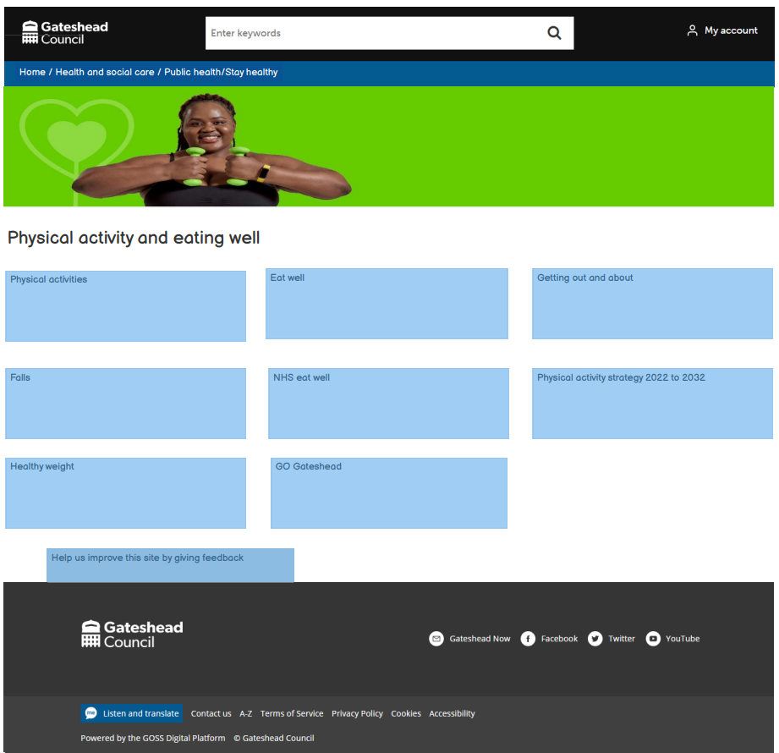
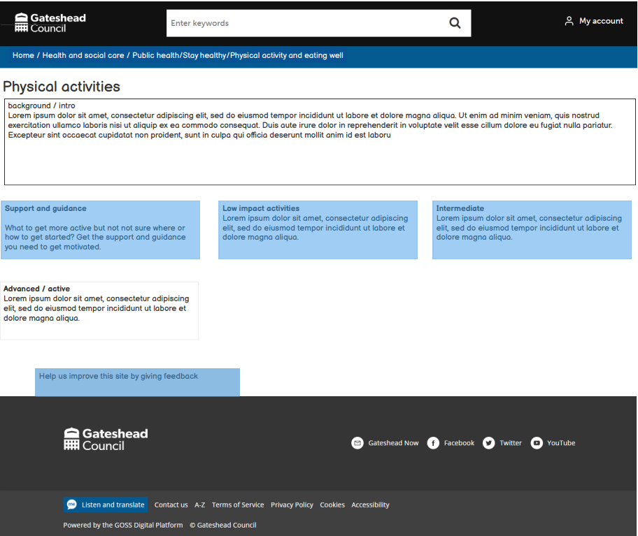
Sprint 19.
Content
Public Health, physical activity content wireframe

Slide 13
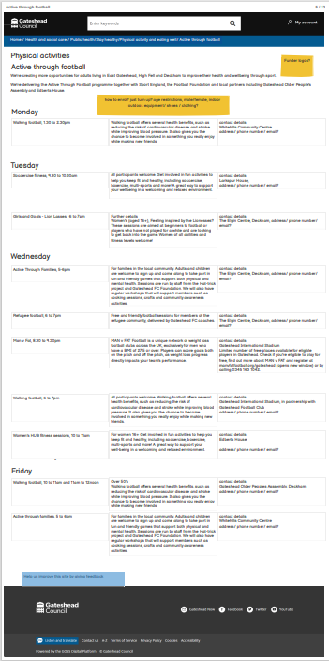
Sprint 19.
Content
Public Health, physical activity - content

Slide 14
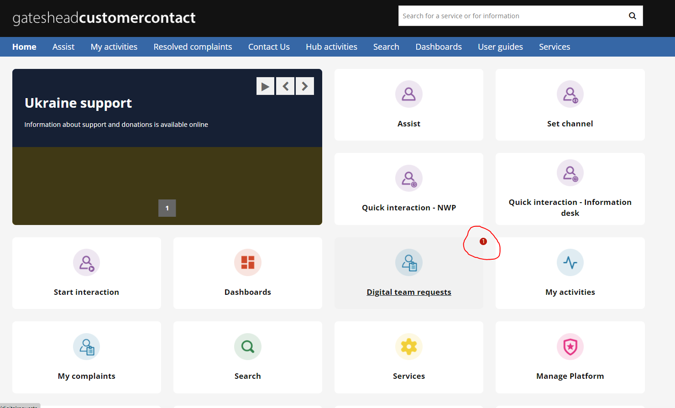
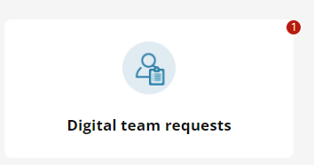
Sprint 19.
Content
Added a task counter to the Digital team request tile in Customer Contact

Slide 15
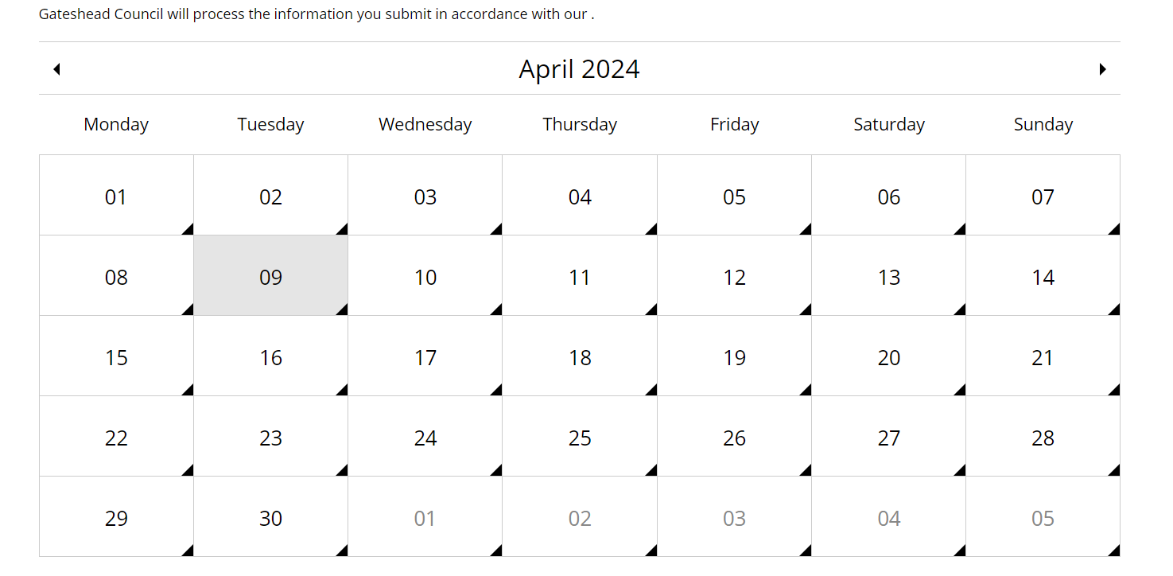
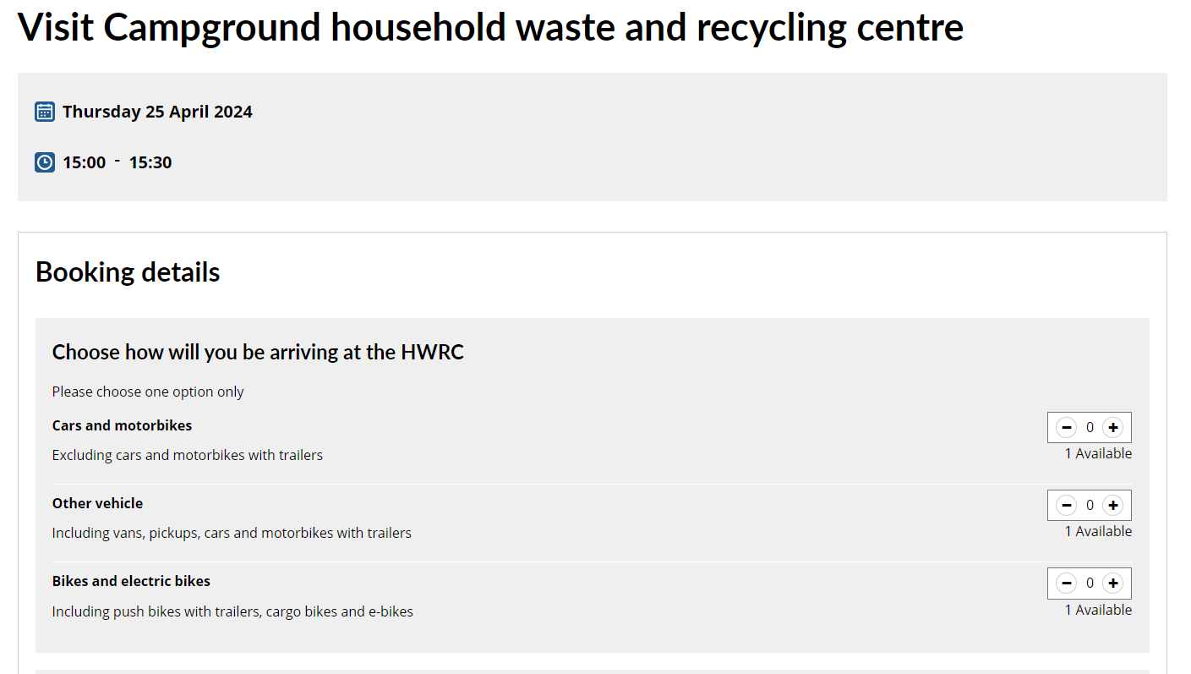
Sprint 19.
Content
Household Waste and Recycling Centre
Updated bookings with summer opening hours and created summer slots

Slide 16
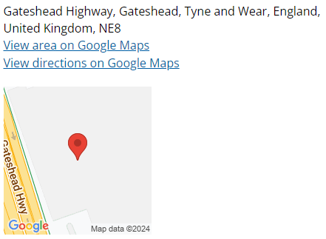
Sprint 19.
Development
Temporary traffic regulation order
Ongoing development to enhance form navigation, case details, and email functionality.
New EndPoint developed as part of the process that when fed Latitude / Longitude data can provide approximate location text, and address details including UPRN from the gazateer.

Slide 17
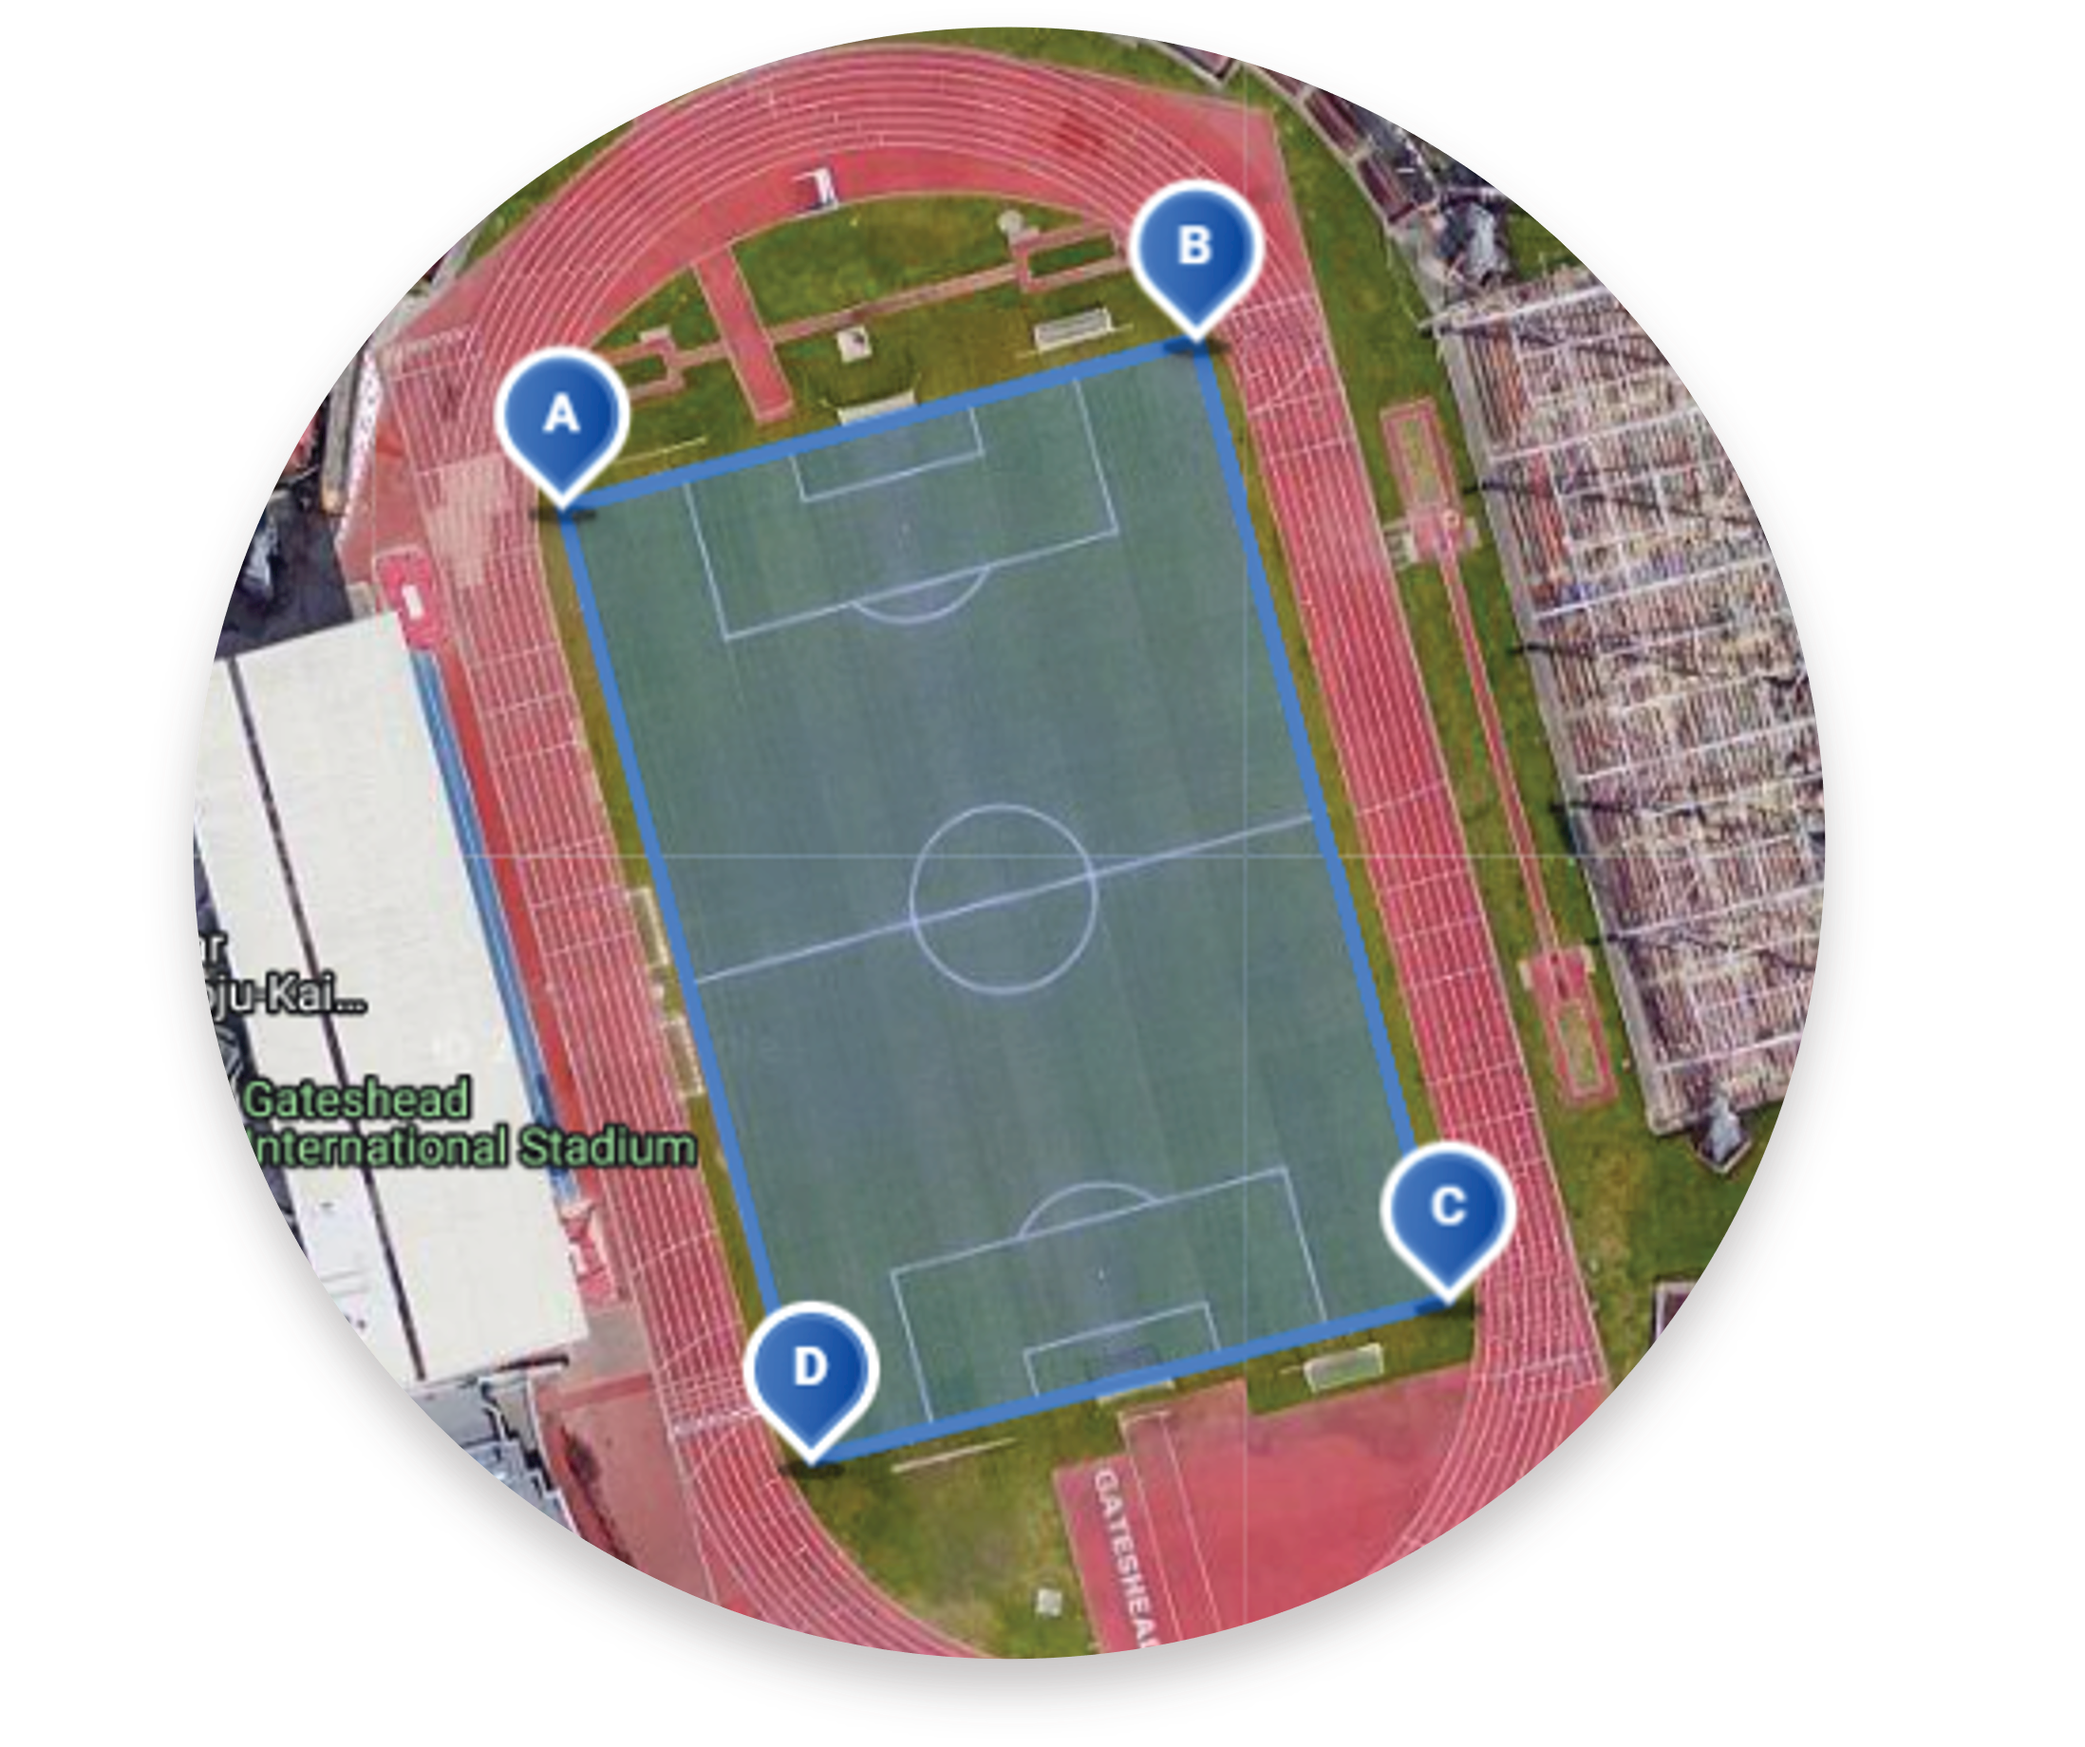
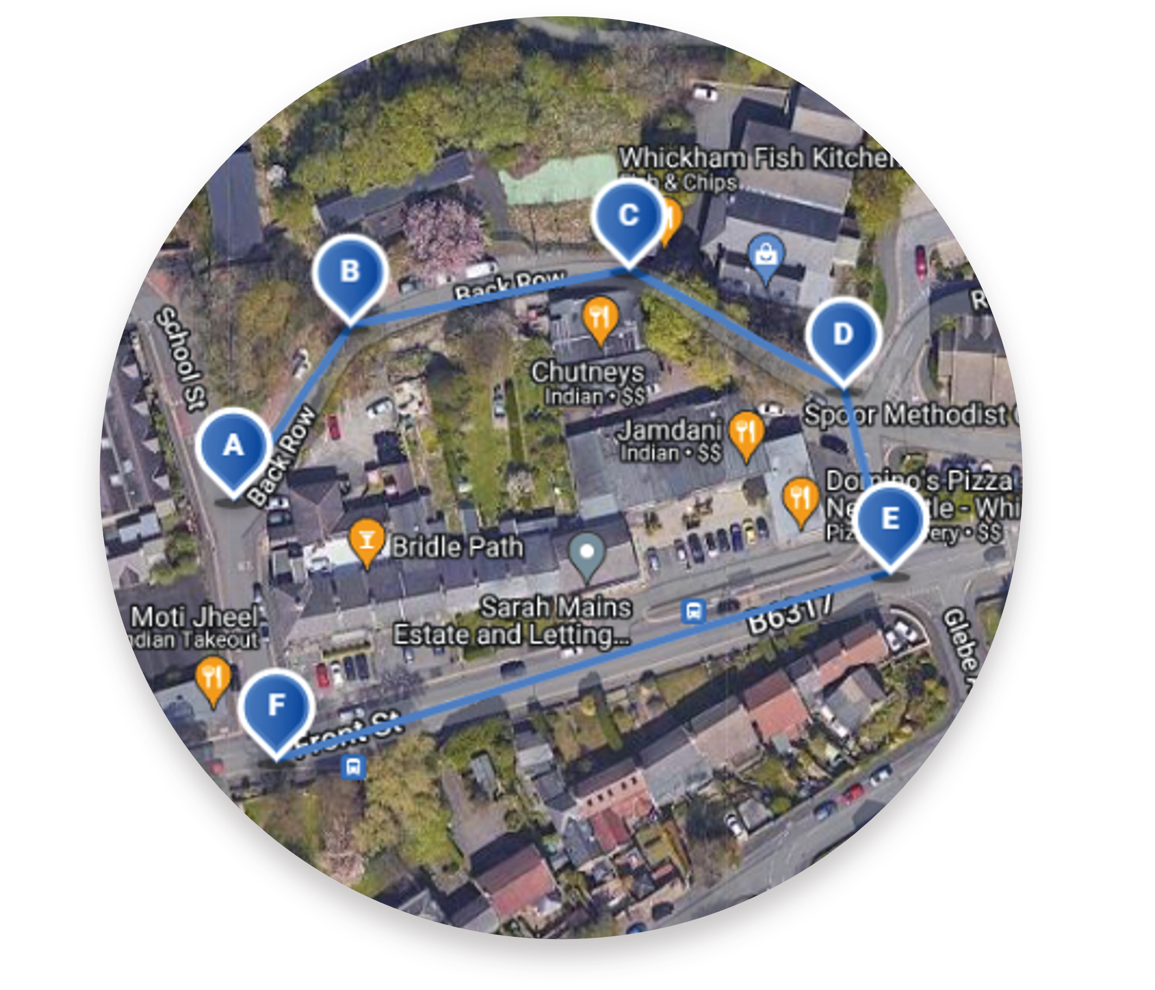
Sprint 19.
Development
MultiPin map
Early development of a MultiPin map that allows users to mark routes and areas.
Offers draggable pins, individual pin selection, remove button, and clear all button.

Slide 18
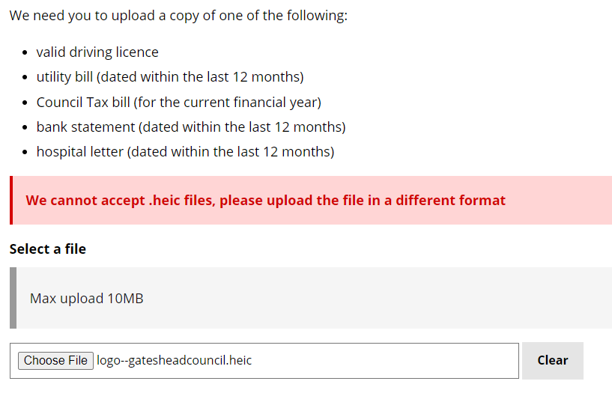
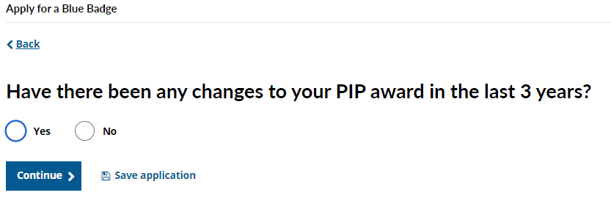
Sprint 19.
Development
Blue Badges
Bug fixes to the 'lost, stolen or not received' form.
Update the main Blue Badge application form so that it doesn't accept .HEIC files
Change to the renewal route if the person is in receipt of DLA or PIP (to help ensure that the service gets all of the information it needs)

Slide 19
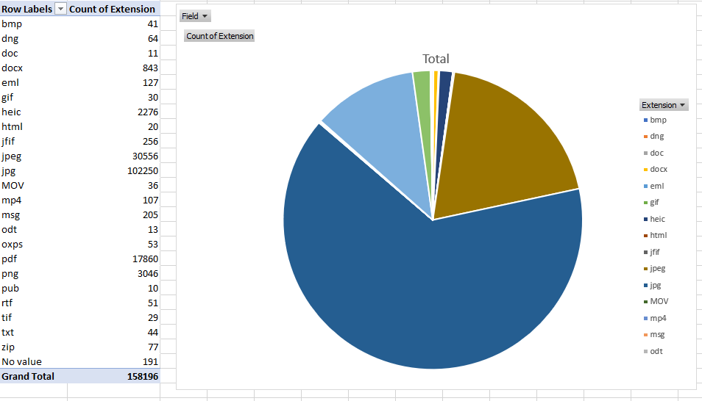
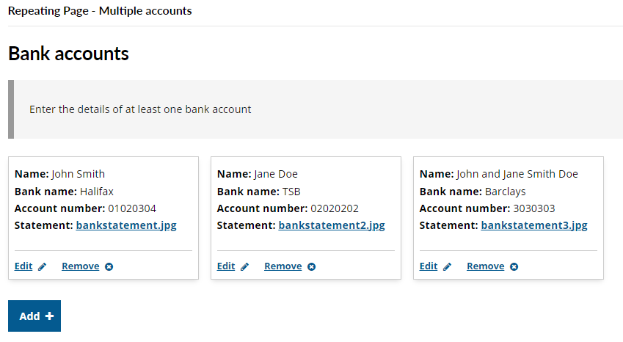
Sprint 19.
Development
Data exports - Learning how to access and query the SQL server that Nick had setup. Using it to see how many Blue Badge applications had .heic file extensions.
HSF exports – 282 applications, volume of applications is decreasing, exported and updated statuses of applications every other day.
Repeating fields – Learning how to use GOSS' repeating fields feature. Set up a dummy form with repeating fields, possibly one to implement with Financial Assessments.

Slide 20
Sprint 19.
What's next?
Council tax discount and exemptions
Homelessness review process
Business rates change of address go live
Libraries booking handover

