Slide 1
Sprint 18 Show and Tell 14/02/2024
C Squad
Digital Team

Slide 2
Sprint 18
Discovery
New bins
Miro board
Engage as-is map
Taxi Vehicle Tests
Miro board
Care cost calculator
Direct payments - Service design proposal & approach planning
Miro board
Direct Payments Review 060224 (1)
Definition of ready for discovery
Miro board
Registrars scoping meeting
Miro board
Data analysis challenge

Slide 3
Sprint 18
Design
Library bookings on Customer Contact – Updates to icons and design consistency
Safeguarding in Gateshead website – Change site design and theme
Design checks with some amends on forms
Working on the Digital services work program content with Claire
Google Data Studio - Create a dashboard for housing
Create report to track UTM links in QR code links
Show Saidat and Tracy how to create dashboards

Slide 4
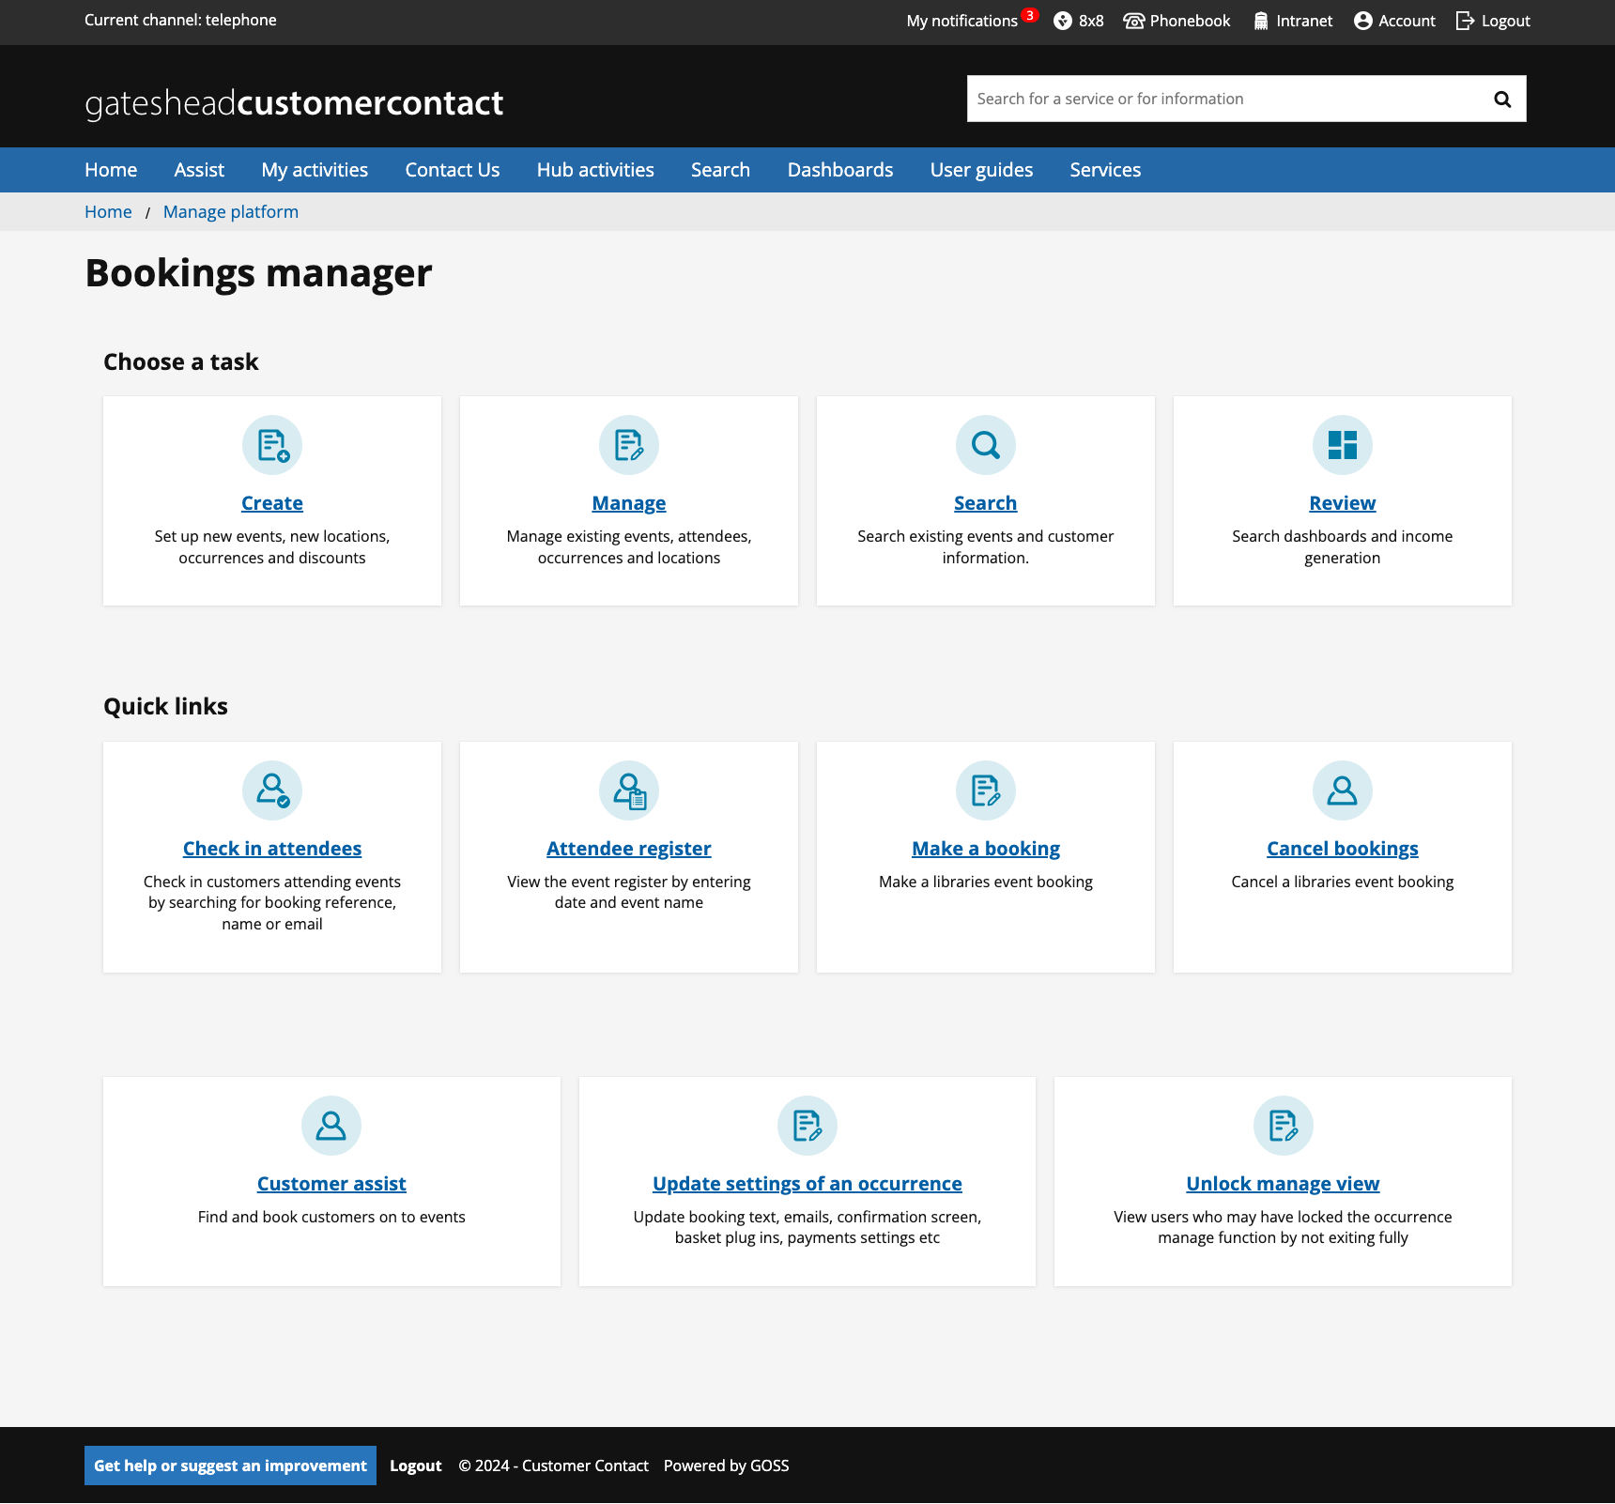
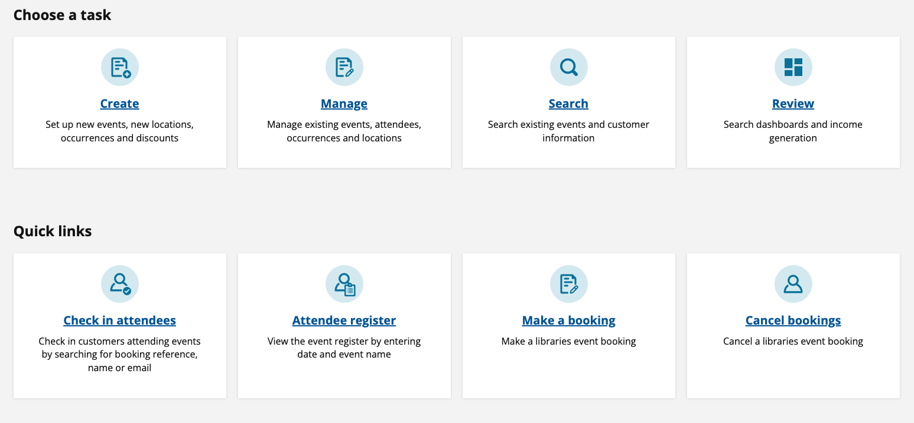
Library bookings on Customer Contact – Updates to icons and design consistency
Updated icon colours
Changed icons to be a more consistent theme
https://customercontact.gateshead.gov.uk/article/15923/Bookings-manager

Slide 5
Safeguarding in Gateshead website – Change site design and theme
Created a site design in Figma from Emma's wireframe
Created a site skin based on the Dynamic theme
Figma file https://www.figma.com/file/hStlMNCx1eDgxXde0Fr8xt/Safeguarding?type=design&node-id=0%3A1&mode=design&t=UQEaYxxm5wy47BmK-1
Dev site https://safeguarding.ghc2-dev.gosshosted.com/

Slide 6
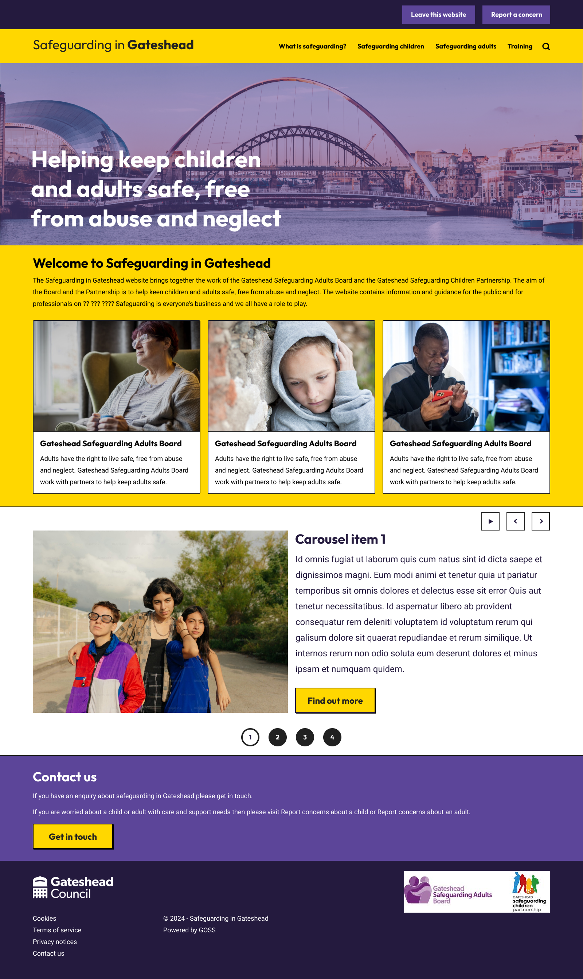
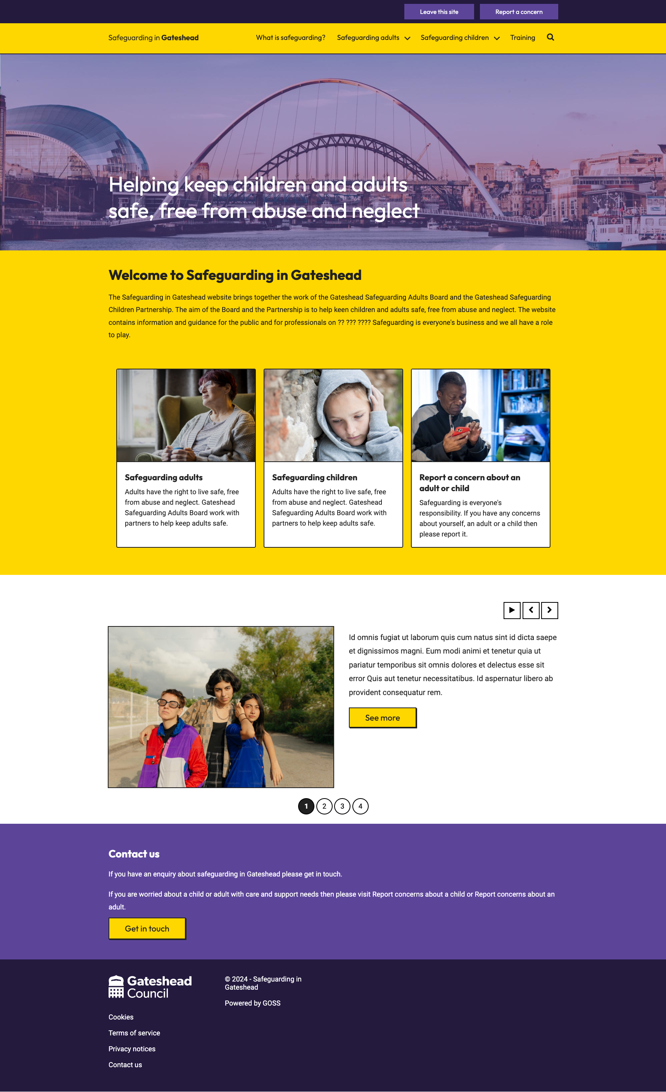
Safeguarding in Gateshead website – Change site design and theme
Figma file
Dev website
https://www.figma.com/file/hStlMNCx1eDgxXde0Fr8xt/Safeguarding?type=design&node-id=0%3A1&mode=design&t=UQEaYxxm5wy47BmK-1
https://safeguarding.ghc2-dev.gosshosted.com/

Slide 7
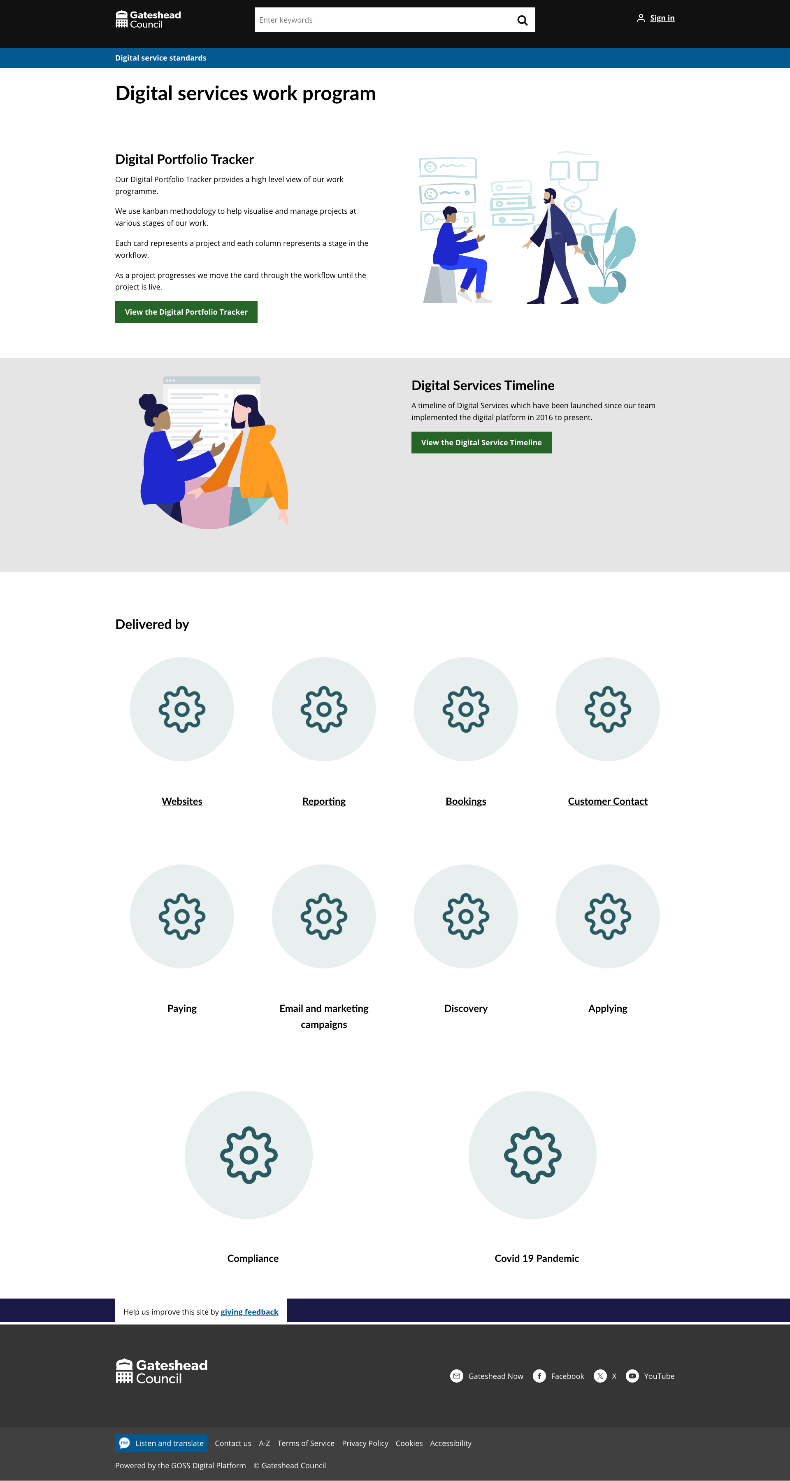
Digital services work program
https://www.gateshead.gov.uk/article/26850/Digital-Services-Work-Programme

Slide 8
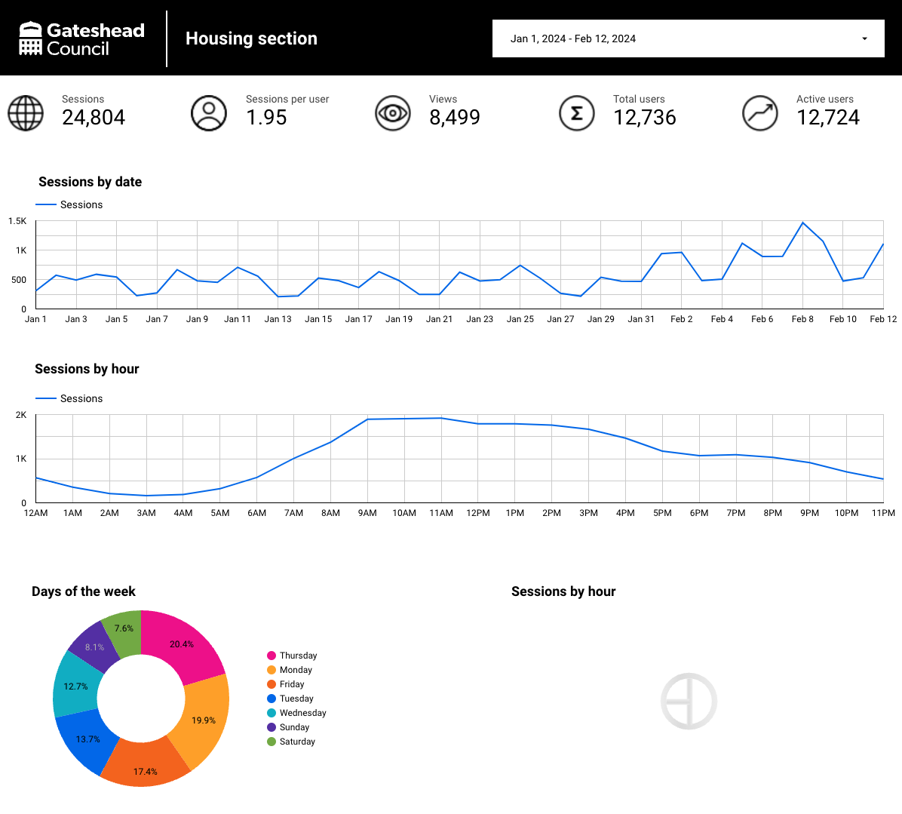
Google Data Studio – Created a dashboard for the Housing section
Duplicated existing section dashboard
https://lookerstudio.google.com/s/kEIrFu9u4gE

Slide 9
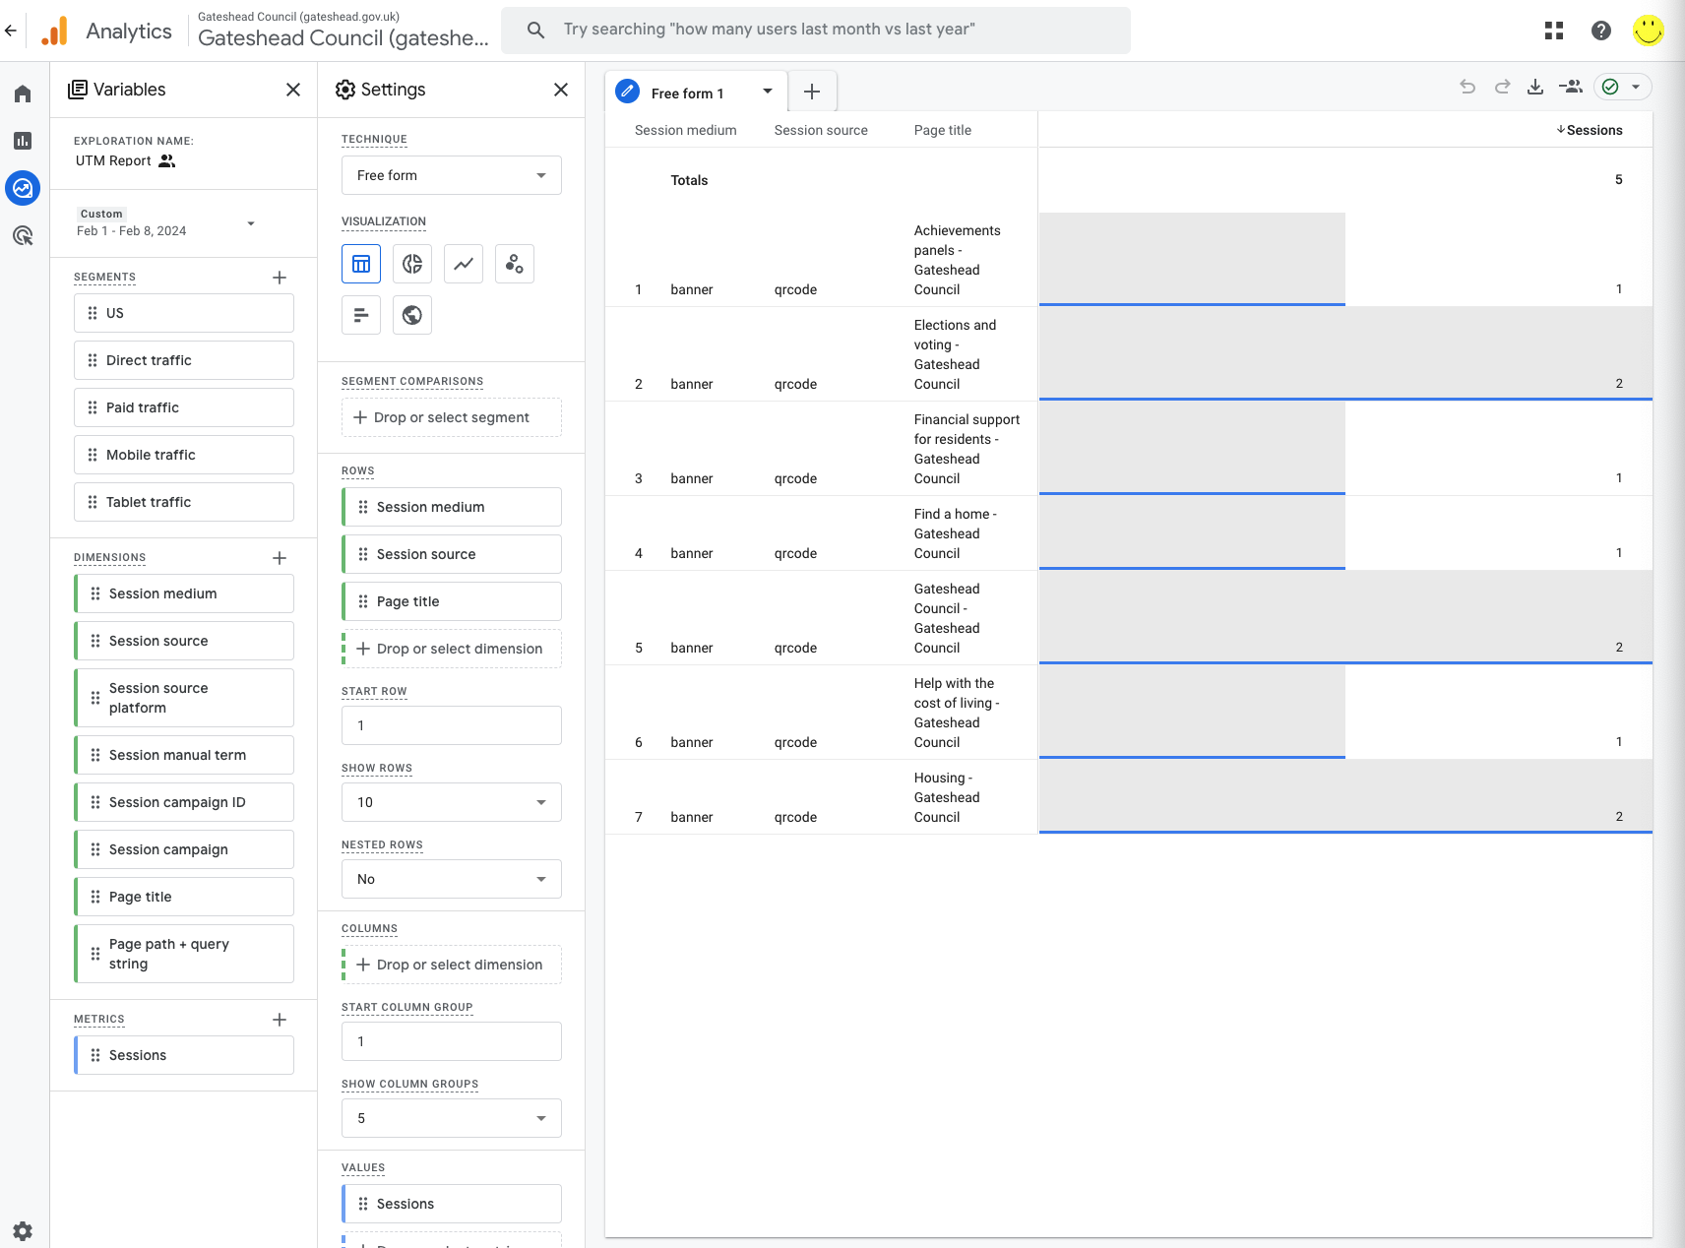
GA4 – Create report to show UTM clicks from QR codes
Report show the number of clicks and which QR code was used
Needs improving (WIP)
https://analytics.google.com/analytics/web/#/analysis/p334704387/edit/PW7XGd5CT7KoNtfL9qvfrw
May need to be logged in as the Digital team to see the report

Slide 10
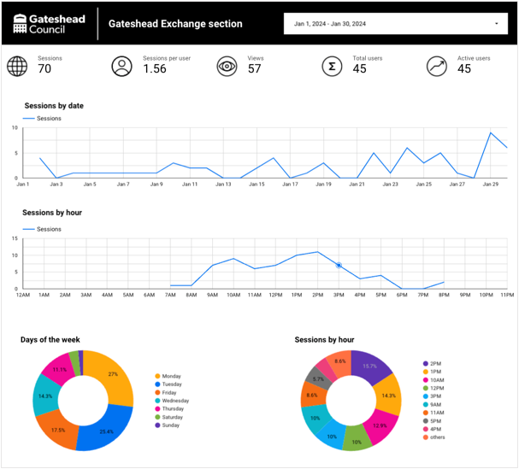
Google Data Studio – Show Saidat and Tracy how to create dashboards
Walked through the process
Created dashboards for
Cost of living
Fostering
Education and learning
https://customercontact.gateshead.gov.uk/article/23778/Google-Analytics-for-all-websites

Slide 11
Sprint 18
Content
Go Gateshead half term activities added to bookings
Libraries bookings training materials Powerpoint slides and Loom videos
New bookings interface live on Prod
IIAs added for Councillors budget intranet page
Gateshead Now - 1 February
Community Led Support
Council News article on digital services
Viewpoint Online survey email campaign
February Leader's blog
Updates to carer's section of website
Wireframe of homepage with proposed new IA

Slide 12
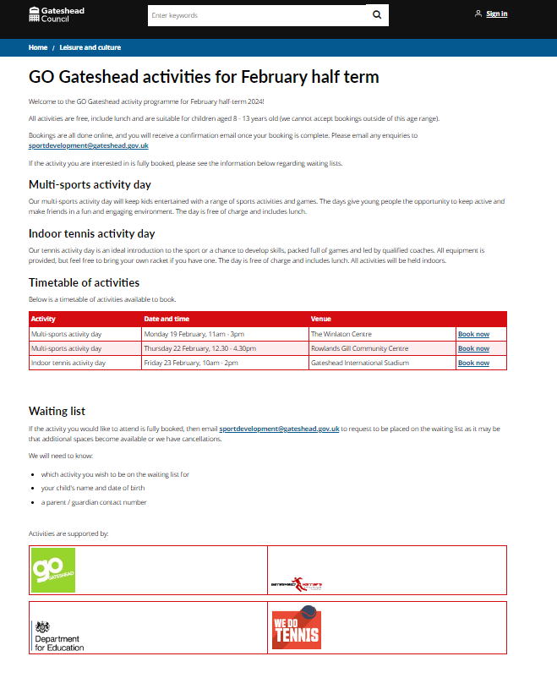
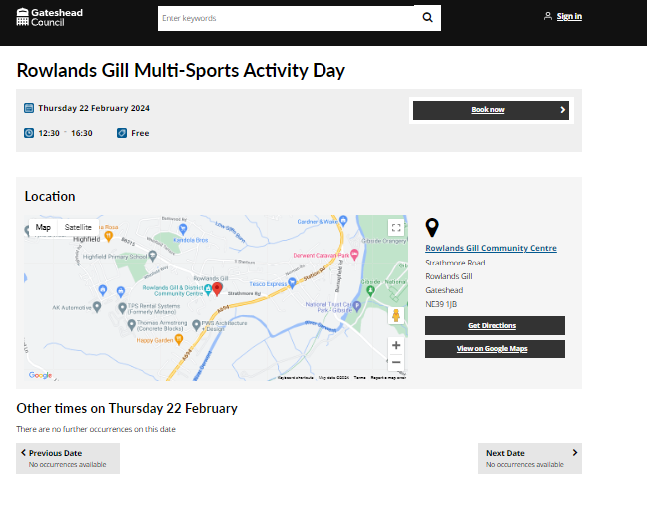
Go Gateshead activities for February half term
Go Gateshead half term holiday activities added to the bookings platform and web content created.

Slide 13
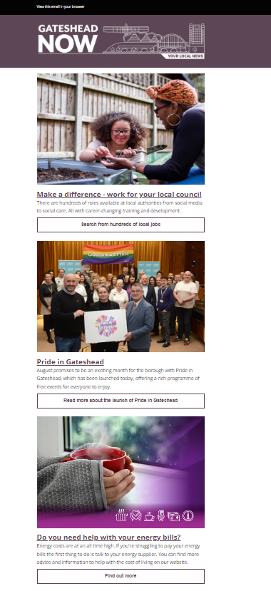
Gateshead Now
Gateshead Now issued on 1 February.
Lead items included:
Launch of Pride in Gateshead
Local government recruitment campaign
Help with energy bills

Slide 14
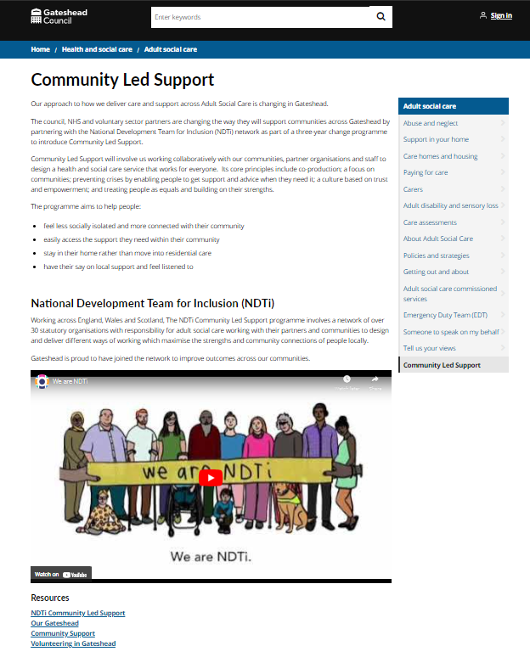
Community Led Support
New content for the council's new approach on how we deliver care and support across Adult Social Care.

Slide 15
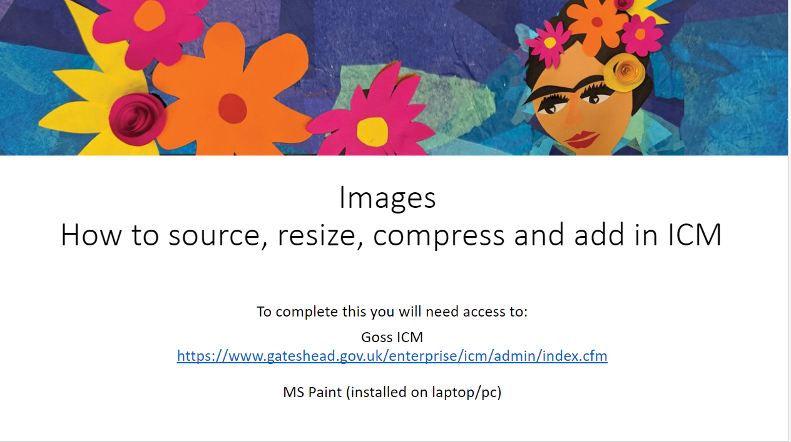
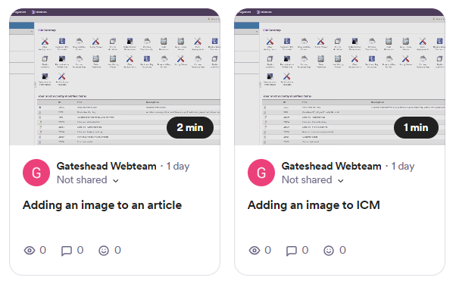
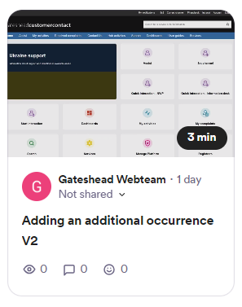
Libraries bookings training materials
Loom videos and Powerpoint slides
How to source, resize, compress and an image
How to add an additional occurrence

Slide 16
Viewpoint online email campaign
Sent on 6 February 2024
Inviting members of the Viewpoint panel to complete the new 'Safer Gateshead' survey

Slide 17
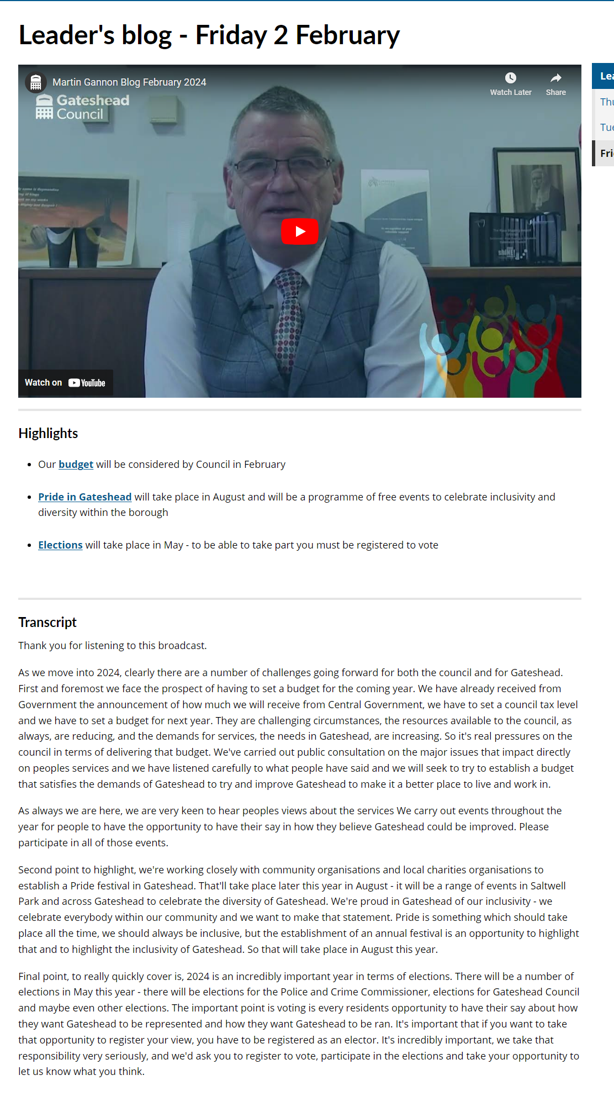
Leader's blog: February 2024
Leader's blog - Friday 2 February - Gateshead Council
New page with link to Leader's blog video and transcript

Slide 18
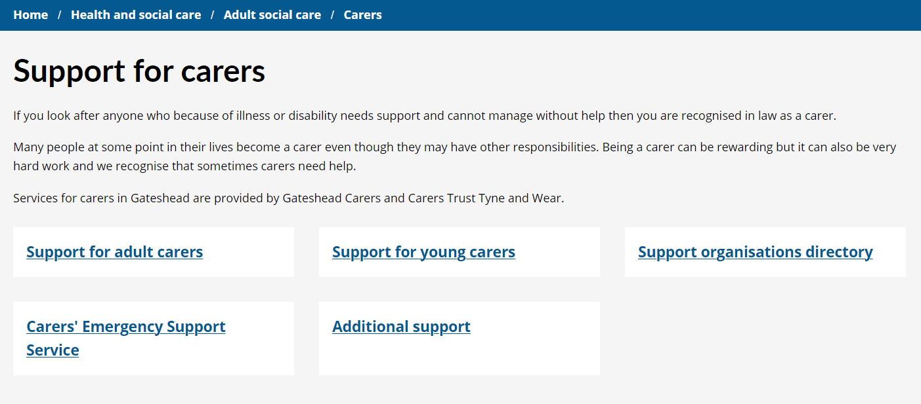
Updates to carer's webpages
Support for carers - Gateshead Council
New page for Carer's Emergency Response service (part of Gateshead Care Call)
New page for 'Additional Support' - a central page for links to external organisations offering help and support to carers
Additional information added to the Carer's Assessment page with information about caregivers and what happens at a carer's assessment

Slide 19
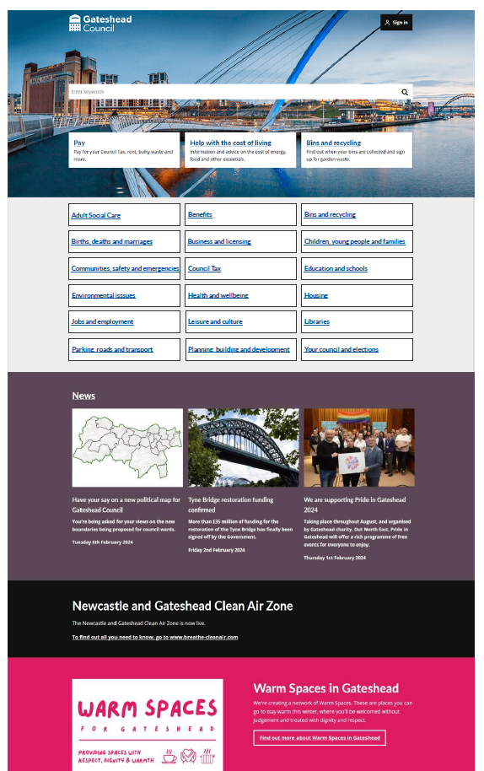
Wireframe of gateshead.gov.uk homepage to show proposed new Information Architecture (IA)
The new IA will have 18 site sections instead of the current 12
This will bring sections such as births, deaths and marriages, libraries, and Adult Social Care to the homepage instead of being hidden under other categories
Some categories have been renamed, such as education and schools; planning, building and development; and communities, safety and emergencies to better explain what is contained in those sections and make the IA more intuitive
A new section, children, young people and families, has been created to bring together sections such as children's social care, childcare, adoption, and fostering instead of this information being divided amongst other categories
As we've moved adult and children's social care into their own sections, a health and wellbeing section has been created to bring together content that was previously under health and social care – public health, JSNA and Healthwatch Gateshead

Slide 20
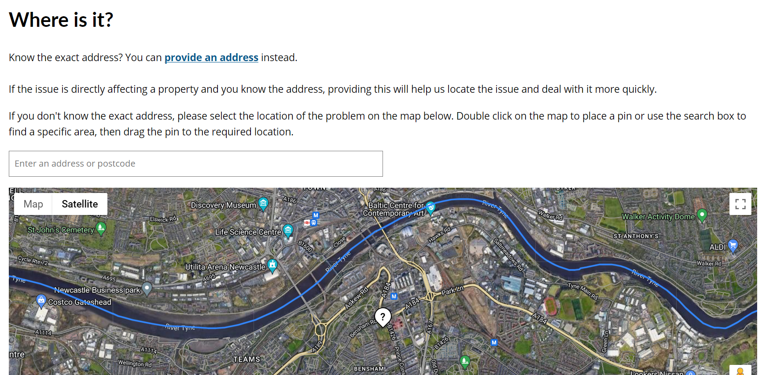
Sprint 18
Development
Update to 20 report it forms

Slide 21
Development
Benefits overpayment - text amend to form invoice number asked for instead of account number

Slide 22
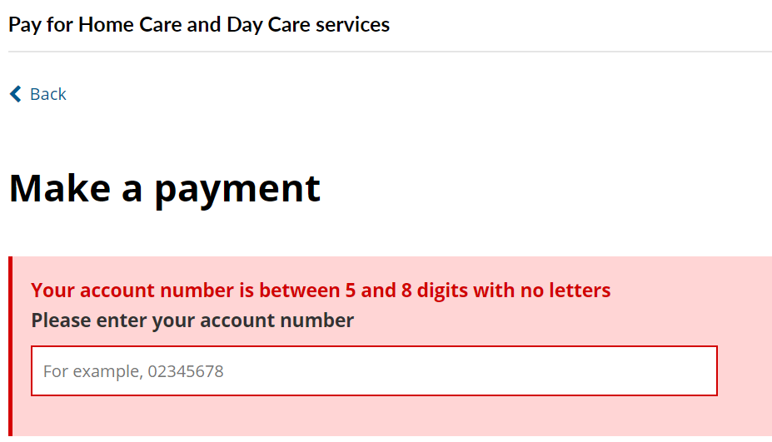
Development
Update to Homecare and day services form

Slide 23
Add character count to all ASCD forms
Add PDF download to safeguarding forms

Slide 24
Development
Family Voice contact us form
https://gateshead.ghc2-dev.gosshosted.com/article/13513/Family-Voice-contact-us
QR Code generator
https://customercontact.ghc2-dev.gosshosted.com/article/6786

Slide 25
Development
Freedom of Information request form and email update
https://gateshead.ghc2-dev.gosshosted.com/article/10864/Freedom-of-Information-Request

Slide 26
Sprint 18
Testing
Map text updates
Freedom of information form
Family Voice contact us form
​Deployment

Slide 27
Sprint 18
Go live
New bookings interface
Updates to in year school transfers

Slide 28
Sprint 18
BAU/ Other tasks

Slide 29
What's coming up in Sprint 20
Discovery
Content
Brighten the Day Easter activities
Safeguarding website – start to add content to pre-prod
Design
Development

Slide 30
Sprint 18
Deployment

