Slide 1
Sprint 17 Show and Tell 7 February 2024
G Squad
Digital Team

Slide 2
Sprint 17.
Discovery
Council Tax discounts, disregards and exemptions

Slide 3
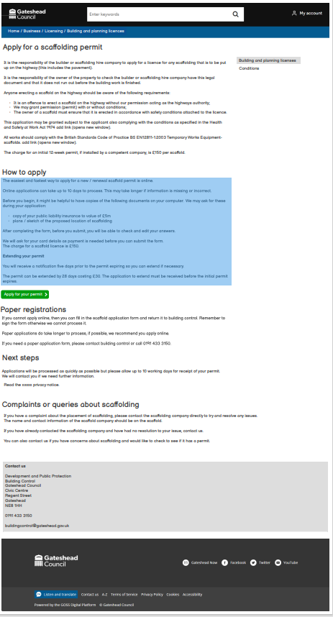
Sprint 17.
Content and wireframing
Revised scaffolding permit wireframe and content

Slide 4
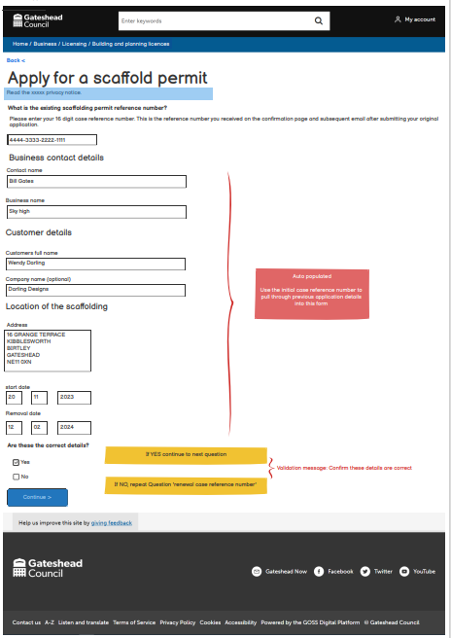
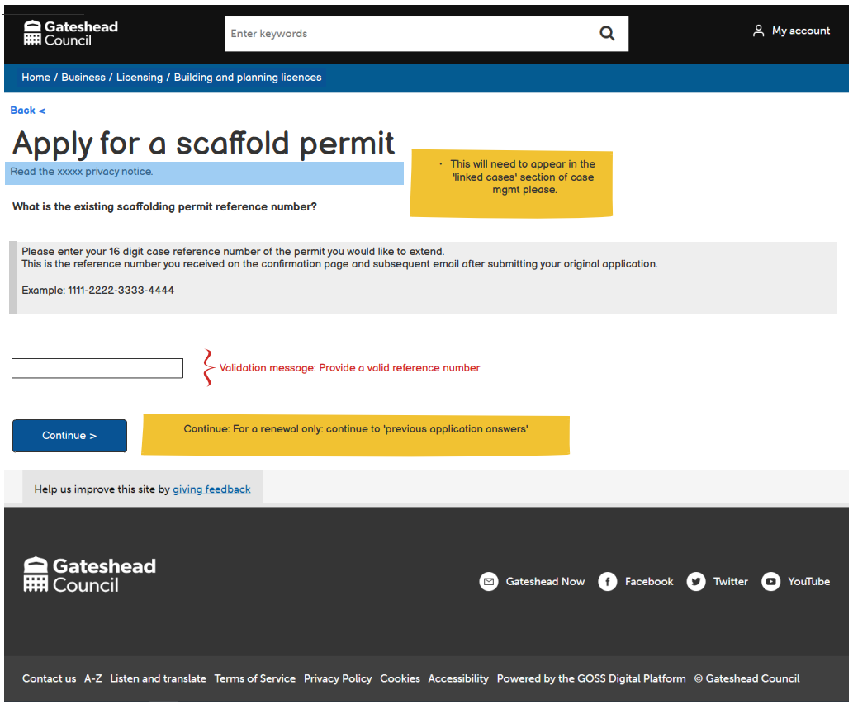
Sprint 17.
Content and wireframing
Revised scaffolding permit wireframe and content

Slide 5
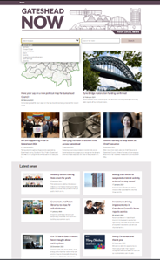
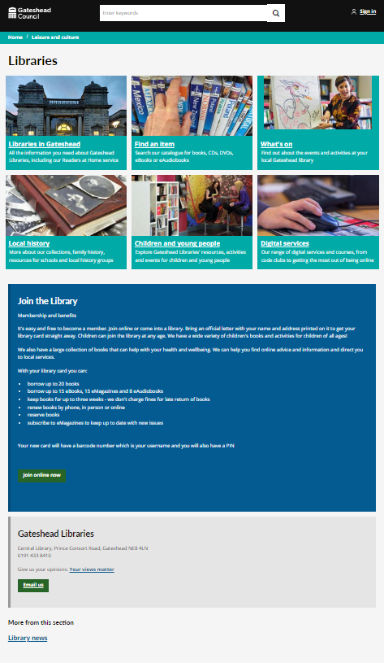
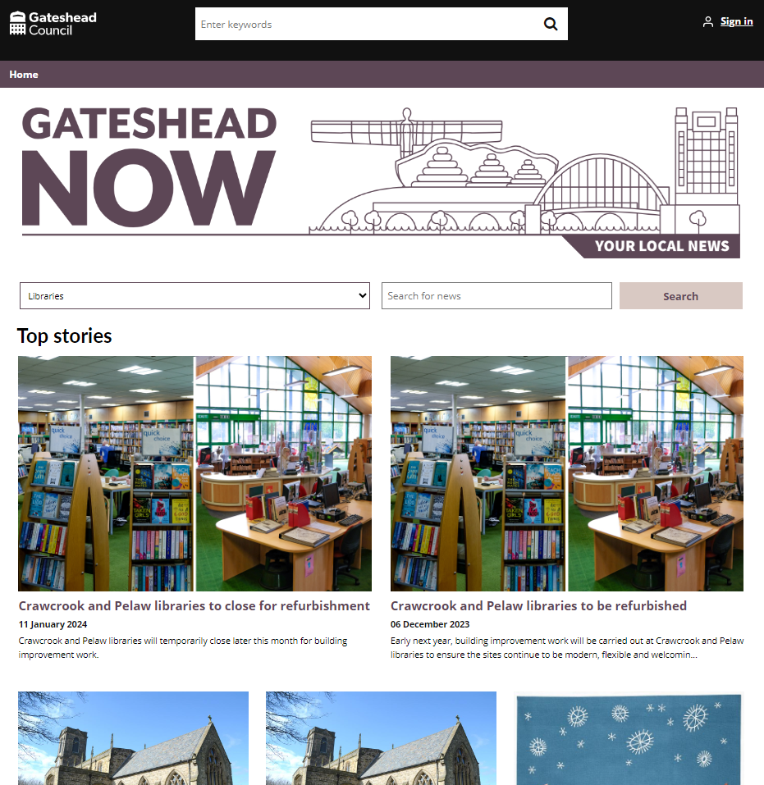
Sprint 17.
Content and wireframing
Revised libraries news content

Slide 6
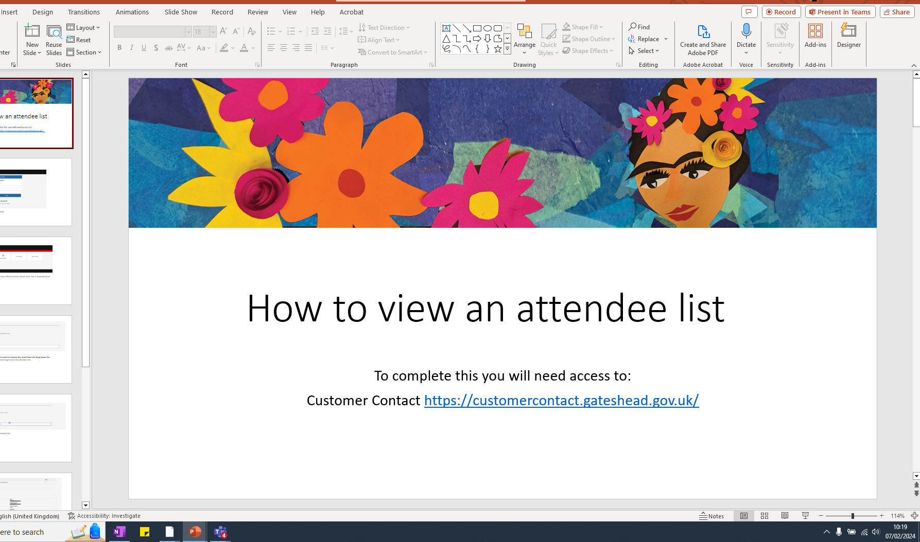
Libraries:​
Increased length of event name​
Attended the libraries to review speed​
Started work on training materials

Slide 7
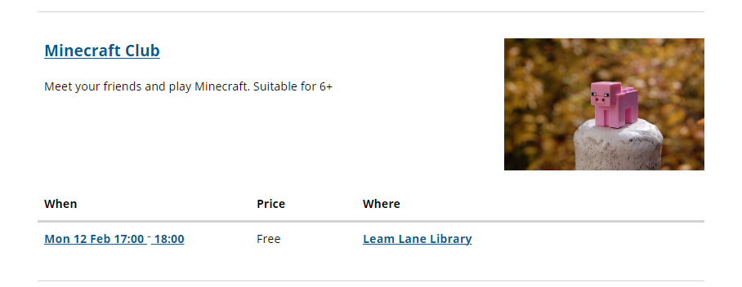
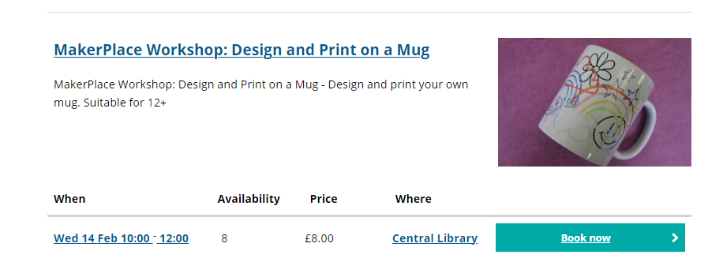
Libraries:​
Added appropriate age range to the summary following feedback​
Added basket ​

Slide 8
Sprint 17.
Content and wireframing
Other:
Edited Day Service training videos
Reduced search for all privacy notices

Slide 9
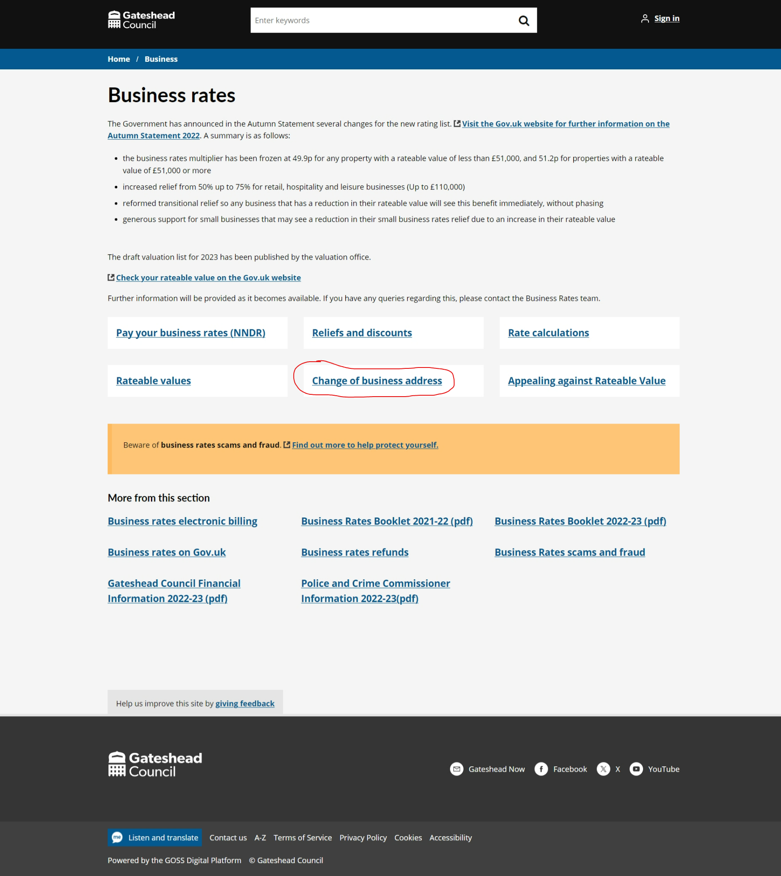
Sprint 17.
Content and wireframing
Business rates change of address – content and form on Preprod and sent to service for UAT

Slide 10
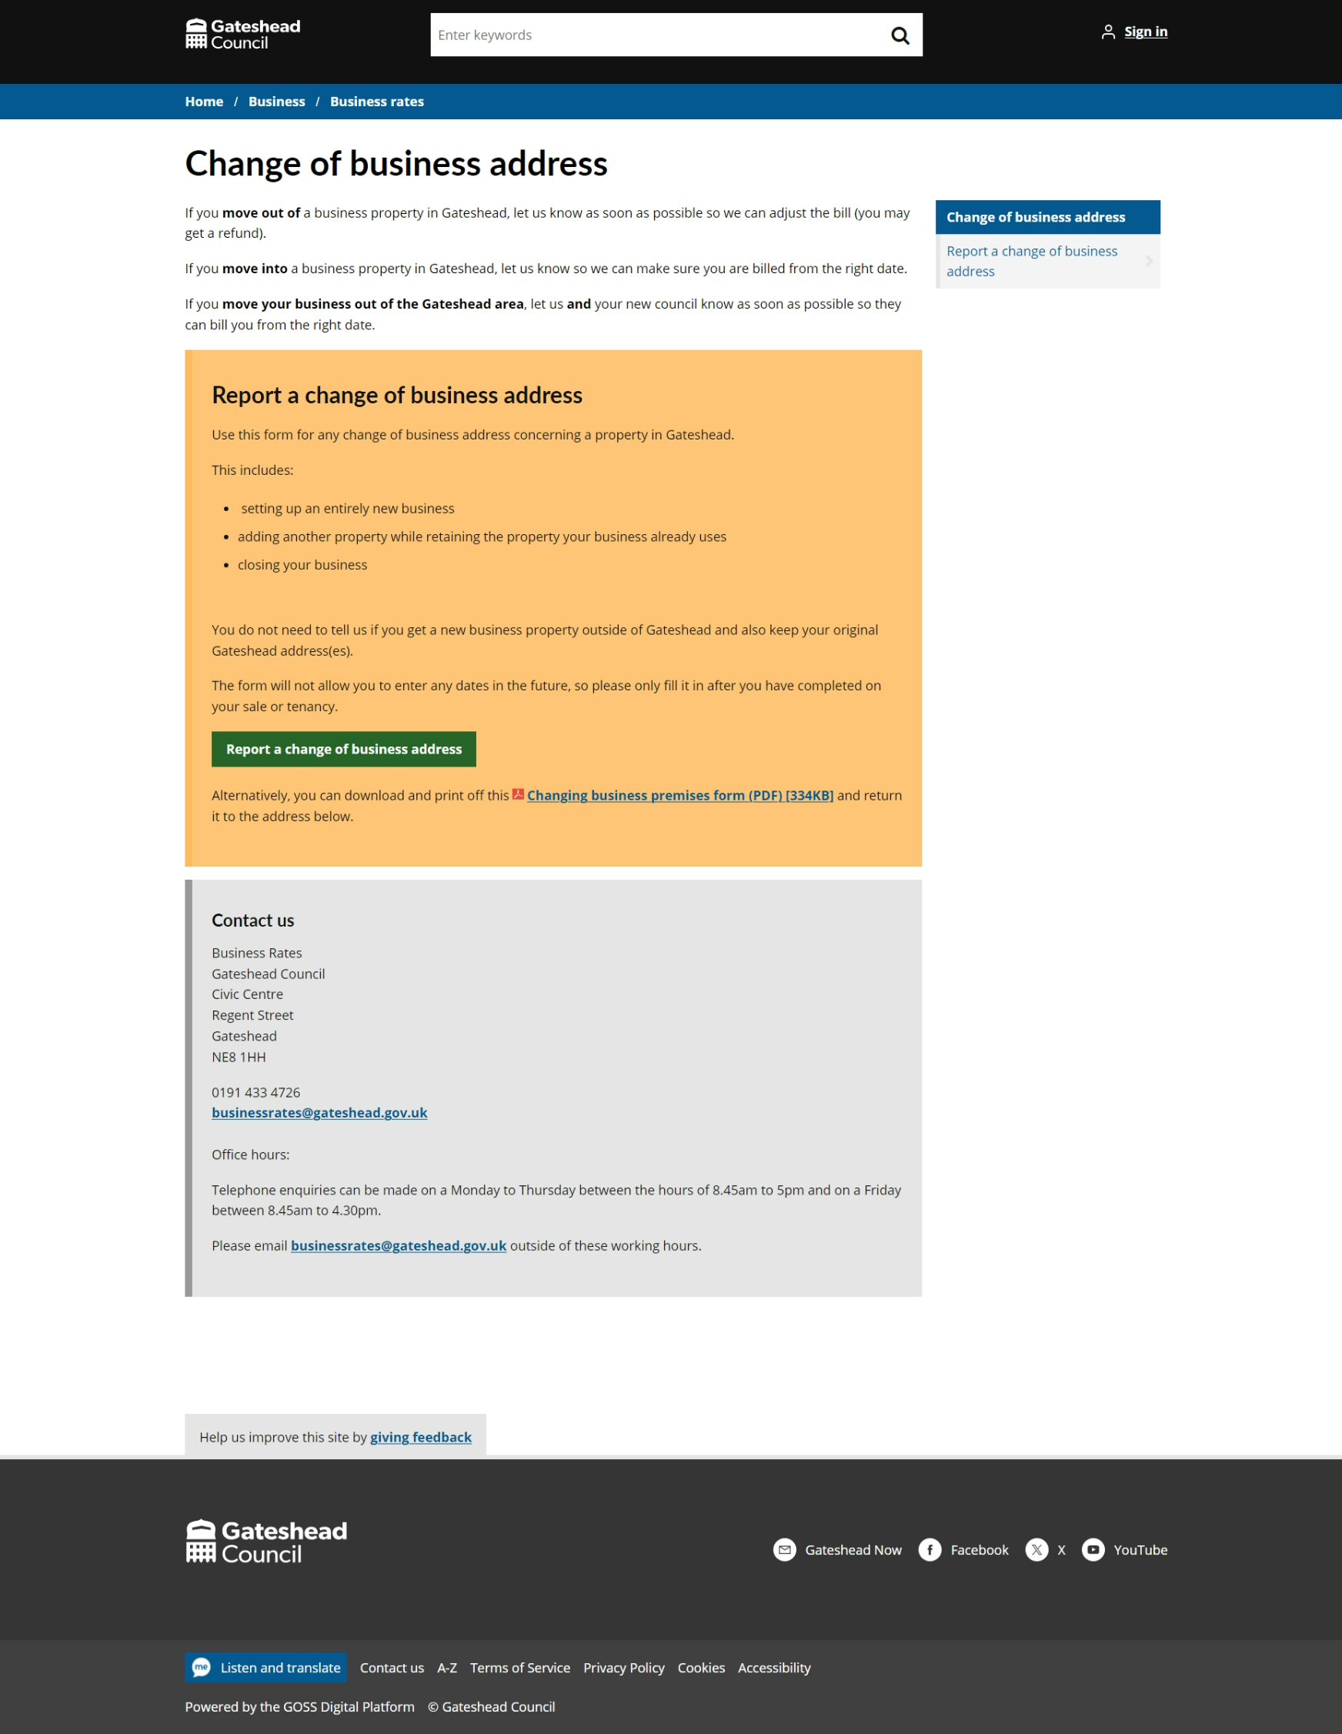
Sprint 17.
Content and wireframing
Business rates change of address – content and form on Preprod and sent to service for UAT

Slide 11
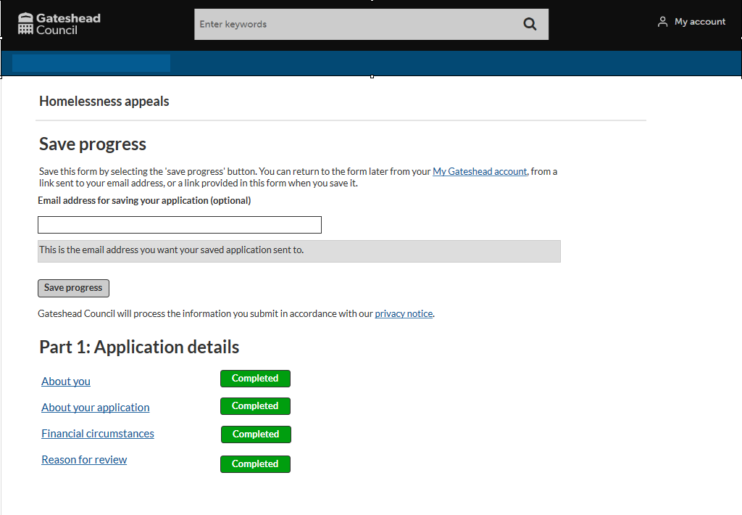
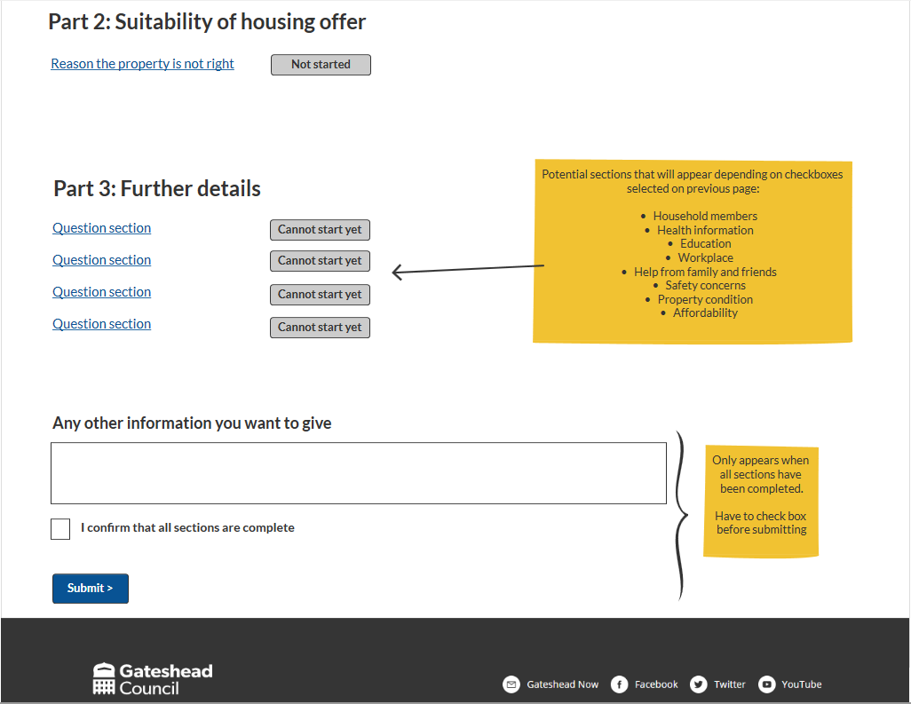
Sprint 17.
Content and wireframing
Homelessness review wireframe (cont.)

Slide 12
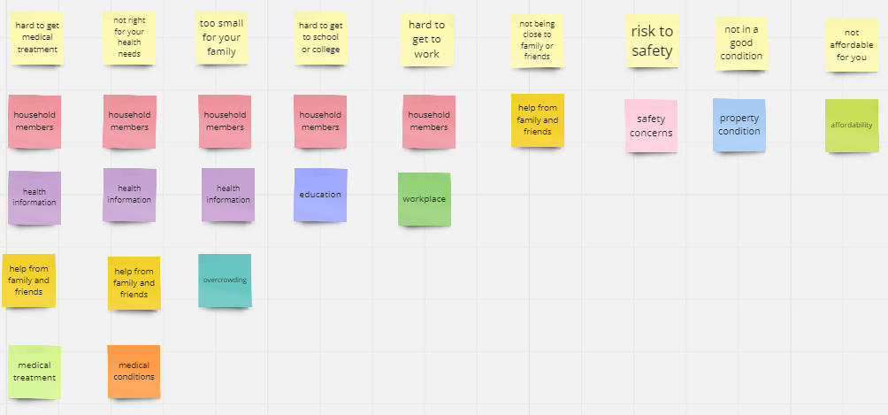
Sprint 17.
Content and wireframing
Homelessness review wireframe (cont.)

Slide 13
Sprint 17.
Training
Corporate complaints, web structure / content and case management

Slide 14
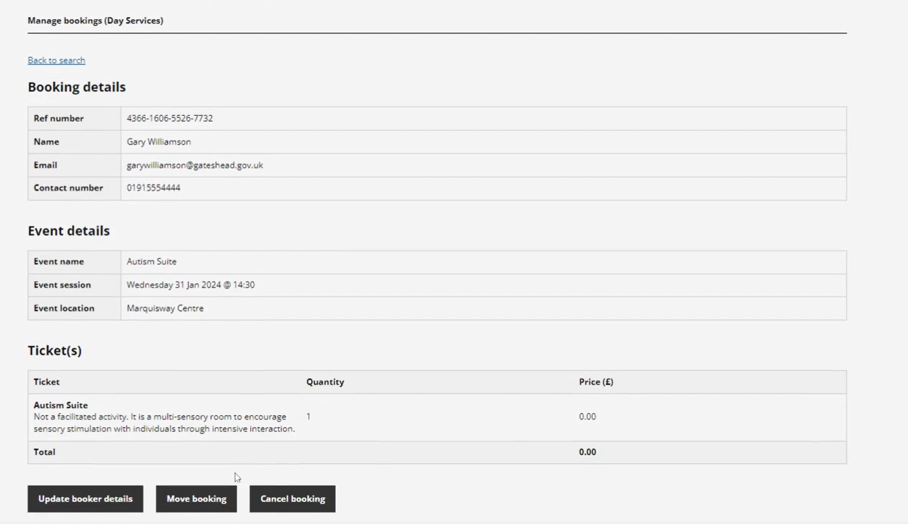
Sprint 17.
Training
Day Services – how to videos

Slide 15
Sprint 17.
Development
In year school transfers
Form updates to improve instructions and user journeys
Workflow updates to improve closing cases, expiring tasks, and service and user notifications.
HR Payroll
Form changes to line up with recent HMRC changes.
Validation bug fixes
Gateshead Energy Company
Additional work on styling (accordions, hover colours)
Preparation for content
Contact form development for Case Manager.

Slide 16
Sprint 17.
Development
Blue Badges
Allow staff to mark applications as 'Not for reassessment' in short form (automatically picked up when badge is created)
Ask all applicants to supply a photograph with their application (except if they have a DS1500)
Creation of a filtered My Activities screen
Swap a bin – add a collect information task
Bewicks order form – Update the menu items
Financial assessment – fix where the applicant's name was sometimes showing twice
Household Support Fund – Processing of applications
Damp and Mould
Update to allow the reports to show on a map
Correction to back button logic

Slide 17
Sprint 17.
Development
Payment process improvement (DC)
Business rates change of address - ‘Check your answers’ edit (DC)

Slide 18
Sprint 17.
What's next?
Council Tax discount / disregard wireframe
Complaints process development
Gateshead District Energy Scheme – CRM process mapping
Homelessness review – form development

