Slide 1
Sprint 16 Show and Tell 31/01/2024
C Squad
Digital Team

Slide 2
Sprint 16
Discovery
New bins
Miro board
Engage as-is map
Direct payments
Definition of ready for discovery
Care cost calculator
Damp and mould reports – case management
Highways licensing meeting

Slide 3
Sprint 16
Design
Libraries events – What's on styling for Customer Contact
Libraries events – Amended bookings page on Customer Contact
Intranet – Created new homepage icon for Job Evaluation
Gateshead Theme – Fixed colour contrast issue with links in success messages
Safeguarding website – Began work on switching the site to the Dynamic theme
Google Data Studio – Created a dashboard for the Gateshead Exchange section
Google Analytics – Added page load times tracking to the Customer Contact site

Slide 4
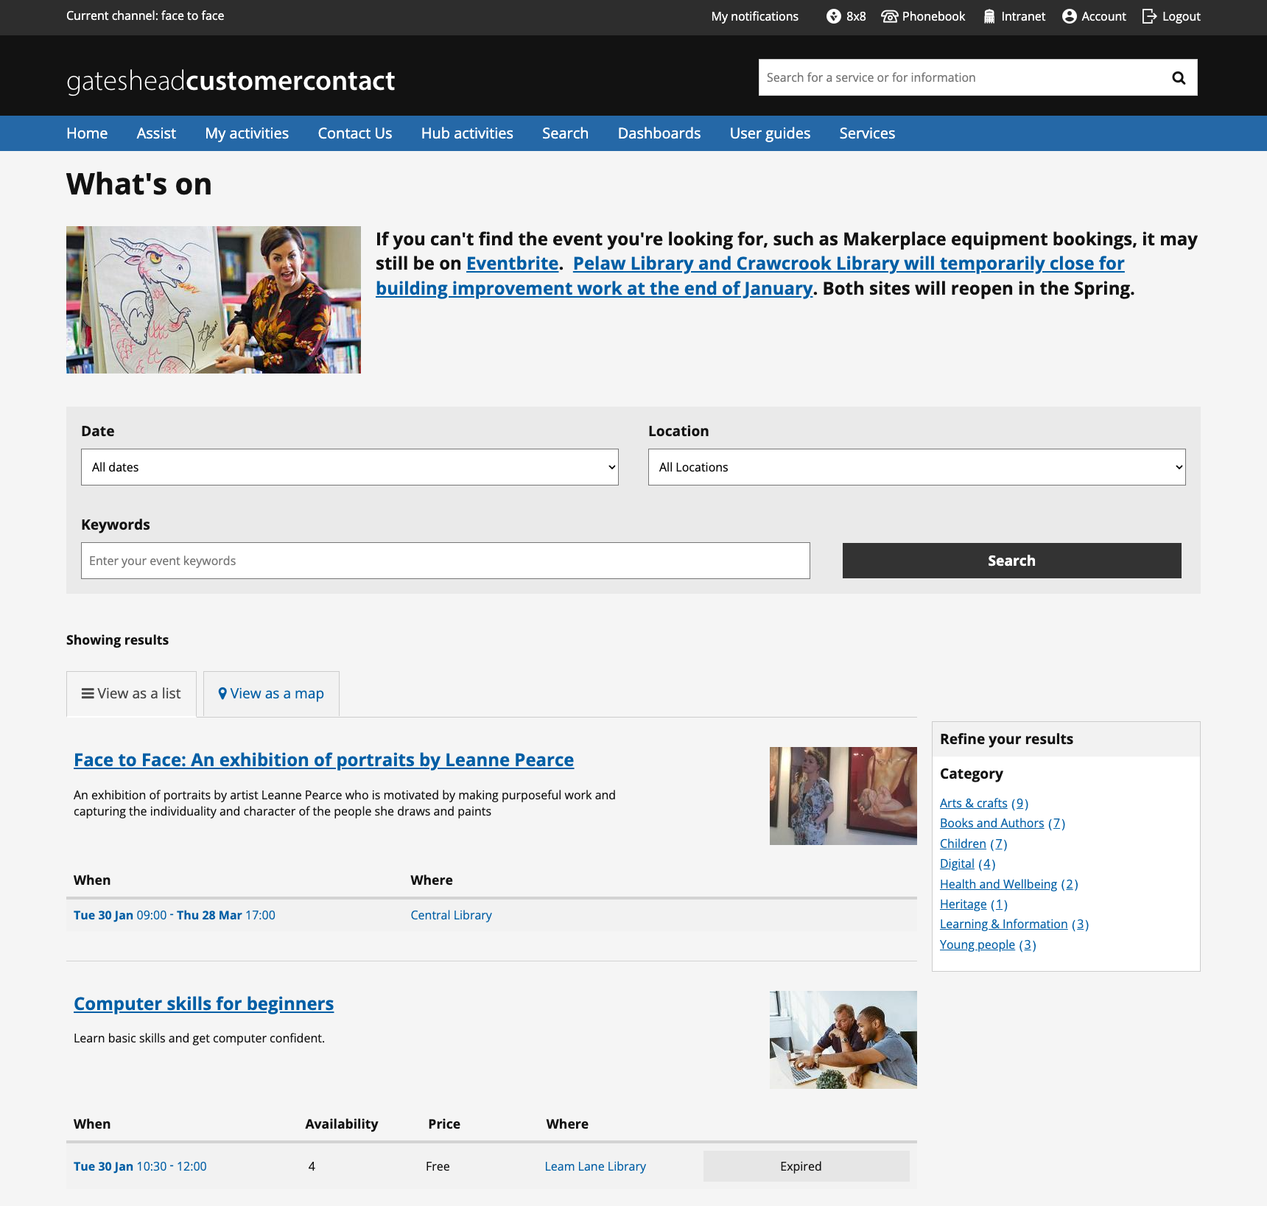
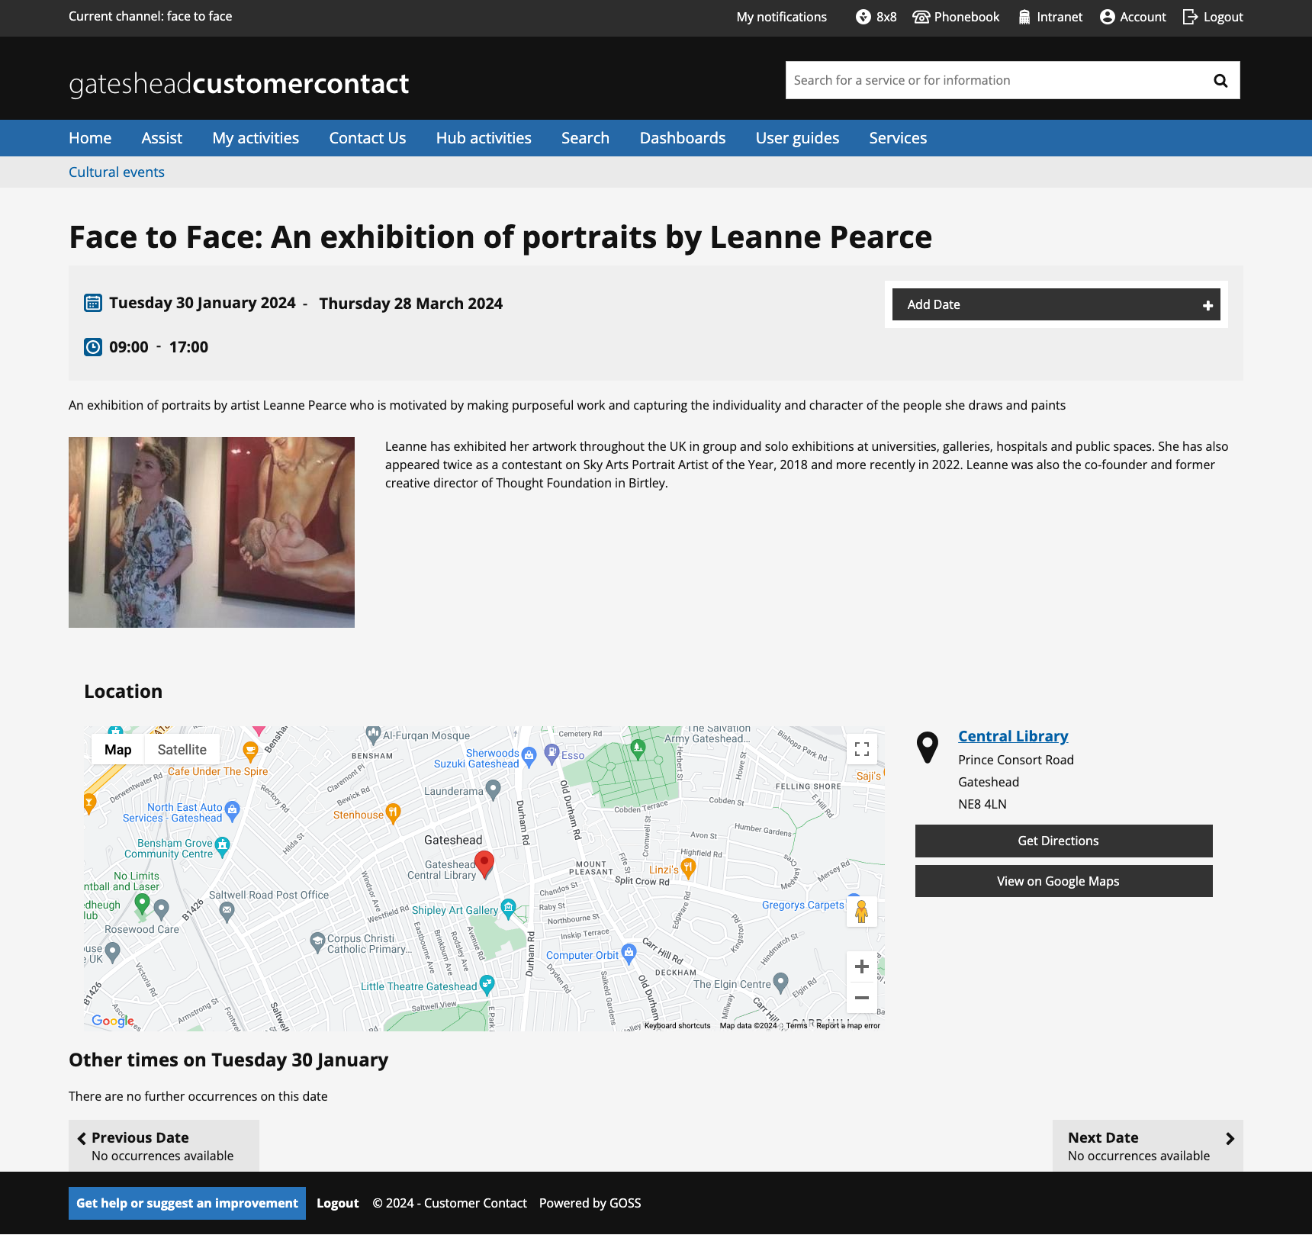
Libraries events – What's on styling for Customer Contact
Update layout to match Gateshead site
Separate styling from the HWRC bookings

Slide 5
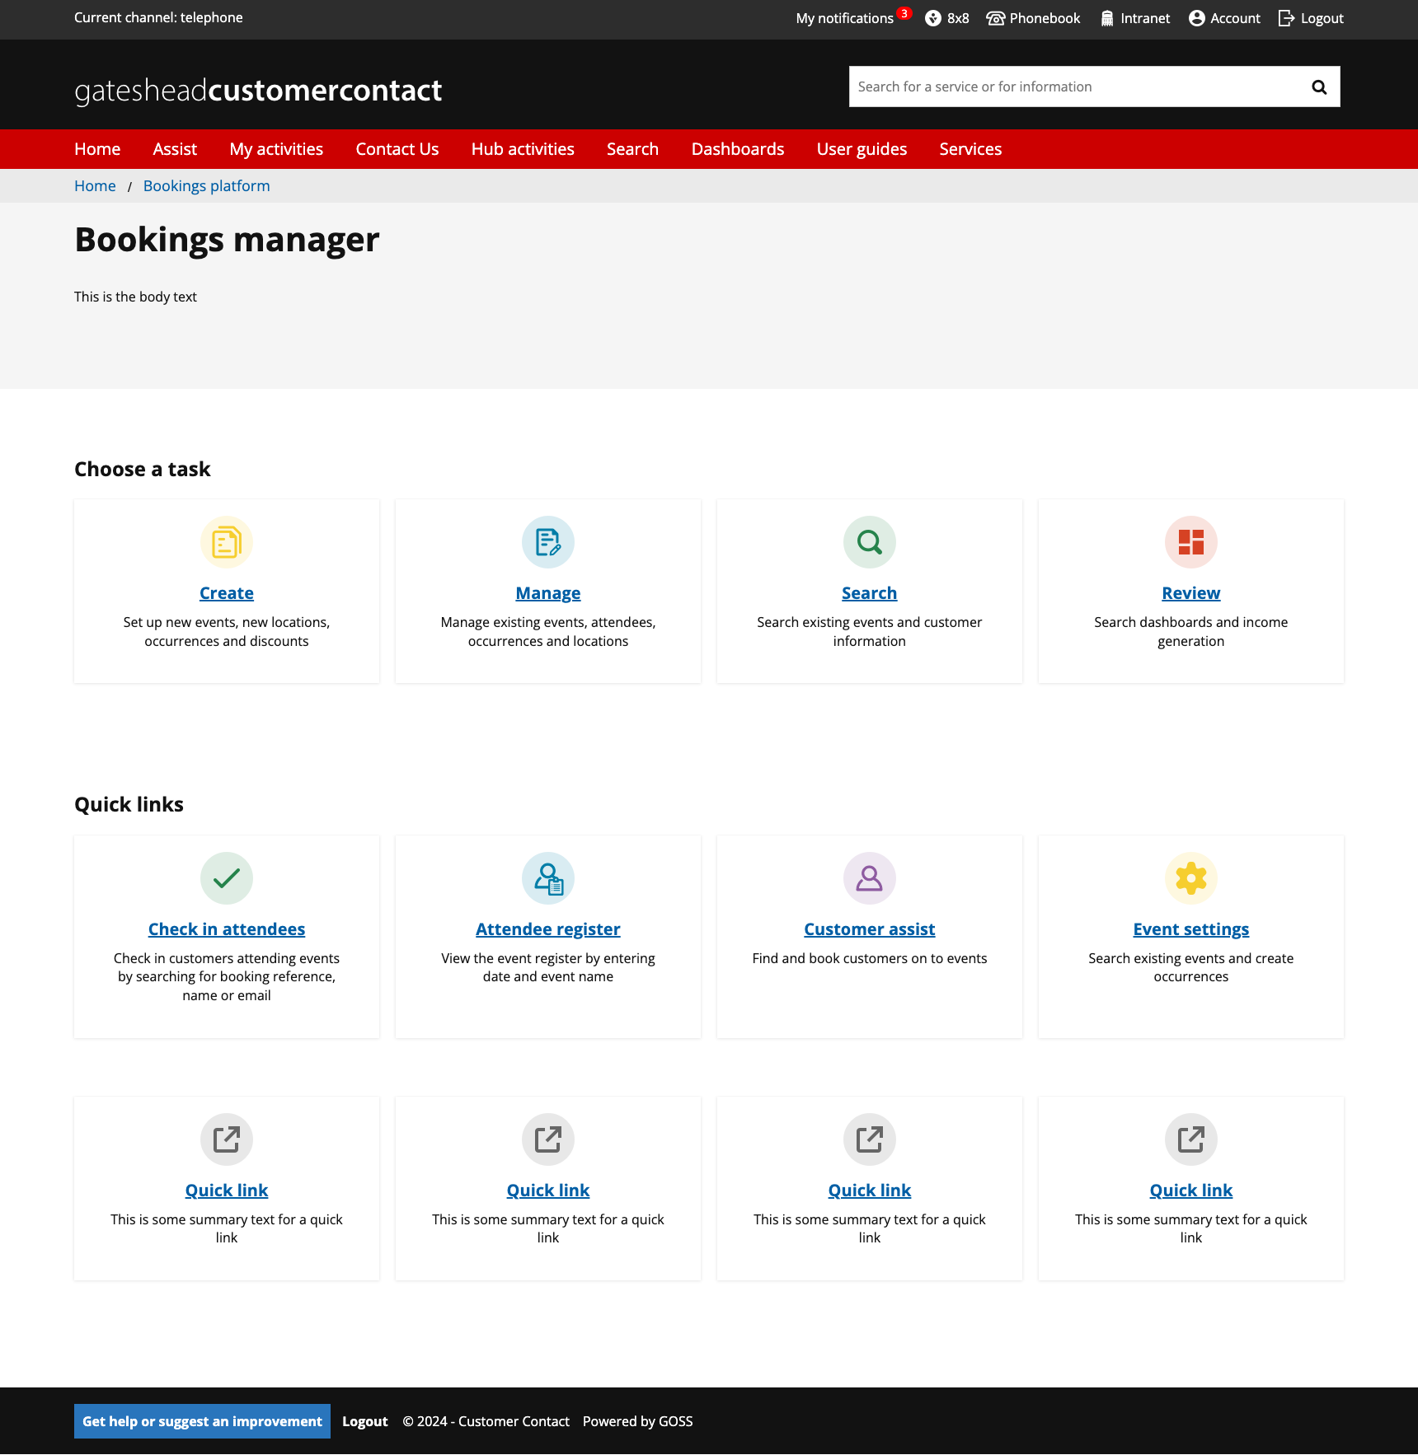
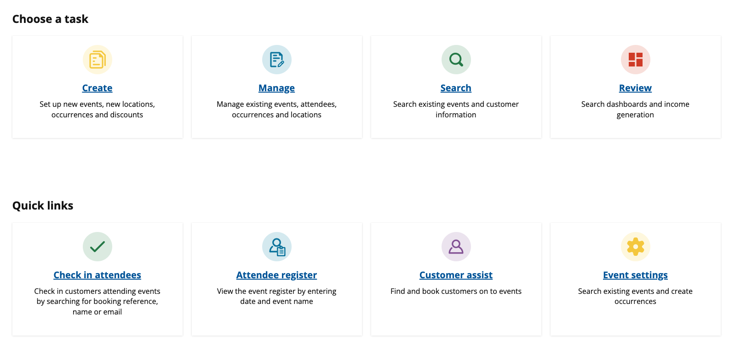
Libraries events – Amended bookings page on Customer Contact
Change page layout using panel template to match wireframe
Add icons and restyle the page

Slide 6
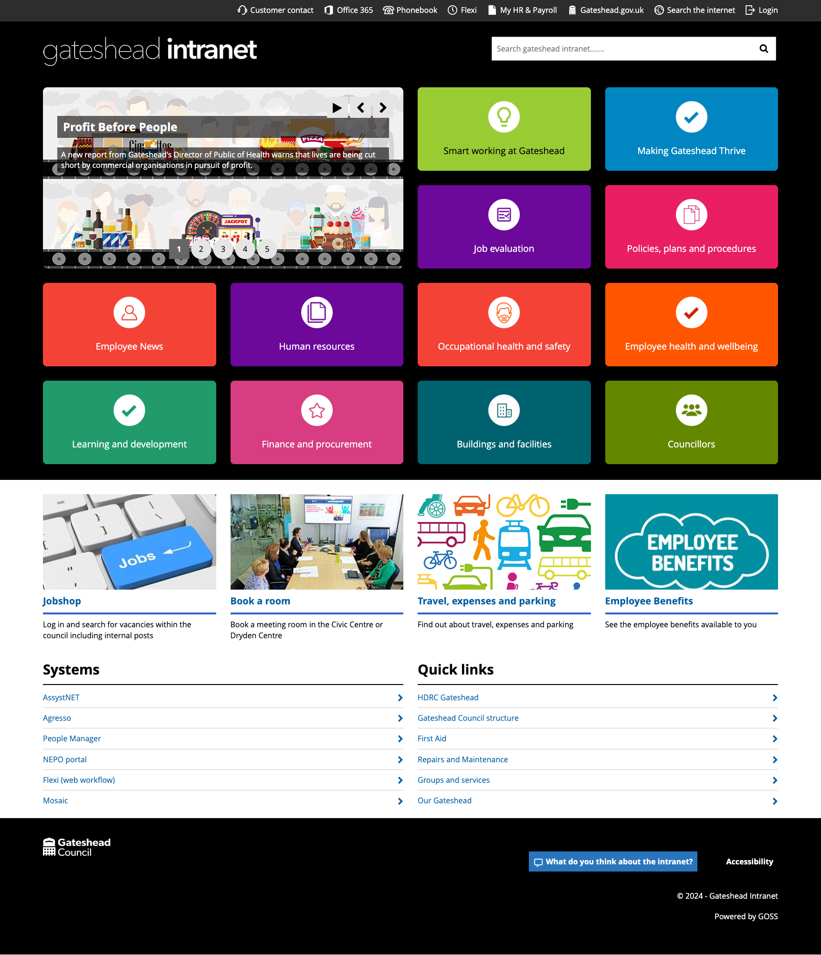
Intranet – Created new homepage icon for Job Evaluation

Slide 7
Gateshead Theme – Fixed colour contrast issue with links in messages
Updated CSS to improve colour contrast
Remove the need for a CSS class on the link

Slide 8
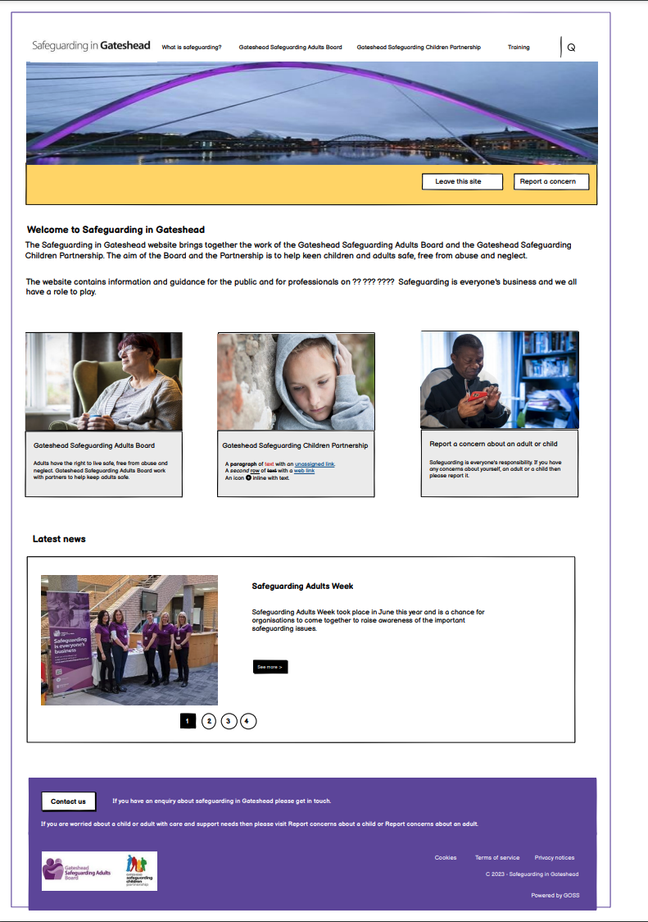
Safeguarding website – Began work on switching the site to the Dynamic theme
Started CSS to update site to Dynamic
Not in a state to show at the moment. Coming soon!
Existing Safeguarding website
Wireframe

Slide 9
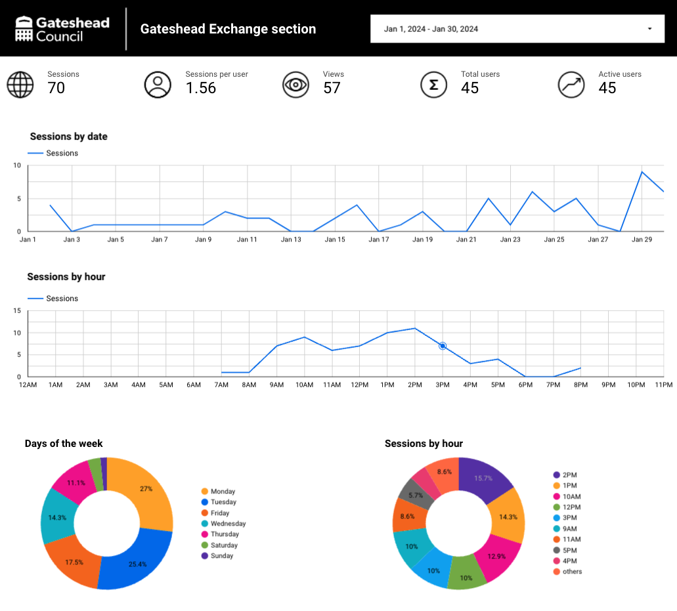
Google Data Studio – Created a dashboard for the Gateshead Exchange section
Duplicated existing section dashboard
Added sessions by hour of the day
https://lookerstudio.google.com/s/gtECxznlszA

Slide 10
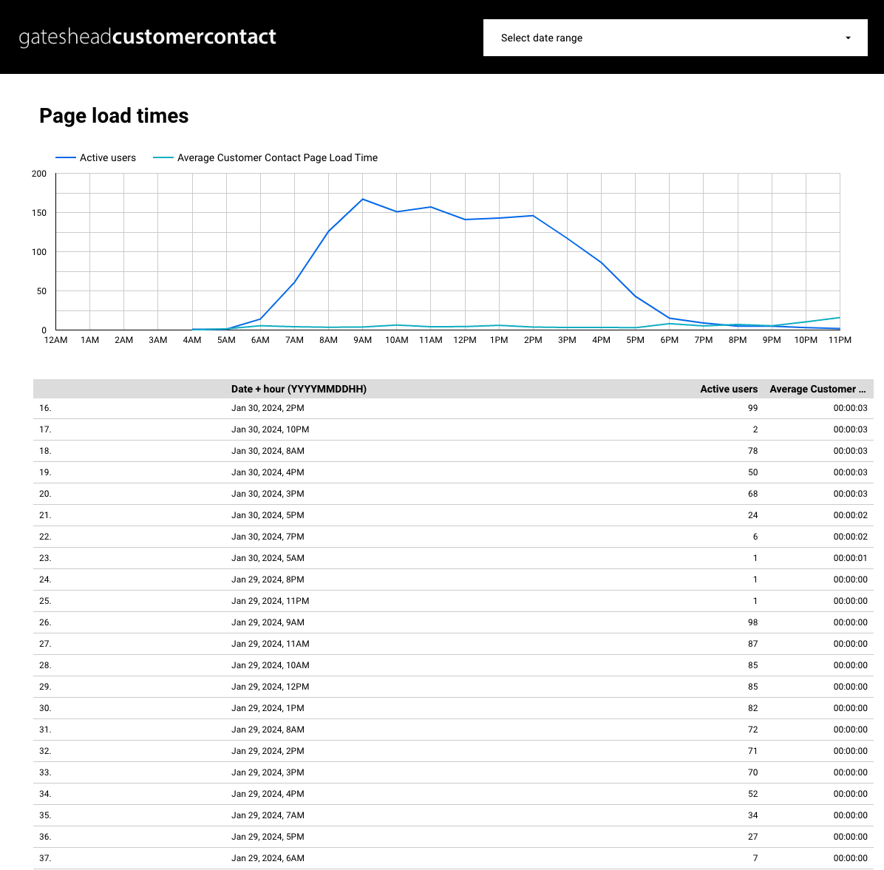
Google Analytics – Added page load times tracking to the Customer Contact site
Replicated the page load times tracking from gateshead.gov.uk
https://lookerstudio.google.com/s/j3tXLWs0_e0

Slide 11
Sprint 16
Content
Improvements to Bookings Manager layout on Customer Contact
Current view of Bookings manager on prod
View of new Bookings Manager on pre-prod
Kinship care webpage design update, wireframe completed
Right Care, Right Person providers' guidance
Family Voice contact us form wireframe
Job Evaluation intranet content
Garden Waste reminder email
Updates to Garden Waste webpages and confirmation emails ready for price change on 1 February
Updated Care Call web content

Slide 12
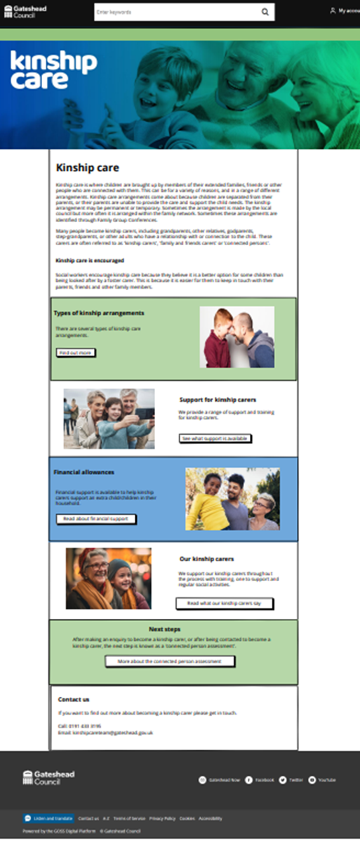
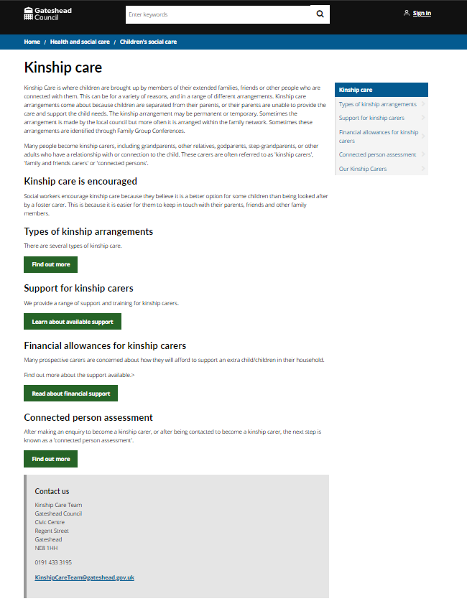
Kinship care
Children's services requested a refresh of kinship care web pages so that they are more engaging and match our fostering web pages.
Wireframe completed using panel template. Work to be done in next sprint.

Slide 13
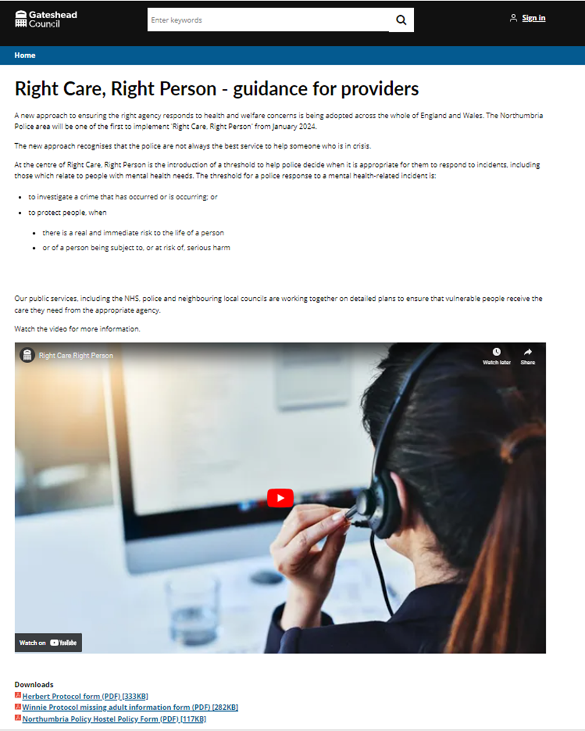
Right care, right person providers guidance
Right Care, Right Person guidance added on hidden part of the website for providers and professionals dealing with missing persons.

Slide 14
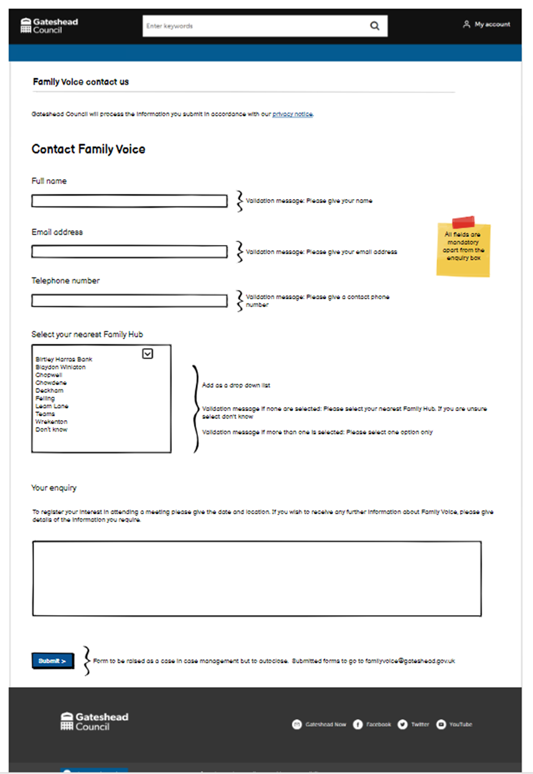
Family Voice
Family Voice is a new parent and carer engagement group to give feedback on Family Hubs. Meetings dates for the year added to the website in the last sprint. Request made for a contact form. Wireframe completed for work to be done in a future sprint.

Slide 15
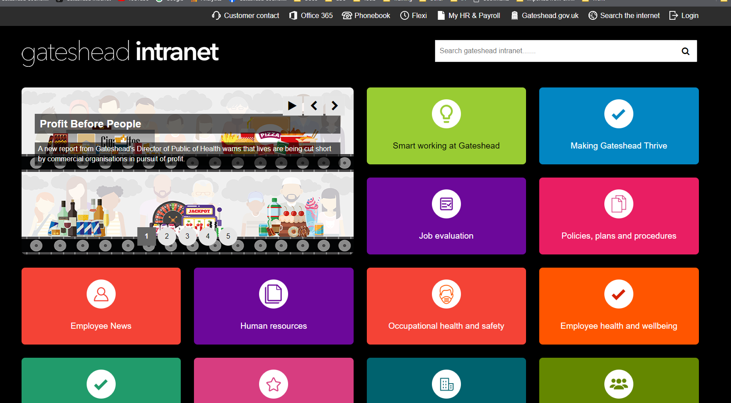
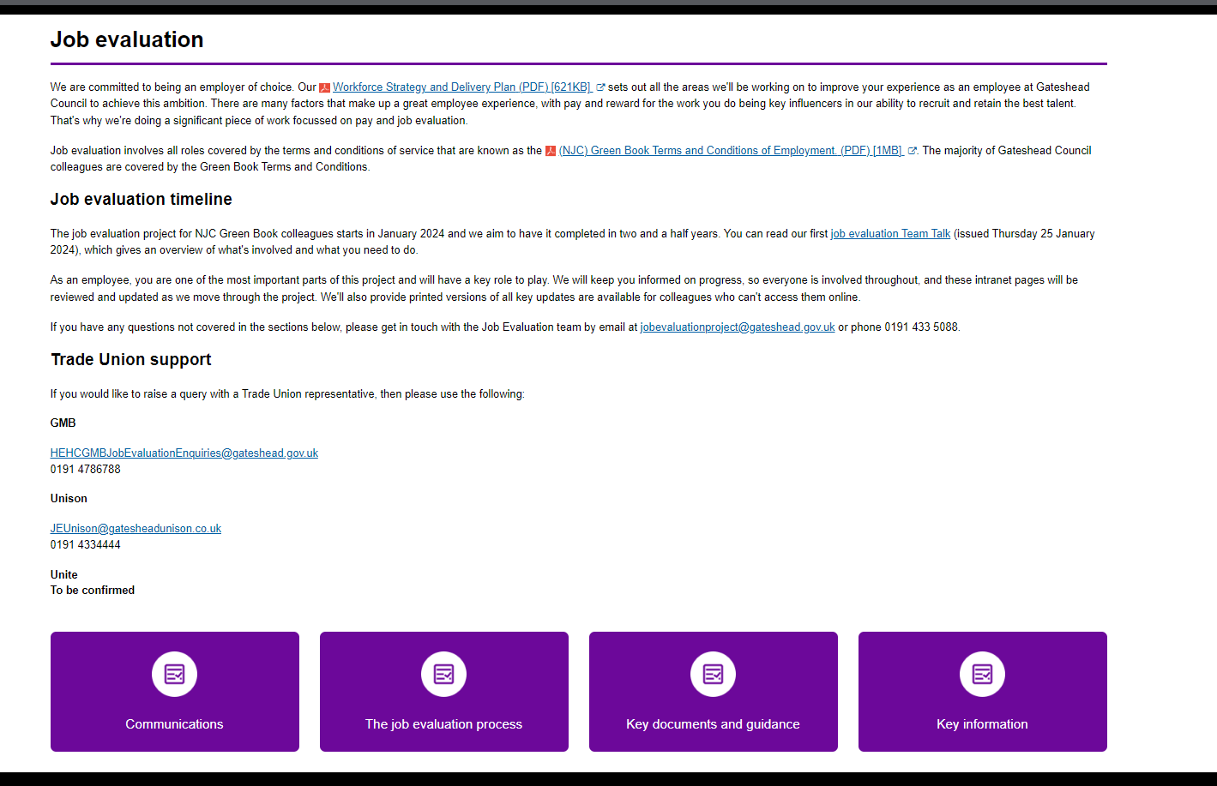
Job Evaluation
New section on the intranet for Job Evaluation, linked from the homepage and within the HR section

Slide 16
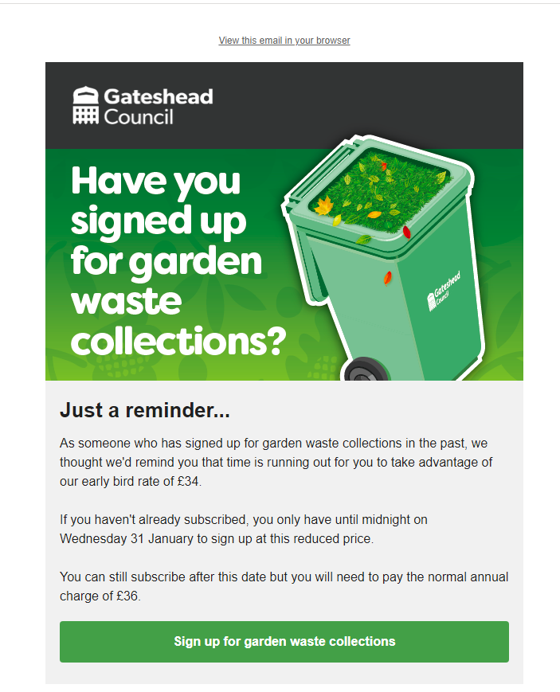
Garden Waste reminder email
Sent to all who have subscribed in previous years but haven't yet signed up to this year – reminding them of the price increase on 1 February.
1495 have subscribed since the email was sent on Monday 29 January.

Slide 17
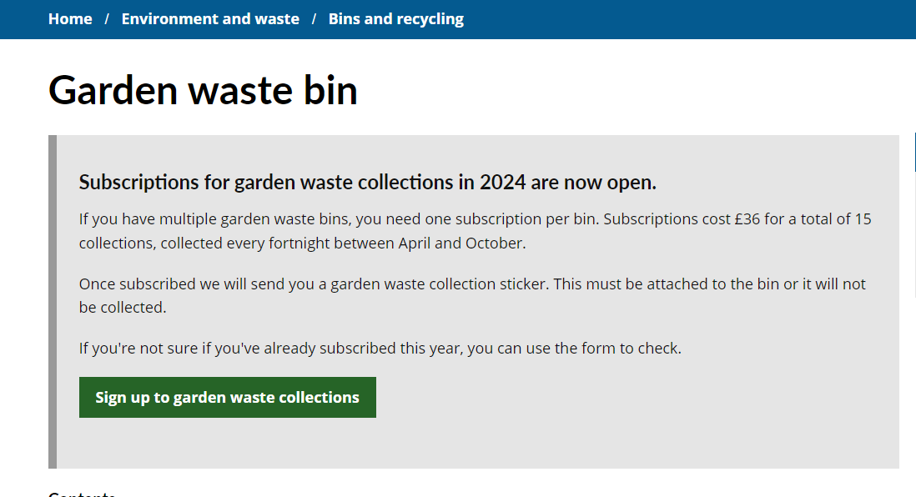
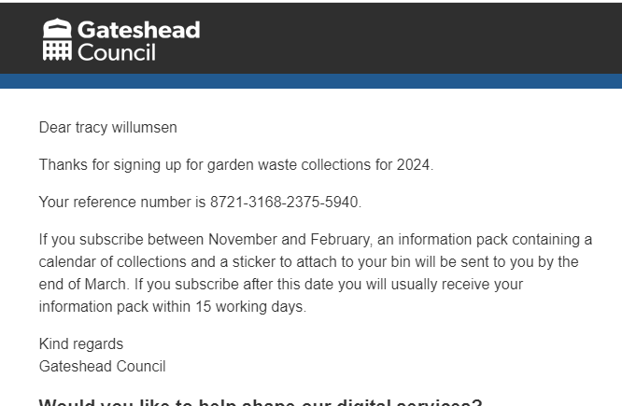
Updates to Garden Waste webpages and confirmation emails ready for price change on 1 February
The email has changed to show different dates for when you can expect your pack and sticker, dependent on when you subscribe

Slide 18
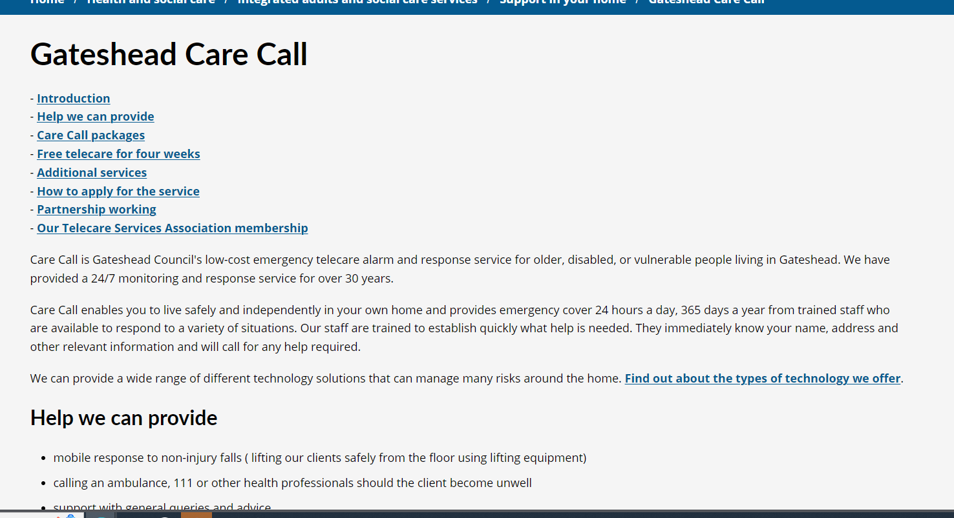
Updated Care Call web content
www.gateshead.gov.uk/carecall
New content added to highlight the types of technology available to customers, and updated content about the service.
Also added information about Telecare Services Association membership including call response, mobile response, and installation figures for the last year.

Slide 19
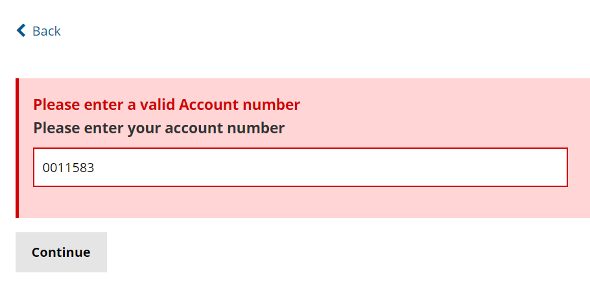
Sprint 16
Development
Open cases investigation (spike)
Homecare and day services form amends

Slide 20
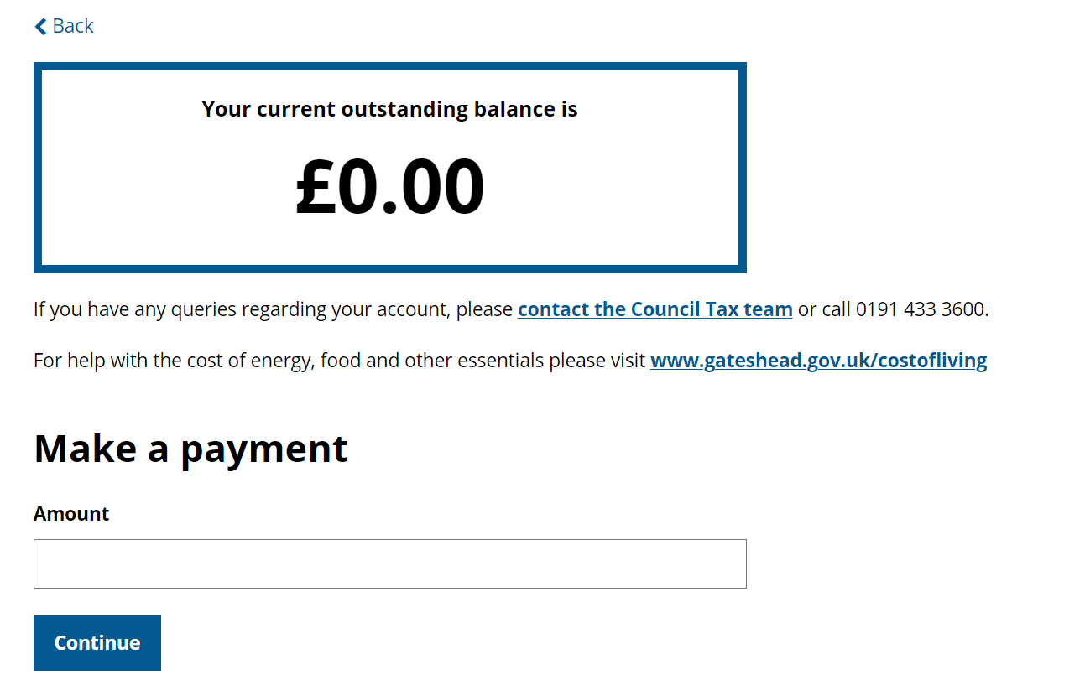
Development
Text update on council tax balance screen

Slide 21
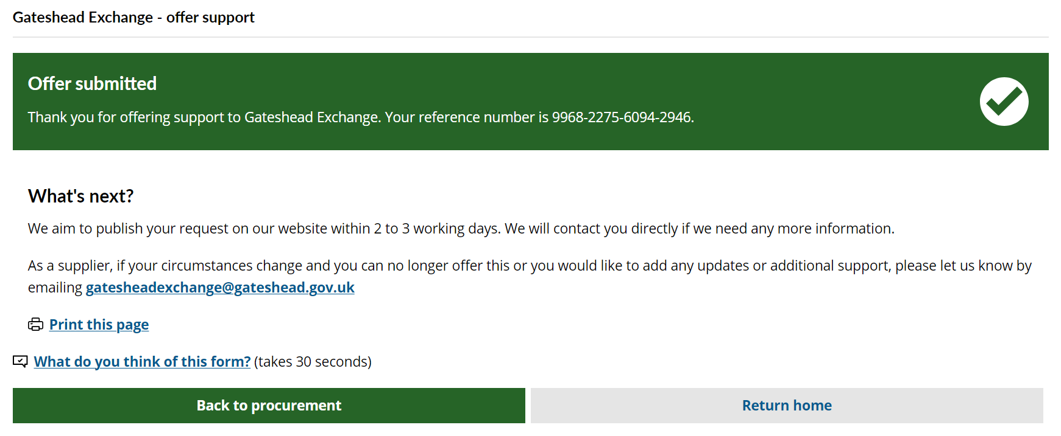
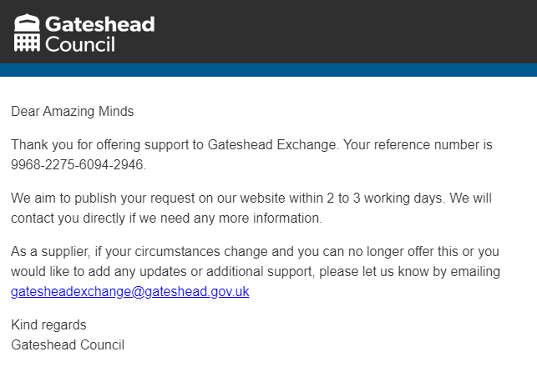
Development
Gateshead exchange forms amends (1)

Slide 22
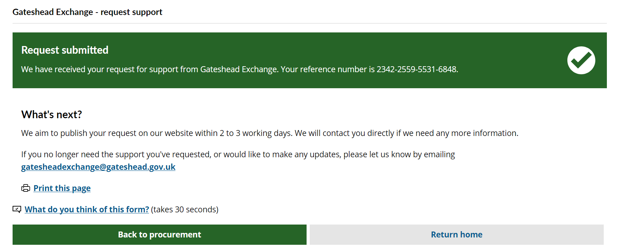
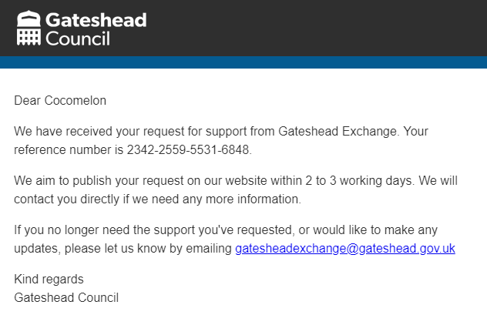
Development
Gateshead exchange forms amends (2)

Slide 23
Development
Care call self-referral form
https://gateshead.ghc2-tst.gosshosted.com/article/14752/Care-Call-request
Registrar escalation form amends

Slide 24
Development
Site feedback form update

Slide 25
Sprint 16
Testing​
Care call self-referral form
Salt bin form
Rebooking bin delivery
Home Care and Day Services form
My Gateshead Account – update your details
Digital team request
Bulky waste collection
In Year School Transfers (dev work by Liam – G squad)

Slide 26
Sprint 16
Go live

Slide 27
Sprint 16
BAU/ Other tasks
Emergency Response Team training (Helen)

Slide 28
What's coming up in Sprint 18
Discovery Direct Payments
Registrars
Financial Assessment Calculator
Content February half term activities Kinship care web page update
Design/Data
Trial alternative web analytics products Safeguarding website Form Design Standards
Development
Family Voice contact us form
Benefits overpayment form update
Freedom of information form update

Slide 29
Sprint 16
Deployment
DCE Report It
Bartec Waste V2
DCE Miscellaneous Payments
Gateshead Resources
Gateshead Bartec Waste Project
DCE Contact Us
DCE Business
DCE Booking Plugins
DCE Bulky Waste Collection
DCE Pest Control

