Slide 1
Sprint 20 Show and Tell 28/02/2024
C Squad
Digital Team

Slide 2
Sprint 20
Discovery
New bins
Miro board
Engage as-is map
Data analysis challenge
Apprentice application process
Engage as-is map
Gateshead District Energy Scheme – CRM request
Miro board
Winter maintenance – salt requests review
Winter maintenance dashboard

Slide 3
Sprint 20
Design
Safeguarding Gateshead – Move to PreProd and various styling amends
Digital standards - Form component style guide
Gateshead theme - RHN title not displaying correctly
Customer Contact - Add digital team request link and icon to the top navigation

Slide 4
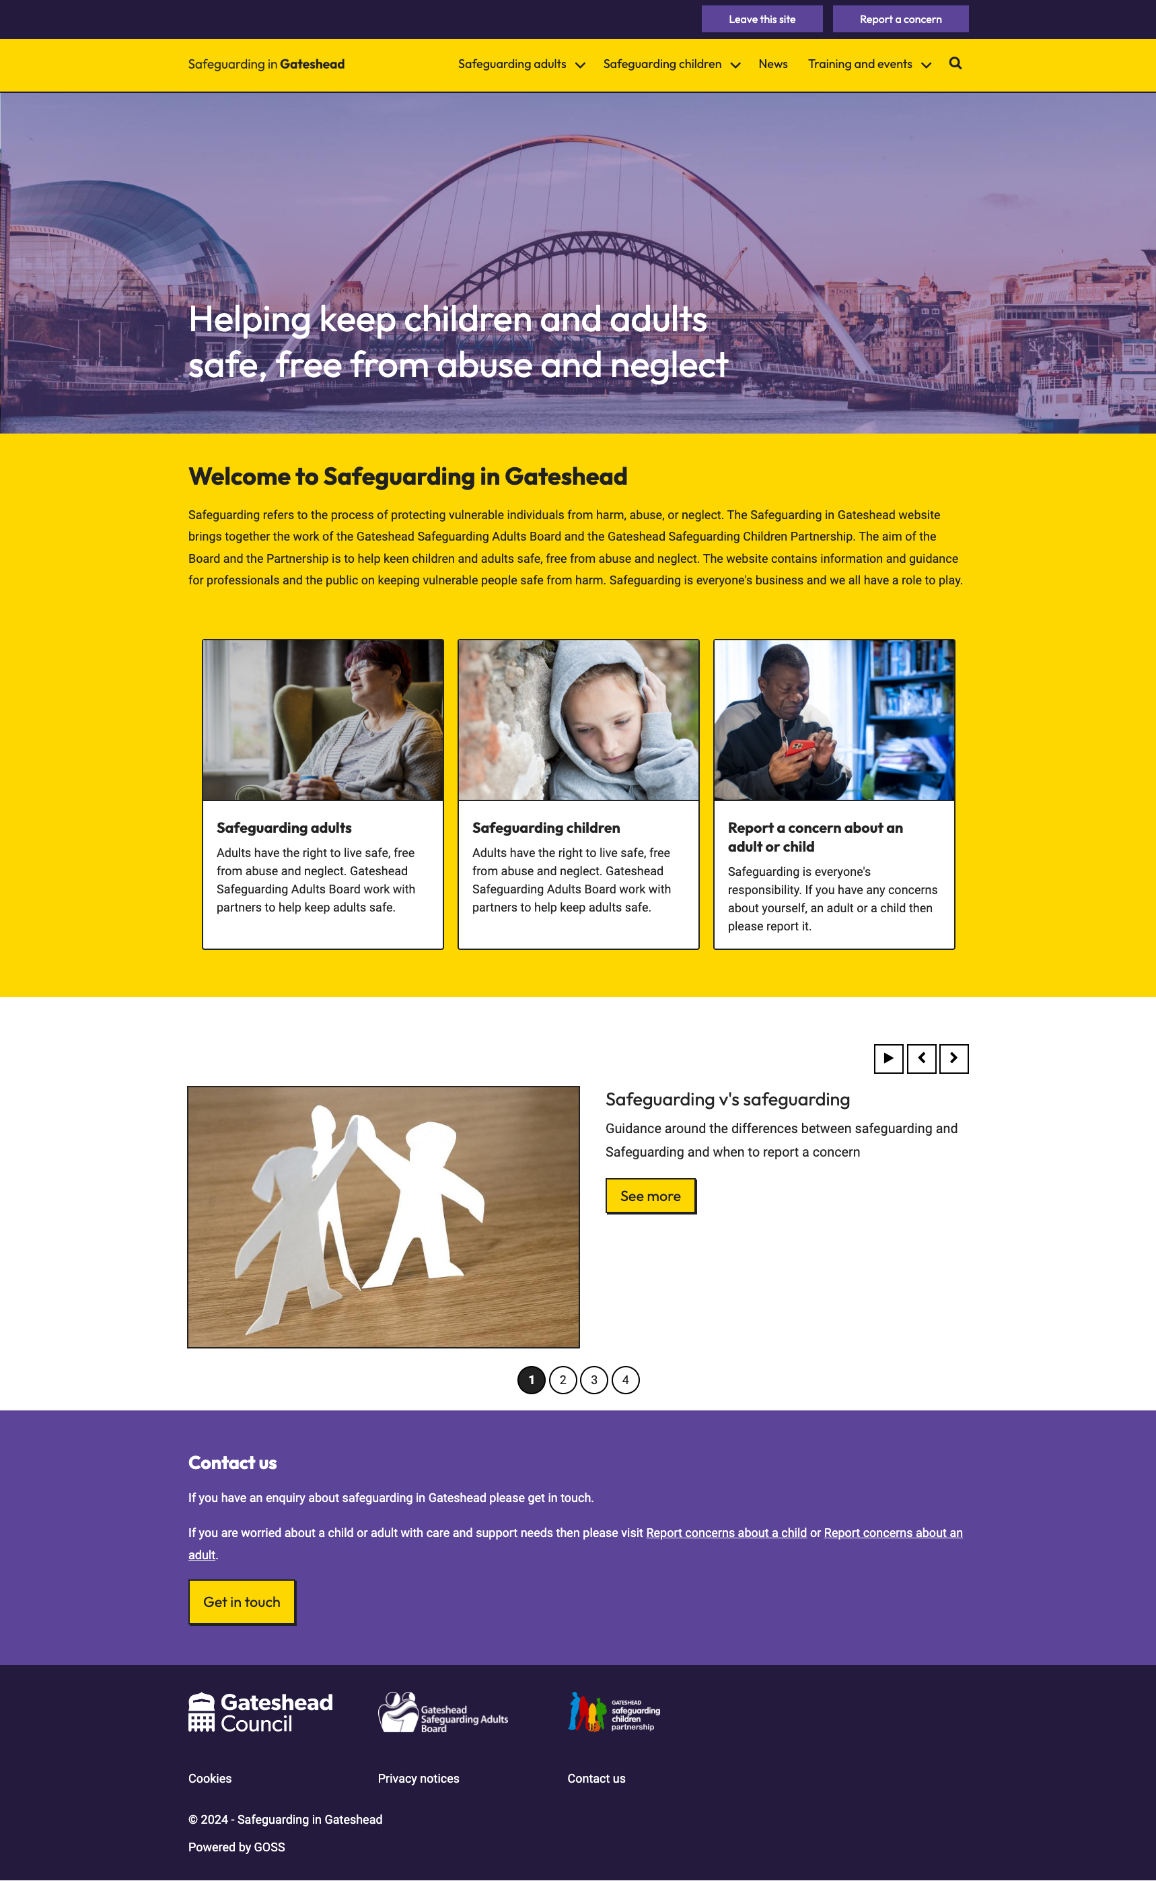
Safeguarding Gateshead
Moved the site update to PreProd
Made various styling amends
https://safeguarding.ghc2-prp.gosshosted.com/

Slide 5
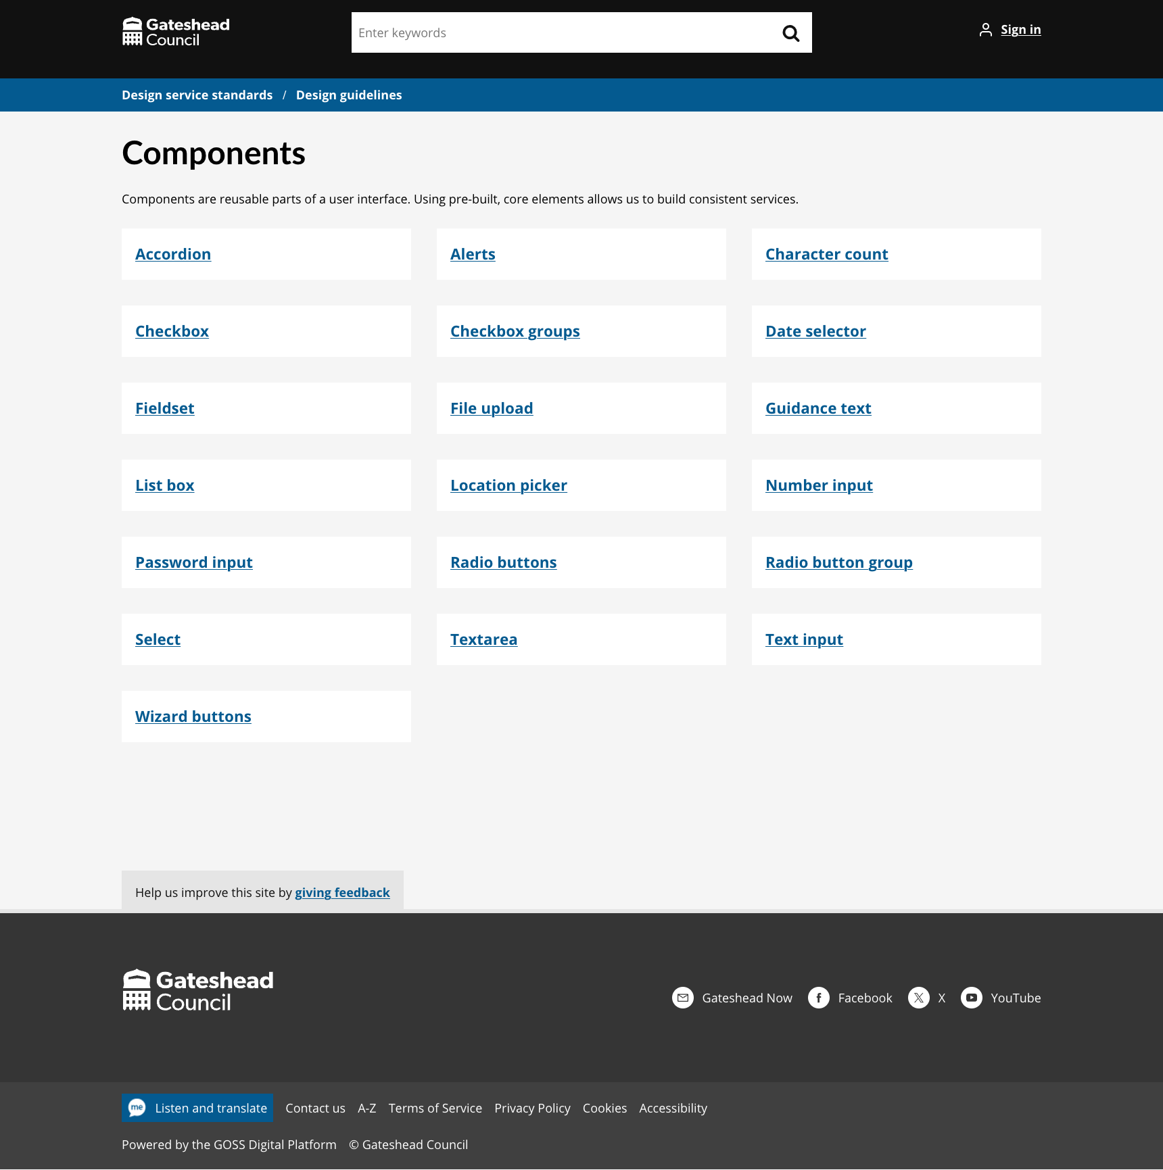
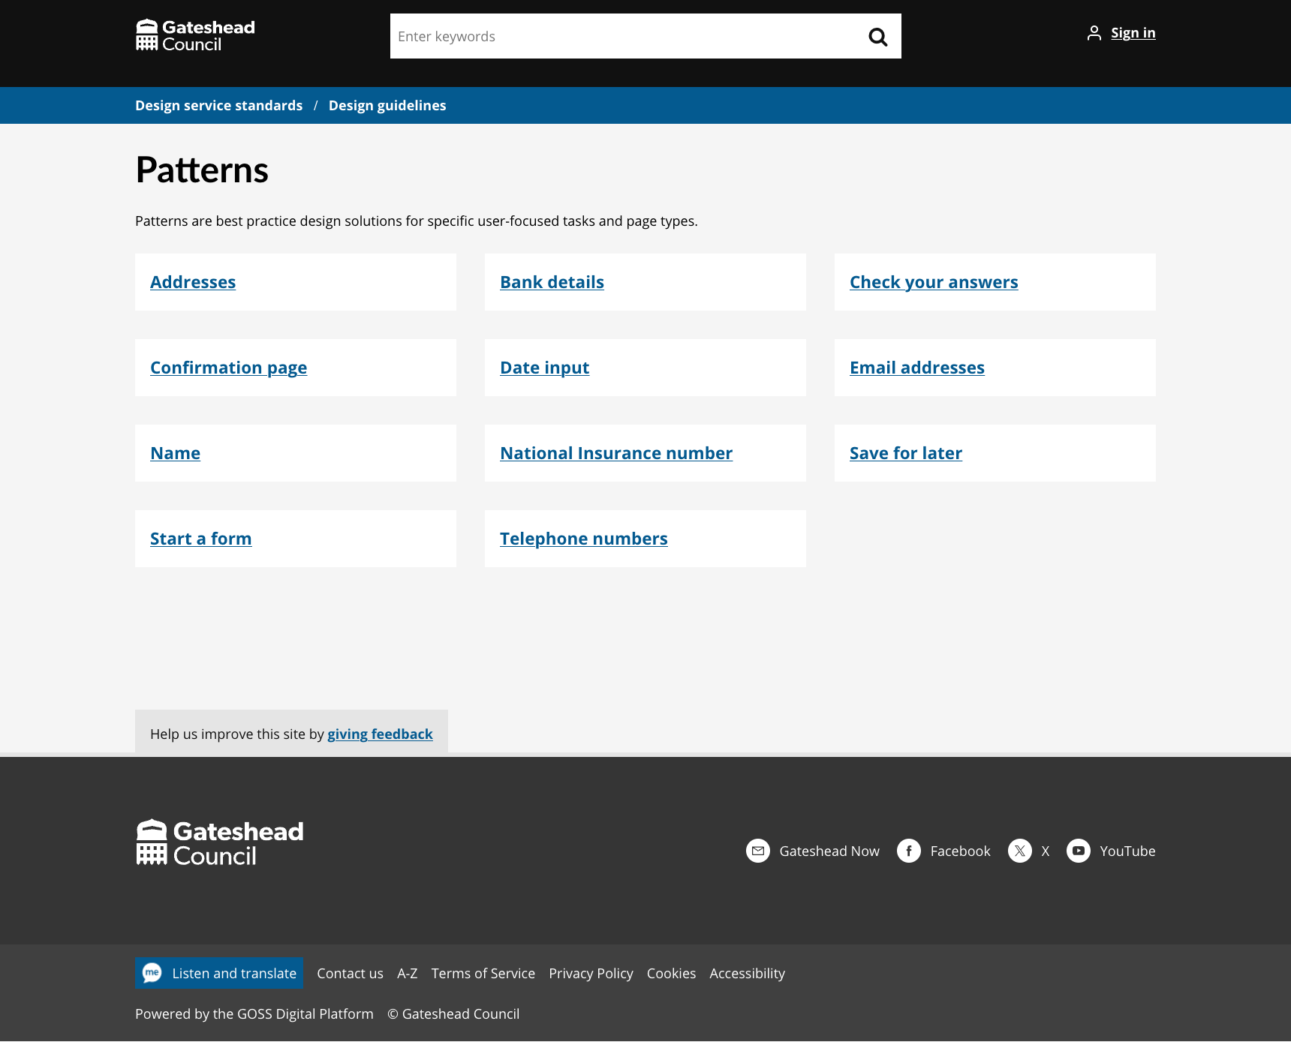
Digital standards - Form component style guide
Form components
Form patterns
https://gateshead.ghc2-dev.gosshosted.com/article/13543/Design-guidelines

Slide 6
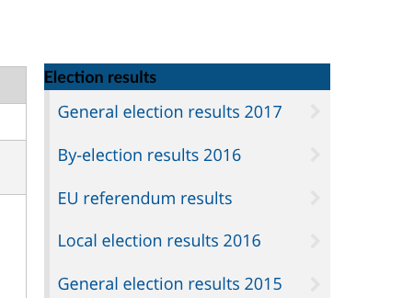
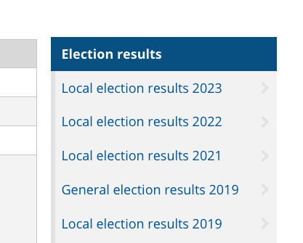
Gateshead theme - RHN title not displaying correctly
Styling issue when text is not a link
https://gateshead.ghc2-dev.gosshosted.com/article/13543/Design-guidelines

Slide 7
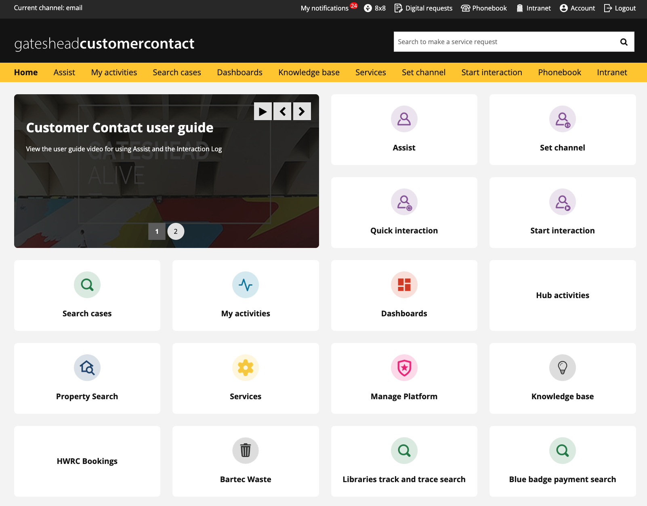
Customer Contact - Add digital team request link and icon to the top navigation
Make the Digital requests form more accessible to CSA's
On Dev/Test at the moment. Preprod and Prod soon.

Slide 8
Sprint 20
Content
Brighten the day Easter holiday clubs for free school meals families event listings and Mailchimp email
Go Gateshead Easter events added to booking system and web content created
Safeguarding website – content added to pre-prod
Intranet – Employee survey
Gateshead Now
Updated Budget information
Viewpoint email
Tynedale House – for sale
Gateshead Awards – nominations closed
Order a bin process

Slide 9
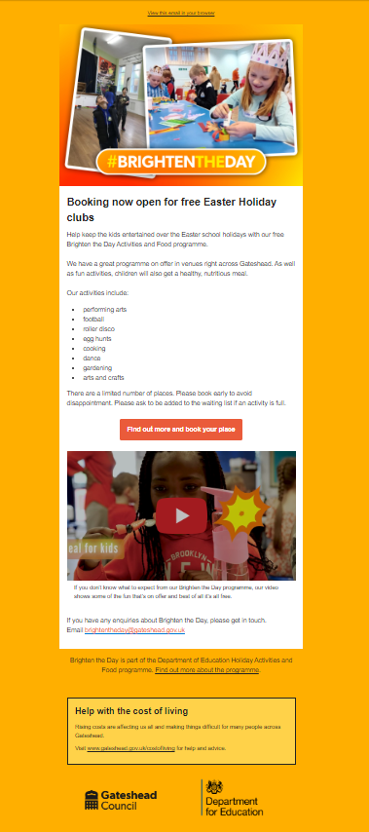
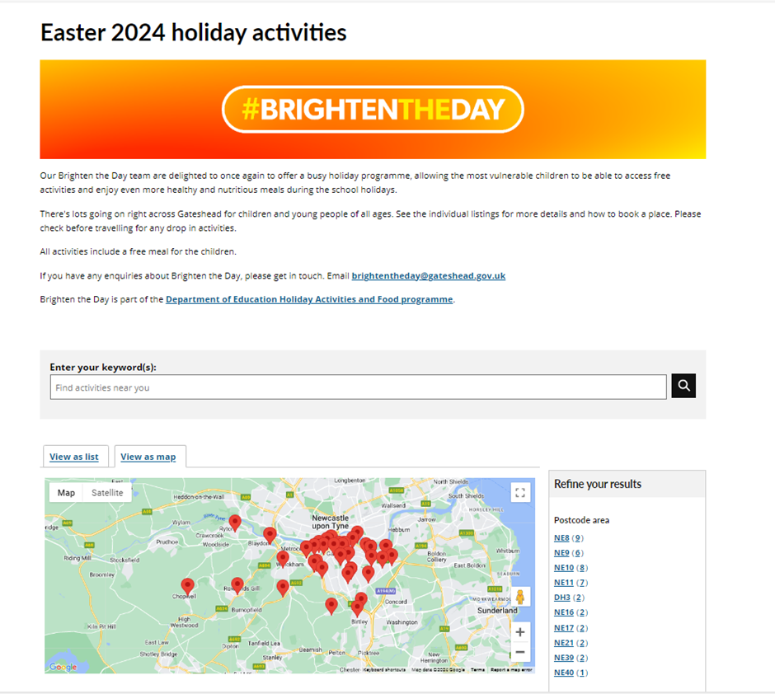
40 holiday activities events added to the website (using location template so that activities can be searched by postcode, age and date). Will be promoted via Mailchimp email to free school meals families on 29 February. Bookings open to all families from 19 March.
Brighten the Day Easter activities
Brighten the Day Easter 24

Slide 10
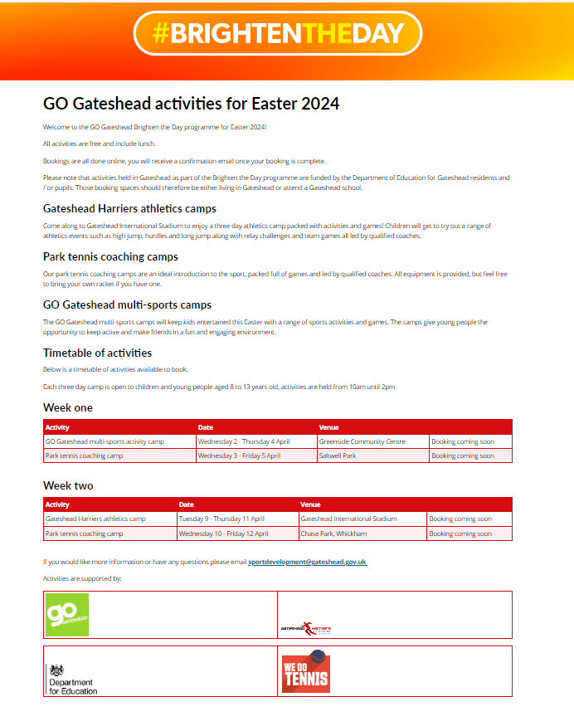
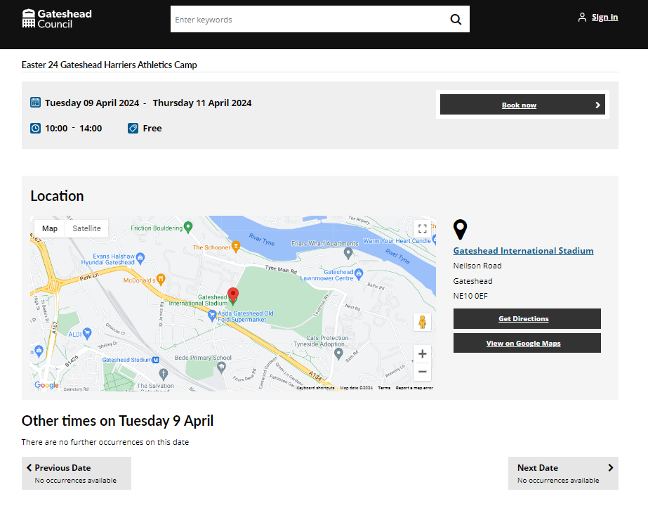
4 sports camps added to the booking system for Go Gateshead. To be promoted to free school meals families by Mailchimp email on 29 Feb.
Go Gateshead Brighten the Day Easter activities

Slide 11
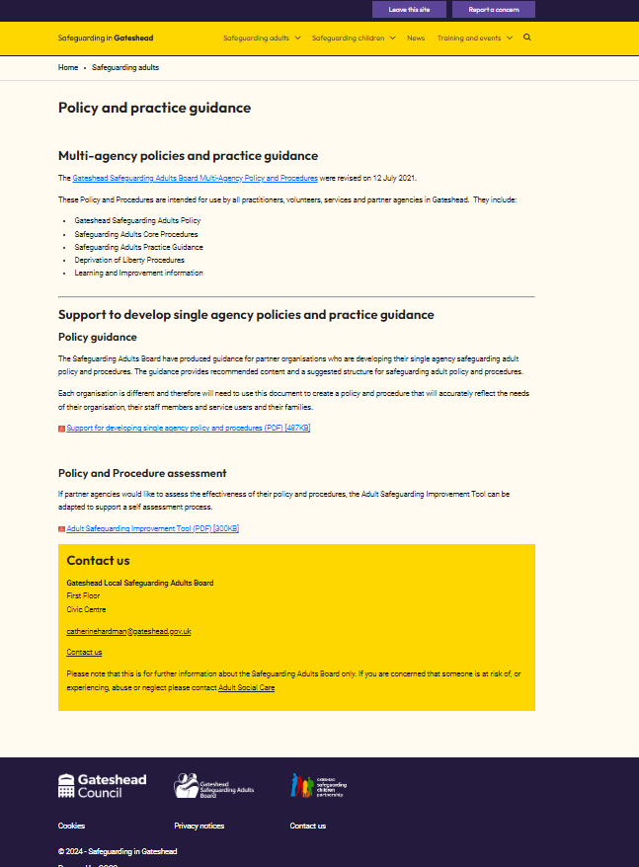
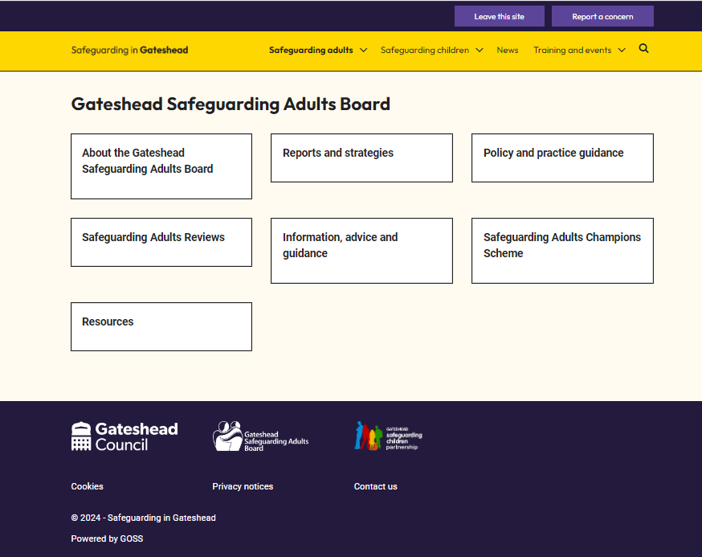
Content added in pre-prod using the new theme for Safeguarding in Gateshead website.
Safeguarding in Gateshead website
Existing site - Safeguarding in Gateshead
New draft site (in prp) - Safeguarding in Gateshead

Slide 12
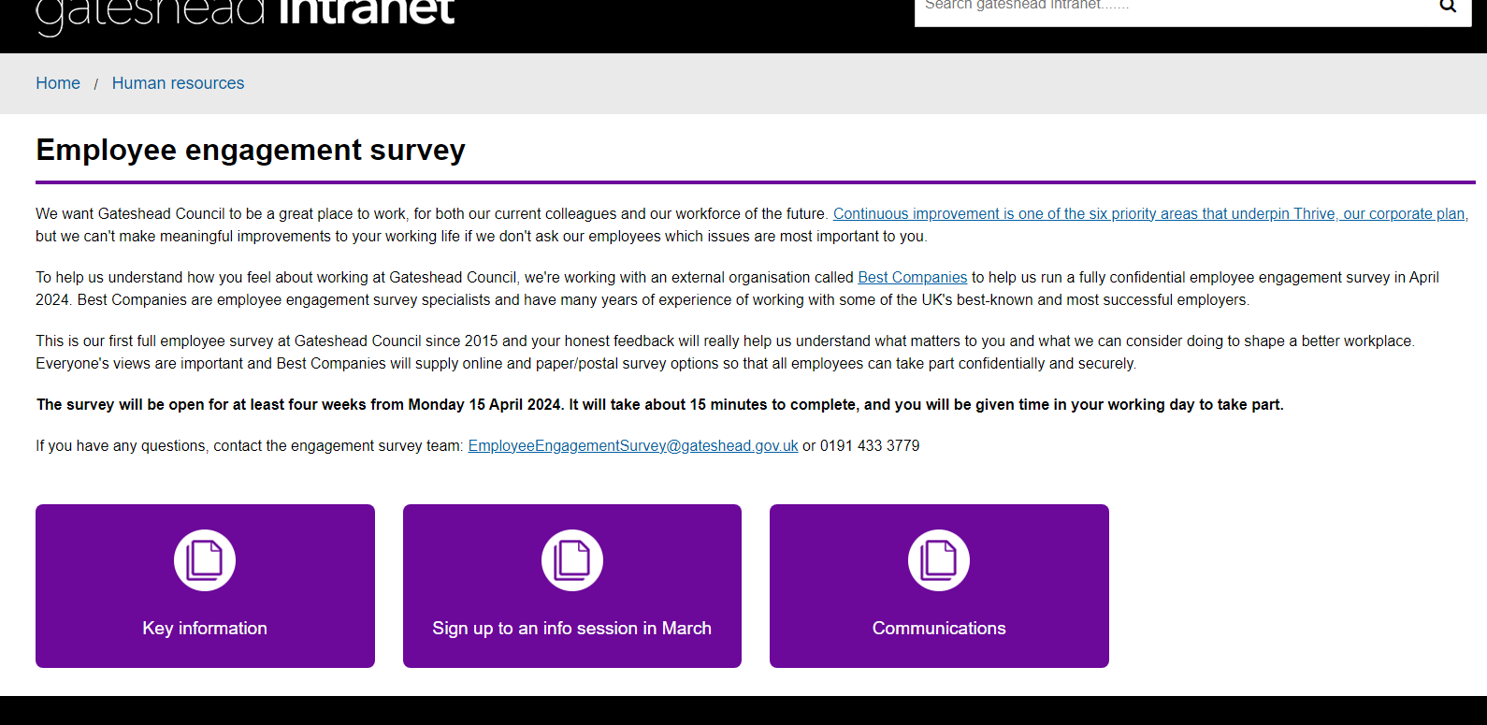
New intranet area for staff engagement survey information Survey to be launched in April 2024
Employee survey intranet page

Slide 13
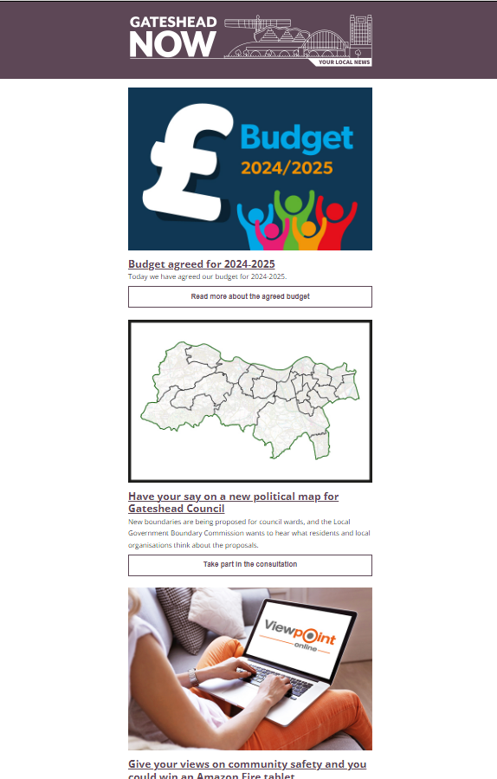
Gateshead Now issued on 22 February.
Lead items included:
Budget agreed for 2024-25
Have your say on new political map for Gateshead
Give your views on community safety
Gateshead Now

Slide 14
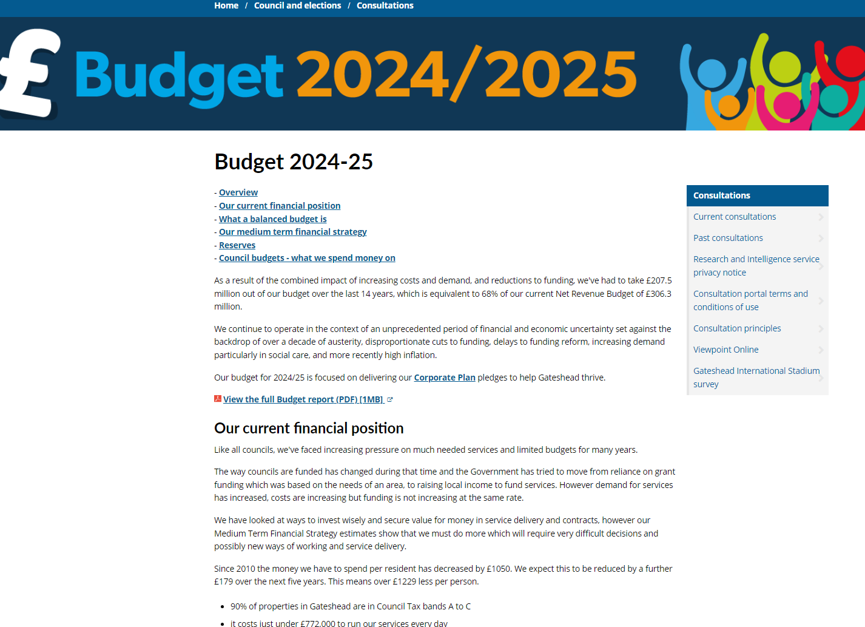
https://www.gateshead.gov.uk/budget Updated budget page after it was agreed by Council on 22 February.
Budget webpage

Slide 15
Viewpoint online email campaign
Sent on 20 February
Reminder email inviting members of the Viewpoint panel to complete the 'Safer Gateshead' survey

Slide 16
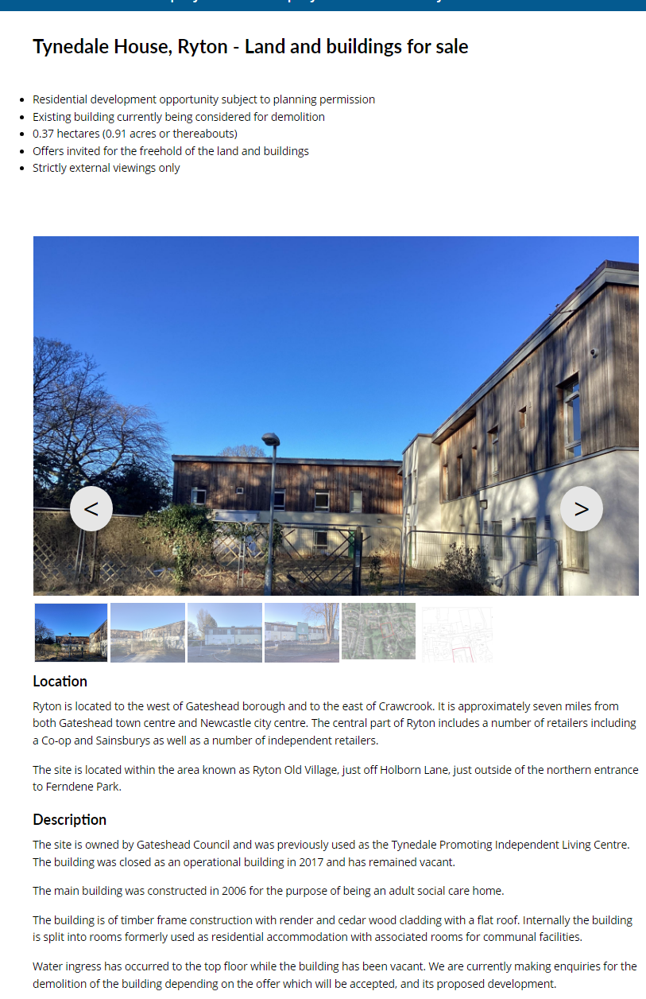
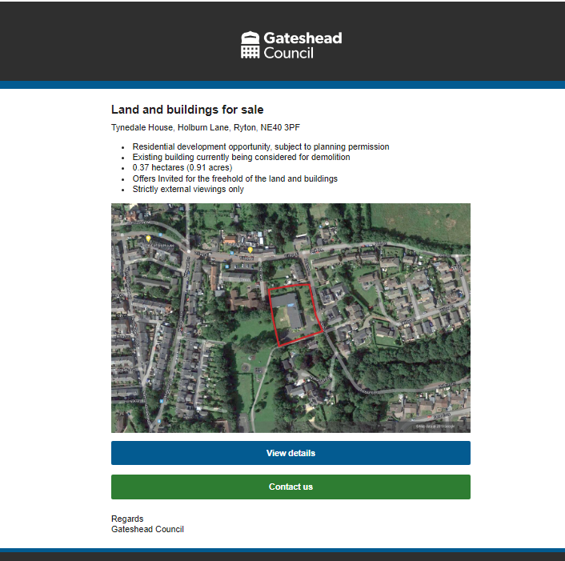
New webpage to advertise Tynedale House, Ryton for sale Email sent to property mailing list
Property for sale – Tynedale House

Slide 17
Nominations closed on Friday 23 February Over 300 nominations received this year! Category winners will be shortlisted by a specialist panel, then voting will open.
Gateshead Awards 2024

Slide 18
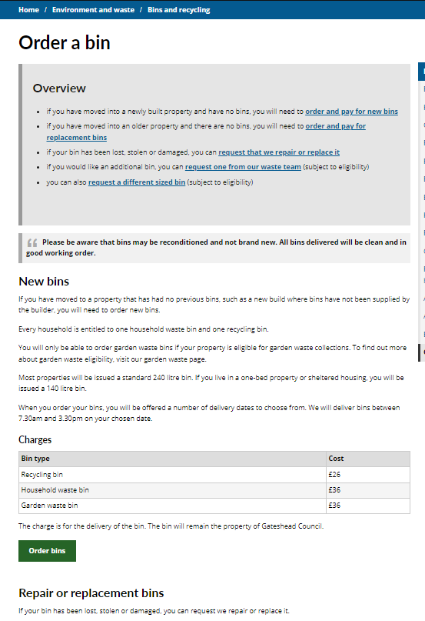
Redesigned webpage so that all types of requests are on one page with clear content to show which form should be used in various situations - Order a new bin – for new build properties - Order a replacement bin if the property you've moved to has no bins (not a new build) - Order a replacement bin if your bin has been lost, stolen or damaged - Request an additional bin - Request a different sized bin
Order a bin

Slide 19
Sprint 20
Development
Update to Damage to building or structure form - map page text.
Dev IP range – Work to allow investigations between Northgate (NEC) and GOSS.
Benefits overpayment – Change of text from account number to invoice number.
Add street cleansing teams to Decontamination case type for reassignment.
Update to Council Tax balance pages – Changes to display information text for the 2024-25 council tax charges.
Miscellaneous payments failing – Update to how an assisted users address is handled.

Slide 20
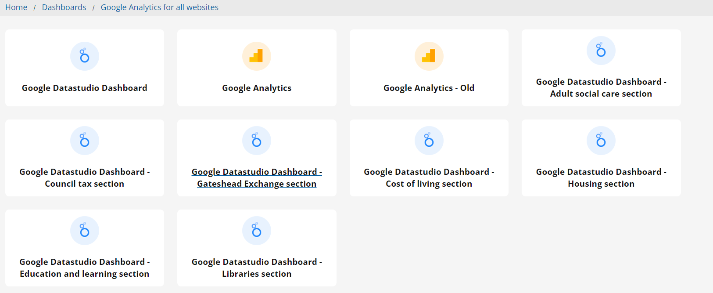
Development
Analytics for libraries: https://lookerstudio.google.com/reporting/00f9538e-4472-451c-87f6-f93b66e1b37f/page/aKq8C

Slide 21
Development
Matomo - Spike: https://jira.gossinteractive.com/secure/attachment/97602/Matomo%20analytics%20report.htm
Performance investigation - Spike:

Slide 22
What's coming up in Sprint 22
Discovery
Data analysis challenge
Salt heaps “repeat customers” – service redesign
Apprentice application process
New bins process
School admissions moving onto case management
Content
Kinship care
Local Nature recovery strategy website
Design
Tyne Derwent Way website
Digital Service Standards
Development
Apprenticeship application build
Forms migrated into Case management

Slide 23
Sprint 20
Deployment

