Slide 1
Sprint 23 Show and Tell 20 March 2024
G Squad
Digital Team

Slide 2
Sprint 23.
Discovery
Council Tax discounts and exemptions process discovery
Notes:
GS

Slide 3
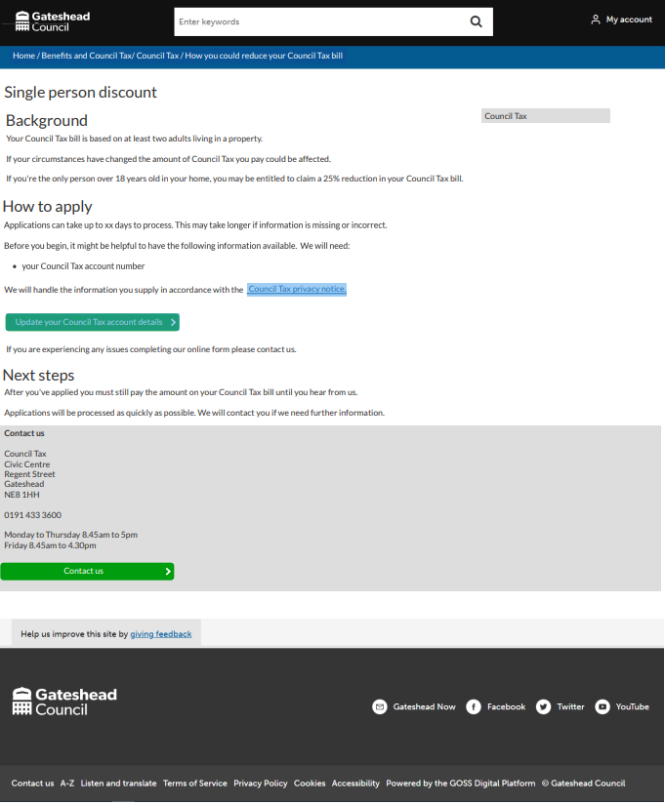
Sprint 23.
Content and wireframing
Council Tax single person discount wireframe – web content
Notes:
GS

Slide 4
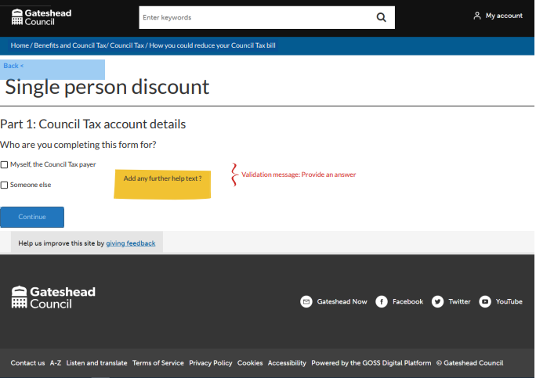
Sprint 23.
Content and wireframing
Council Tax single person discount wireframe
Notes:
GS

Slide 5
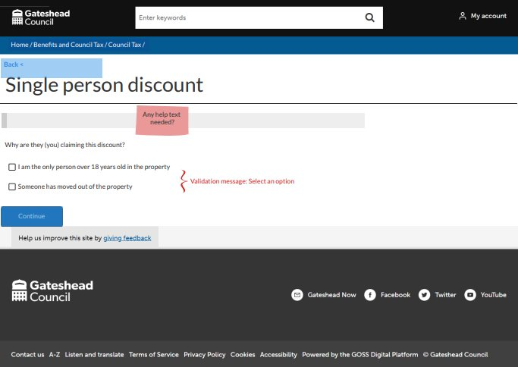
Sprint 23.
Content and wireframing
Council Tax single person discount wireframe
Notes:
GS

Slide 6
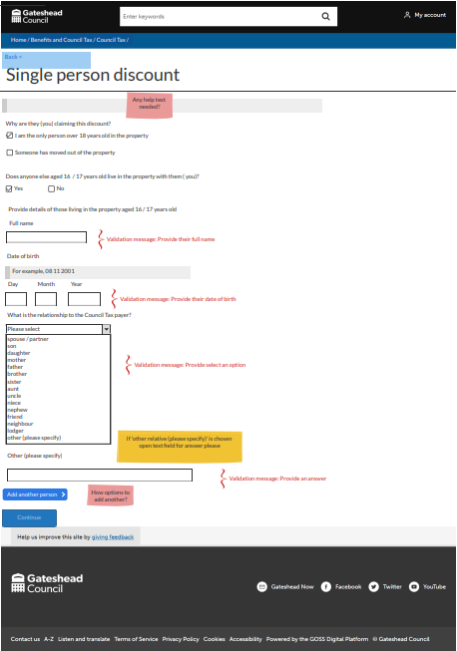
Sprint 23.
Content and wireframing
Council Tax single person discount wireframe
Notes:
GS

Slide 7
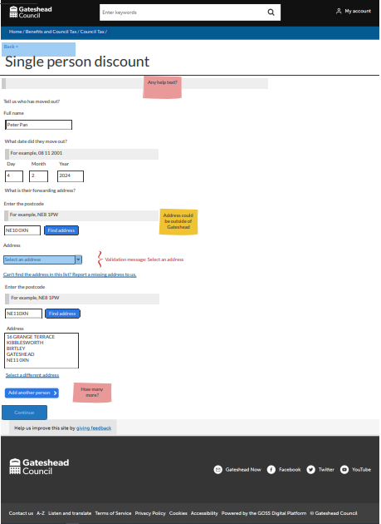
Sprint 23.
Content and wireframing
Council Tax single person discount wireframe
Notes:
GS

Slide 8
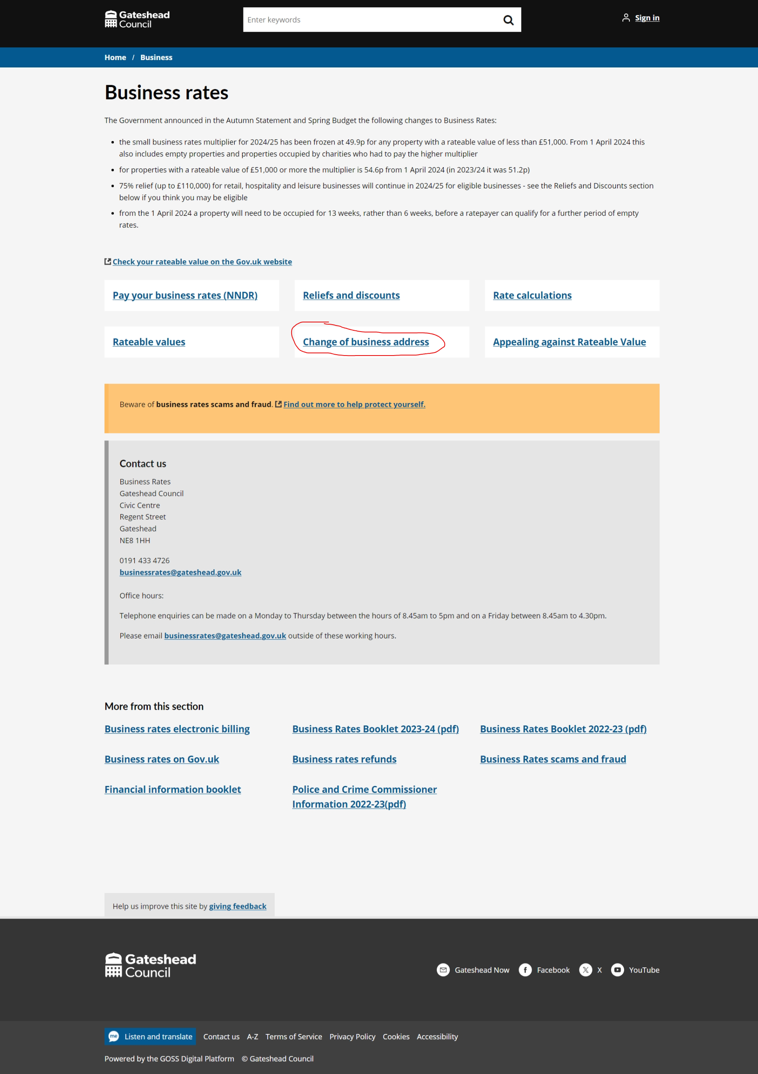
Sprint 23.
Content and wireframing
Business rates change of address go-live
Notes:
GS

Slide 9
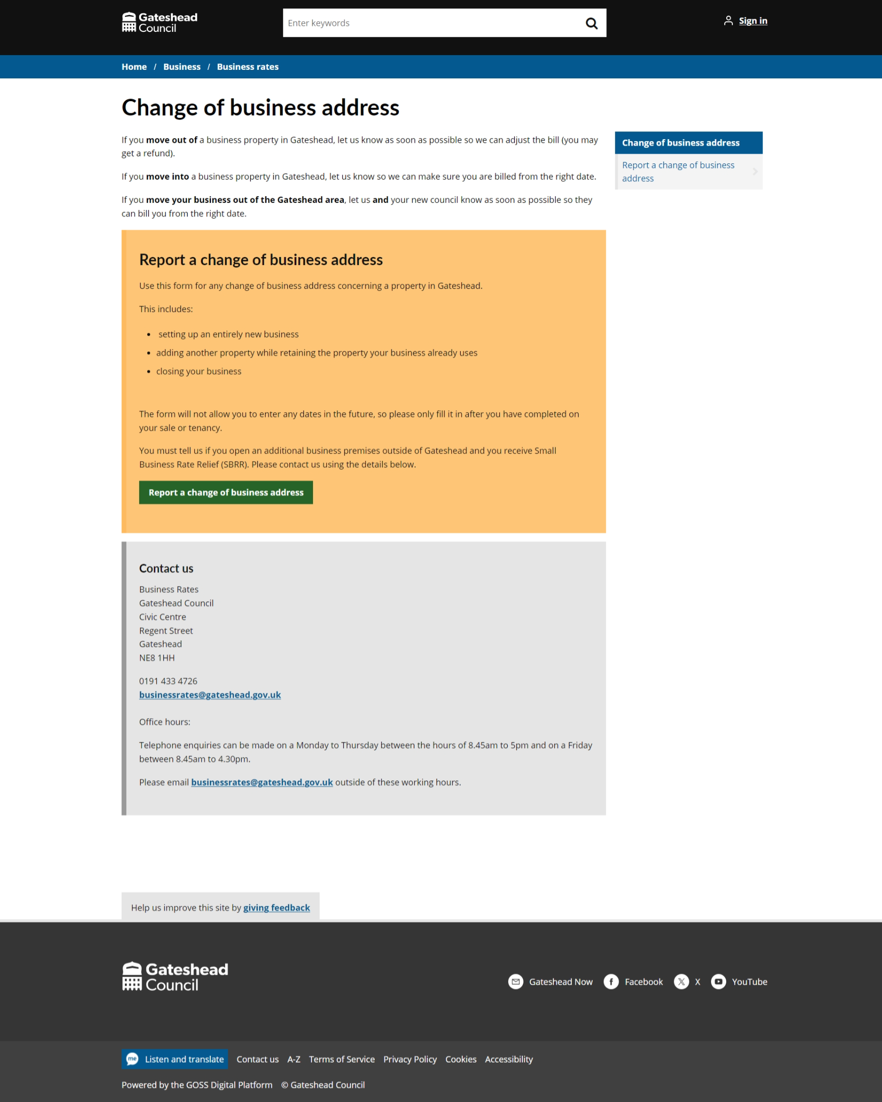
Sprint 23.
Content and wireframing
Business rates change of address go-live
Notes:
GS

Slide 10
Sprint 23.
Data
Blue Badge dashboard
Notes:
GS

Slide 11
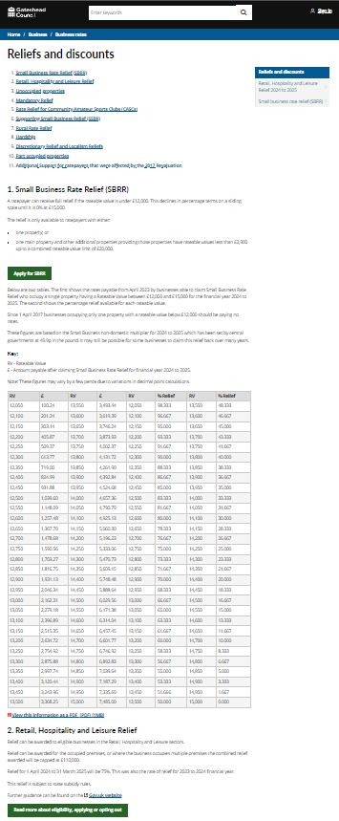
Sprint 23.
Content and wireframing
Reliefs and Discounts content
Notes:
GS

Slide 12
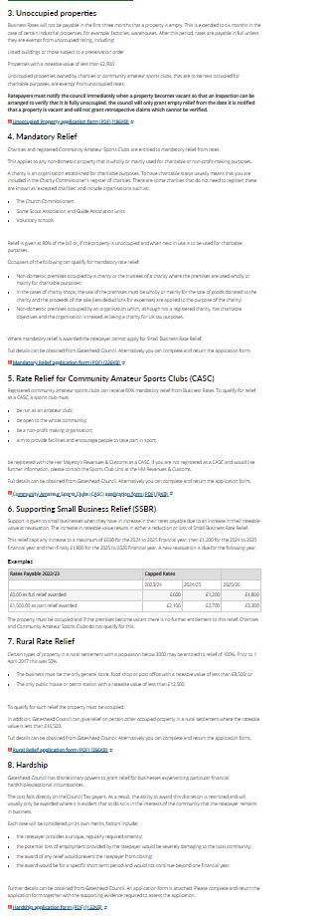
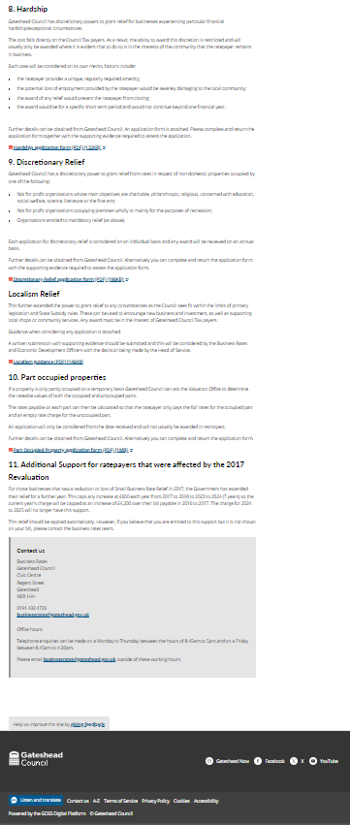
Sprint 23.
Content and wireframing
Reliefs and Discounts content
Notes:
GS

Slide 13
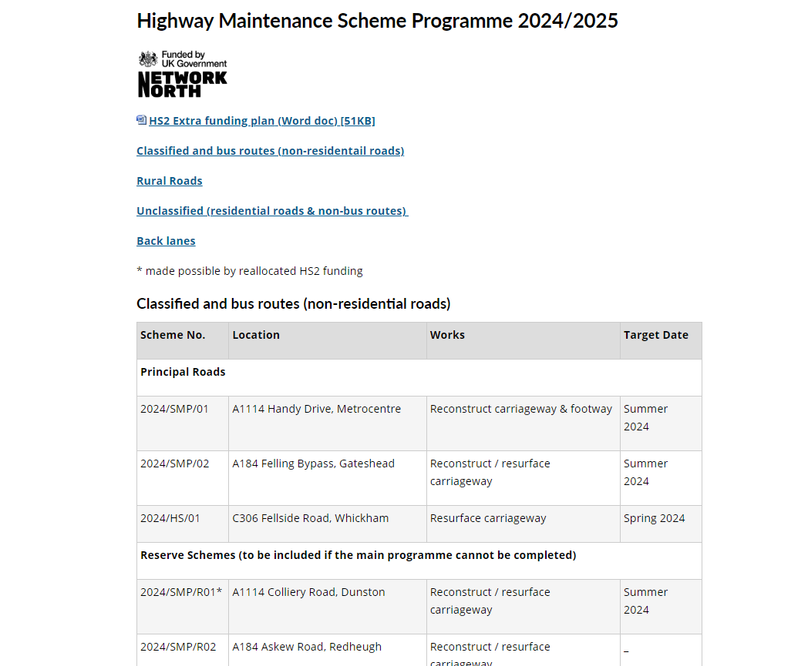
Sprint 23.
Content and wireframing
Highway maintenance content
Logos
HS2 Funding
Notes:
GS

Slide 14
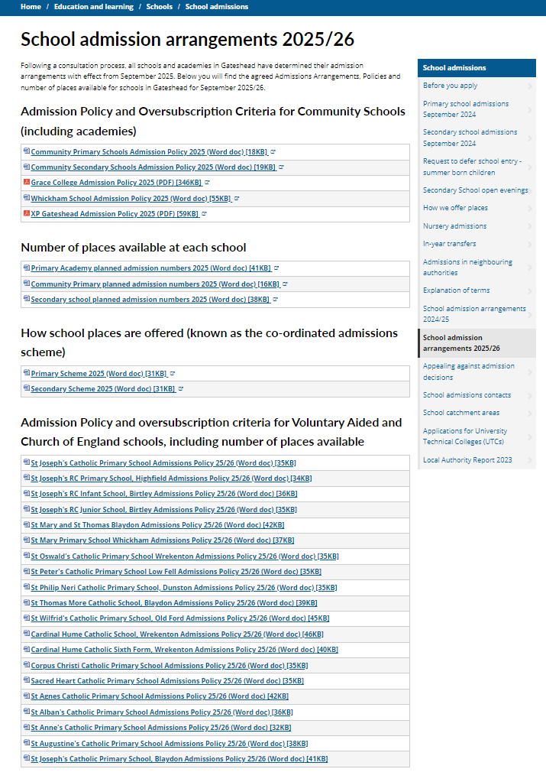
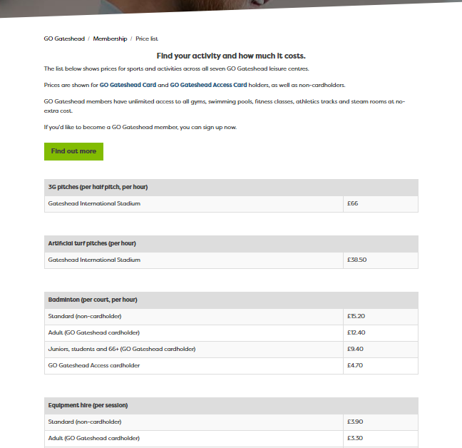
Sprint 23.
Leisure pricing for April and School admission docs 2025
Notes:
GS

Slide 15
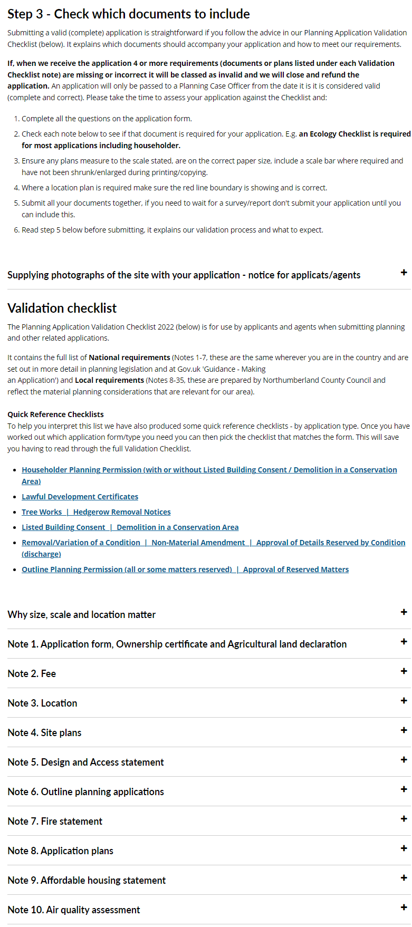
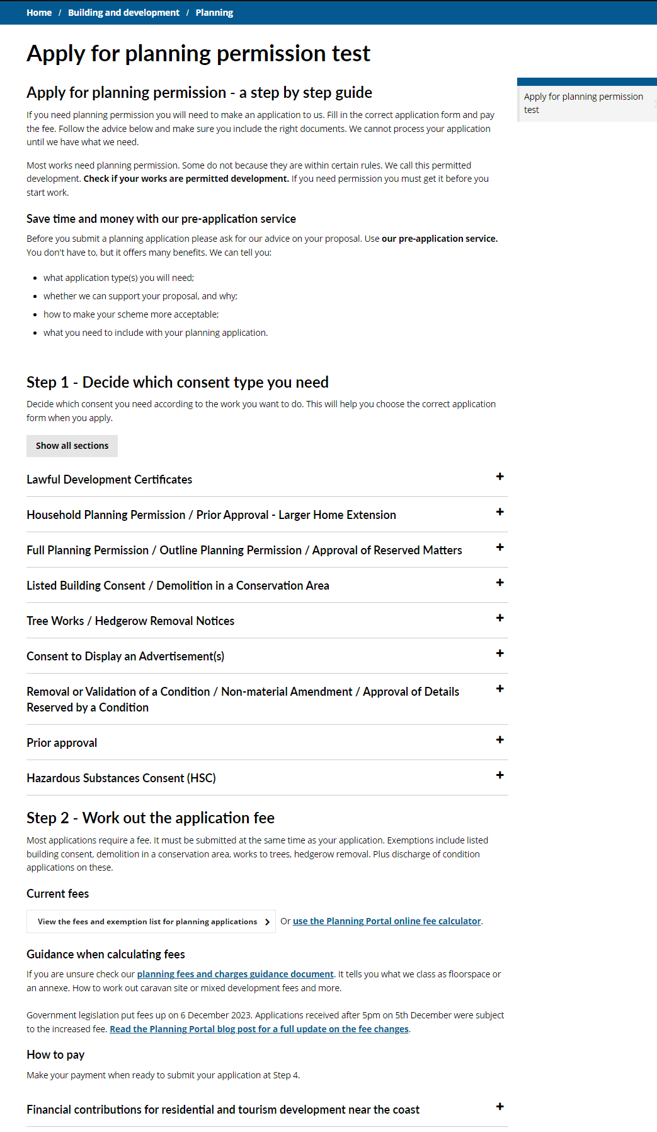
Sprint 23.
Apply for planning permission mock up
Notes:
GS

Slide 16
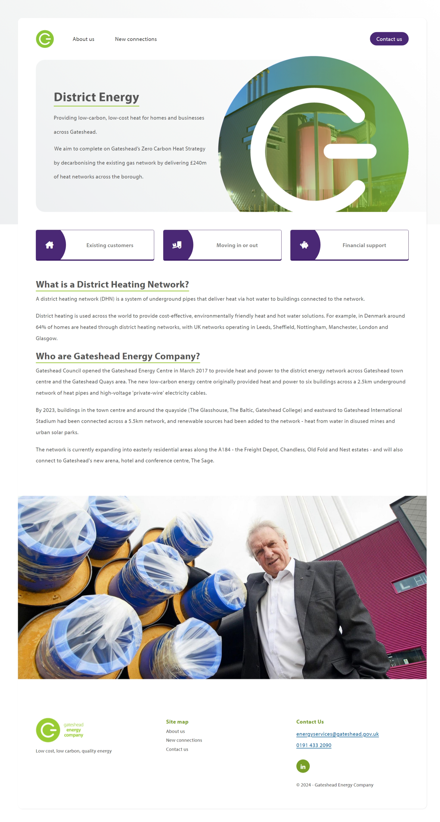
Sprint 23.
Content and wireframing
Gateshead Energy Company
Notes:
GS

Slide 17
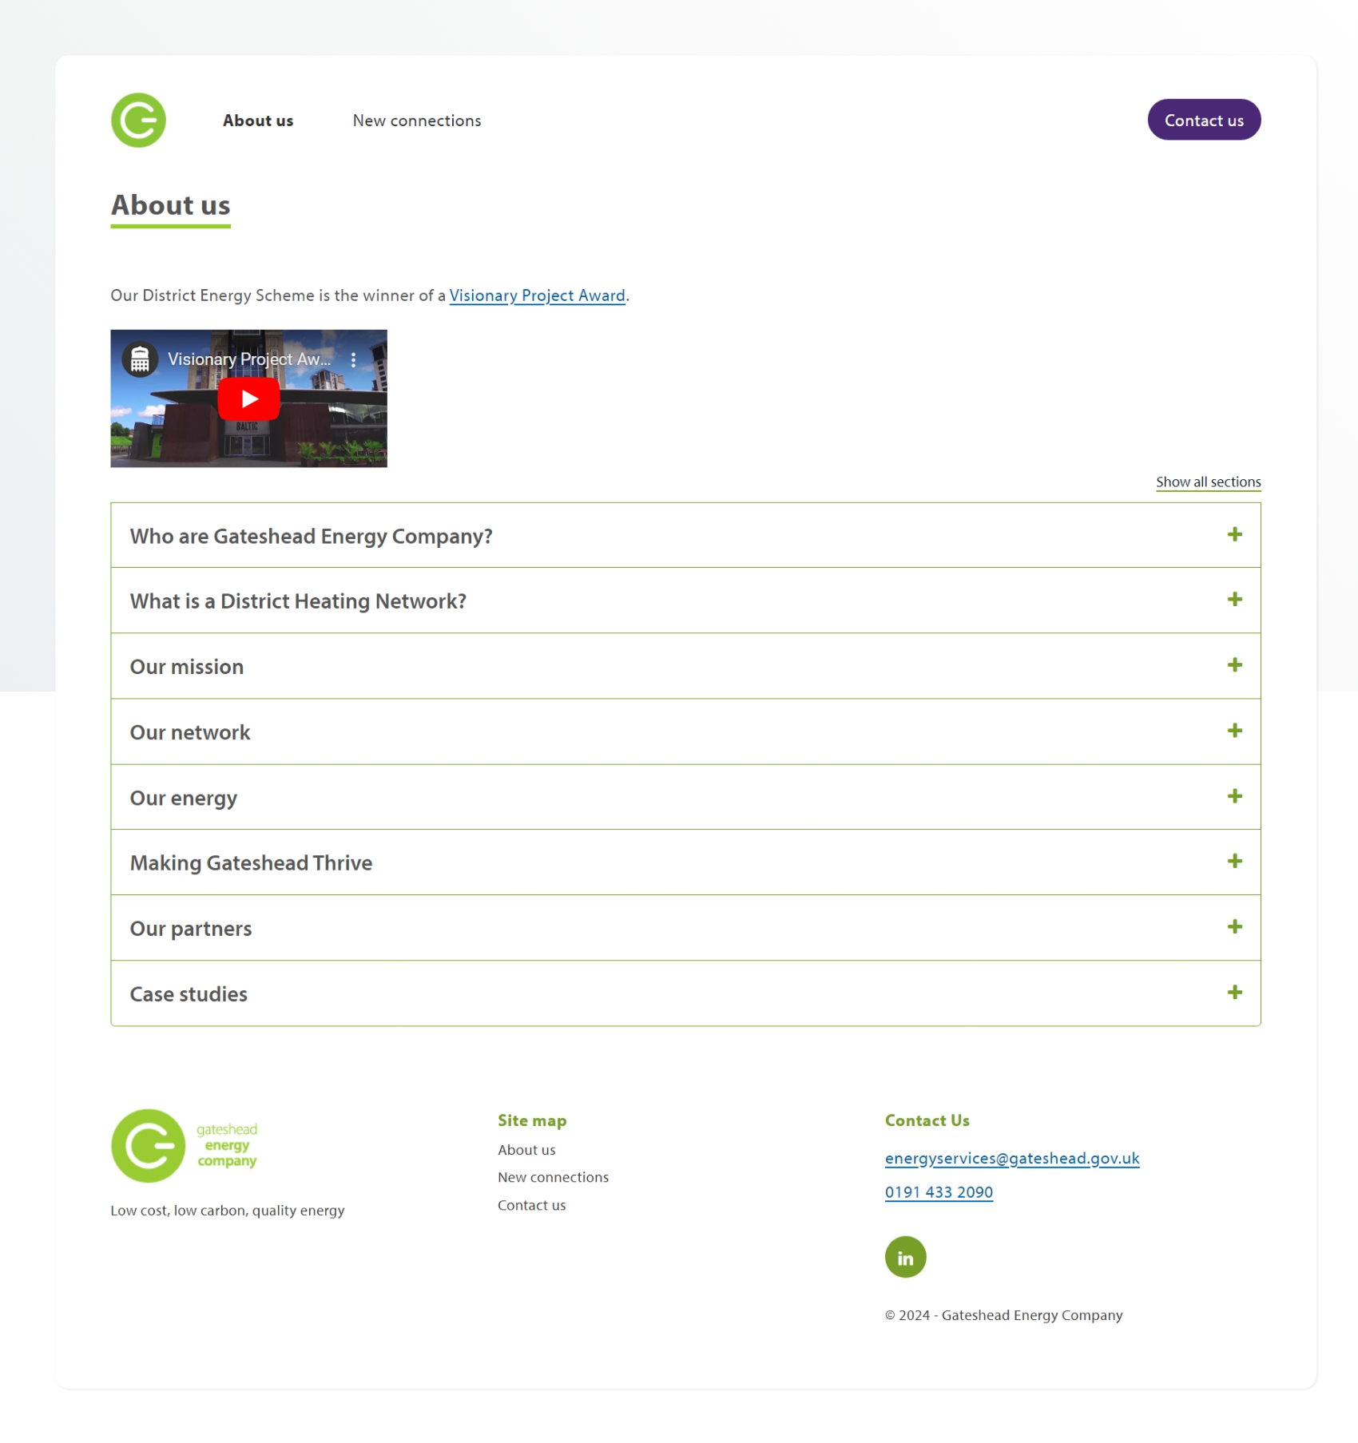
Sprint 23.
Content and wireframing
Gateshead Energy Company
Notes:
GS

Slide 18
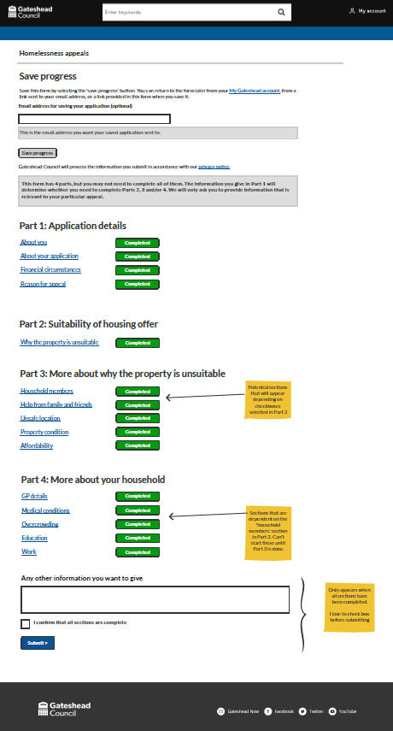
Sprint 23.
Content and wireframing
Homelessness appeals wireframe, config and page content
Notes:
GS

Slide 19
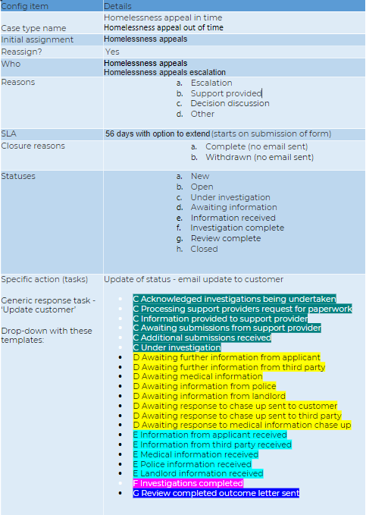
Sprint 23.
Content and wireframing
Homelessness appeals wireframe, config and page content
Notes:
GS

Slide 20
Sprint 23.
Homelessness appeals
Form development demo
Notes:
GS

Slide 21
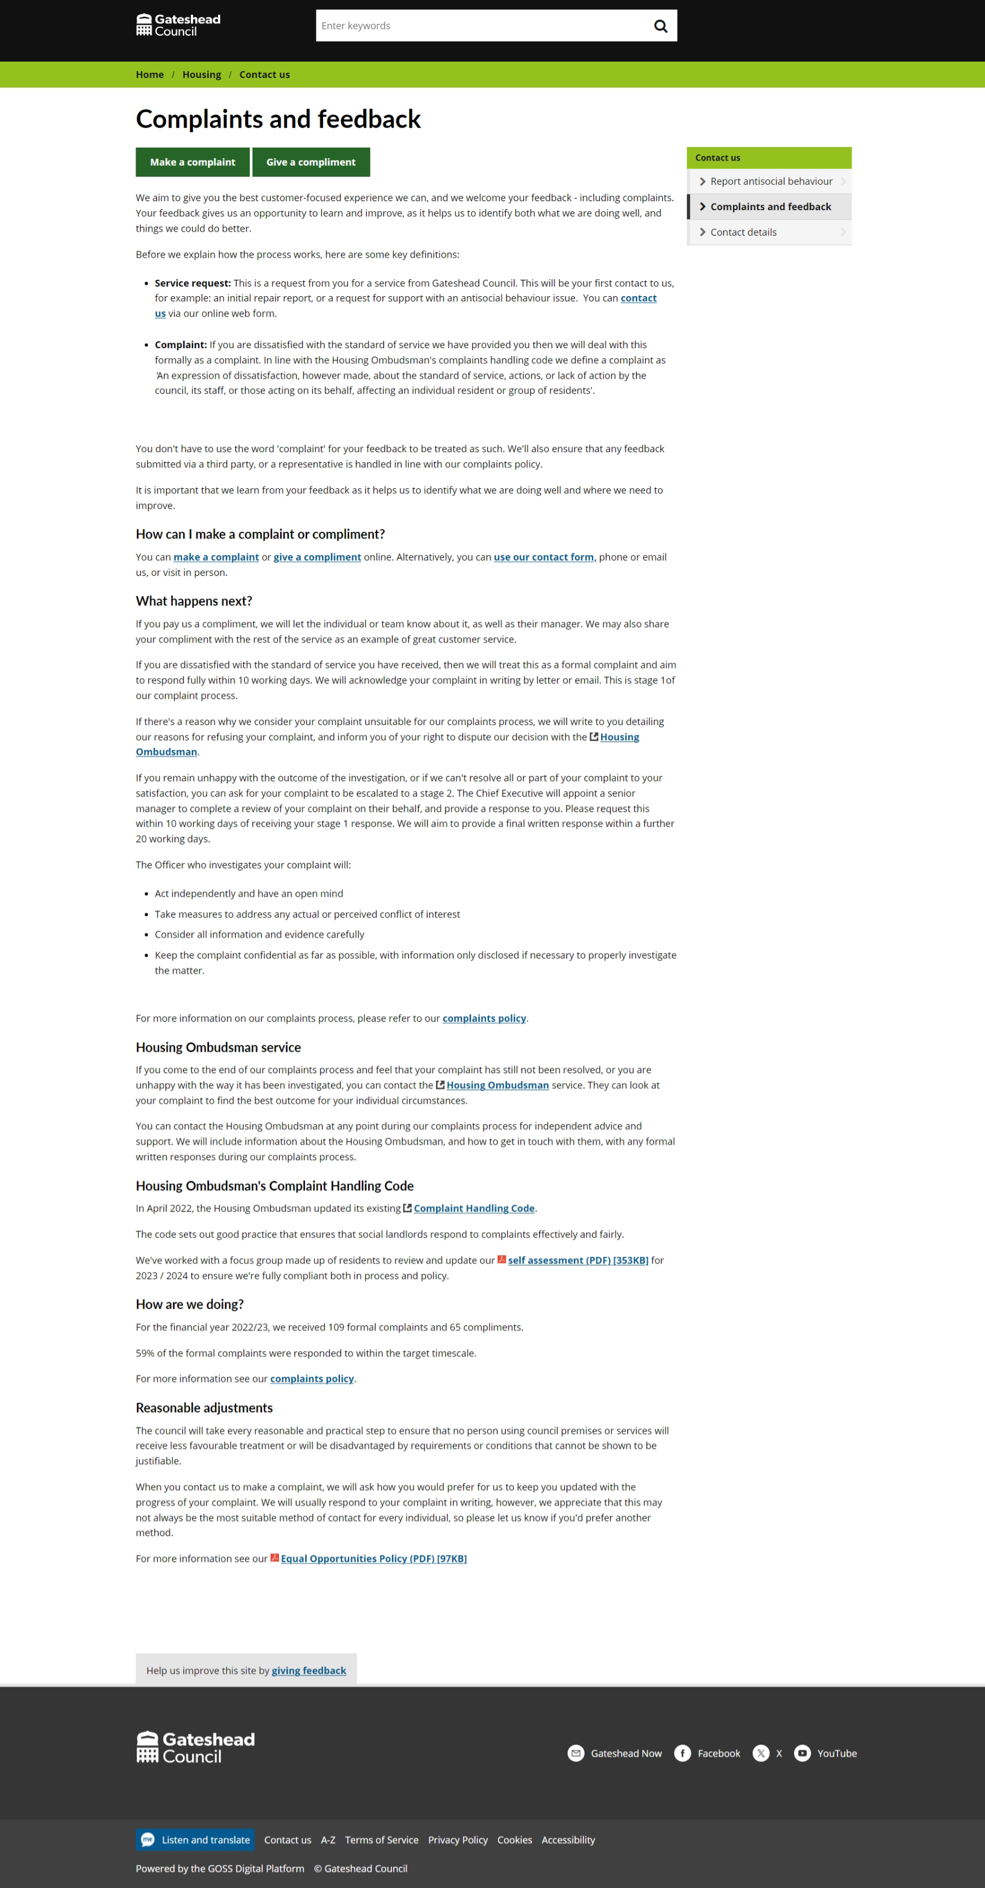
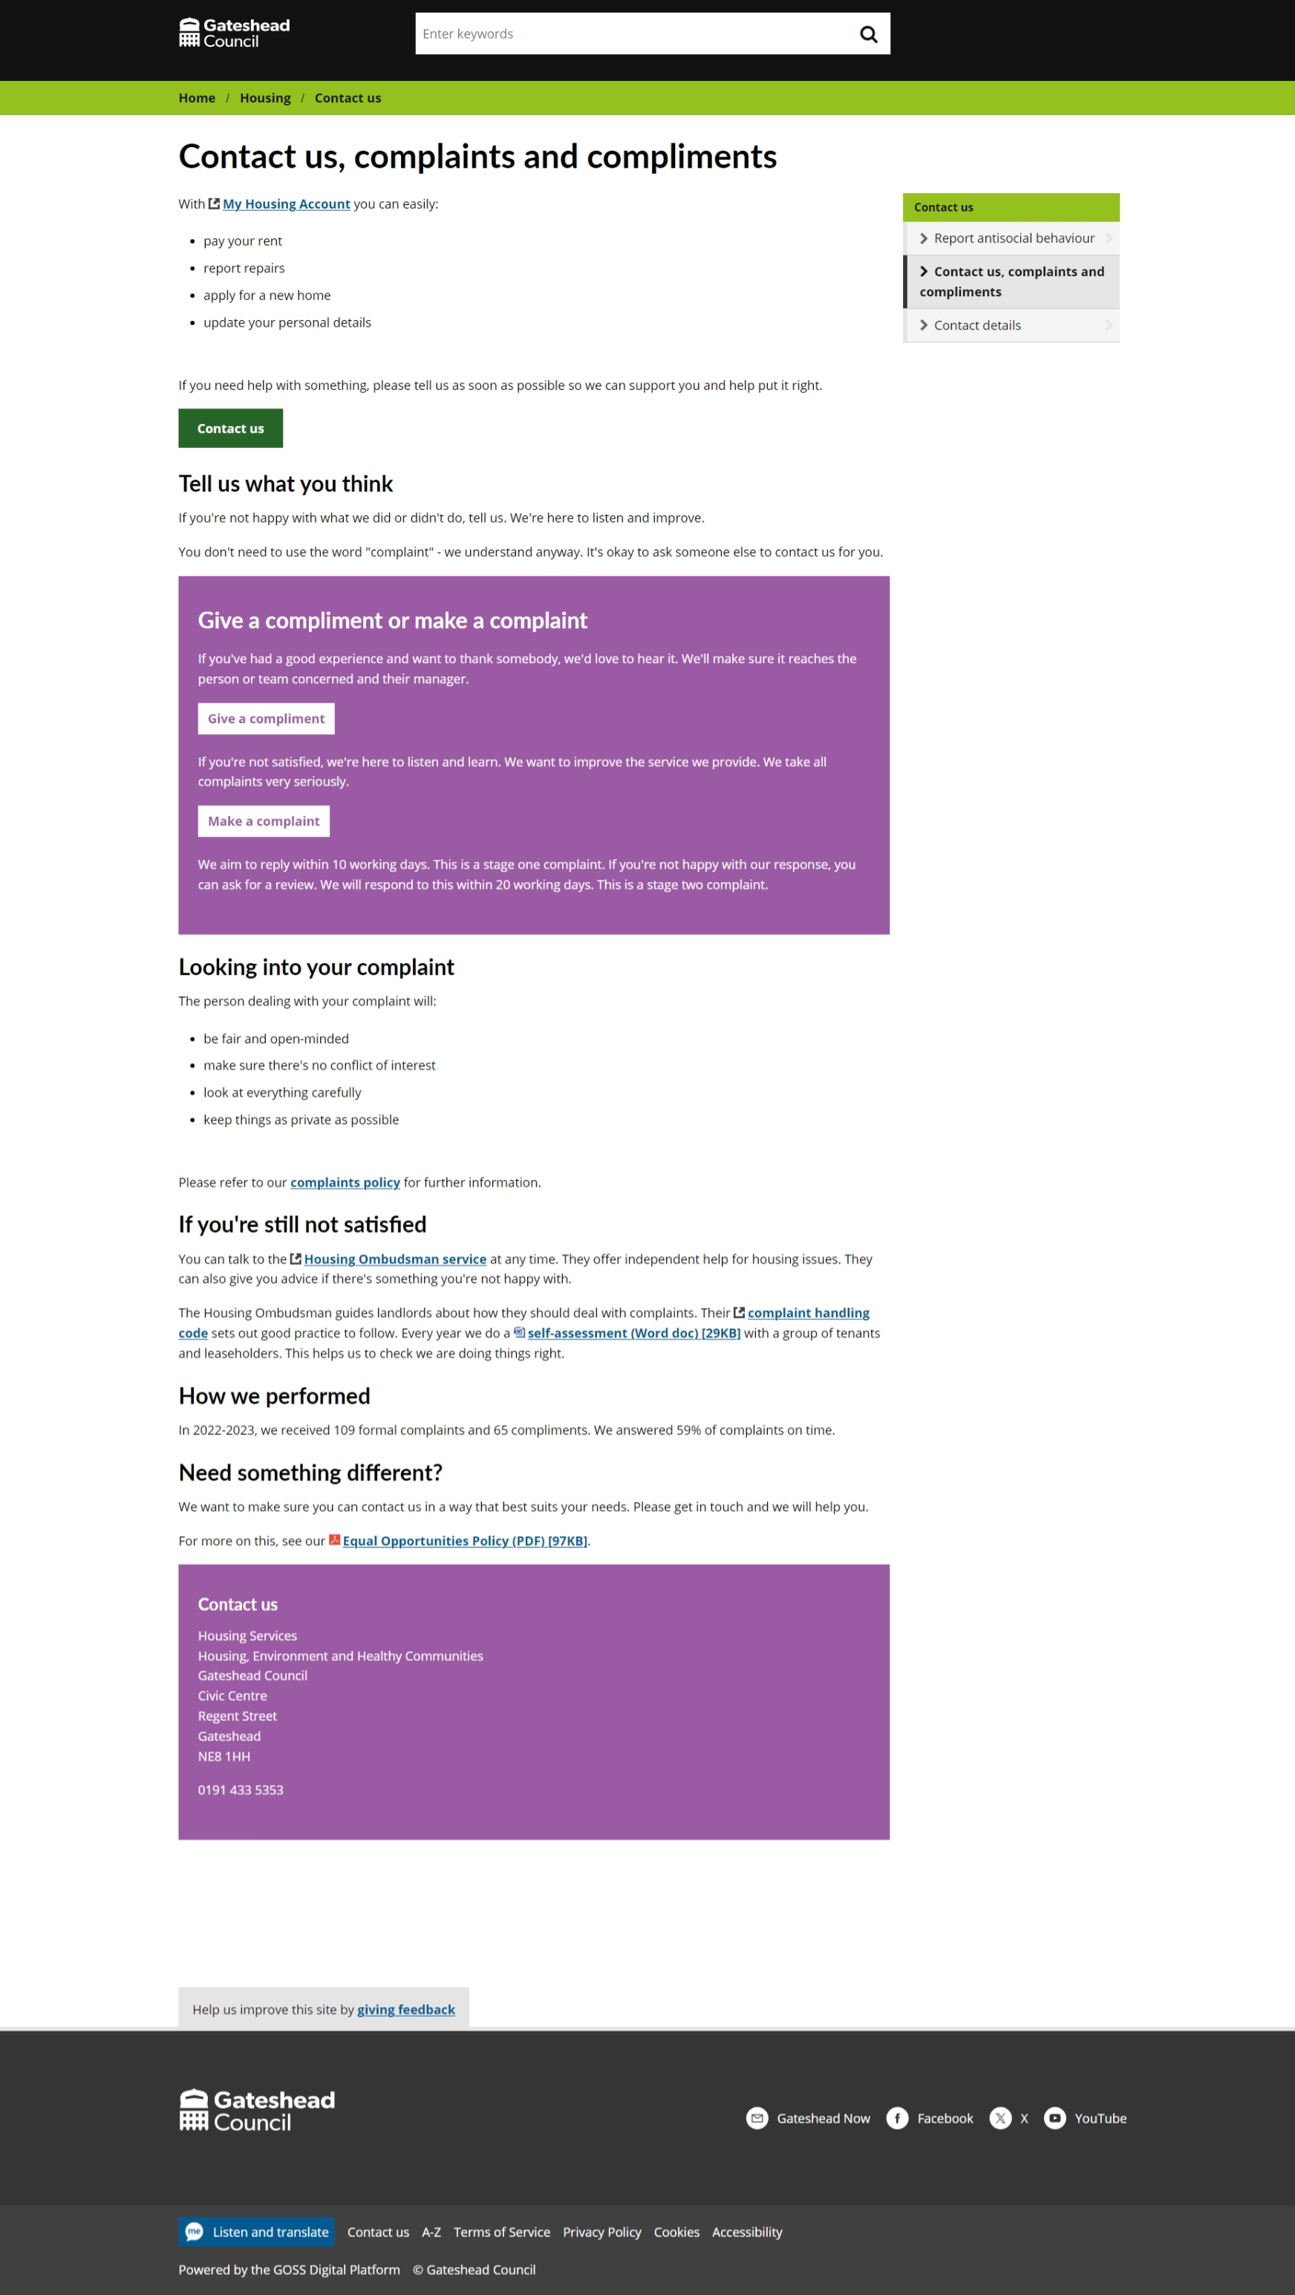
Sprint 23.
Content and wireframing
Housing contact us, complaints and feedback
Notes:
GS

Slide 22
Sprint 23.
Development
Business rates change of address
New email that sends case details and attachments into Capita D360 assigned to the relevant business rates account number.
Walk and wheel form
Updated navigation logic
In year school transfers
Added logic to change email address for Kingsmeadow school due to specific email not receiving emails from form.
Blue badges
Added logic to the date of birth field to prevent applications entering incorrect birthdays (Miss-typings before 1900)
Design​
Gateshead energy company​
Further improvements made to styling​
​
Housing page​
Updated social media icons to modern variations​
​
Update my details form image​
Updated Council tax account number reference image with new Gateshead logo​
Notes:
SR / DC

Slide 23
Sprint 23.
Development
Damp and Mould reporting Reports from private tenants to be sent to private sector housing
Scaffolding permit demo
Notes:
SR / DC

Slide 24
Sprint 23.
What's next?
Homelessness appeals form development (ongoing piece of work)
Council Tax single person discount form development
Council Tax student discounts and exemptions wireframing
Council Tax change of address process mapping
Graffiti - Improvements for case managers
Notes:
GW

