Slide 1
Sprint 26 Show and Tell 09/04/2024
C Squad
Digital Team

Slide 2
Sprint 26
Sprint goals
Be ready for Tyne Derwent Way go live (11 April)
Blaydon birth registration bookings go live
Continue monitoring performance

Slide 3
Tyne Derwent Way
https://www.tynederwentway.co.uk/
Event styling
Contact form styling
General styling snagging
General updates to website
Added GA4 tracking
Now live for launch event

Slide 4
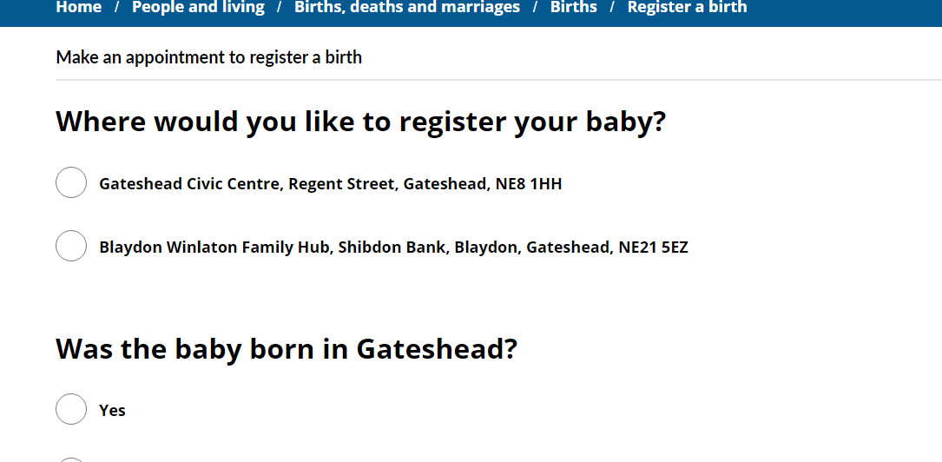
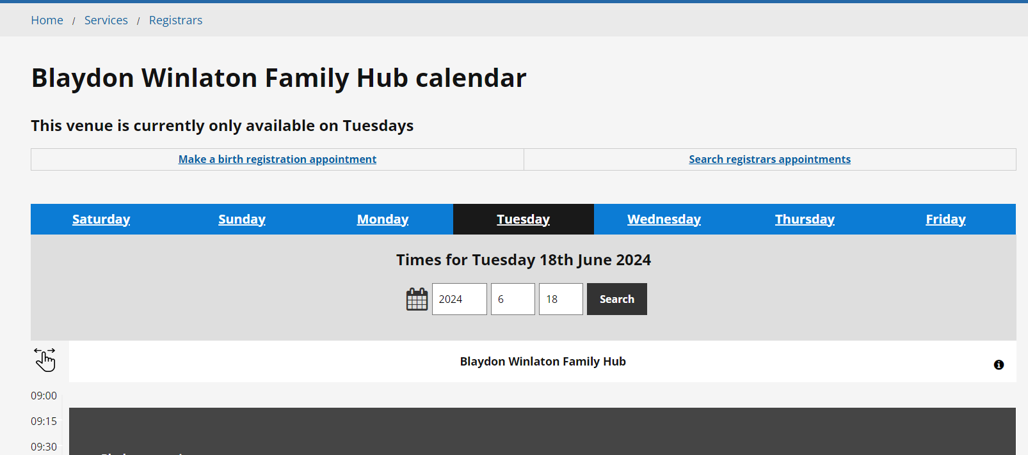
Registrars – Blaydon bookings
Ability to book a birth registration appointment at Blaydon Winlaton Family Hub
New calendars created for Registrars, CSU and Blaydon staff in Customer Contact

Slide 5
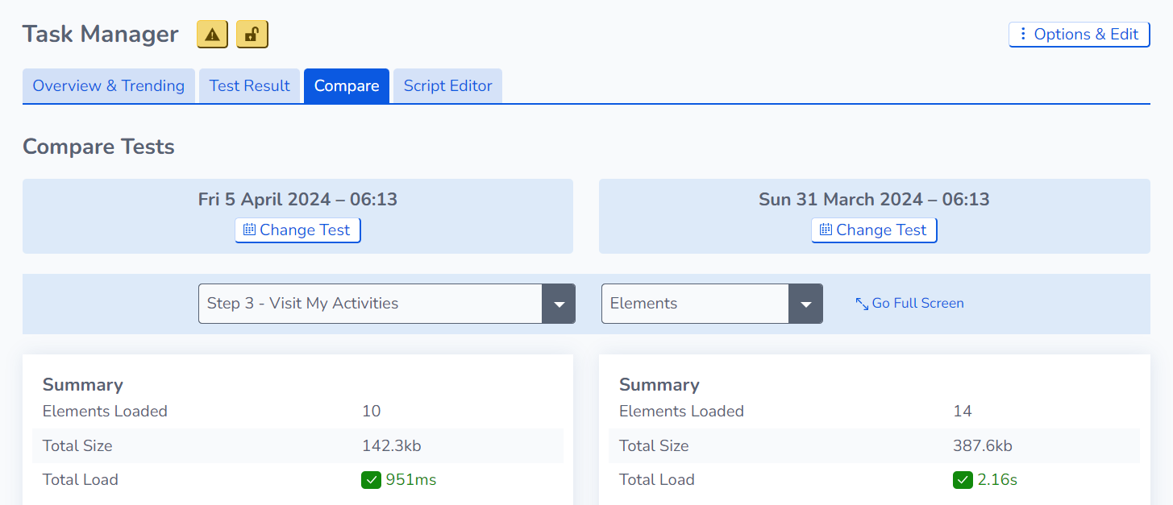

Slide 6
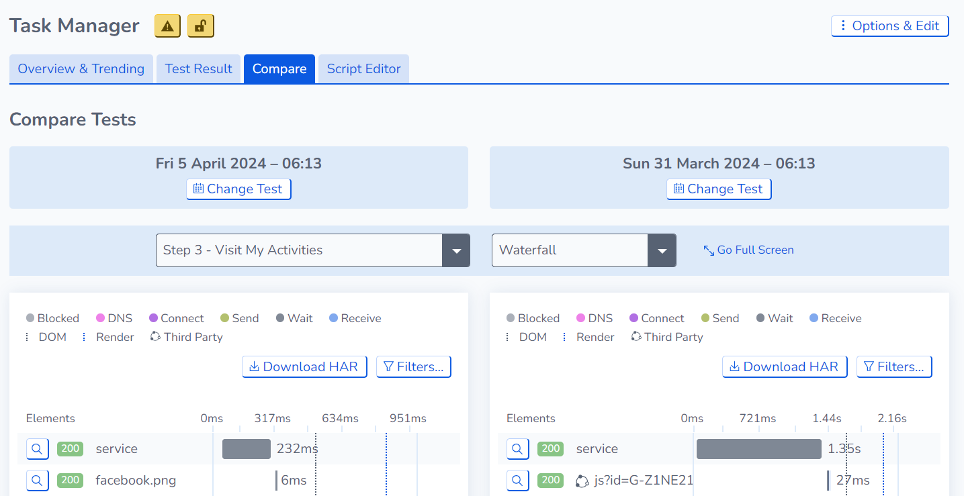

Slide 7
Sprint 26
Discovery
Care cost calculator
Research and compare existing care cost calculators
Miro board

Slide 8
Sprint 26
Content
Tyne Derwent Way content​
Fostering events Fostering information events - Gateshead Council
Gateshead awards Gateshead Awards - Gateshead Council
Gateshead Now issued 3 April
Regent Funeral Services updates
Gateshead Adult Caregivers Strategy 2024-2029
Registrars – Blaydon Winlaton Family Hub bookings
Taxi Vehicle Testing wireframe

Slide 9
Sprint 26
Gateshead Now
Gateshead Now went out on Wednesday 3 April​
​
Lead items:​
​
Trade apprenticeships
Gateshead Awards​
New promoting independence centre

Slide 10
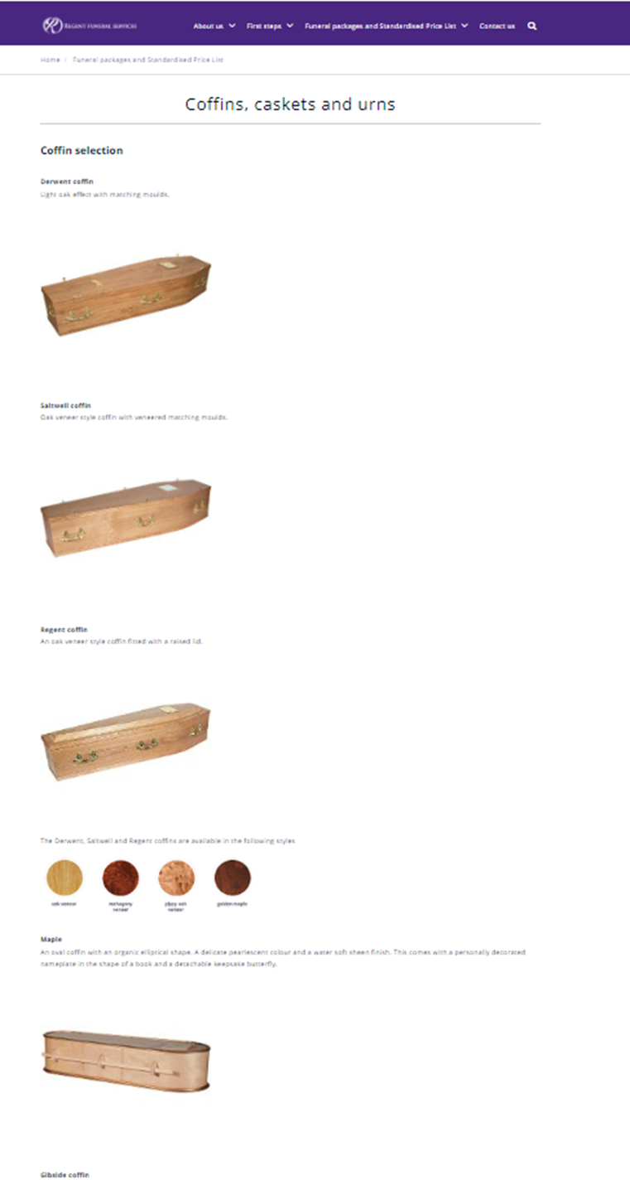
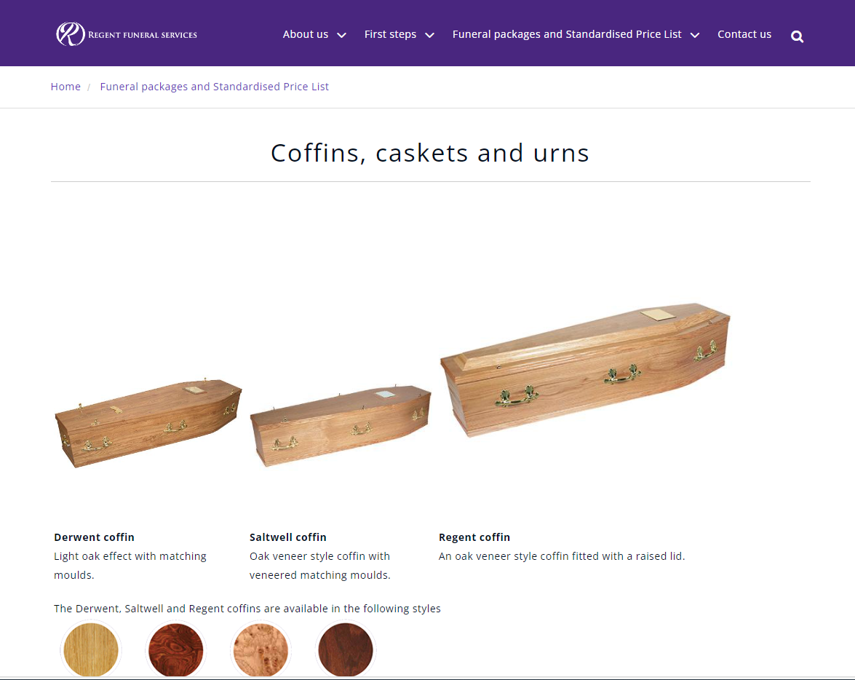
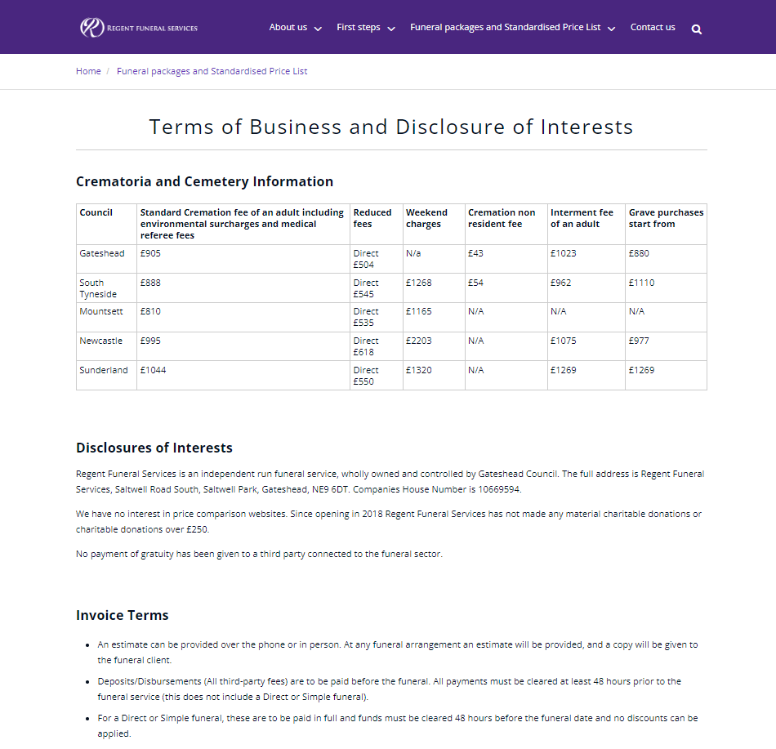
Sprint 26
Regent Funeral Services
Updates to Regent Funeral Services price list and funeral package offer.
Not all content was web content to converted pdfs to web content.
Amended Coffin and Urn pages as it was formatted in a table so wasn’t displaying correctly and is not accessible.
www.regentfuneralservices.co.uk

Slide 11
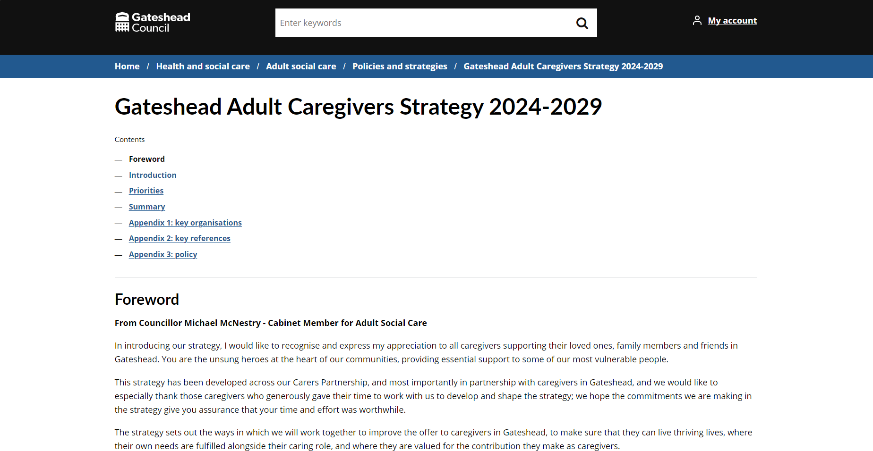
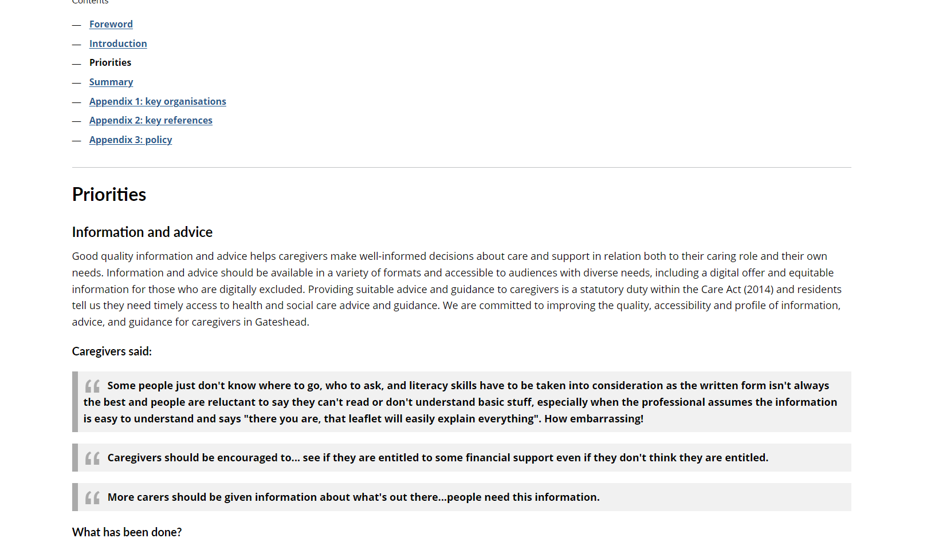
Sprint 26
Gateshead Adult Caregivers Strategy
2024-2029
Converting pdf strategy into web content to improve accessibility.
https://www.gateshead.gov.uk/article/27546

Slide 12
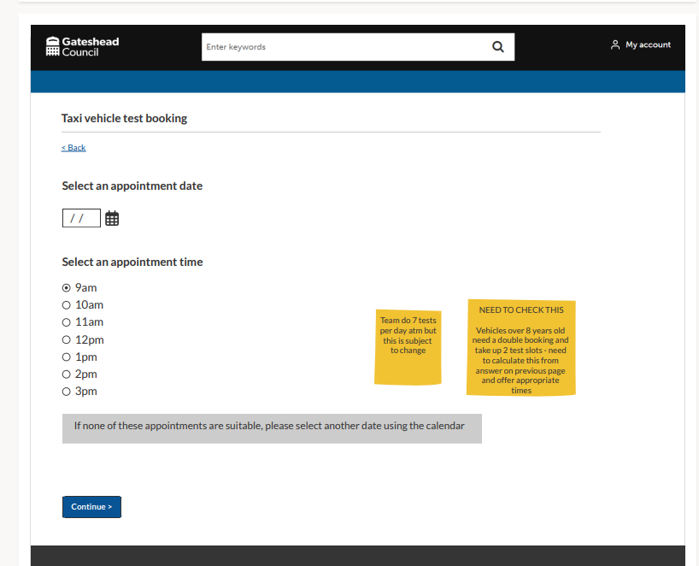
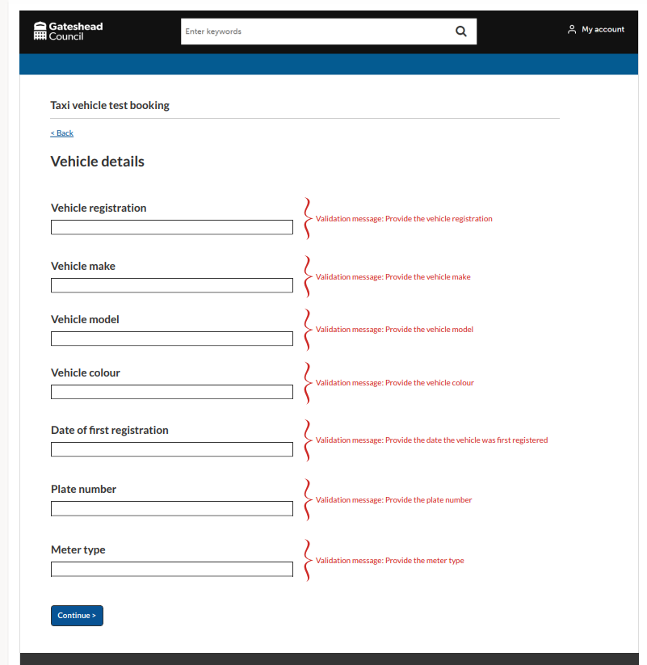
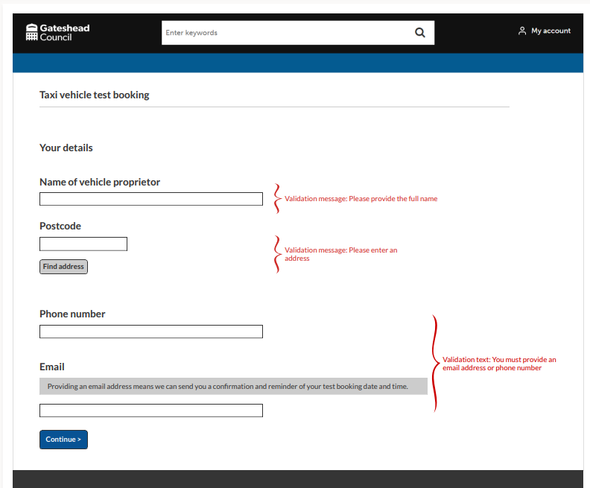
Taxi vehicle test bookings
Wireframe for taxi drivers to book an appointment for their vehicle test

Slide 13
Sprint 26
Development
Gambling Licence Payment: https://gateshead.ghc2-dev.gosshosted.com/article/13646/Gambling-licence-payment
Update to fees for taxi licence and animal licences
Performance monitoring: improvement noticed on My activities page

Slide 14
Sprint 26
Other​
DRM
Locations template

Slide 15
What's coming up in Sprint 28
Discovery
Content
Design
Development

Slide 16
Sprint 26
Deployment

