Slide 1
Sprint 25 Show and Tell 3 April 2024
G Squad
Digital Team

Slide 2
Sprint 25.
Sprint goals
Council Tax
Change of address as is
Discount and exemption wireframing
Housing
Homelessness appeals development
Content updates
ICT security policies
Blue badge system improvements
Notes:
GS

Slide 3
Sprint 25.
Council Tax
Discount and exemption mapping
Notes:
GS

Slide 4
Sprint 25.
Dashboard: Waste and Environmental Service
Developing a dashboard giving an overview of demand related to Waste and Highways Services, and Environment and Fleet.
Easy to update
Do something with spatial
Form a template for other services
Notes:
GS

Slide 5
Sprint 25.
Dashboard: Waste and Environmental Service
Next steps:
Work on spatial data, automating the extraction and processing
Review current content with service
Address data quirks – ticket to be raised
Notes:
GS

Slide 6
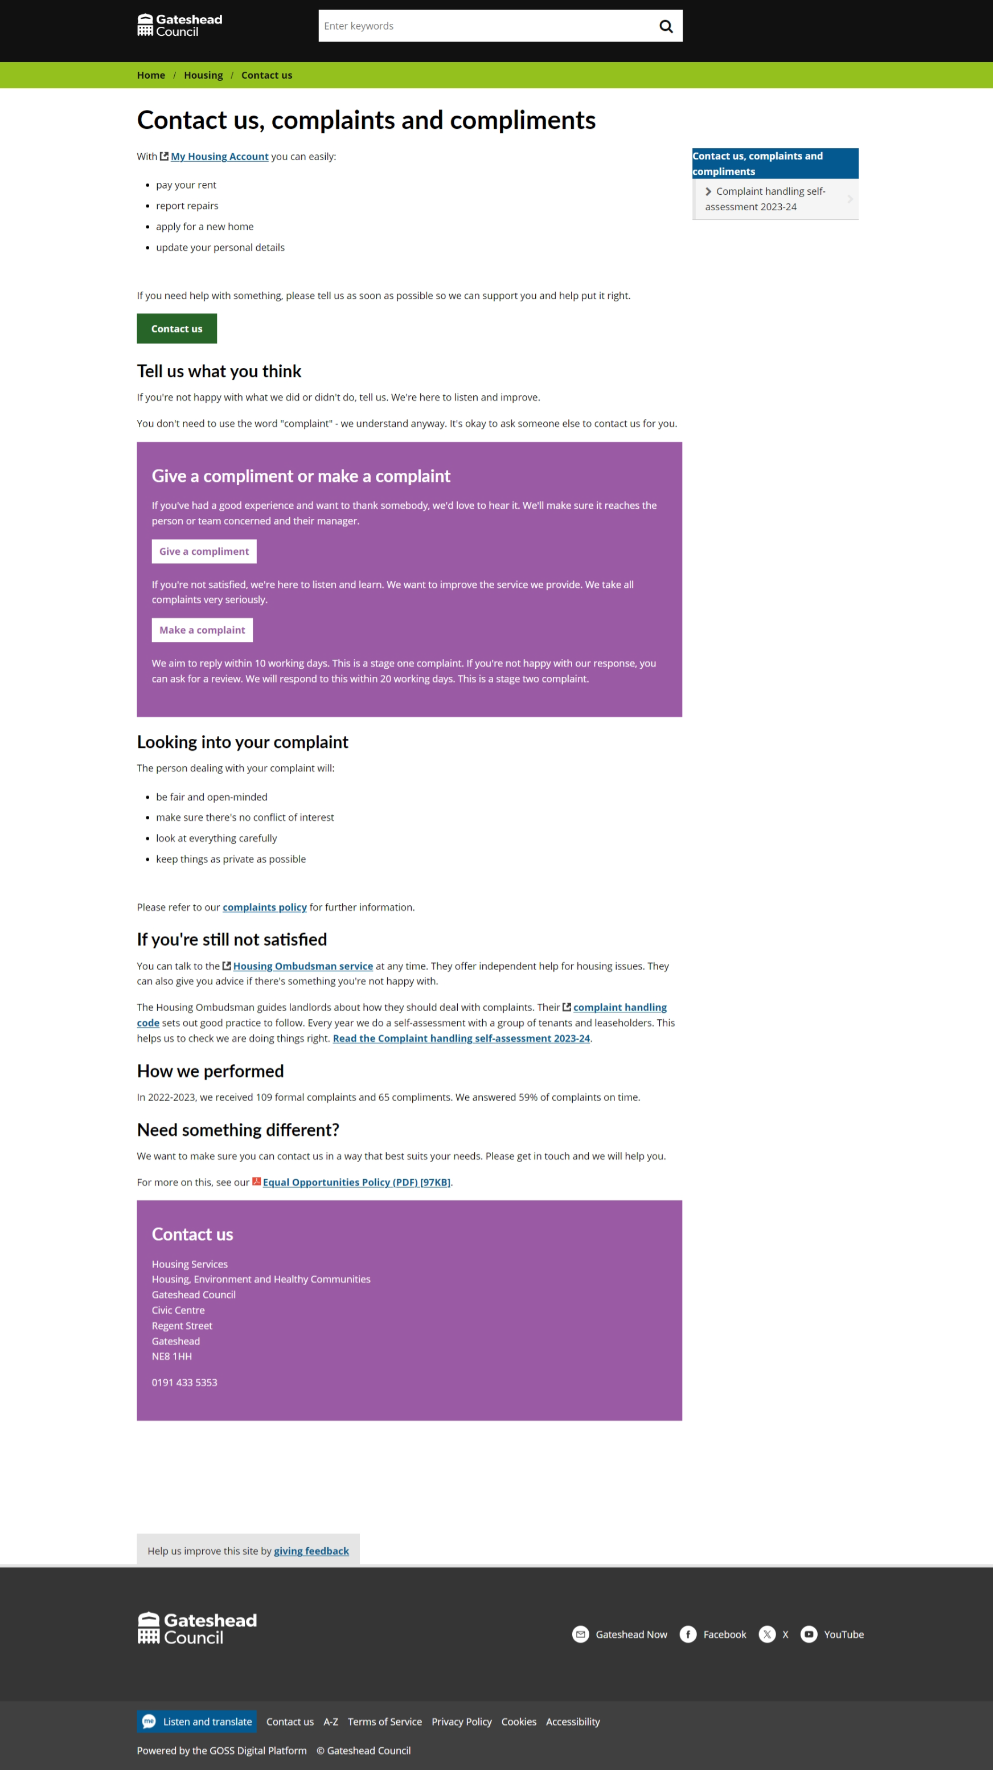
Sprint 25.
Housing
Contact us, complaints and compliments
Content
Notes:
GS

Slide 7
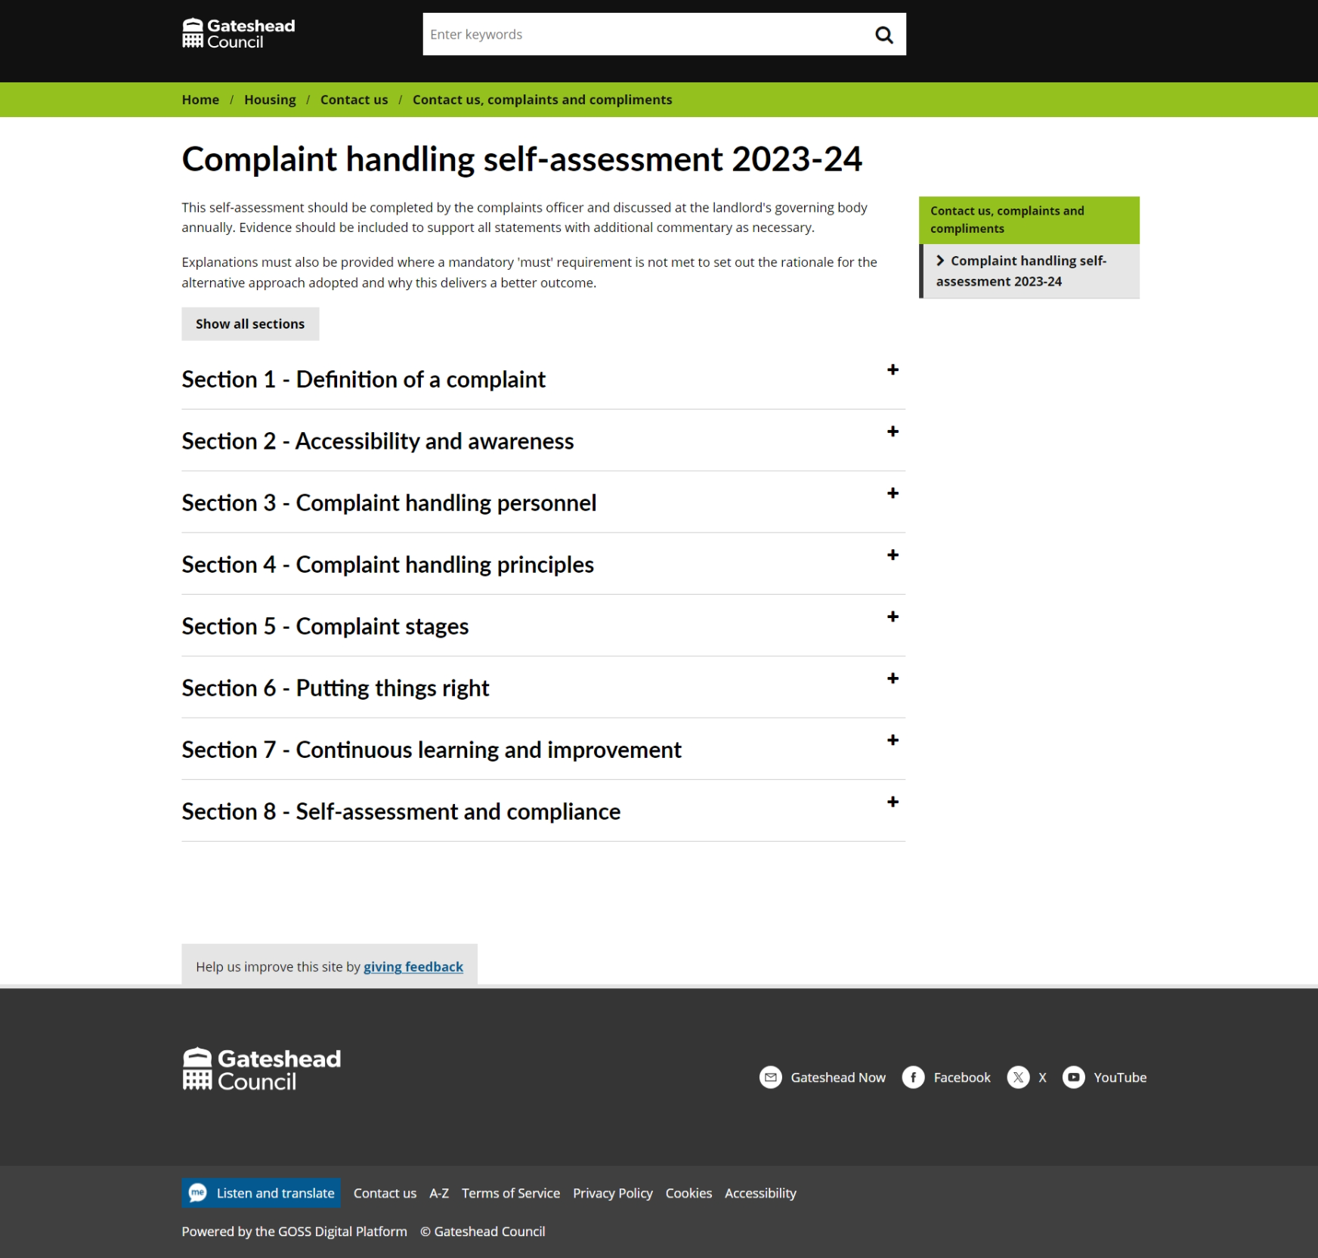
Sprint 25.
Housing
Contact us, complaints and compliments
Content
Notes:
GS

Slide 8
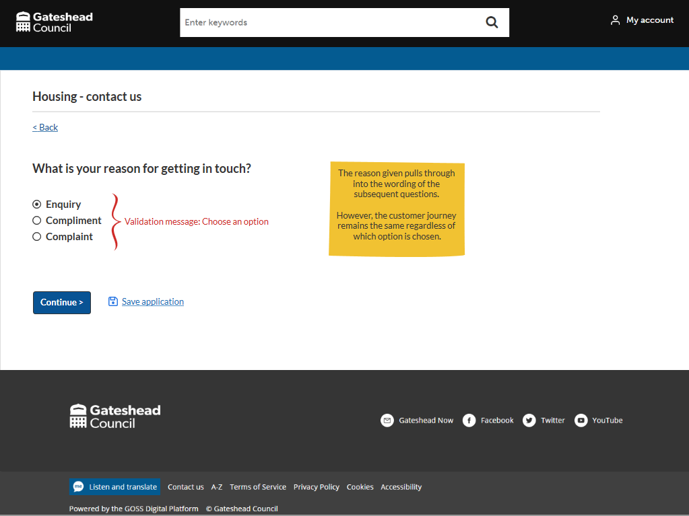
Sprint 25.
Housing
Contact us, complaints and compliments
Wireframe
Simple form, goes to email
Aims
Reduce contacts going to wrong department
Make the process clearer and simpler for customers
Based on data research by Holly Smiles
Notes:
GS

Slide 9
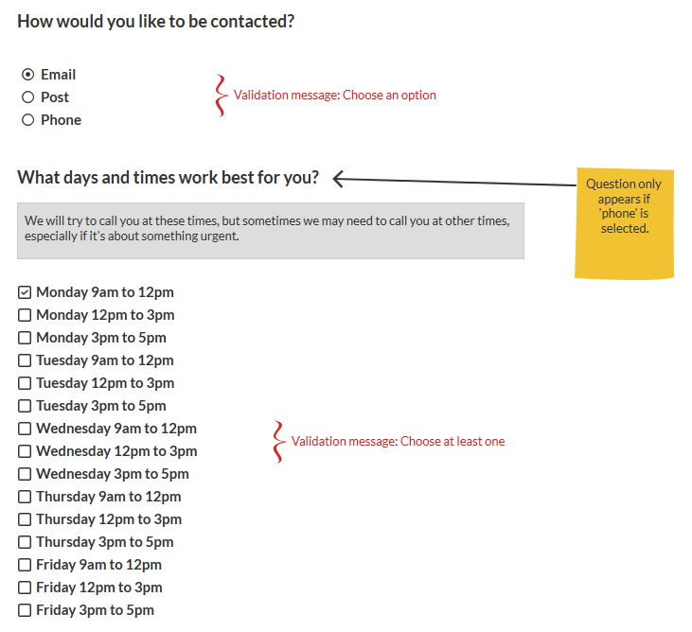
Sprint 25.
Housing
Contact us, complaints and compliments
Wireframe
Enhancement – asks how and when customers would prefer to be contacted
Notes:
GS

Slide 10
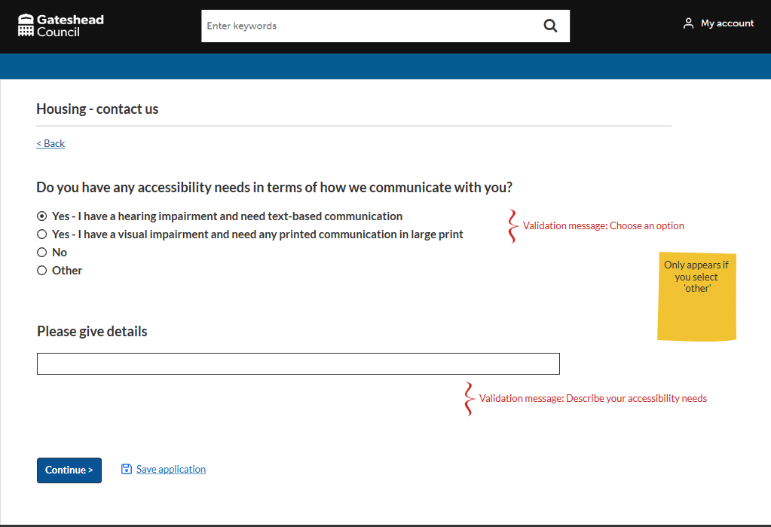
Sprint 25.
Housing
Contact us, complaints and compliments
Wireframe
Enhancement – asks if customer has accessibility needs
Notes:
GS

Slide 11
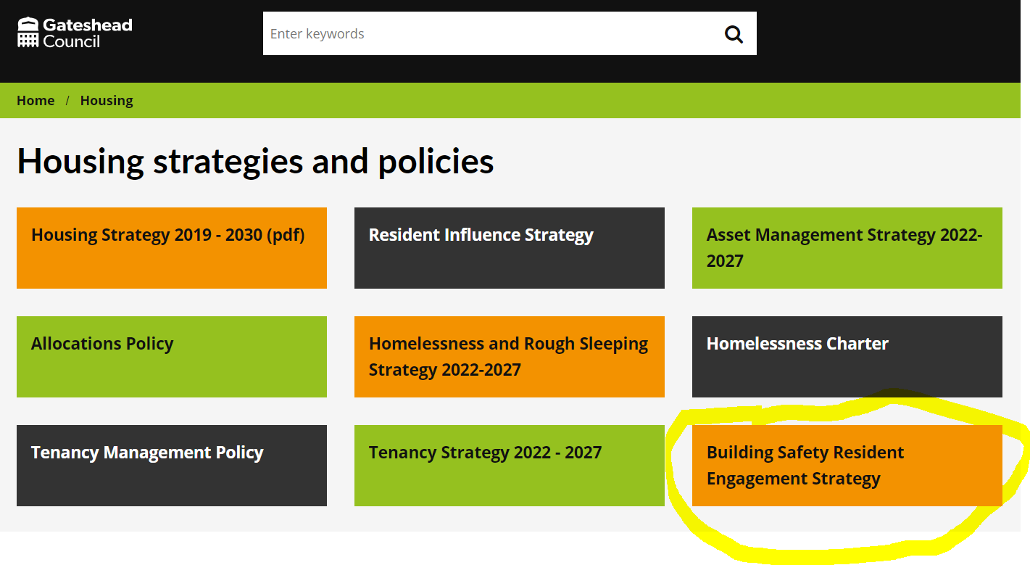
Sprint 25.
Housing
Building safety customer engagement strategy
Notes:
GS

Slide 12
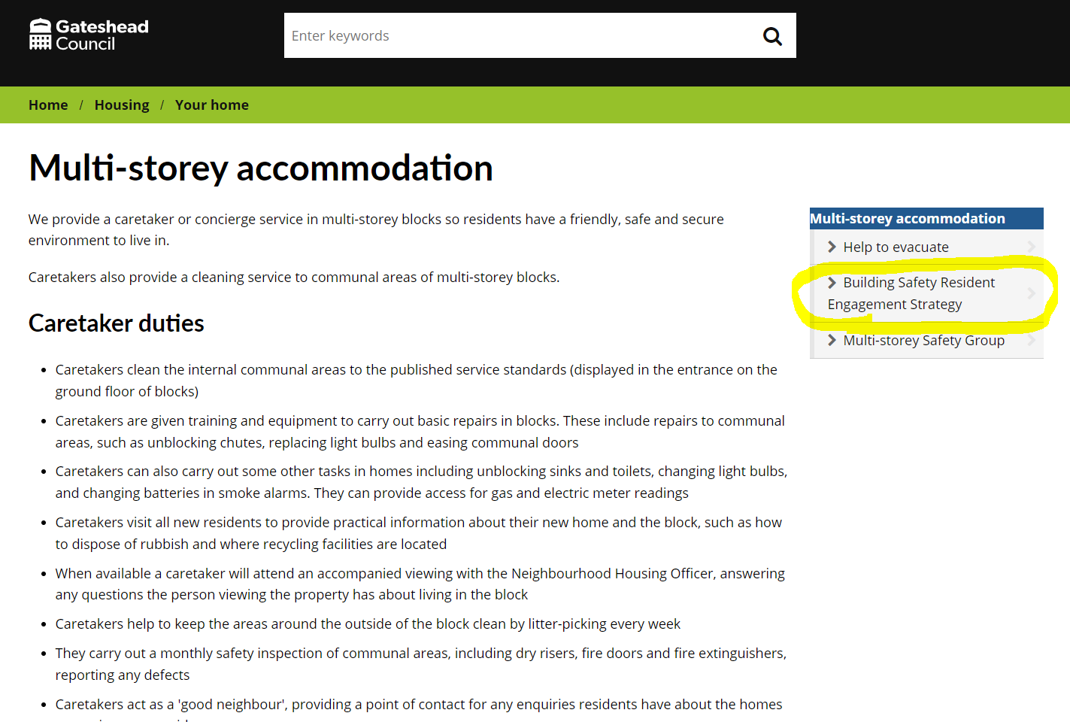
Sprint 25.
Housing
Building safety customer engagement strategy
Notes:
GS

Slide 13
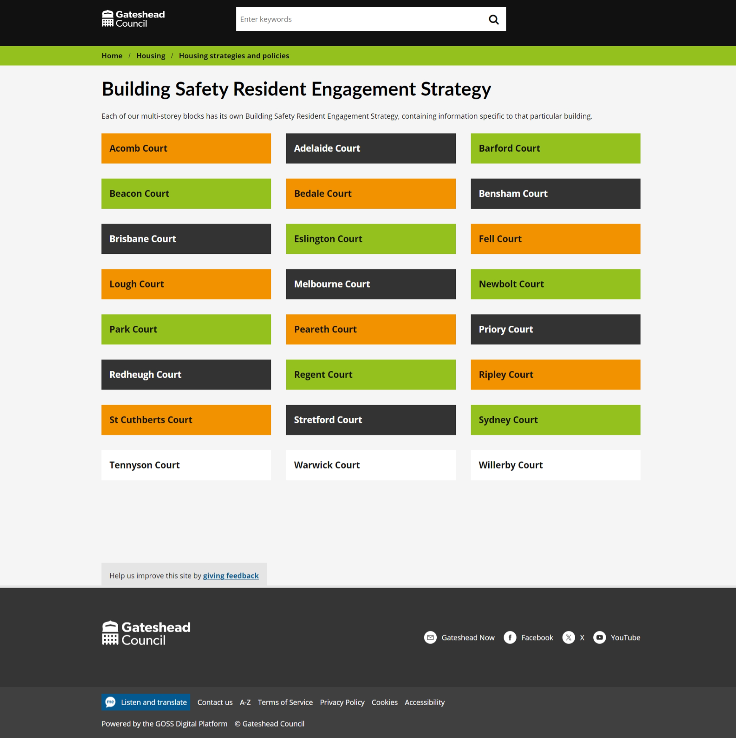
Sprint 25.
Housing
Building safety customer engagement strategy
Notes:
GS

Slide 14
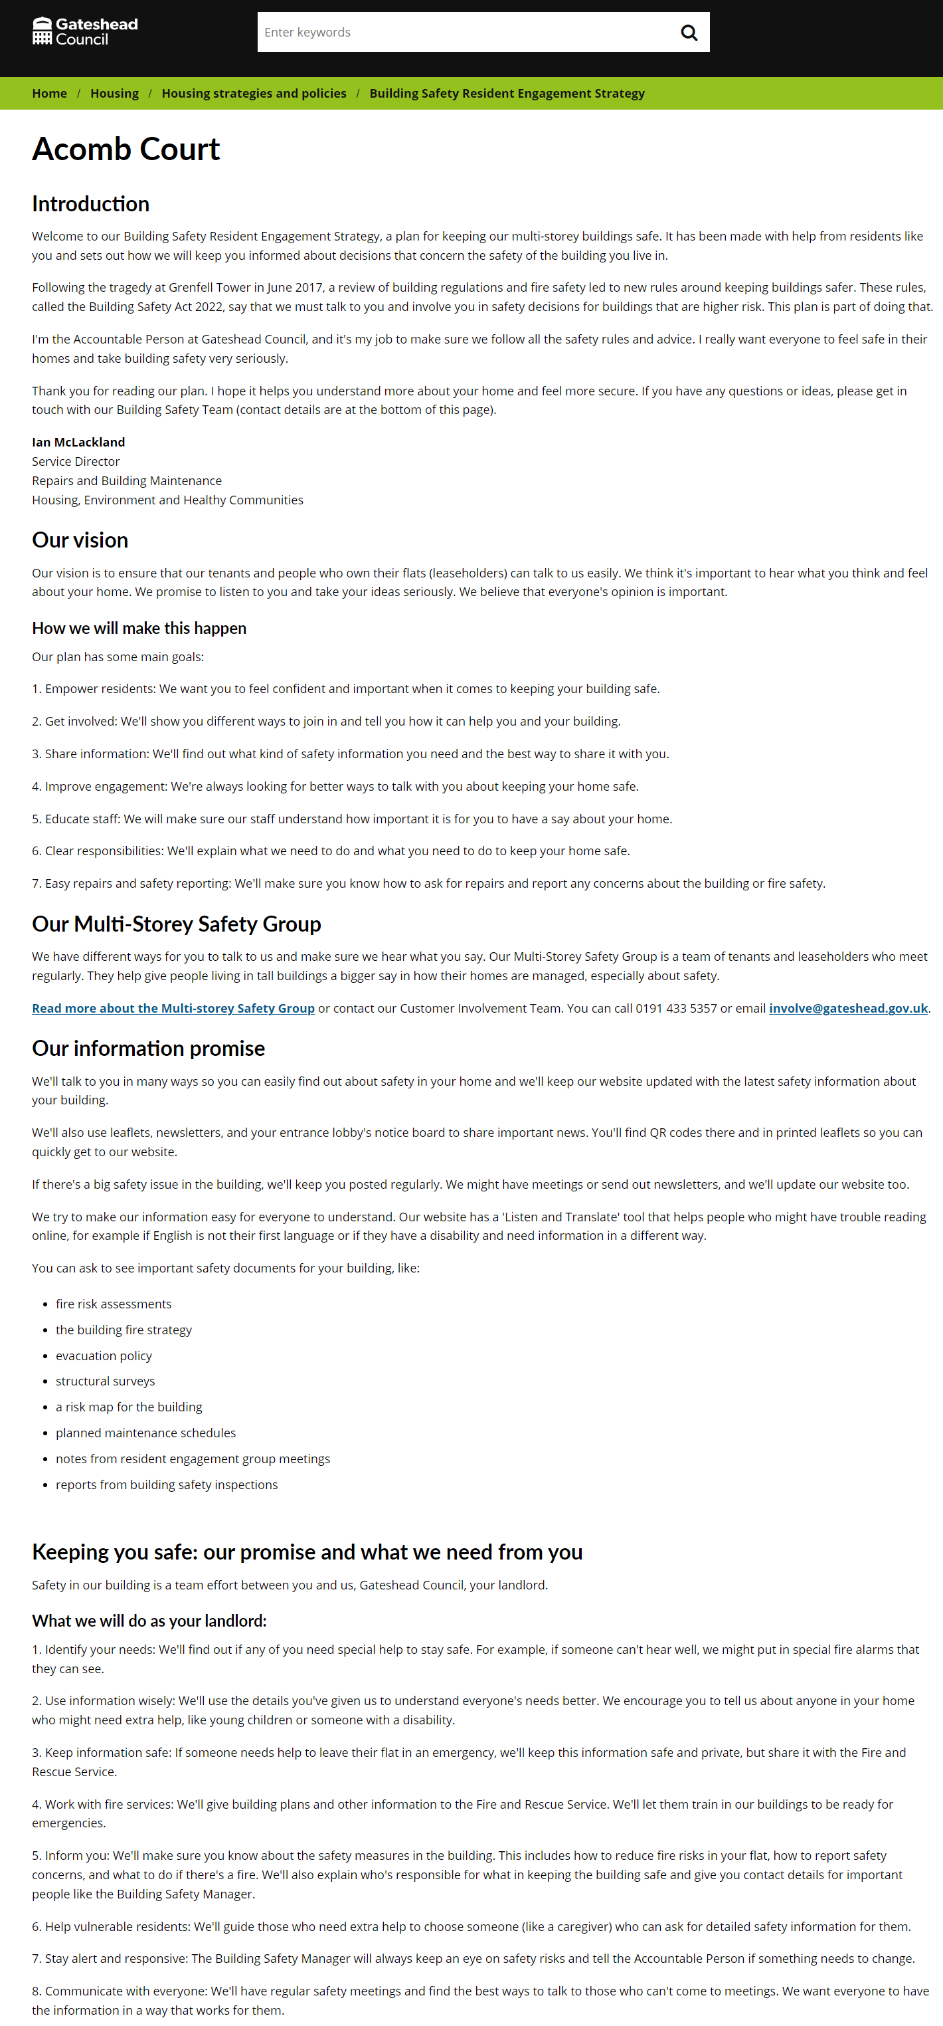
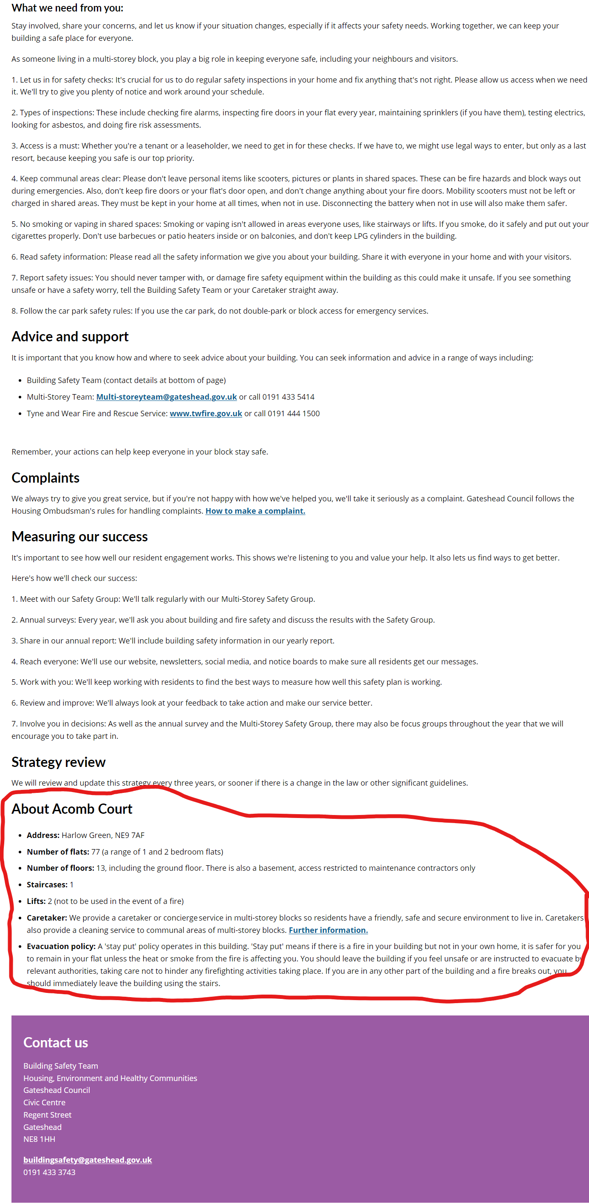
Sprint 25.
Housing
Building safety customer engagement strategy
Notes:
GS

Slide 15
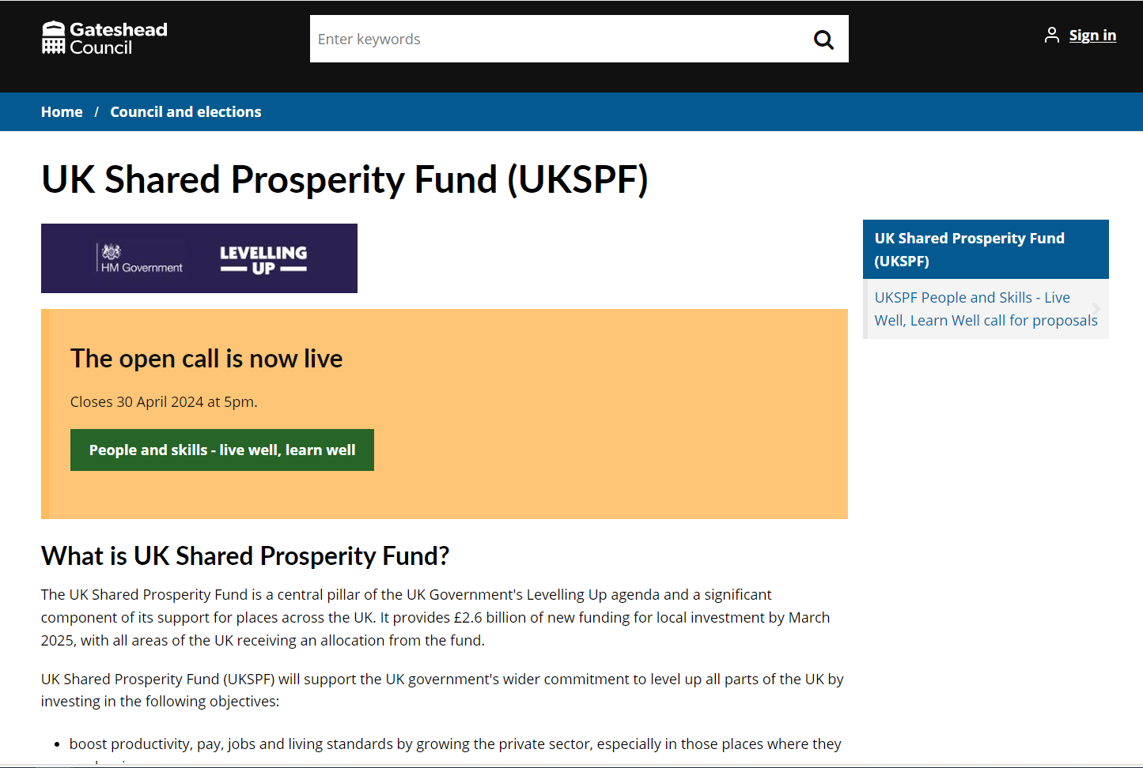
Sprint 25.
UK Shared Prosperity Fund
Notes:
GS

Slide 16
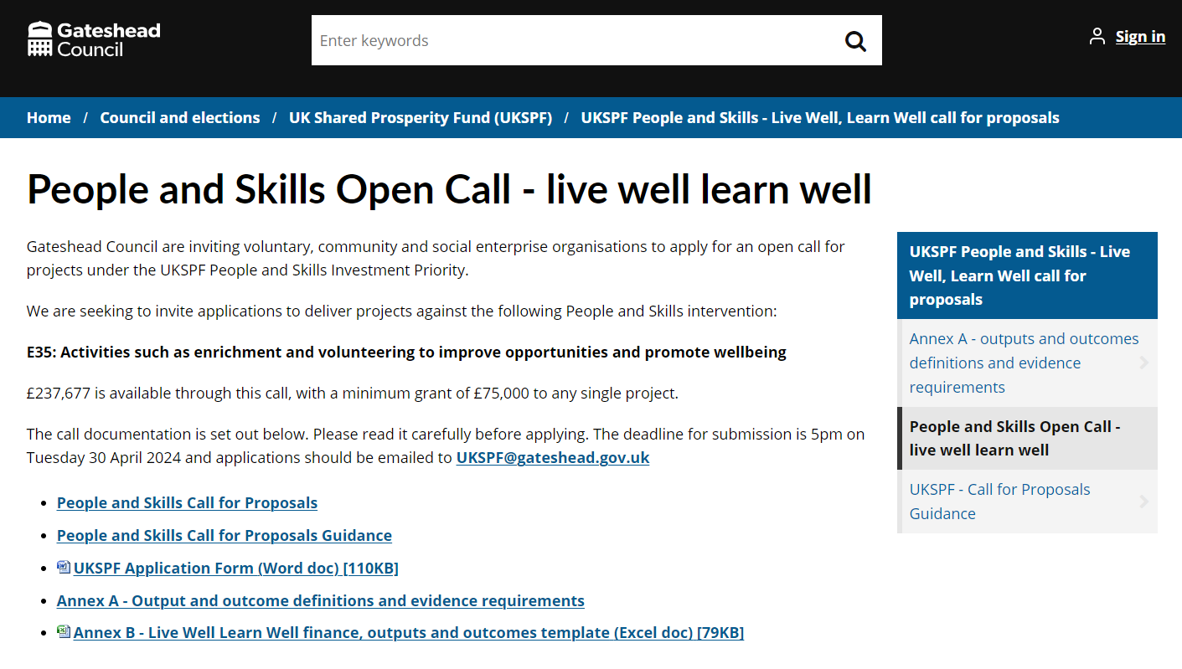
Sprint 25.
UK Shared Prosperity Fund
Notes:
GS

Slide 17
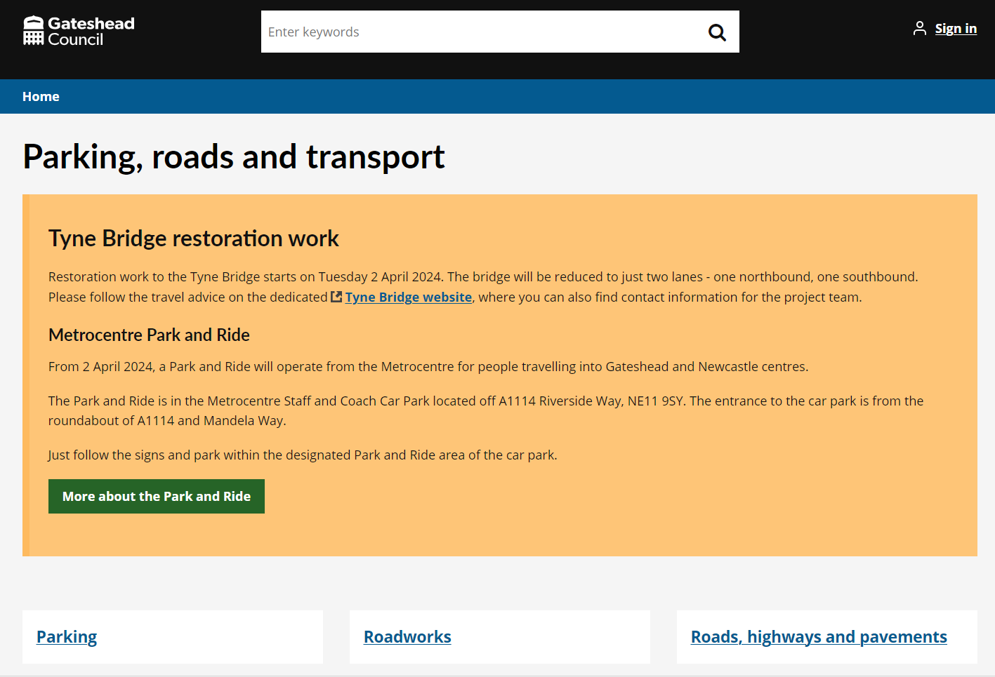
Sprint 25.
Tyne Bridge /
Park and Ride content
Notes:
GS

Slide 18
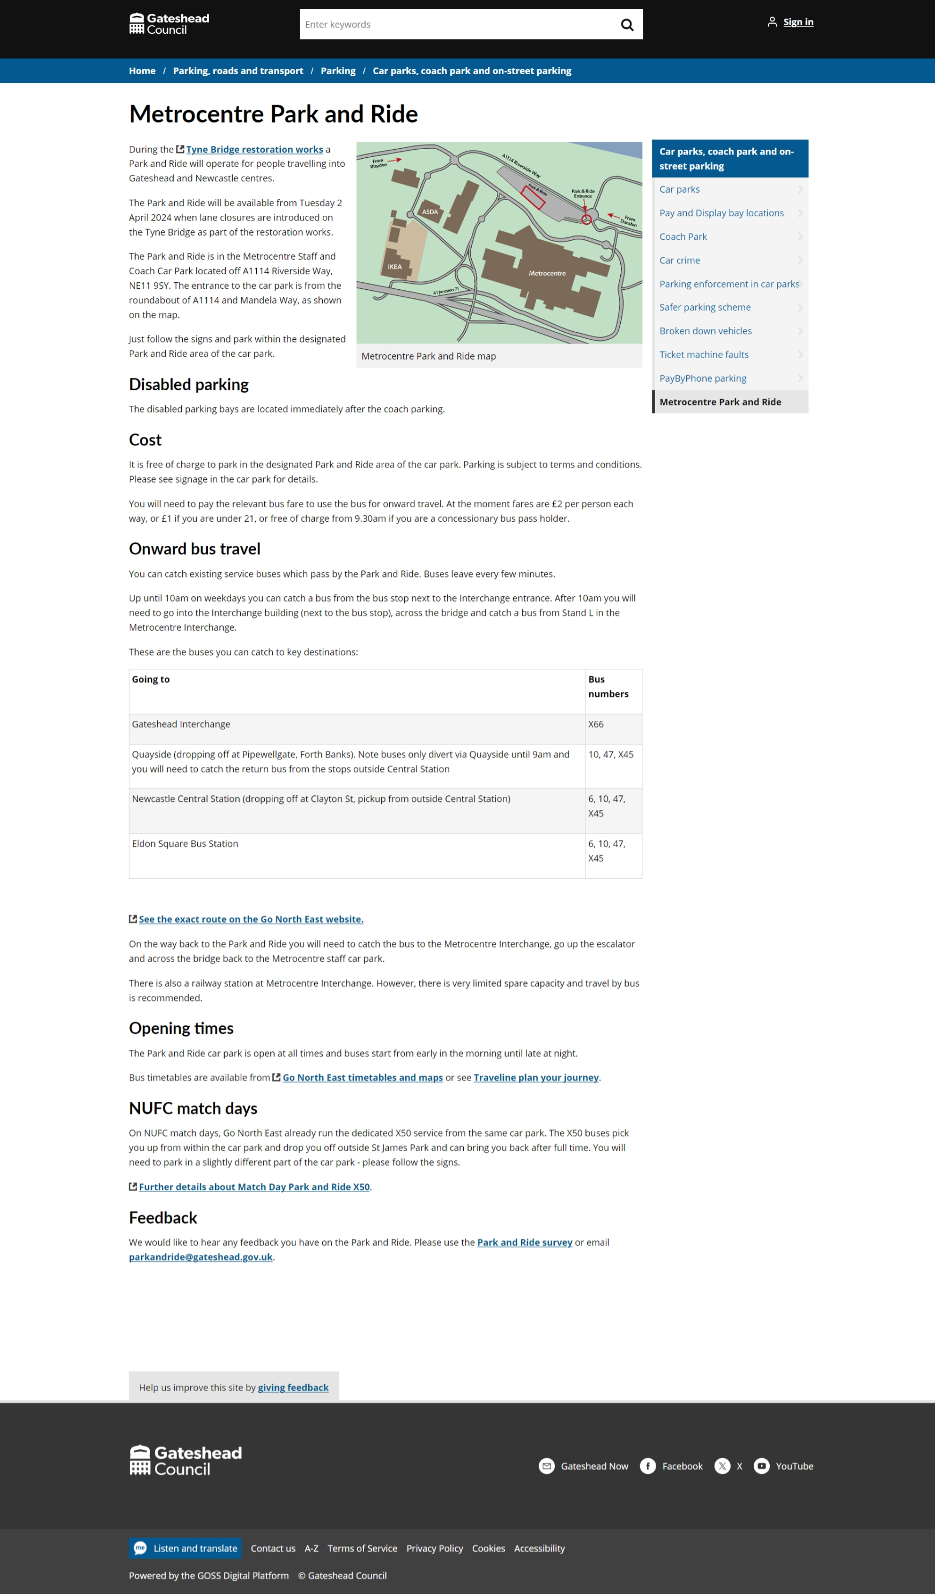
Sprint 25.
Tyne Bridge / Park and Ride content
Notes:
GS

Slide 19
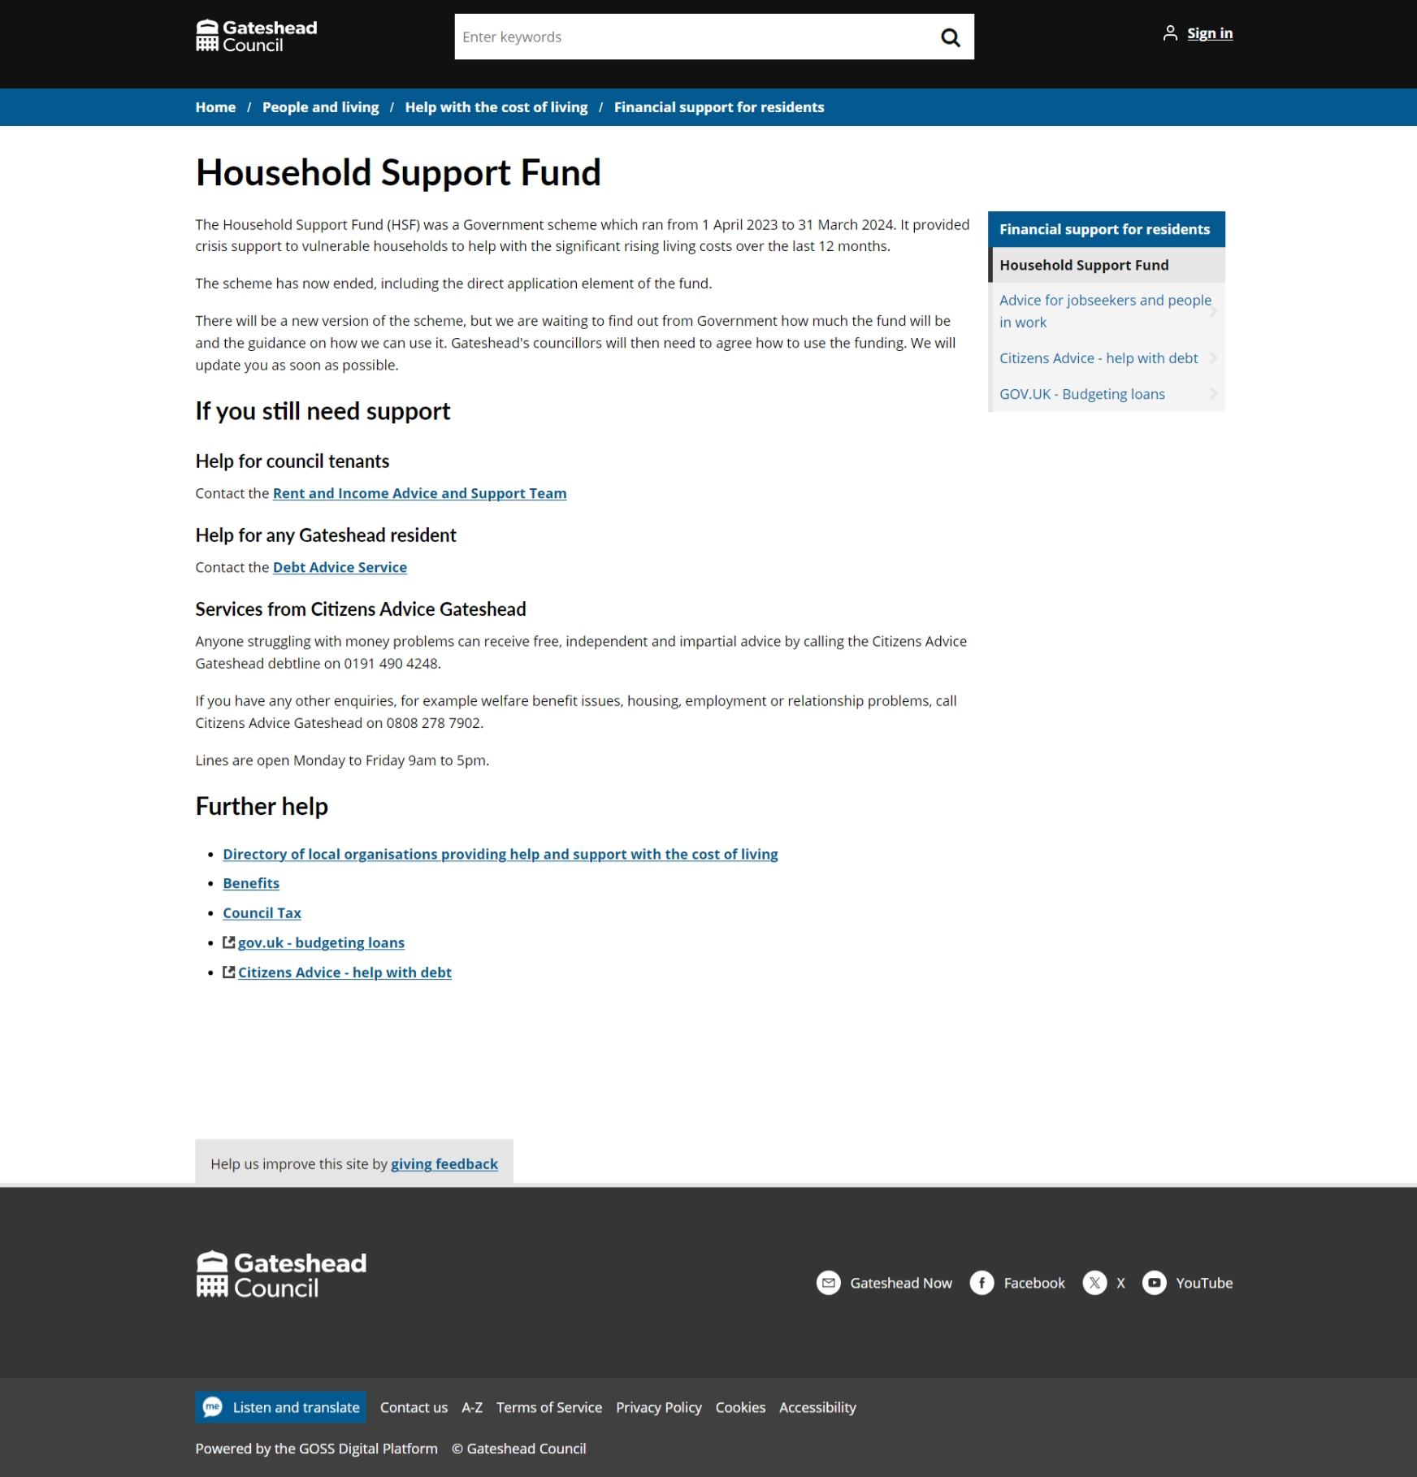
Sprint 25.
Household Support Fund closed
Content updated with next steps and form removed
Notes:
GS

Slide 20
Sprint 25.
ICT security policies
Notes:
GS

Slide 21
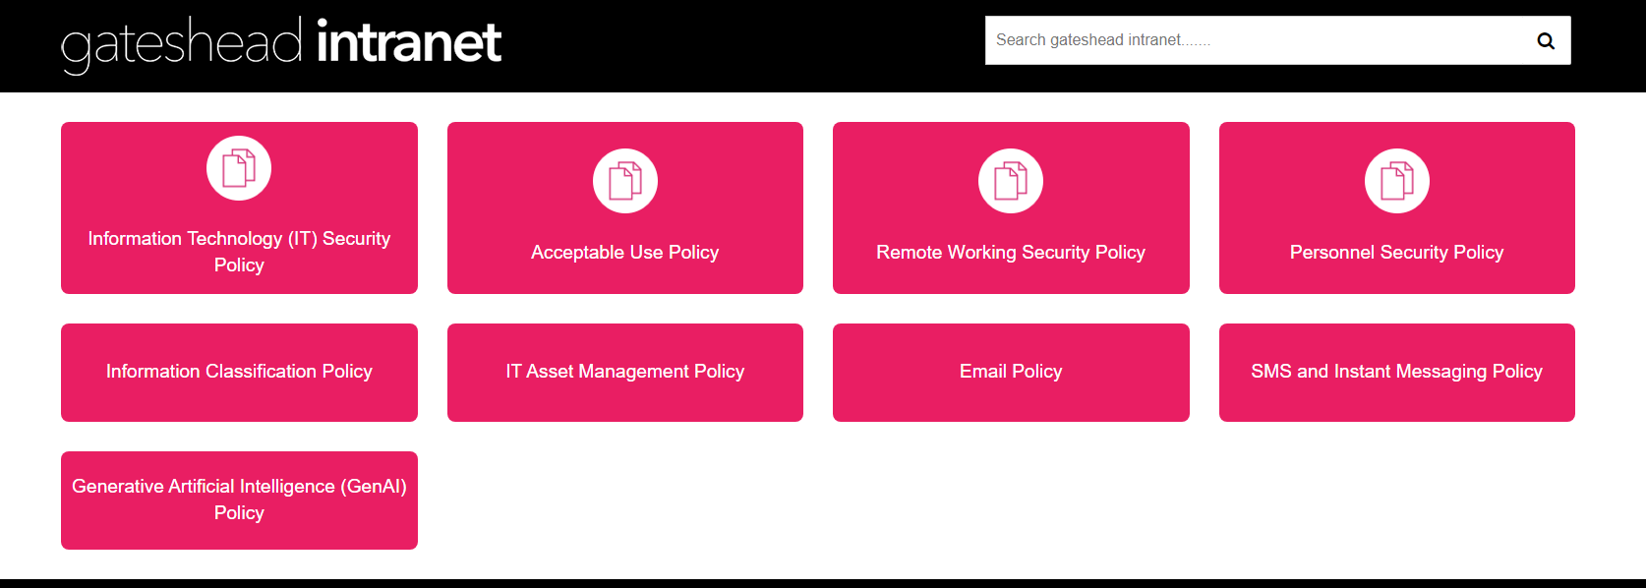
Sprint 25.
Notes:
GS

Slide 22
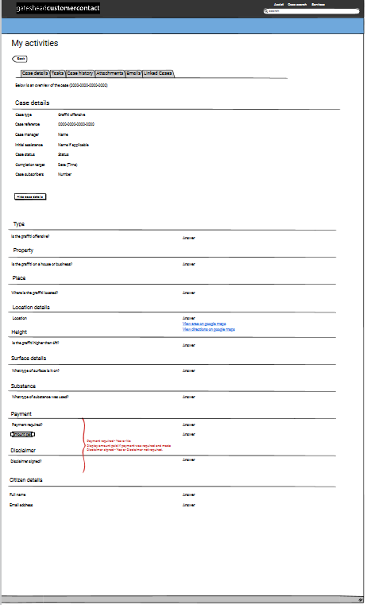
Sprint 25.
Graffiti
Notes:
GS

Slide 23
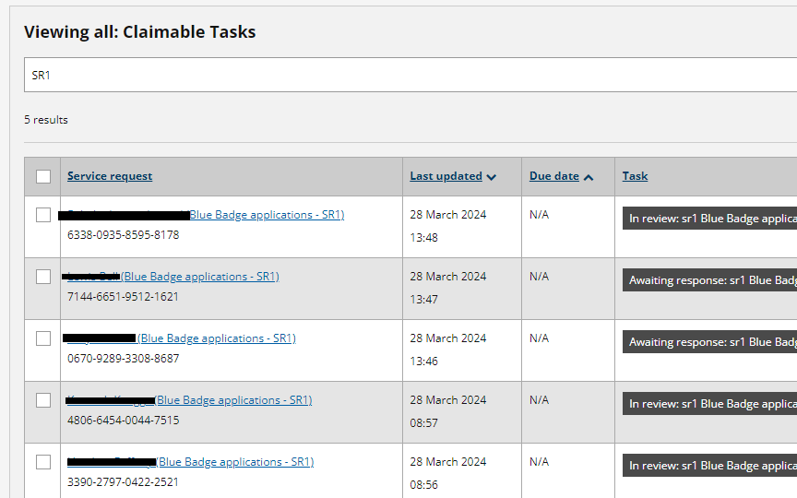
Sprint 25.
Blue Badge improvements
Highlight priority cases:
Cases where the applicant has indicated that they have a terminal illness are highlighted allowing staff to prioritise these applications
Notes:
GS

Slide 24
Sprint 25.
Blue Badge improvements
Routines to automatically change the status: When the 'Request payment' or the 'Request payment and photo' tasks are run a routine will automatically changes the status of the case to 'Pending payment' - saving staff time in processing
Backlog pruning: Worked through the backlog and closed down over 100 cases where the case had been rejected over a month ago or where information was pending from the applicant for over 3 months. Thanks to Nick for providing the data exports.
Identified future improvements: Gayle is going to wireframe a form to allow the staff to request information from the customer. This will be a more user-friendly interface than the 'contact loop' for both staff and the applicants. It will also allow us to use routines to automate status updates when a response is received.
Product suggestion to be raised which will auto populate the payment details, saving staff time on rekeying this each time a payment is required.
Notes:
GS

Slide 25
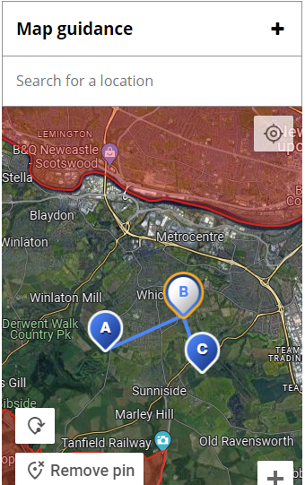
Sprint 25
Maps Development
Place Autocomplete (Search)
Prioritises results within an 8-mile radius of Gateshead counties center.
Limits searched to Great Britain to optimise API calls.
Zooms and pans map to selected location without dropping pins.
Updates: Improved script to be dynamic between environments and implementation into forms.
UI: Improvements made to UI after implementation of Place Search bar and Map guidance.
Efficiency: Reduced calls to Geocoder API to cut usage costs.
Bug fixes: Fixed bug where data approximate address was not syncing between markers when markers where removed and re-added.
Testing: Identified issue with marker selection on mobile devices.
Notes:
GS

Slide 26
Sprint 25.
Other development
Financial assessments:
Fixed a bug relating to the formatting of dates (DCE-9121)
HSF processing and improvements:
Processed the last of the current round of HSF applications
Small amend to the application form (DCE-9202)
Met with Nick and John McCabe on automating this process. John has developed an endpoint that we will be able to query whilst the person is submitting an application. This will remove manual steps when the applications are opened again in May.
Bulky waste amend form:
Fixed a bug to accurately update process data when citizens submit an amendment to their items.
Notes:
GS

Slide 27
Sprint 25.
What's next?
Council Tax single occupier discount development
Council Tax – user research
Council Tax – discounts / exemptions wireframing
Council Tax - change of address as is process mapping
Homelessness appeals - development
Blue Badge improvements
Notes:
GW

