Slide 1
Sprint 24 Show and Tell 27/03/2024
C Squad
Digital Team

Slide 2
Tyne Derwent Way site build
https://tynederwentway.ghc2-prd.gosshosted.com/

Slide 3
Tyne Derwent Way site build
https://tynederwentway.ghc2-prd.gosshosted.com/27359
https://tynederwentway.ghc2-prd.gosshosted.com/27475
https://tynederwentway.ghc2-prd.gosshosted.com/27472

Slide 4
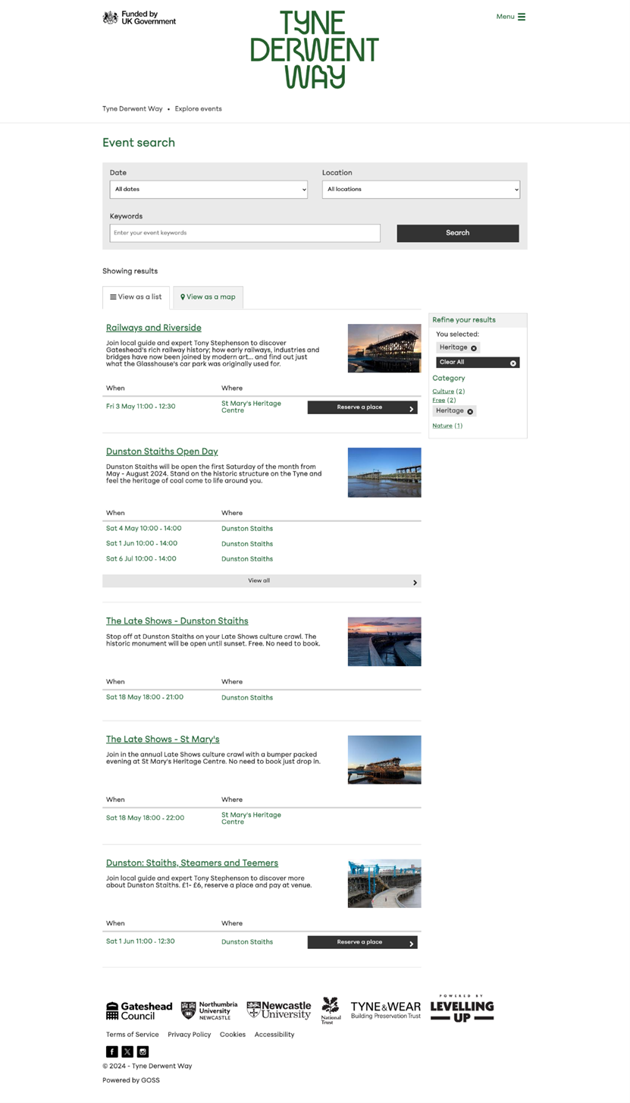
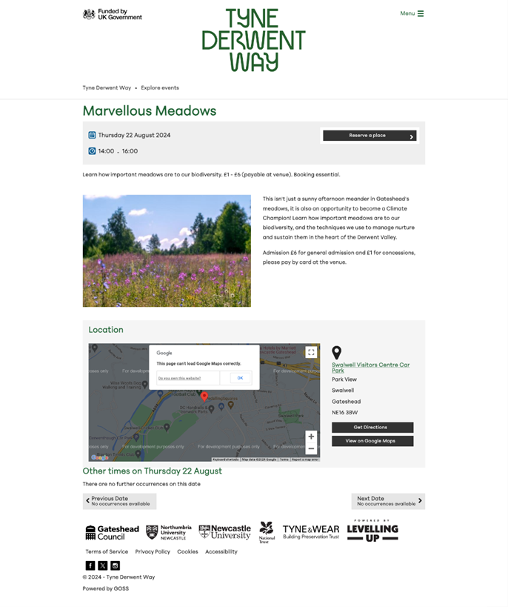
Tyne Derwent Way events
New events platform created for Tyne Derwent Way website
35 events added up to 31 August
New email templates created
Tyne Derwent Way event search

Slide 5
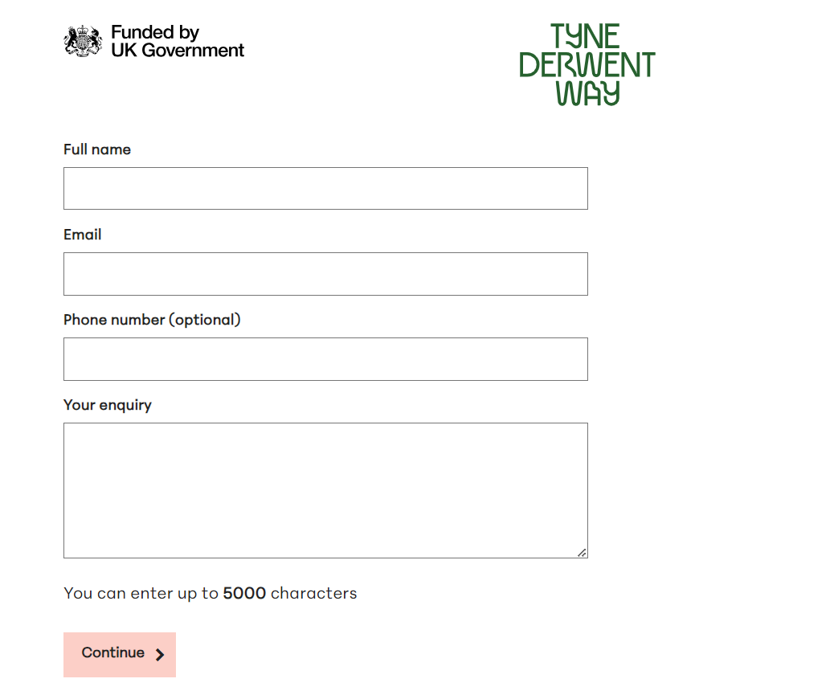
Tyne Derwent Way form
New enquiry are emailed to the service
Cases are autoclosed but searchable on Customer Contact.
https://tynederwentway.ghc2-tst.gosshosted.com/article/14781/Tyne-Derwent-Way-contact-us

Slide 6
Sprint 24
Discovery
Council tax e-billing - user research planning
Miro board
Highways licensing workshop
Damp and mould reporting for private sector tenants
Data challenge
Taxi vehicle testing
To be process map completed and sign off with service
Miro board
Engage to-be map
Care cost calculator
Research and compare existing care cost calculators
Miro board

Slide 7
Sprint 24
Content
Prep work for birth registrations at Blaydon
Updating fees and charges
Viewpoint – 21 March email
Tyne Derwent Way new bookings platform – set up and events added
Trade apprenticeships web content and email config
Gateshead Now issued 20 March
Trusting Hands content

Slide 8
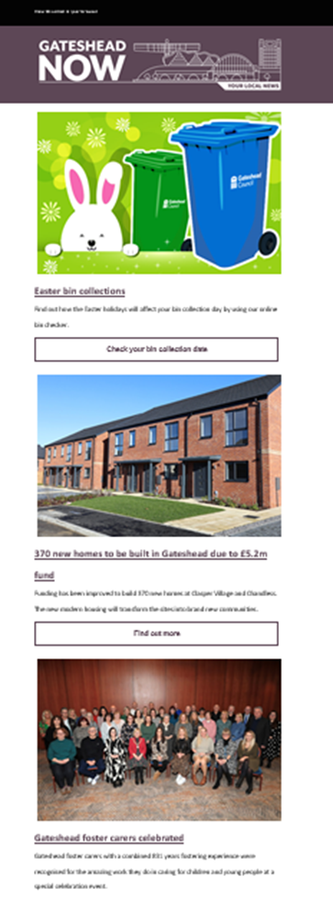
Gateshead Now
Gateshead Now went out on Wednesday 20 March.
Lead items:
Easter bin collection changes
370 new homes
Foster carers celebration
Trade apprenticeships

Slide 9
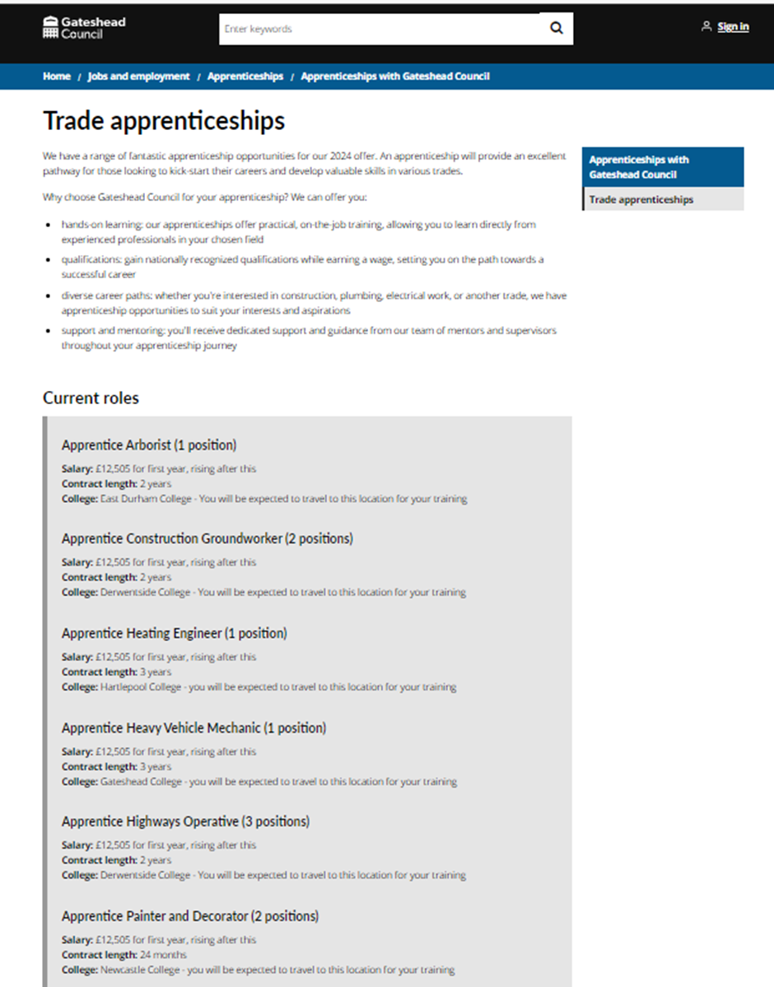
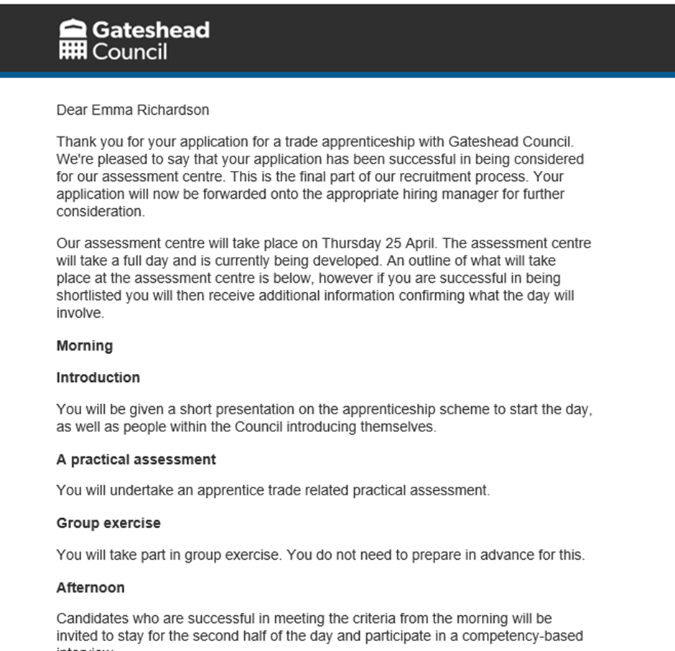
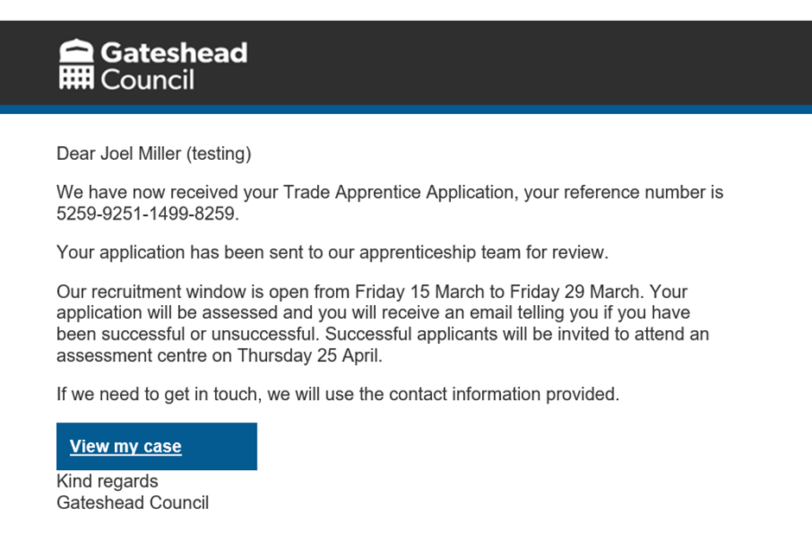
Trade apprenticeships
Content added for Trade apprenticeships (updated with change of closing date).
Email content for form submission, successful and unsuccessful applicants.

Slide 10
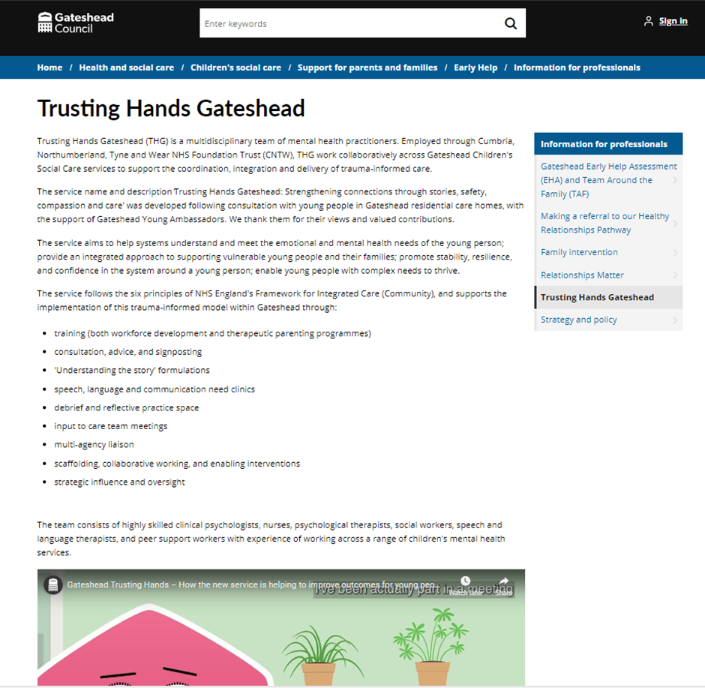
Trusting Hands Gateshead
New content for Trusting Hands Gateshead, a new service for professionals to help improve outcomes for young people.
Trusting Hands Gateshead

Slide 11
Sprint 24
Development
Move to AWS SES mailserver
Standard payment:
Building notices payment form: https://gateshead.ghc2-dev.gosshosted.com/13643
Food hygiene re rating form: https://gateshead.ghc2-dev.gosshosted.com/article/13641/Food-hygiene-re-rating-payment
Food safety export certificate payment form: https://gateshead.ghc2-dev.gosshosted.com/article/12385/Pay-for-a-food-safety-export-certificate

Slide 12
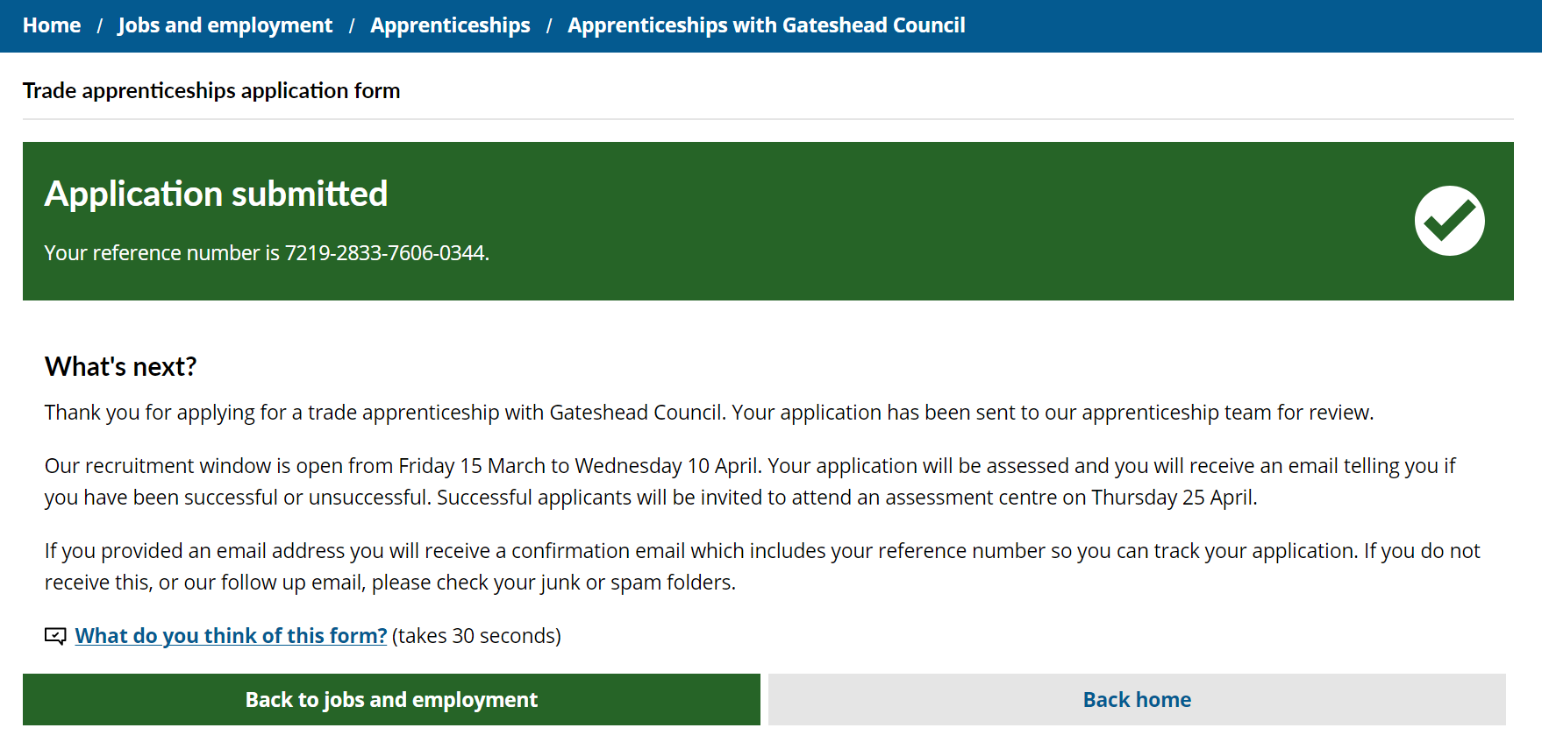
Amends to apprenticeship form

Slide 13
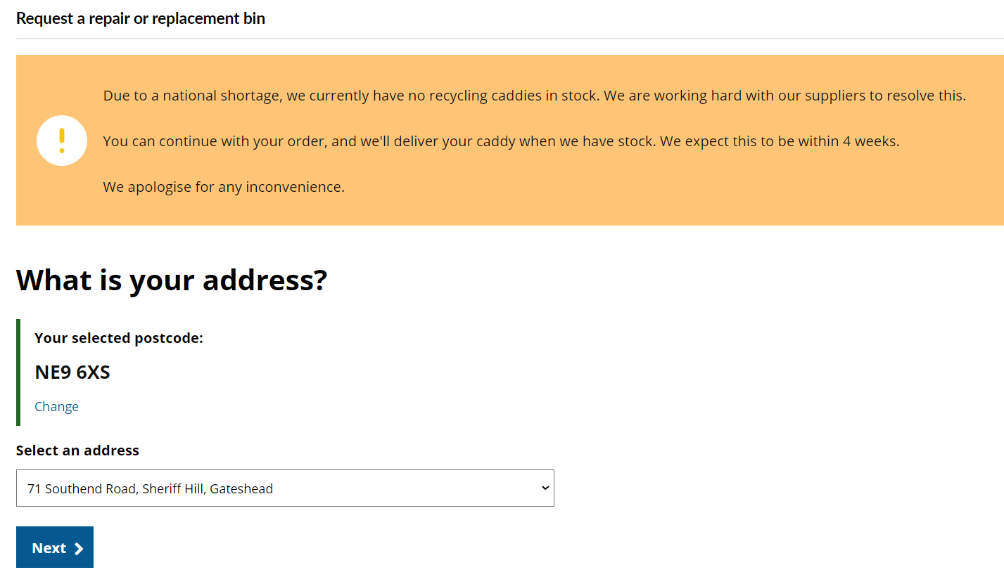
Amends to repair or replacement bin form

Slide 14
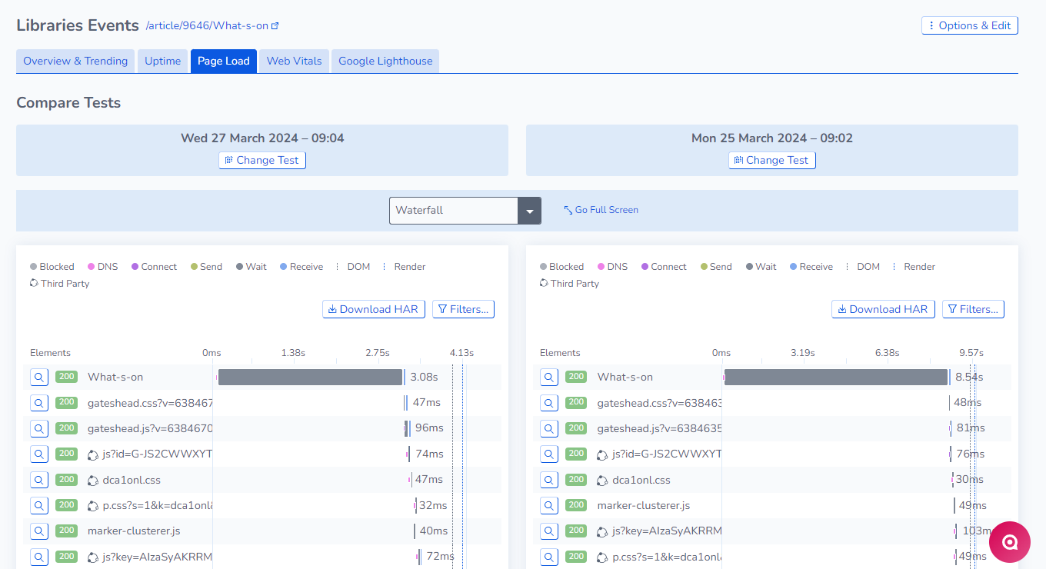
Data reporting
20,700 residents have subscribed for garden waste between November 2023 and March 2024.
Performance monitoring
Libraries what's on page
Case management for blue badge officers

Slide 15
Sprint 24
BAU/ Other tasks
Stakeholder leadership masterclass

Slide 16
What's coming up in Sprint 26
Discovery
Direct payments
Content
Tyne Derwent Way
Go live Blaydon birth registrations
Compress library images
Design
Tyne Derwent Way website build
Development
Standard payments
A to Z of forms
Performance monitoring

Slide 17
Sprint 24
Deployment

