Slide 1
Sprint 32 Show and Tell 05/06/2024
C Squad
Digital Team

Slide 2
Sprint 32
Sprint goals
Develop plan for gateshead.gov.uk Information Architecture (IA)
Progress with taxi licensing vehicle testing wireframes
Ready to go live with new digital pages

Slide 3
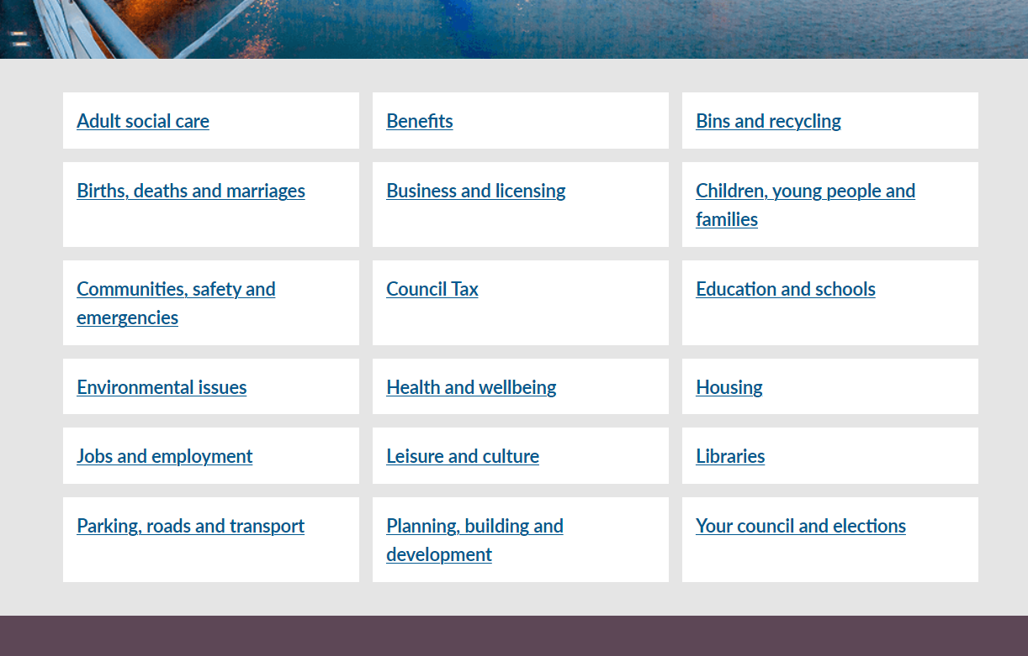
Develop plan for new IA rollout on gateshead.gov.uk
The new site IA / structure will have 18 site sections instead of the current 12​
The plan is to incrementally make the changes to the structure in a way that will have the least impact on site users
​
Sections such as births, deaths and marriages; libraries; bins and recycling; and Adult Social Care will be brought to the homepage instead of being hidden under other categories​
Some categories will be renamed, such as education and schools; planning, building and development; and communities, safety and emergencies to better explain what is contained in those sections and make the IA more intuitive​
A new section, children, young people and families, will be created to bring together sections such as children's social care; childcare; adoption; fostering; and Family Hubs instead of this information being divided amongst other categories​
As we've moved adult and children's social care into their own sections, a health and wellbeing section will be created to bring together content that was previously under health and social care – public health, JSNA and Healthwatch Gateshead

Slide 4
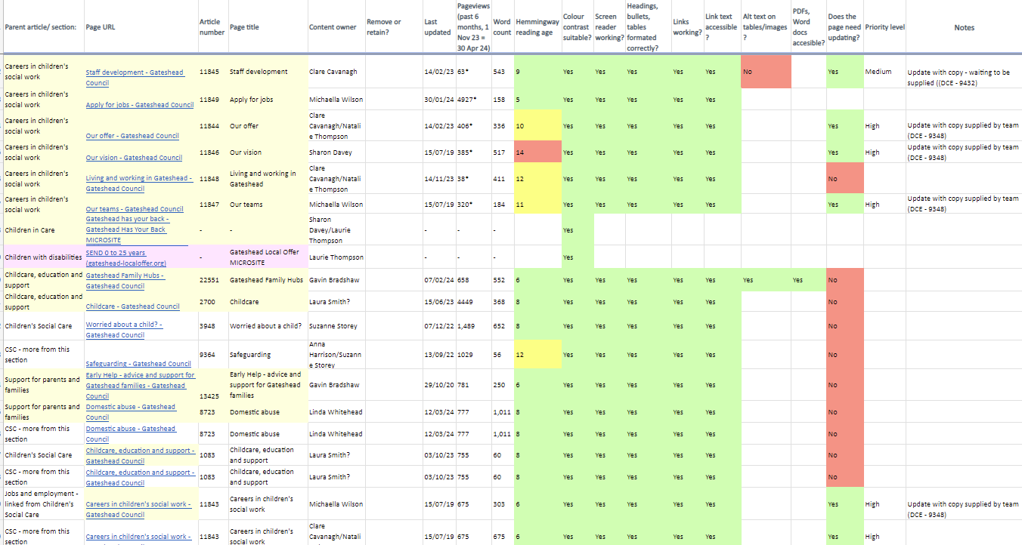
Children's Social Care content audit
Completed content audit for CSC section of the website:
86 pages reviewed
Summary findings reported
Shared with service
Forward plan agreed with service to identify content owners and to update content/remove out-of-date content

Slide 5
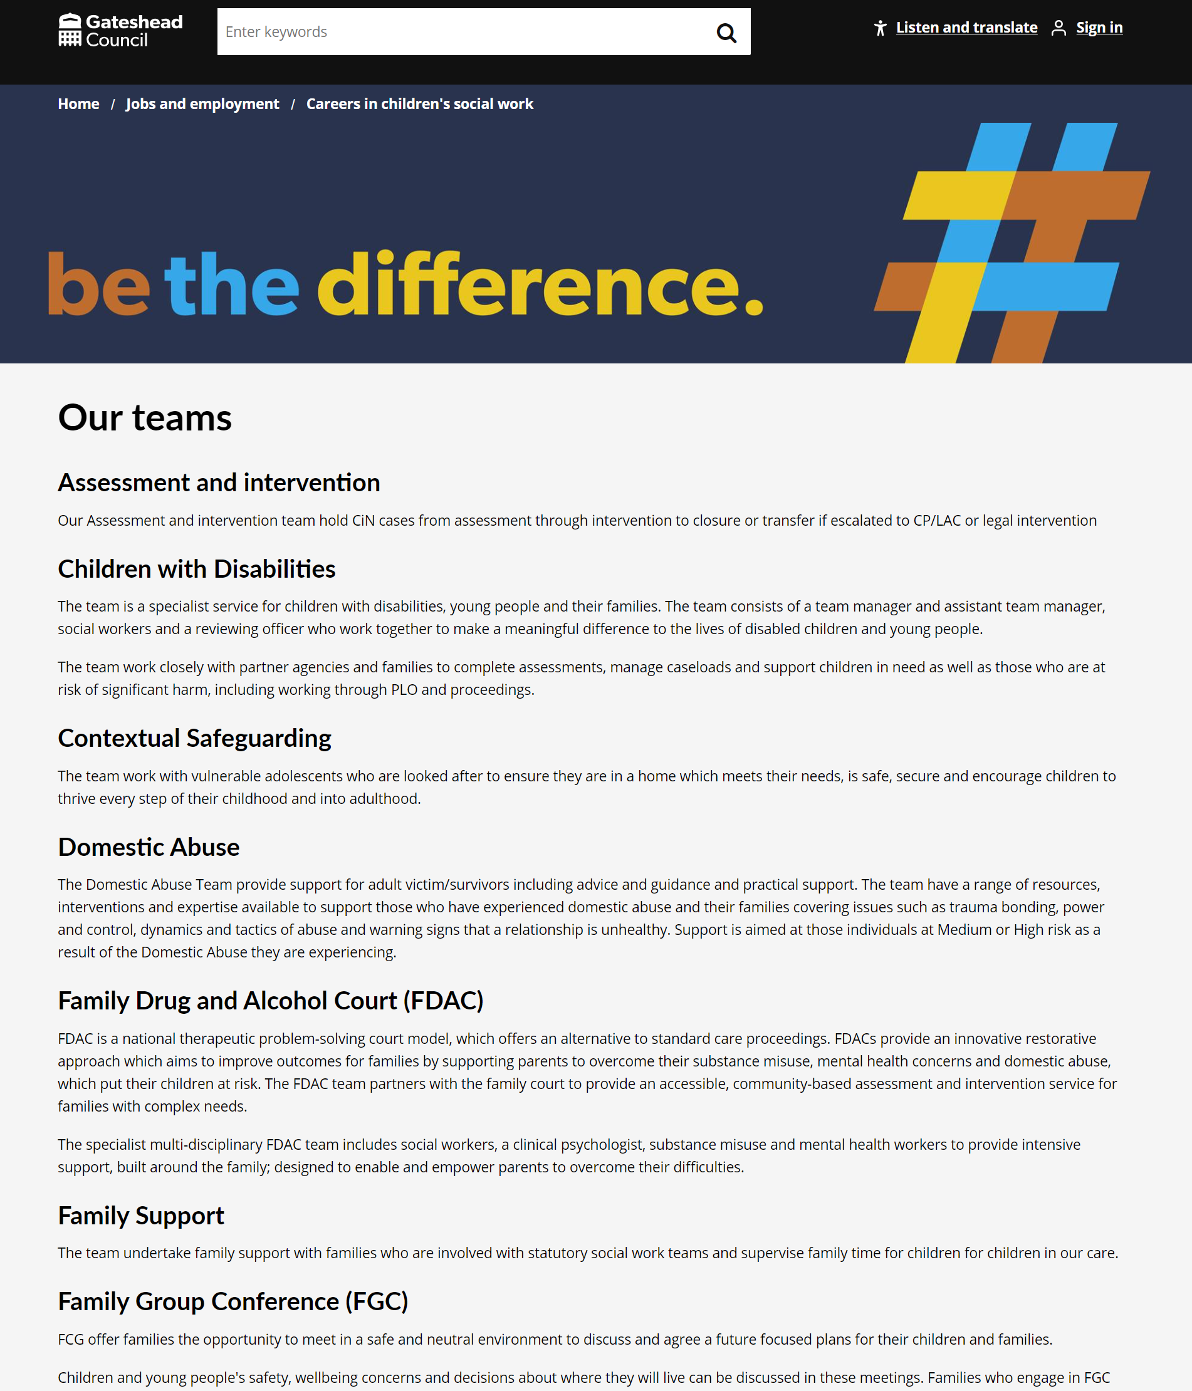
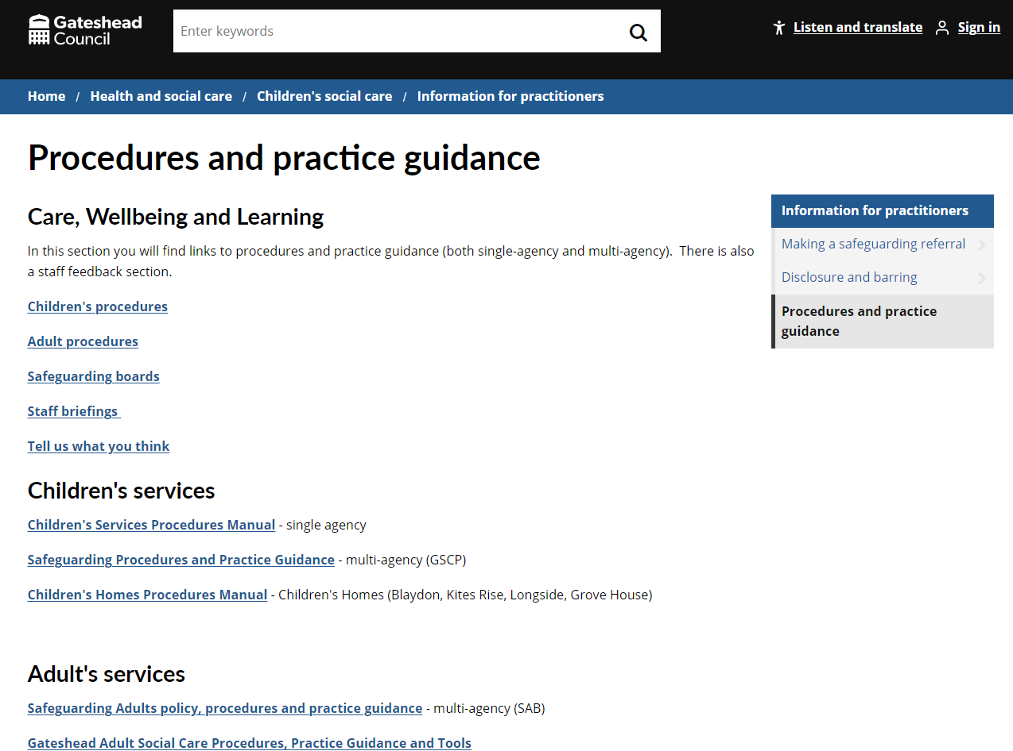
Content updates and removal of out-of-date information for CSC
Content updates to Careers in Children's Social Care pages along with adding new branding/colour to pages
Emails sent to content owners across service and out of date links/pdfs have been updated on various pages. Some old content removed.

Slide 6
User Brain testing across Children's Services webpages
Tested 5 different scenarios on User Brain including: fostering, careers, worried about a child, family hubs and children with disabilities
Fostering scenario
You and your partner are looking to foster a child. You decide you would be best suited to fostering an older child, around 12 years old.
You want to find out more information on how much you would receive financially for this as well as seeing if there is a way you can find out more information about fostering by speaking with someone.
Outcomes:
5/5 testers found the fostering section and relevant information
3 on computer used the search bar and found information quickly
2 testers on mobile struggled to find the section using the main menu button homepage
"Structured well"
"The information when I got there was really comprehensive"
"Easy to read and digest"
Careers in CSC scenario
You are looking for a new job as a children’s social worker in Gateshead and want to know more about this. Demonstrate how you would navigate the Gateshead Council website to do this.
Outcomes:
5/5 testers found the careers in CSC pages
All 5 testers clicked on the Jobs and employment section on the main menu on homepage
"Very easy, very clear, very concise"
"Information is orderly, neat and not complicated"

Slide 7
User Brain testing across Children's Services webpages
Worried about a child scenario
You are becoming concerned about a young child who lives at a neighbouring house. You often see the young child outside by themselves – crossing roads in busy traffic and late at night without any supervision. You also often hear shouting, crying and screaming coming from their house. You want to know what can be done to protect them from coming to any harm.
You have already contacted the police who said to contact the local authority as the child wasn’t in immediate danger.
Outcomes:
5/5 testers found relevant information
2 people ended up on Children's Safeguarding website
3 testers ended up on Worried about a child webpage
"The information was exactly where I would expect it to be"
"A lot easier to find than I thought it would be"
Family hubs/early help scenario
You’ve got a 9 month old child – you’re looking for support for yourself and child. You want to see if there are any centres near you that you can attend baby/toddler groups to meet others or places you can get support as a parent.
Outcomes:
Only 2 testers found the Family Hubs section of the website
Every tester clicked on People and living section where the information isn’t linked
"Hard to find the information"
"Once you get there the information is easy to understand"
Children with disabilities scenario
You have a child with a disability. You are wanting to access extra support but don’t know what support there is that you can access.
Outcomes:
3/5 testers found the relevant information on the Children with disabilities section
The 2 testers who couldn't find it clicked on Benefits and People and Living
"Entering the keywords in the search made it easy to find"
"I don’t know if I'm in the right place"

Slide 8
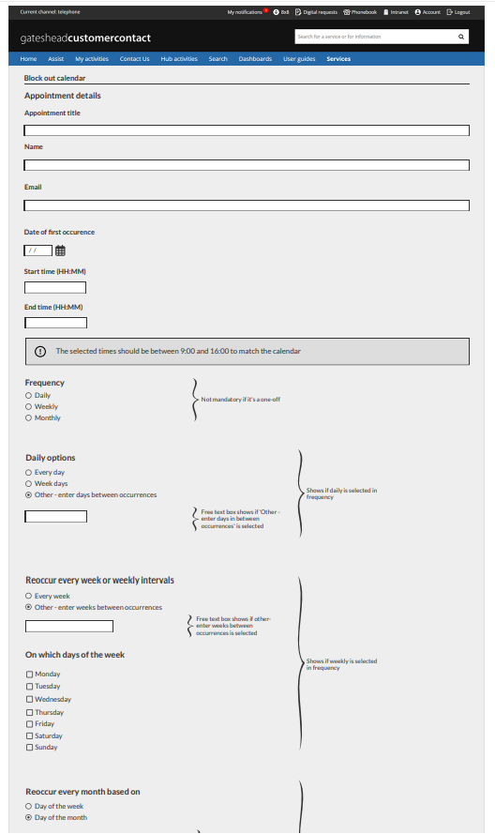
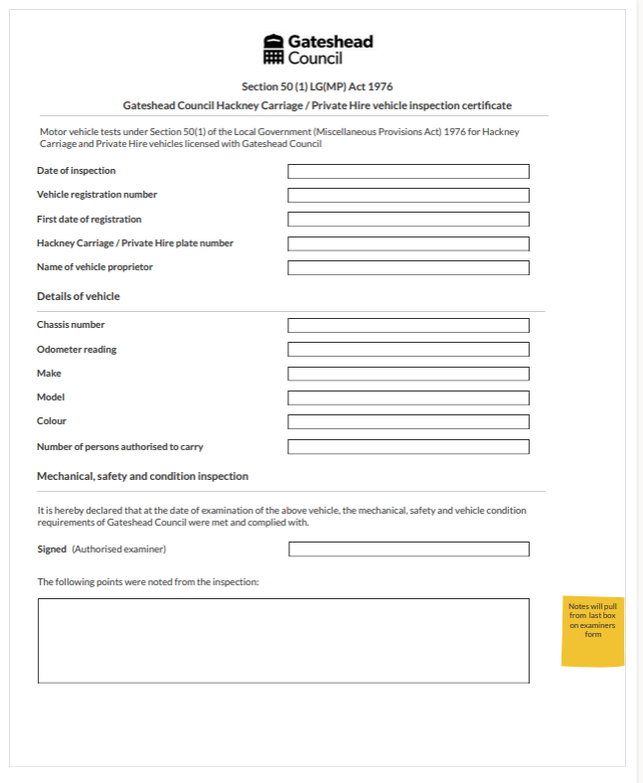
Taxi vehicle testing: wireframes for Section 50 certificate and block bookings

Slide 9
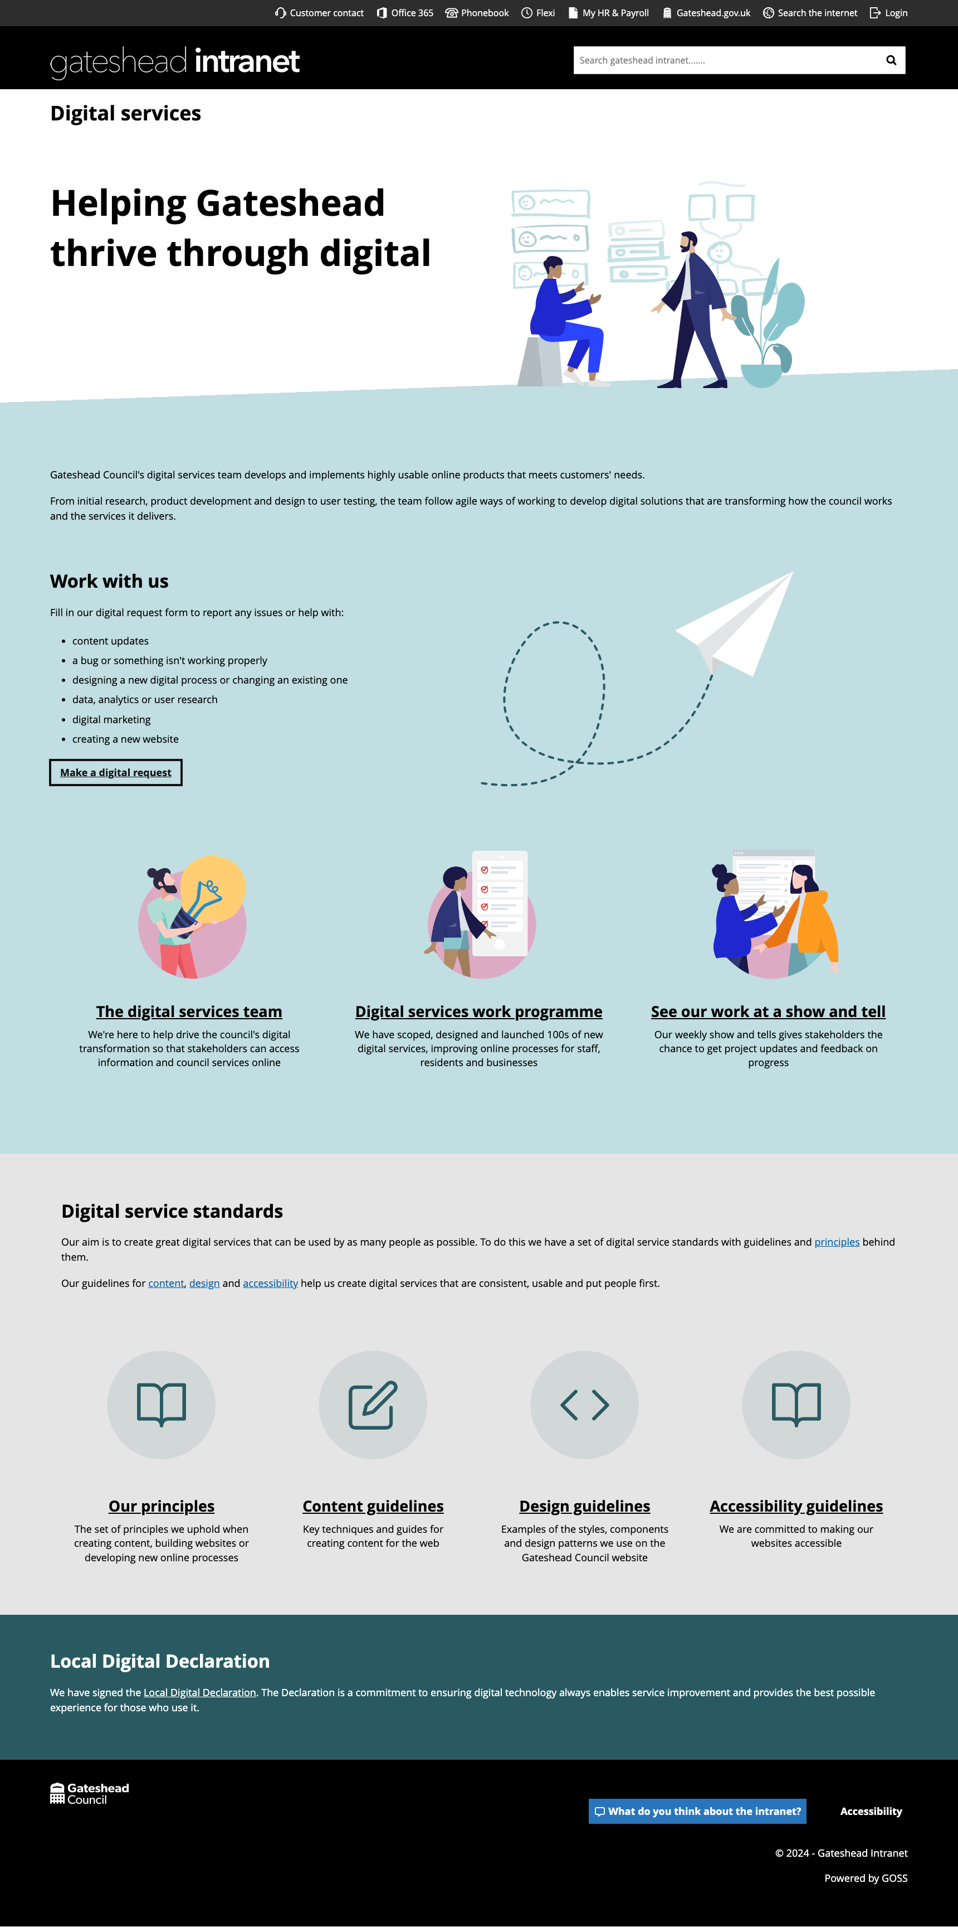
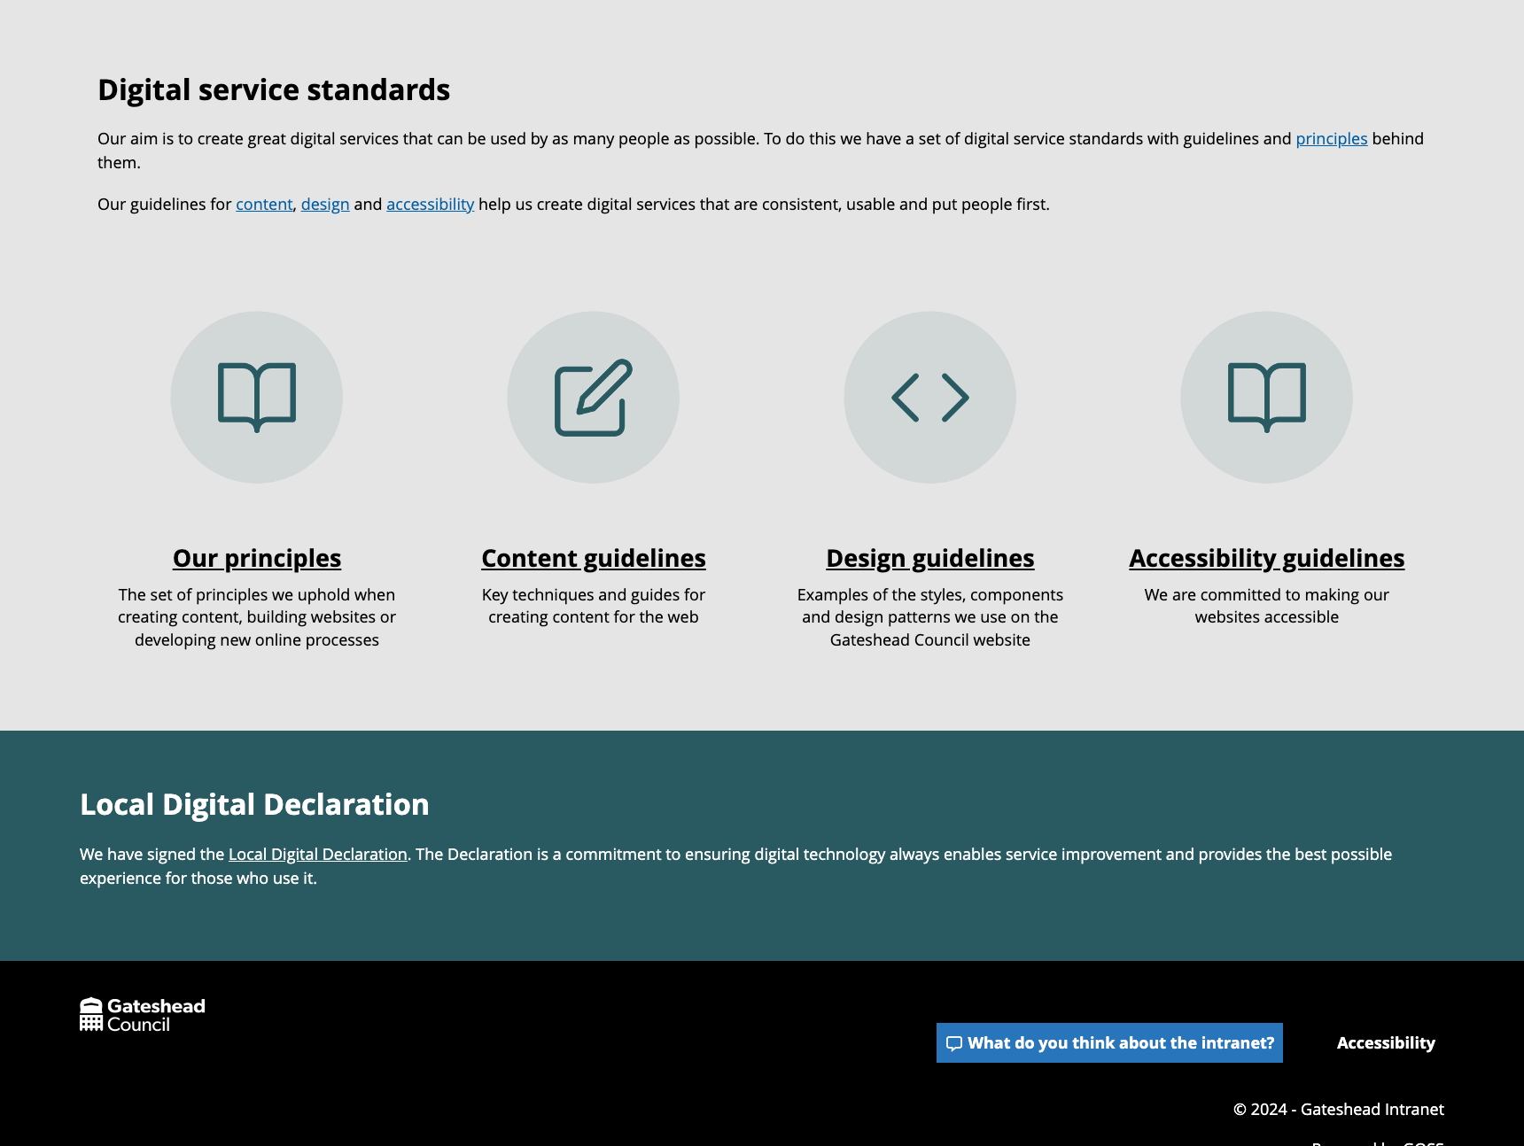
Digital services

Slide 10
Digital services
Reorganised content on the home page
Checked and updated content throughout the site
https://intranet.gateshead.gov.uk/article/24880/Digital-service-standards

Slide 11
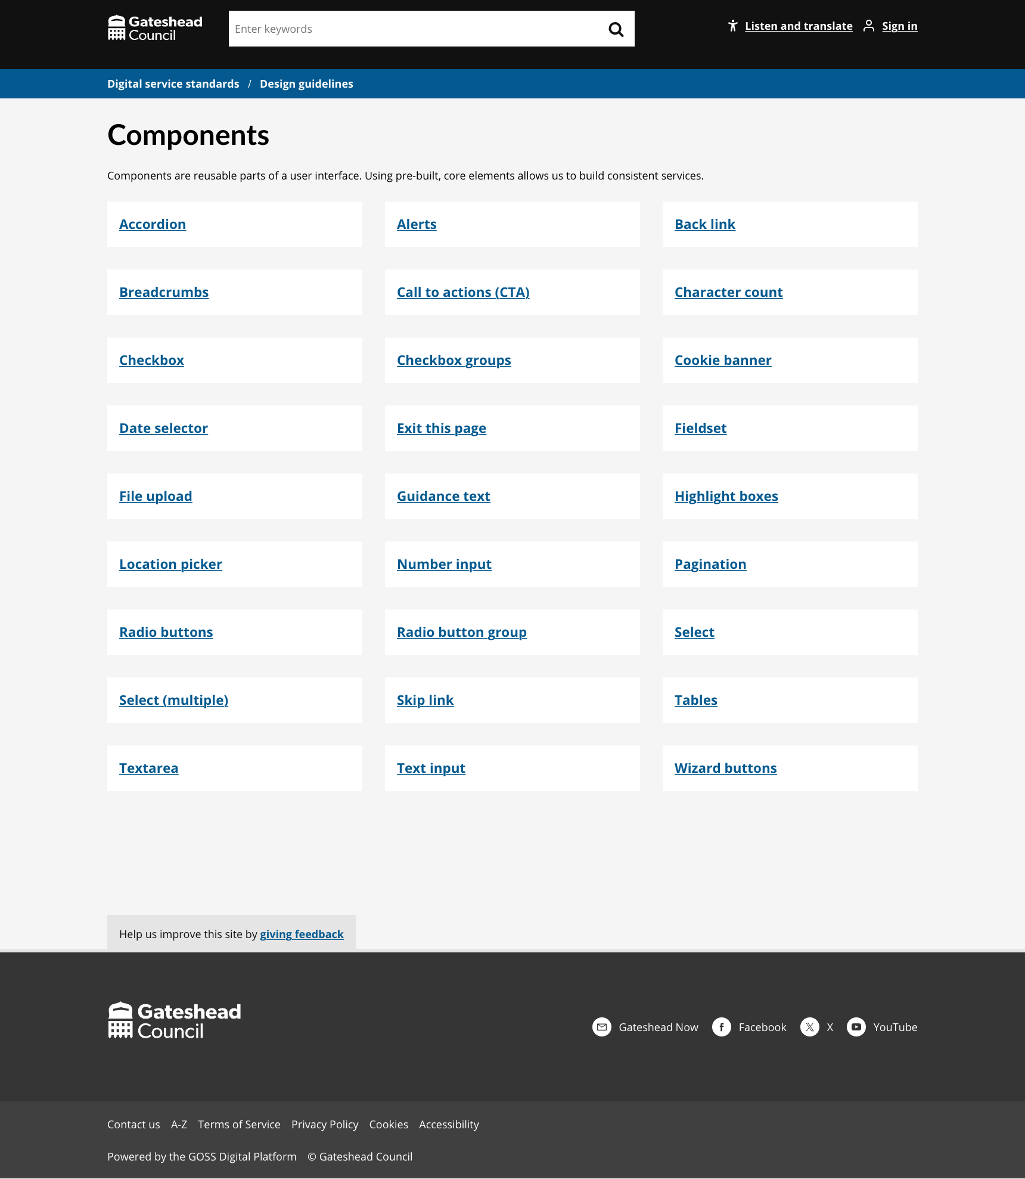
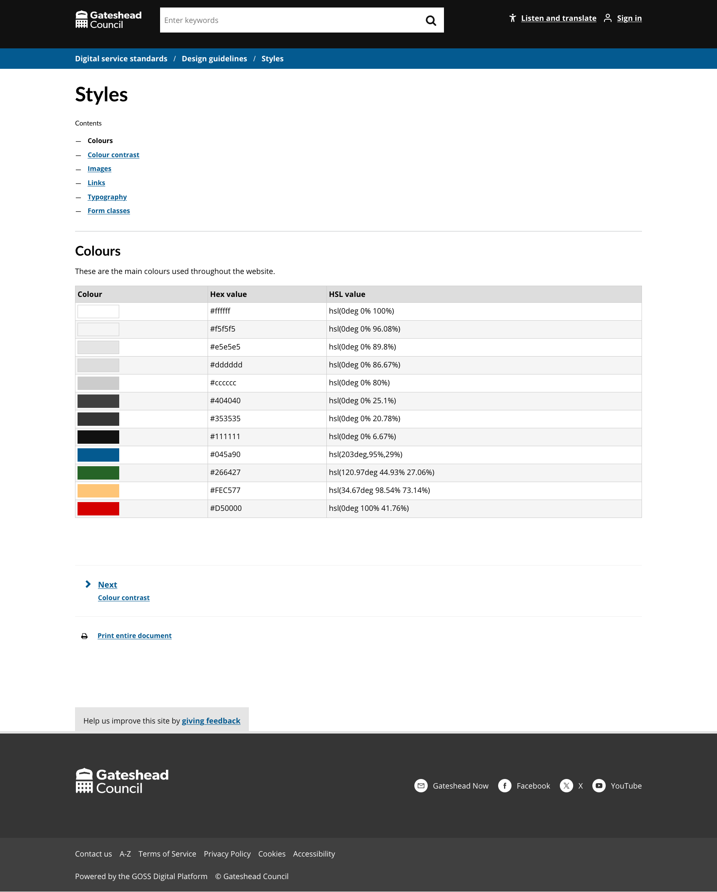
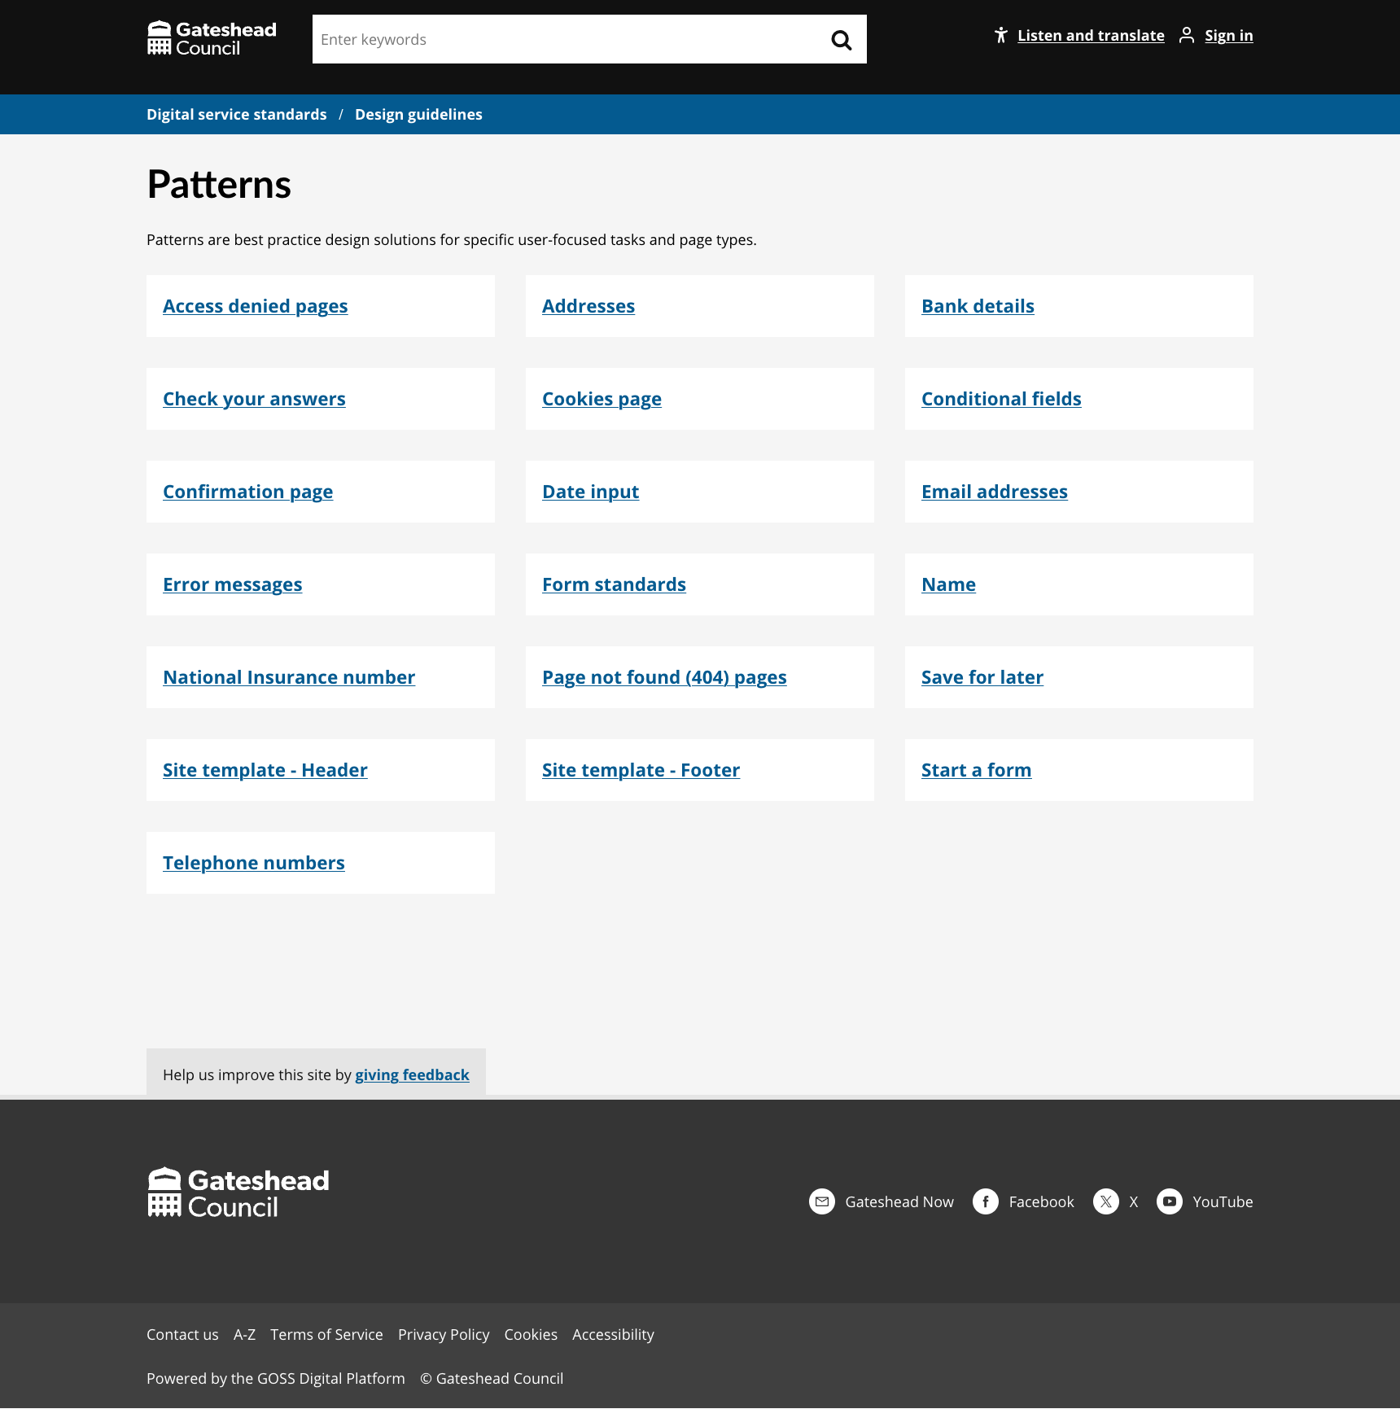
Digital standards
Digital standards – Design section
Checked and added content to the sub sections
Styles
Components
Patterns
https://www.gateshead.gov.uk/article/24857/Design-guidelines

Slide 12
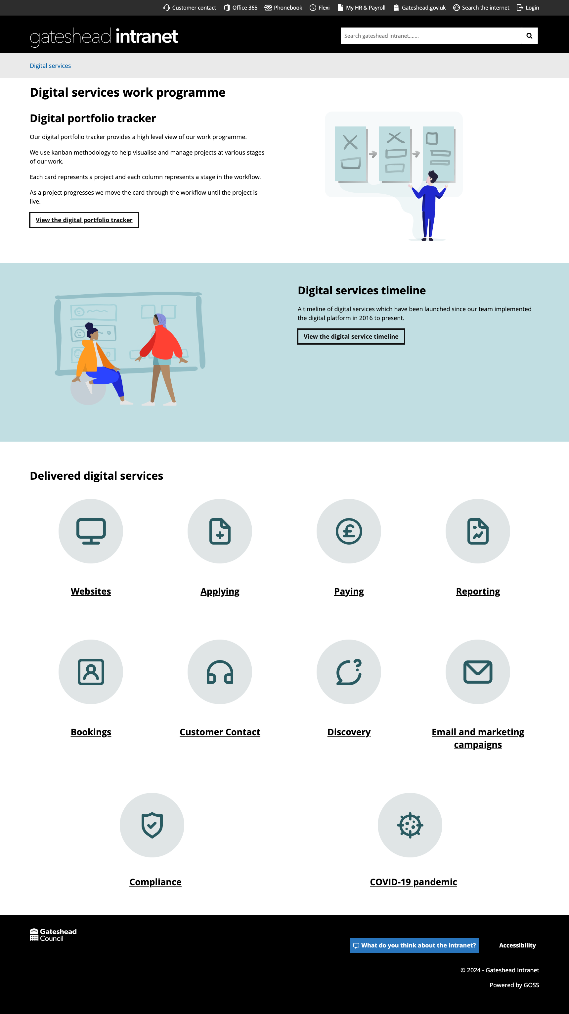
Digital standards
Digital services work programme
Added illustrations to panels
Added icons to each section
https://intranet.gateshead.gov.uk/article/26850/Digital-services-work-programme

Slide 13
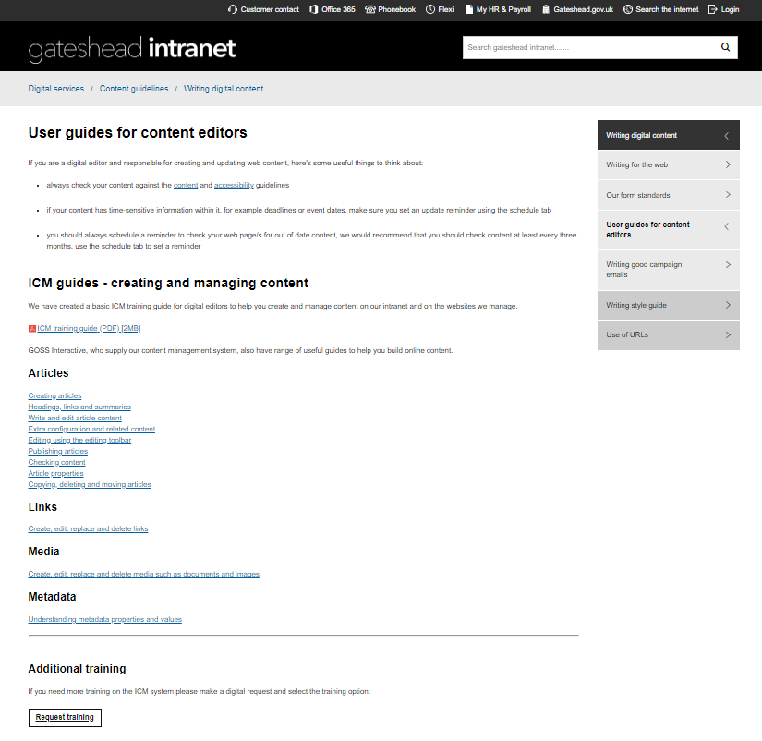
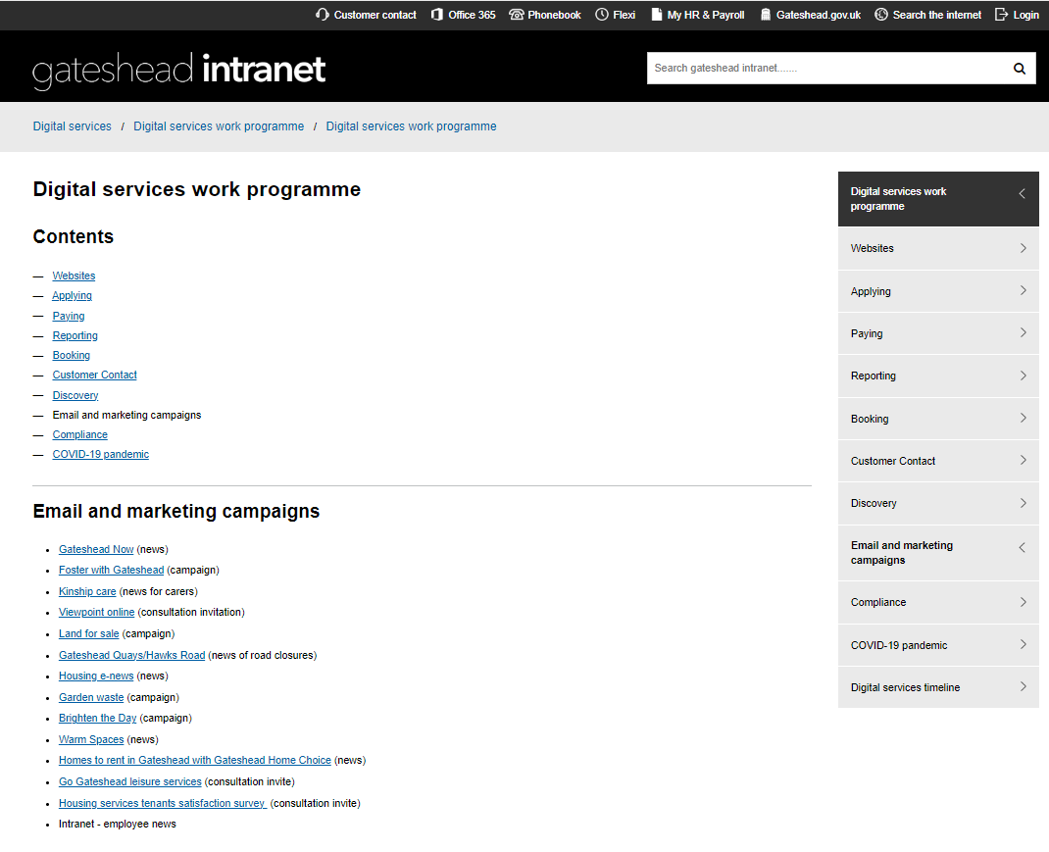
Digital standards
Digital standards – Writing digital content
Added ICM training guides for content editors to refer to after we give initial training. User guides for content editors
Added examples of current email marketing campaigns that we have delivered using Mailchimp. Email and marketing campaigns

Slide 14
Sprint 32
Discovery
Care cost calculator
Session with service to share insights from research and gather requirements
Direct payments
Third mapping session to identify pain points in process
Miro board
Creating Engage process map
Engage map
Attended Direct payments champions group
Adult social care
Analysis of contact us data
Dashboard

Slide 15
Sprint 32
Design
Nature Plan - Local Nature Recovery Strategy website went live
Nature Plan – Contact form
Digital Standards
Customer contact – Add highlight box styling
Intranet – Add option to hide right hand navigation using metadata
Council tax – Single person discount email styling
HSF – Form styling
GA4 Dashboard for Schools and Children's services

Slide 16
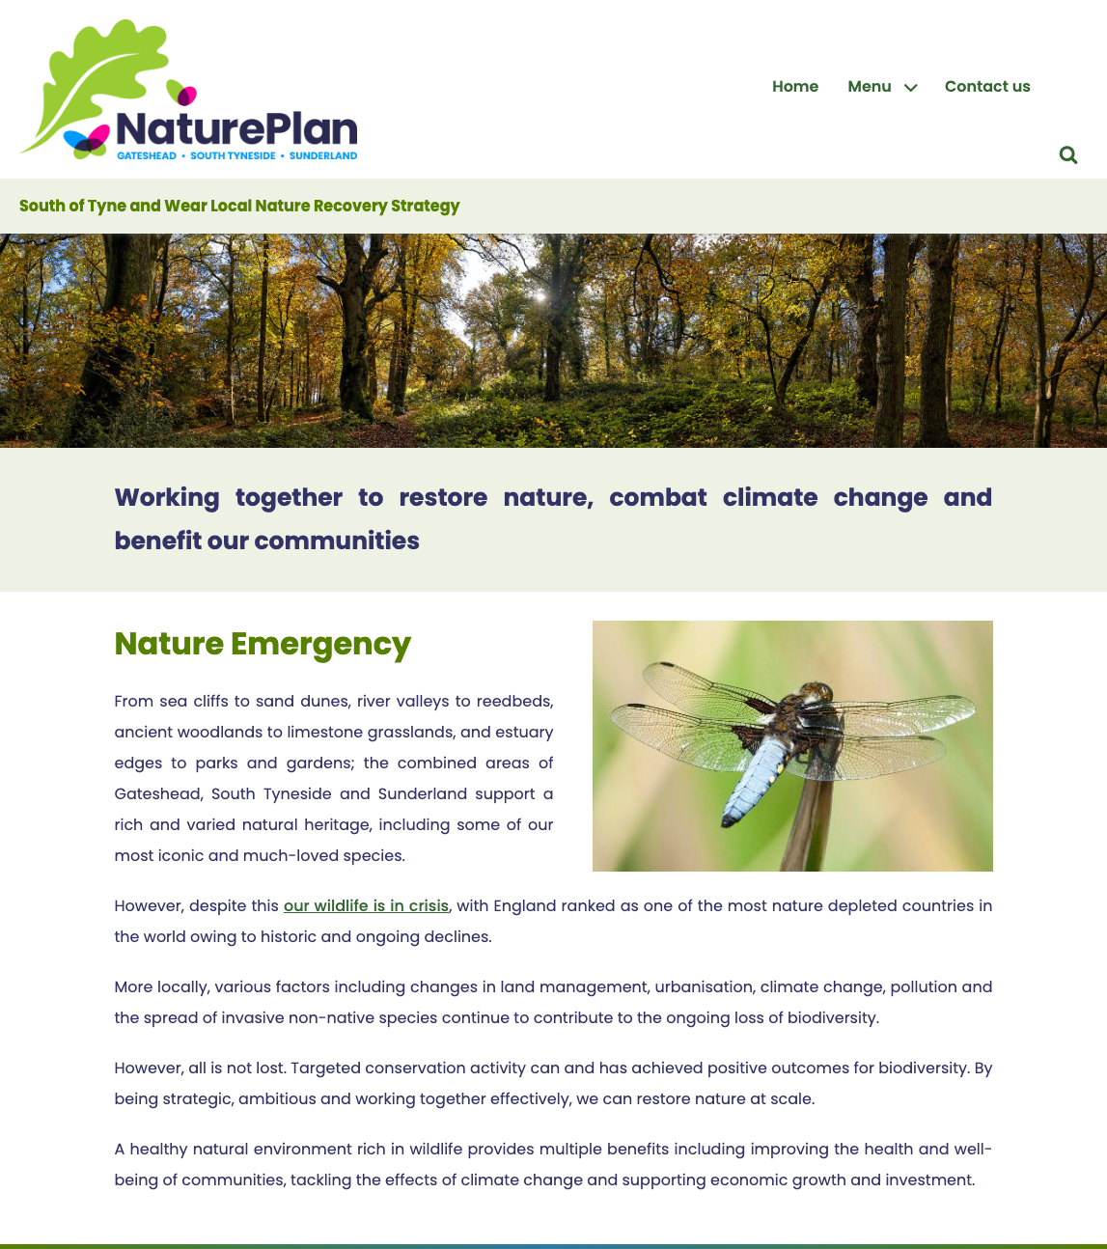
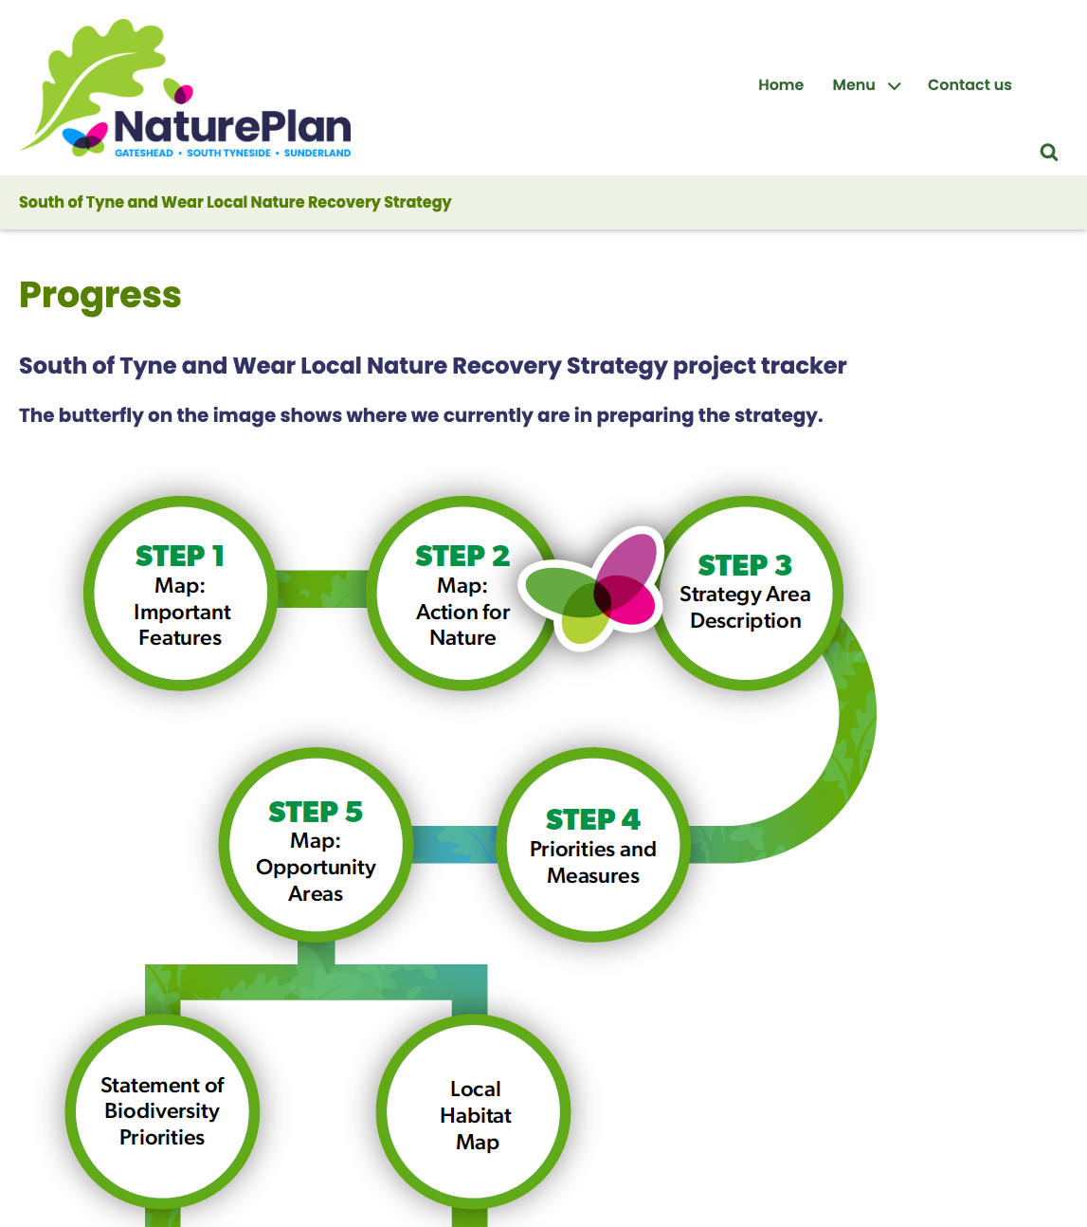
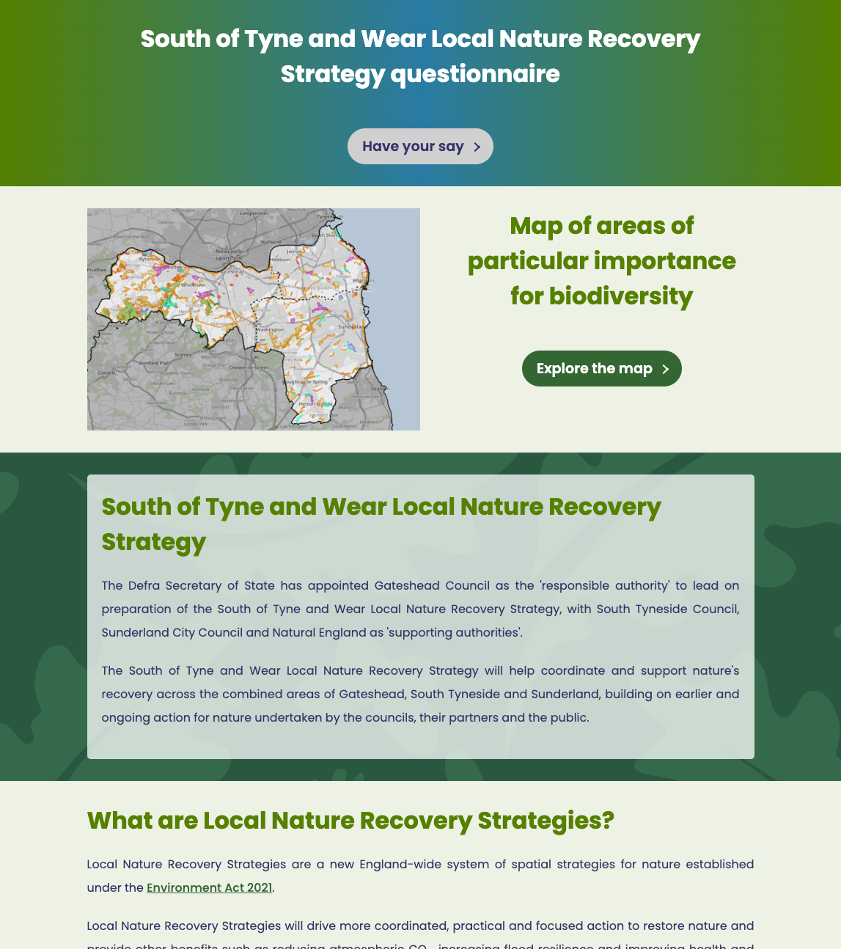
Nature Plan website
www.natureplan.org.uk

Slide 17
Nature Plan website
Updated content and images
Added contact form
Various styling amendments
call to action buttons
embedded maps
option to hide related images
updated logo
Add GA4 tracking
Launched website
www.natureplan.org.uk

Slide 18
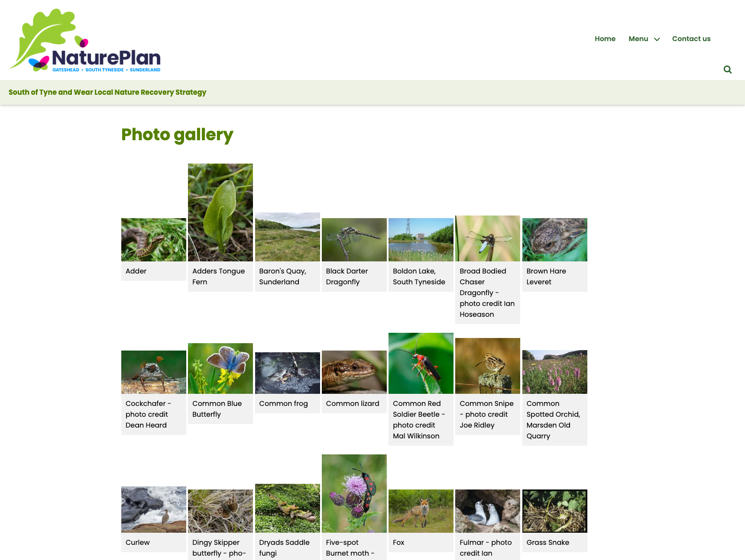
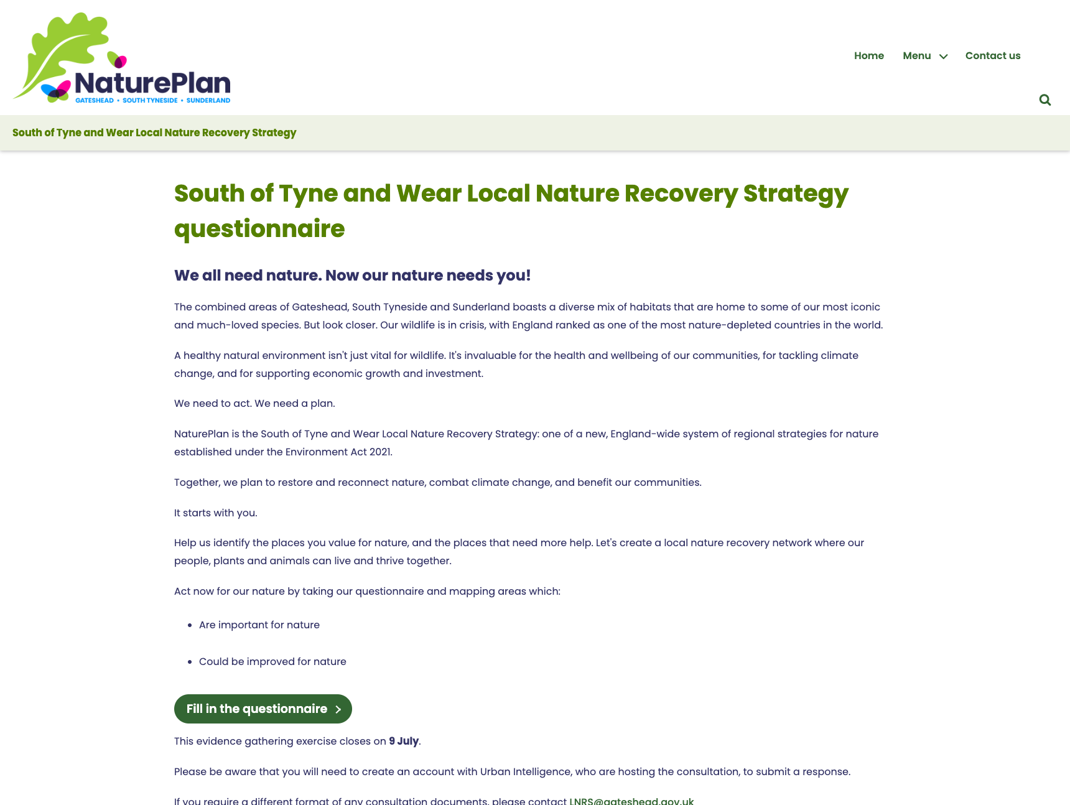
Nature Plan website

Slide 19
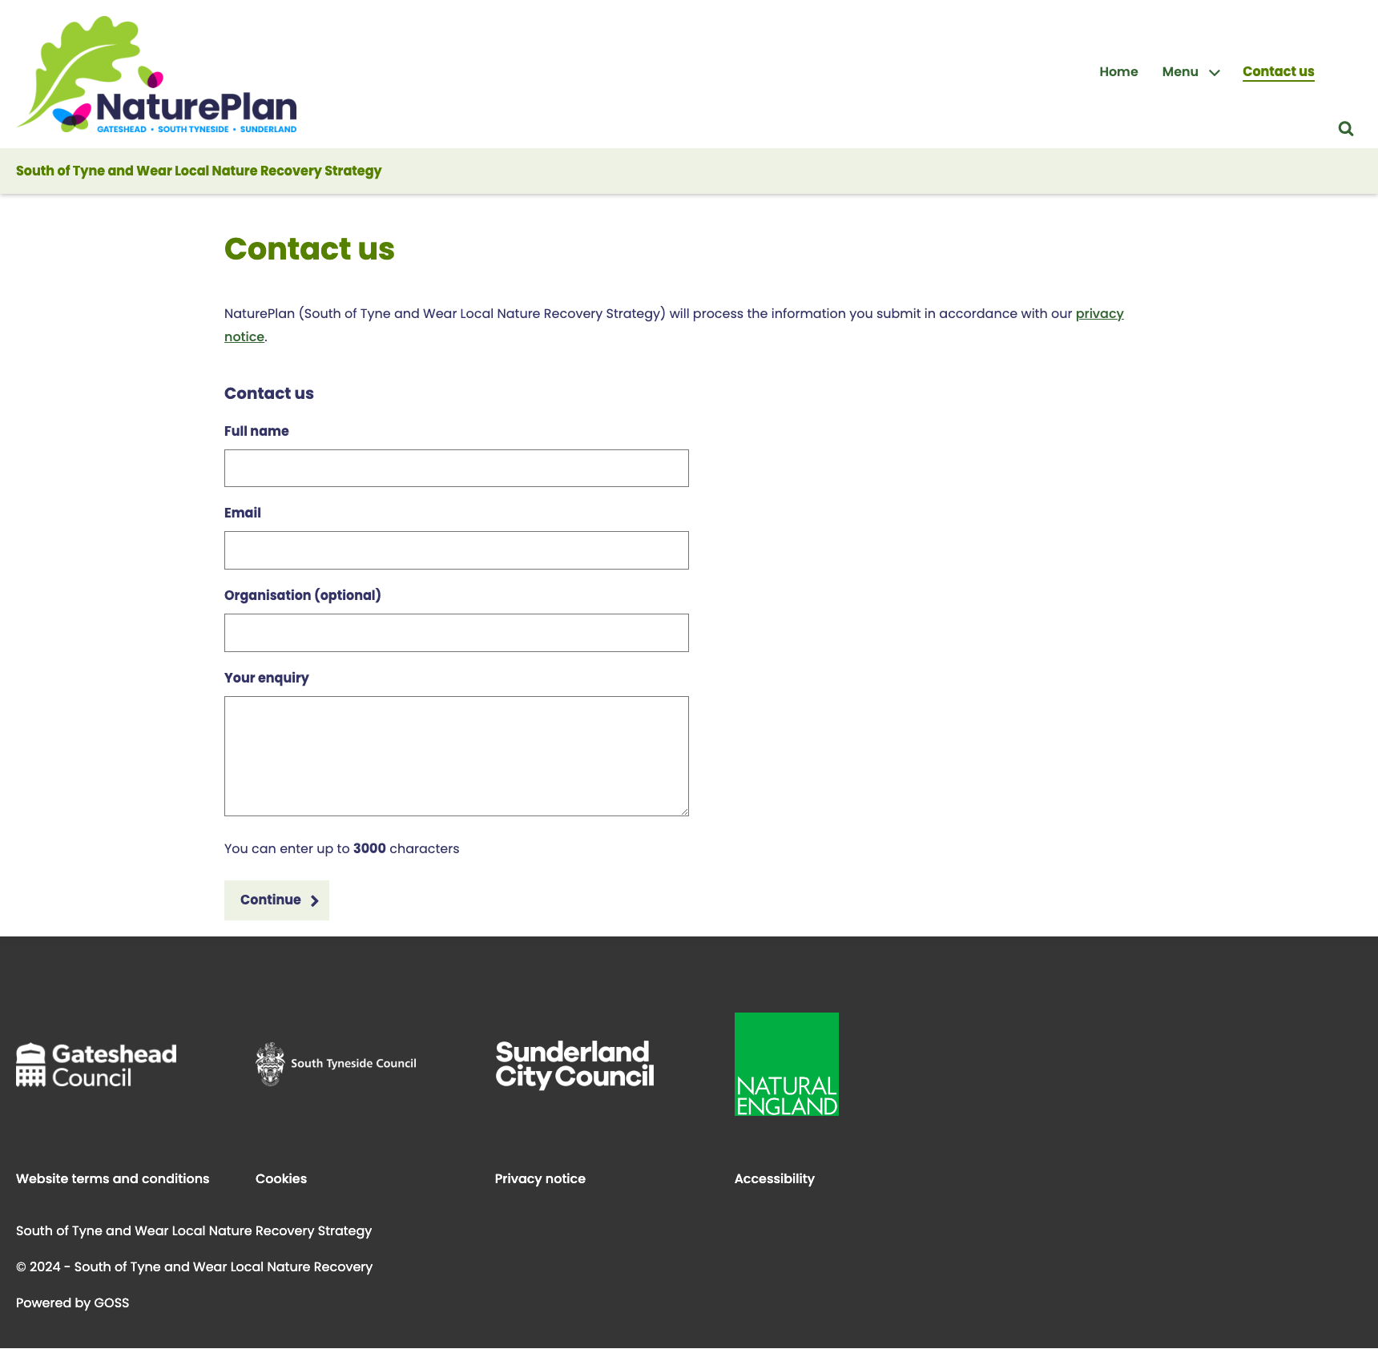
Nature Plan contact form
New enquiry are emailed to the service
Cases are autoclosed but searchable on Customer Contact.
https://www.natureplan.org.uk/article/28166/Contact-us

Slide 20
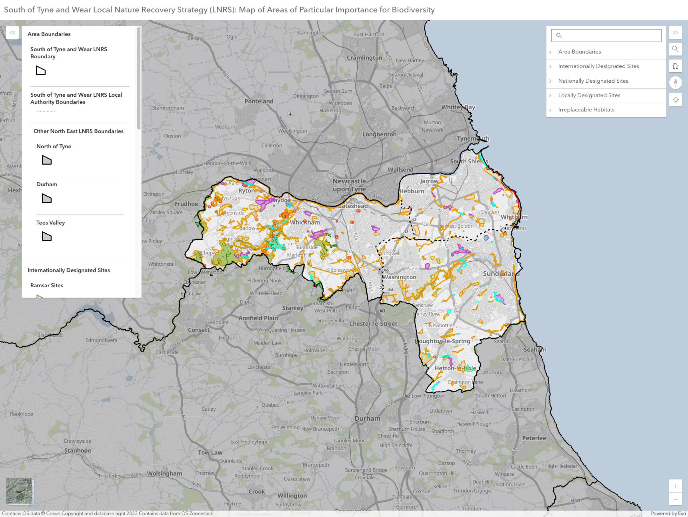
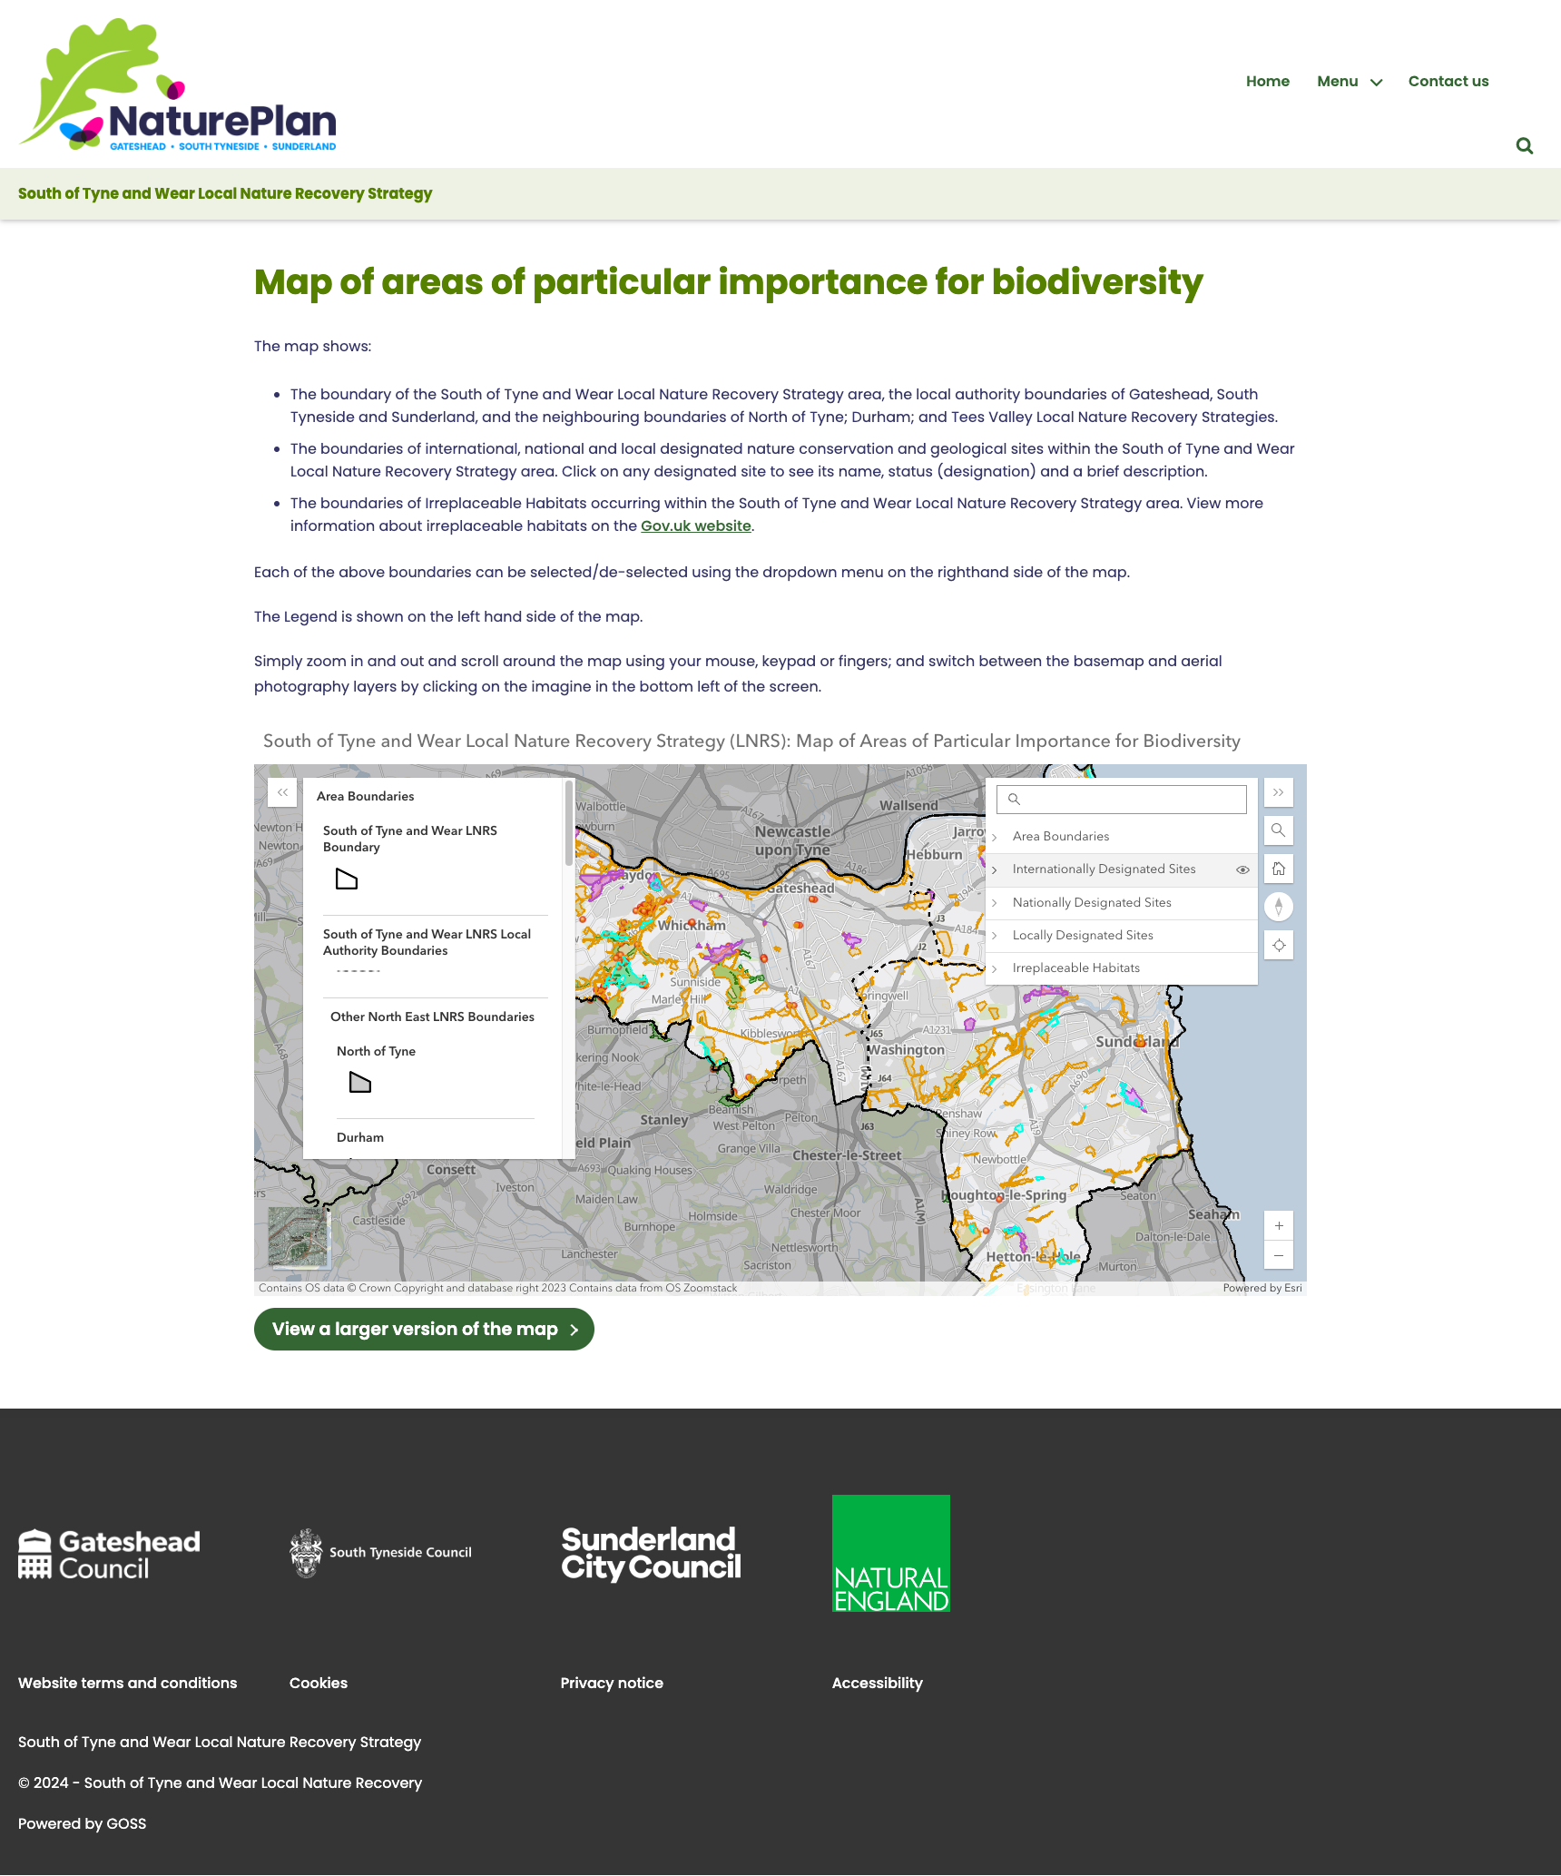
Nature Plan map
Added CSS to make the embedded map display in any screen size from desktop to mobile
Added CSS to style the call to action button link to the larger external version of the map
https://www.natureplan.org.uk/article/27730/Map-of-areas-of-particular-importance-for-biodiversity

Slide 21
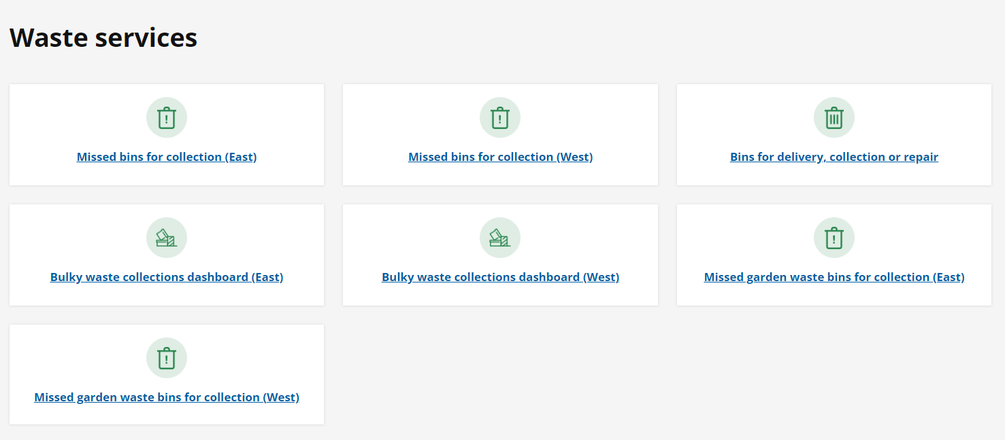
Customer Contact – waste services

Slide 22
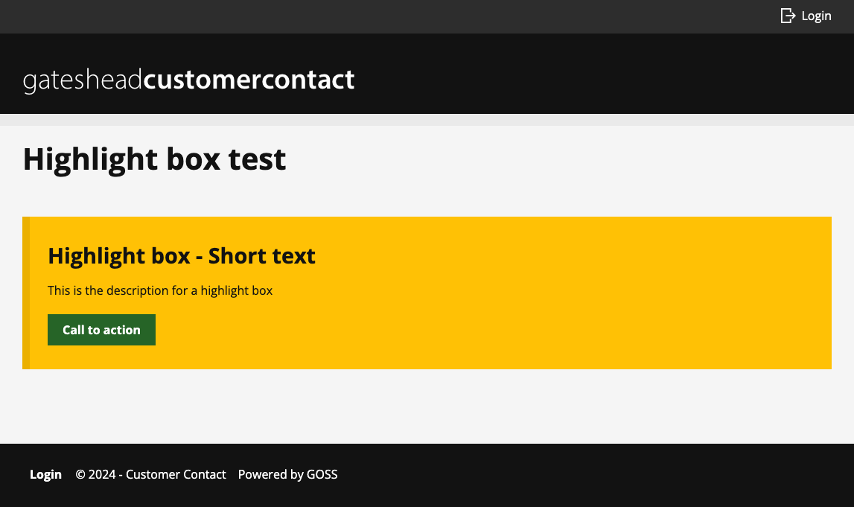
Customer contact site
Add styling for highlight boxes
https://customercontact.gateshead.gov.uk/article/28137

Slide 23
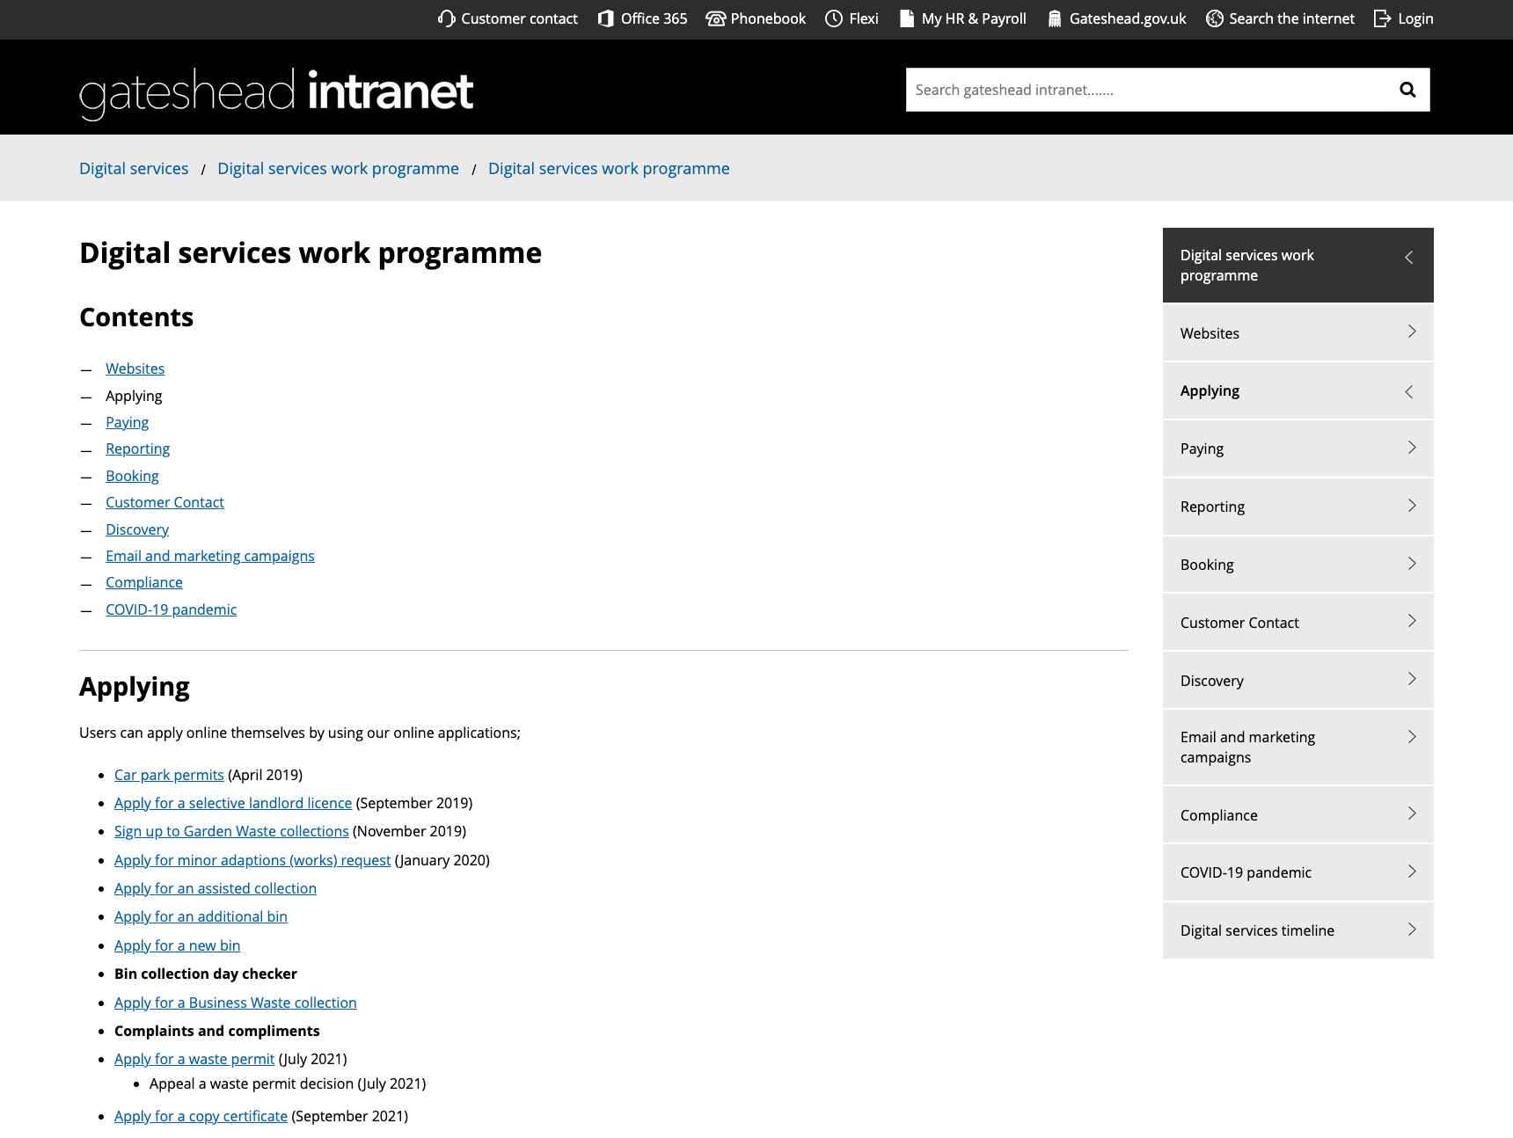
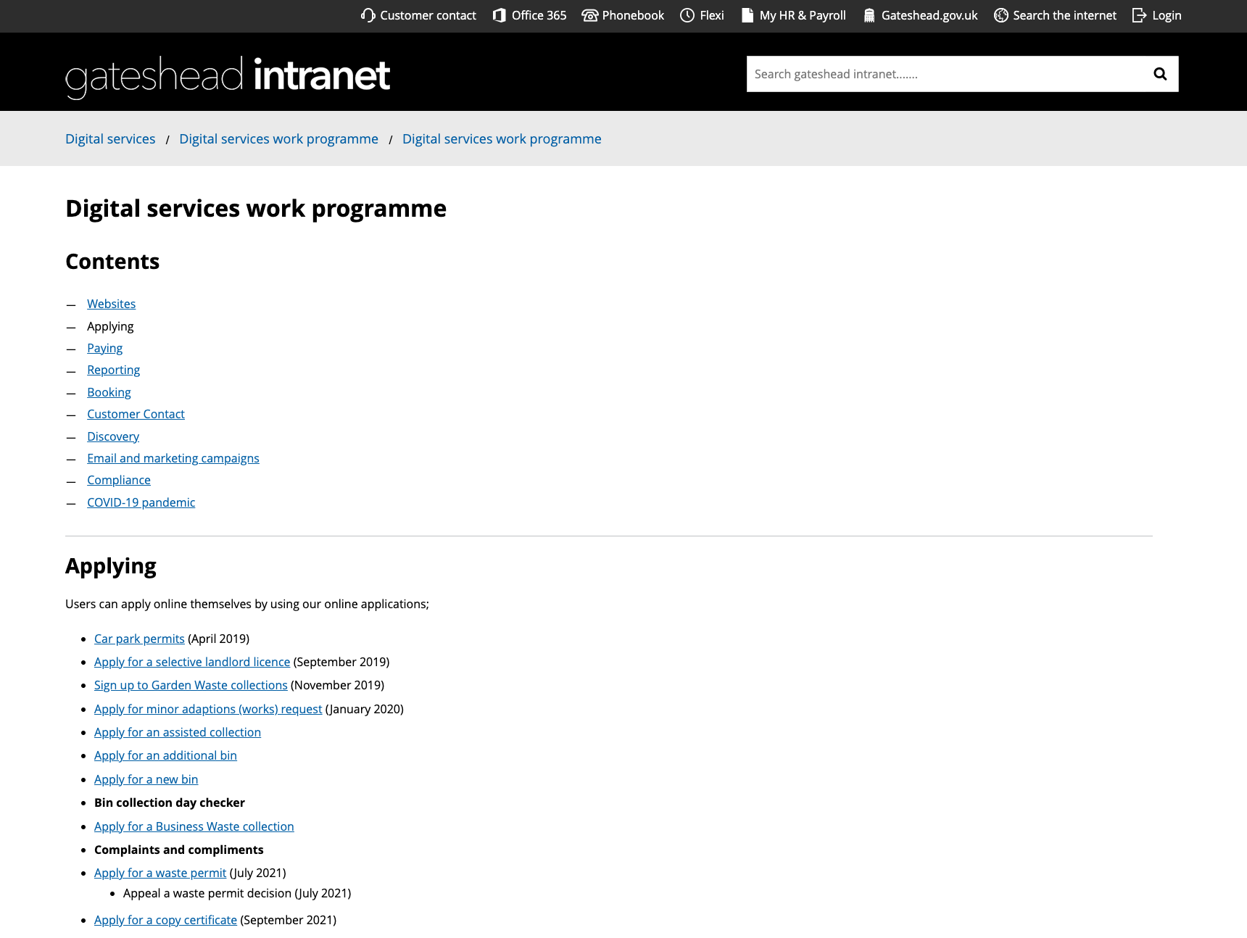
Intranet right-hand navigation
Add CSS/metadata to create the option to hide the right-hand navigation of an article

Slide 24
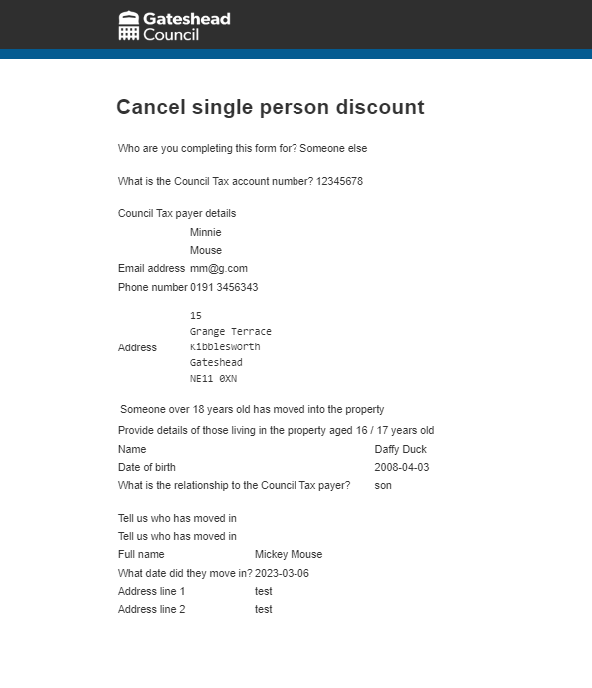
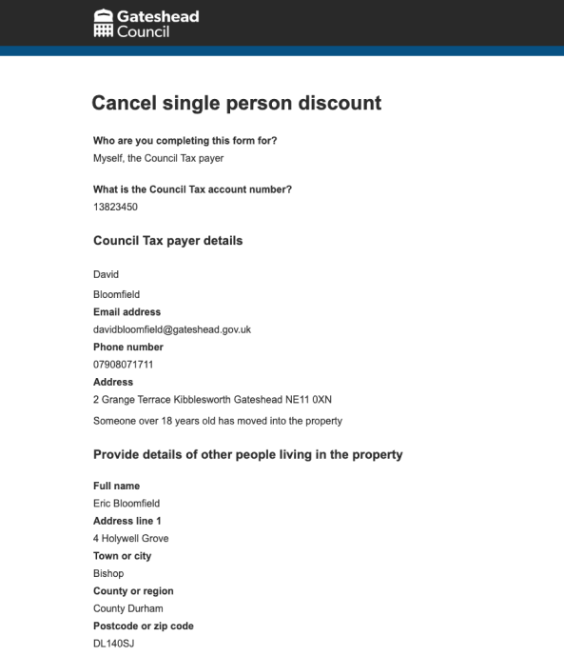
Council tax – Email styling
Tidy up the presentation of the council tax single person discount emails

Slide 25
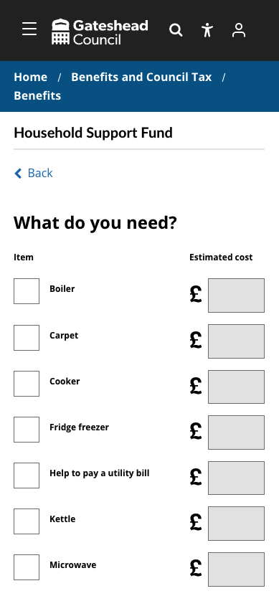
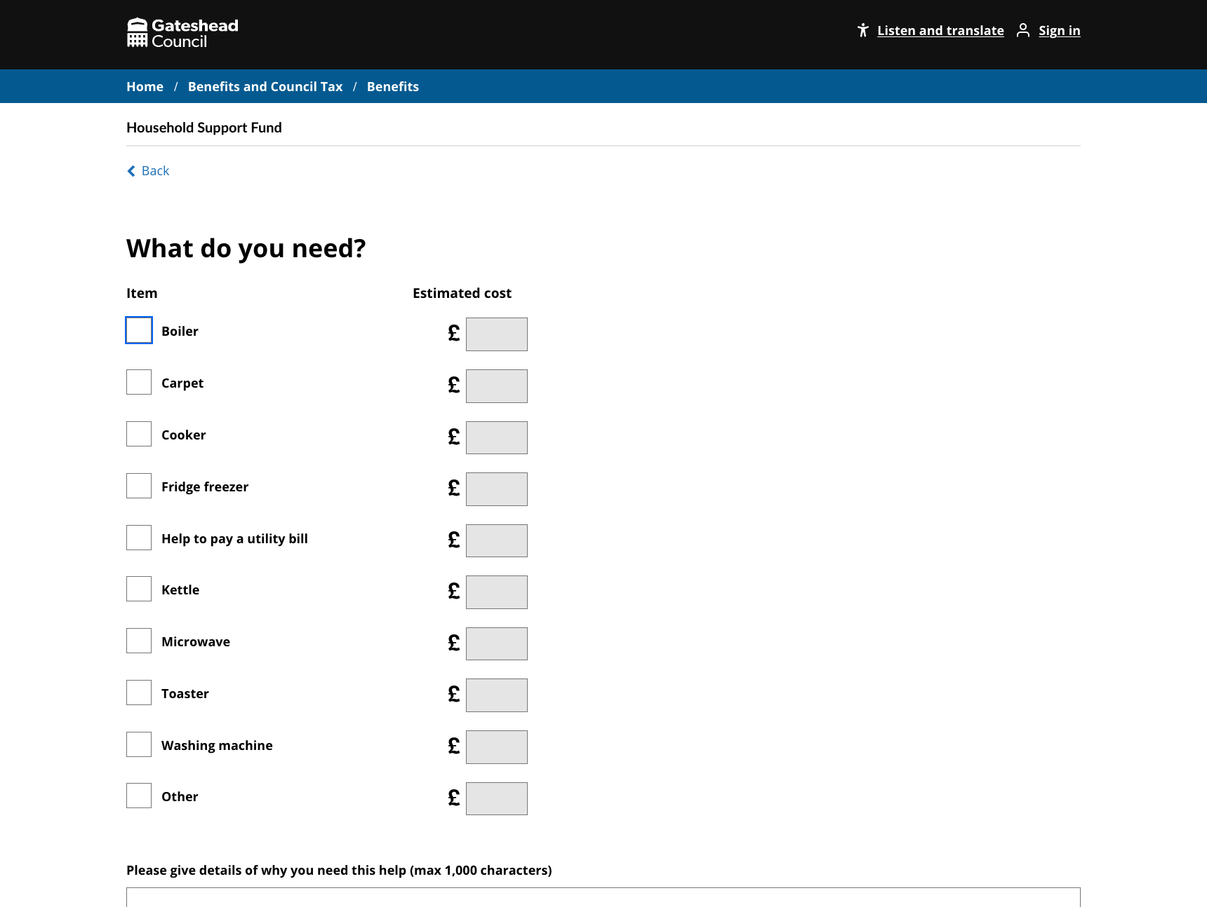
HSF form styling
Styled the "What do you need?" section of the form
Aligned checkbox and cost
Ensured it displays correctly on desktop and mobile
https://gateshead.ghc2-dev.gosshosted.com/article/13687/Household-Support-Fund-4

Slide 26
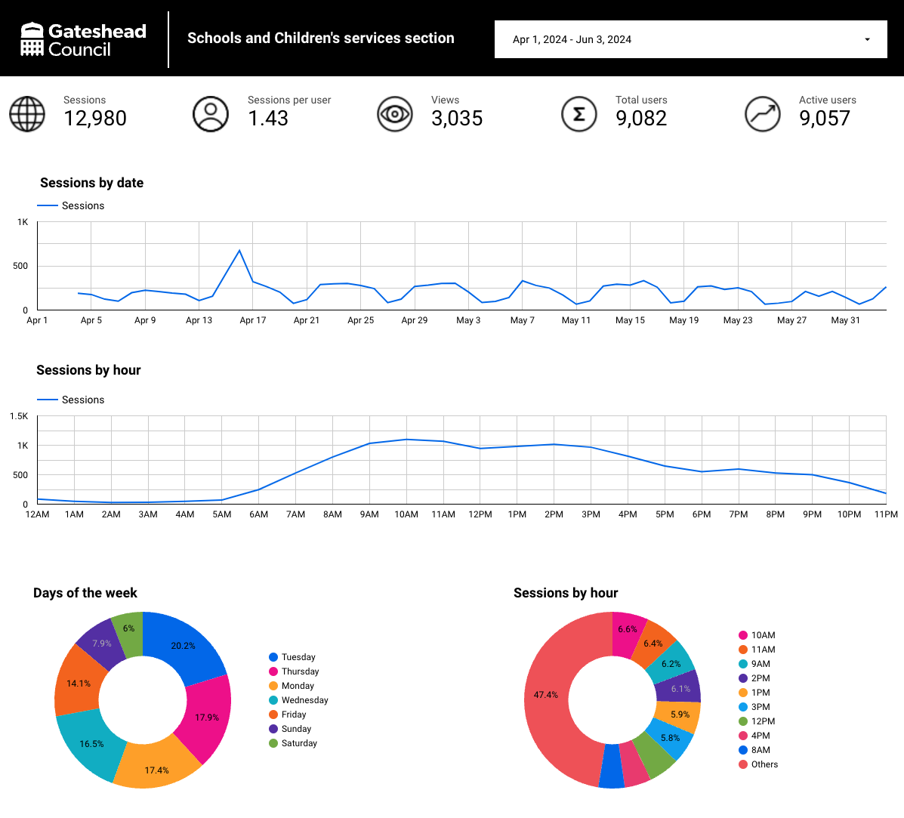
Created a GA4 dashboard
Created a GA4 dashboard for Schools and Children's services
Combined multiple areas of the website into one dashboard
https://lookerstudio.google.com/reporting/49df2d33-6fee-49ea-a307-64d5a9a117e6

Slide 27
Sprint 32
Content
Improvements to householder planning content – made live
Gateshead Now – 3 issues sent on 9 May, 22 May and 5 June
Community sports half term activities
UK Shared Prosperity Fund (UKSF) open calls
Children's Social Care content audit
Content updates and removal of out of date information for CSC
Userbrain testing across CSC
Work started on both alternative provision register and SEND activities directory
Converting pdfs to html web content

Slide 28
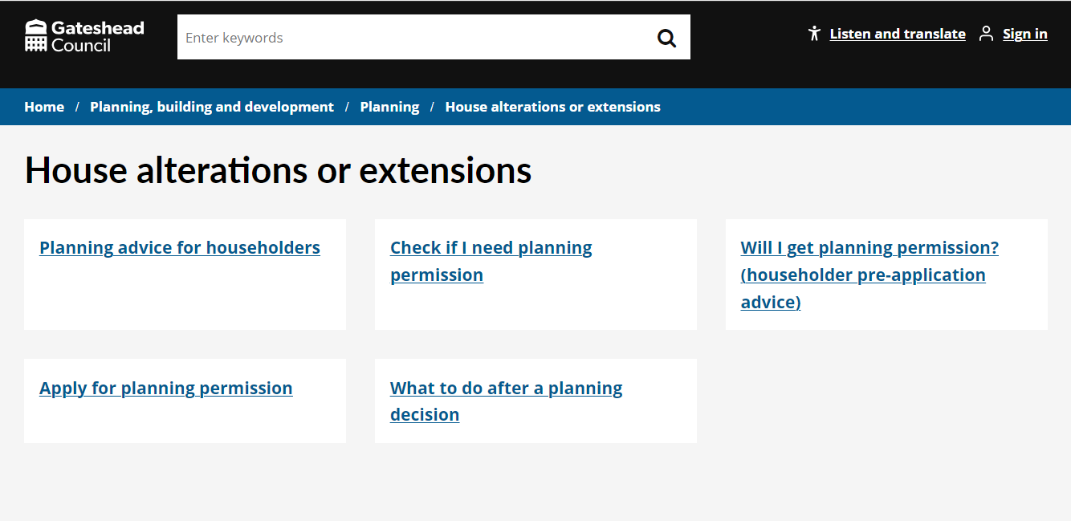
Householder planning content now live
Improvements to planning content for householders made live. In addition to improvements to content and overall user experience, we now link to Plan X, a free planning advice service for residents to check if they need planning permission.
Since go live 45 users have used Plan X with 62% completing using the service saving administration time for our planning officers.
House alterations or extensions - Gateshead Council

Slide 29
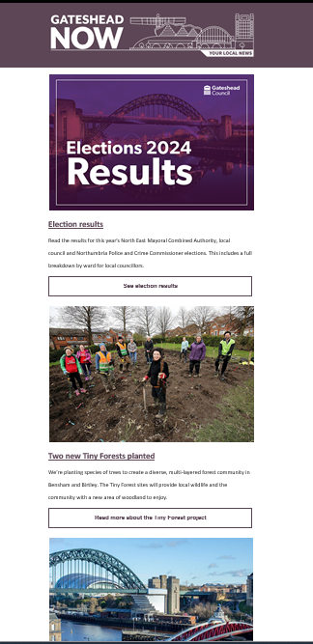
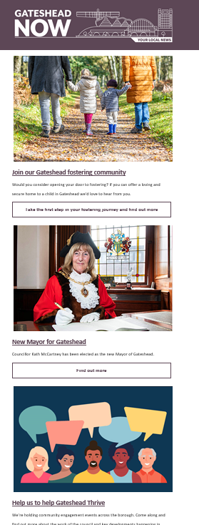
Gateshead Now
Three issues of the email newsletter Gateshead Now sent to 33k email subscribers.​
​
9 May 2024
Election results
Planting of tiny forests
Restoration of Tyne Bridge
22 May 2024
Fostering journey
New Mayor
Thrive consultation events
​
5 June 2024
Community engagement events
Register to vote
Big Help Out
​

Slide 30
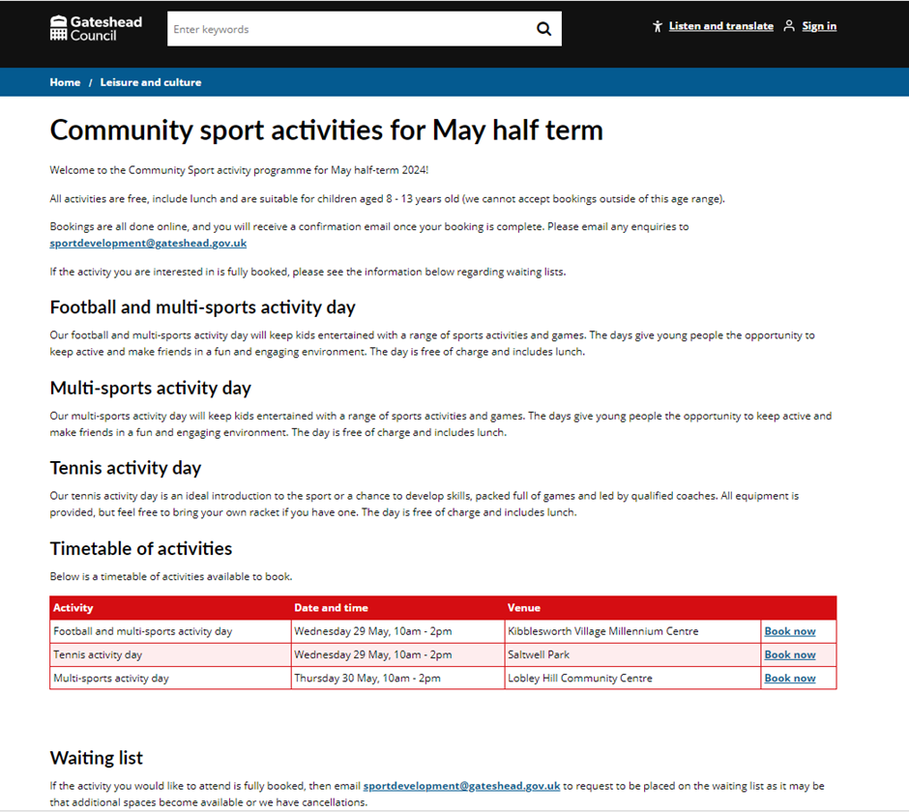
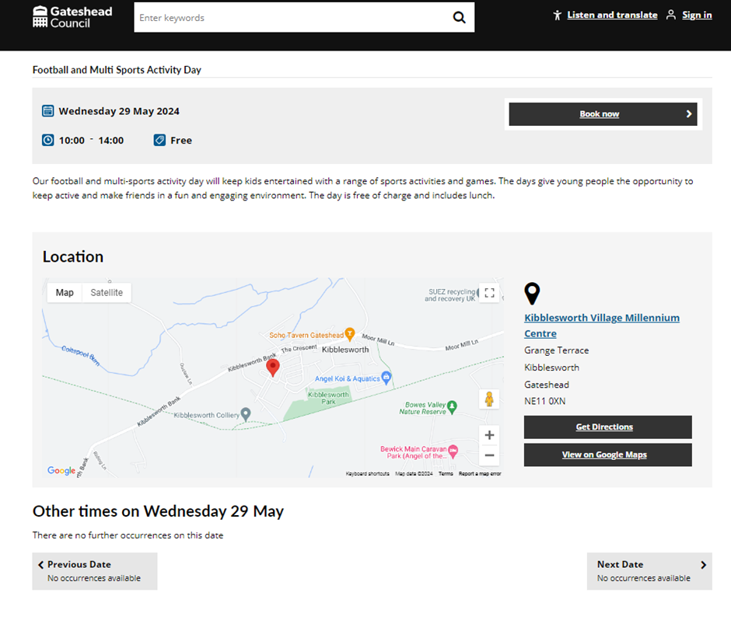
Community sport activities for May half term
Booking platform used for families to book on to three community sports activities for families to book during the May half term holidays.

Slide 31
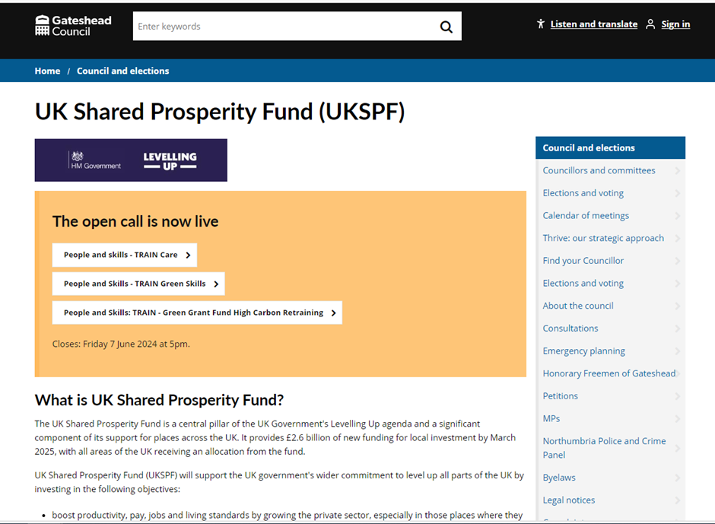
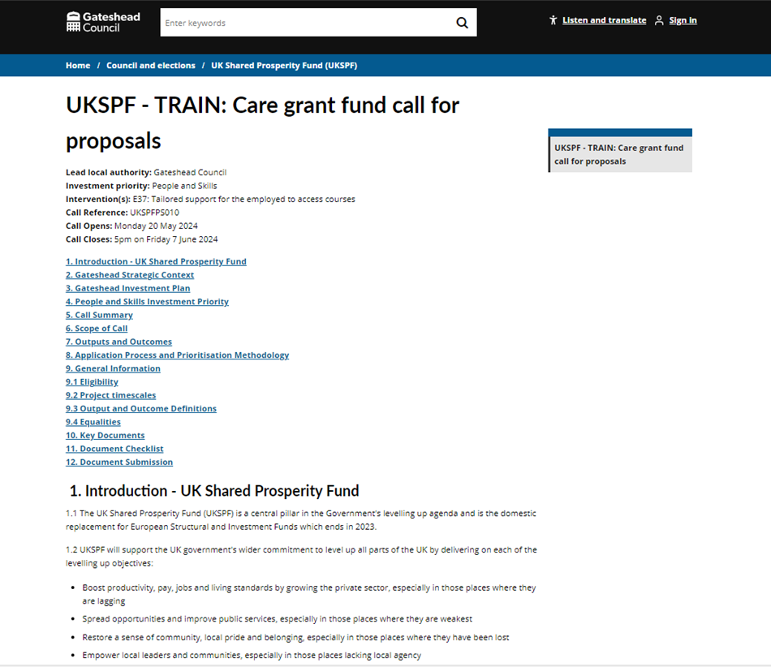
UK Shared Prosperity Fund (UKSPF) open calls
Three open calls added to the website to bidding for funding around training and employment.

Slide 32
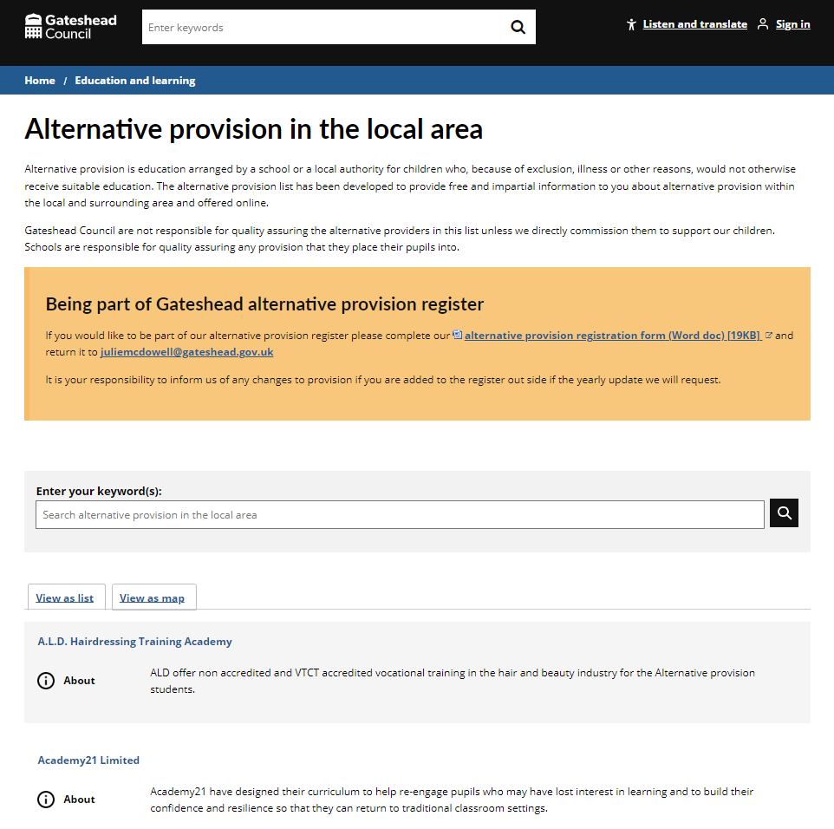
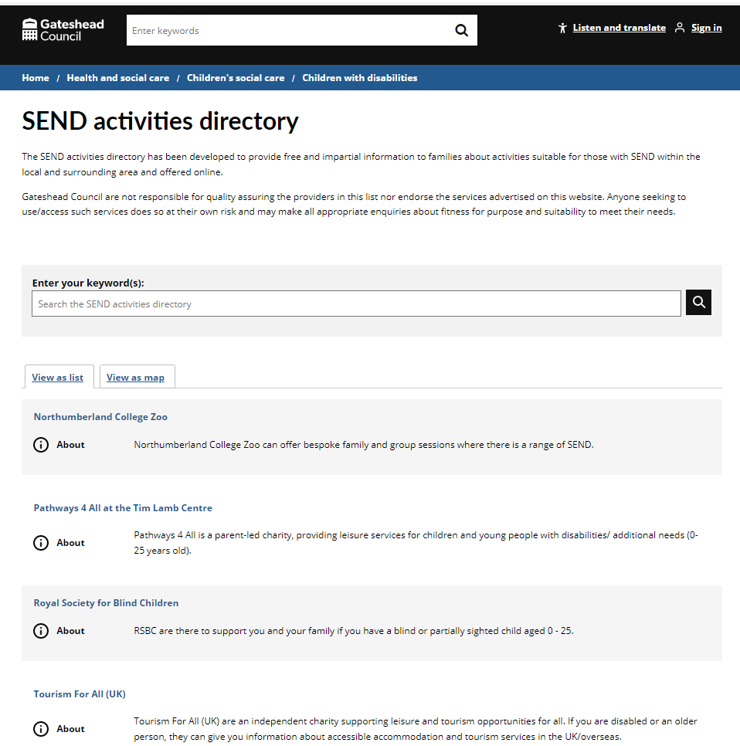
Alternative provision register and SEND activities directory
Work started on both alternative provision register and SEND activities directory.
To be progressed in the next sprint. Alternative provision in the local area - Gateshead Council (gosshosted.com)

Slide 33
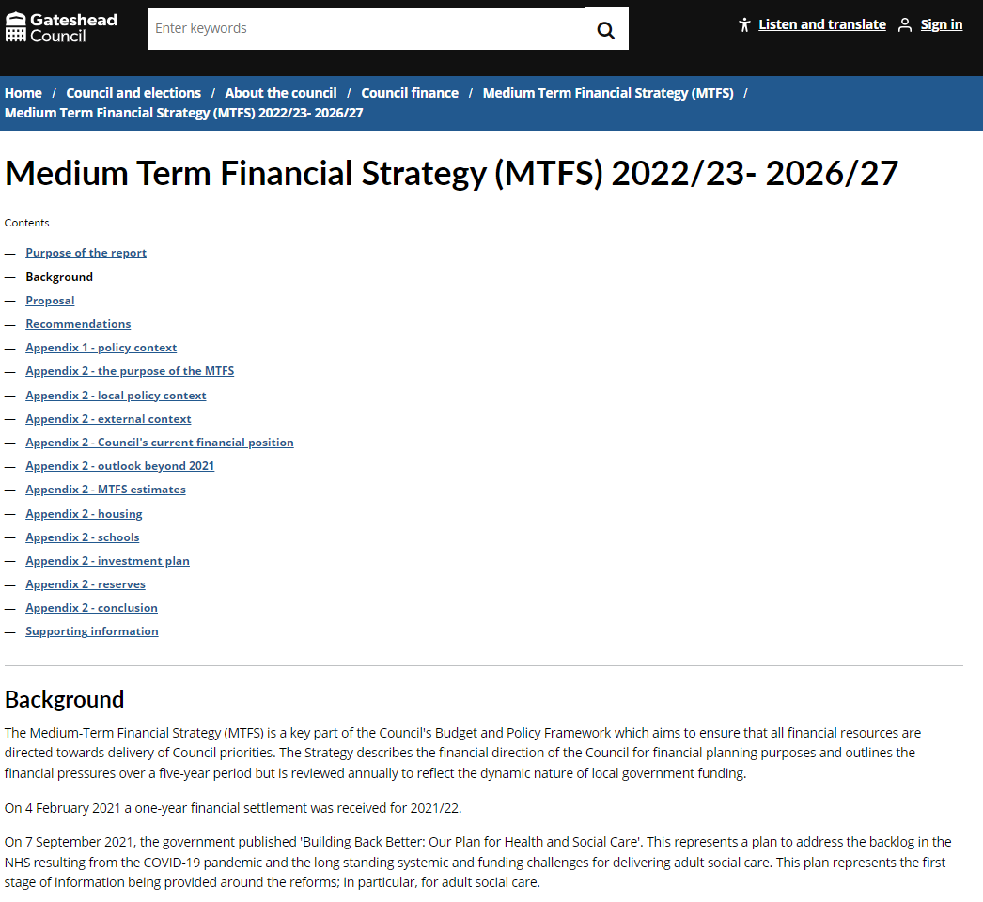
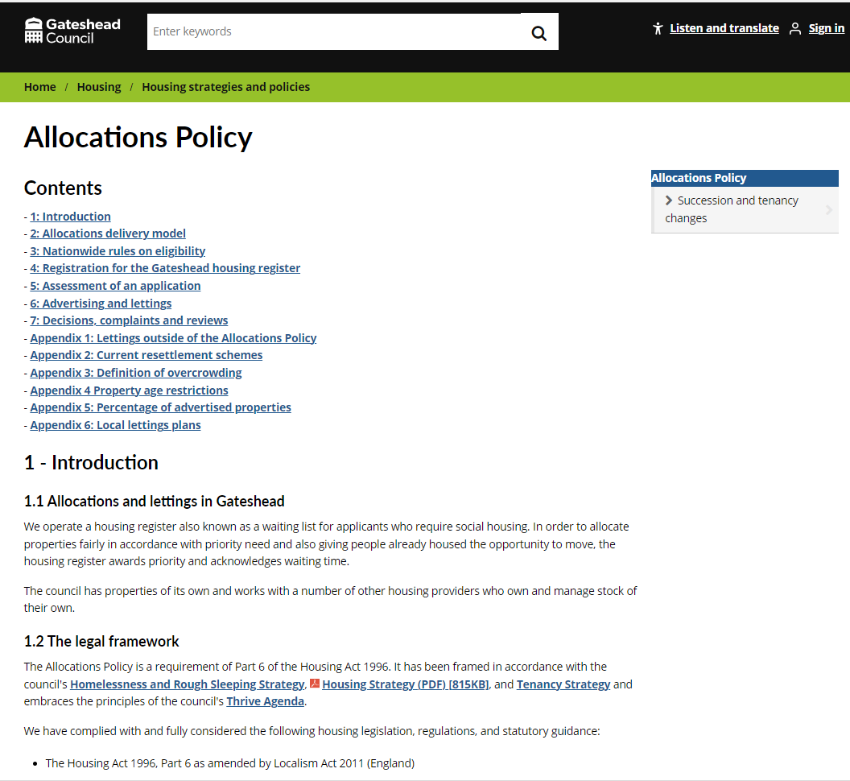
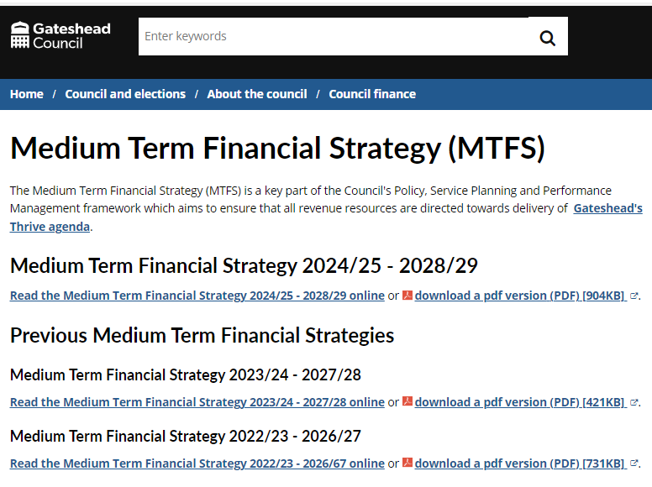
Converting pdfs to html web content
Updates to the Allocations Policy from pdf to html content
Converting MTFS pdfs to html content

Slide 34
Careers Gateshead – appointment request
[DCE-9758] Careers Gateshead - appointment request update to form - Jira (gossinteractive.com)
Foster with Gateshead – information events
Fostering information events - Gateshead Council

Slide 35
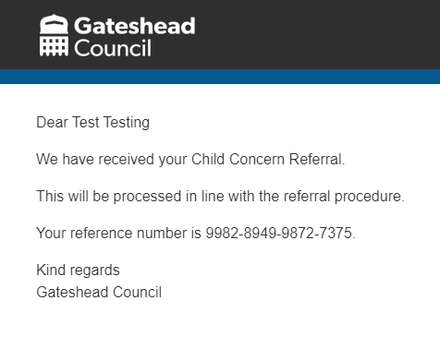
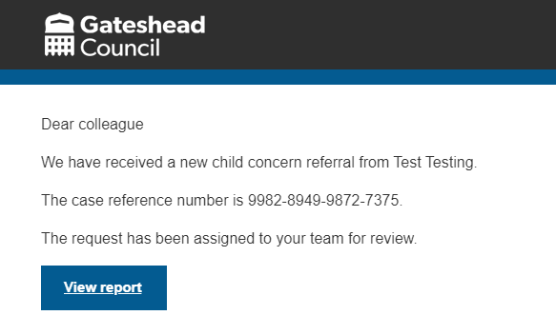
Sprint 32
Development
Child in need child protection referral form and case management:
https://gateshead.ghc2-dev.gosshosted.com/article/9369

Slide 36
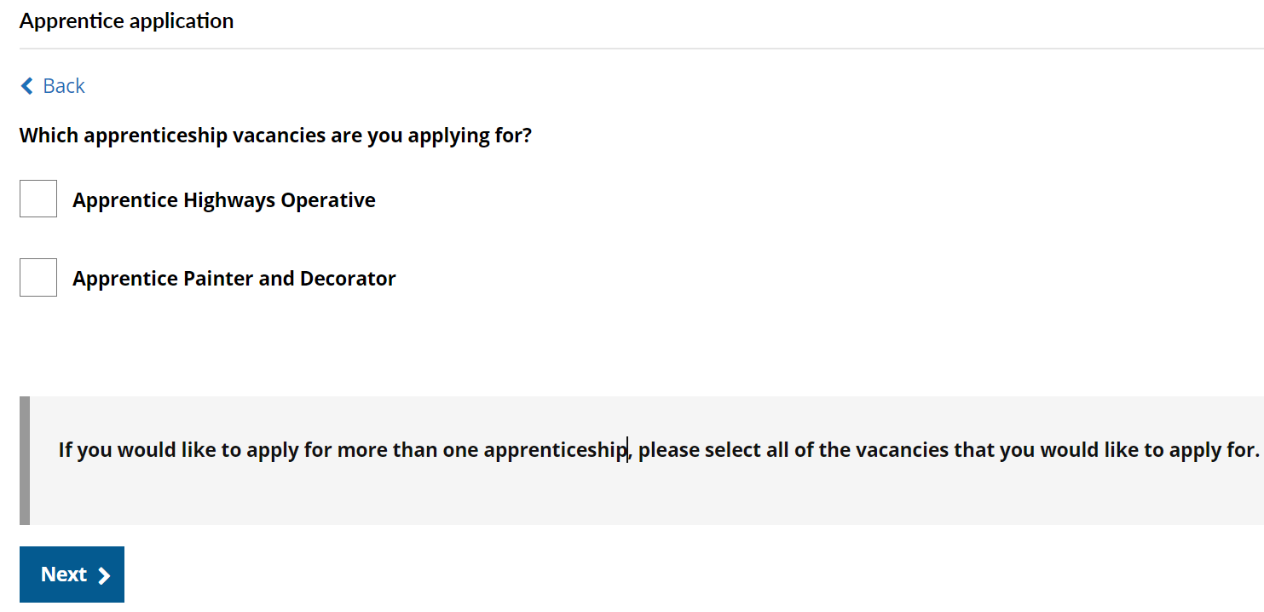
Plugin forms
Christmas activities
Fostering information events
Tyne Derwent Way bookings
Update to trade apprentice application form

Slide 37
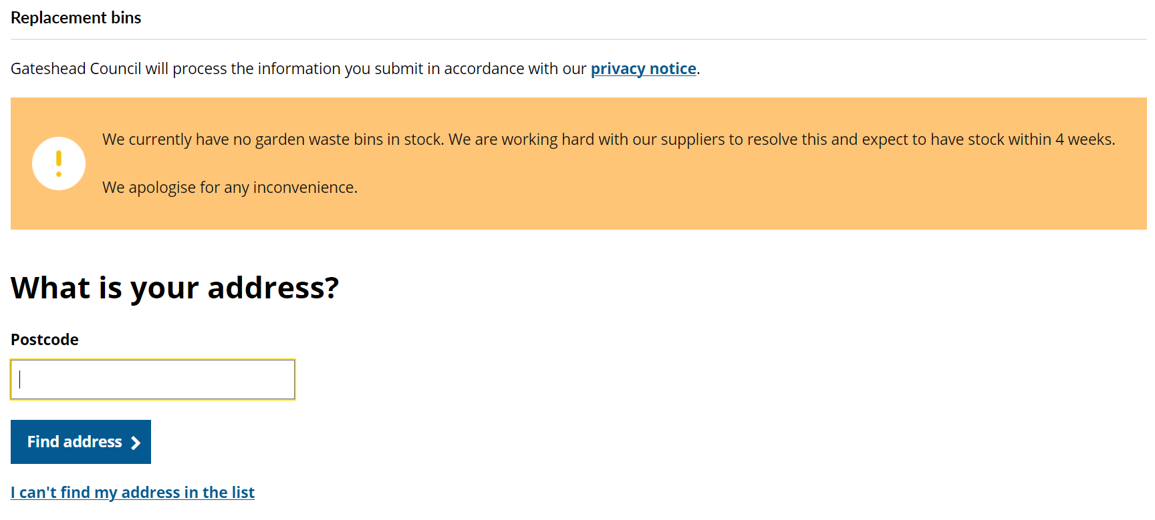
Add a configurable alert to bins forms

Slide 38
Update to links in replacement bin form
Bug fixes
Update to the phone number in the closure email for pest control cases.
Update to service email address in care call request cases.

Slide 39
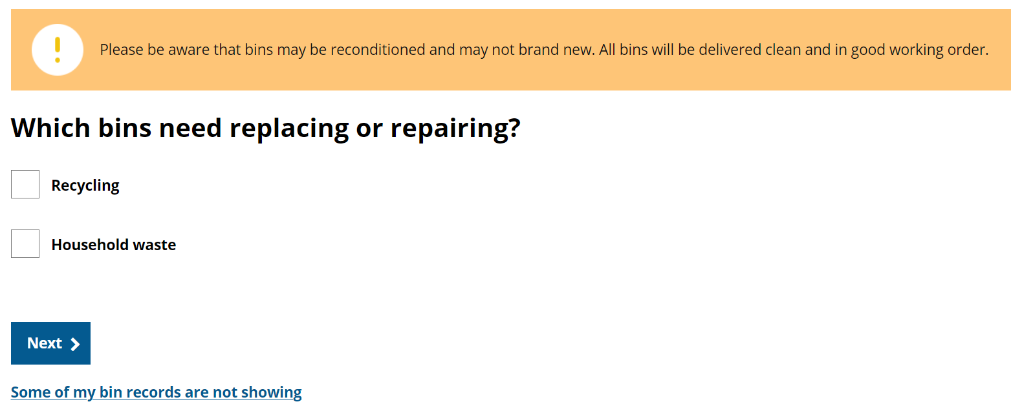
Remove garden waste bin option
Additional bin
New bin
Replacement bin

Slide 40
Improved animal licensing payment forms
Additional work licence
Animal boarding licence
Dangerous animals licence
Dog breeders licence
Host licence
Performing animals licence
Pet shop licence
Riding establishment licence
Zoo licence

Slide 41
What's coming up in Sprint 34
Discovery
Direct Payment user research
Content
Brighten the Day holiday activities to be added ahead of booking window opening on 25 June
Begin the changes to IA
Design
Taxi vehicle testing hub and spoke
HDRC – Health determinants research council
Development
Updates to damaged or dangerous structures
Careers Gateshead updates to appointment request

Slide 42
Sprint 32
Deployment

