Slide 1
Sprint 33 Show and Tell 29 May 2024
G Squad
Digital Team

Slide 2
Sprint 33.
Sprint goals
Household support fund changes
Change of address wireframe

Slide 3
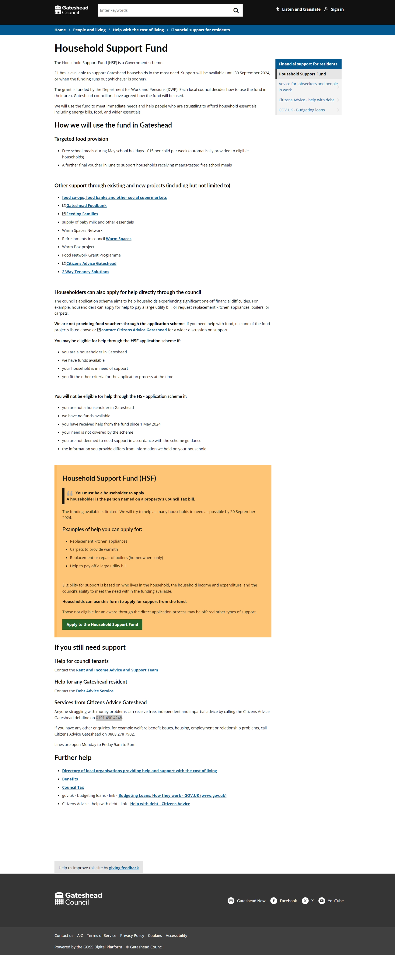
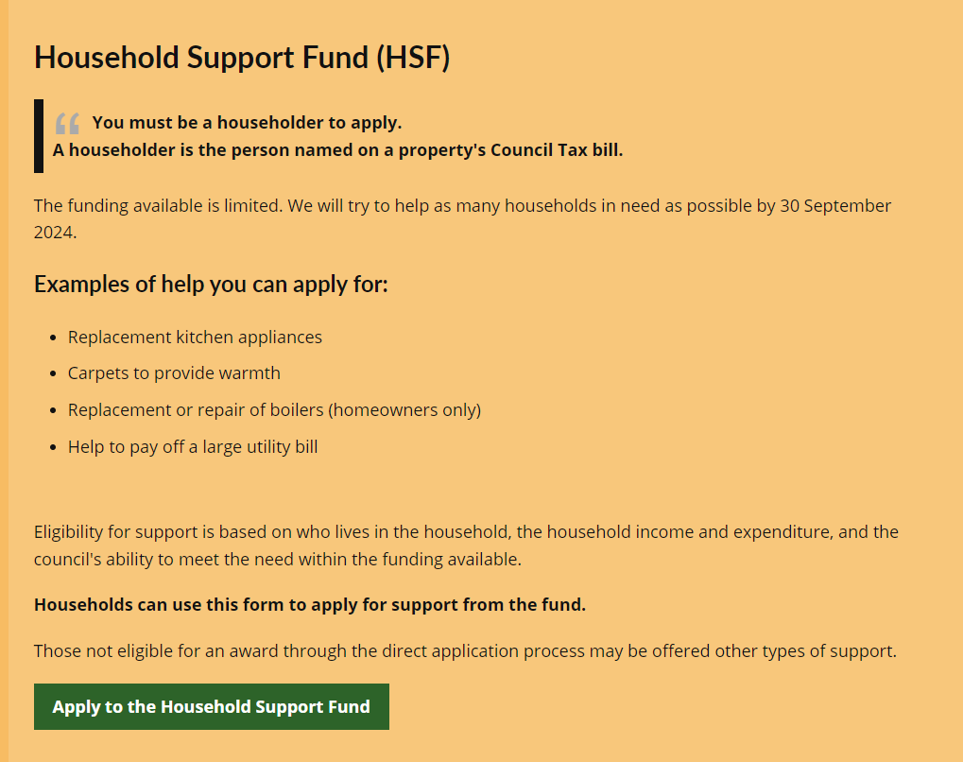
Sprint 33.
Household Support Fund
Runs for 6 months
Different tack this time
Longer-term help

Slide 4
Sprint 33.
Household Support Fund
Only 'knock-out'
Still asking about benefits and ages of household members, but only for info
More thorough with income and expenses questions

Slide 5
Sprint 33.
Household Support Fund

Slide 6
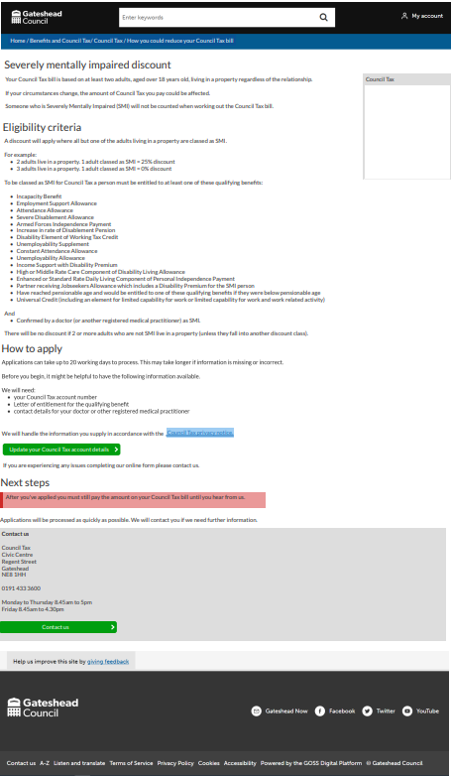
Sprint 33.
Council Tax severely mentally impaired proposed web content.
Still to be approved by Council Tax team.

Slide 7
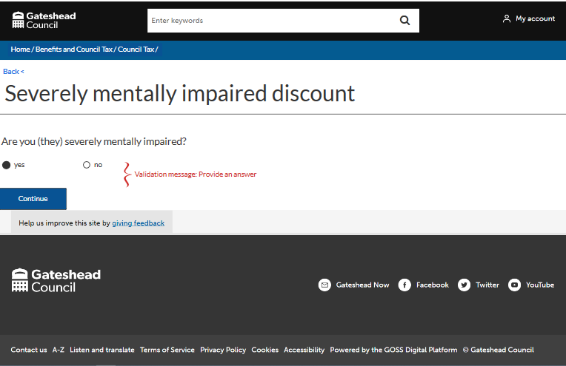
Sprint 33.
Council Tax severely mentally impaired wireframe, also to be approved by the Council Tax team.
Counci Tax payer, SMI, yes/no

Slide 8
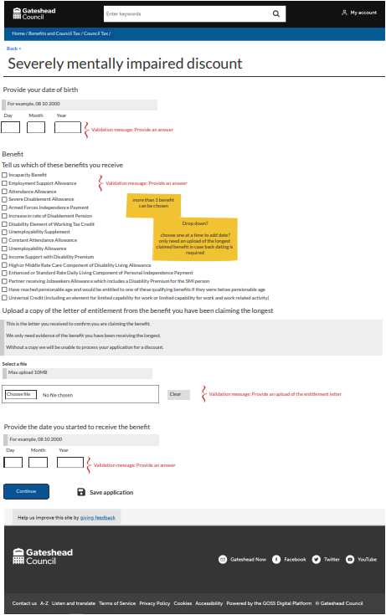
Sprint 33.
Council Tax severely mentally impaired wireframe.
Council Tax SMI, yes, details

Slide 9
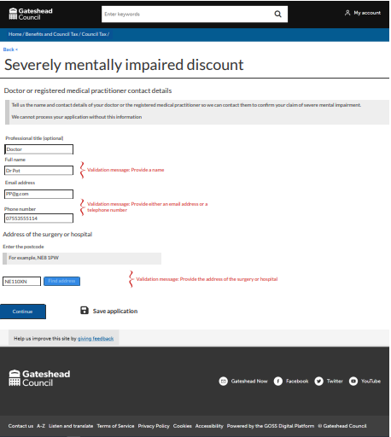
Sprint 33.
Council Tax severely mentally impaired wireframe
Council Tax payer, SMI, yes, doctor/practitioner details

Slide 10
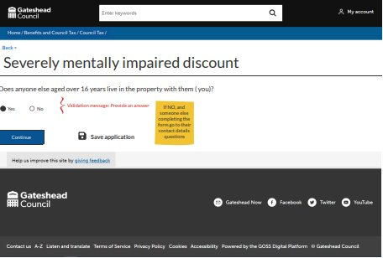
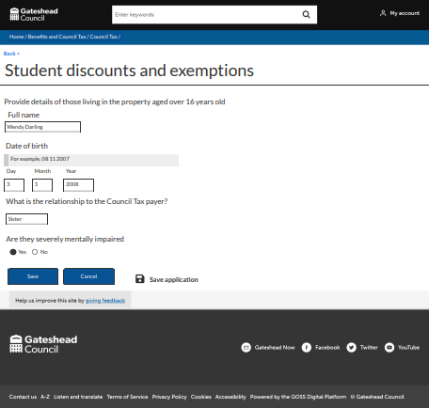
Sprint 33.
Council Tax severely mentally impaired wireframe
Occupant over 16, details, SMI yes/no

Slide 11
Sprint 33.
Council Tax severely mentally impaired wireframe
Occupants over 16, yes/no
If yes, details added

Slide 12
Sprint 33.
Council Tax severely mentally impaired wireframe
Doctor/practitioner details required

Slide 13
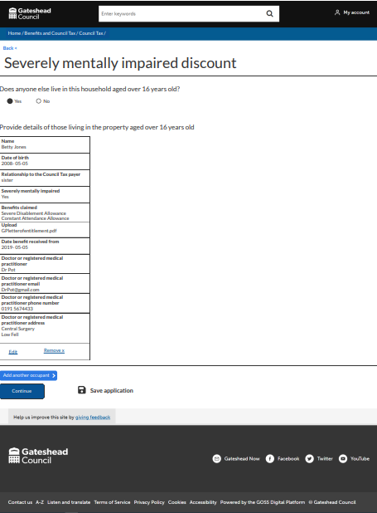
Sprint 33.
Council Tax severely mentally impaired wireframe
Details of other occupants over 16, and option to add another

Slide 14
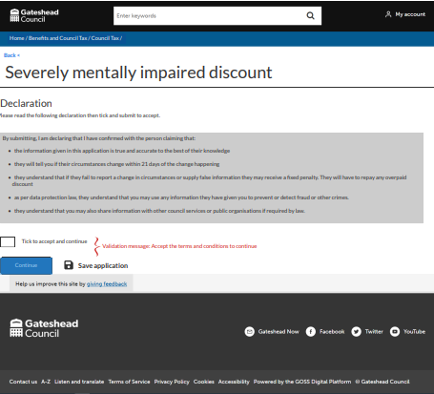
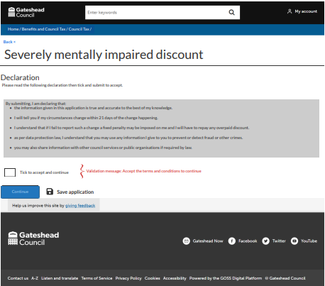
Sprint 33.
Council Tax severely mentally impaired wireframe
Declarations, completed by CT payer / On behalf of

Slide 15
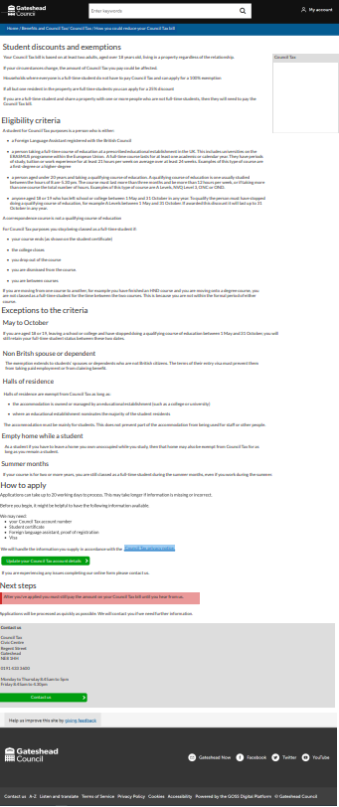
Sprint 33.
Council Tax Student discount/exemptions proposed web content,
Still to be approved by Council Tax team.

Slide 16
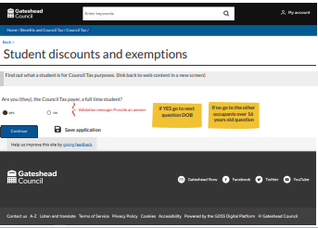
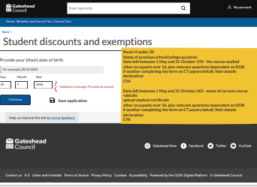
Sprint 33.
Council Tax Student discount/exemptions wireframe.
Still to be approved by Council Tax team.
Council Tax payer is a student. DOB calculates under or over 20

Slide 17
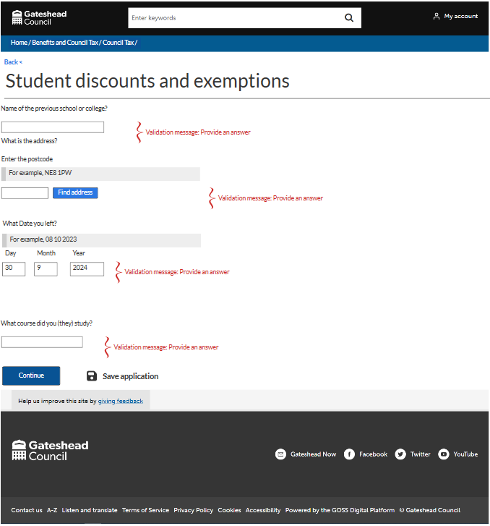
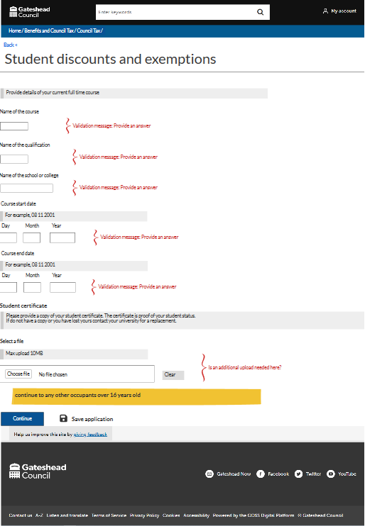
Sprint 33.
Council Tax Student discount/exemptions wireframe

Slide 18
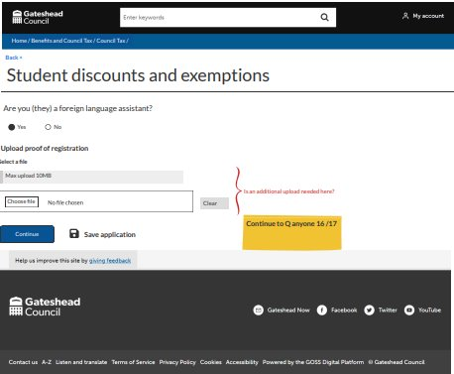
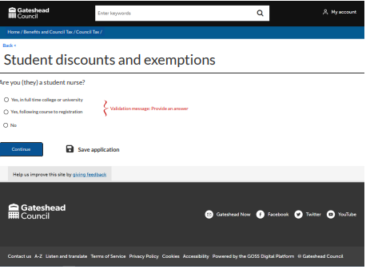
Sprint 33.
Council Tax Student discount/exemptions wireframe
Foreign language assistant
Student nurse (3 routes)

Slide 19
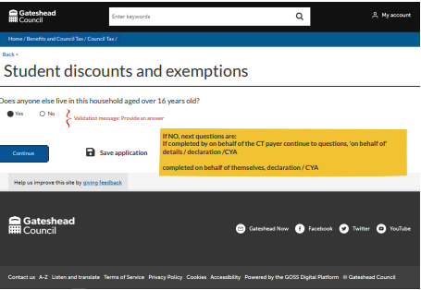
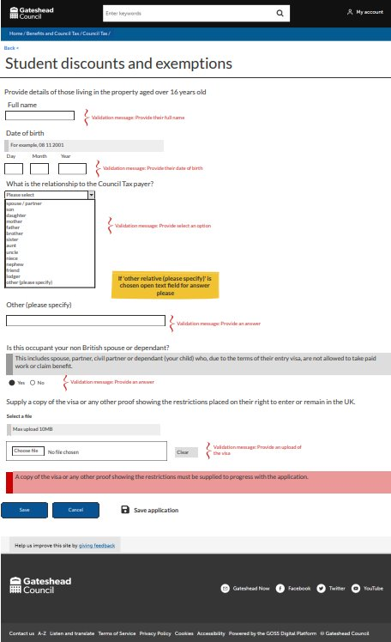
Sprint 33.
Council Tax Student discount/exemptions wireframe
Other occupants over 16
Non-British national

Slide 20
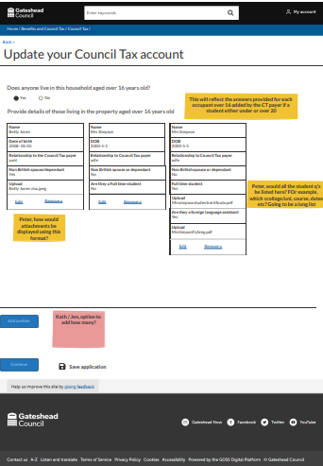
Sprint 33.
Council Tax Student discount/exemptions wireframe
Details of occupants over 16.
Still a few questions to be answered and approval from Council Tax.

Slide 21
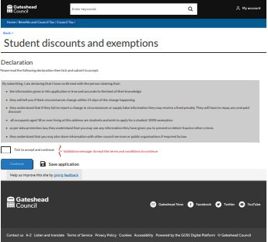
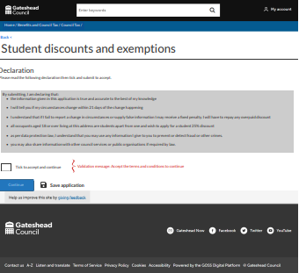
Sprint 33.
Council Tax Student discount/exemptions wireframe.
Declarations dependant on who is completing the form and if claiming 100% exemption or 25% discount.

Slide 22
Sprint 33.
Council Tax user scenarios

Slide 23
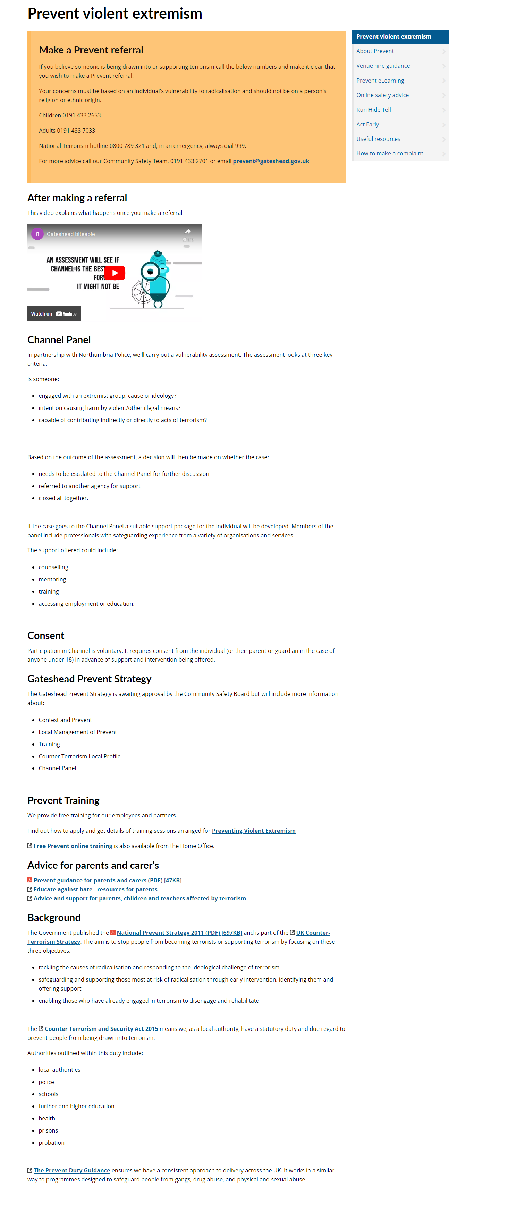
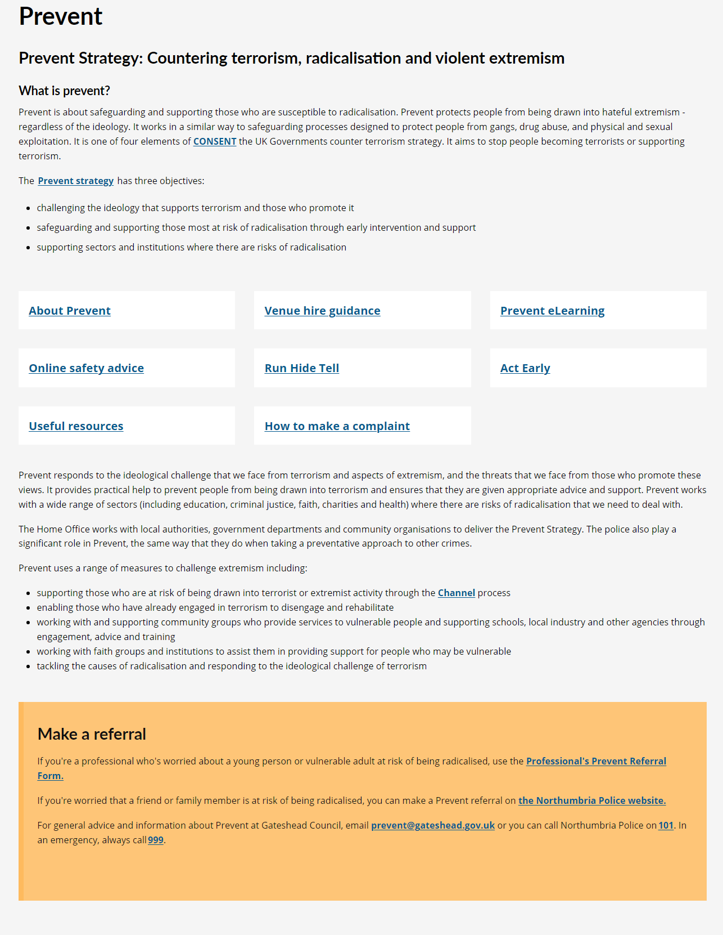
Sprint 33.
Prevent content

Slide 24
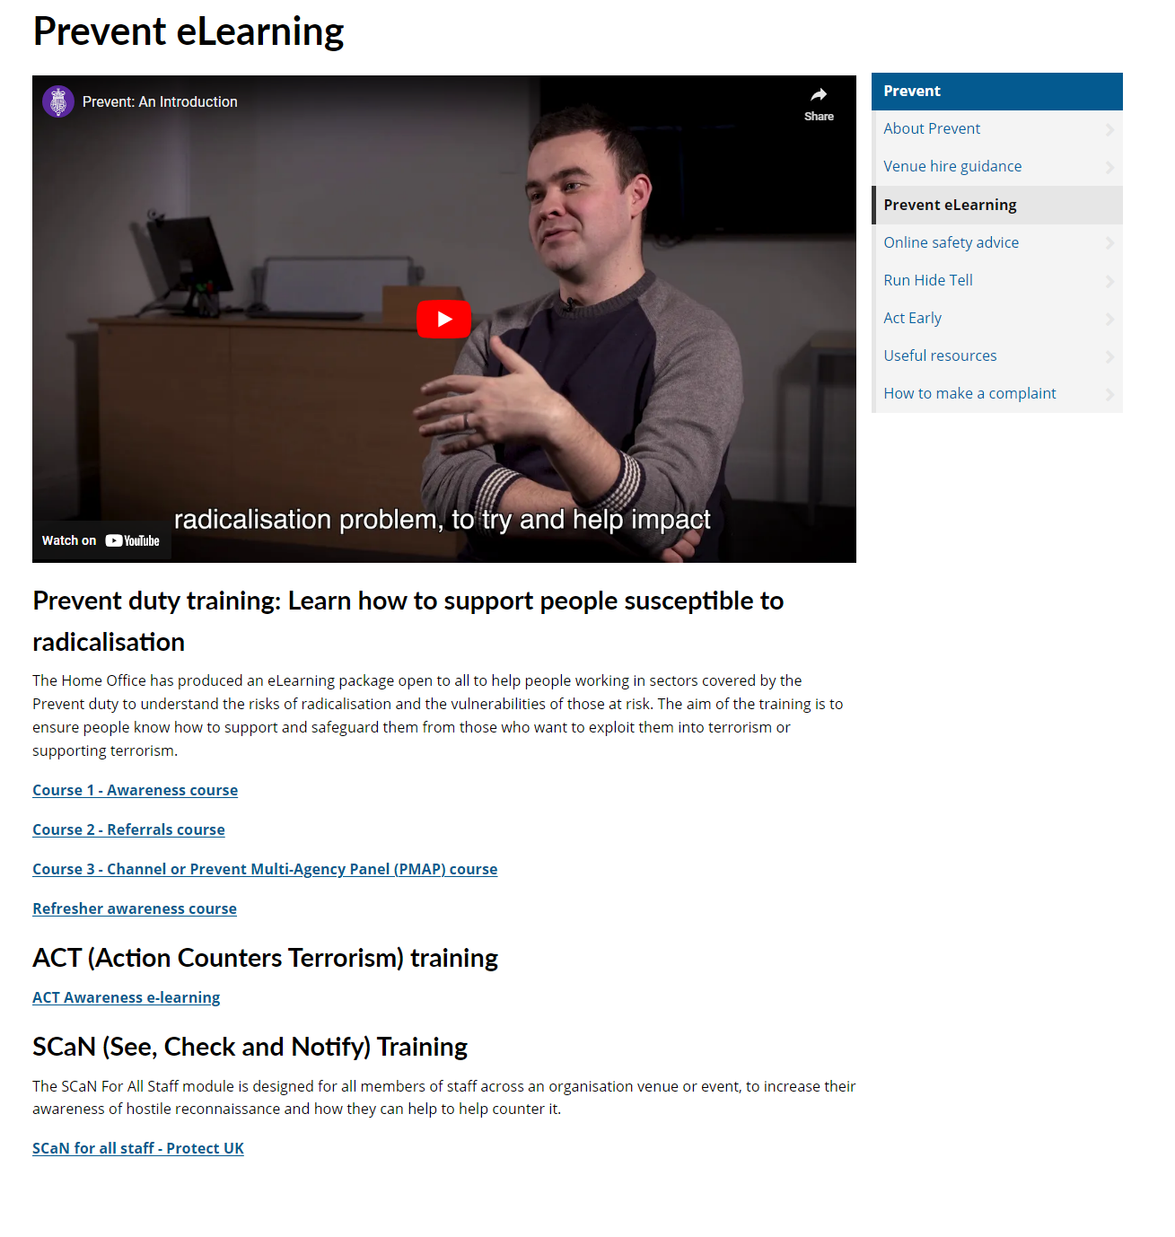

Slide 25
Sprint 33
Development
Form Abandonment Tracking
Enhanced insights to improve user experience
Notes:
RA - LS

Slide 26
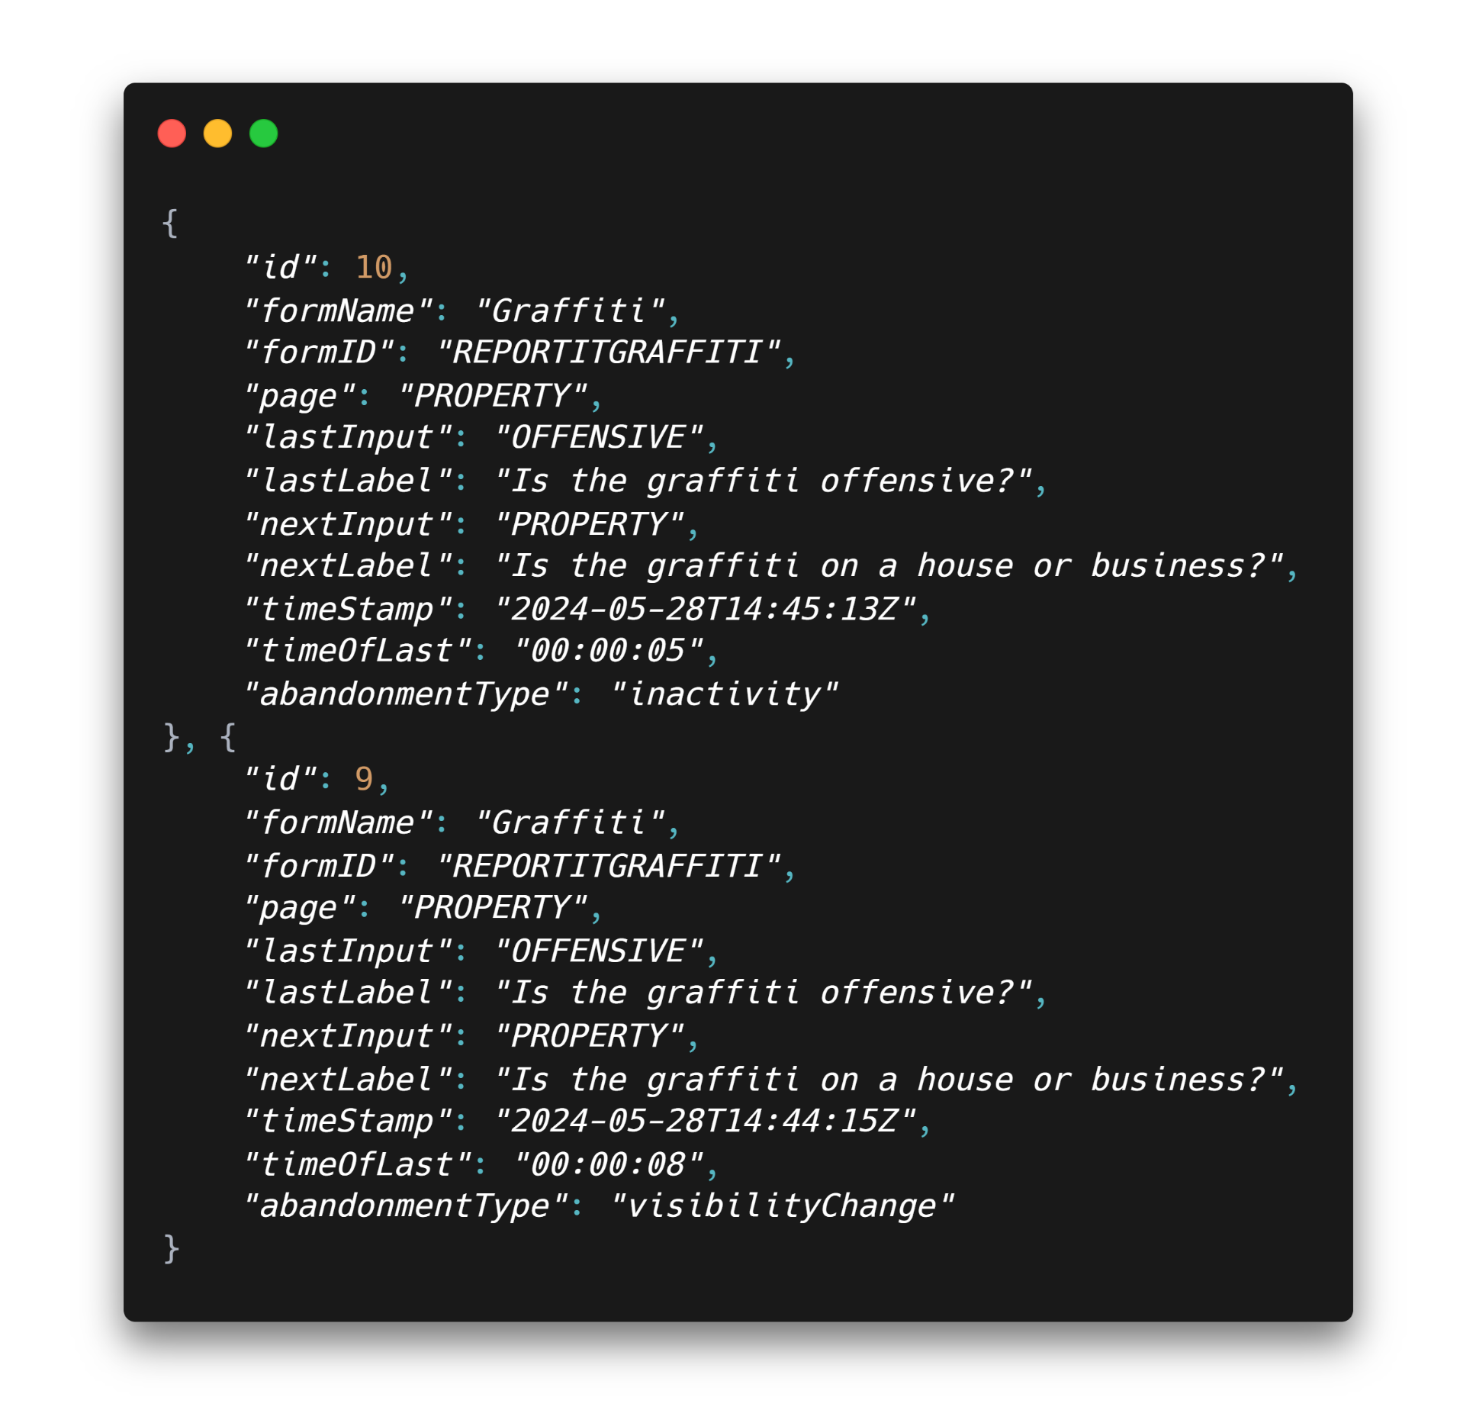
Sprint 33
Development
Details
The script detects and logs each user interaction on a form identifying form details, last and next inputs, time spent, time abandoned, and the type of abandonment.
Abandonment is detected when:
Window closed
Inactivity for X number of minutes
Tab / Window hidden for X amount of time
Notes:
LS

Slide 27
Sprint 33
Development
Benefits
Identify user pain points: Determine the specific pages and fields that are overly lengthy, complex, or frustrating, which lead to user fatigue.
Optimise user experience: By analysing the data to identify patterns, we can make targeted improvements to our digital forms, thereby reducing the likelihood of users seeking alternative channels for assistance.
Notes:
LS

Slide 28
Sprint 33.
What's next?
Improvement to libraries basket functionality
Household Support Fund – continue development
Council Tax change of address wireframe
Landlord licensing – FPN payments and amendments
Blue Badge – physio desktop assessments

