Slide 1
Sprint 35 Show and Tell 14 June 2024
G Squad
Digital Team

Slide 2
Sprint 35.
Sprint goals
Council Tax - change of address wireframe.
Housing contact form go live.
General Election content

Slide 3
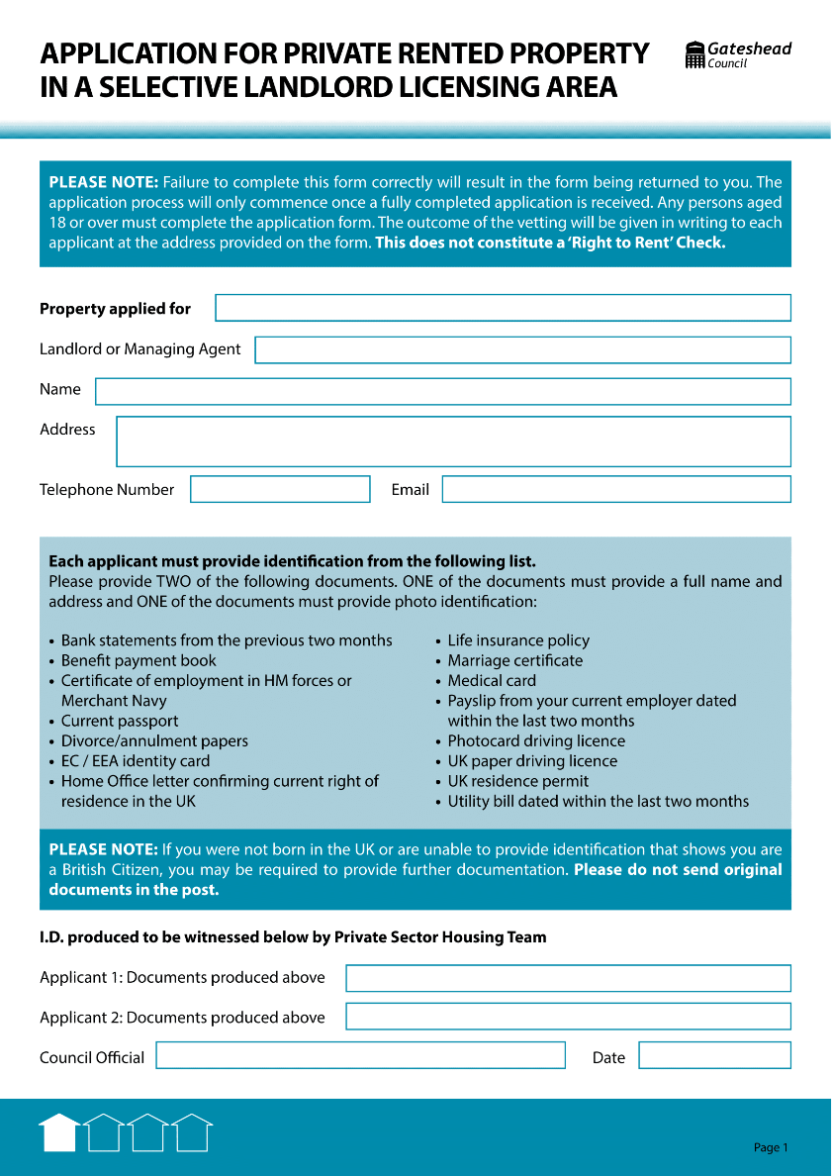
Sprint 35.
Tenant vetting

Slide 4
Sprint 35.
Council Tax
Change of address
Current web content

Slide 5
Sprint 35.
Council Tax
Change of address
Proposed web content

Slide 6
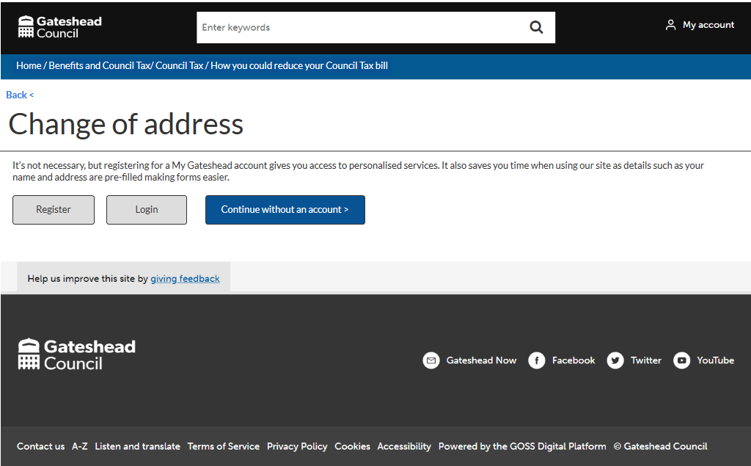
Sprint 35.
Council Tax
Change of address
Wireframe

Slide 7
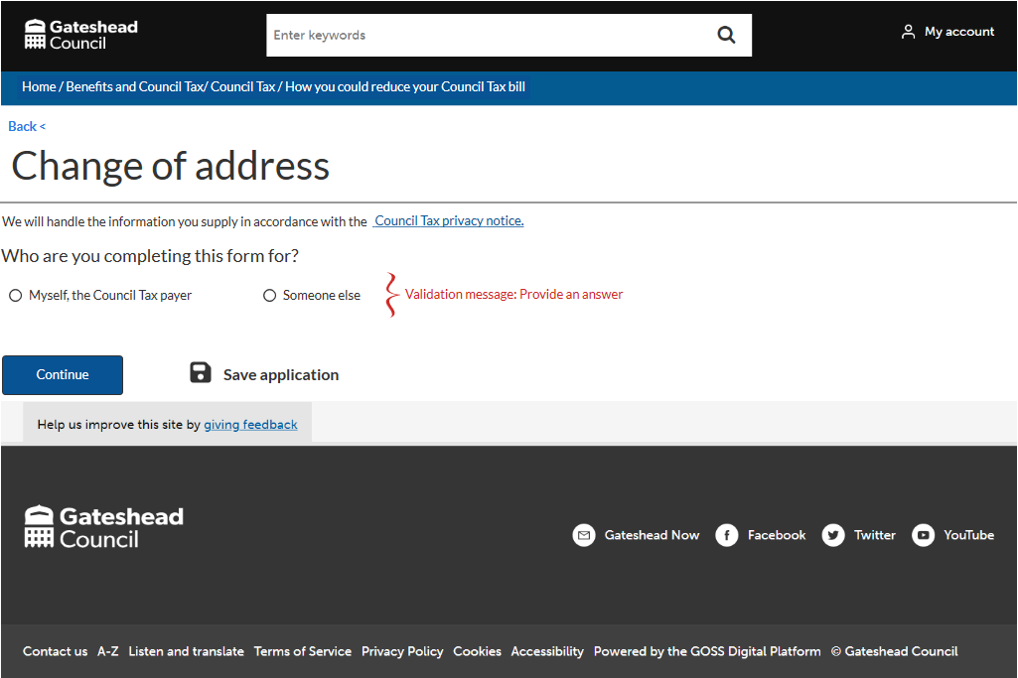
Sprint 35.
Council Tax
Change of address
Wireframe

Slide 8
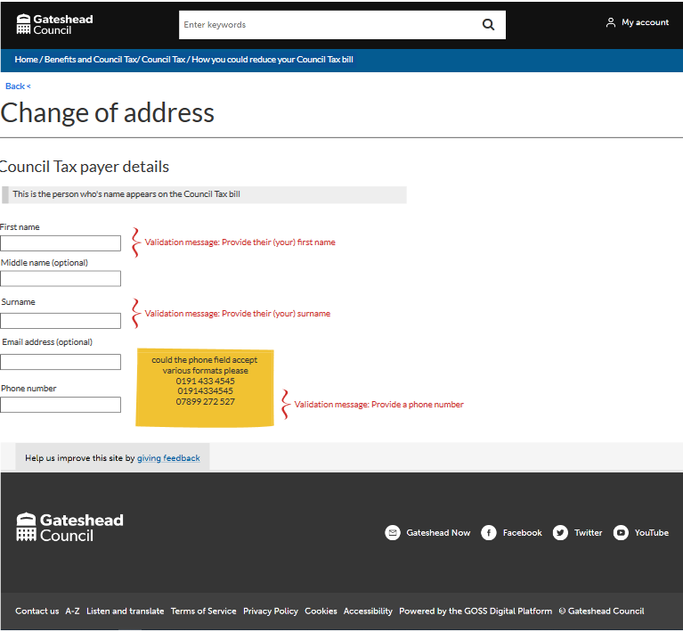
Sprint 35.
Council Tax
Change of address
Wireframe
Council Tax payer details and Council Tax number

Slide 9
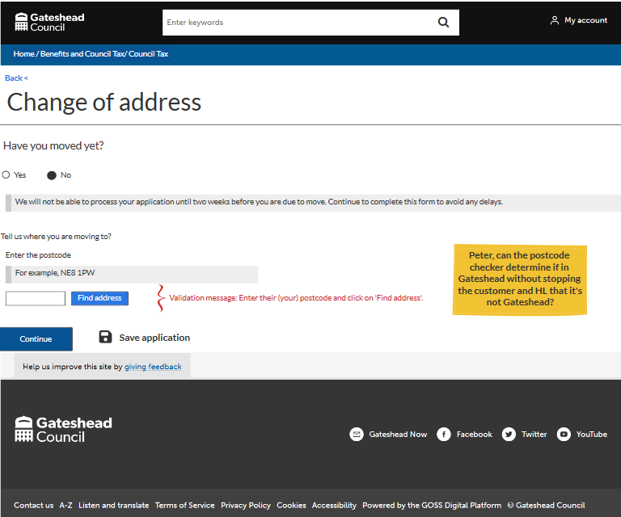
Sprint 35.
Council Tax
Change of address
Wireframe

Slide 10
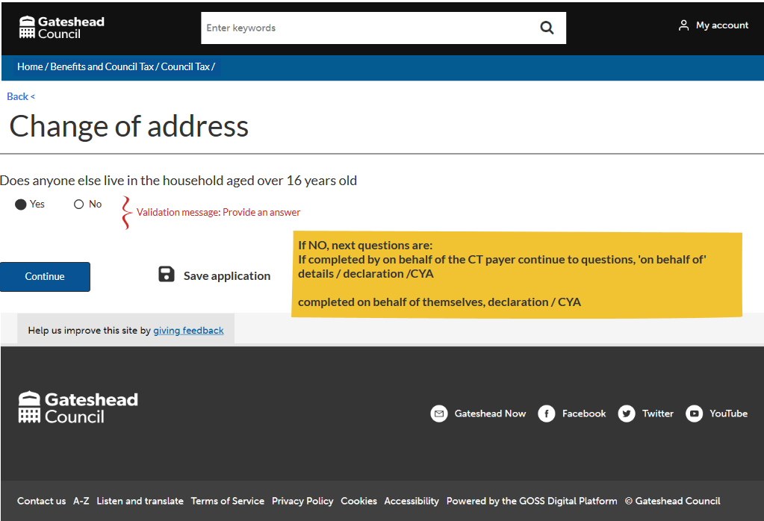
Sprint 35.
Council Tax
Change of address
Wireframe

Slide 11
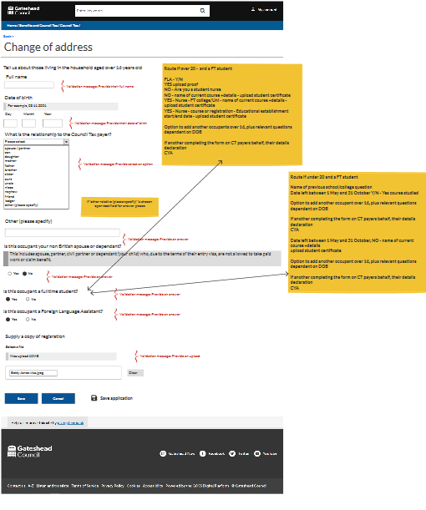
Sprint 35.
Council Tax
Change of address
Wireframe
Other occupants 16+

Slide 12
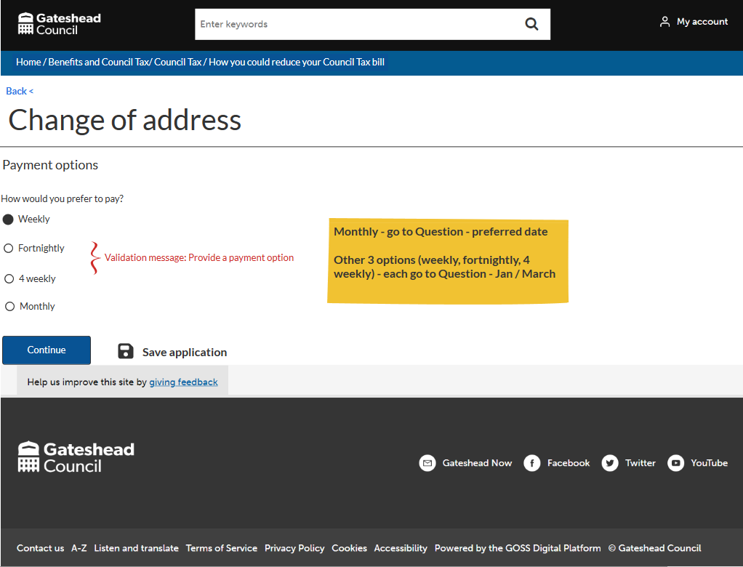
Sprint 35.
Council Tax
Change of address
wireframe
Payment options include:
DD or Post Office payment card
frequency
preferred date if monthly
10 or 12 months

Slide 13
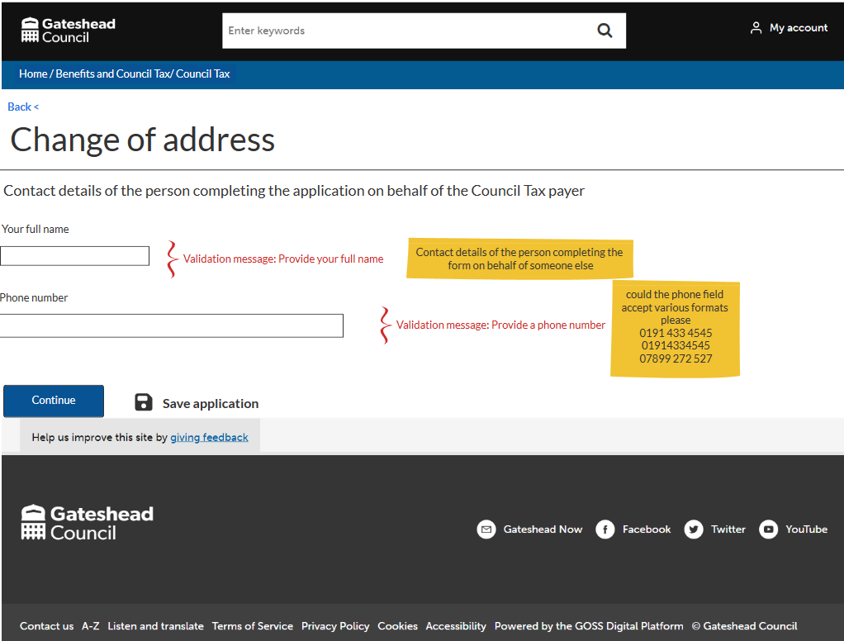
Sprint 35.
Council Tax
Change of address
wireframe

Slide 14
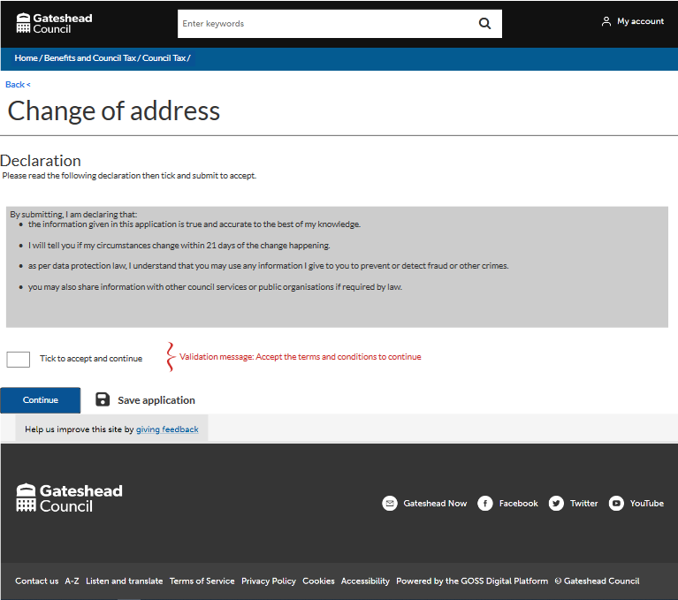
Sprint 35.
Council Tax
Change of address
wireframe

Slide 15
Sprint 35.
Digital Transactions Dashboard
Aim:
Create a quick view dashboard of demand for digital service.
Provide evidence for Productivity Plans
Includes:
Provides the total count
Percentage completed online
Percentage change for things completed online
Summary of payment value by channel

Slide 16
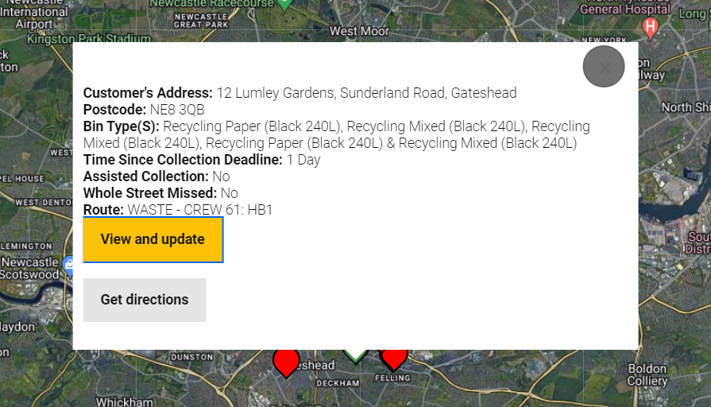
Sprint 35.
User story
As a waste services supervisor
I need to see which round has missed the bin
So that I can allocate the collection to the correct crew
Missed bins – include crew information

Slide 17
Sprint 35.
Contaminated bins – clearer information for customers

Slide 18
Sprint 35
Development
Form Abandonment Tracking
Using Insights to Improve User Experience
Notes:
RA - LS

Slide 19
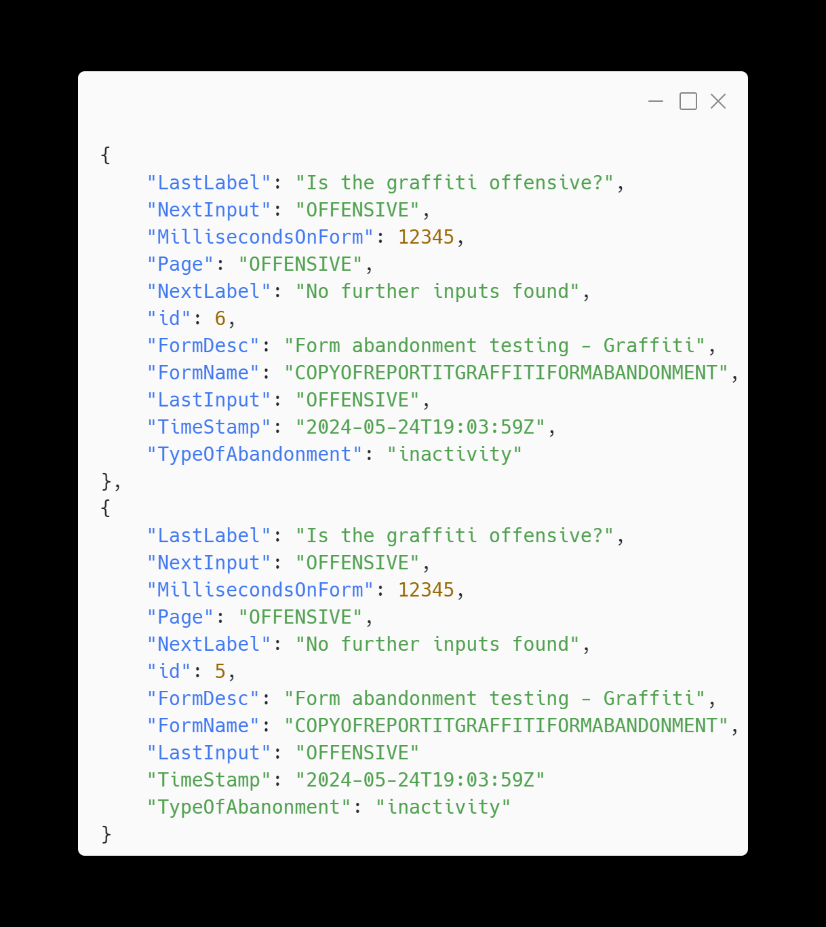
Sprint 35
Development
Details
Our script tracks every user interaction on a form. It records details like the last and next inputs, time spent on the form, when users leave, and why they leave.
We detect abandonment when:
The window is closed.
There’s inactivity for a certain amount of time.
The tab or window is hidden for a while.
Notes:
LS - This JSON snippet shows how we log these interactions. Each entry captures the form details, user inputs, timestamps, and the type of abandonment.

Slide 20
Sprint 35
Development
Benefits
Understand User Pain Points: We can see which pages and fields are too long, complicated, or frustrating. This helps us understand why users might give up on filling out the form.
Improve User Experience: By looking at this data, we can make specific improvements to our forms. This reduces the chances of users abandoning the form and looking for help elsewhere.
Notes:
LS – Quick demo

Slide 21
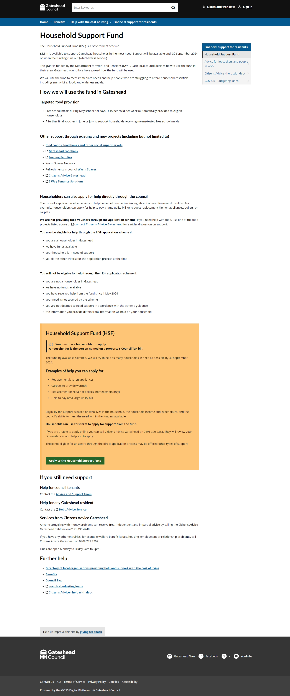
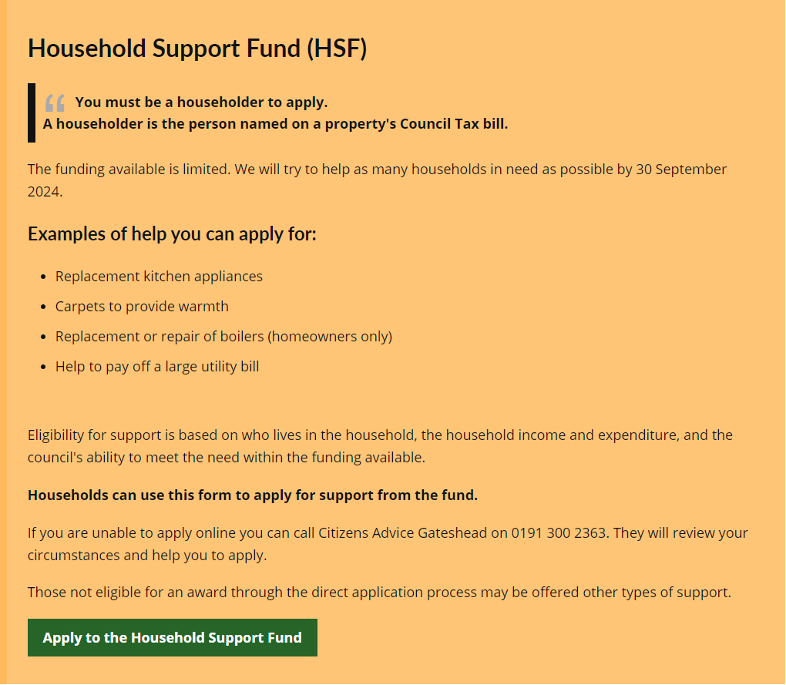
Sprint 35.
Household Support Fund
Web content

Slide 22
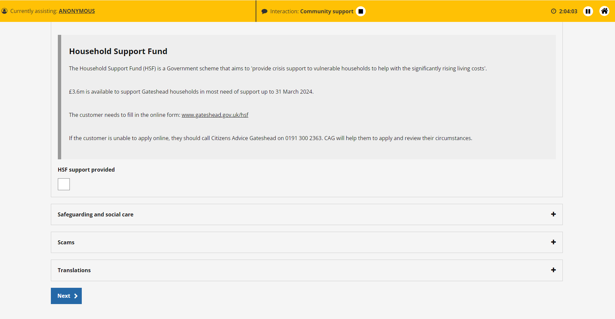
Sprint 35.
Household Support Fund - Customer Contact content

Slide 23
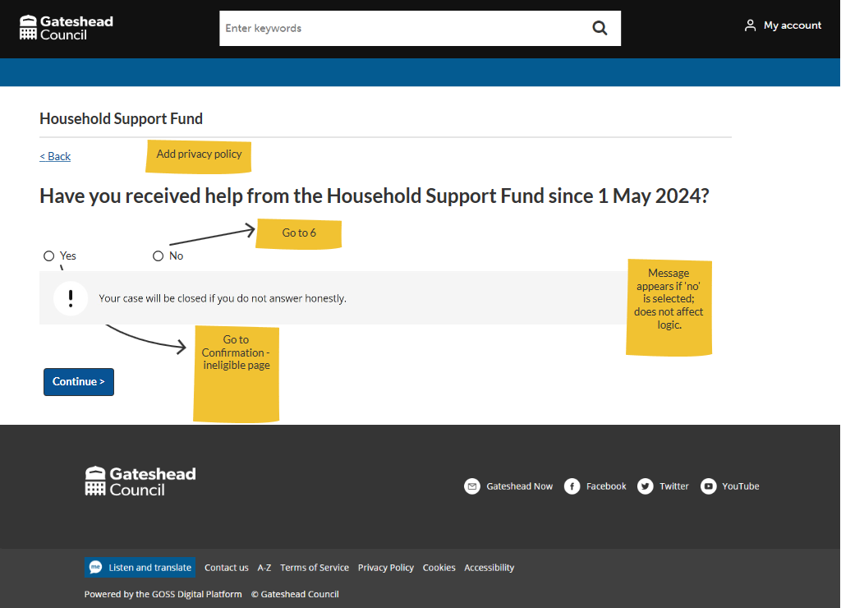
Sprint 35.
Household Support Fund
Wireframe

Slide 24
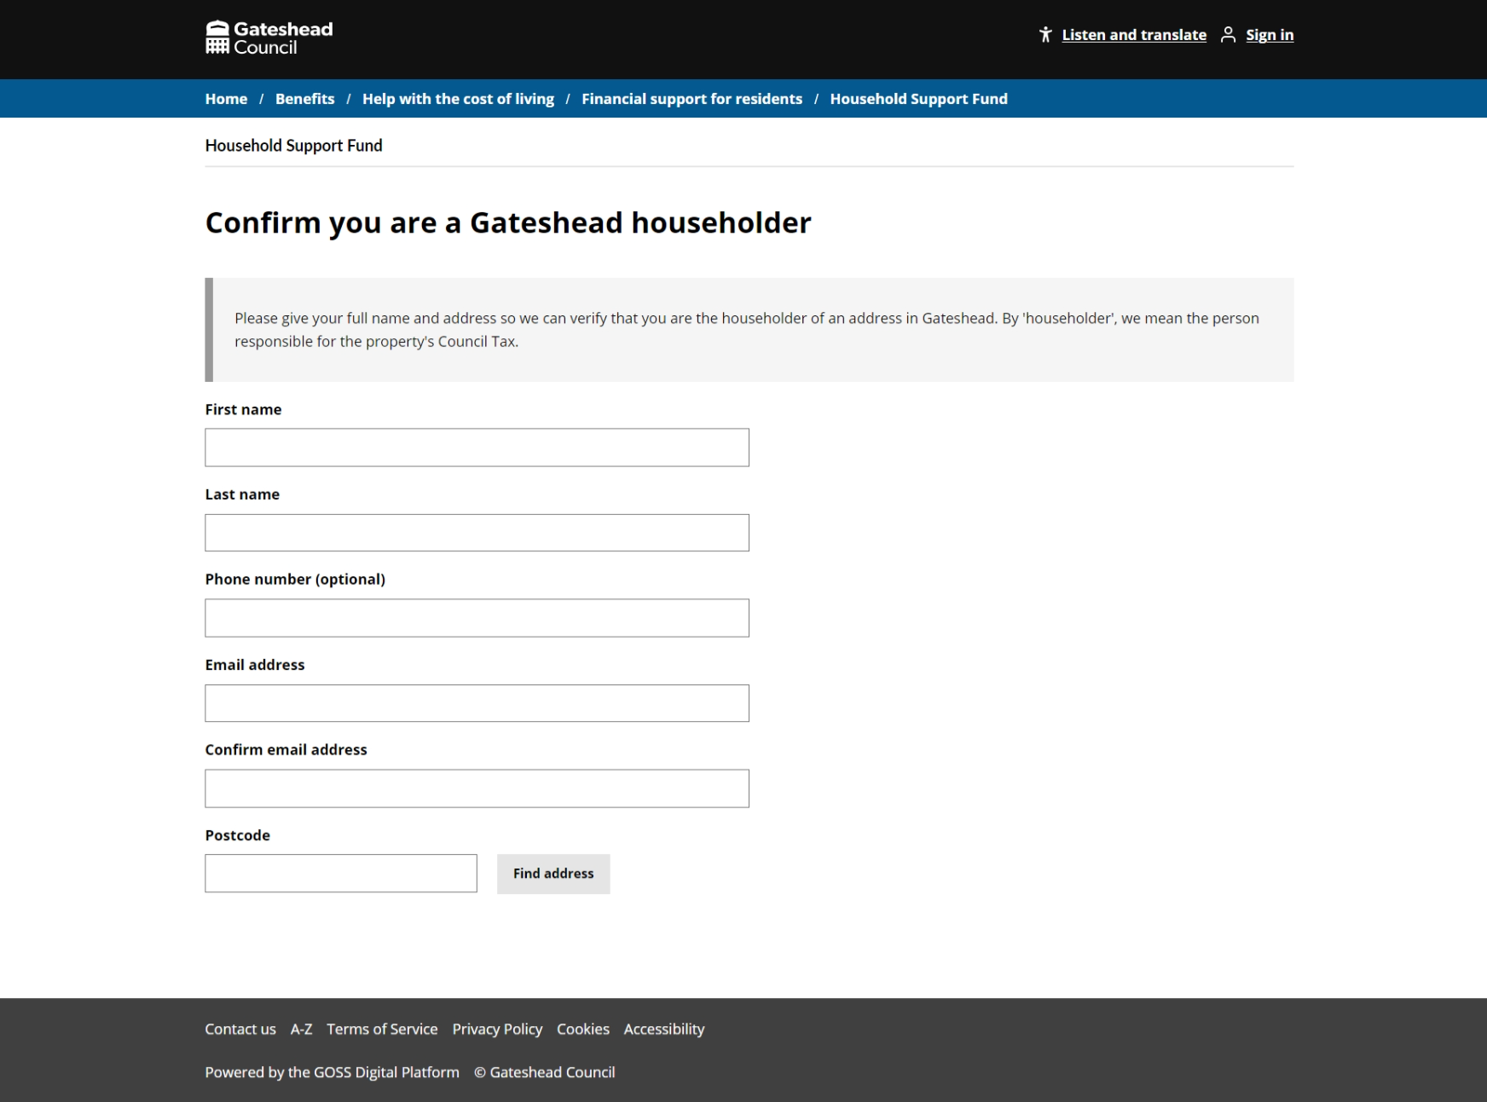
Sprint 35.
Household Support Fund
Form demo

Slide 25
Sprint 35.
What's next?
Council Tax
Change of address - continue developing wireframe
Severe mental impairment disregard and exemption form build
Student exemption and discount development
Housing
Alterations discovery

