Slide 1


Sprint 36
Show and Tell
19/06/2024
C Squad
Digital Team

Slide 2

Sprint 36
Sprint goals
Implement IA
Start user research for direct payments

Slide 3
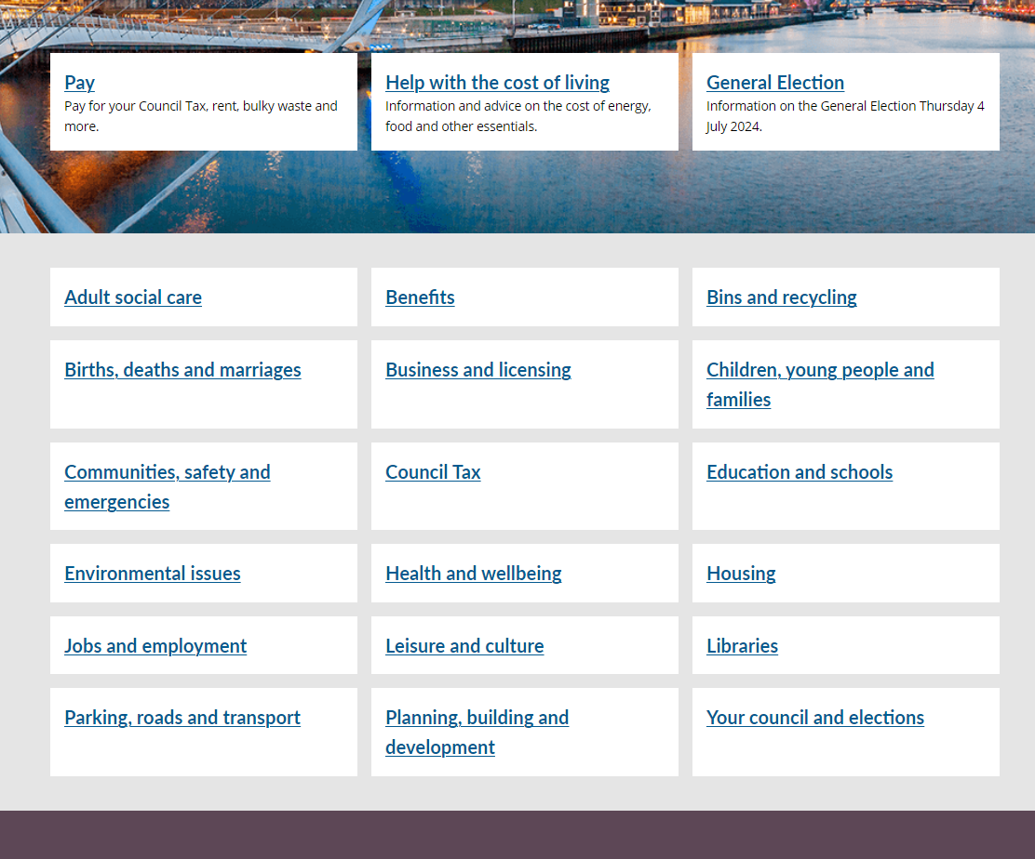
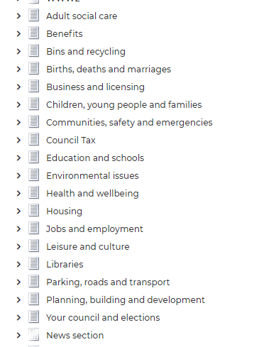
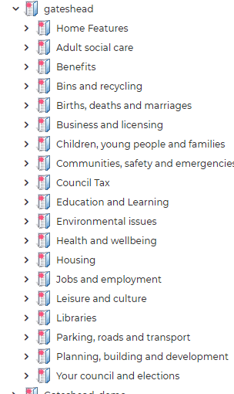
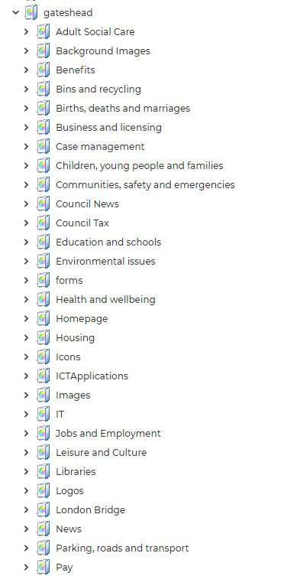
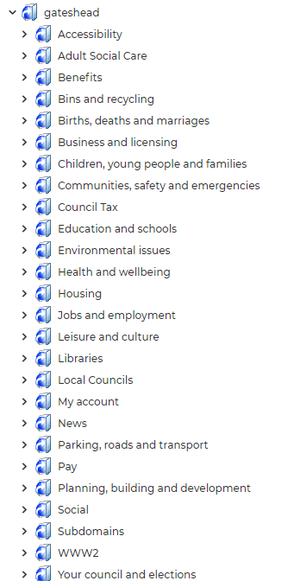
Implement the new IA on gateshead.gov.uk
All new and renamed site sections are now live
The media library, features library and links library in iCM have all been updated to follow the new structure
Feedback from services has been very positive

Slide 4
Sprint 36
Discovery
Direct payments
  Fourth mapping session – continued to identify pain points
  Met with Heather to review process maps for DP Team
  UR shadowing session with DP team
  UR planning for DP recipients
  DP data analysis – beginnings of dashboard
  Adult social care
    Presented Contact us data dashboard to the business
    Attended Community Led Support workshop at Leam Lane library
  Council Tax billing survey
    Mailed out to various groups on Mailchimp and live on more webpages
    Live on consultation portal
    Gone out in Gateshead Now

Slide 5
Sprint 36
Design
Comms - iCM shortcuts
Figma templates for wireframing
HDRC - panel template design
HDRC - mailchimp template
Digital services tweaks
Global CSS - Align related images to the right
Council tax single person discount email amends
My service - Update

Slide 6
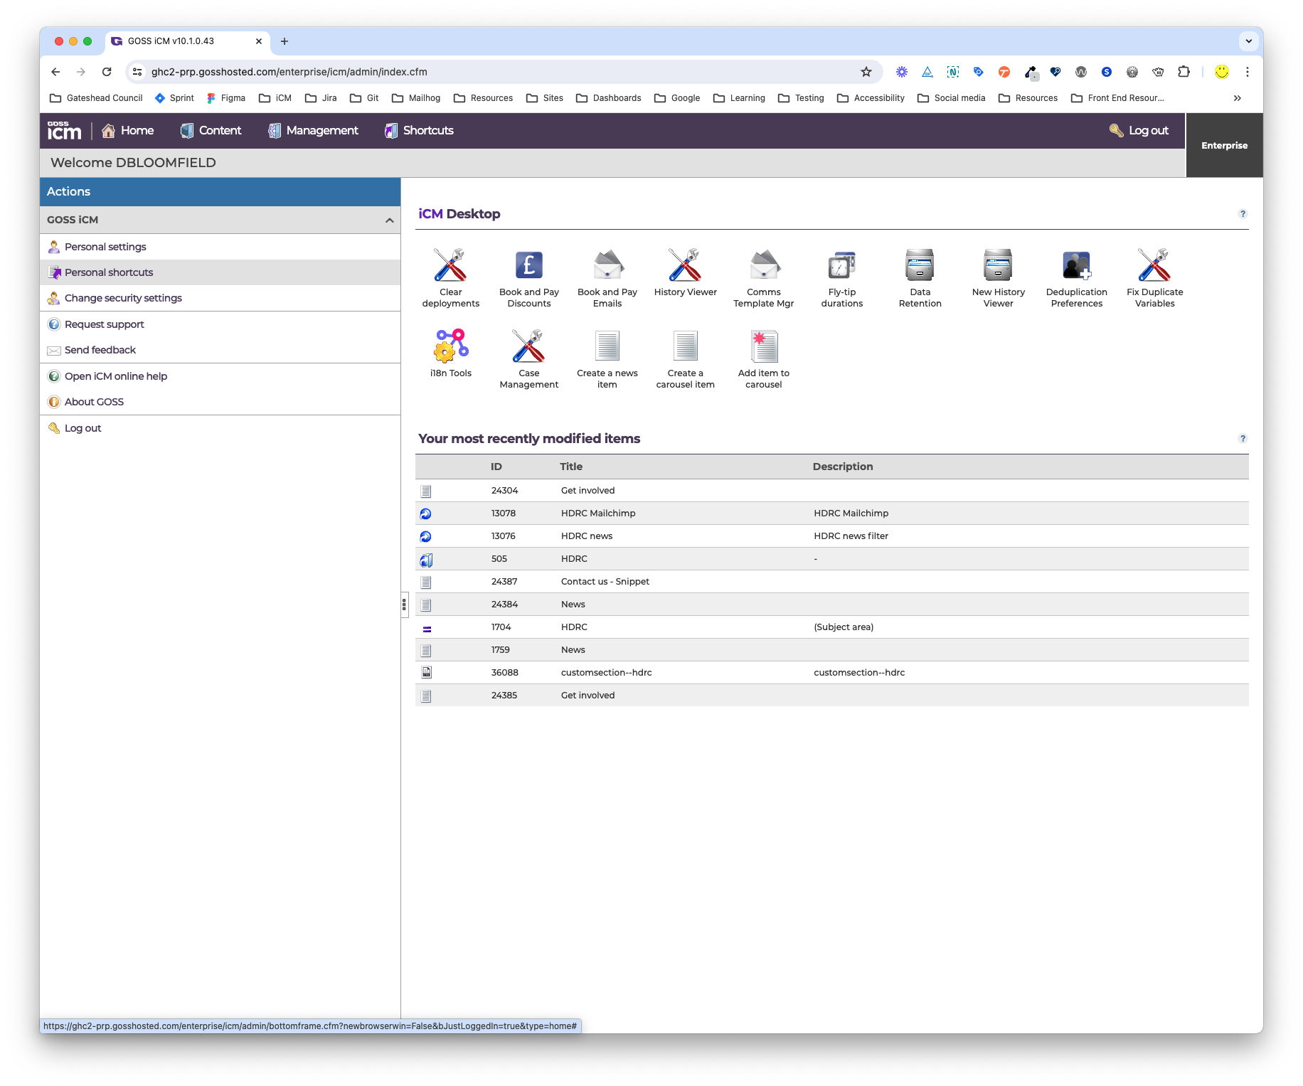
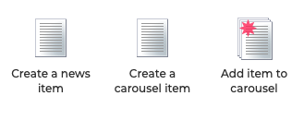
iCM shortcuts
Added iCM shortcuts to help comms add news articles and the carousel on the intranet
Created shortcuts to
Create a news article
Create a carousel item
Add item to carousel
Future work
Add shortcuts for the creation of Gateshead Council website news articles
Any other ideas?

Slide 7
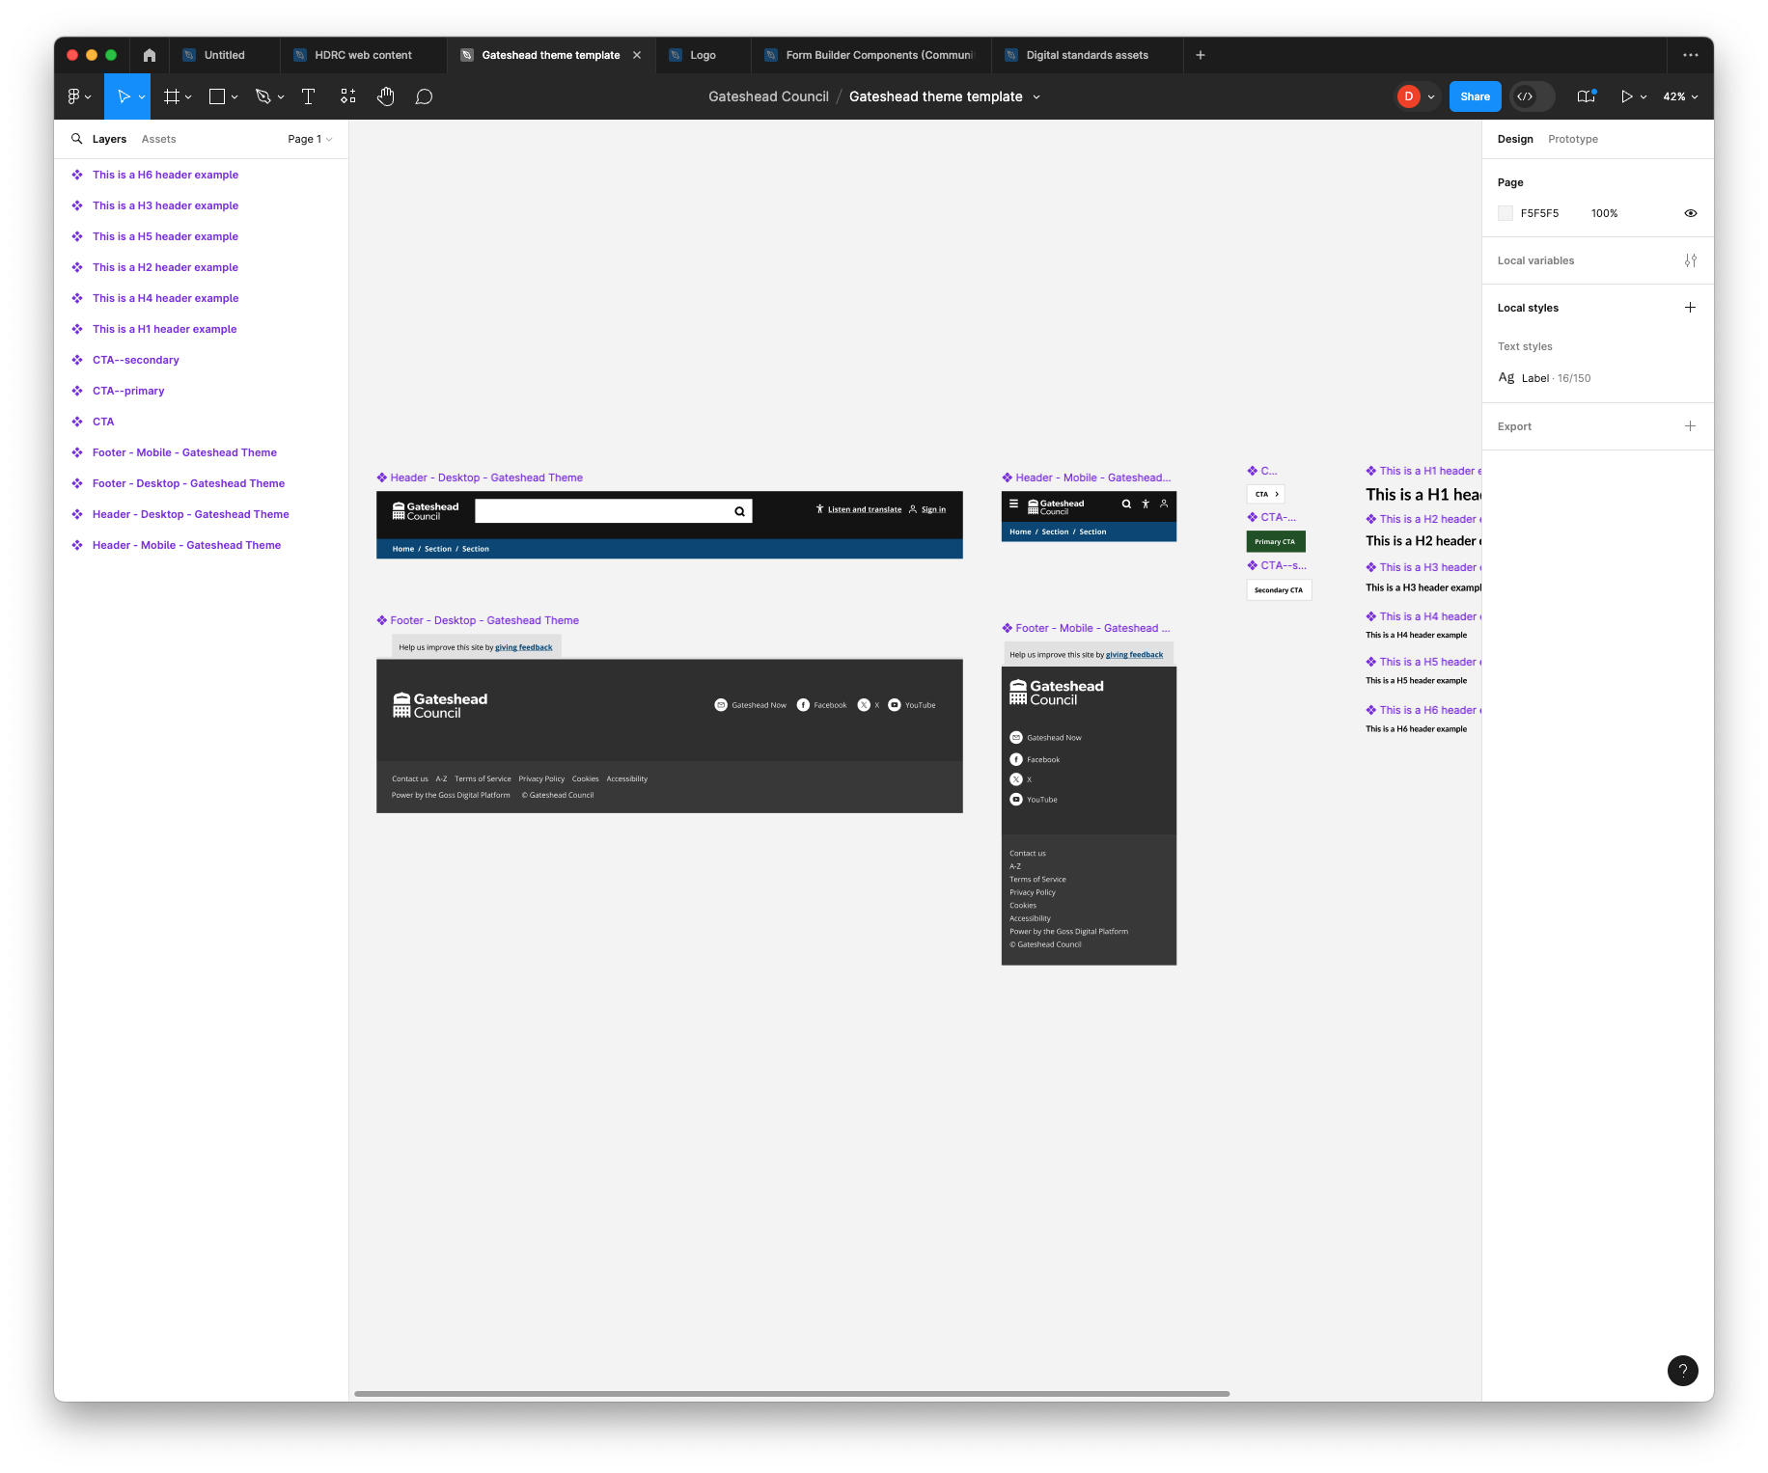

Figma template
Created in this sprint
Headers (desktop and mobile)
Footers (desktop and mobile)
Some basic elements (CTA's and text styles)
Tested the library works within the team projects
Future work
Replicate the Balsamiq master template in Figma

Slide 8
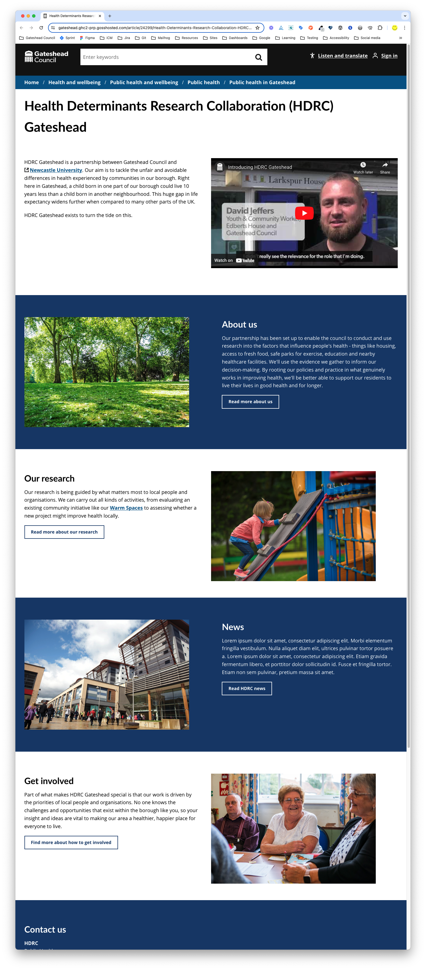
HDRC panel template
Health Determinants Research Collaboration (HDRC) Gateshead
Changed content to use panel template
Added YouTube panel styling
Added custom colours
https://gateshead.ghc2-prp.gosshosted.com/article/24299/Health-Determinants-Research-Collaboration-HDRC-Gateshead

Slide 9
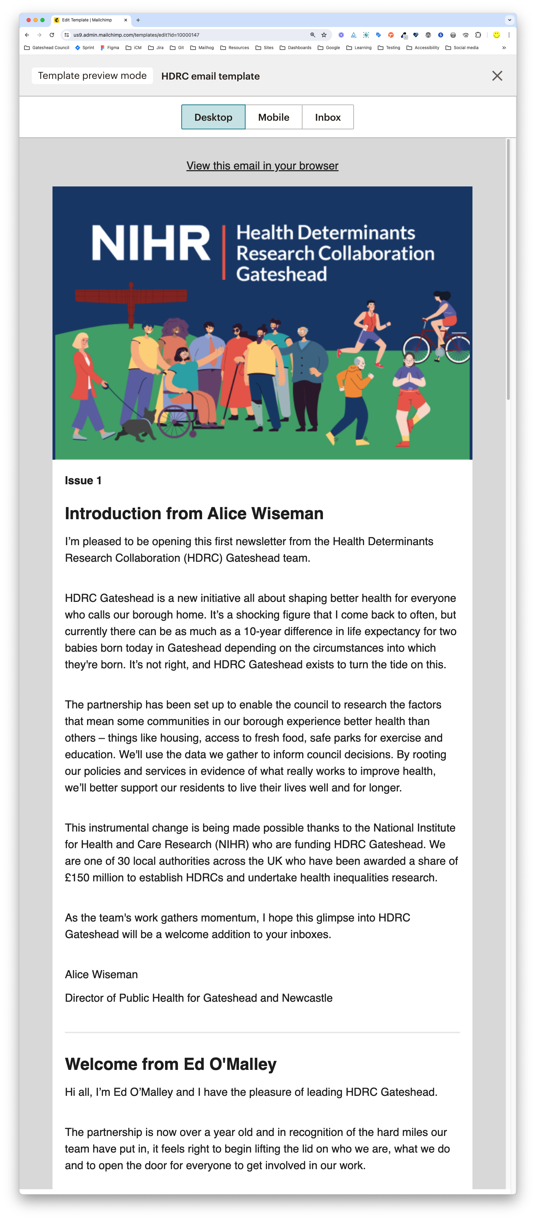
HDRC MailChimp
Health Determinants Research Collaboration (HDRC) Gateshead MailChimp template
Updated content
Updated images
Awaiting approval

Slide 10

Digital services
Update CSS to align related images to the right (Global CSS and can be applied to any website)
Updated icons
Add icons to list template pages - required a change to the CSS / metadata
https://intranet.gateshead.gov.uk/article/24880/Digital-service-standards

Slide 11
Sprint 36
Content
Implemented the new IA
General election notices added
Trade apprenticeships - 2 vacancies readvertised
Brighten the day summer holiday activities and new content for SEND
HAFplus email marketing sent to free school meals families
Gateshead Now issued 19 June
Education and schools content audit
Alternative provision register - live
SEND activities directory

Slide 12
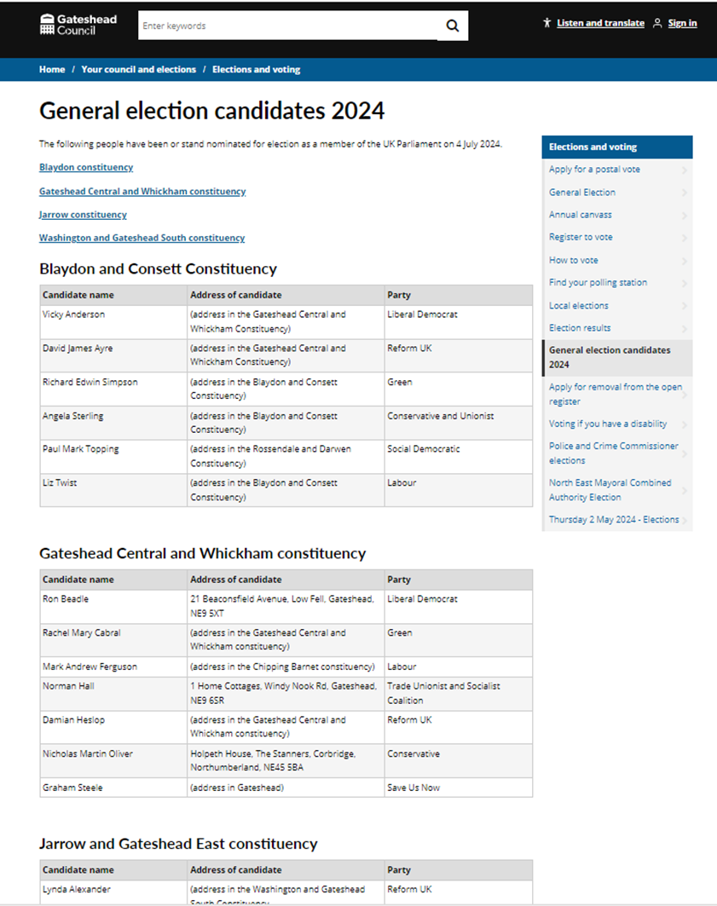
Election notices for the general election 4 July
Statement of persons nominated for the 4 constituency areas of:
Blaydon and Consett
Gateshead Central and Whickham
Jarrow and Gateshead East
Washington and Gateshead South

Slide 13
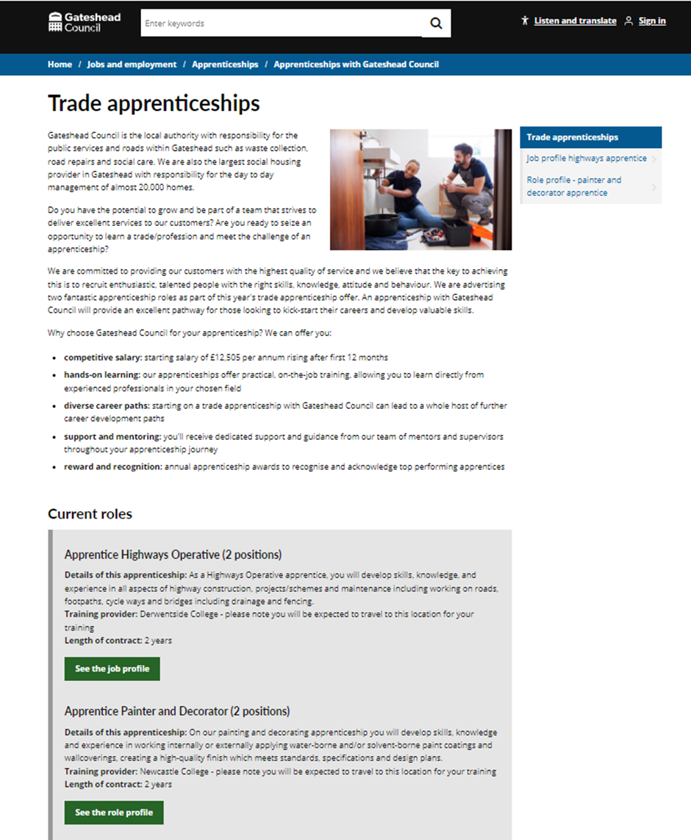
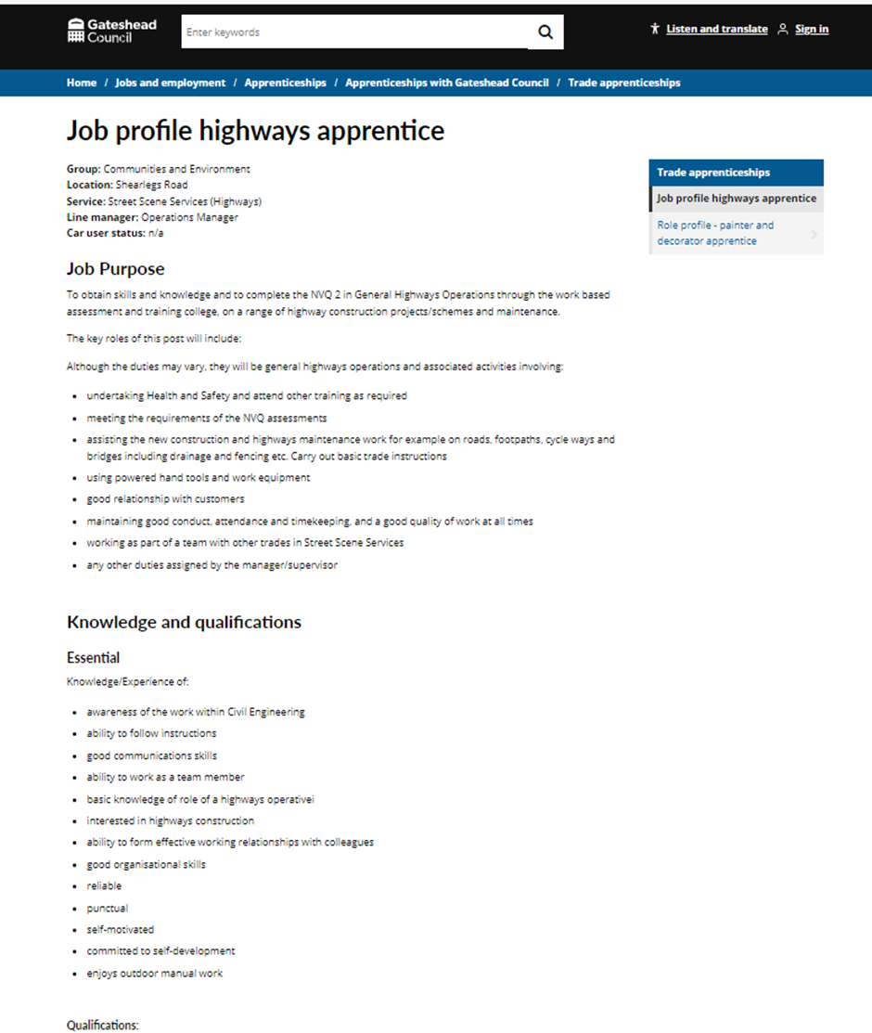
Trade apprenticeships
Two trade apprenticeship vacancies re- advertised - highways apprentice and painter and decorator apprentice.
Content amended and put back live with two additional job profiles added.
Trade apprenticeships - Gateshead Council

Slide 14
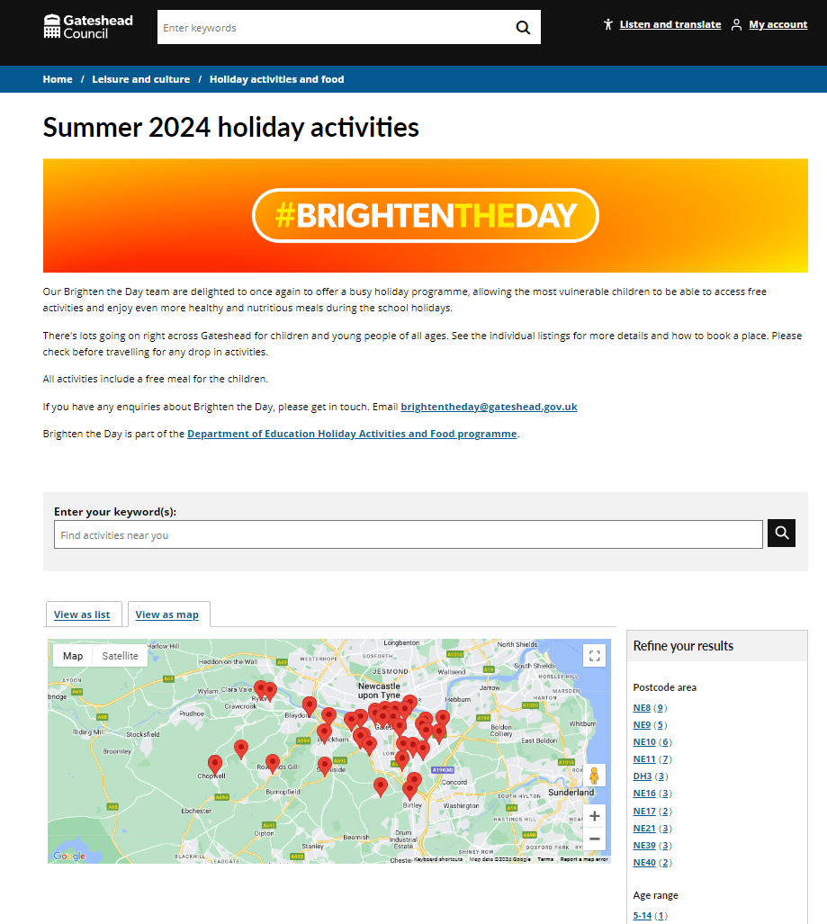
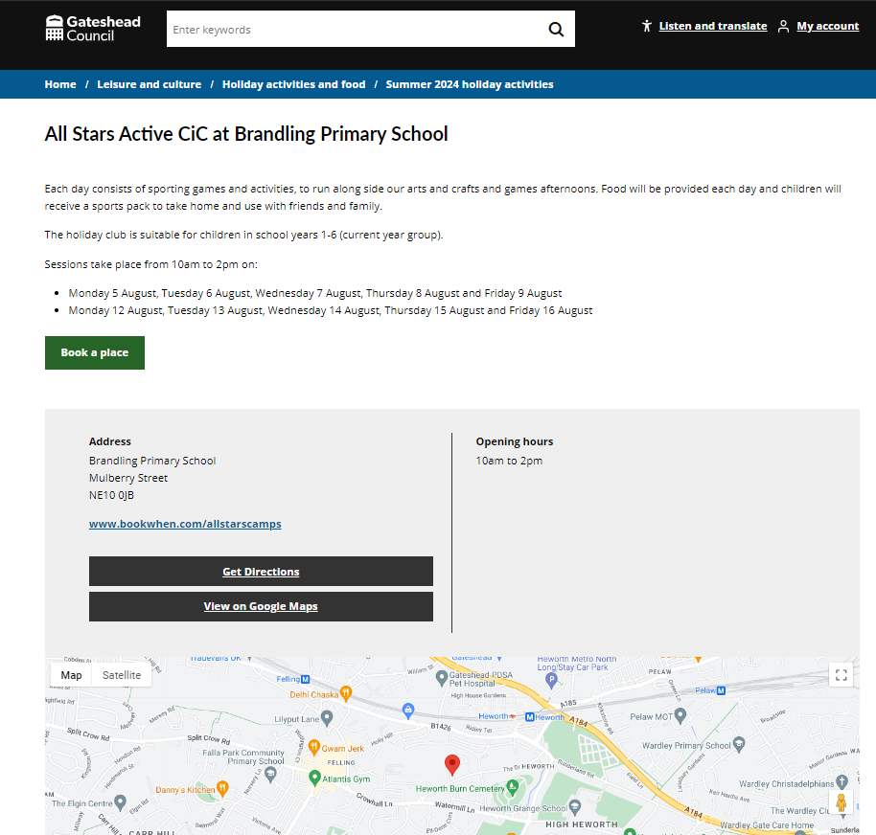
Brighten the Day summer activities
50 events added to the website for the summer holiday activities and food programme Brighten the Day.
To be promoted next week to families entitled to free school meals for advanced booking.
www.gateshead.gov.uk/brightensummer24

Slide 15
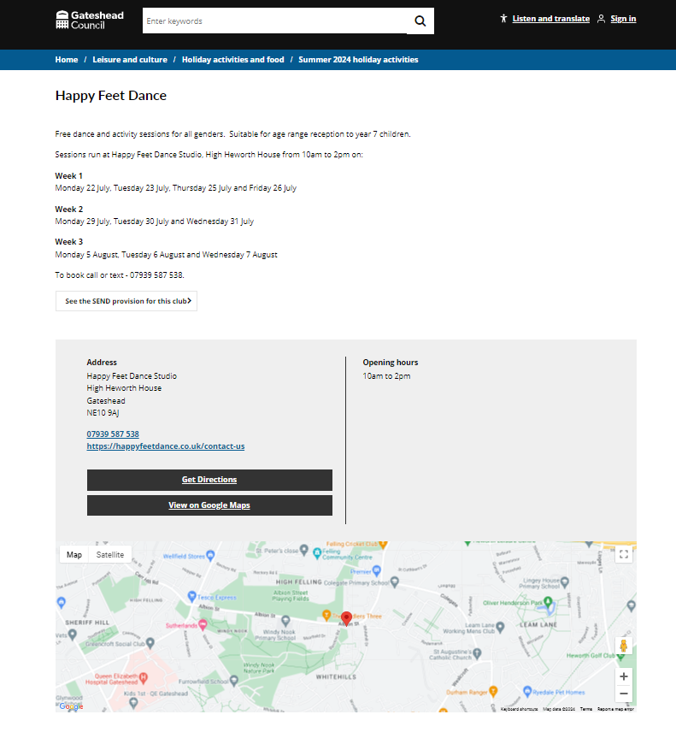
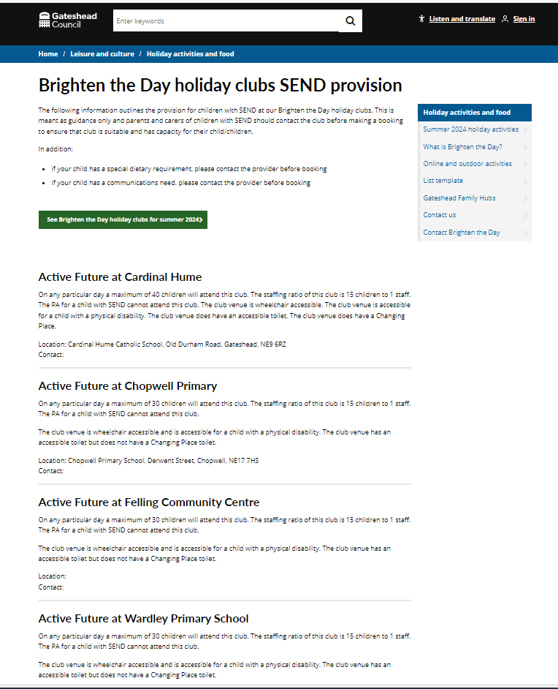
Brighten the Day summer activities – SEND provision
Request to promote the SEND provision offered at each holiday club.
Created content where all the holiday club SEND provision is in one place so families can see what support is available.
Happy Feet Dance - Gateshead Council

Slide 16

HAFplus email campaign
Email marketing sent to families entitled to free school meals to register their interest in the new summer HAF Plus programme aimed at young people aged 14 - 16.
New app to be launched in the summer for HAF Plus.

Slide 17
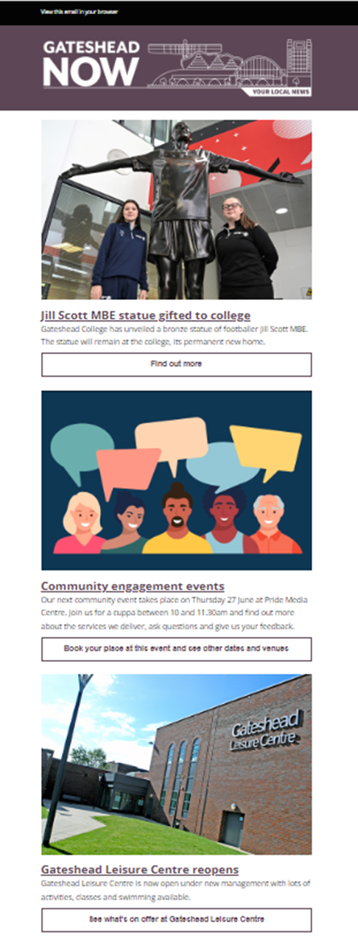
Gateshead Now - 19 June
Items featured in this issue:
Jill Scott MBE statue unveiled at Gateshead College
Community engagement events
Gateshead Leisure Centre reopens
Council Tax bill survey

Slide 18
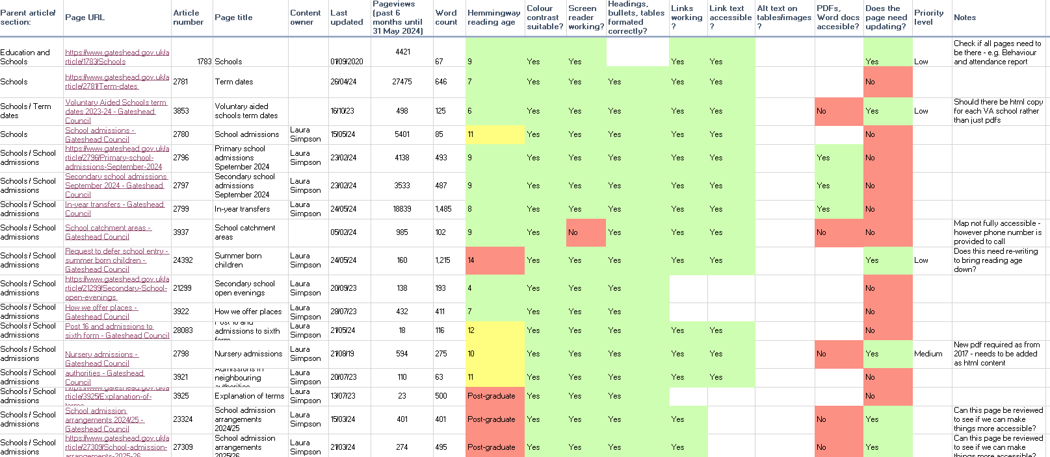
Education and schools content audit
Completed content audit for Education and schools section of the website:
99 pages reviewed
Summary findings reported
Next steps:
Share with service
Identify content owners and update content/remove out-of-date content

Slide 19
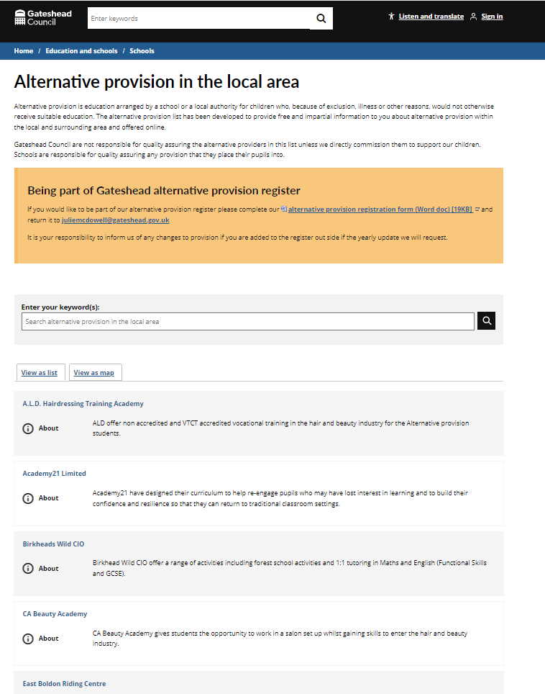
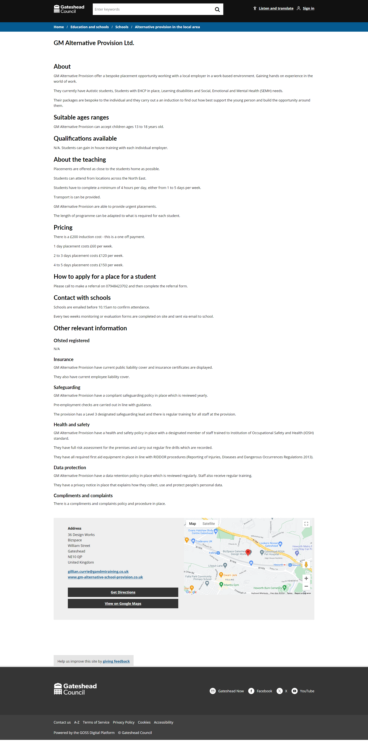
Alternative provision register
Alternative provision register now live.
Next steps:
Beta testing with headteachers
Wireframe and development of registration form

Slide 20
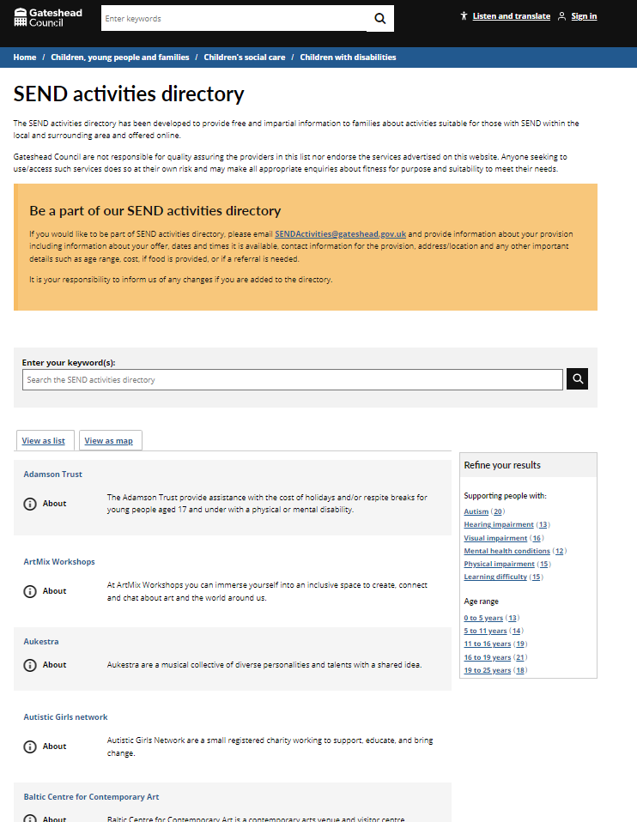
SEND activities directory
Progressing SEND activities directory:
Over 70 provisions in total
Filters added
Comms to provide header image for directory
Further copy to come from service

Slide 21
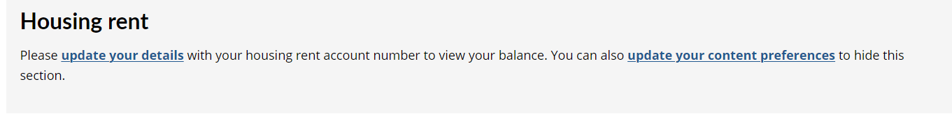
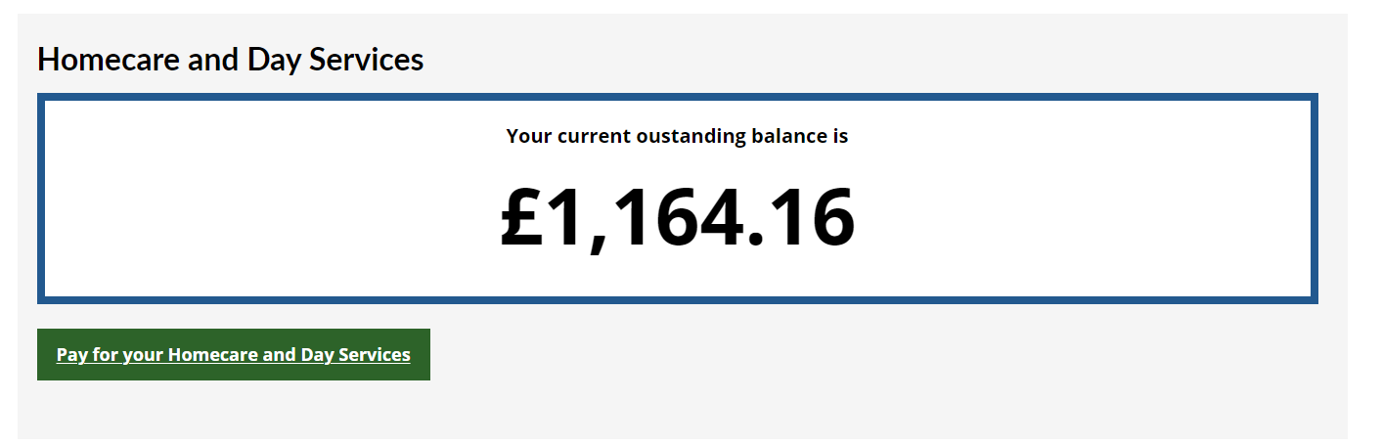
Sprint 36
Development
Updates to My Gateshead Account
Link: https://gateshead.ghc2-tst.gosshosted.com/login

Slide 22
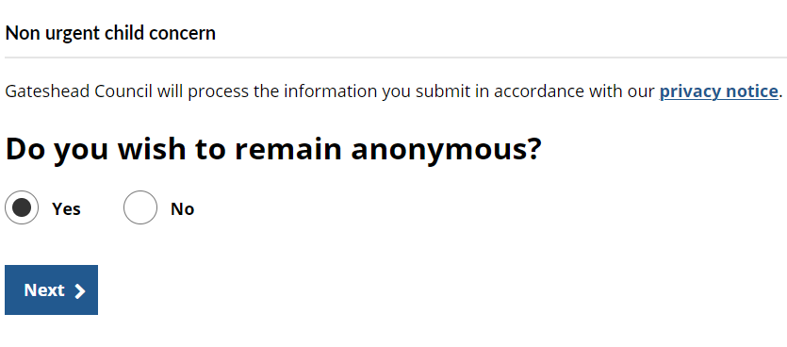
Update to non-urgent child concern referral form
Link: https://gateshead.ghc2-dev.gosshosted.com/article/13677/Non-urgent-child-concern

Slide 23
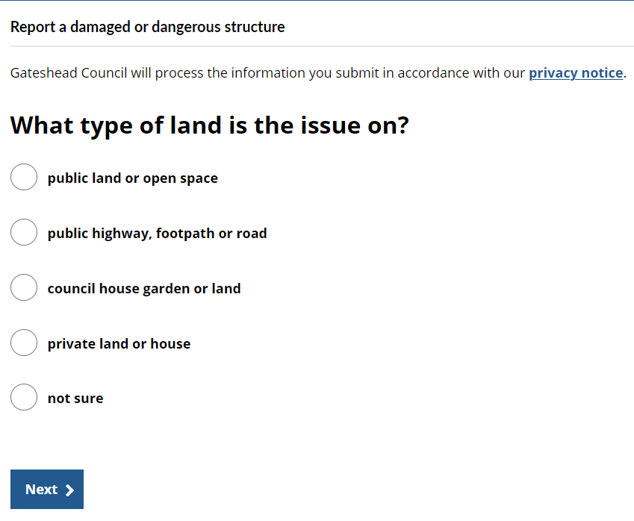
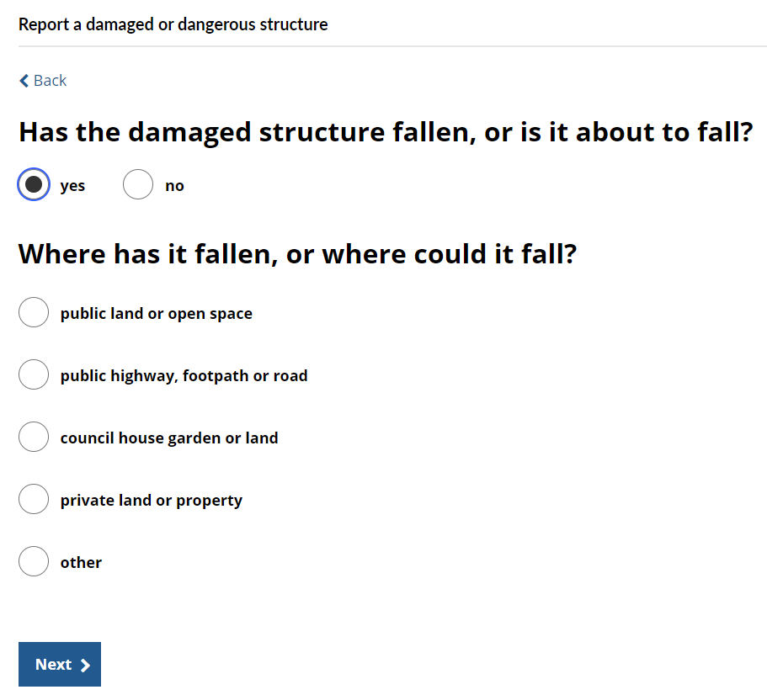
Update to damaged or dangerous structure form
Link: https://gateshead.ghc2-dev.gosshosted.com/article/12474/Report-a-damaged-or-dangerous-structure

Slide 24
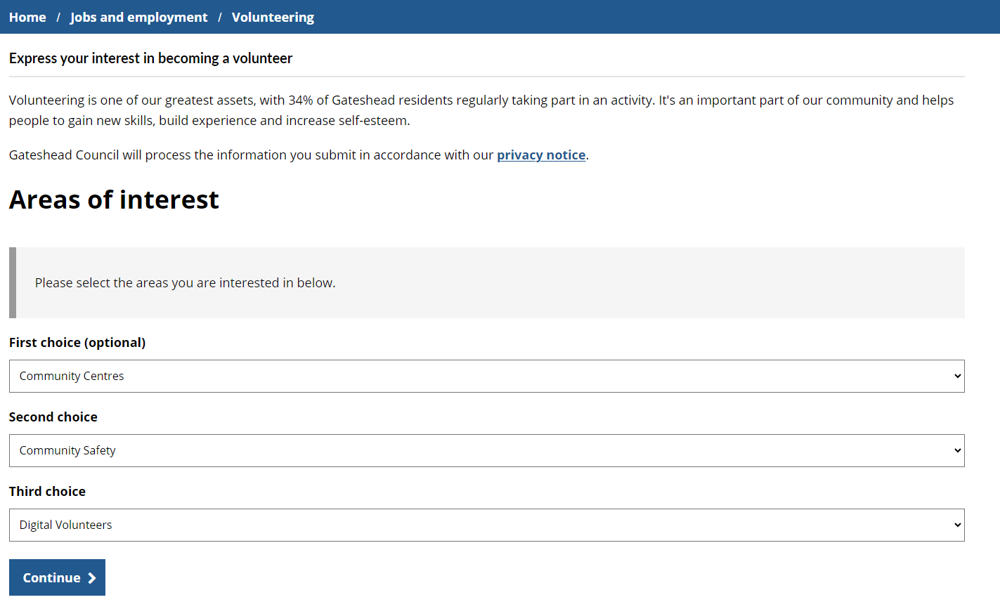
Update to volunteering form
Link: https://gateshead.ghc2-dev.gosshosted.com/article/4788/Express-your-interest-in-becoming-a-volunteer

Slide 25
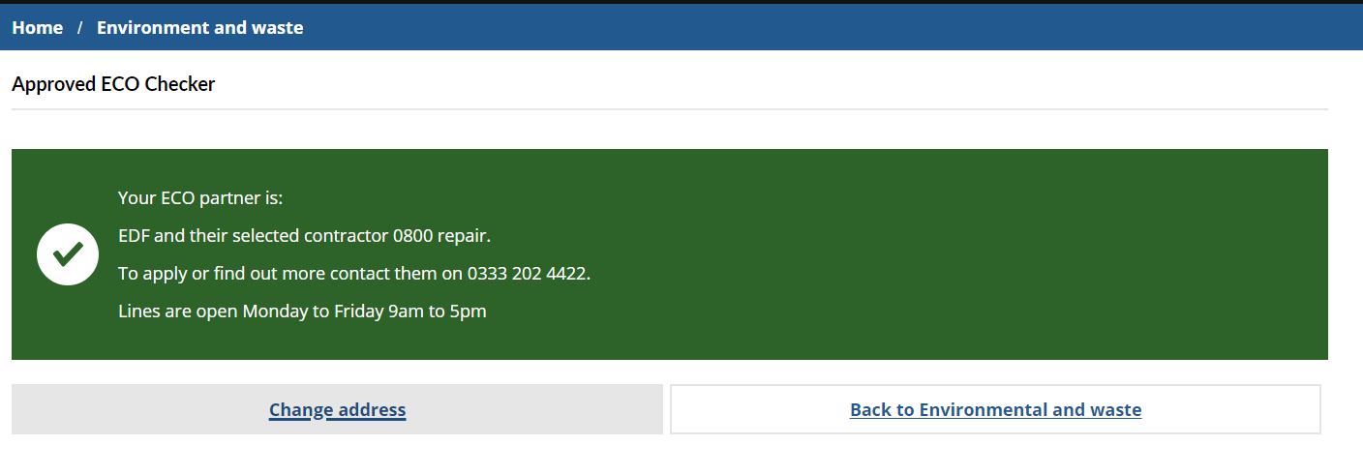
Update to approved ECO flex form
Link: https://gateshead.ghc2-dev.gosshosted.com/article/13673/Approved-ECO-Checker

Slide 26
What's coming up in Sprint 38
Discovery
ASC data analysis
School penalty notice payment
Content
Brighten the day summer email
Community sport summer activities
Design
Householder planning
Digital services squad portfolios
Development
Taxi licensing build
Careers Gateshead appointment form
Update to street lighting case management

Slide 27
Sprint 36
Deployment

Slide 28


