Slide 1
Sprint 38 Show and Tell 03/07/2024
C Squad
Digital Team

Slide 2
Sprint 38
Sprint goals
Complete the examiners testing element of taxi vehicle testing
Launch summer activities

Slide 3
Sprint 38
Taxi vehicle testing
Examiners process wireframe
Examiners process build
Block bookings

Slide 4
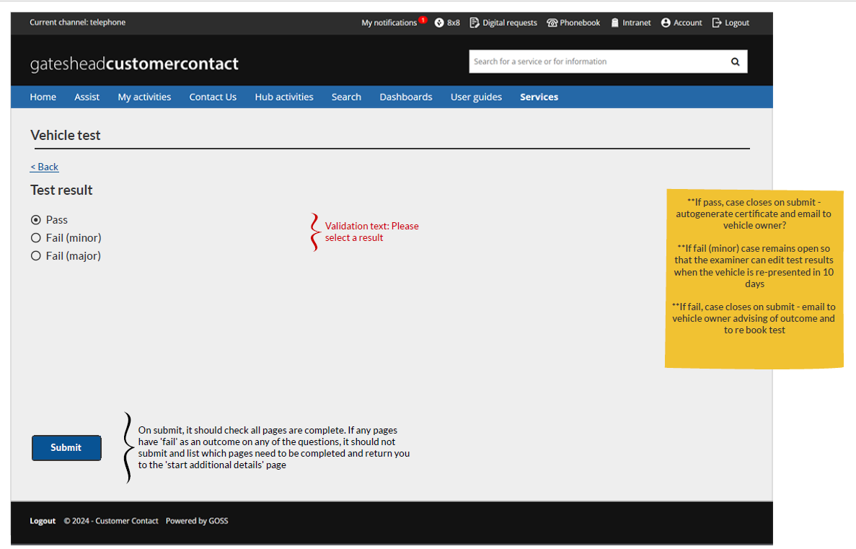
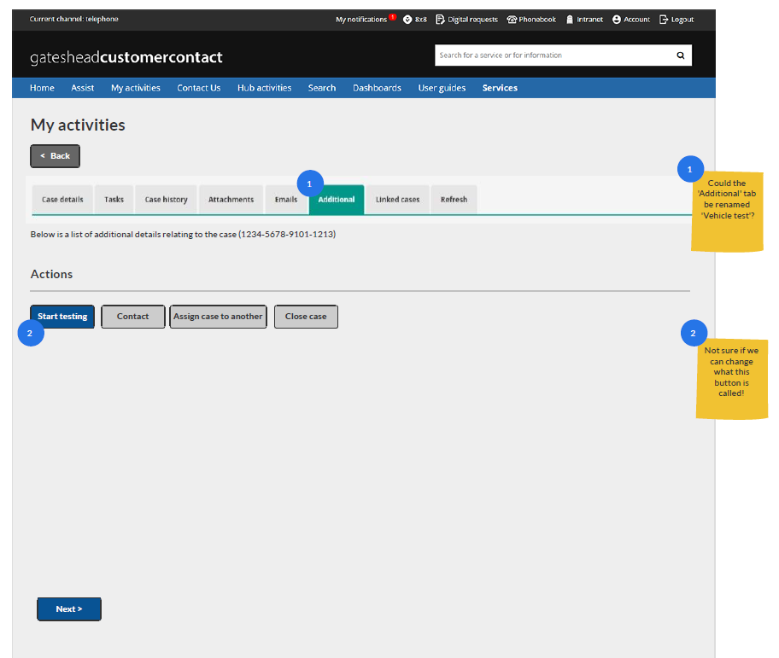
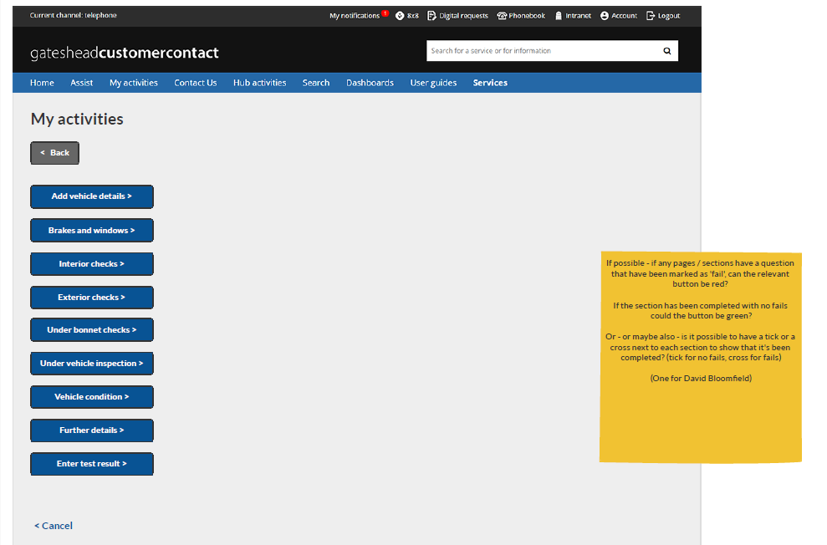
Taxi vehicle testing -wireframe

Slide 5
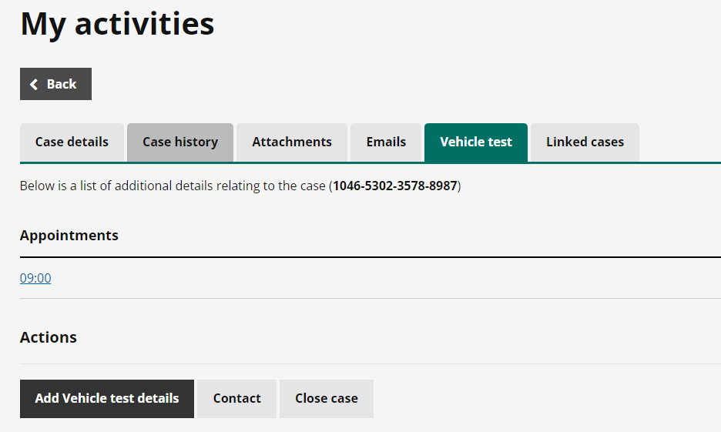
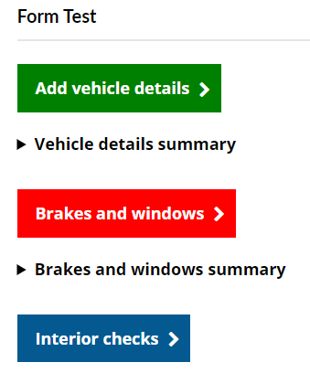
Taxi vehicle testing - form build

Slide 6
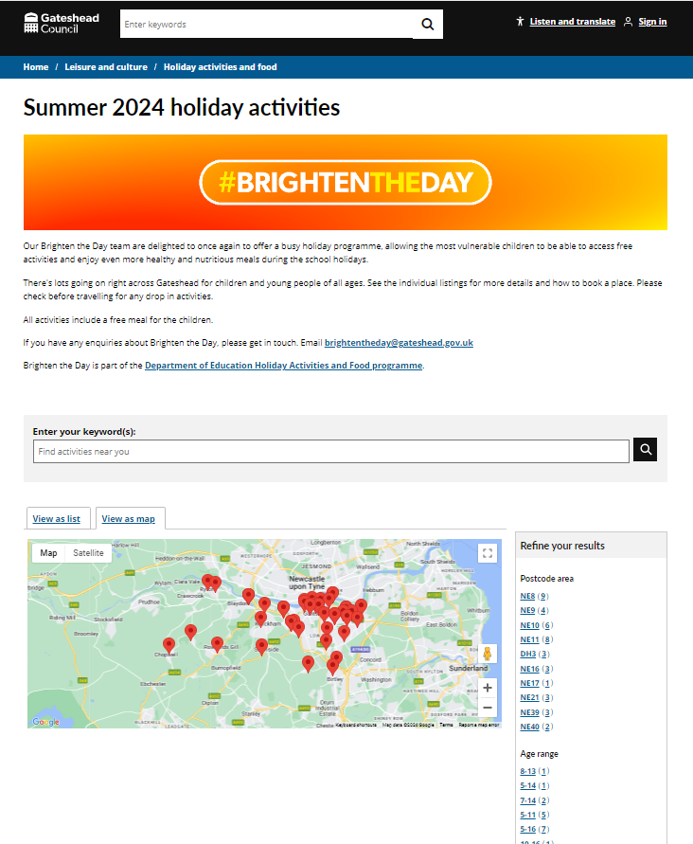
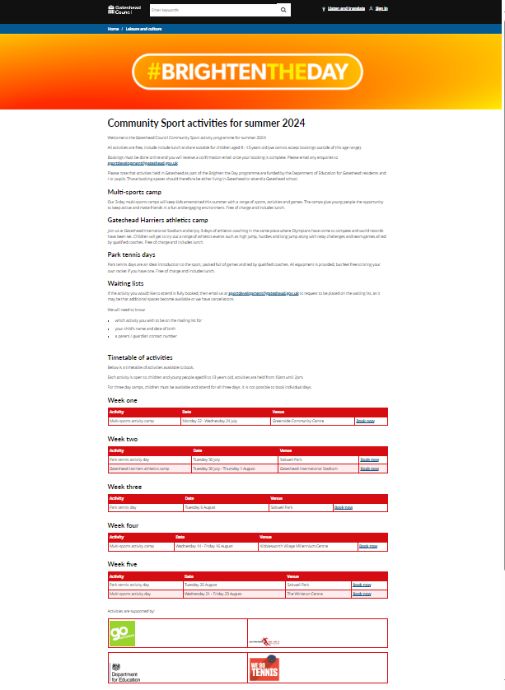
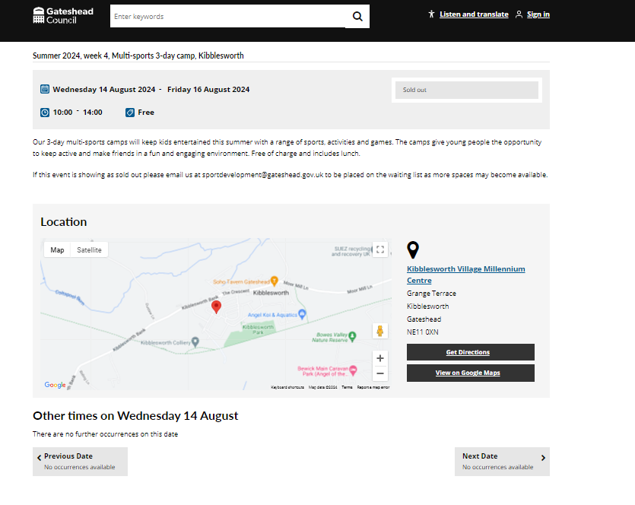
Sprint 38
Launch summer activities
Community Sport activities
Summer holiday activities made available to eligible families to book. Families sent email via Mailchimp to book. Over 50 clubs added including 8 community sport sessions added to our bookings' platform for online booking.

Slide 7
Sprint 38
Direct payments
Last mapping session – Miro board
Engage map
Issue logging and solution theming
User research planning
Data and dashboard

Slide 8
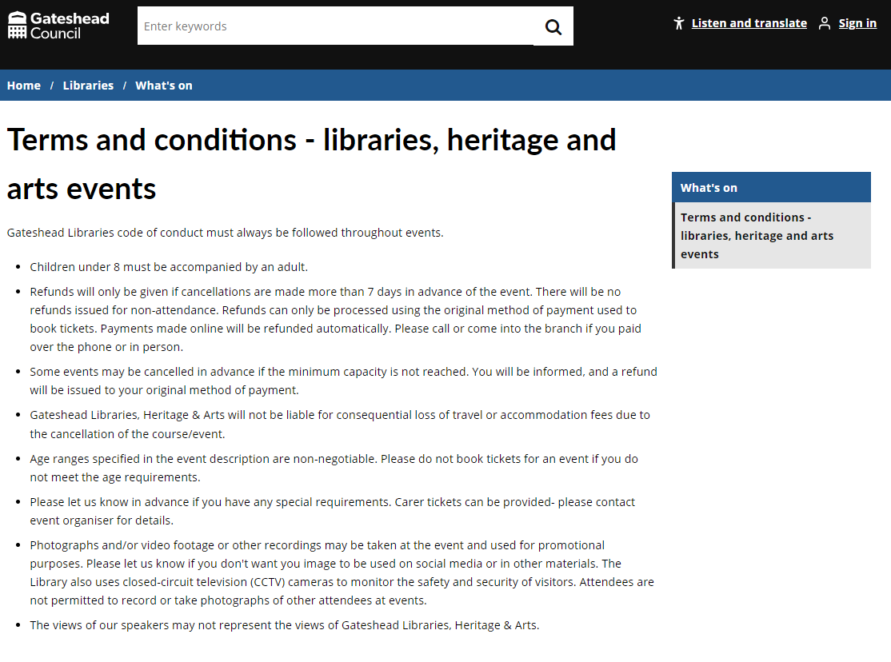
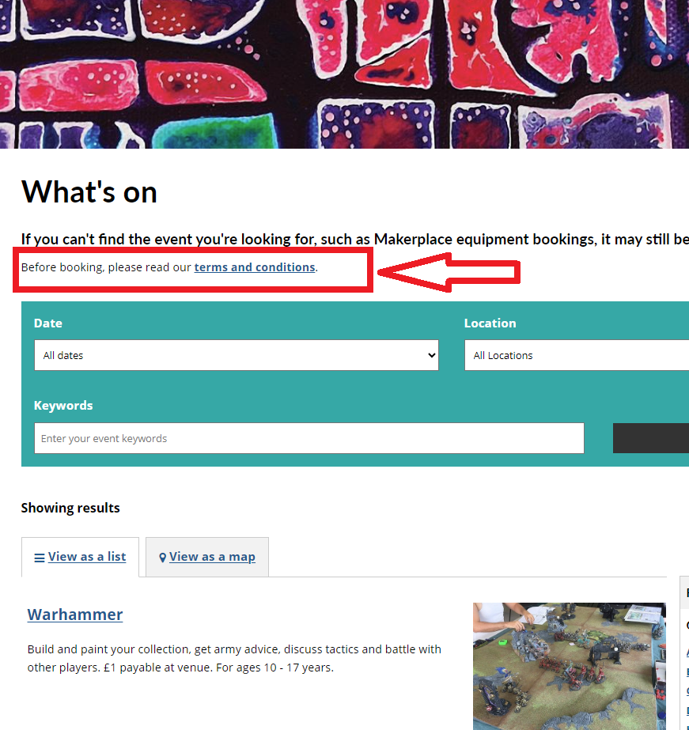
Sprint 38
Libraries – terms and conditions
Added content on the website for the library events terms and conditions and linked to them from relevant places.

Slide 9
Sprint 38
Children's services
School penalty notices
Process map - logic for new rules
Future of Colegate school
Holiday activities and food annual report

Slide 10
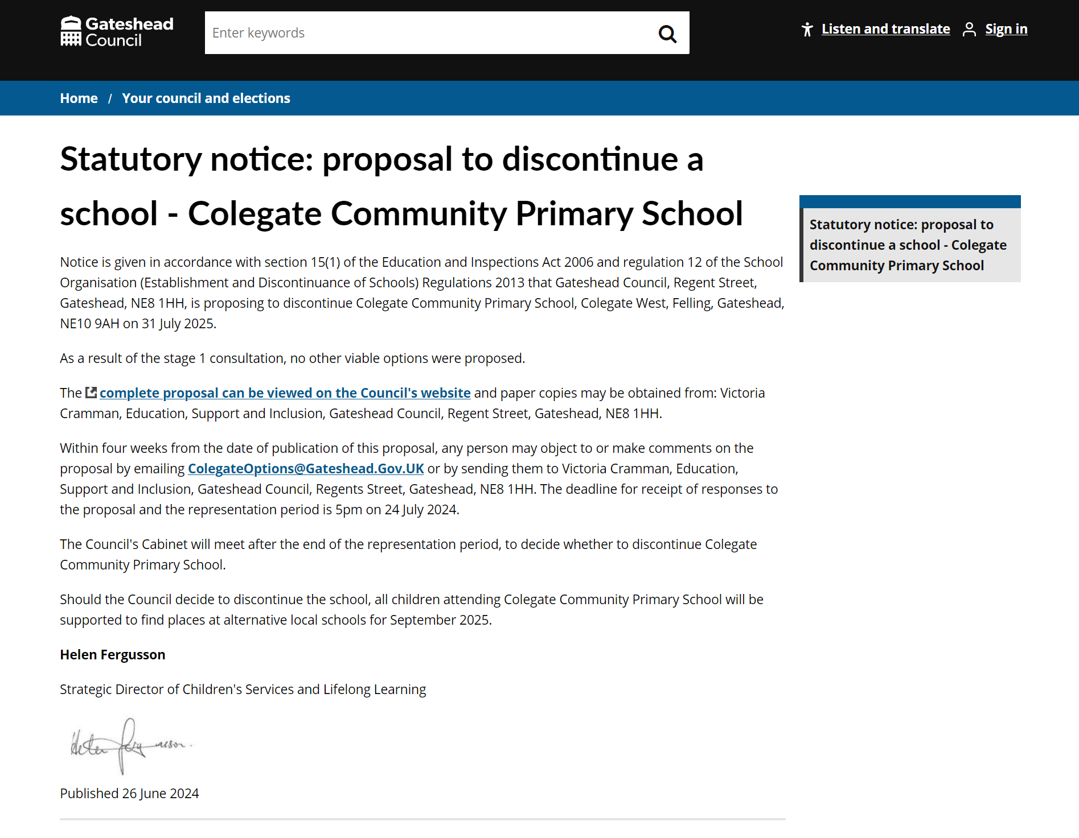
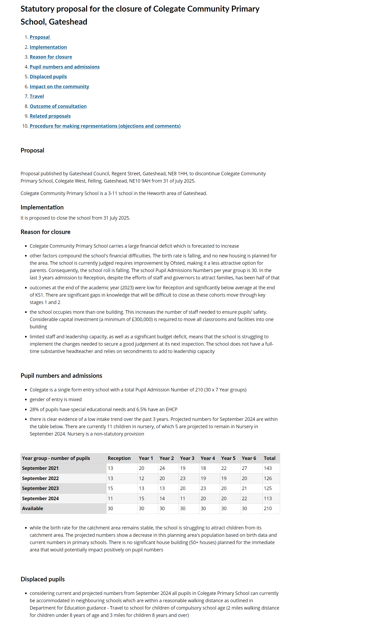
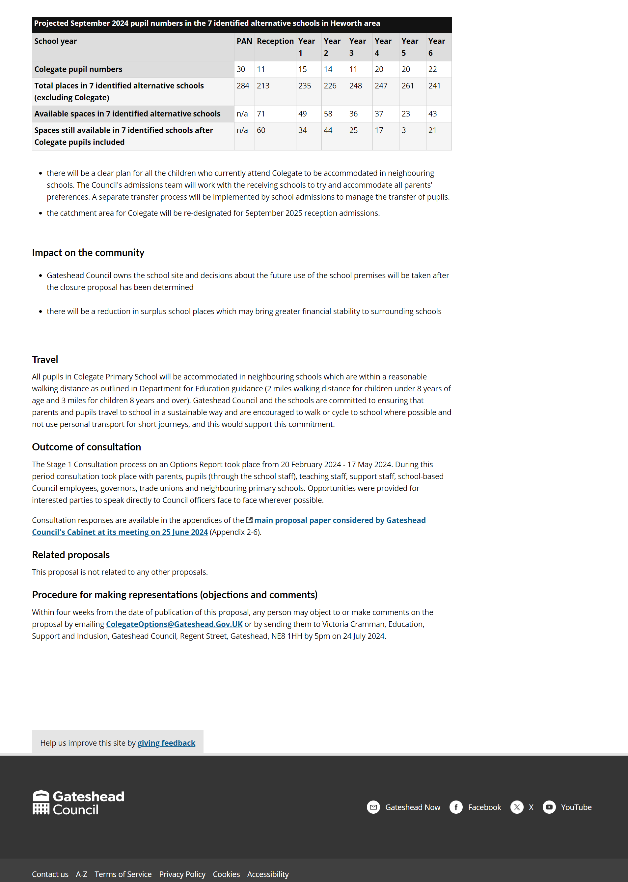
Sprint 38
Children's services -
The future of Colegate school

Slide 11
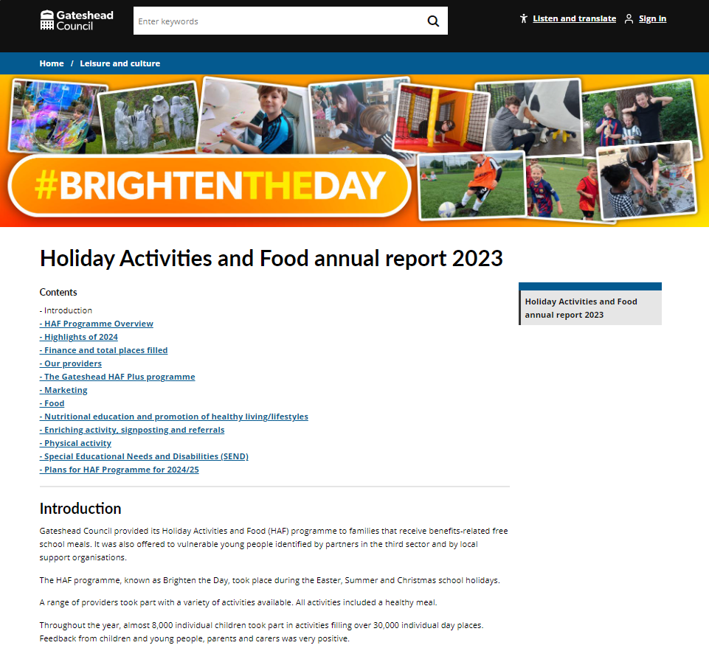
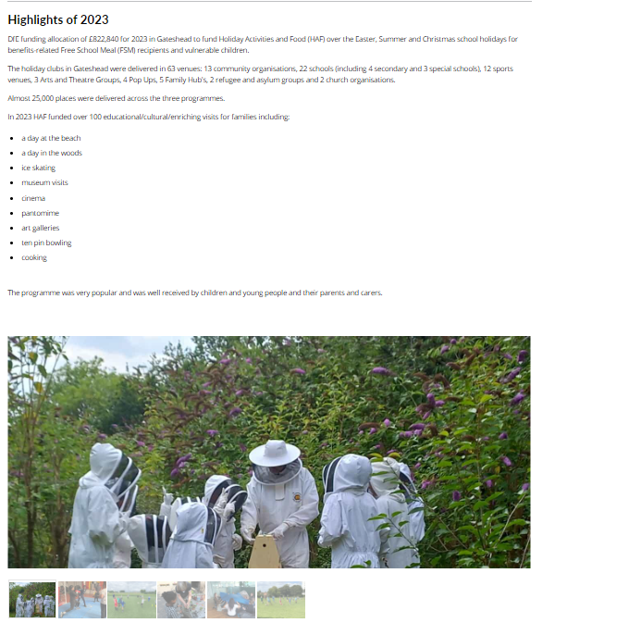
Sprint 38
Children's services -
HAF annual report 2023
Holiday Activities and Food annual report 2023 - Gateshead Council
2023 annual report for holiday activities and food programme added to the website.
Added just as web content this year. Service were happy with the approach last year and asked not to create a pdf this year. Image galleries used to show the activities included in the programme.

Slide 12
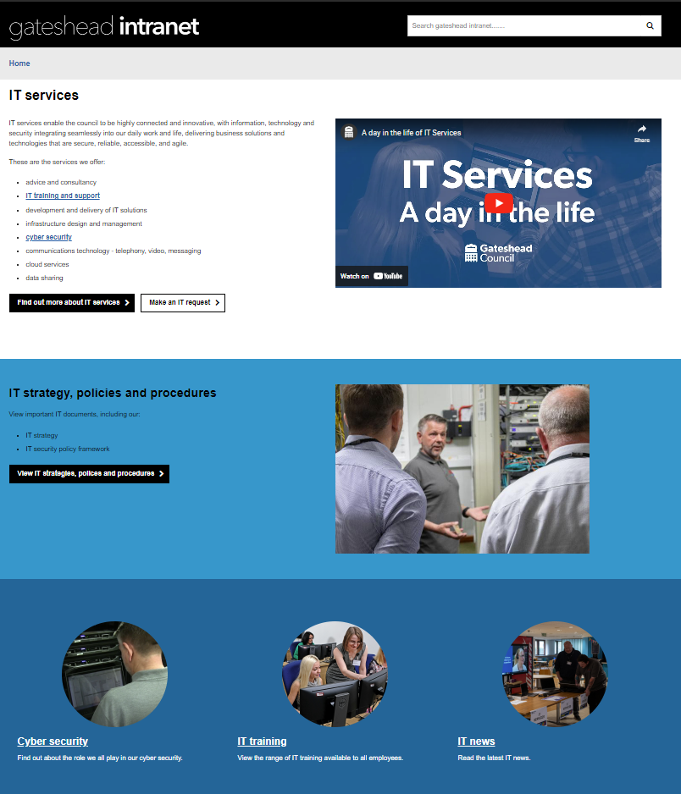
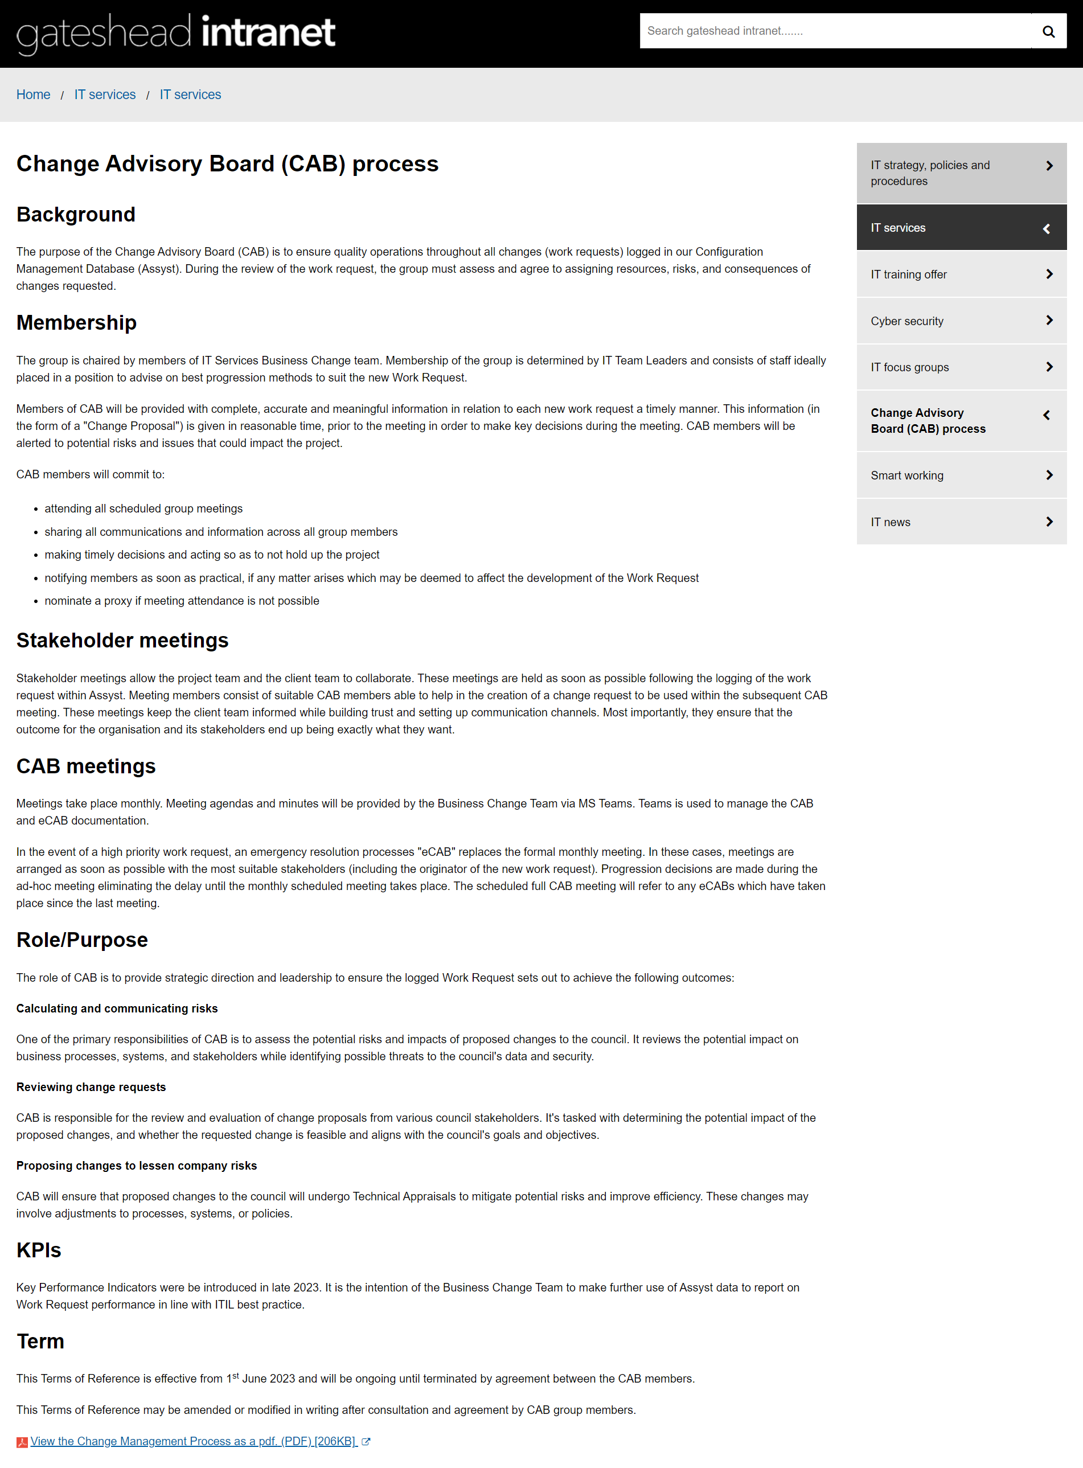
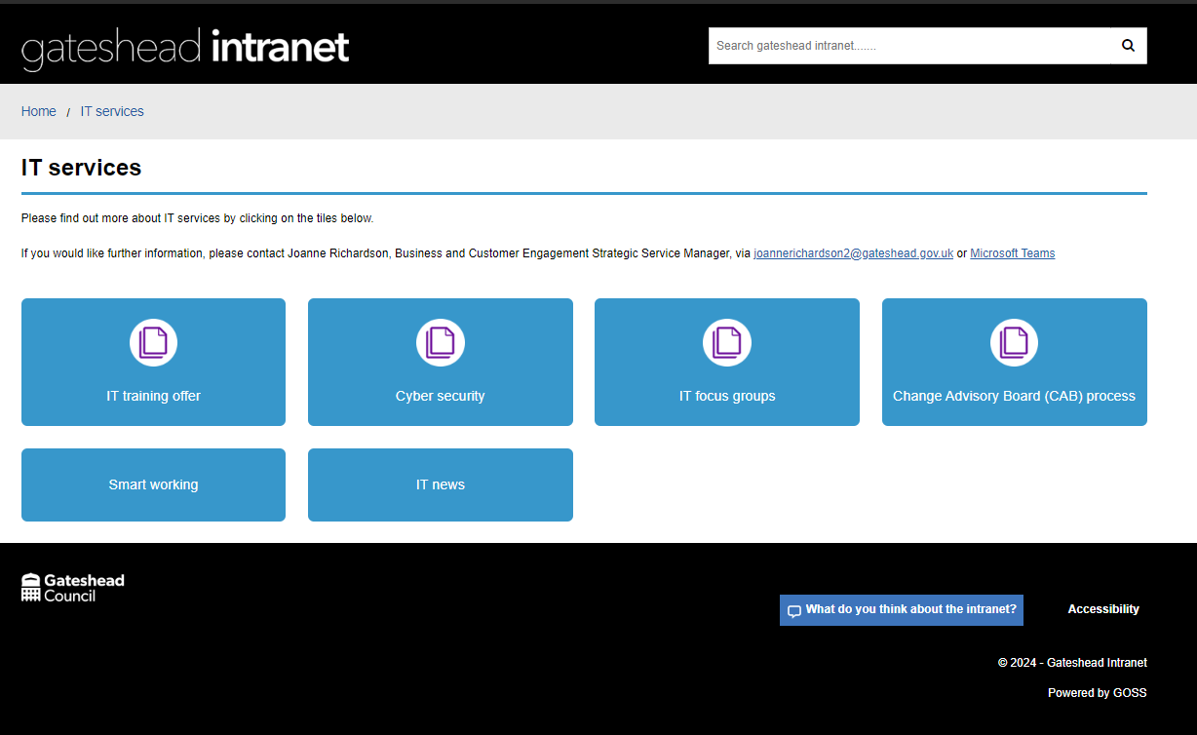
Sprint 38
IT services – intranet pages and design
IT services - Gateshead Intranet
New intranet section created for IT services
Design work to use panel template, images and Thrive colours on section
New pages and sections created for services they offer

Slide 13
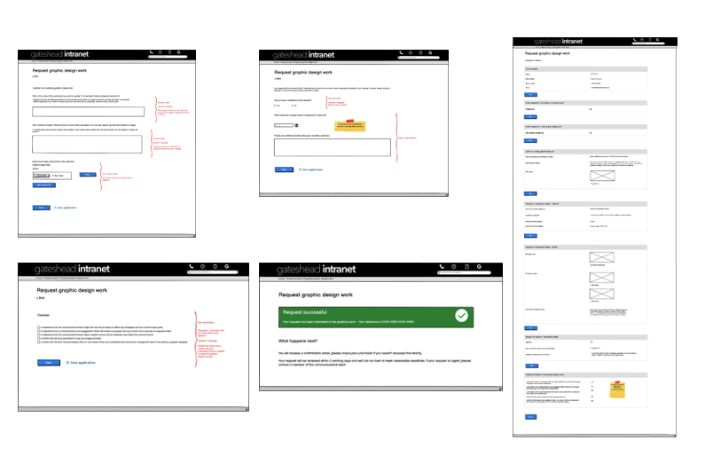
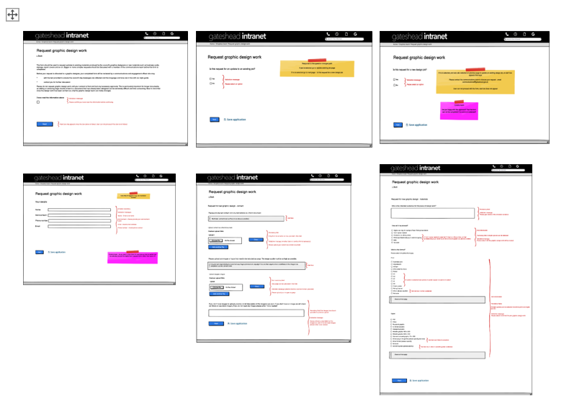
Sprint 38
Corporate - new online process - graphic design request wireframe

Slide 14
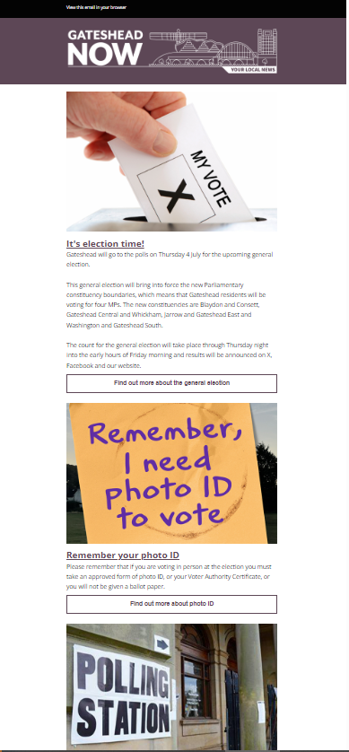
Sprint 38
Corporate - Gateshead Now - elections special
Gateshead Now sent on 2 July to 32k subscribers ahead of the election on 4 July.
Featured items linking to web content:
find your polling station
photo ID
candidates
voting with a disability

Slide 15
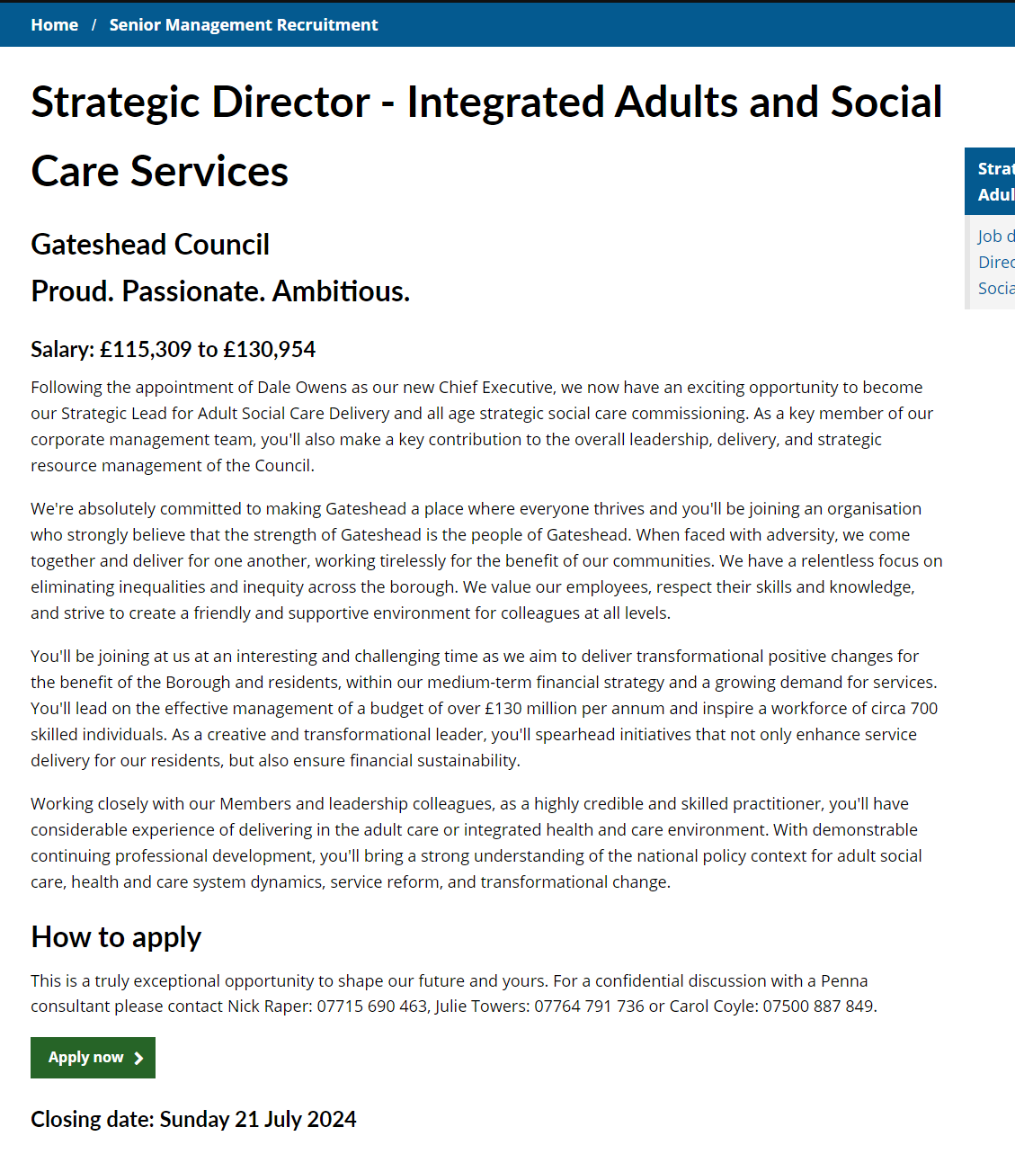
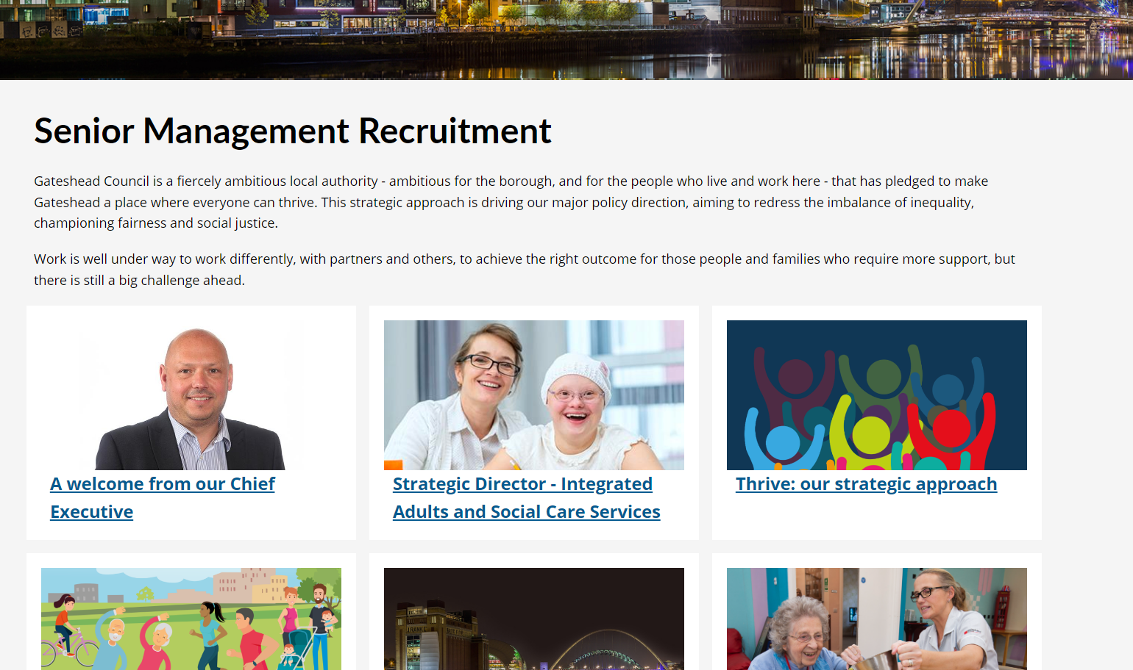
Sprint 38
Corporate - Senior Management Recruitment
Advert for Strategic Director - Integrated Adults and Social Services
Senior Management Recruitment - Gateshead Council

Slide 16
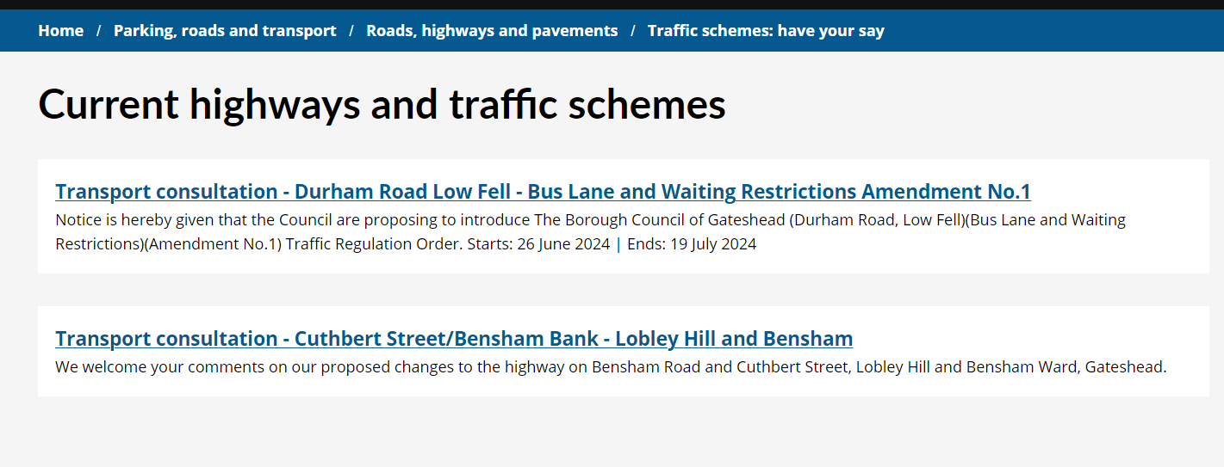
Sprint 38
Corporate - Consultation database
New content for traffic schemes to replace pages on consultation database
Traffic schemes: have your say - Gateshead Council

Slide 17
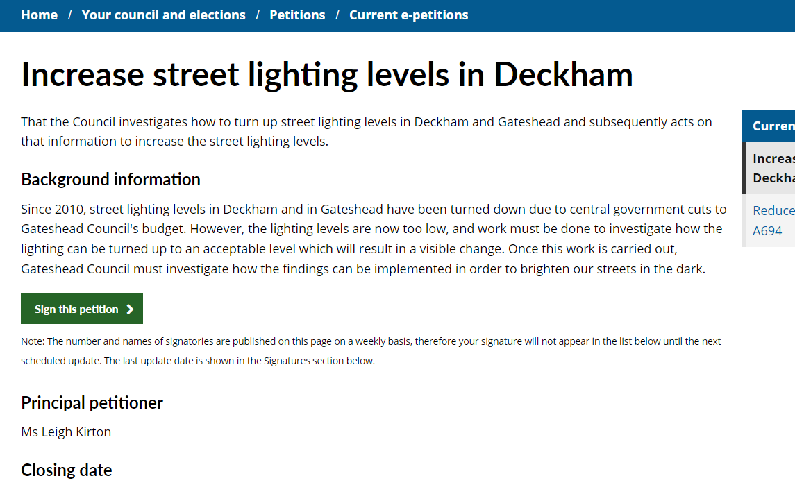
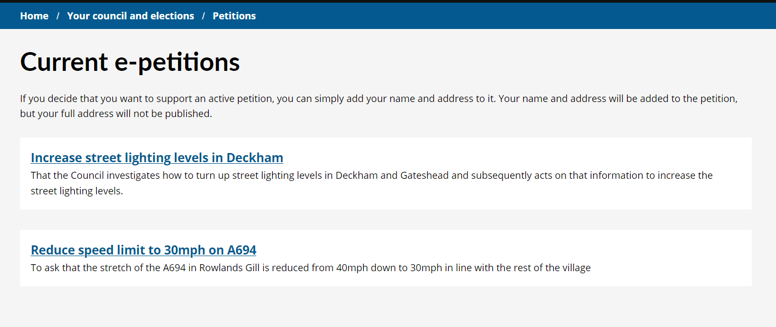
Sprint 38
Corporate - Consultation database
New content for petitions to replace pages on consultation database
Petitions - Gateshead Council

Slide 18
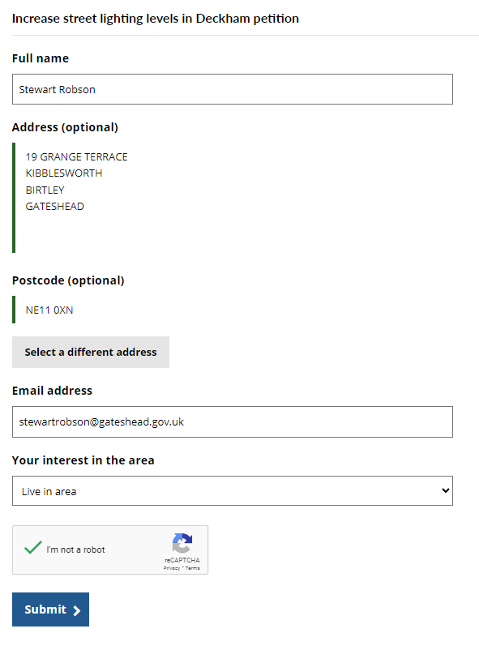
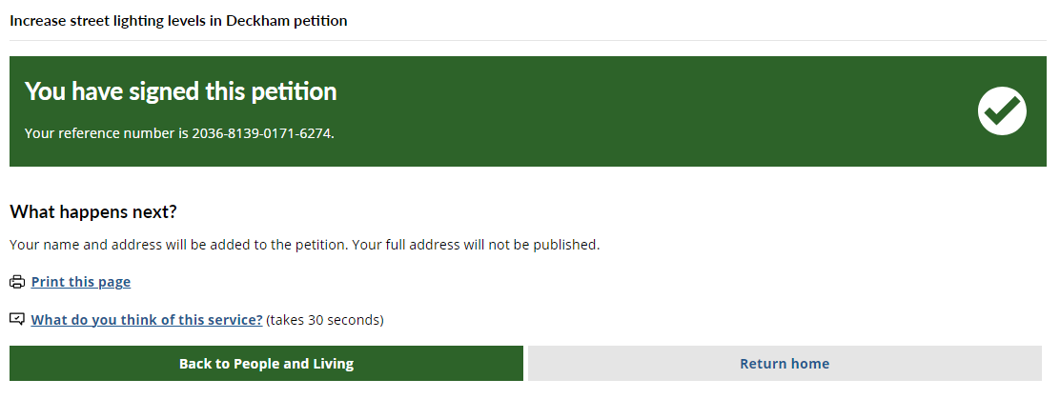
Sprint 38
Current features
Case management - auto close
Form data - manual export
Future enhancements
Dynamic update of signature list

Slide 19
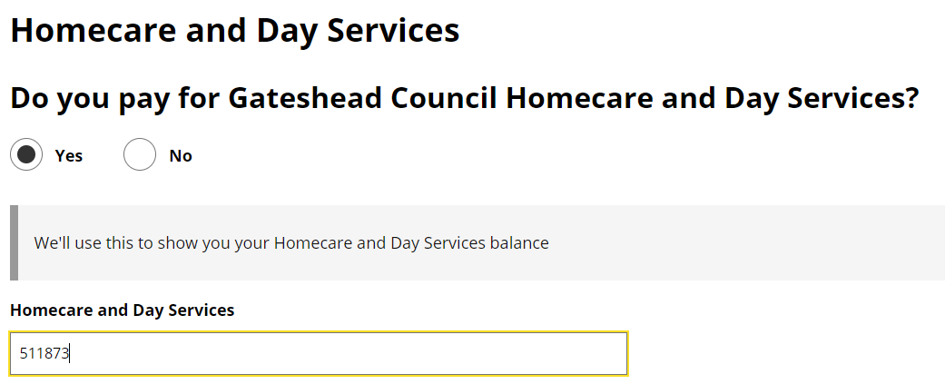
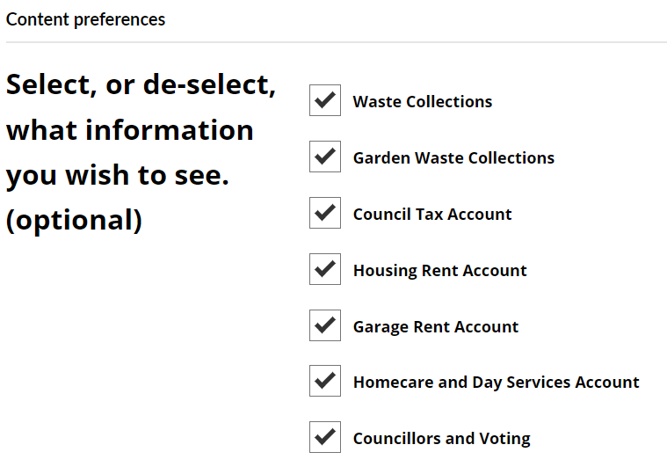
Sprint 38
Homecare payments in My Account

Slide 20
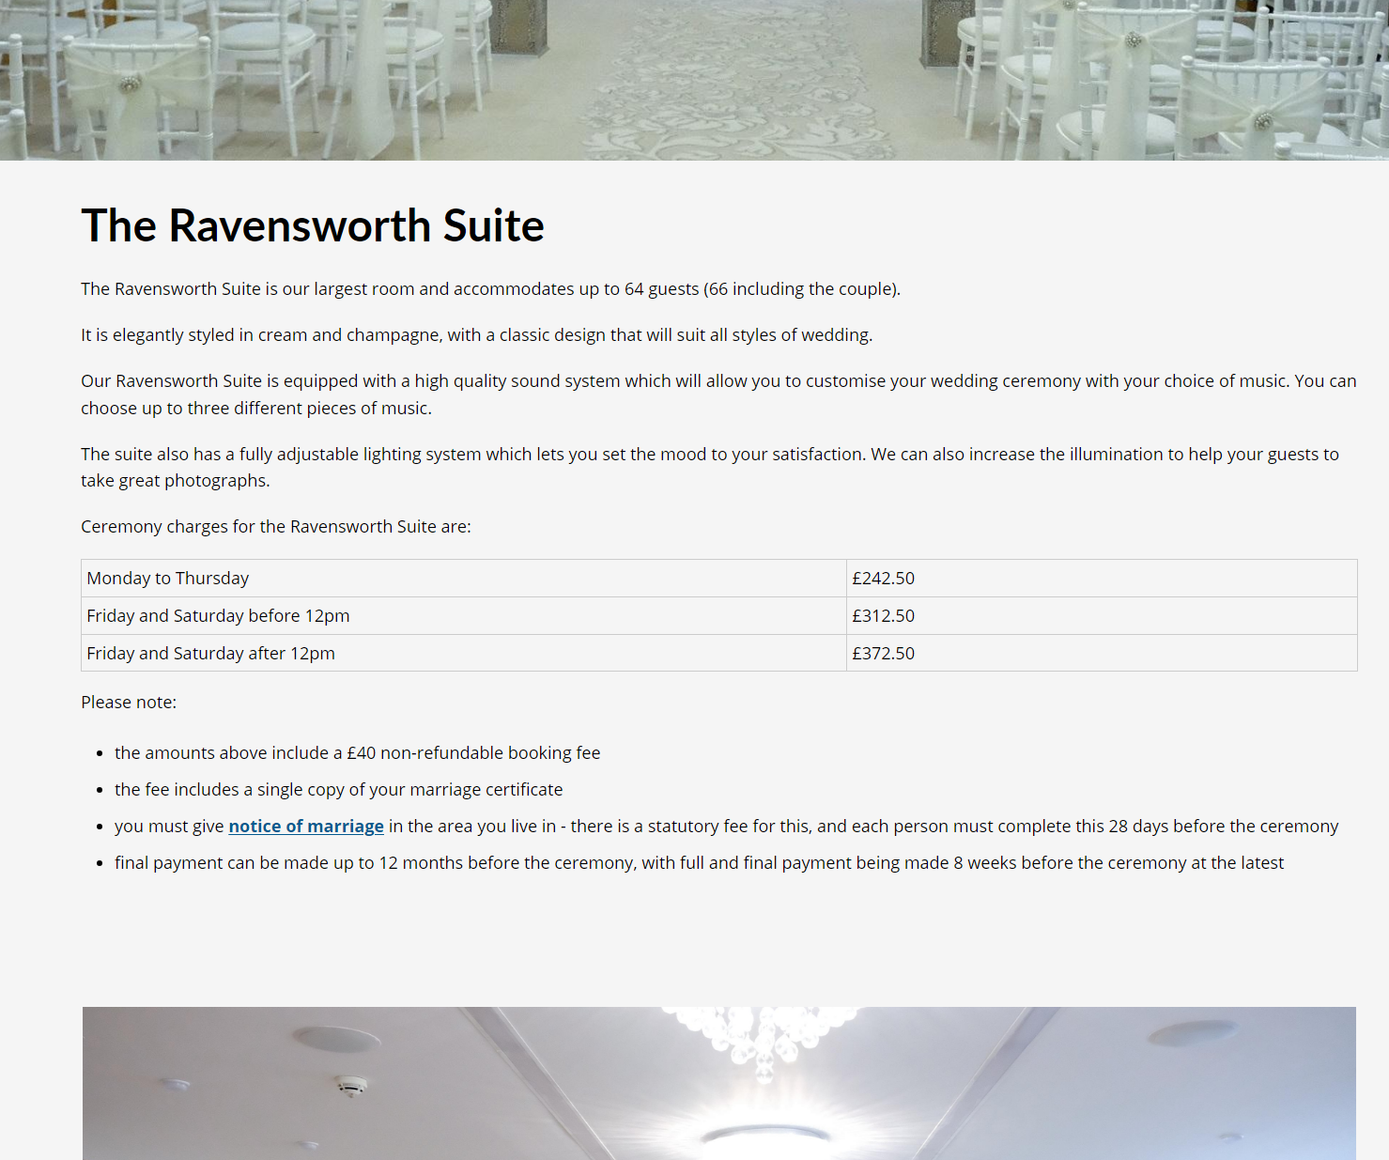
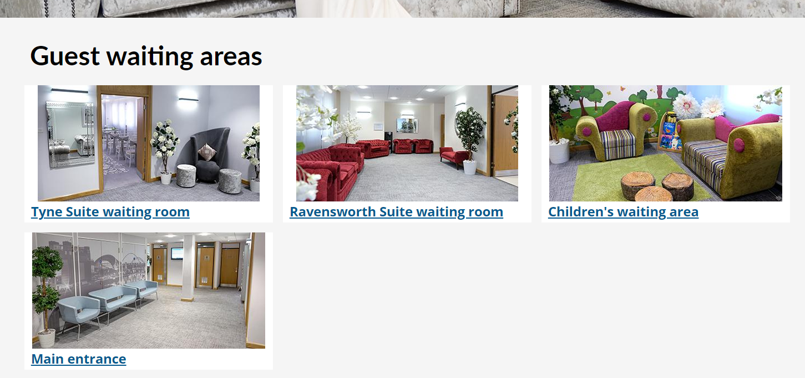
Sprint 38
Registrars - marriages and ceremonies web content refresh
Added costs to relevant pages to avoid unnecessary phone calls
Renewed image galleries
Created new pages for guest waiting areas

Slide 21
Sprint 38
Design
Adding icons to digital services pages
Styling on squad portfolios - digital services pages
Testing jQuery 3
Updating the call-to-action styling across the sites
Updated to the Gateshead theme - list template to display 1 or 2 columns

Slide 22
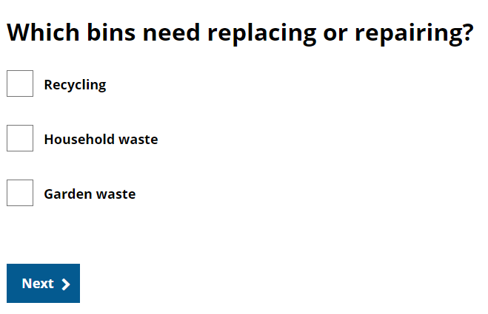
Sprint 38
Routine development
Update to libraries booking plug in to improve accessibility.
Rename Maker place plug in to make more generic
Reduced the character limit for address line 1 in bin forms
Reinstated bin delivery on Tuesdays
Reinstated garden waste in the bin forms
Added ability to define a date range in bin deliveries

Slide 23
What's coming up in Sprint 40
Direct payments – user research plans and hosting DP champions group
Overpayment payment arrangements
ASC data analysis
Mobile Elevated Working Platform (MEWP) Licence discovery
Housing complaints performance and service improvement annual report
UK Single Prosperity Fund (UKSPF) funded projects in Gateshead
Taxi licensing build and testing
School penalty notice payment
Careers Gateshead appointment form

