Slide 1
Sprint 39 Show and Tell 10 July 2024
G Squad
Digital Team

Slide 2
Sprint 39
Introduction
NEC integration
Housing contact dashboard
Council Tax change of address.
Sprint goals

Slide 3
Sprint 39
Introduction
Sections
NEC integration – demo
HWRC Contact
Update on Alterations
Code breakers – Pins on maps
HDRC content
Scaffolding permits

Slide 4
Sprint 39
Development
NEC Integration
Demonstrating UI capabilities

Slide 5
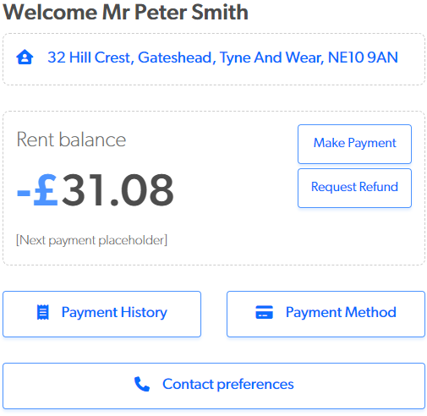
Sprint 39
Development
Improving UIs
I've developed a live demo by integrating the Northgate API, demonstrating enhancements to user experiences with their housing accounts.
By leveraging APIs, we replicate existing UIs and introduce user-centric improvements.
This approach grants us greater product control, enabling continuous evolution aligned with user requirements.

Slide 6
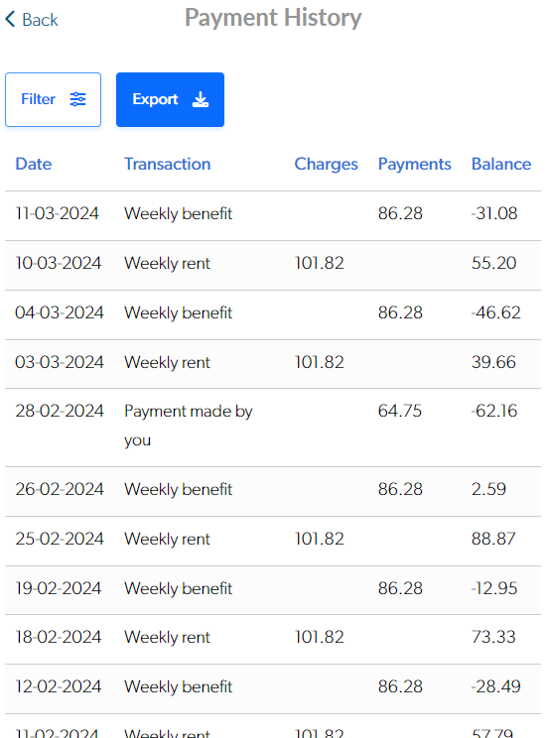
Sprint 39
Development
Mobile-Focused
The UI design prioritizes mobile usability, focusing on essential data and actions for easier user access and account management.
Optimising for mobile is important because many people own or have access to mobile devices, making it vital for expanding accessibility and ensuring our users can engage with the service more effectively.

Slide 7
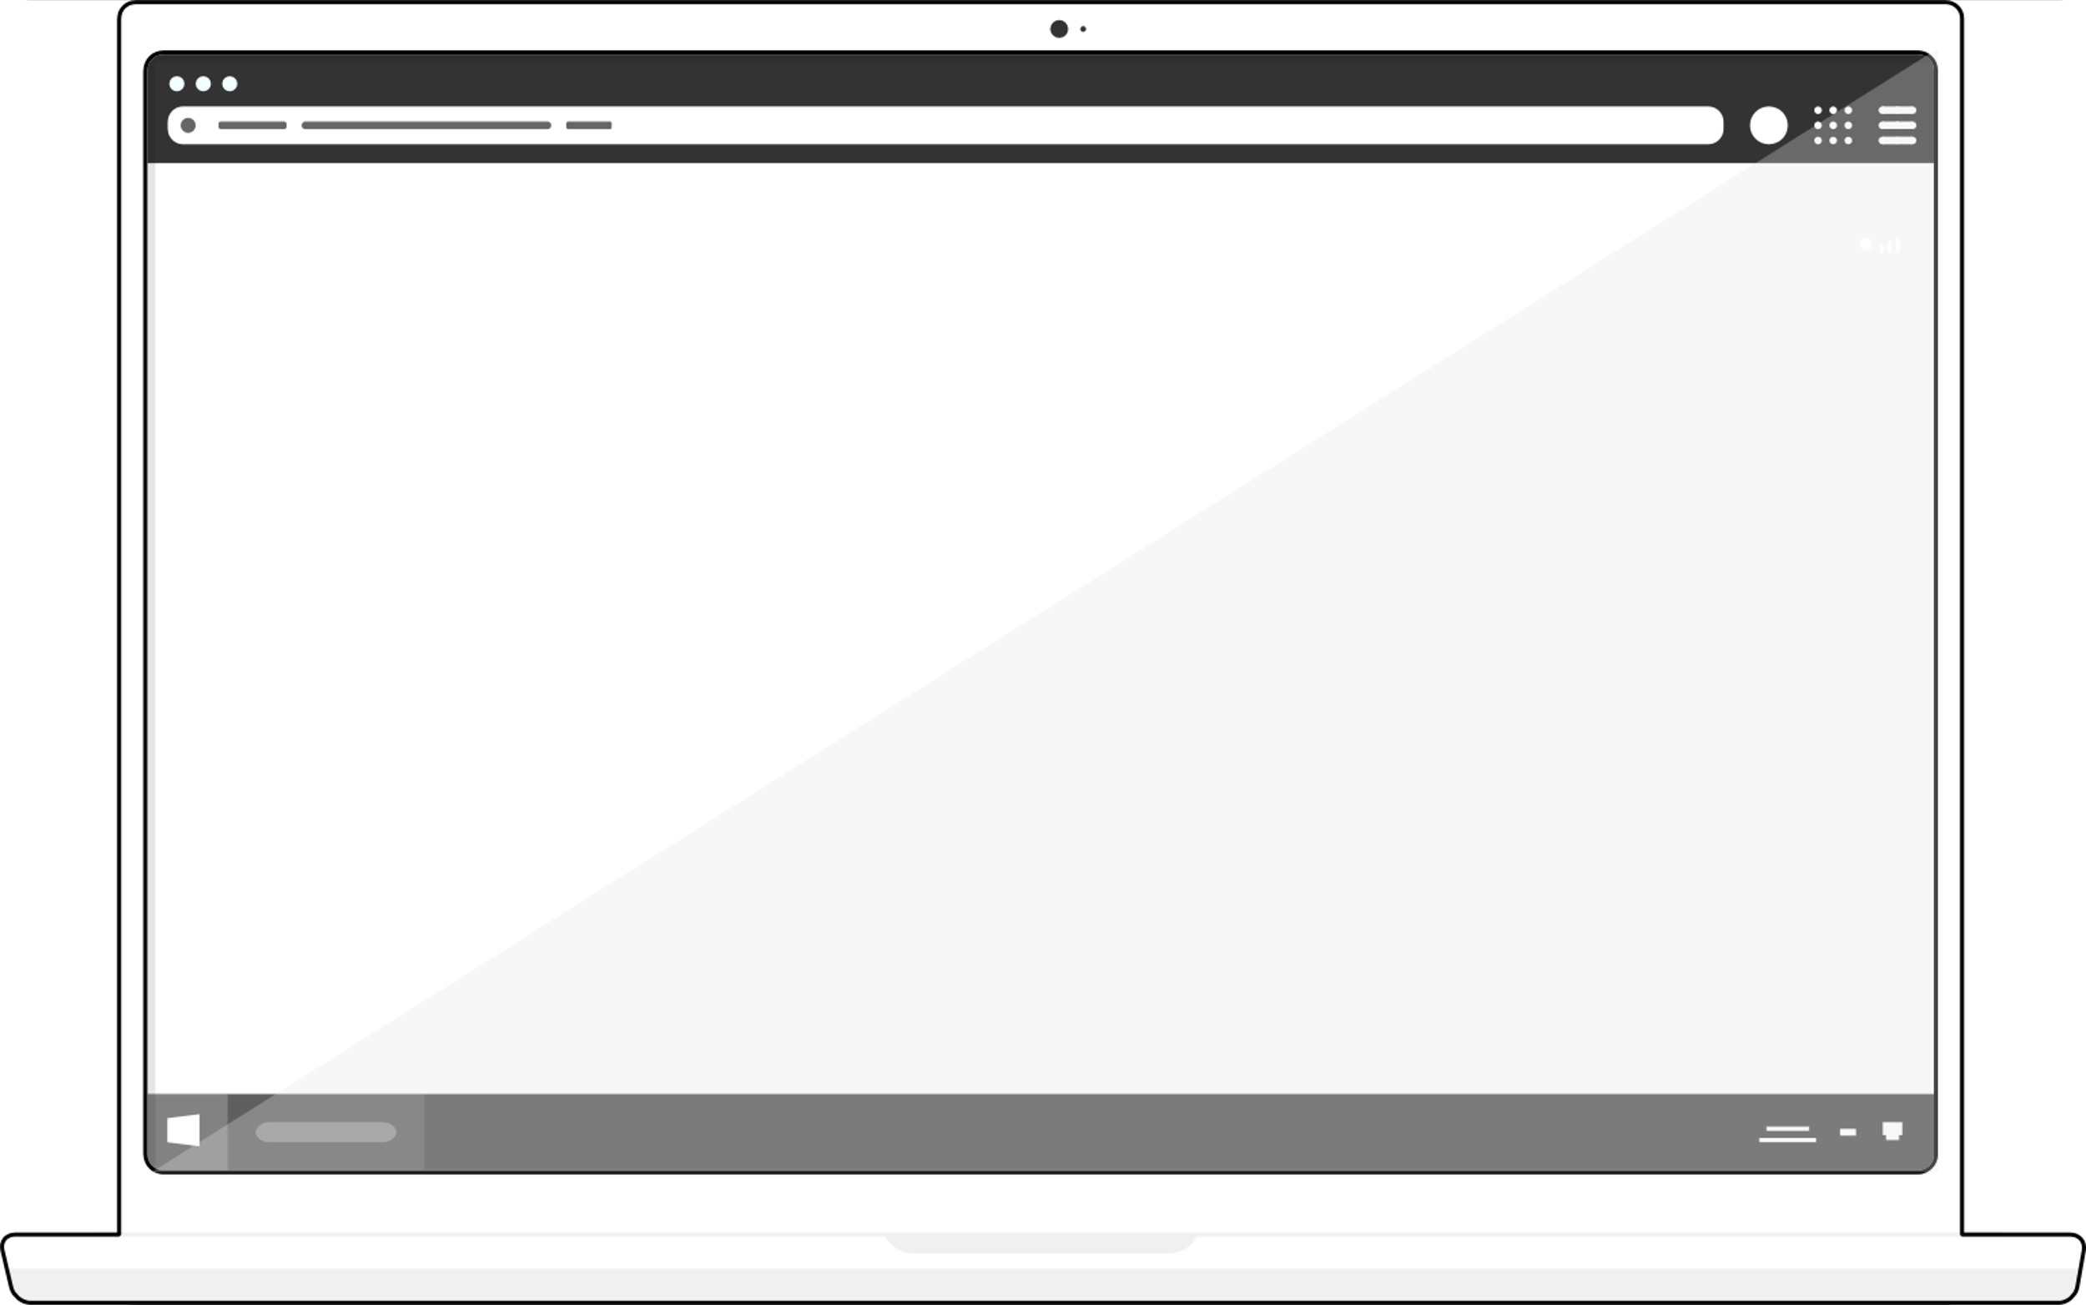
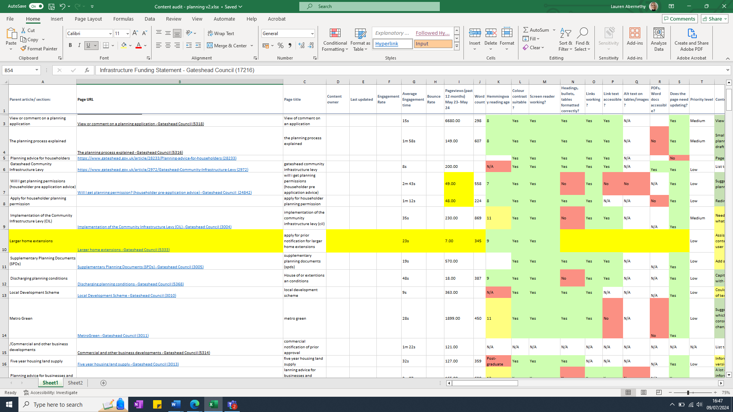
Sprint 39
Content
Planning content audit

Slide 8
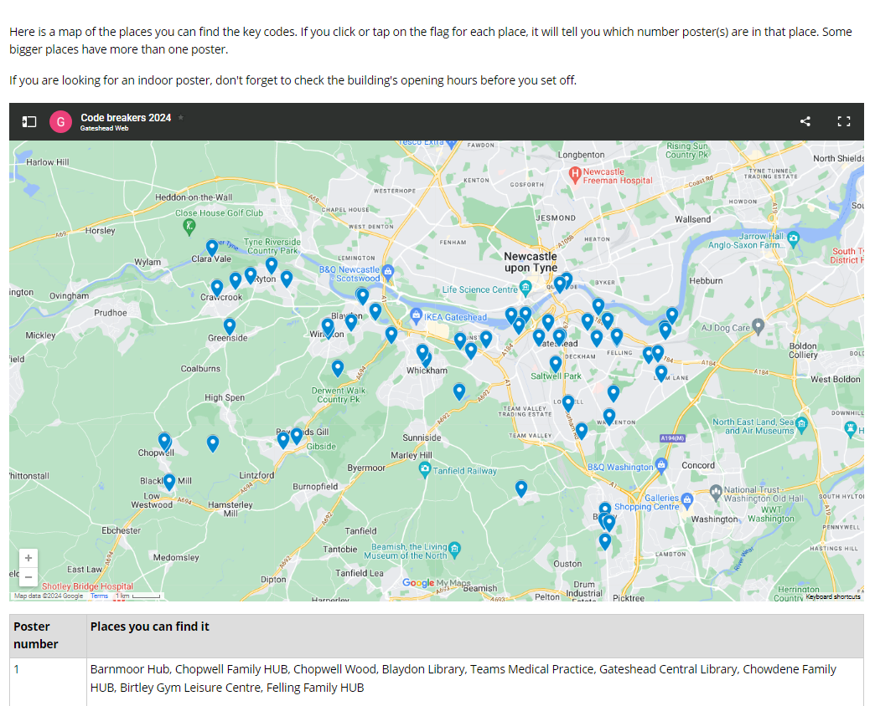
Sprint 39
Content
Code Breakers 2024

Slide 9
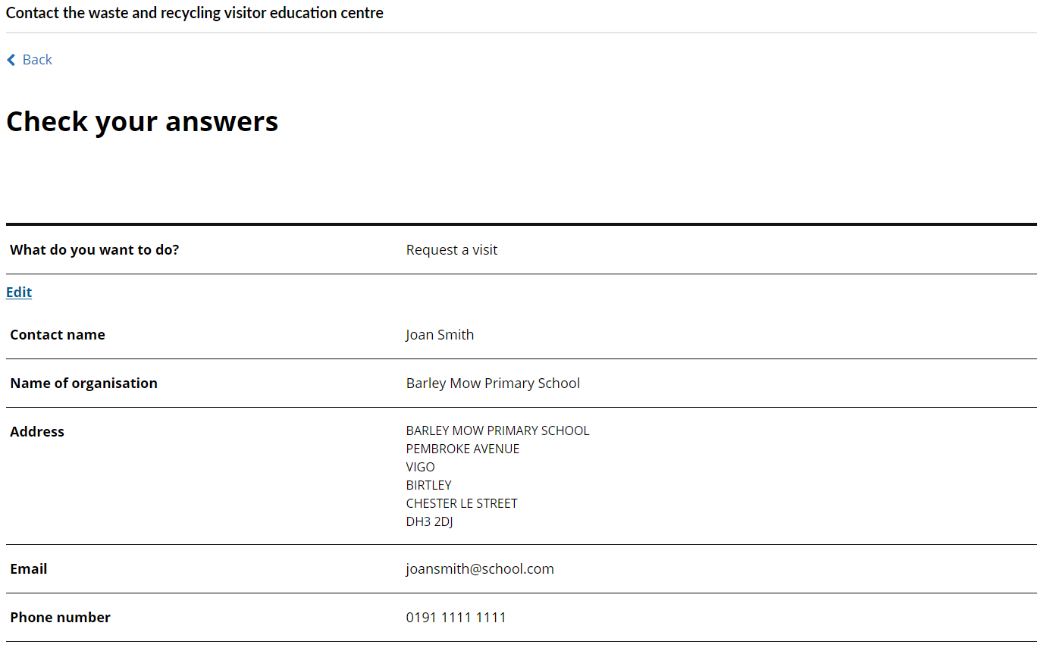
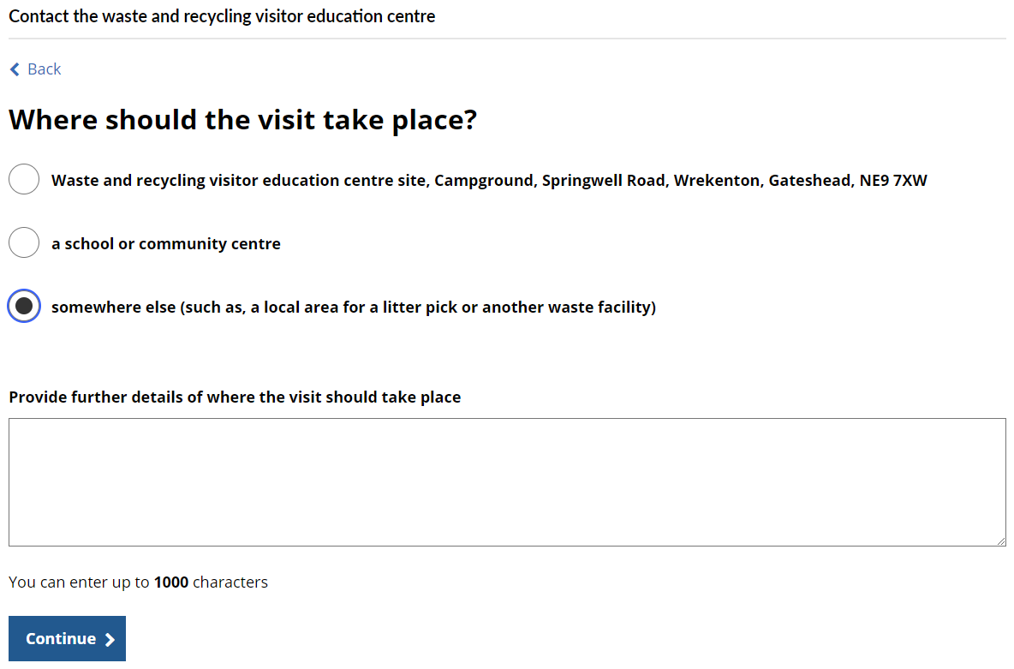
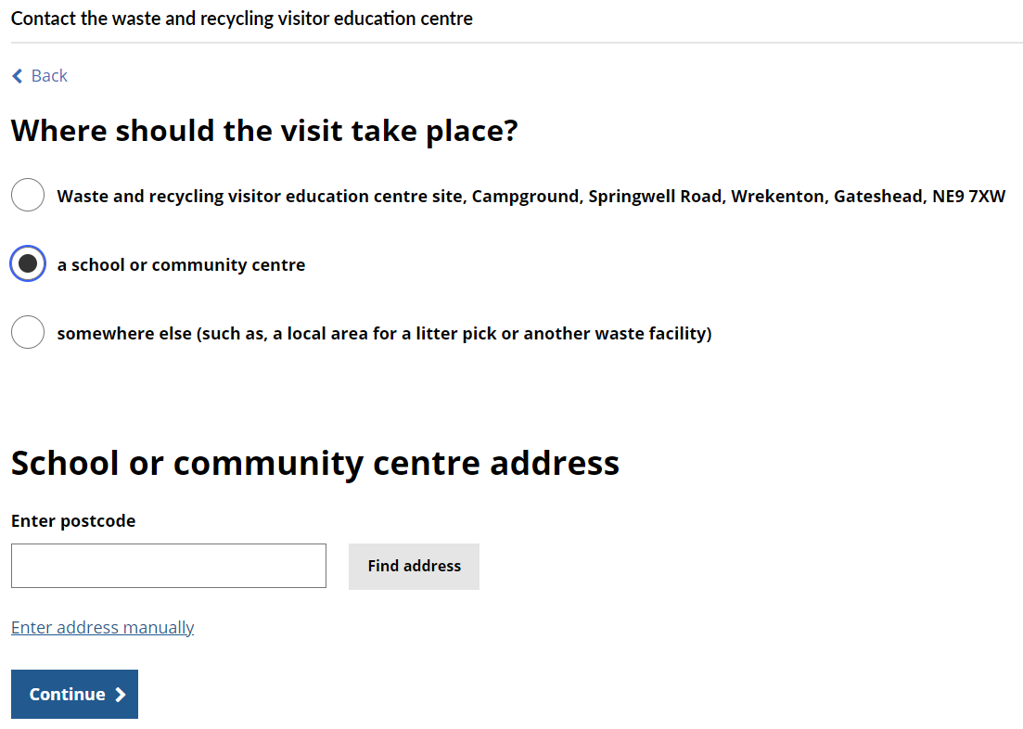
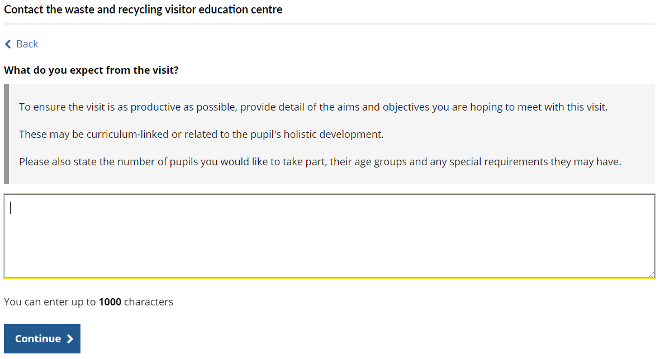
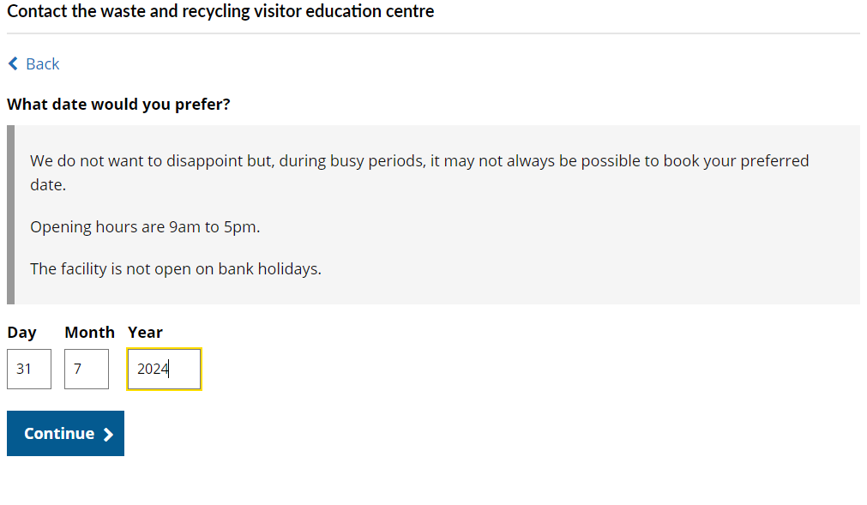
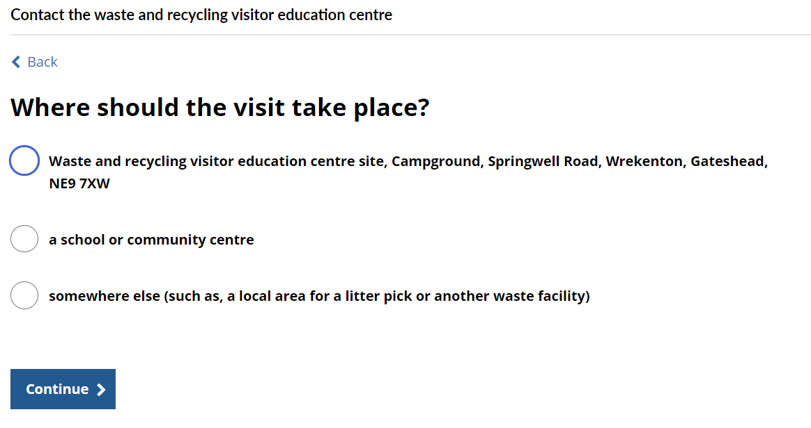
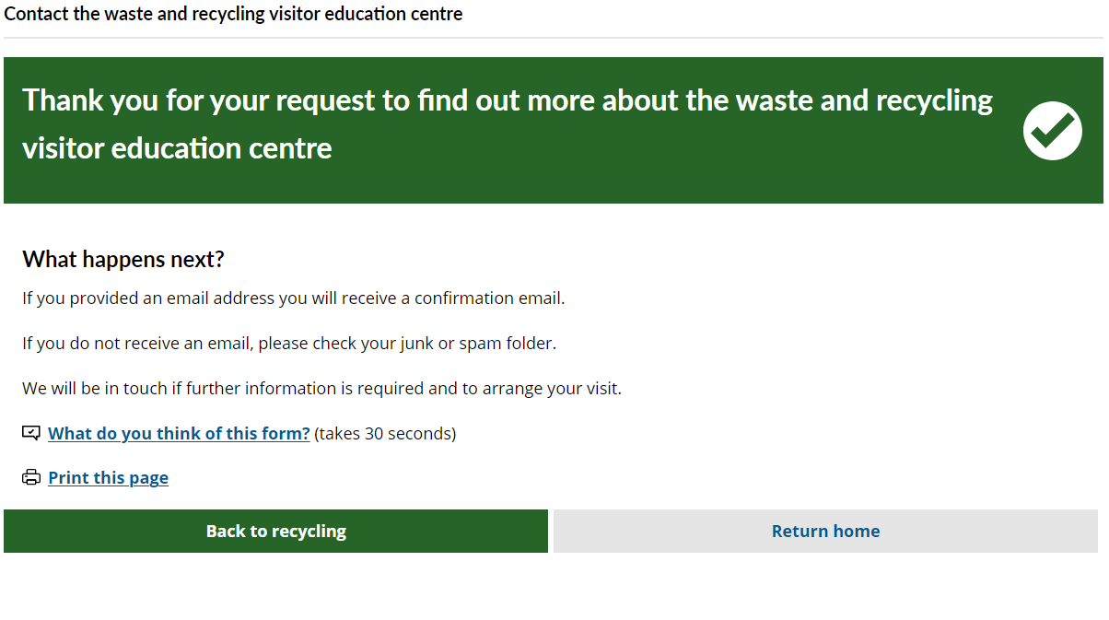
Sprint 39
Content
HWRC Contact
A contact form to allow residents of Gateshead, Sunderland and South Tyneside to make an enquiry or to request a visit to the Visitor Centre at Campground.
Submissions are sent to Groundwork and a case is raised and autoclosed.

Slide 10
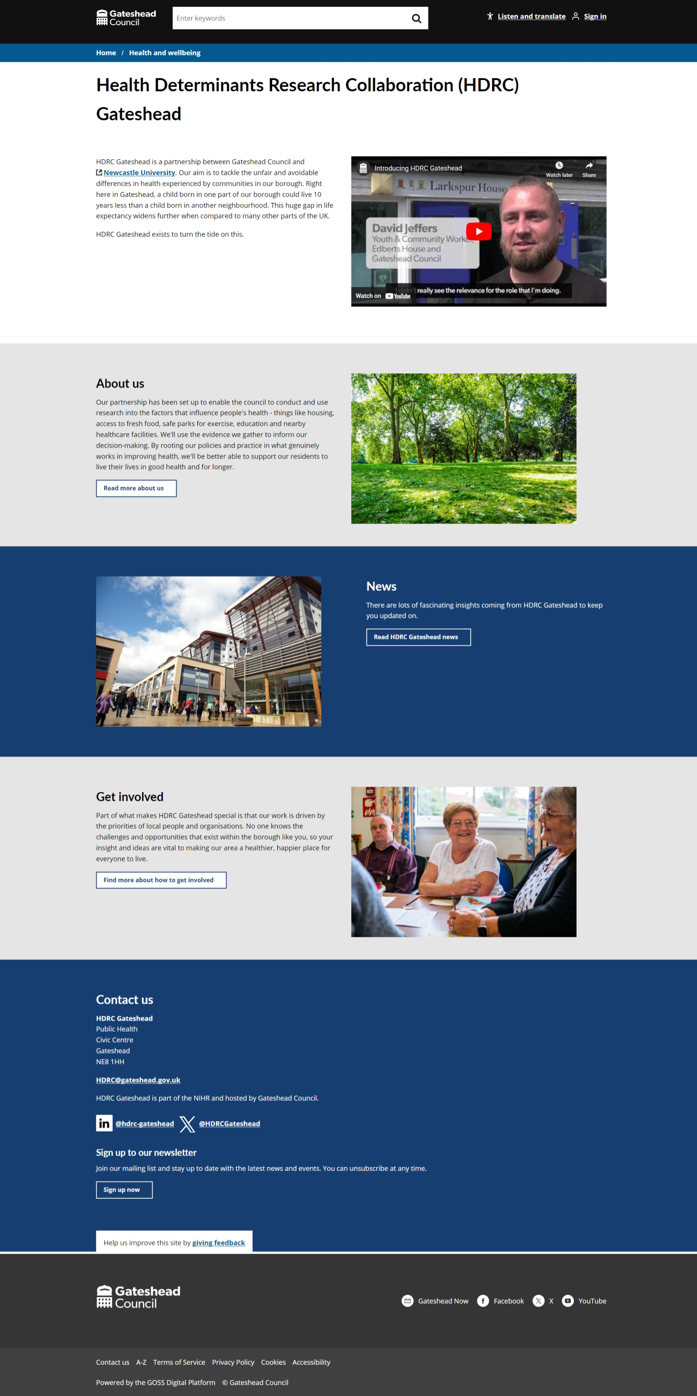
Sprint 39
Content
HDRC Gateshead

Slide 11
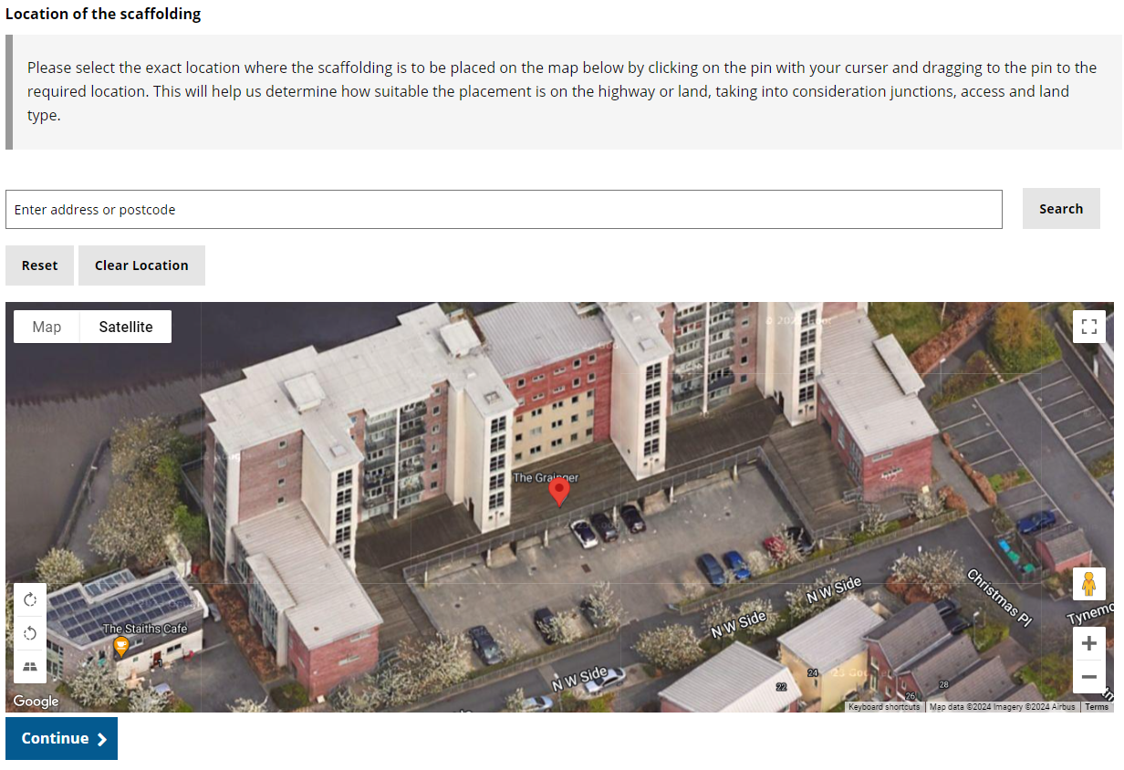
Sprint 39
Content
Scaffold Permits
A form to allow customers to apply for a scaffold permit, similar to skip permits.
Originally built with Report It. Refactored in this sprint to take it out of Report It.
Payment is collected upfront with the application
Uses tasks to allow the team to grant or refuse the applications

Slide 12
Sprint 39
Conclusion
What’s next?
Scoping Housing alteration API integration
Council Tax SMI and Student form development
TTRO amendments ahead of go live
Homelessness appeals go live

