Slide 1
Sprint 40 Show and Tell 17/07/2024
C Squad
Digital Team

Slide 2
Sprint 40
Sprint goal
Complete taxi licensing vehicle testing process

Slide 3
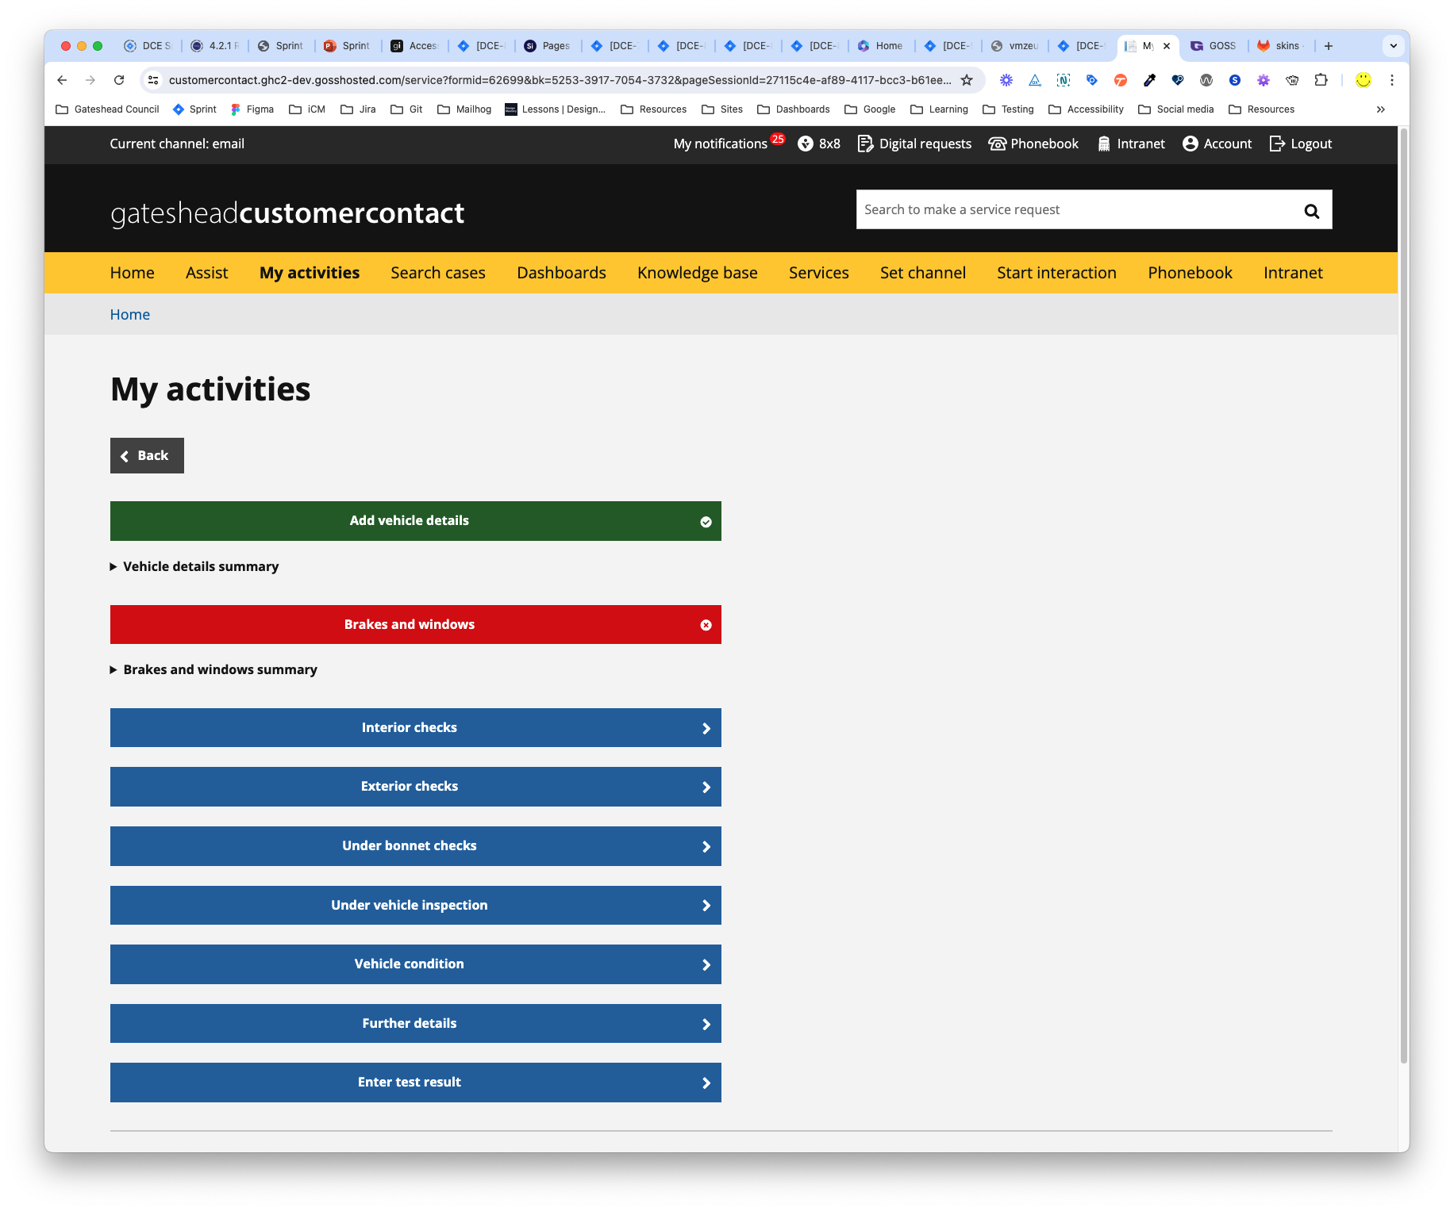
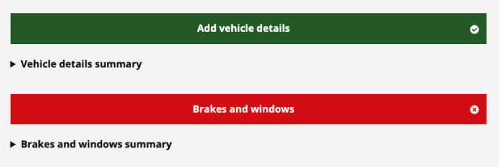
Taxi vehicle testing
Styled the taxi vehicle testing form to indicate if a vehicle has passed or failed a section of the test.
This was achieved by
Using JS to add classes to the button
One class for a pass
One class for a fail
Using CSS to change the button colour and add icons (tick for a pass and a cross for a fail)
Notes:
SA

Slide 4
Sprint 40
Mobile elevated working platforms (MEWPs) licensing
Mapping session with colleagues from Network Management and Enforcement – Miro board
Confirmed new high level application process and filled out detail of front-end customer application
Notes:
HS

Slide 5
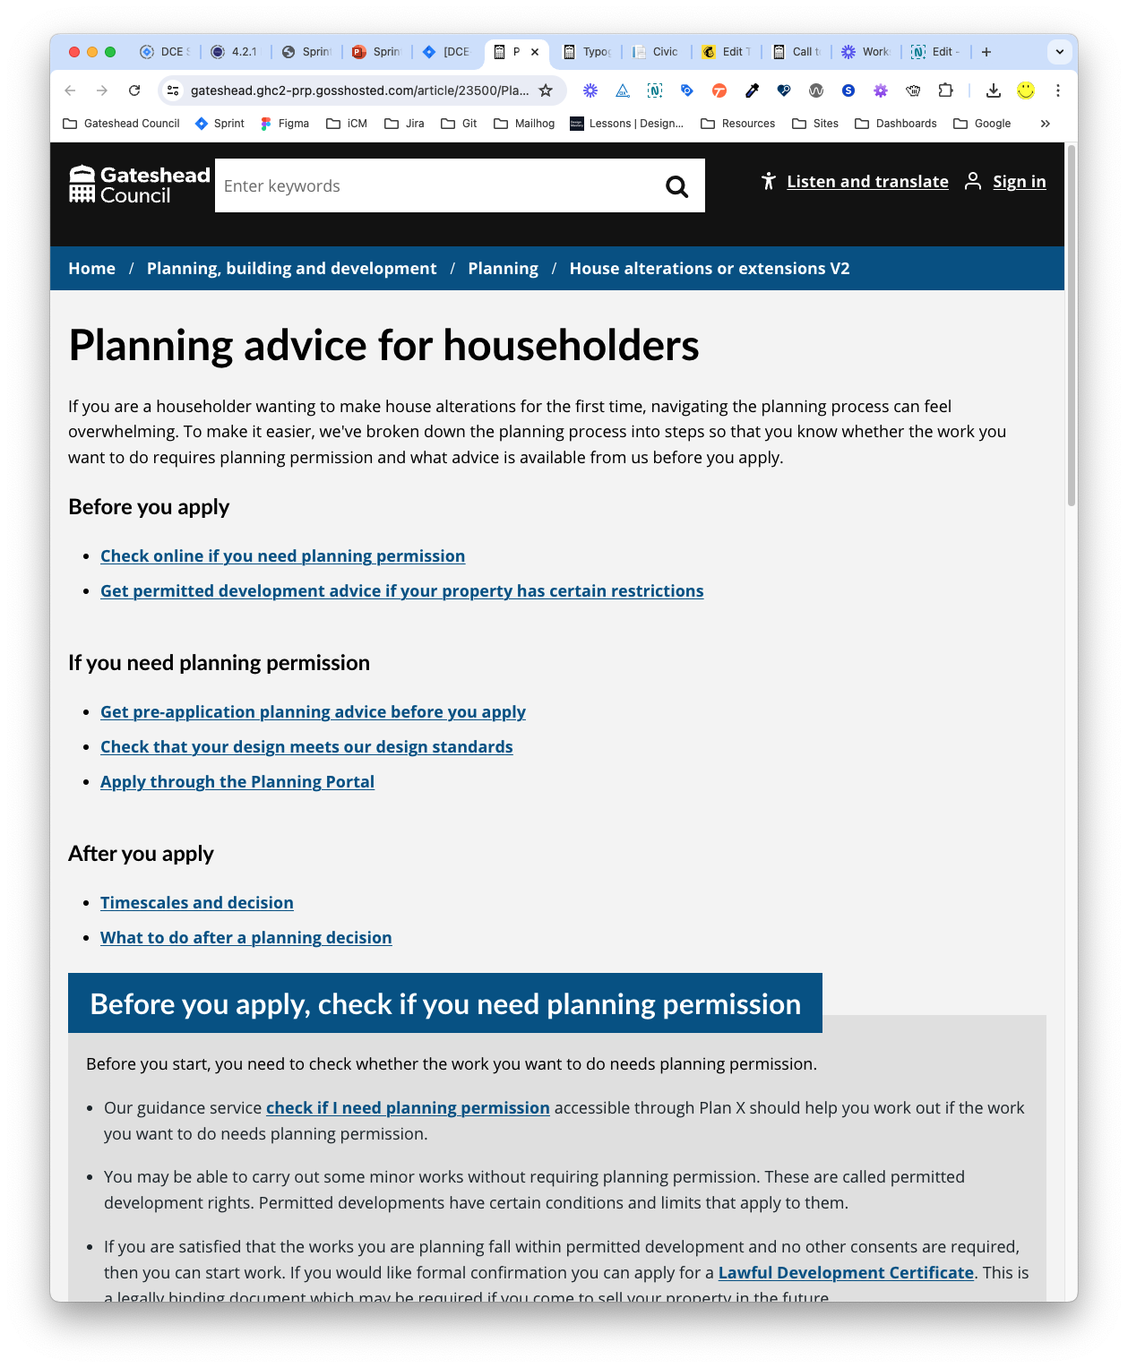
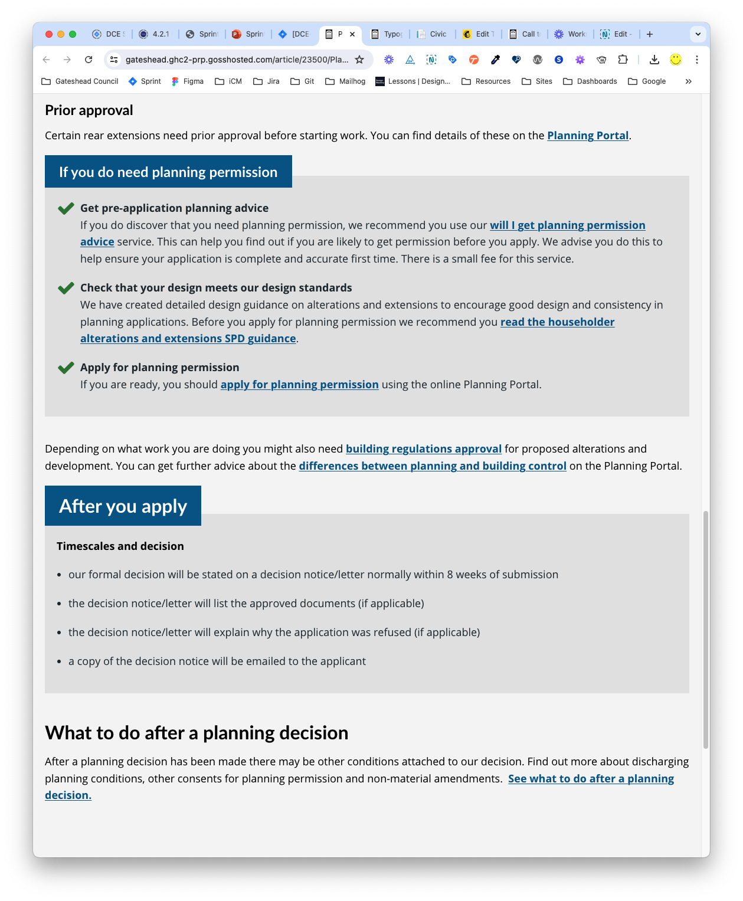
Planning advice for householders
Helped to improve the landing page of the Planning advice for householders section
This was improved by
Making use of the advice boxes in iCM. These help to split the content into readable chunks of information.
Applying the improved list styles to the website
Notes:
ER

Slide 6
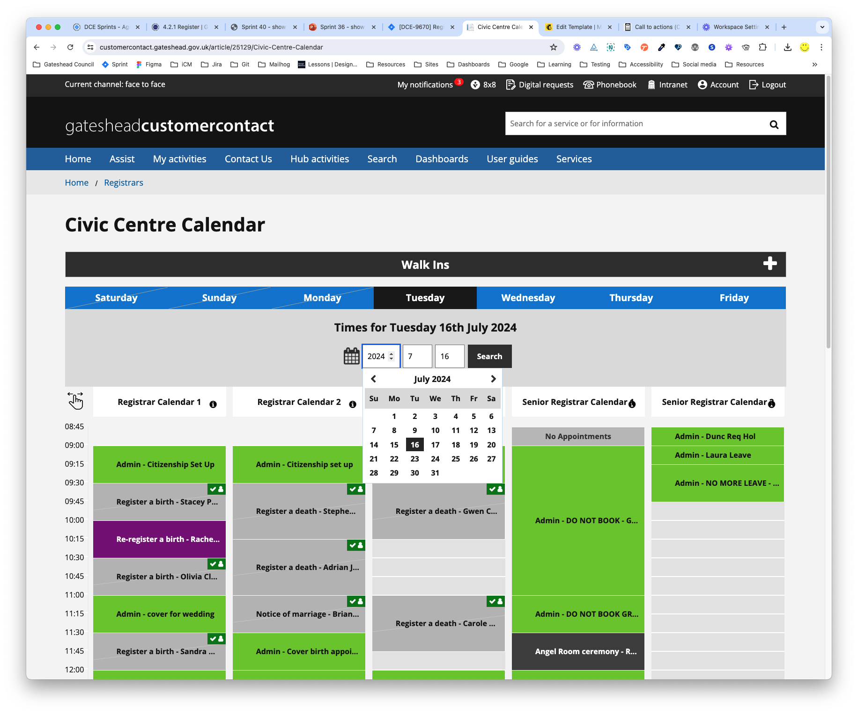
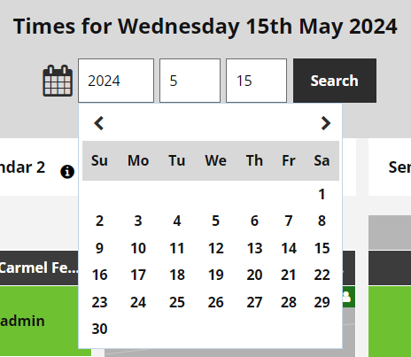
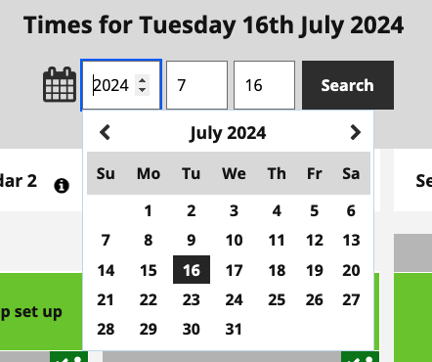
Registrars and pest control calendars
The date picker on the registrars and pest control calendars were not displaying the month and year.
This was resolved by
Updating the CSS for the date picket to change the colour of the text and increase colour contrast
Notes:
TW

Slide 7
Sprint 40
Direct payments
User research planning
New mailbox / drafted comms / plan for distribution
Data and dashboard
First draft of report to ASC GMT submitted for review
Issues and solutions log complete – beautiful Miro board
Direct Payment champions group
Notes:
HS

Slide 8
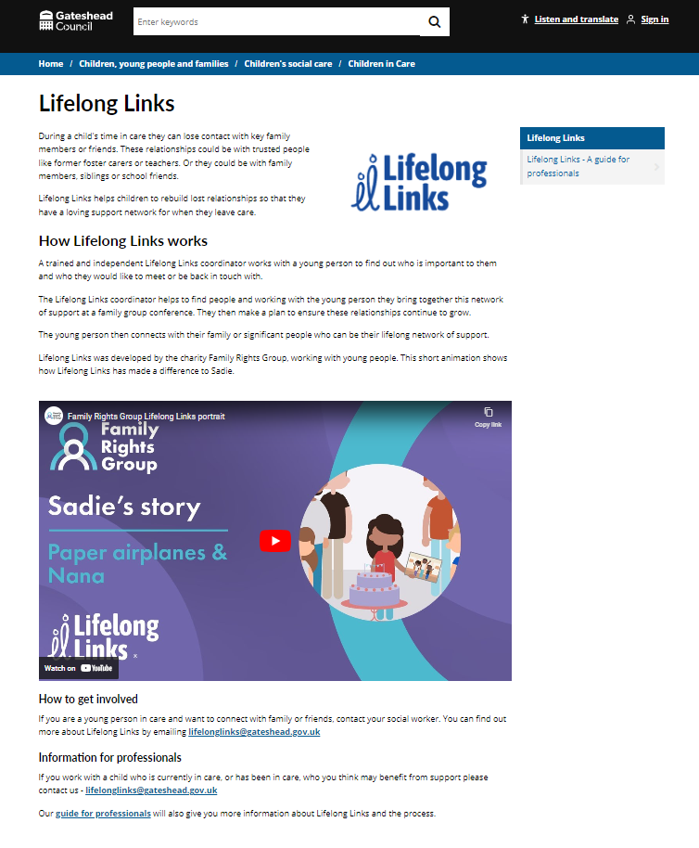
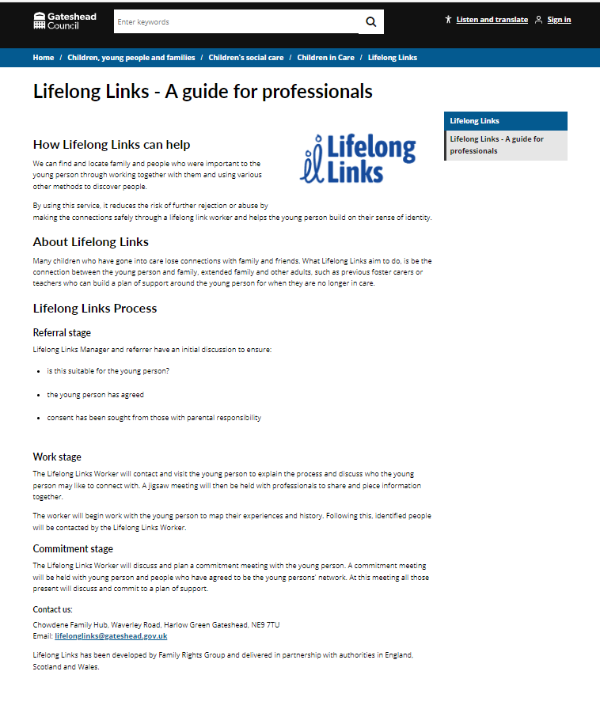
Sprint 40
Children's - Lifelong Links support for children in care
Content added for Lifelong Links which supports children in care to rebuild lost relationships. Information for children in care and for professionals.
Notes:
ER

Slide 9
Sprint 40
Benefits – Overpayment payment arrangements
Mapping sessions with Benefits
To-Be process map created and agreed with Benefits – ready for wireframing
Notes:
HS

Slide 10
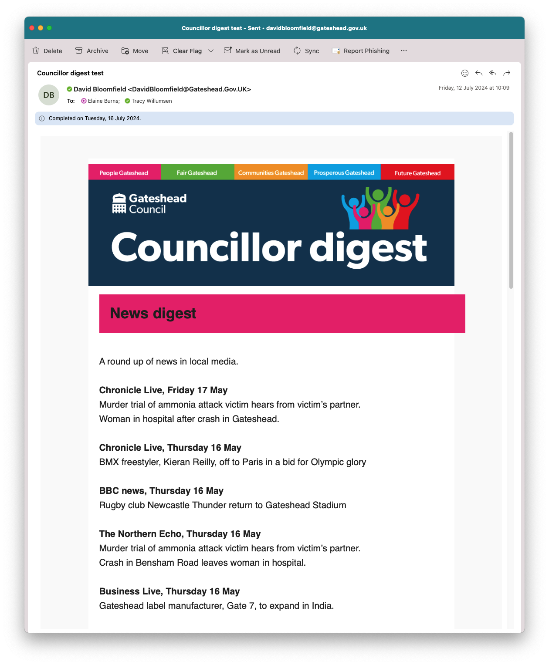
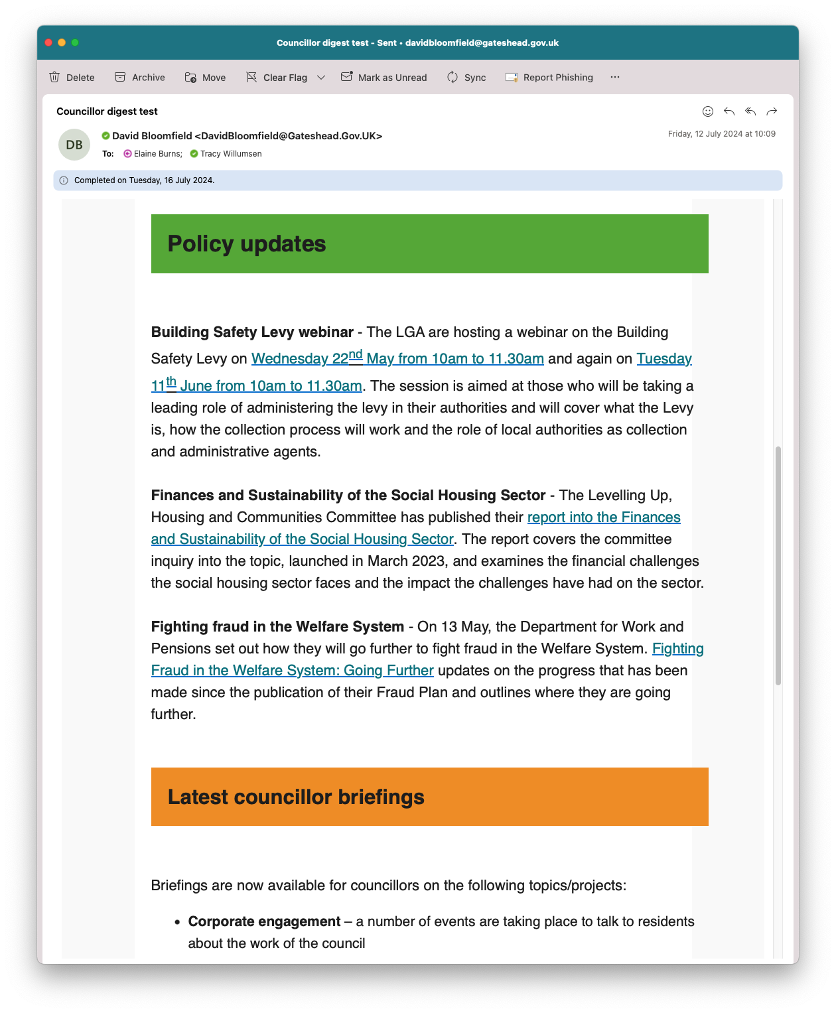
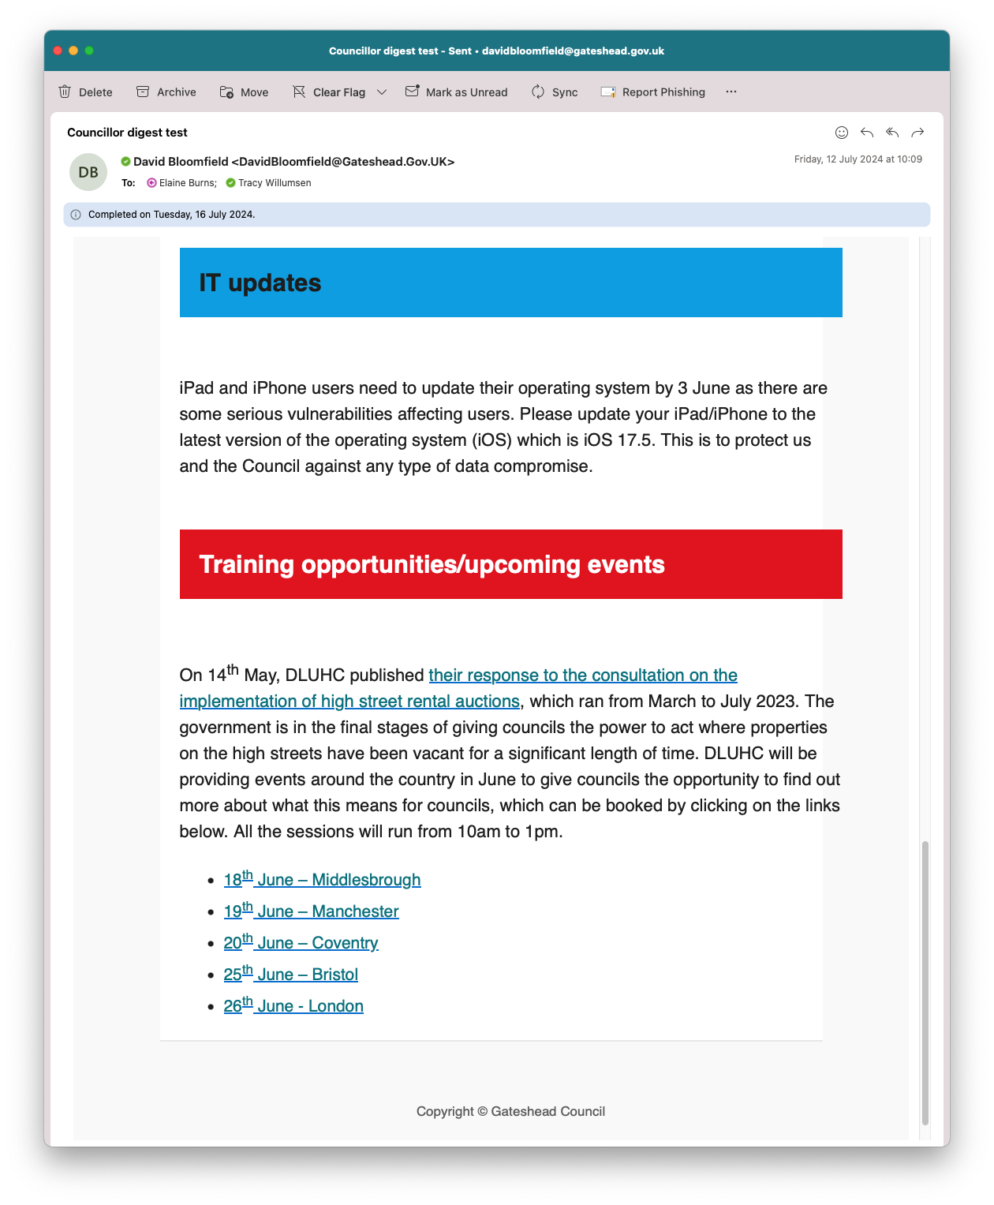
Councillor digest
Created a template for a daily councillor digest email for the Communcations team
Created using example content supplied by Communcations
Made use of the Thrive colours
Had to be easy to edit and be sent from Outlook
Designed in Mailchimp
Exported as HTML
Edited HTML to remove elements that were not needed (e.g. unsubscribe links)
Imported to Outlook
Notes:
RA

Slide 11
HDRC MailChimp
Health Determinants Research Collaboration (HDRC) Gateshead MailChimp template
Further amends to design, text and images.
Notes:
RA

Slide 12
Sprint 40
Corporate - Gateshead Now
Items featured in this issue:
Pride in Gateshead
Brighten the Day Summer activities
Gateshead Award winners
Notes:
TW

Slide 13
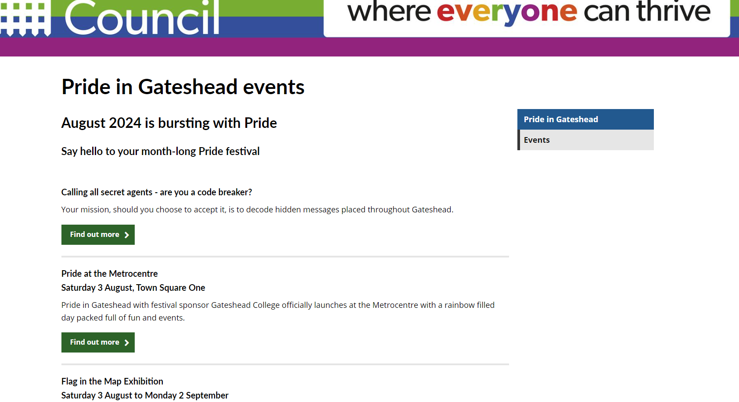
Sprint 40
Corporate - Pride in Gateshead webpages
Content to support promotion of Pride month
More content to be added
Notes:
TW

Slide 14
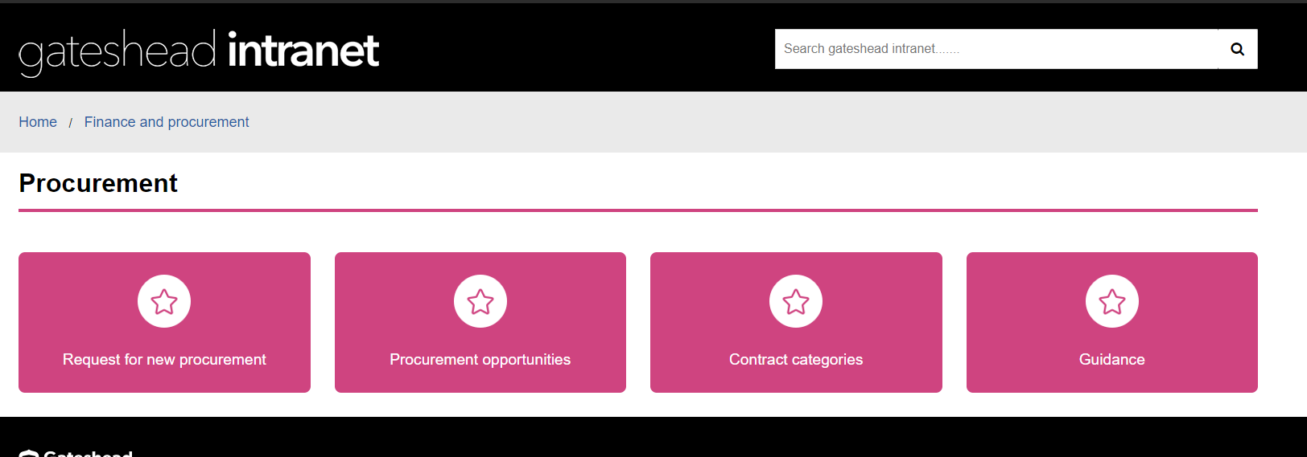
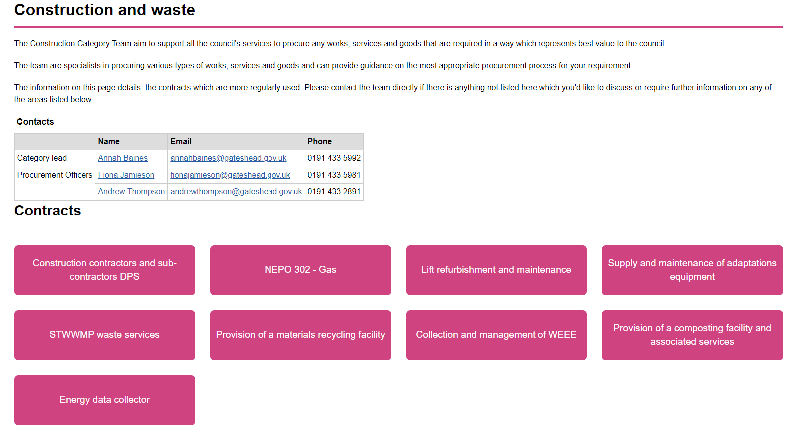
Sprint 40
Corporate - Publish new Procurement intranet pages
Notes:
TW

Slide 15
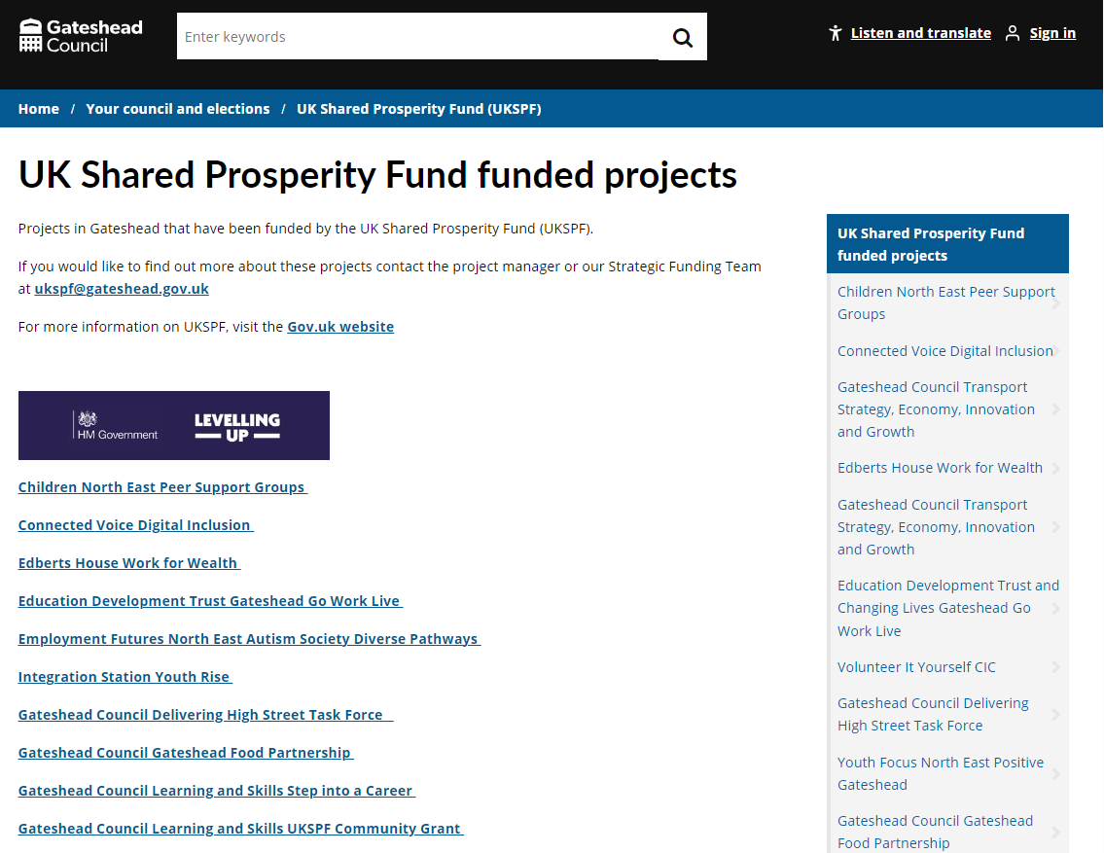
Sprint 40
Corporate - UKSPF funded projects
Service wanted to promote projects that have been funded by UK Shared Prosperity Fund in Gateshead.
Summary of each project added with contact details, logo and website link.
Notes:
ER

Slide 16
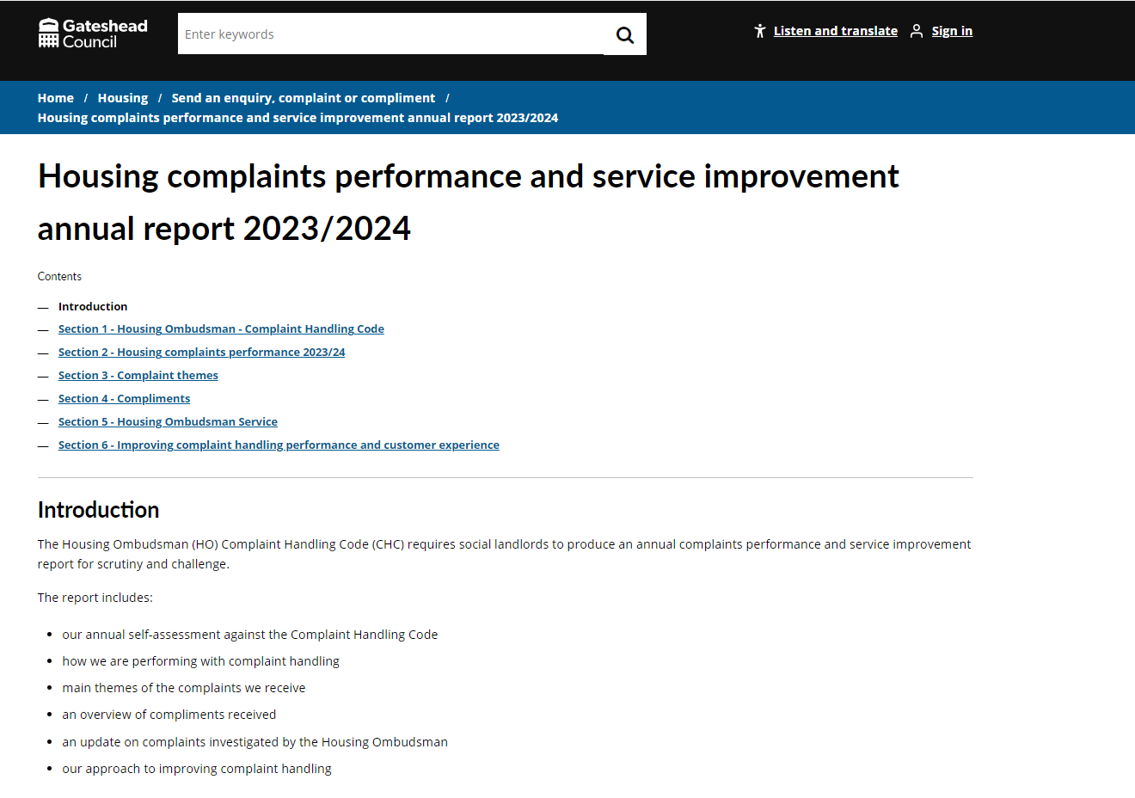
Sprint 40
Housing - Complaints performance and service improvement annual report
Housing complaints performance and service improvement annual report 2023/2024 added using the document template.
Notes:
ER

Slide 17
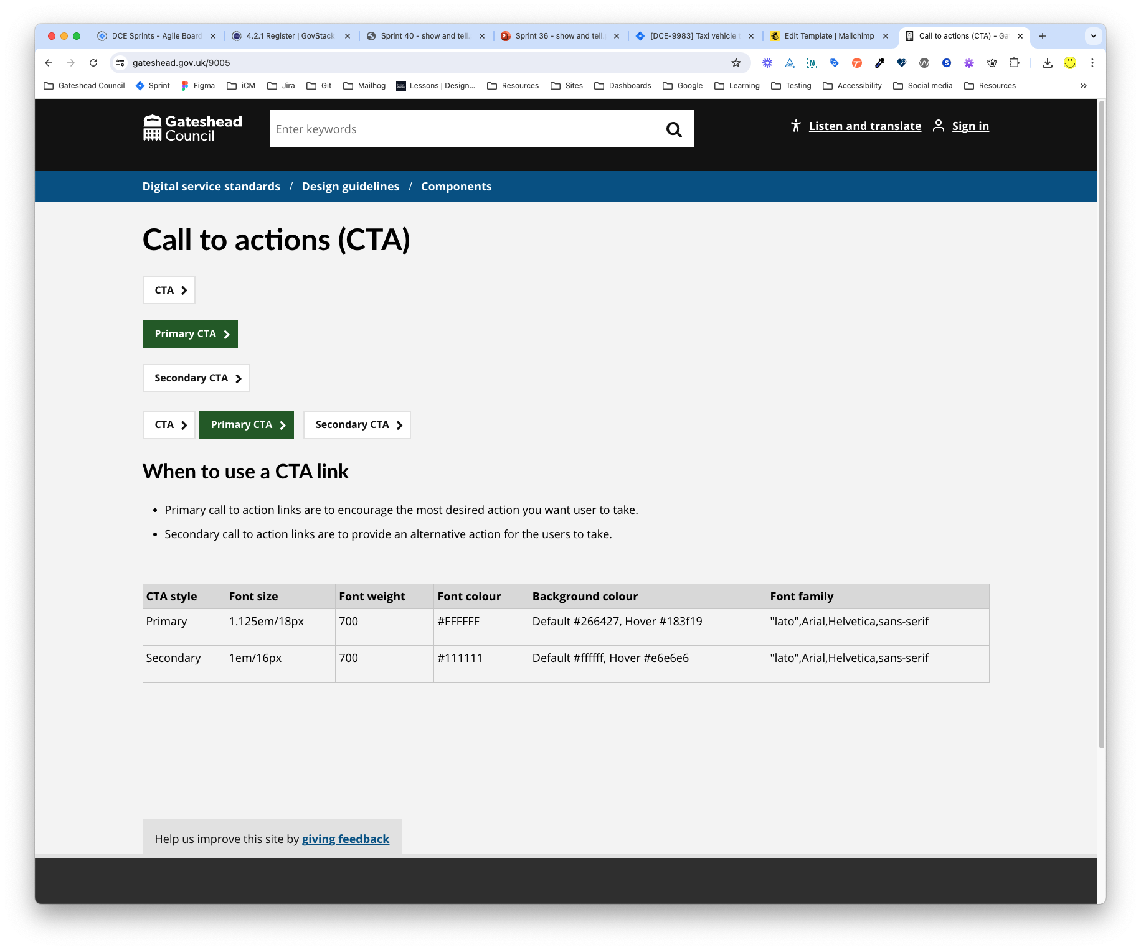
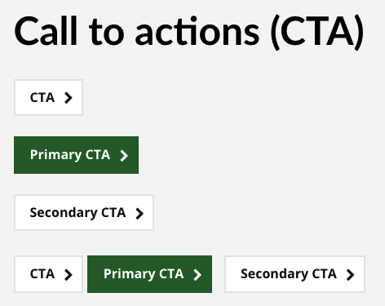
CTA styling on subsites
An update to STAN (Standardised site) added chevrons and box shadows to the CTA links.
This caused issues with our own styling of CTA links
This was resolved by
Updating all CTA styles on each subsite (17 in total)
Creating a page on each subsite (like the example shown) that displayed the CTA links. This helped check that they had been updated correctly.
Each site now makes use of the CTA inline in the iCM editor.
Notes:
RA

Slide 18
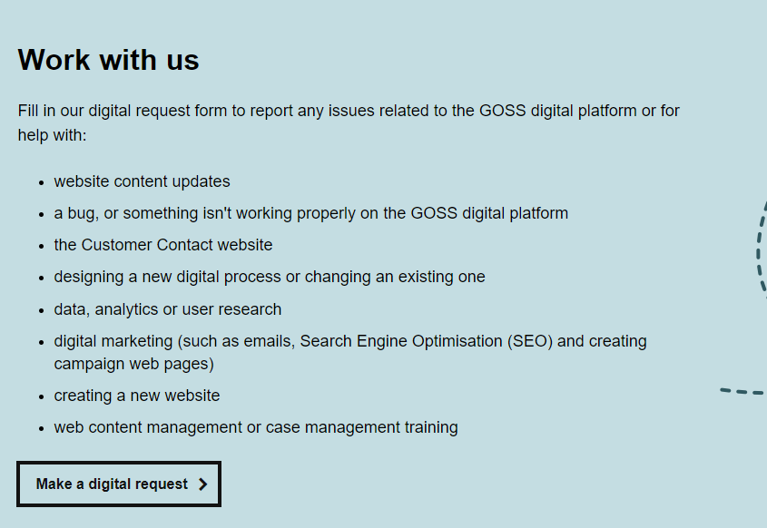
Sprint 40
Improvements to the digital request process content
Updates to make it clearer what can and can't be requested
Notes:
TW

Slide 19
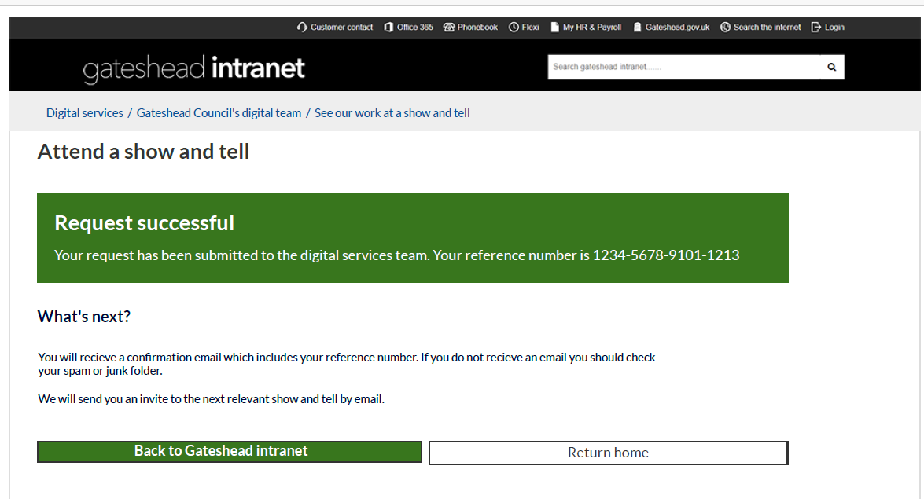
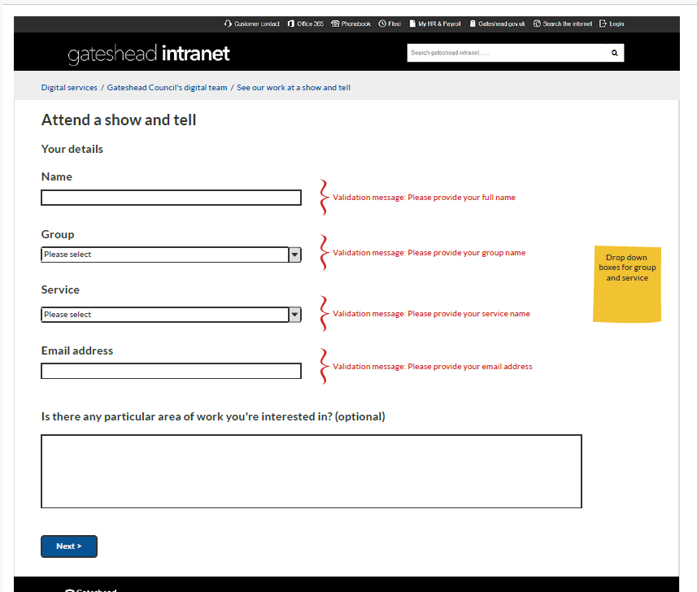
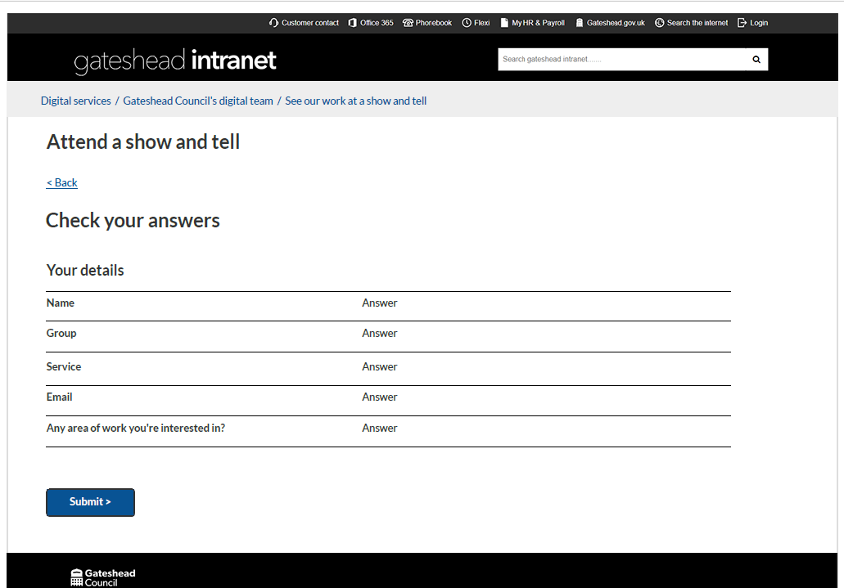
Sprint 40
Show and tell attendance request wireframe
Notes:
TW

Slide 20
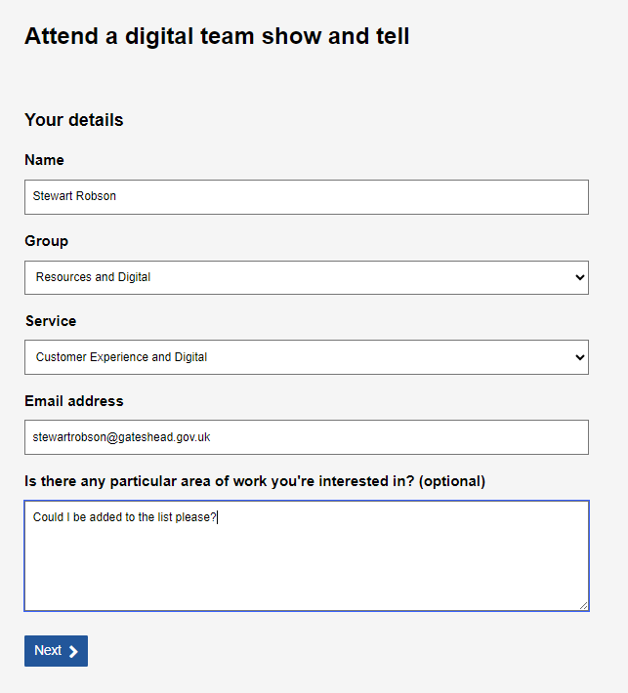
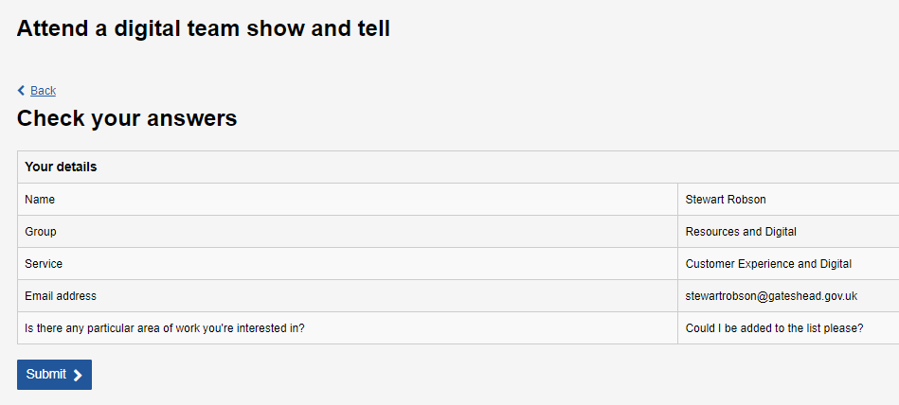
Sprint 40
Show and tell attendance request
Notes:
TW

Slide 21
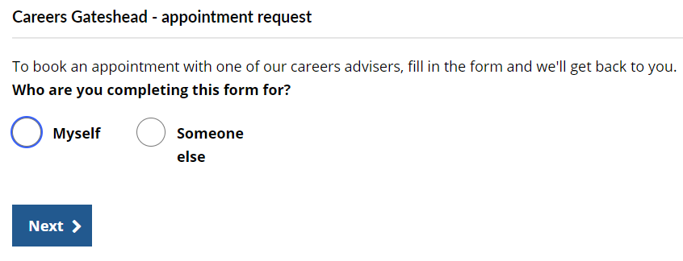
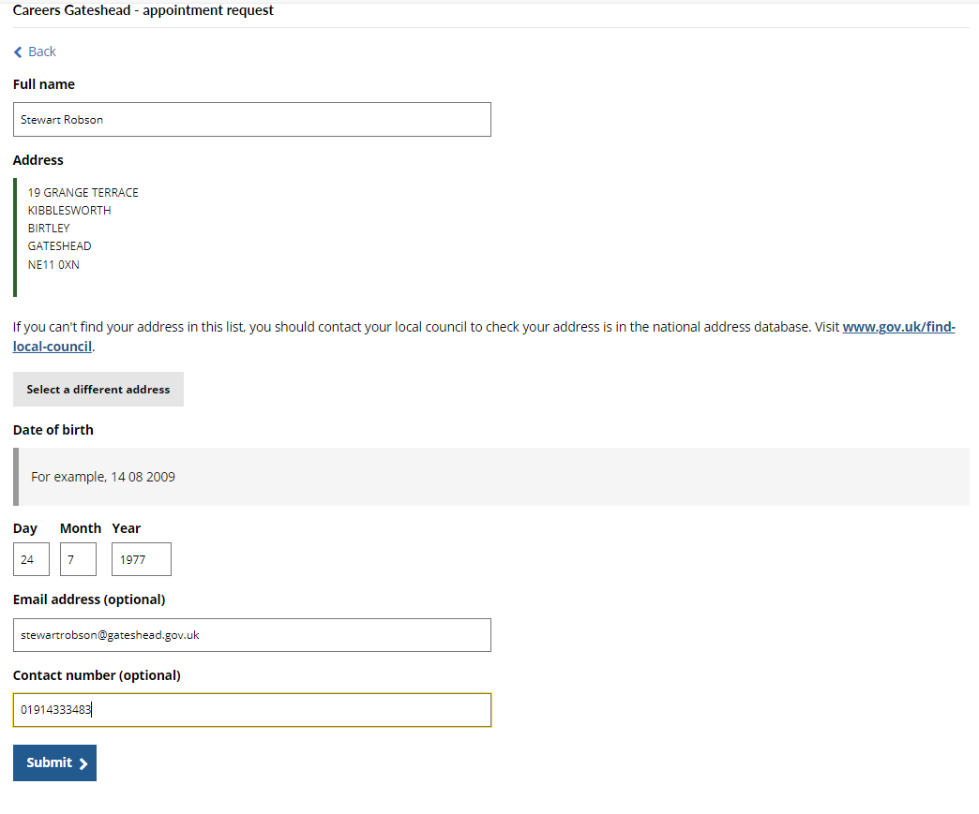
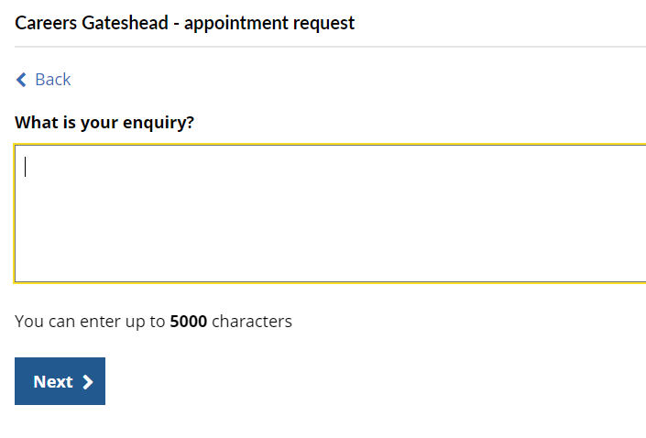
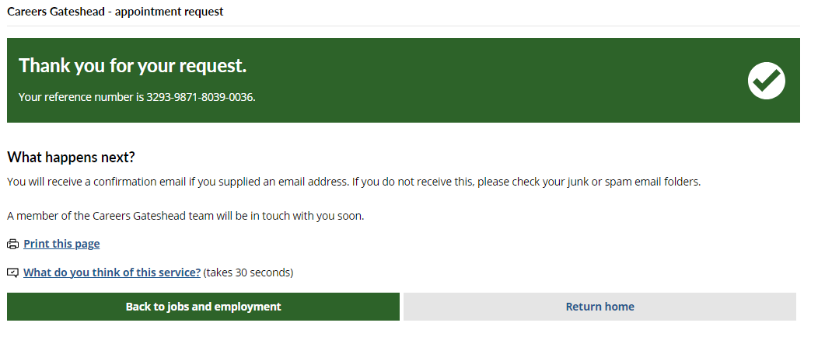
Sprint 40
Careers Gateshead appointment request
Notes:
TW

Slide 22
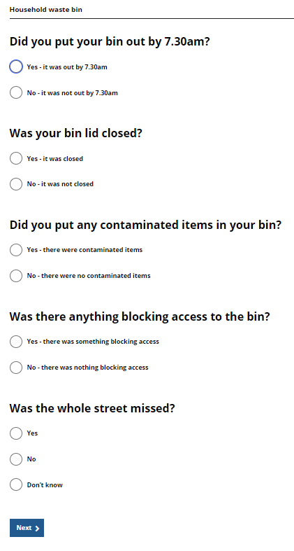
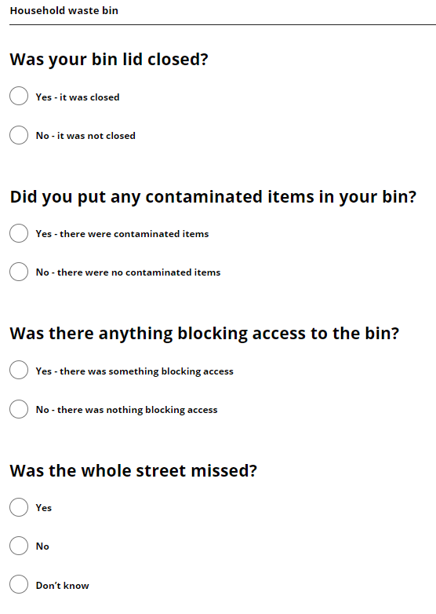
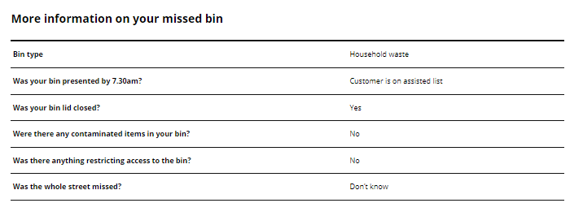
Sprint 40
Missed bin - Assisted collection updates
Notes:
RA- Check Bartec to see if customers on the assisted list - if they are it doiesn't presennt the 'why wasn't your bin out by 7:30@

Slide 23
Sprint 40
Routine development
Amazon SES investigation work - account management
Missed bin dashboards - limiting jobs to under 10 days
Updates to site user profile form - Homecare and day services
Track the performance of missed bin dashboards using Rapidspike
Replaced hardcoded emails in form with email stored in config endpoints
Update email template for replacement bin request
Notes:
RA

Slide 24
What's coming up in Sprint 42
Taxi Vehicle Licensing form - more testing
School penalty notice payment
Mobile Elevated Working Platform (MEWP) Licence – wireframe
Direct payments – user research
Housing over payments and discretionary housing payments
Council Tax survey analysis

Slide 25
Sprint 40
Deployment

