Slide 1
Sprint 41 Show and Tell 24 July 2024
G Squad
Digital Team

Slide 2
Sprint 41
Introduction
Sprint goals
Housing alterations integration
NEC Homelessness appeals go live
Tenant vetting wireframe
Temporary Traffic Regulation Orders - final amendments
Council Tax Support – Universal Credit only wireframe

Slide 3
Sprint 41
Development
Housing Alterations
UX Update and Investigating property APIs

Slide 4
Sprint 41
Development
This sprint involved exploring the potential of NEC APIs to enhance automation in the Housing Alterations process.
The primary goal was to retrieve property details, including property types, tenure types, and individual property elements.
Property APIs

Slide 5
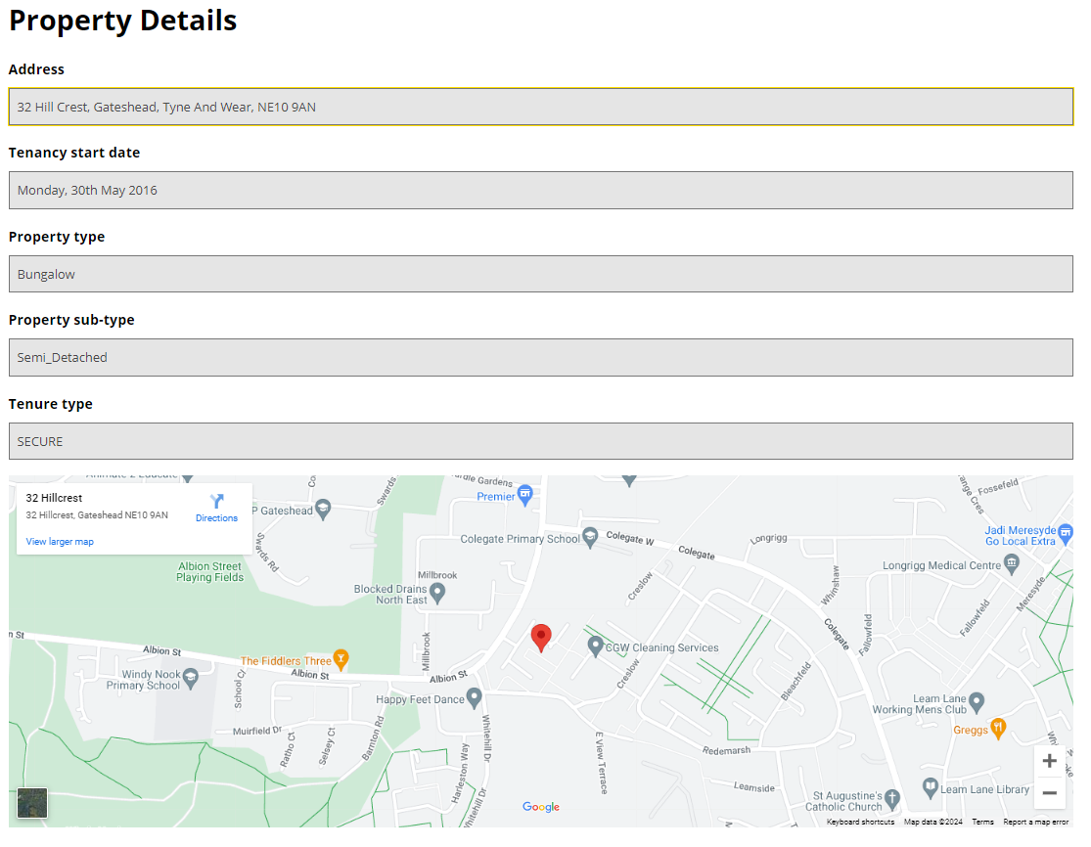
Sprint 41
Development
During the API investigation, property types, subtypes, and tenure types were successfully retrieved, and property information was integrated into Google Maps for visual display.
Property APIs

Slide 6
Sprint 41
Development
A bug in the API has prevented the retrieval of individual property elements. This issue has been reported to the supplier for further investigation.
Fixing this would allow the online form to automatically adjust the process based on property information, which would be highly beneficial, but isn’t necessary to proceed.
Property APIs

Slide 7
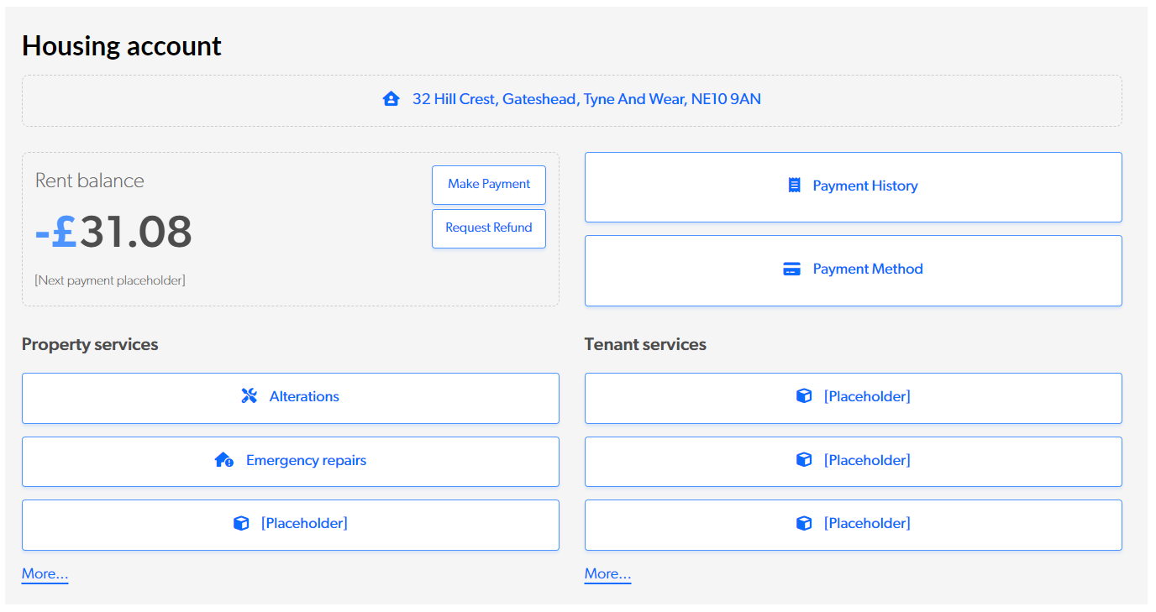
Sprint 41
Development
UX Updates
Improved flow of linking an account
Integrated account linking into MyAccount page
Form updates for different account states
Additions for Alterations
Slight layout adjustments
Demo

Slide 8
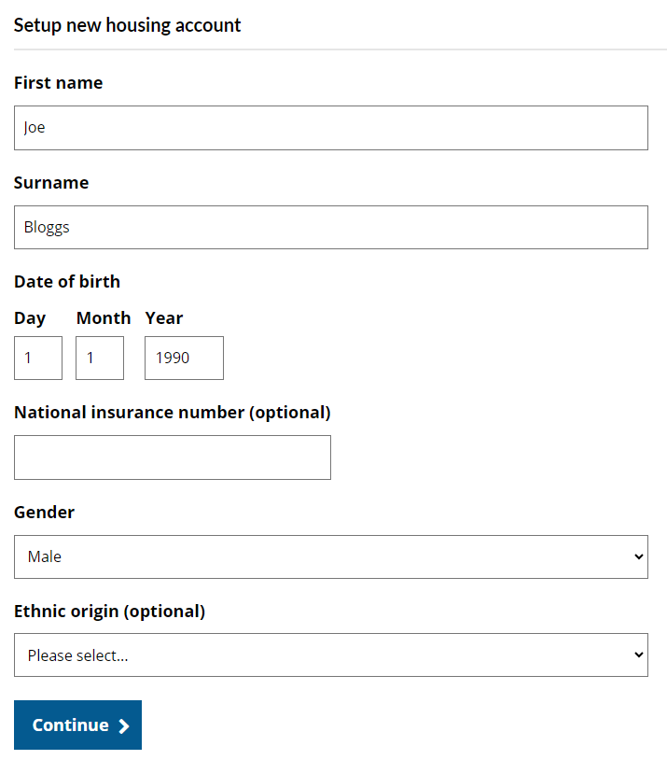
Sprint 41
Development
Creating Accounts
Investigations into creating NEC user accounts via the GOSS Platform using APIs are ongoing. This could lead to several improvements, including:
Enhanced UI and instructions
Additional fields
Account synchronization
Auto-population of fields based on Gateshead accounts
Demo

Slide 9
Sprint 41
Homelessness appeals
Go live – tasks

Slide 10
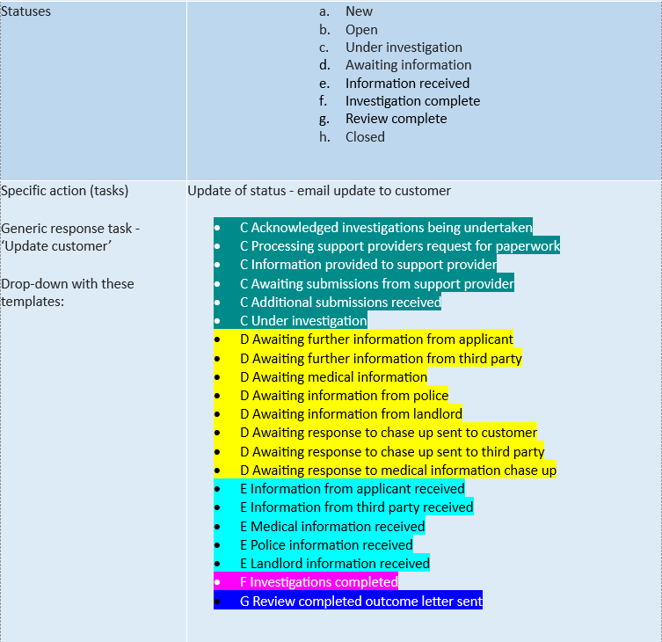
Sprint 41
Go live
Homelessness appeals
21 different response templates

Slide 11
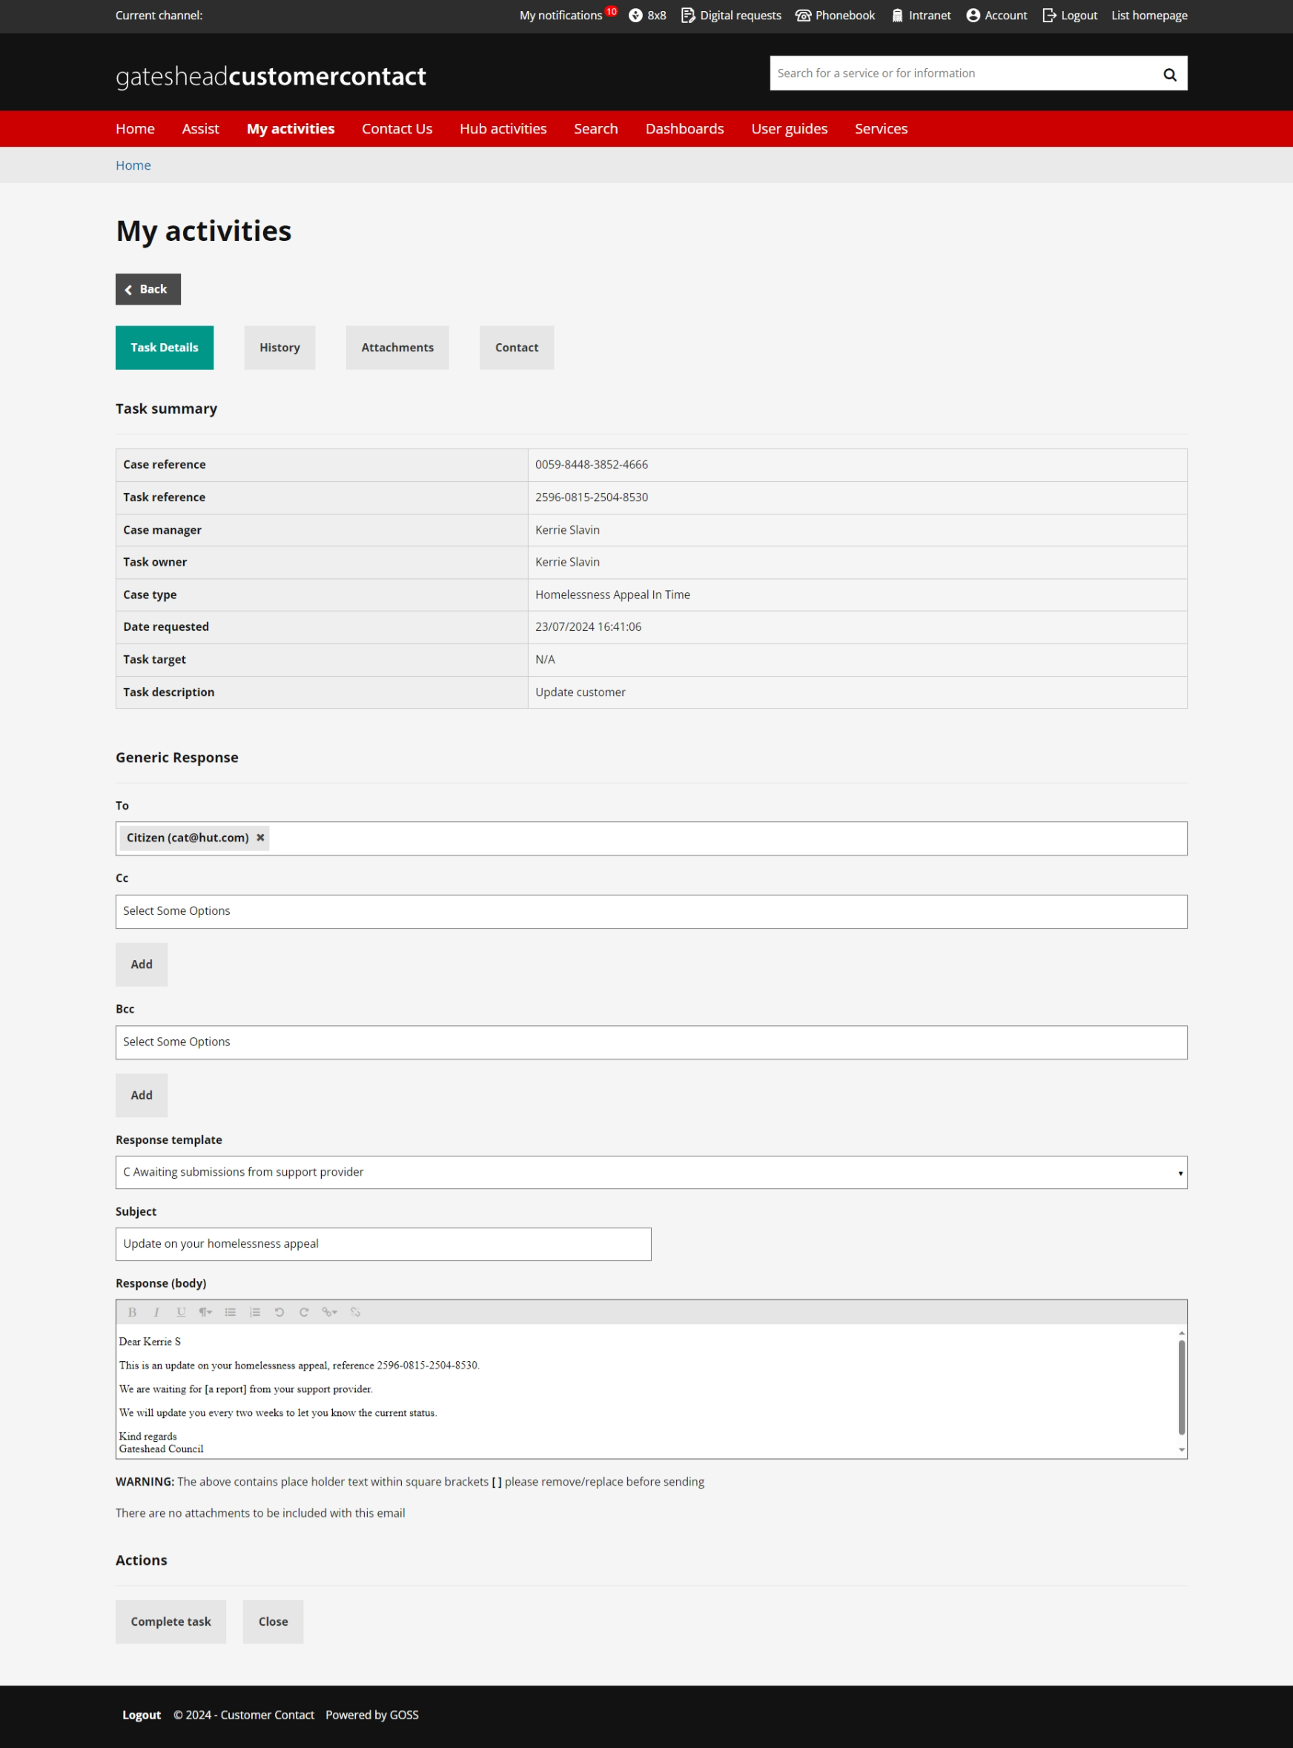
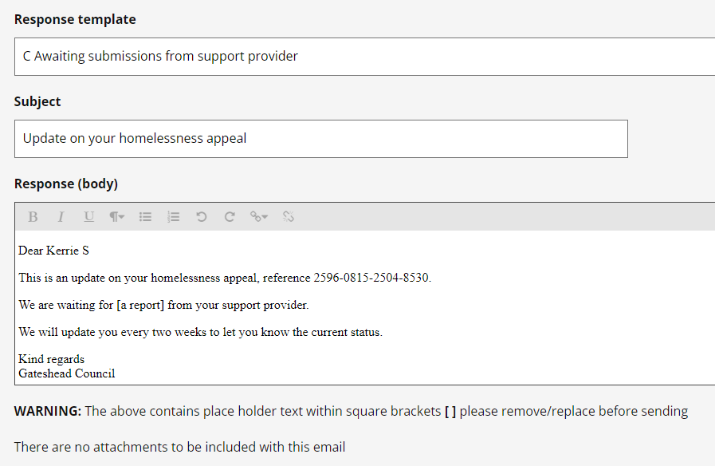
Sprint 41
Go live
Homelessness appeals

Slide 12
Sprint 41
Data and analysis
Housing Customer Contact dashboard
Data

Slide 13
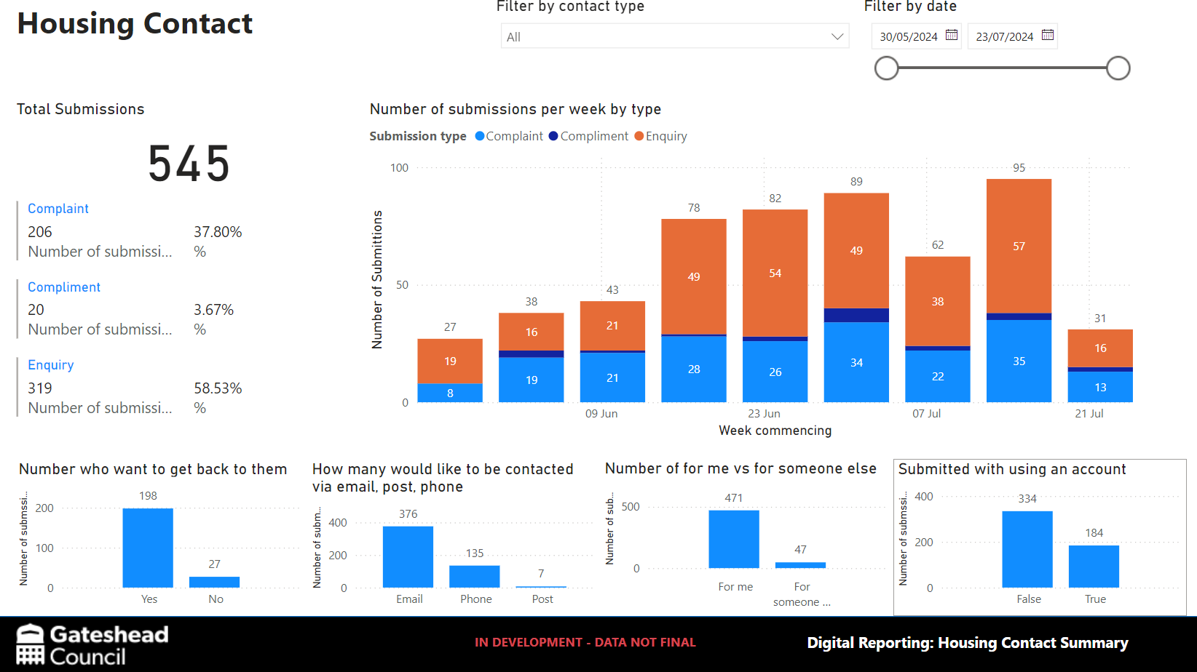
Sprint 41
Development
Housing customer
contact dashboard

Slide 14
Sprint 41
Text
Housing Tenant Vetting form

Slide 15
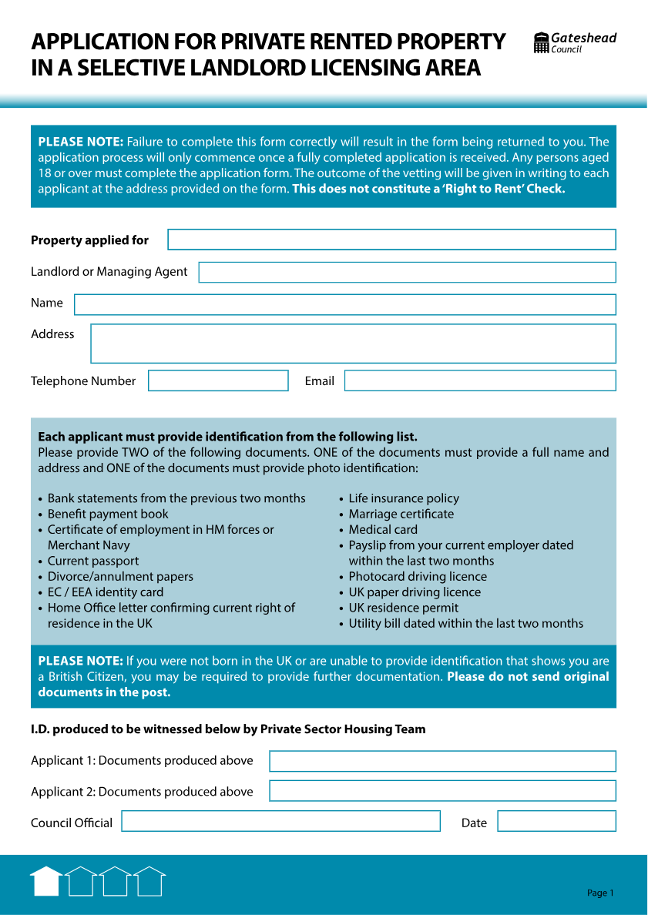
Sprint 41
Development
Housing tenant vetting form
private-sector housing
for selective landlord licensing areas (which are increasing)
approx 30 applications per month
currently a paper form

Slide 16
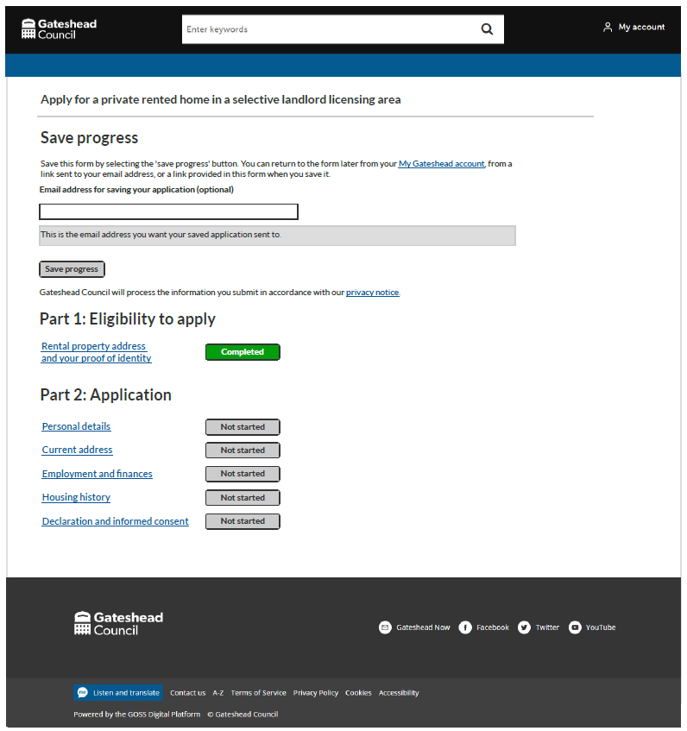
Sprint 41
Development
Housing tenant vetting form wireframe
two versions – one for the main applicant and one for other household members

Slide 17
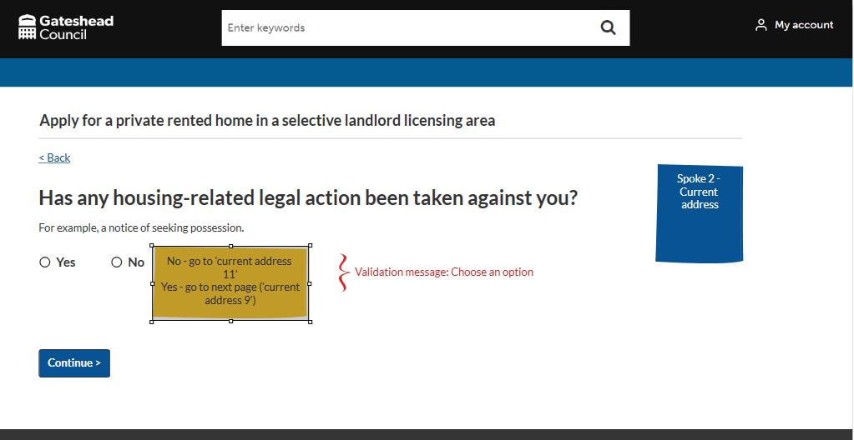
Sprint 41
Development
Housing tenant vetting form wireframe
Repeating pages example

Slide 18
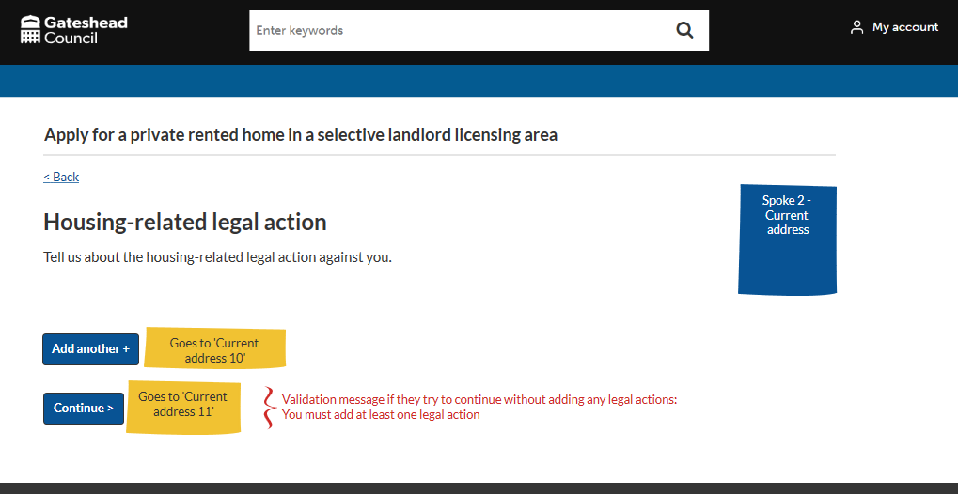
Sprint 41
Development
Housing tenant vetting form wireframe
Repeating pages example

Slide 19
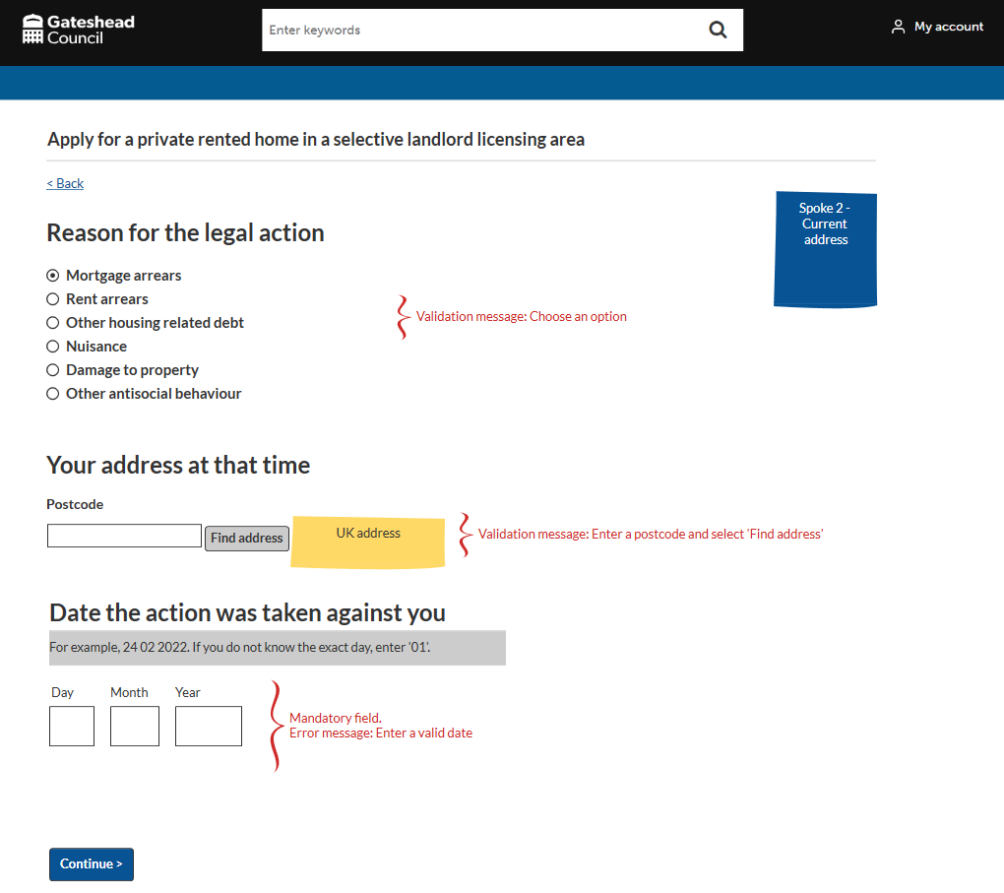
Sprint 41
Development
Housing tenant vetting form wireframe
Repeating pages example

Slide 20
Sprint 41
Text
Council Tax
Online applications and report forms

Slide 21
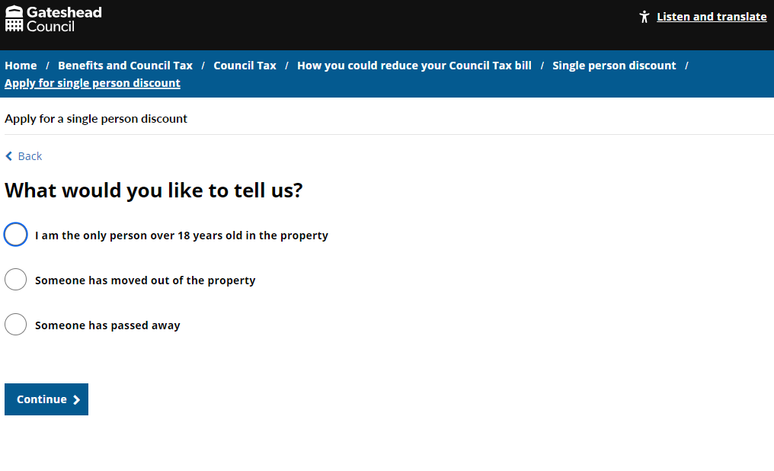
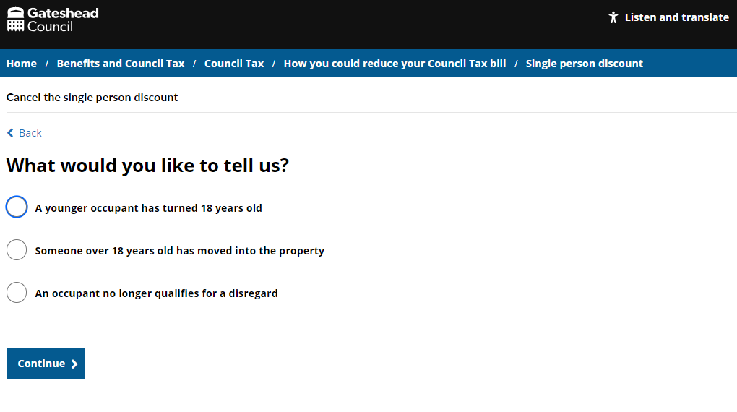
Sprint 41
Development
Further development of the 'single person discount' application form and the 'single person discount cancellation form'.
Updated with feedback from code review and with amends and fixes from internal testing.
Single person discount

Slide 22
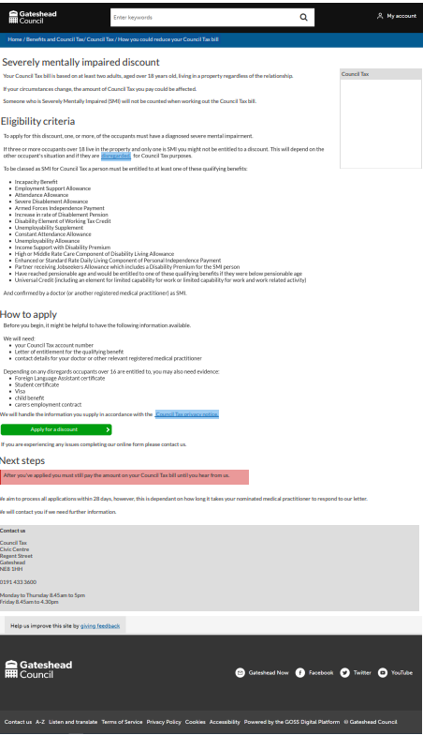
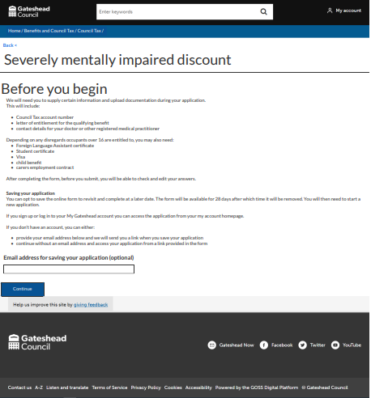
Sprint 41
_{Pr}
Development
SMI wireframe
Severely Mentally Impaired
Discount
Prototype of the form
Proposed web content
Standard Council Tax payer questions beginning and end of the form
Before you begin screen listing evidence required for completing the form
Save your application option

Slide 23
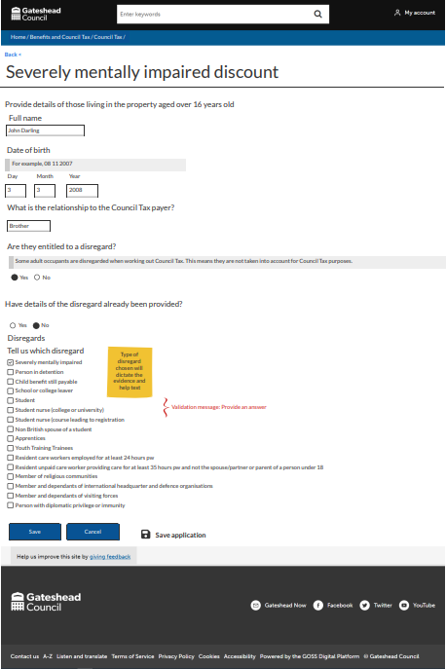
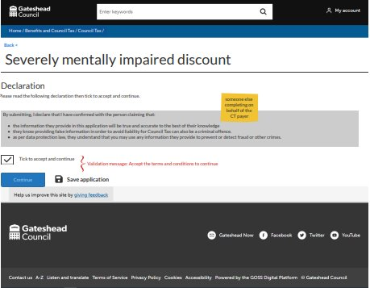
Sprint 41
Development
SMI wireframe
Initial declaration
Example of questions for an occupant over 16 years old

Slide 24
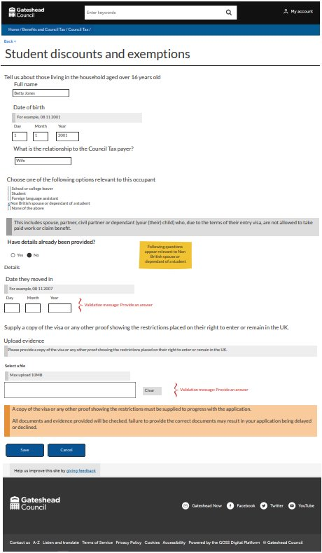
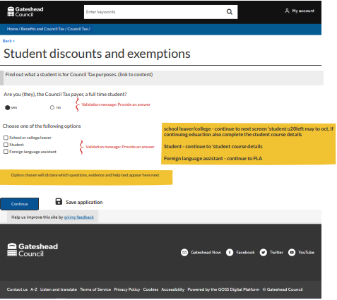
Sprint 41
Development
CT - Student discount
Standard Council Tax payer questions beginning and end of the form
Student options for Council
Tax payer and for occupants

Slide 25
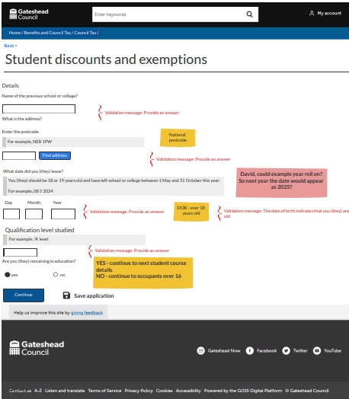
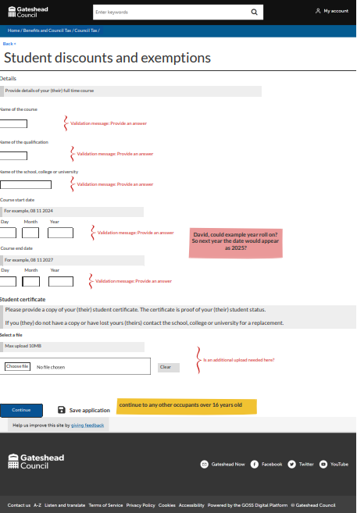
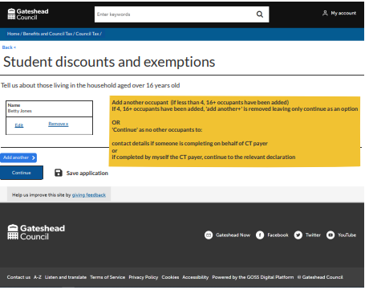
Sprint 41
Development
CT - Student discount

Slide 26
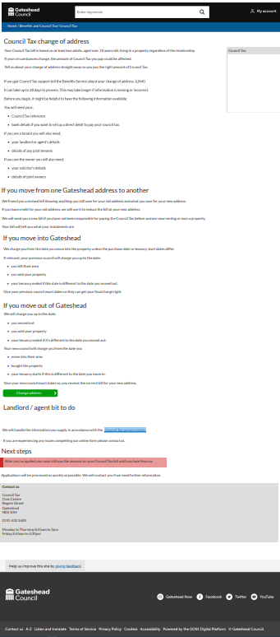
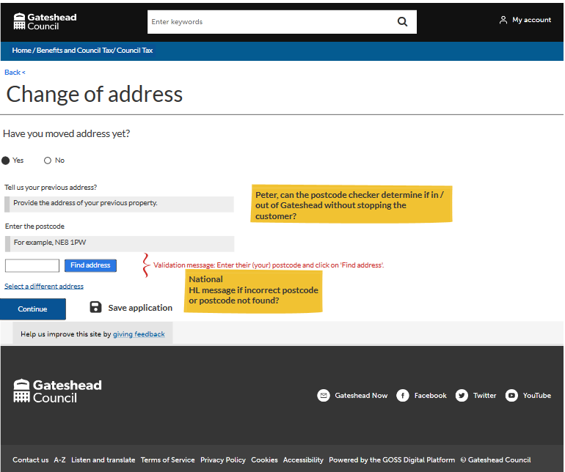
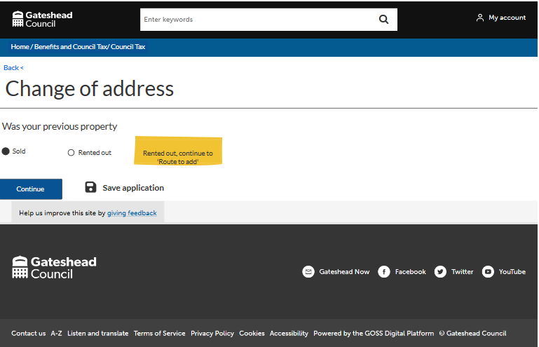
Sprint 41
Development
CT - Change of address
Wireframe still in progress
Standard Council Tax payer questions beginning and end of the form
Proposed web content

Slide 27
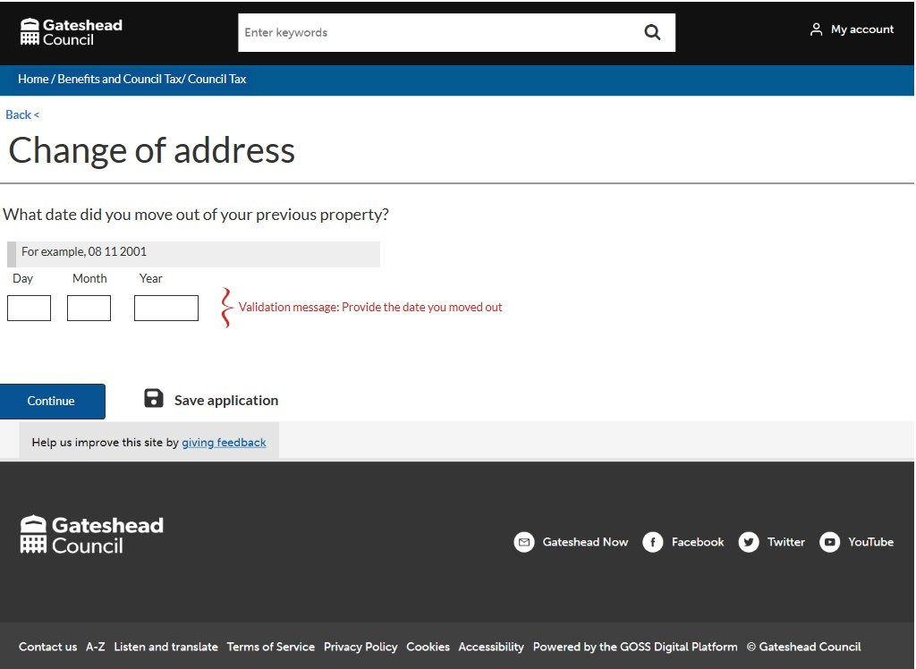
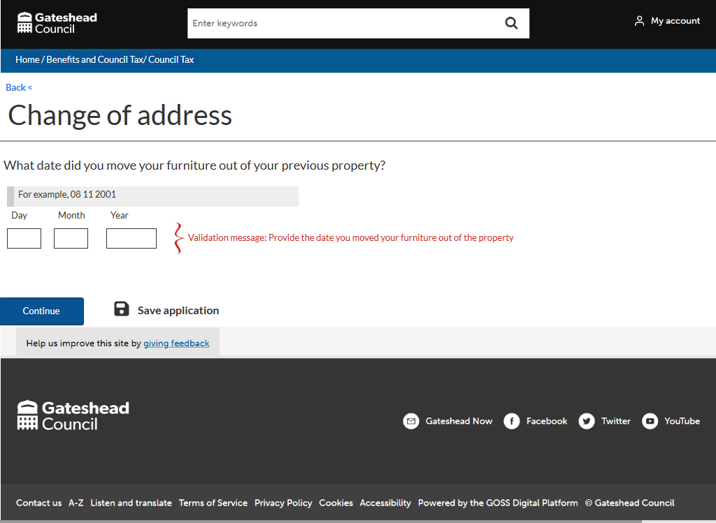
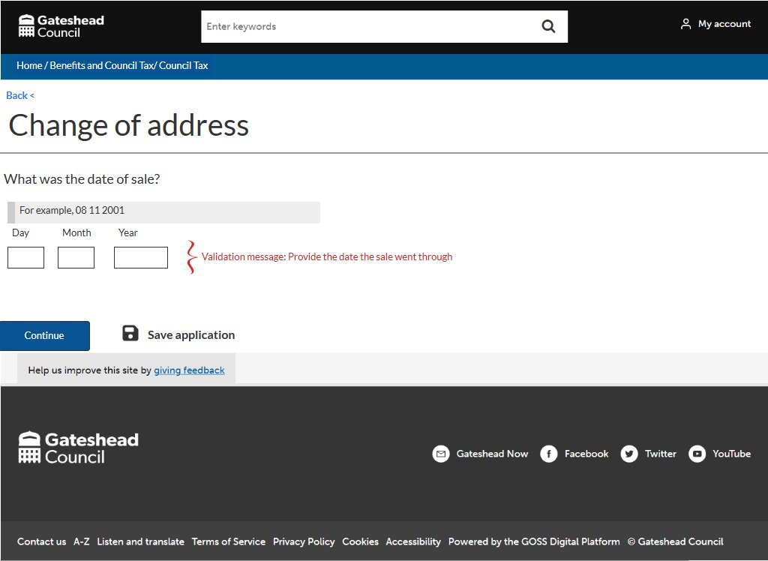
Sprint 41
Development
CT - Change of address

Slide 28
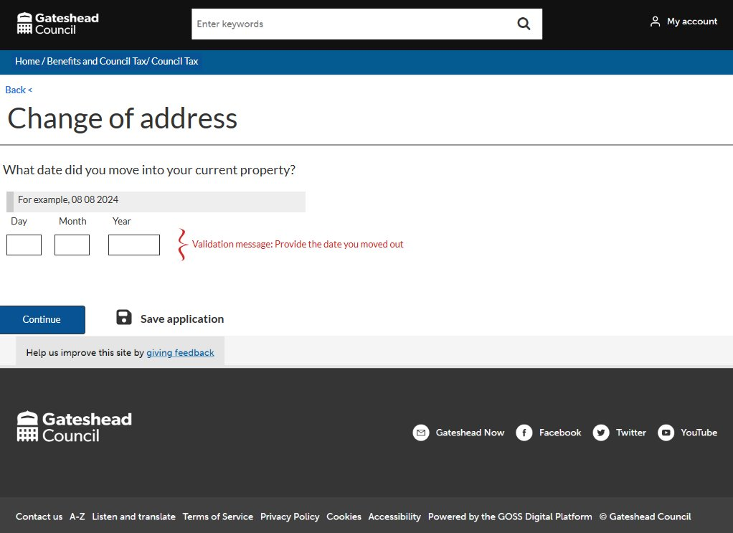
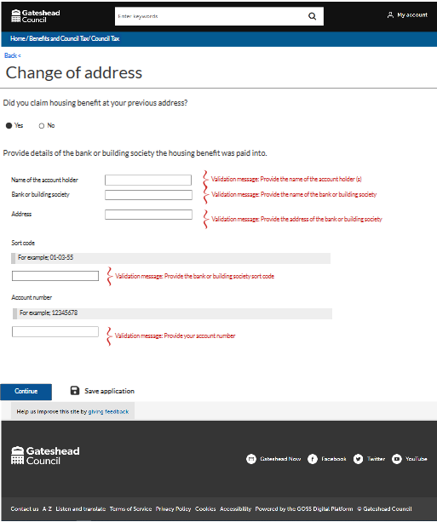
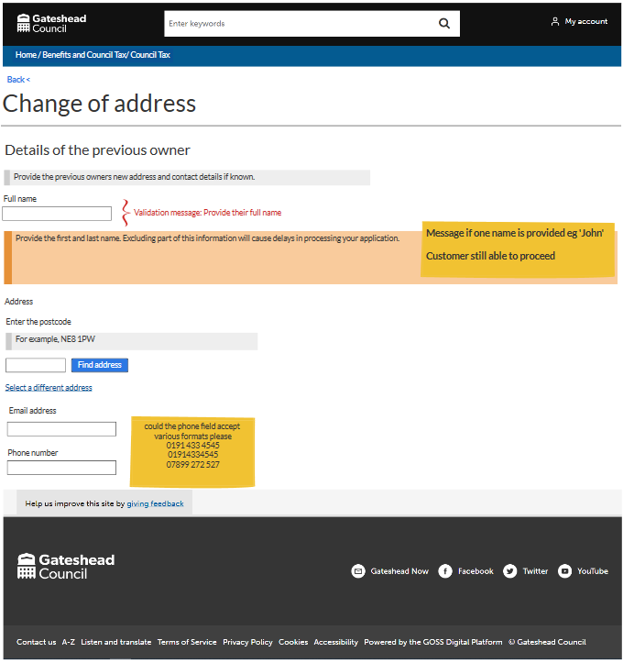
Sprint 41
Development
CT - Change of address

Slide 29
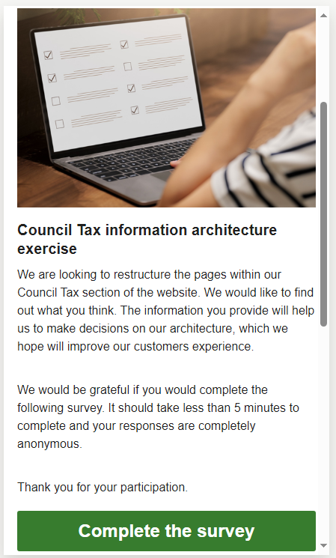
Sprint 41
Content
User research - Card sorting

Slide 30
Sprint 41
Development
Temporary traffic regulation order
Diversion route map and Final amendments

Slide 31
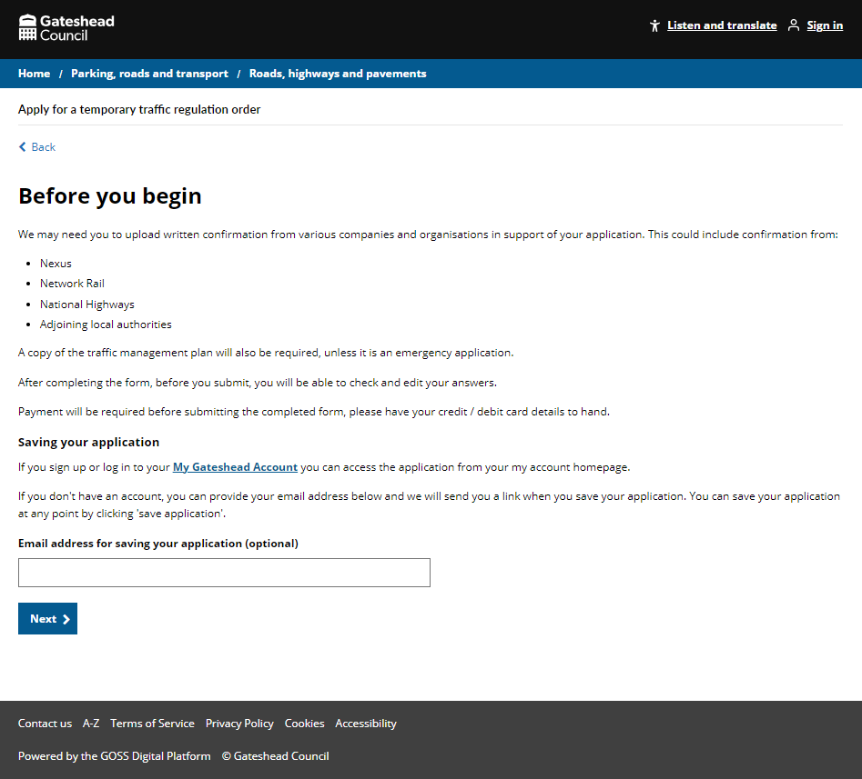
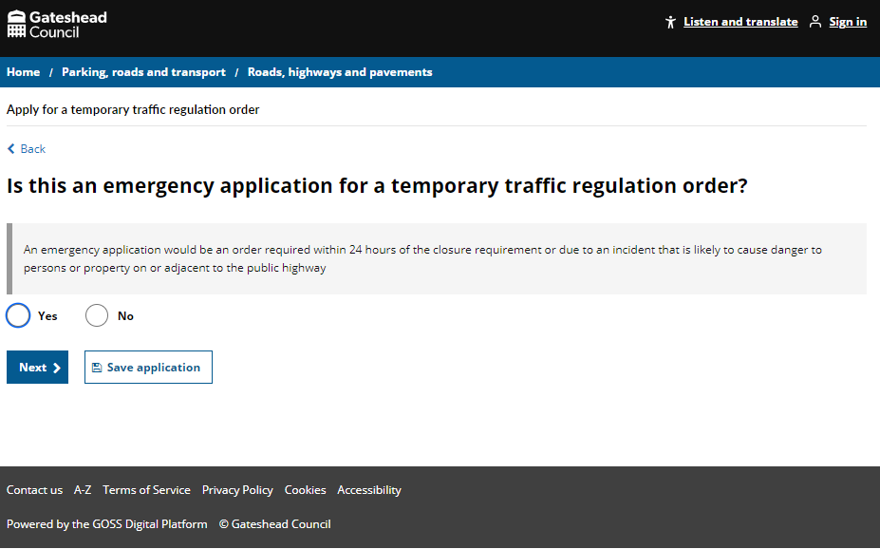
Sprint 41
Development
TTRO
Run through with the engineers in Highways
Nearly ready to pass for testing

Slide 32
Sprint 41
Development
The Temporary traffic regulation order form is the first live form to implement Multi-Pin map functionality.
Applicants can use the Multi-Pin map to mark their diversion routes by dropping multiple markers onto a map.
Diversion map

Slide 33
Sprint 41
Diversion map
Data Viewer
After implementing the Multi-Pin map, it became evident that the existing case management data viewer was limited.
To improve this, I created a Case Management “Map Data Viewer” form. This new form allows case managers to view a read-only version with Google Map controls instead of a static image.

Slide 34
Sprint 41
Diversion map
The initial approach sent data to the Map Data View form via query string parameters, but large data sets caused errors.
The solution was to pass only the business key and form data field name, saving readable data and retrieving it through an endpoint call in the Map Data View form.
Initial method
Method(s)
?data={Label,Lat,Lng,Text},{Label,Lat,Lng,Text},{Label,Lat,Lng,Text},{Label,Lat,Lng,Text},{Label,Lat,Lng,Text},{Label,Lat,Lng,Text},{Label,Lat,Lng,Text},{Label,Lat,Lng,Text}&type=LINE&center={Lat,Lng}&zoom=12
New method
?case=0000-0000-0000-0000&field=MAPDATA

Slide 35
Sprint 41
Diversion map
Modifications were made to the existing script to address unforeseen issues, including adding code for case management data and adjusting dynamic field relationships for multiple maps.
A separate JavaScript file was also created for the read-only view map.
Adjustments

Slide 36
Sprint 41
Diversion map
The new Multi-Pin map functionality and Map Data Viewer form greatly enhance the application process by allowing applicants to digitally plot routes.
This improvement simplifies route data entry, leading to a better user-friendly experience for applicants and the service area.
Conclusion

Slide 37
Sprint 41
Text
Scaffolding Permits

Slide 38
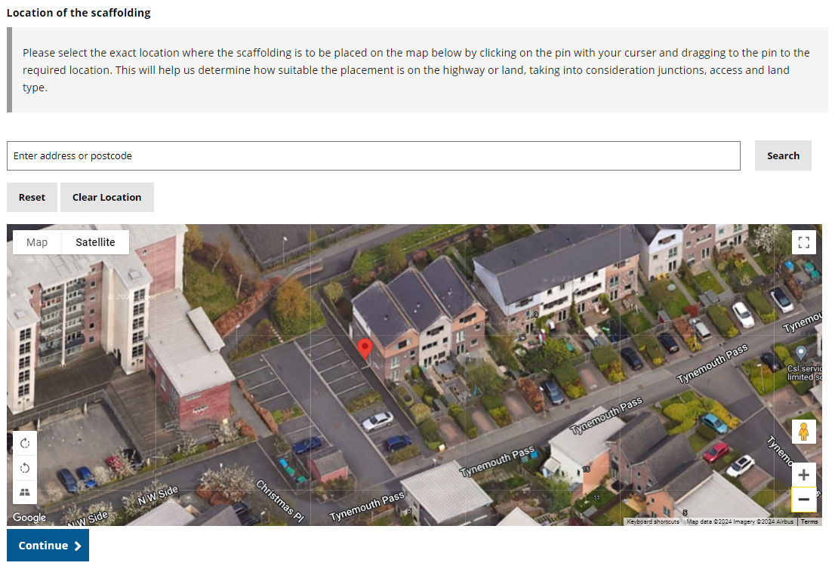
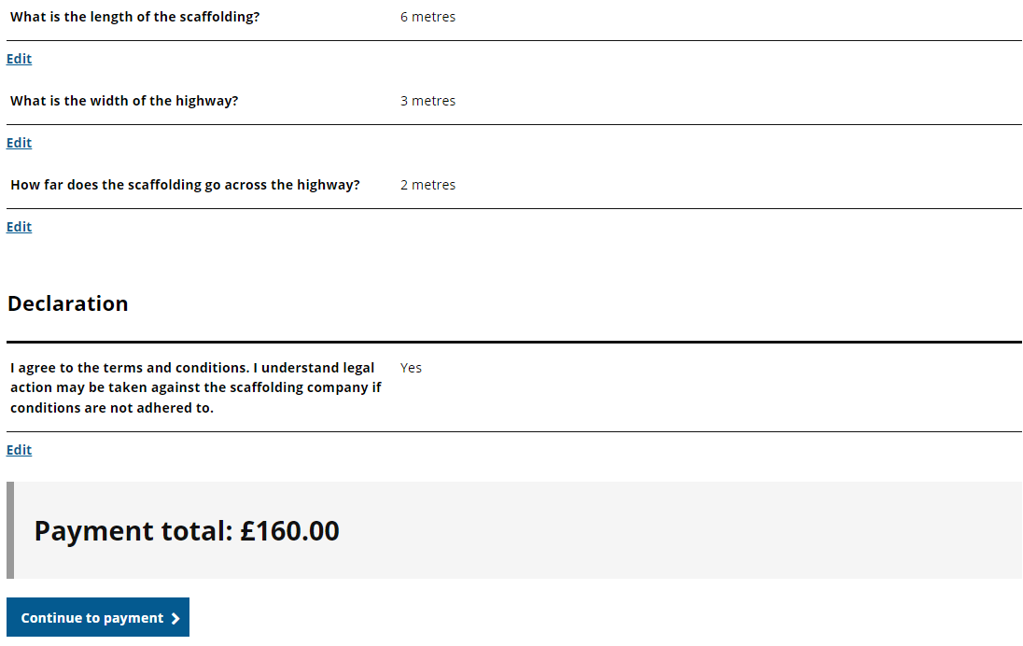
Sprint 41
Development
Updated with feedback from the code review and fixes from internal testing.
Pushed to preprod and handed over to the service for user acceptance testing.
Scaffolding permits

Slide 39
Sprint 41
Development
Household Support Fund: Added the ability to list up to 10 regular household expenses (DCE-10116) Housing contact form: Updated to ensure the address of the person is always collected and to list the reasons for contact in alphabetical order (DCE-10075 & DCE-9970) HWRC contact form: Updated with code review changes, emails are now sent from an endpoint ensuring that they are recorded within case management (DCE-9454) Flooding reporting form: Updated to ensure attachments are included in the email to the service (DCE-10134)
Other development

Slide 40
Sprint 41
Text
Digital services volumes

Slide 41
Sprint 41
Conclusion
What’s next?
Housing alterations wireframe
Mapping out Customer/ tenant account
Council Tax Support – UC wireframe only development
Severe Mental Impairment form build
Student exemption form build

