Slide 1
Sprint 43 Show and Tell 7 August 2024
G Squad
Digital Team

Slide 2
Sprint 43
Introduction
Sprint goals
Council Tax SMI and Student form development
NEC / My Account integration
TTRO final amends
Minor works and adaptations discovery

Slide 3
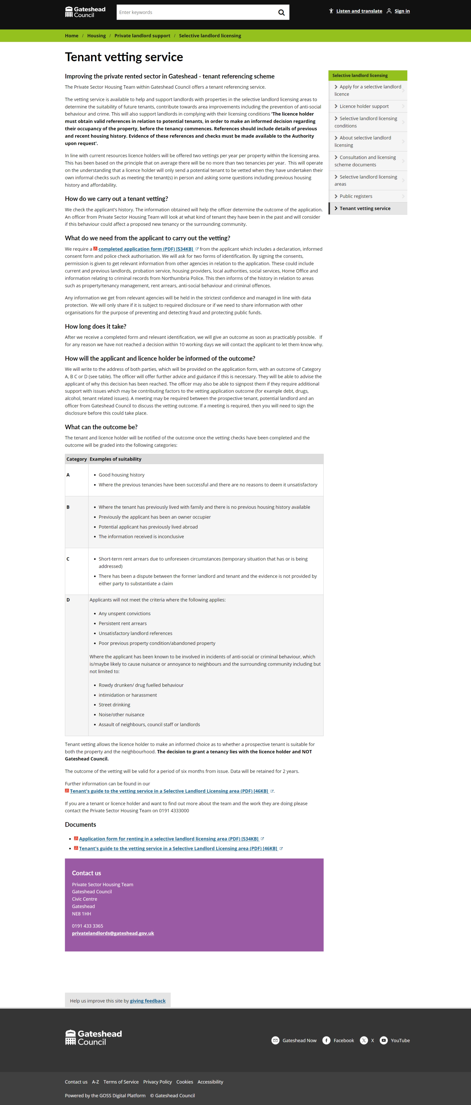
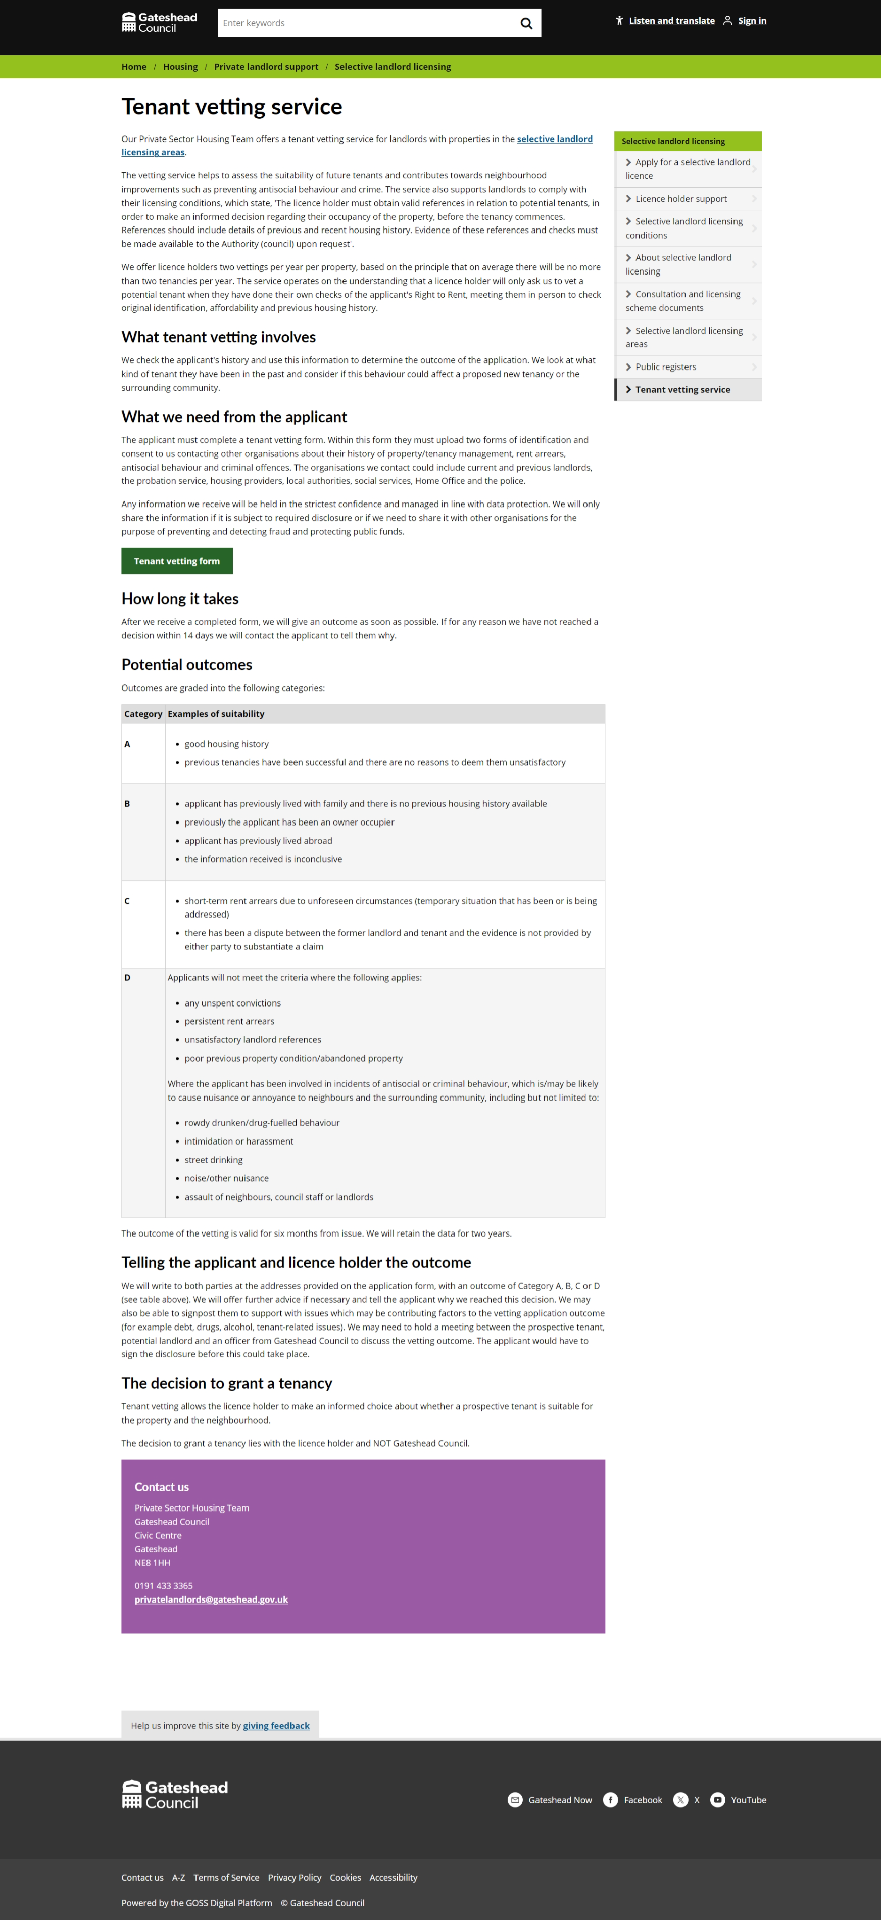
Sprint 43
Tenant vetting
Content

Slide 4
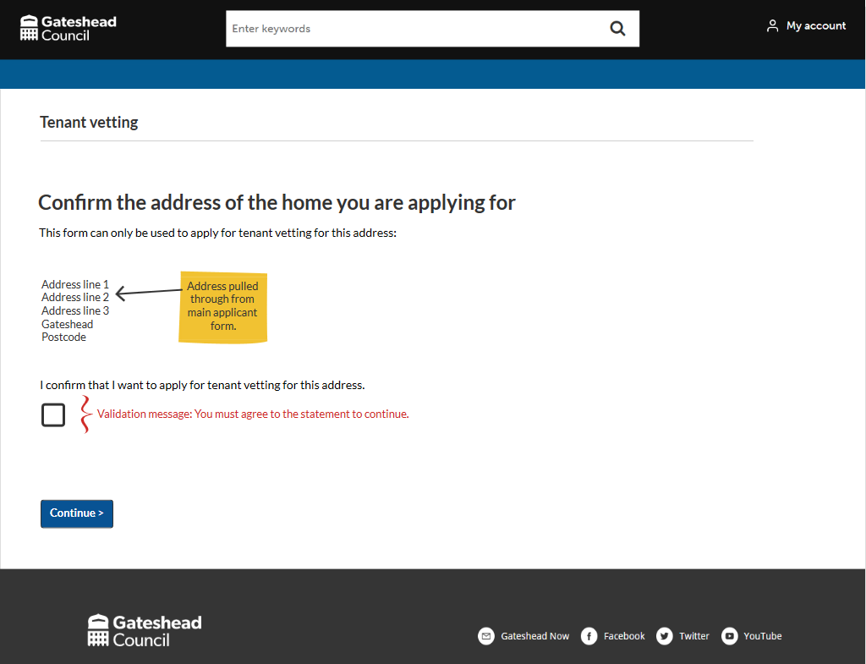
Sprint 43
Wireframe
Tenant vetting
'Other household member' form Asks for confirmation of address first
Showstopper

Slide 5
Sprint 43
Wireframe
Tenant vetting
Form frontloaded to confirm compliance and eligibility first

Slide 6
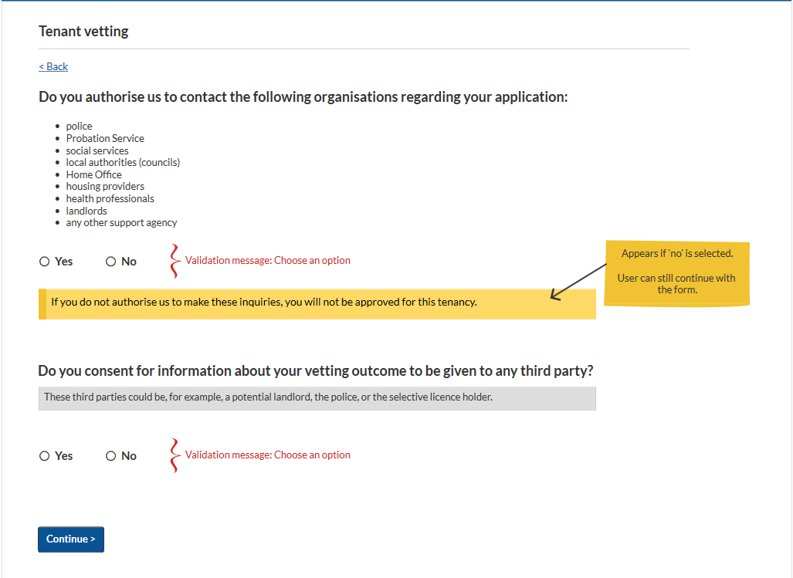
Sprint 43
Wireframe
Tenant vetting
Form frontloaded to confirm compliance and eligibility first

Slide 7
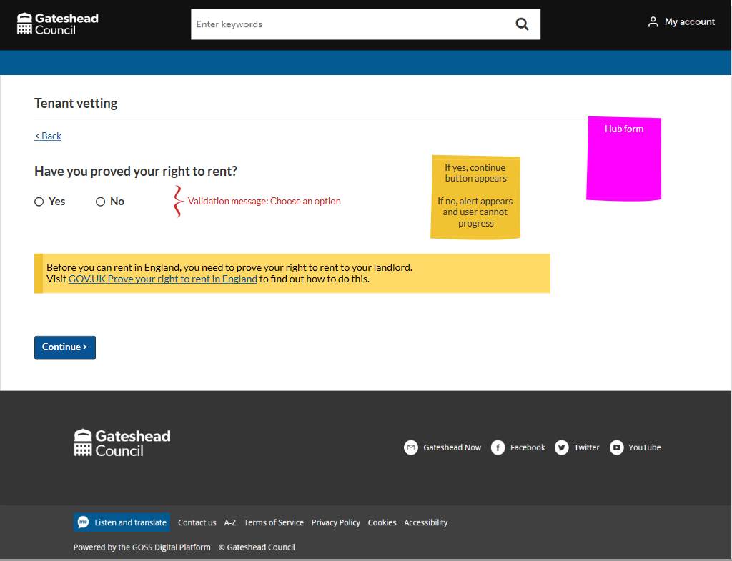
Sprint 43
Wireframe
Tenant vetting
Form frontloaded to confirm compliance and eligibility first

Slide 8
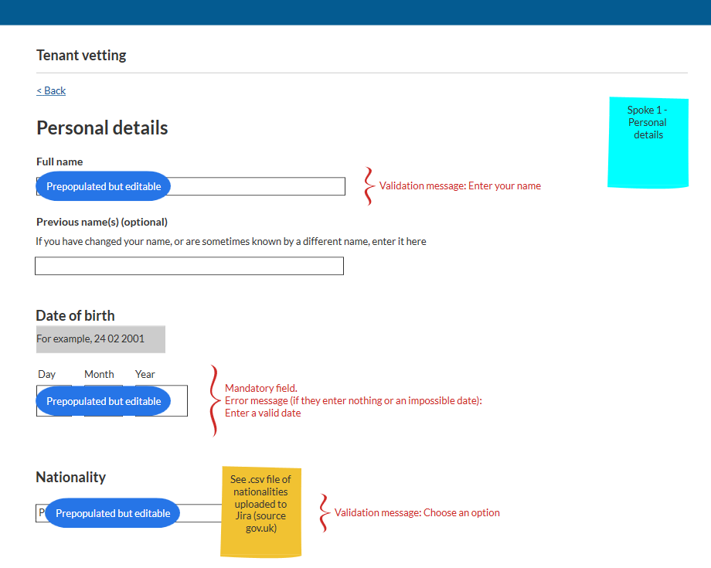
Sprint 43
Wireframe
Tenant vetting
Pulls through content provided by main applicant

Slide 9
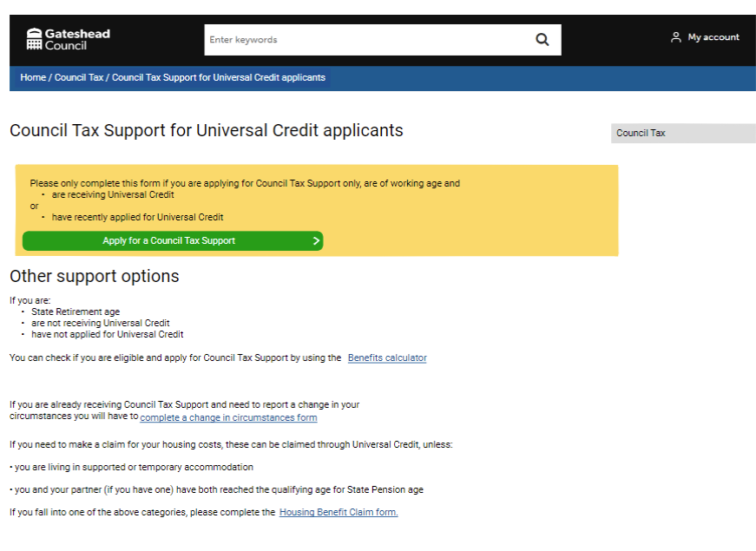
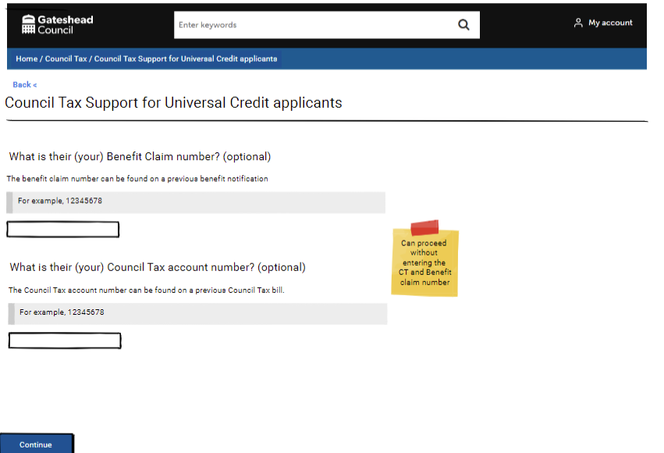
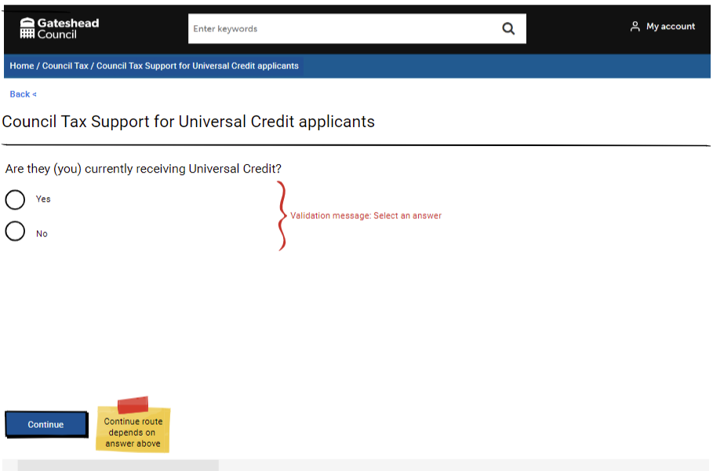
Sprint 43
Wireframe
Council Tax
Shorter Council Tax Support claim form designed for Universal Credit claimants
Collects less information to encourage more people to claim Council Tax Support if they are in receipt of or have applied for Universal Credit.

Slide 10
Sprint 43
Council Tax
Continuing with the change of address wireframe
Single person discount, apply and cancel. Council Tax team testing
Student discount form development
Severe mentally impaired form development

Slide 11
Sprint 43
Council Tax
Council Tax discount for students demo

Slide 12
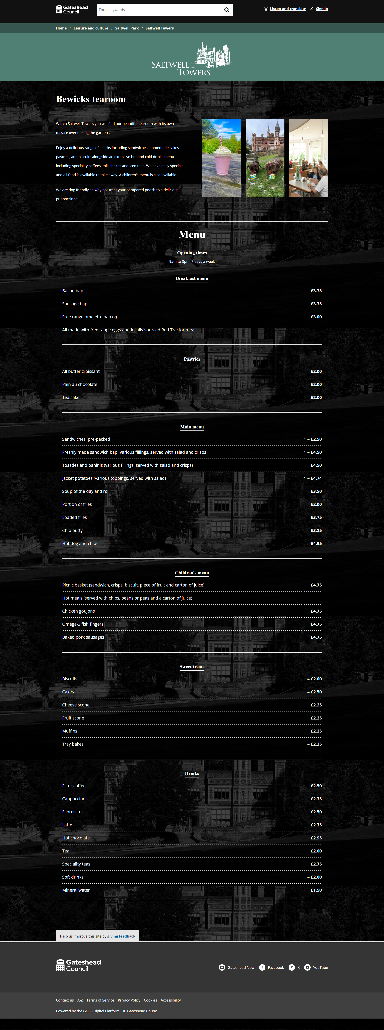
Sprint 43
Design
Saltwell Towers
This sprint I have been working on the design of Saltwell Towers pages to help promote their services.

Slide 13
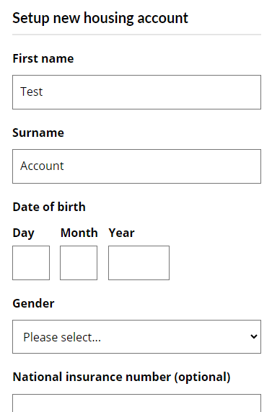
Sprint 43
Development
MyHousing
We have advanced the MyHousing APIs to allow new account creation via GOSS forms, syncing details like name, address, and contact information.
This involves using Northgate's address APIs to find existing address records or create new ones as needed.
Demo

Slide 14
Sprint 43
Development
My Account
Enhancements have been made to My Account to improve load times and reduce server calls.
These improvements have resulted in a 2-second reduction in load times.
Additionally, logic has been implemented to retain the Content preferences settings.
Demo

Slide 15
Sprint 43
TTRO
Temporary Traffic Regulation Order
Form ready for deployment

Slide 16
Sprint 43
Other development
Blue badges: Improvement to the staff view to make the display of existing badges clearer. Improvement to the Blue Badge creation process so that the system waits for confirmation from Valtech when a badge is ordered (David Cassidy).
Household Support Fund: Addition of 'Funded by UK Government' branding to the application form and automated emails.
Scaffold permits: Cases automatically close if a permit application has been rejected.
Addition of a permit end date which is automatically calculated and pulled into the permit email when a permit is issued.

Slide 17
Sprint 43
What’s next?
Universal Credit Council Tax Support form development
Tenant vetting form development
Housing alterations (continue with wireframe)
Update to Housing contact form
Council Tax discount form development (Unpaid carer and moved out to receive personal care)
Improvements to website search

