Slide 1
Sprint 44 Show and Tell 14 August 2024
C Squad
Digital Team

Slide 2
Sprint Goals
Make improvements to waste service operations
Start fact finding for Children’s Services web structure review

Slide 3
Sprint goal 1 - Make improvements to waste service operations

Slide 4
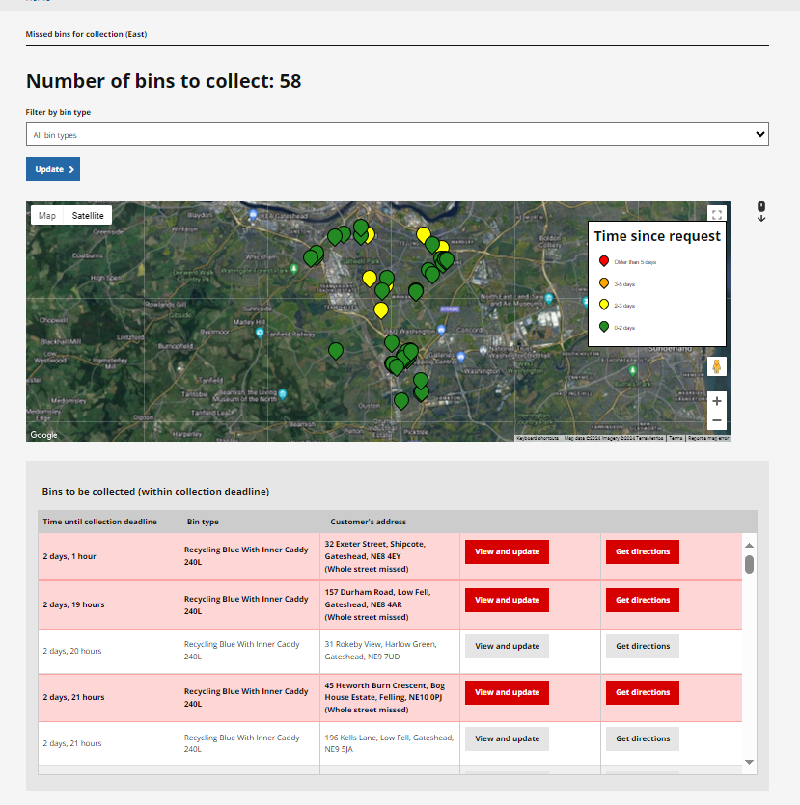
Make improvements to waste service operations
Gave Brian Drummond access to all waste services dashboards​ - missed bins, bin delivery, bulky waste / special collections
This allows Brian to view all individual cases rather than needing to use the search function

Slide 5
Make improvements to waste service operations
Updated the customer emails for missed bin collections:
Added a new template for customers with assisted collections as the current email advised them to put their bin out for collection
Changed 'next working day' to 'next day (Monday to Saturday) as the service now collect missed bins on Saturdays

Slide 6
Sprint goal 2 - Start fact finding for Children’s Services web structure review

Slide 7
Start fact finding for Children’s Services web structure review
Link to Miro board: Children's social care web pages - Miro
Met with Karen Graham & Melanie Maitland
Previous public consultation carried out by Alex Thompson on Local Offer site – reviewing findings

Slide 8
Children's

Slide 9
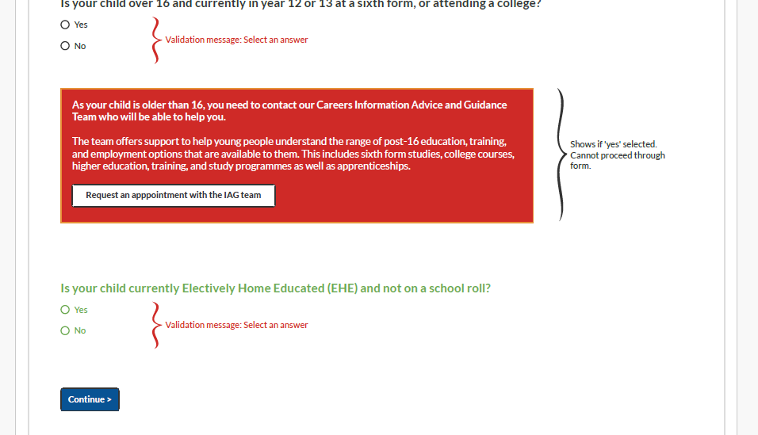
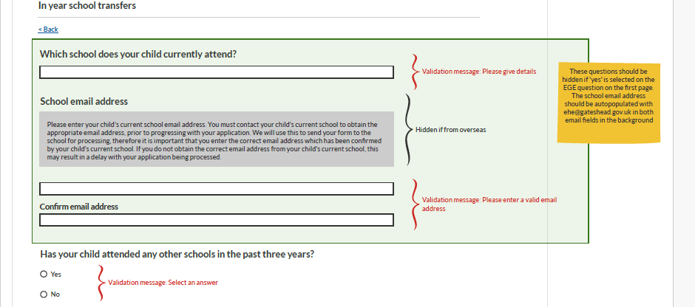
Wireframe to include Electively Home Educated (EHE) children in the current In Year School Transfers process
Added a question to the current process to allow parents with EHE children to request a transfer into school during the school year
Certain questions within the form are hidden if this option is selected

Slide 10
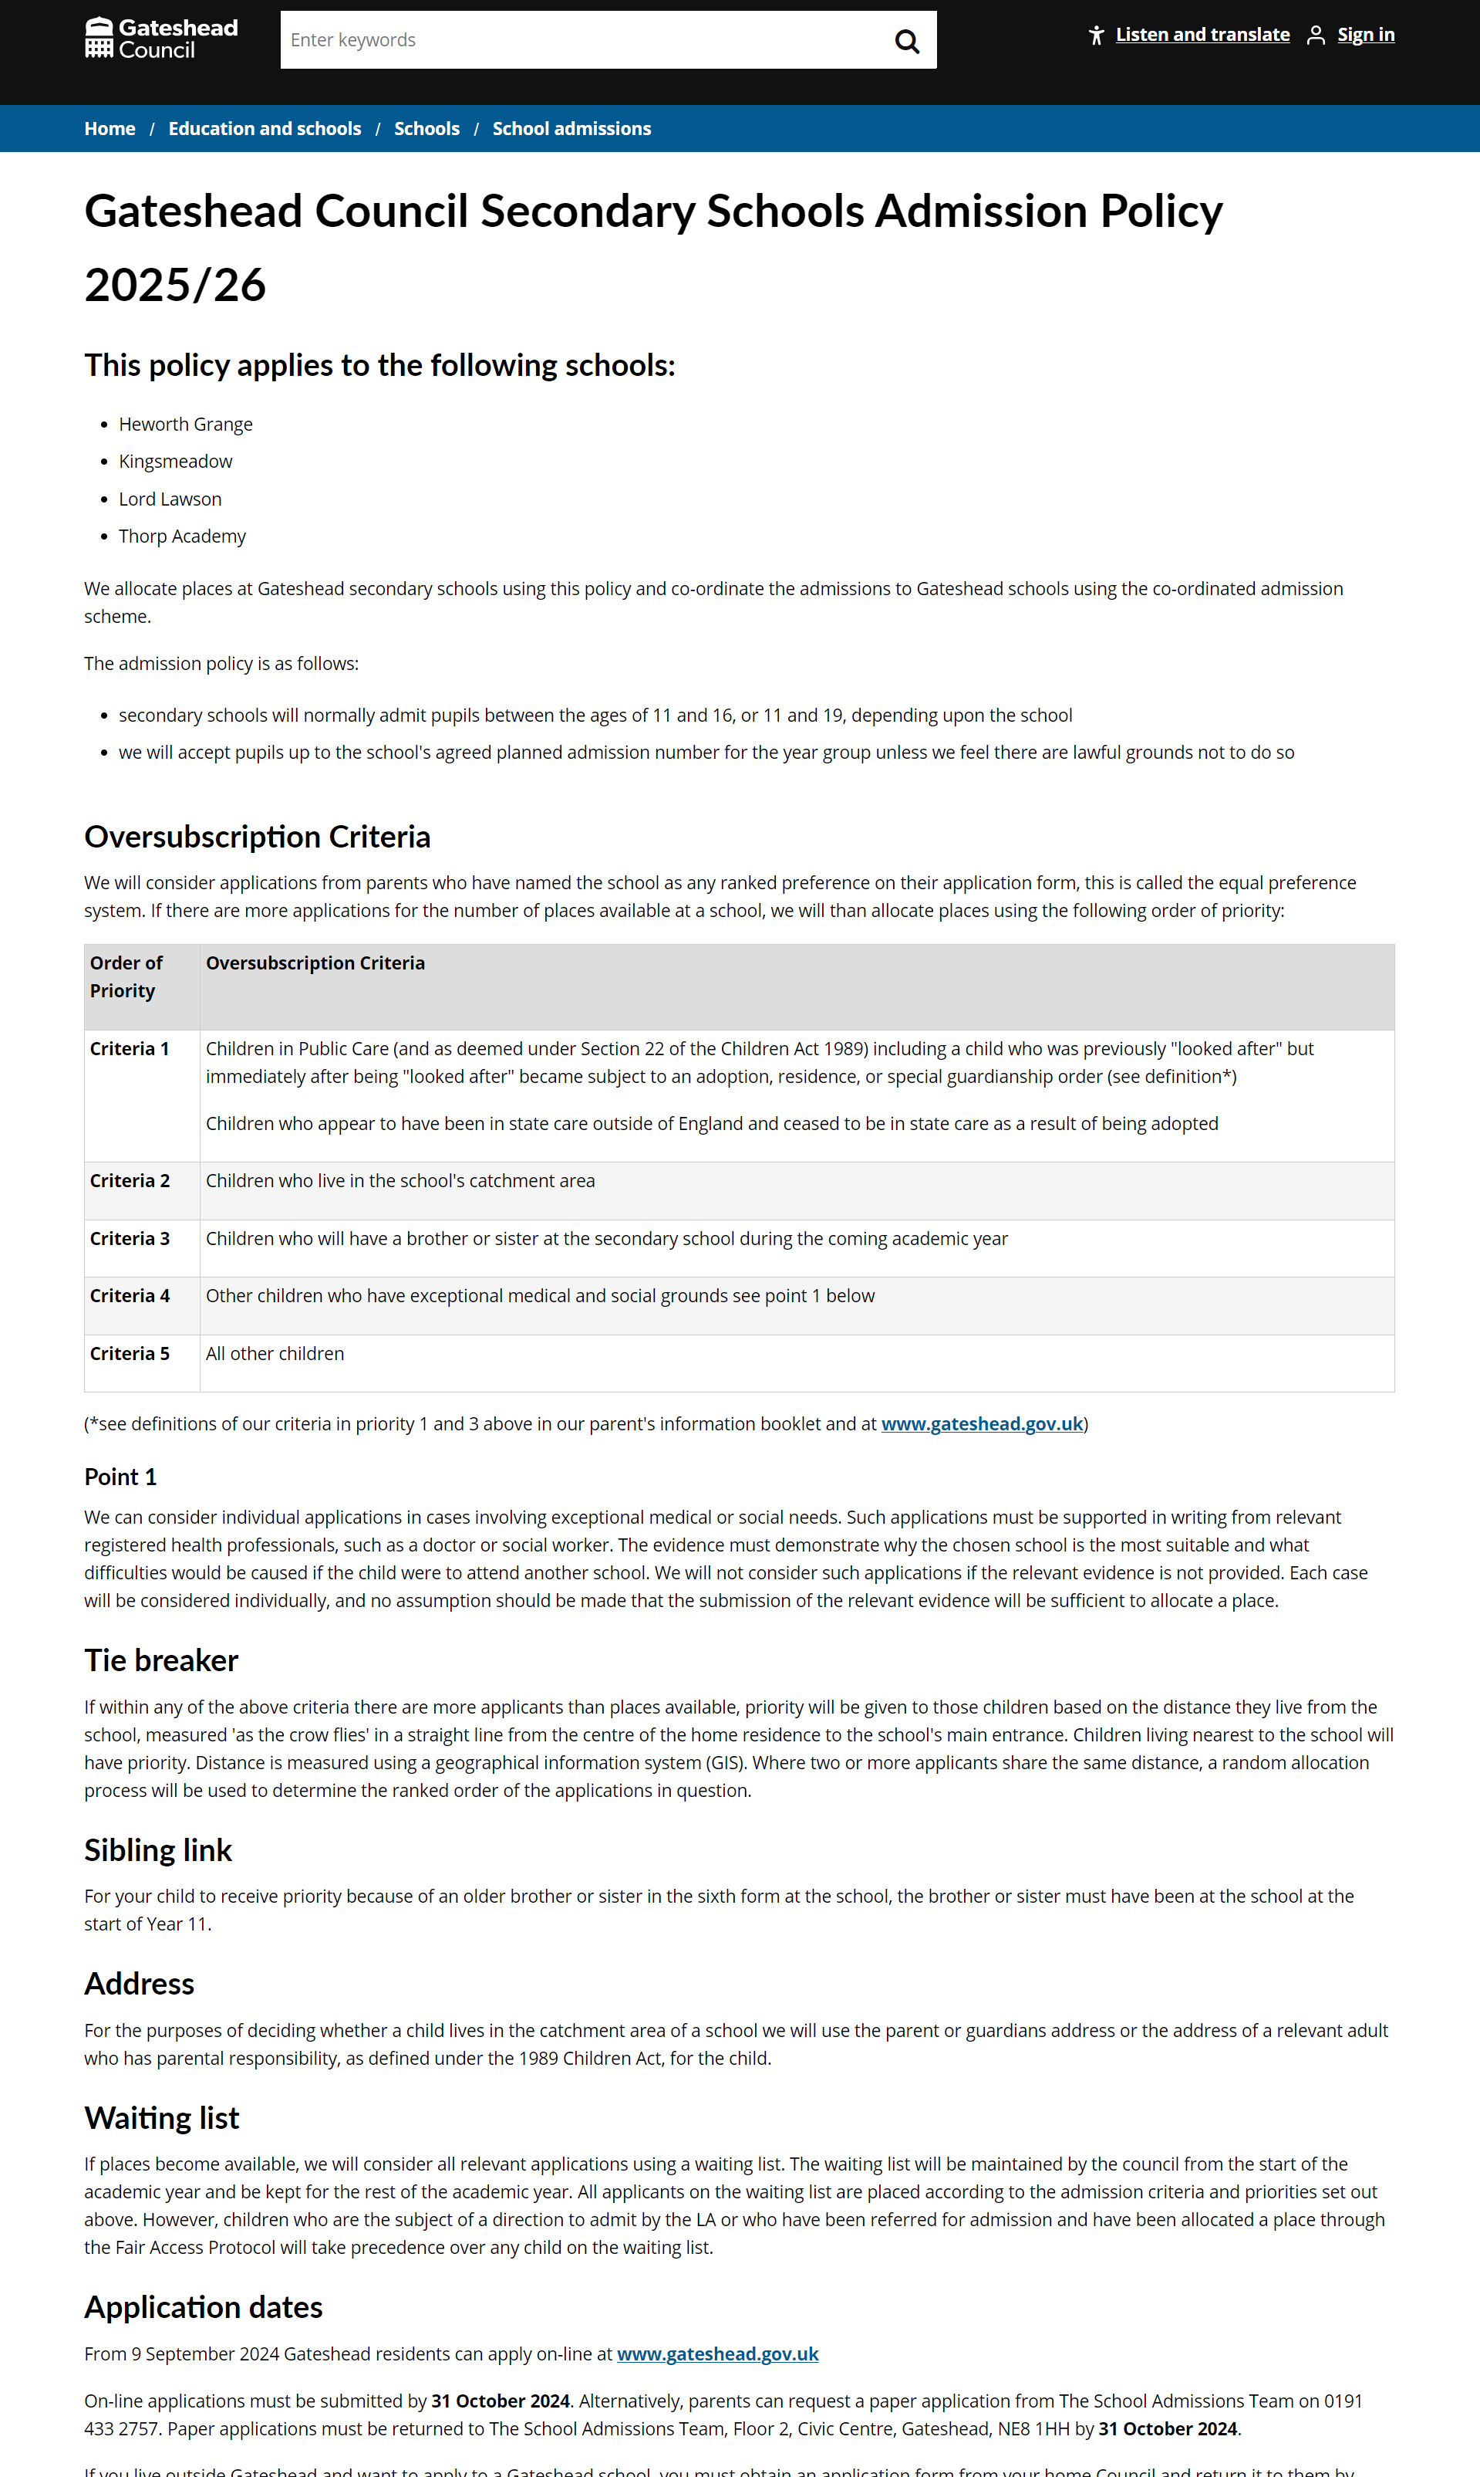
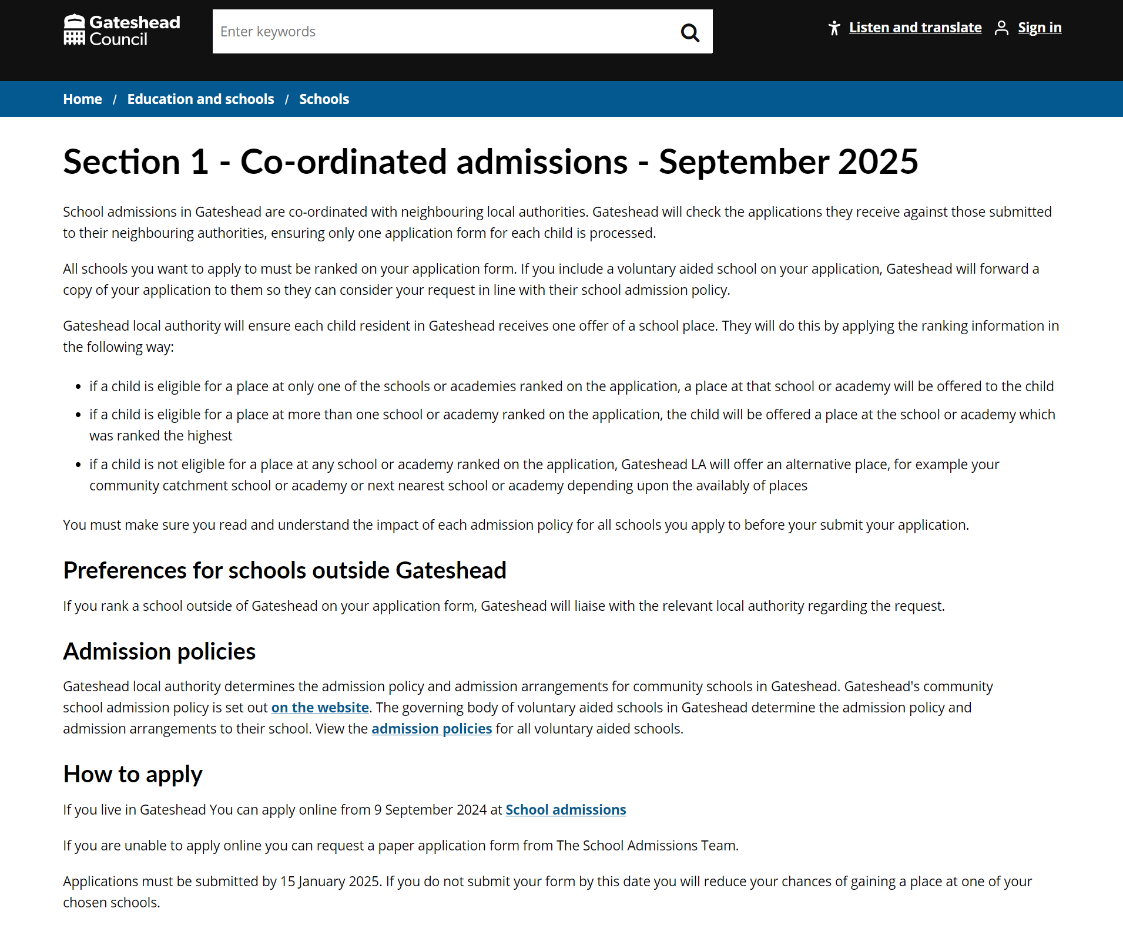
School admissions updates and other schools' updates
Updating content across primary and secondary school admissions pages – scheduled to go live on 2 September 2024
Continuing content updates following on from the content audit
Beginning to look at updating school meals menus ready for the new school year

Slide 11
Corporate

Slide 12
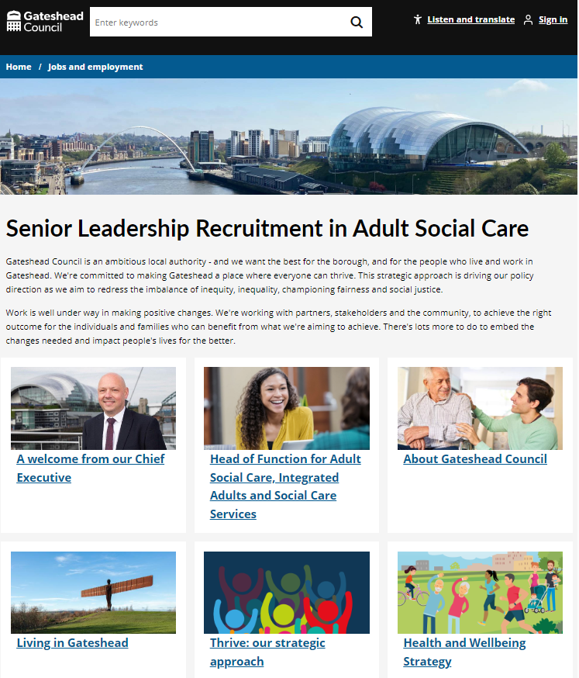
Microsite for senior leadership recruitment – adult social care
Developed senior leadership microsite for new head of function role in adult social care.
Worked with North Yorkshire Council (who are leading on recruitment) to develop the site.
Senior Leadership Recruitment in Adult Social Care

Slide 13
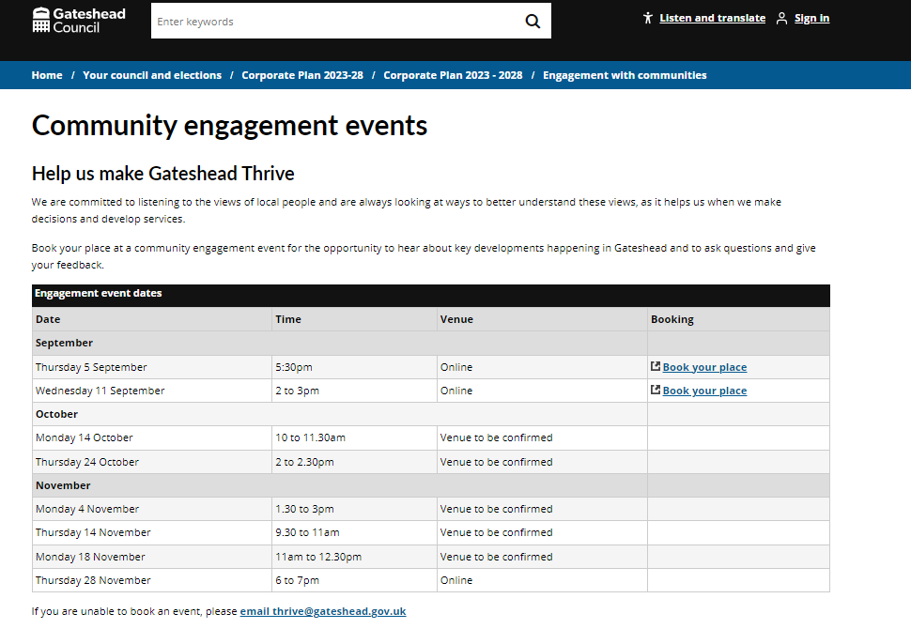
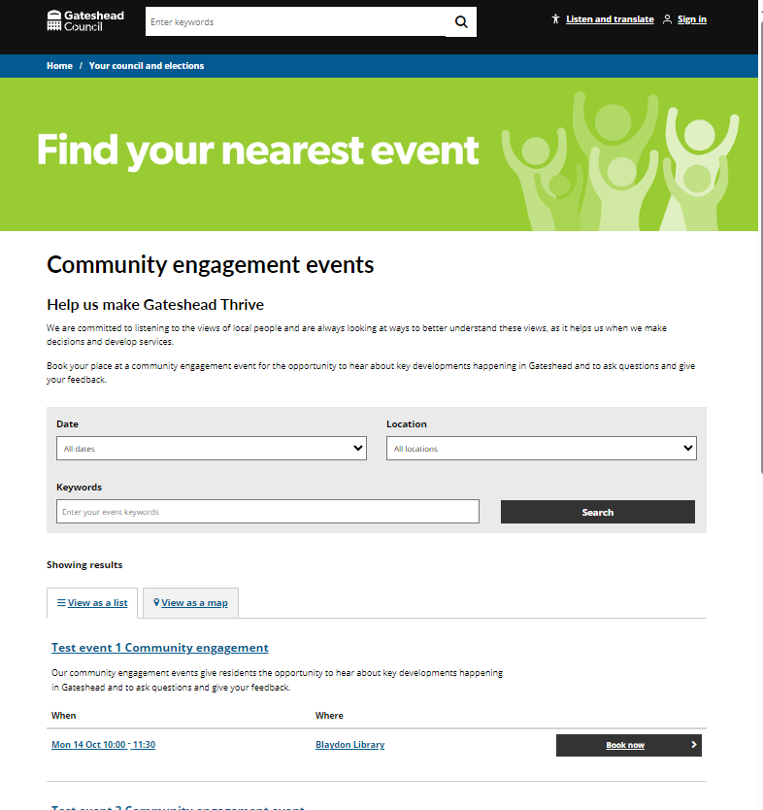
Community engagement events hosted on bookings platform
Corporate community engagement events hosted on our website but bookable via Ticketsource
Working with communications to bring all events from October on to bookings platform to go live in September.
Set up test events until final venues and capacities confirmed.
Community engagement events

Slide 14
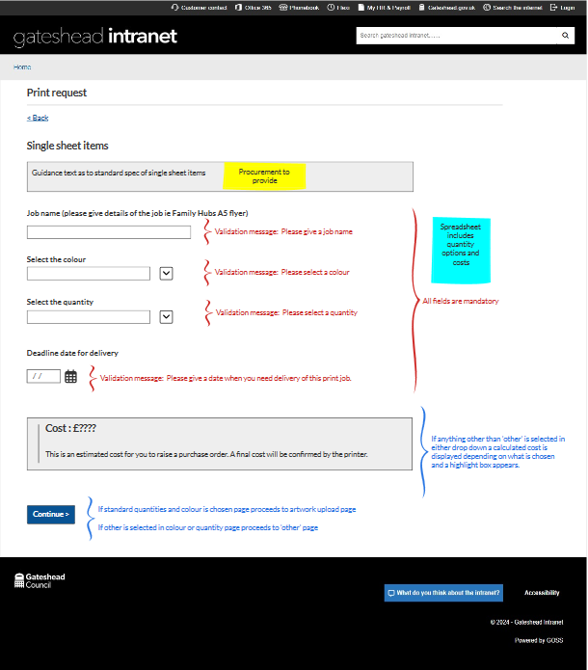
Print ordering wireframe
Developing a new digital process for procurement so that employees can order their own print.
Users will be able to see a cost up front populated from an agreed pricing structure from the print framework and place an order direct with the printer.
Wireframe developed and with the service.
Aim to go live end of October.

Slide 15
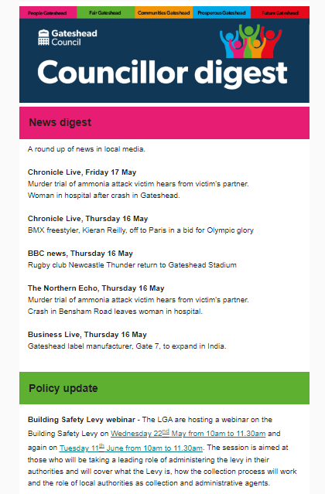
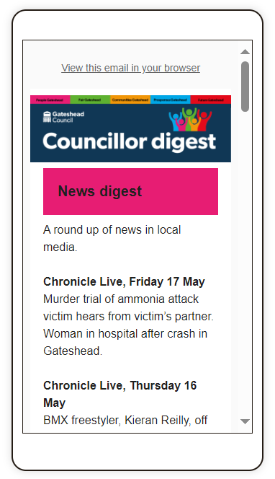
Daily Councillor digest email
Finalised design for daily Councillor digest email

Slide 16
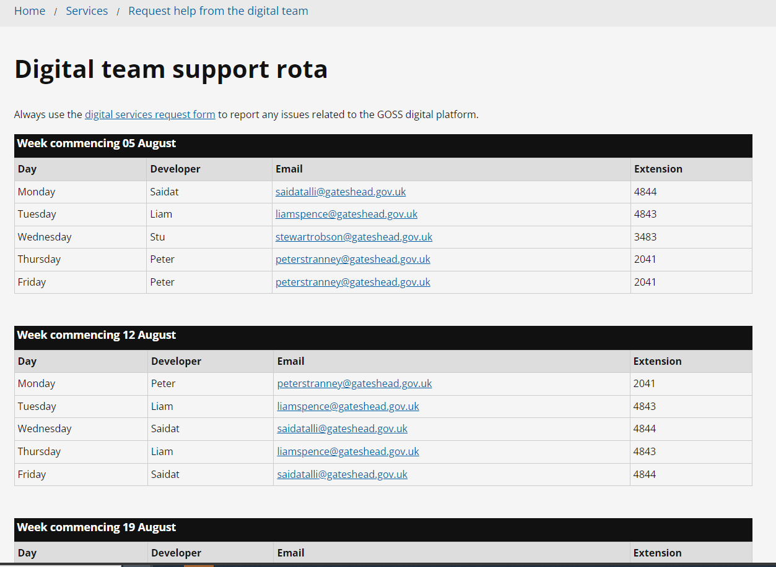
Digital team support rota
Added a page for the Digital team support rota to Customer Contact
Added alongside the request help form, visible to the Digital team and Customer Services staff
customercontact.gateshead.gov.uk/digitalteamsupport

Slide 17
Design

Slide 18
Design
Gateshead Theme – Add styling for smaller form legends
Gateshead.gov.uk - Config for site search to improve results
Google analytics – Created dashboard for Children's social care

Slide 19
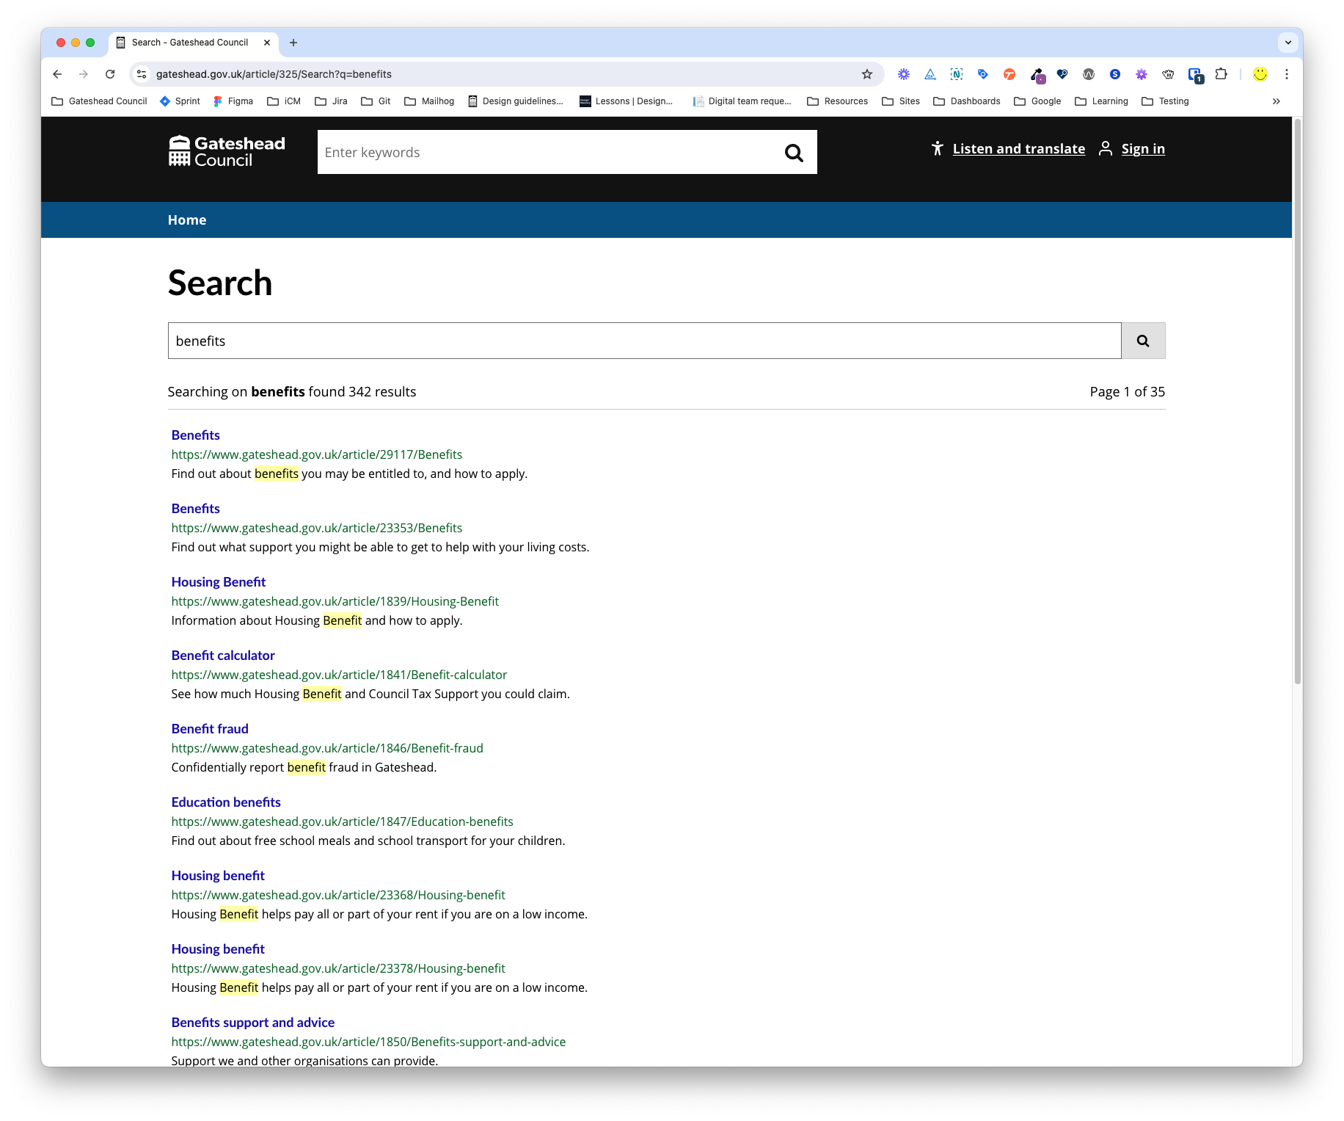
Sprint 44
Config
Create redirect articles to the root articles
Move redirect articles to a hidden sub folder
Add redirects to the searchable articles list in article 325 extras
Make sure all root articles are added to the search article 325 extras
Boost redirect articles in the search
Add summary text to the redirect articles
Gateshead.gov.uk site search config

Slide 20
Content

Slide 21
Content
Riverside Routes events added to libraries and Tyne Derwent Way what's on
Summer of cycling events added to Tyne Derwent Way website
Gateshead Now issued – 14 August
Creation of 2 new webpages for VCSE Small Grants Project
Updates to the IT services intranet section

Slide 22
Deployments

Slide 23
Development
Section 50 generated from taxi vehicle test

Slide 24
Development

