Slide 1
Sprint 45 Show and Tell 21 August 2024
G Squad
Digital Team

Slide 2
Sprint 45
Areas of focus
Council Tax forms and content
Sheltered Housing
Housing Alterations
Housing contact form
Account deduplication using AI

Slide 3
Sprint 45
Council Tax forms update
Live
Single person discounts – apply and cancel
Testing
Severely mentally impaired
Wireframe
Contact and triage form
Development
Student discounts
SMI form (DC)

Slide 4
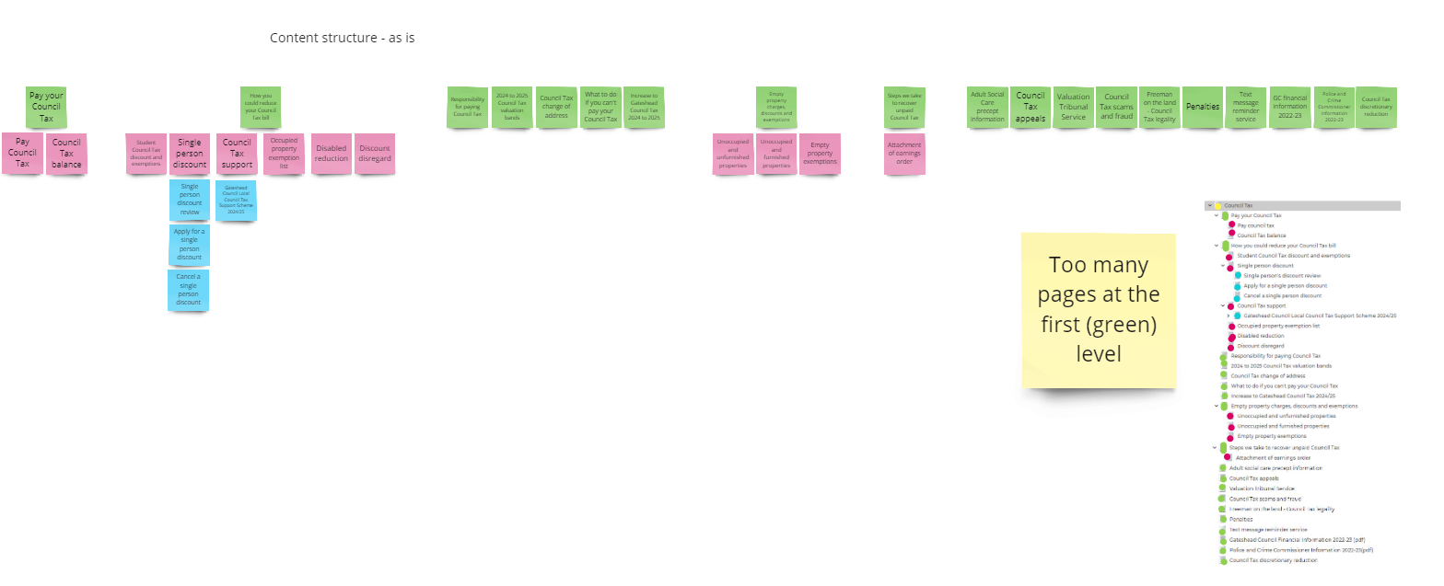
Sprint 45
Council Tax content plan
Content

Slide 5
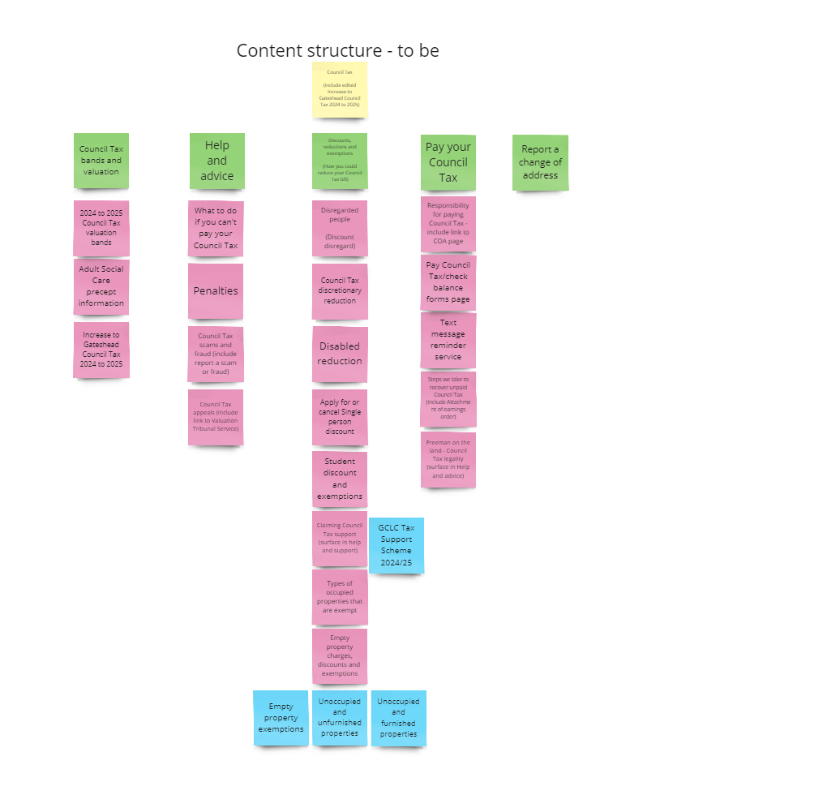
Sprint 45
Content
Council Tax content plan

Slide 6
Sprint 45
Design
During this sprint, a live design for the Sheltered Housing web pages has been developed. The design prioritises simplicity in content editing and setup, using only CSS for styling. It also incorporates inline galleries and tables to improve both the layout and overall design.
Sheltered Housing

Slide 7
Sprint 45
Wireframe
Housing Alterations
Current process is done via post/email
All alterations have to be approved
Reduce admin burden (fast track)
Reduce unauthorised alterations (slow response is often taken as agreement)
Keeps a record of requests
Eight case types
Integrates with NEC (APIs now functioning)

Slide 8
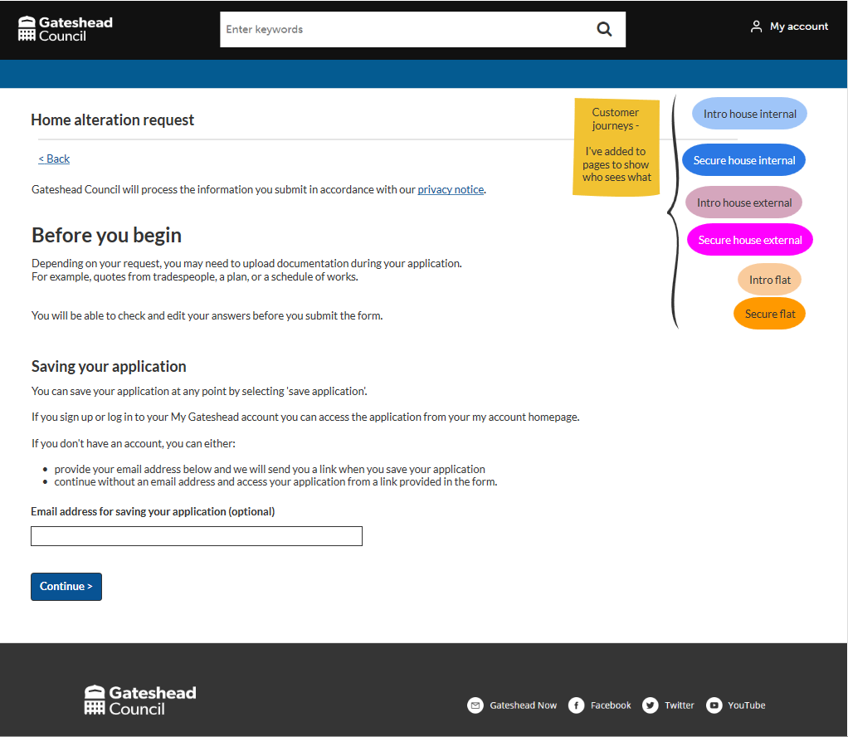
Sprint 45
Wireframe
Housing Alterations
What you'll need
Customer journey types
Showing fast-track secure flat type

Slide 9
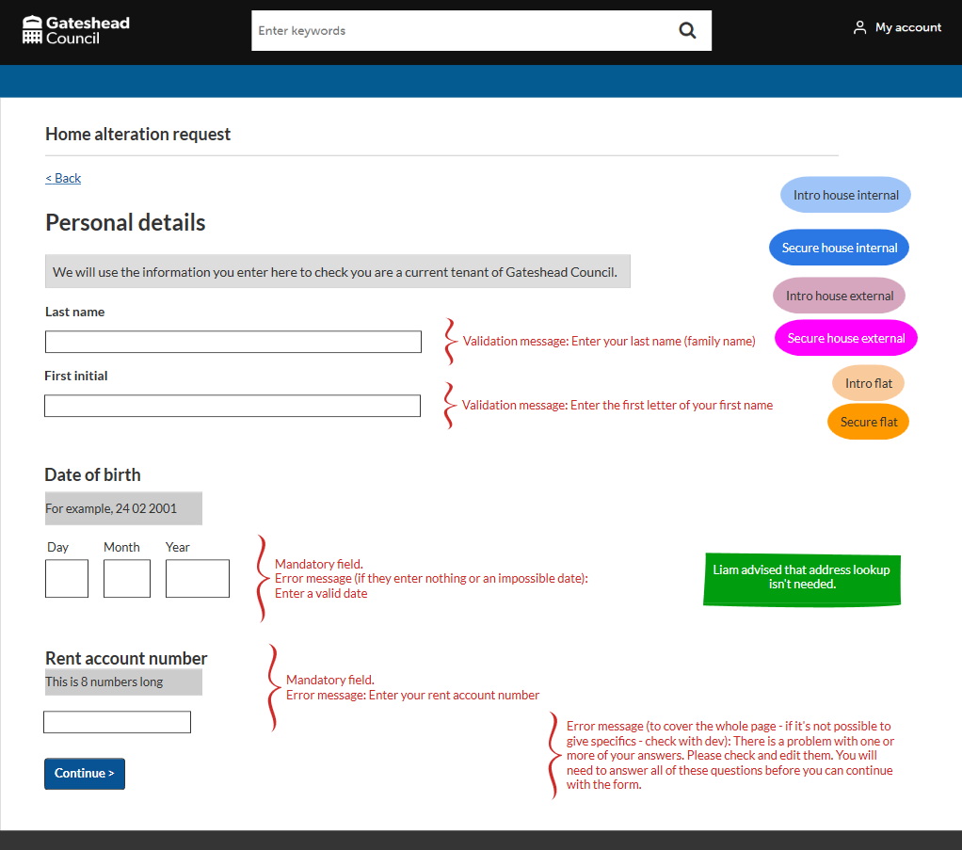
Sprint 45
Wireframe
Housing Alterations
NEC integration tells form which journey they are on

Slide 10
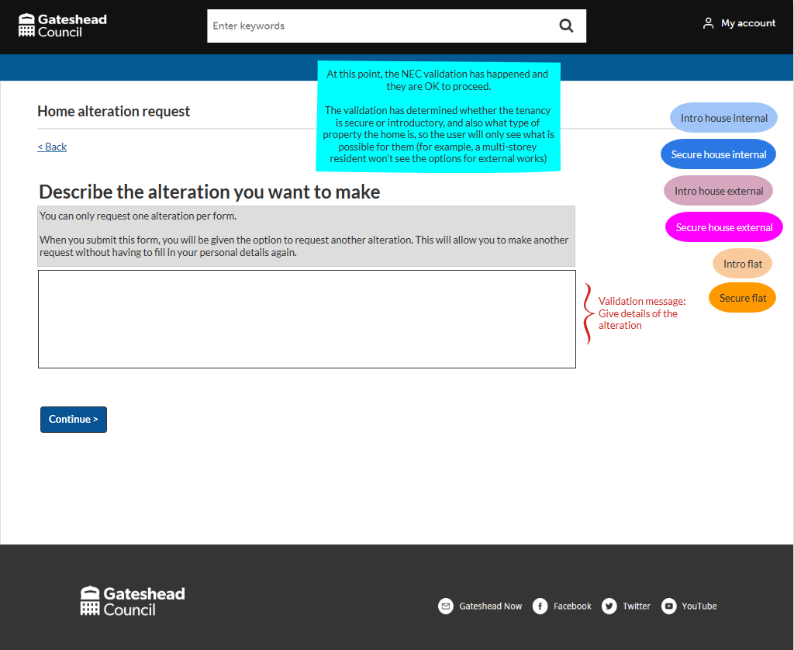
Sprint 45
Wireframe
Housing Alterations
All users asked this upfront

Slide 11
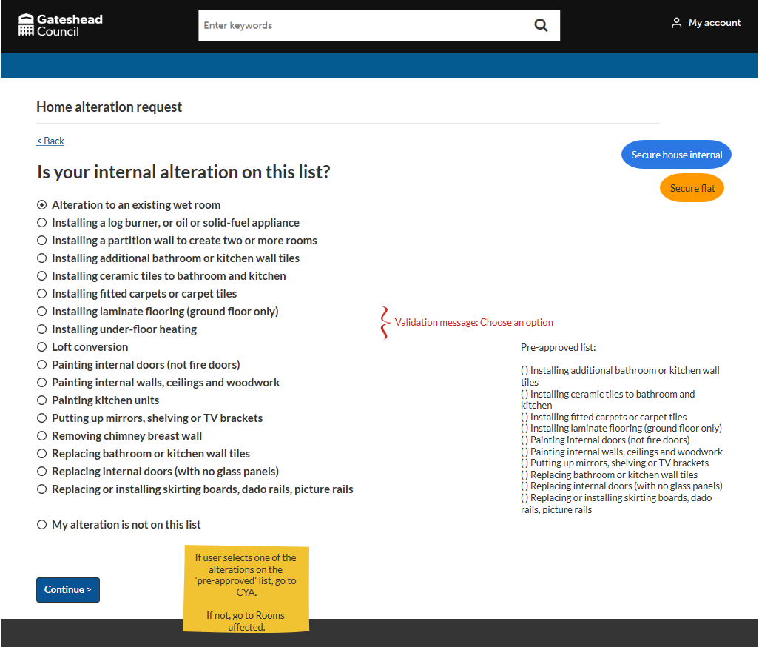
Sprint 45
Wireframe
Housing Alterations
Skipped 'internal or external' question
List includes pre-approved alterations and prohibited ones
Choosing a pre-approved option takes user to CYA, skipping questions about which rooms are affected and trades/contractors

Slide 12
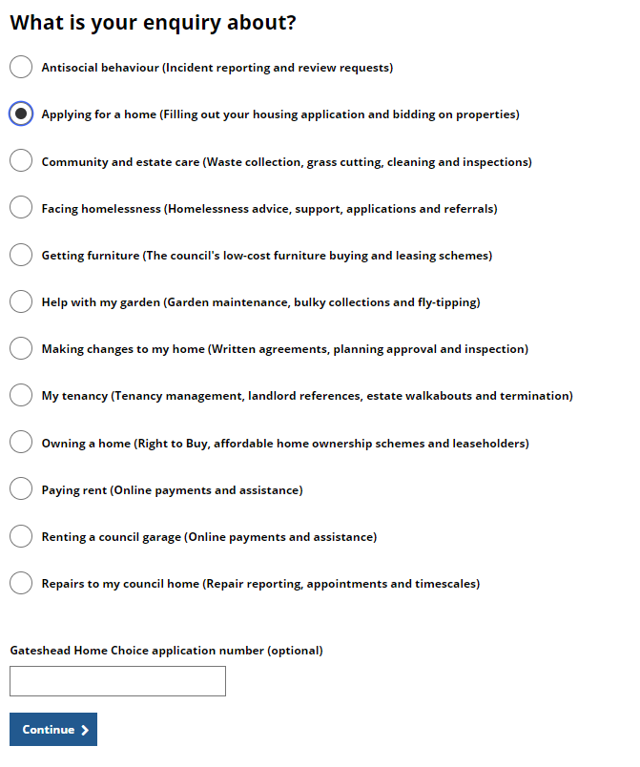
Sprint 45
Development
Housing contact form
The housing contact form has been updated to collect the Gateshead Home Choice application number if the query is about 'applying for a home'

Slide 13
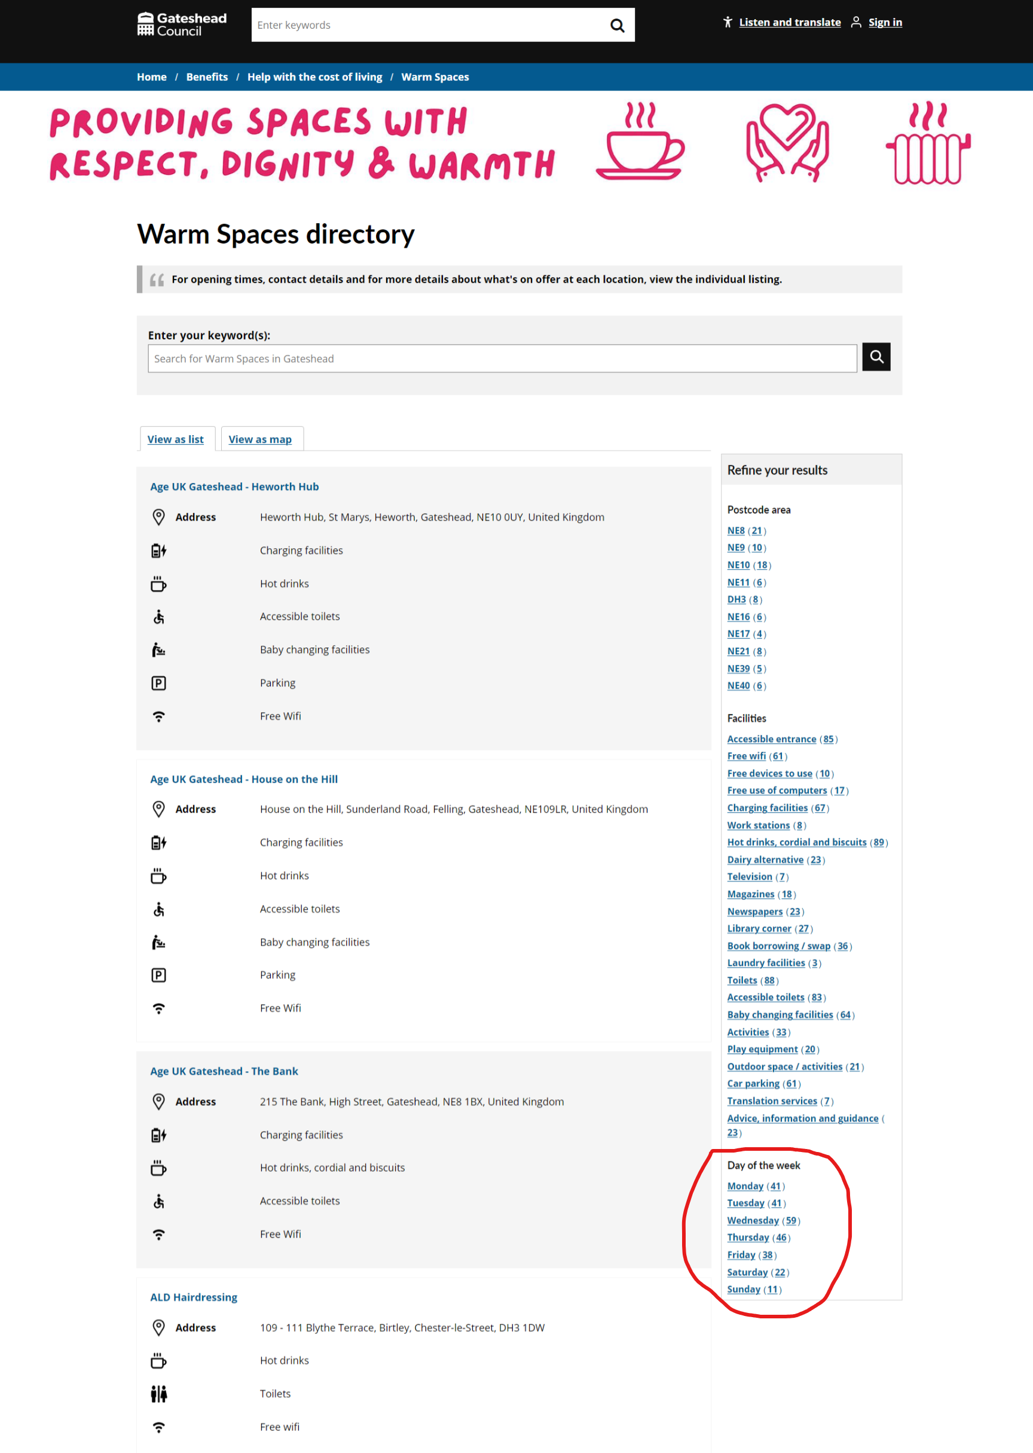
Sprint 45
Content
Warm Spaces
Filter added for days of the week

Slide 14
Sprint 45
Data (Science)
Account Deduplication
Initial Analysis in previous Sprint
How can we identify duplicates on an on-going basis?
Develop an automated solution that provides consistent results on a reliably.
Implement a machine-learning based solution

Slide 15
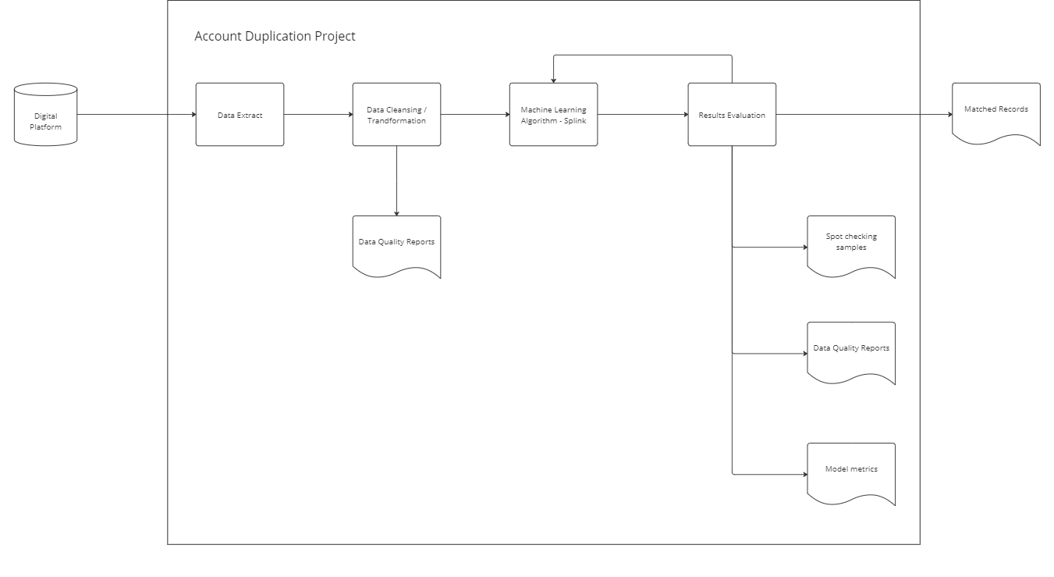
Sprint 45
Data (Science)
Account Deduplication

Slide 16
Sprint 45
Data (Science)
Account Deduplication
Define what rules are indicative of a duplicate
Records with the same email
Records with the same name
Records with the same address
Define how it should compare different bits of information
Exact match
String distance metrics - measure differences in strings
Specialised options for specific data (emails, post codes, dates of birth)

Slide 17
Sprint 45
Data (Science)
Account Deduplication
Processing 142,068 user records
Based on current model parameters:
Model output 118,8597 clusters of matching records
Clusters with more than one matching record: 17,673
Current duplicate estimate: 17%

Slide 18
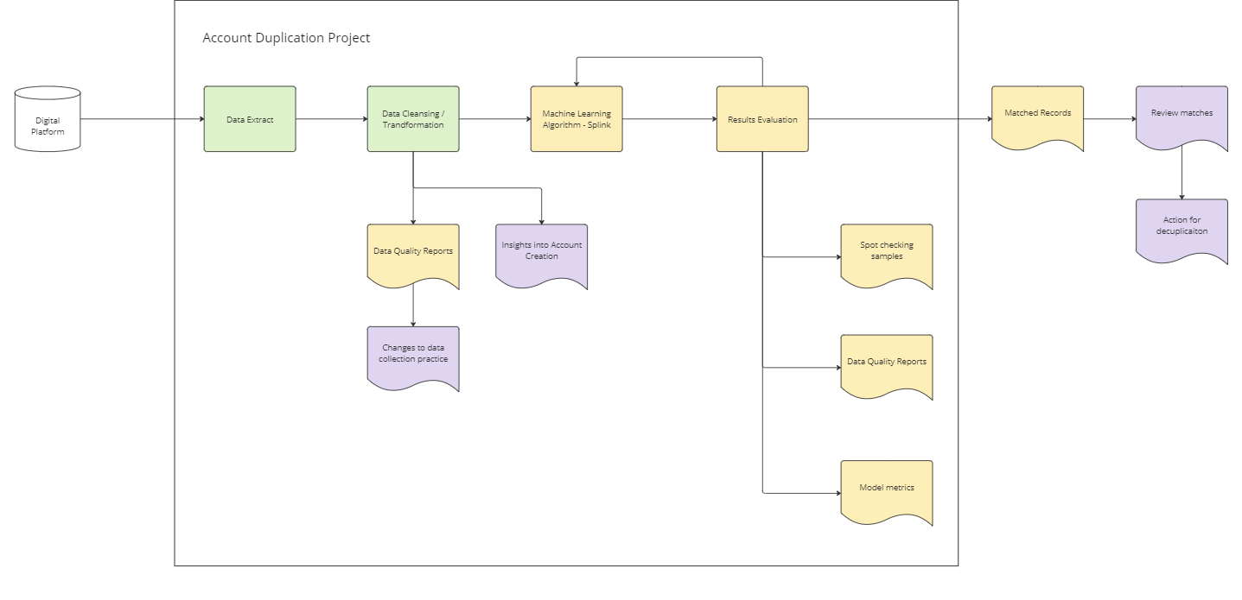
Sprint 45
Data (Science)
Account Deduplication

Slide 19
Sprint 45
Other development
Scaffold permits application live
Waste and Recycling Visitor Education Centre new web content and query/book a visit form
Bridges ward by-election web and Customer Contact content

Slide 20
Sprint 45
What’s next?
Ex Offenders housing request wireframe
Council Tax general discounts (smart snippets)
Minor works discovery
Complaints

