Slide 1
Sprint 46 Show and Tell 28 August 2024
C Squad
Digital Team

Slide 2
Sprint Goals
Complete qualitative analysis of preferred billing method survey results.
Update schools content for new term starting

Slide 3
Sprint goal 1 – Complete qualitative analysis of preferred billing method survey results

Slide 4
Complete qualitative analysis of preferred billing method survey results
Recap
Council Tax billing survey completed recently
Primary aim to understand how residents want to receive their bills
800+ respondents
For first choice preference, 49% said post, 34% said email and 17% said online account

Slide 5
Complete qualitative analysis of preferred billing method survey results
Qualitative analysis
Respondents then asked ‘please tell us why’
718 written responses for this
Analysis completed with categorisation exercise of results
Dashboard updated

Slide 6
Sprint goal 2 – Update schools content for new term starting

Slide 7
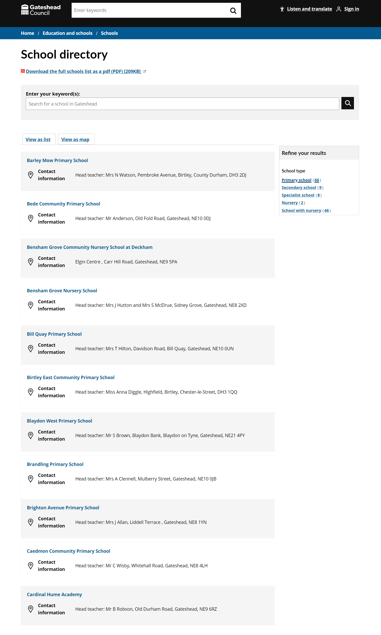
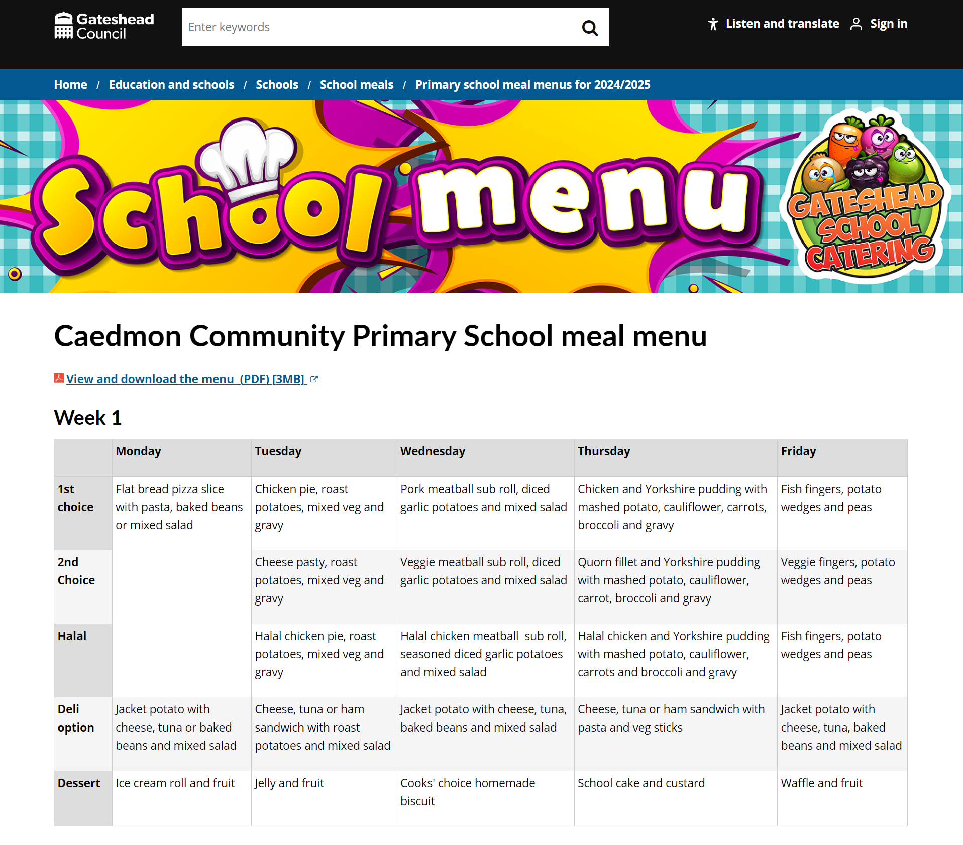
Update schools content for new term starting
Updated the school meals menus for all schools for the new school year
Updates across the school directory

Slide 8
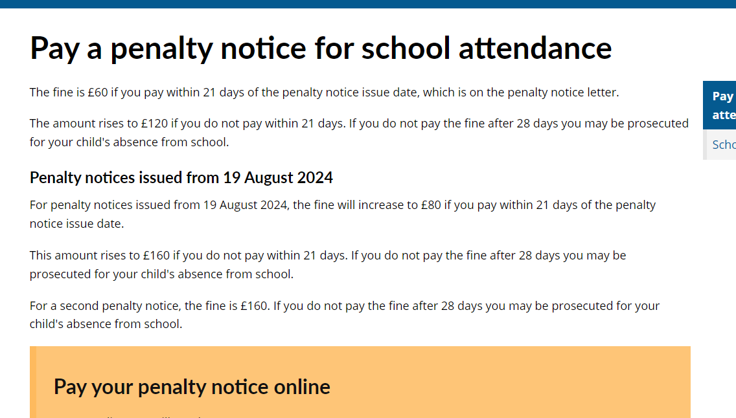
School attendance penalty notice update
From 19 August a new charging structure is being introduced to school attendance penalty notices
Updated webpage for crossover period of fines and scheduled update for 16 September when the new charging structure starts

Slide 9
Alternate provision registration form
Join the alternative education provision register - Gateshead Council (gosshosted.com)

Slide 10
Customer Experience and Digital

Slide 11
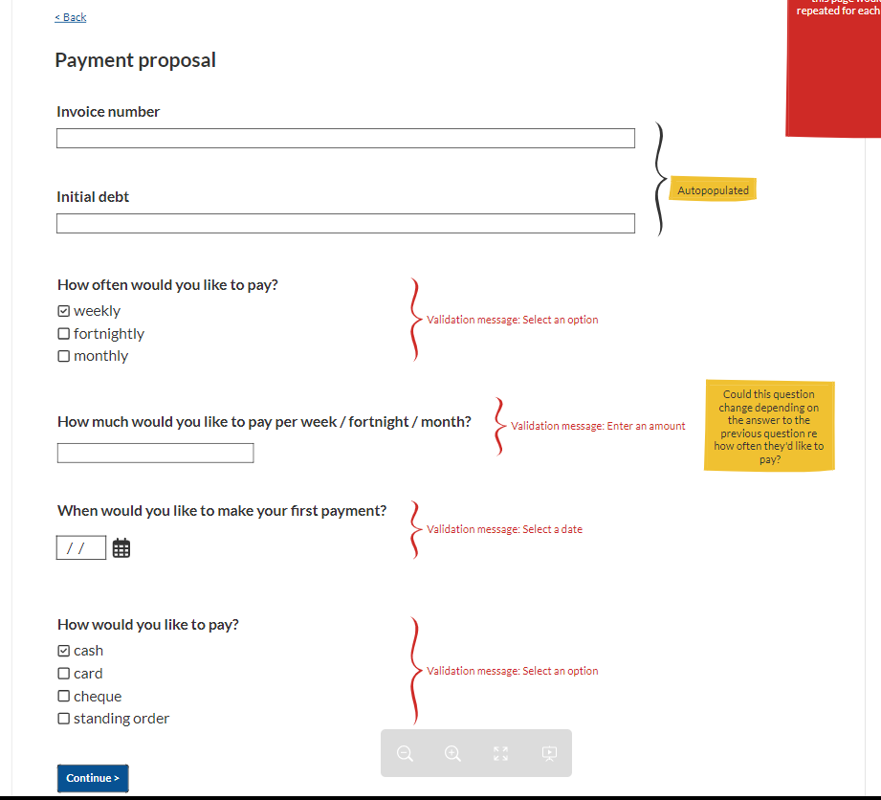
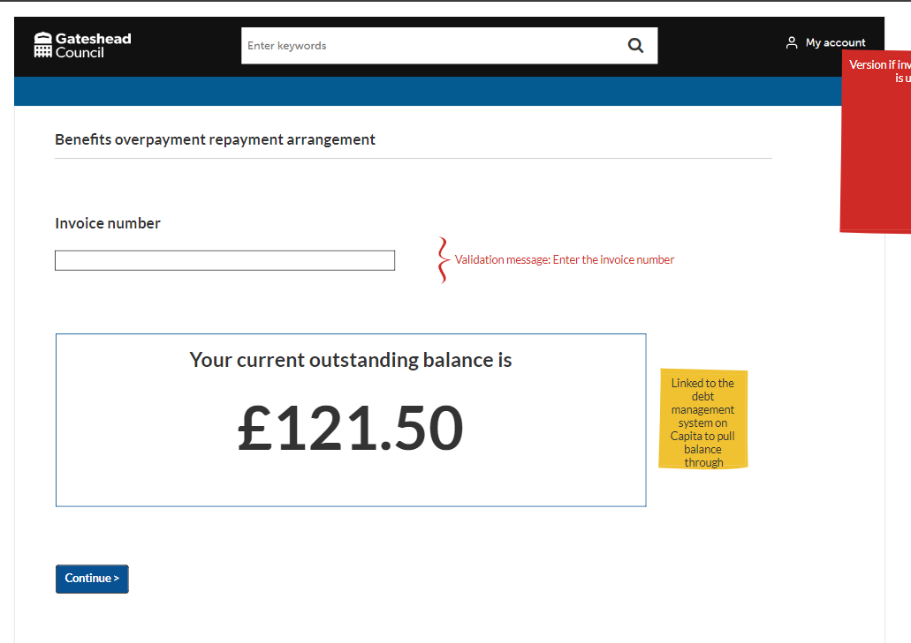
Wireframe for overpayment payment arrangement
Created a wireframe for the benefit overpayment payment arrangement process
Customers will be able to propose a payment arrangement using this form

Slide 12
Other services

Slide 13
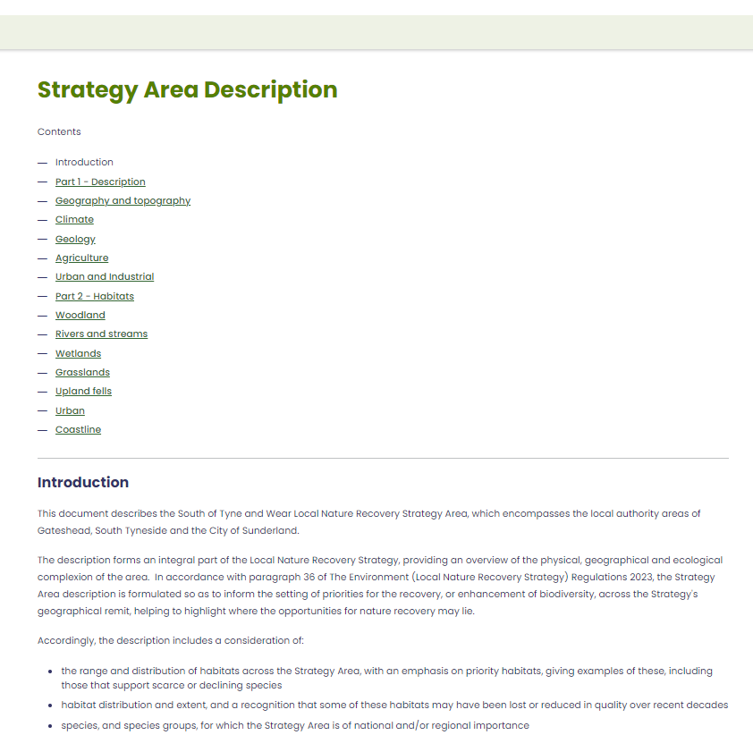
New section for the Local Nature Recovery Strategy website
Created a new section, 'Strategy area description' on natureplan.org.uk
This is a large document describing the area that the strategy covers

Slide 14
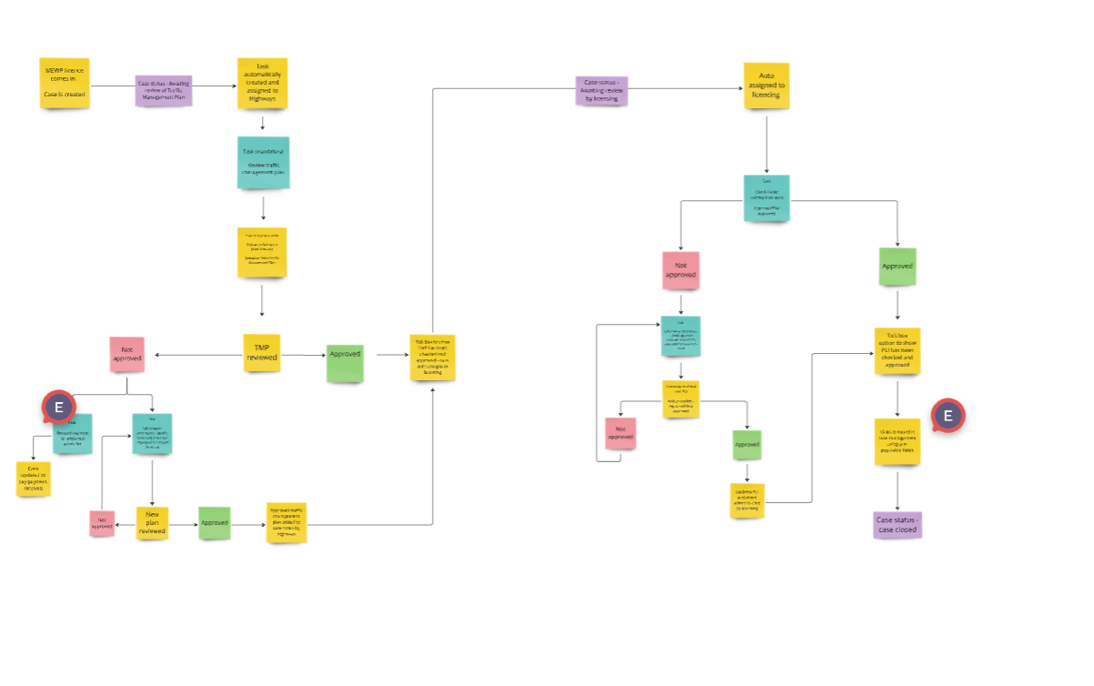
MEWP case management
Mapped out case management for Mobile Elevated Working Platform new digital process

Slide 15
What’s next?

Slide 16
Sprint 48
SENCo Newsletter
Overpayment payment arrangement build
Finalise details for MEWP

Slide 17
Deployments

