Slide 1
Sprint 47 Show and Tell 04 September 2024
G Squad
Digital Team

Slide 2
Sprint 47
Sprint goals
Council Tax – SMI
Student discount forms tested and content review completed
Put TTROs live

Slide 3
Sprint 47
Council Tax forms update
Live
Single person discounts – apply and cancel
Testing
Severely mentally impaired (SMI)
Student discounts/exemptions
Wireframe
Change of address
Development
Council Tax contact us form

Slide 4
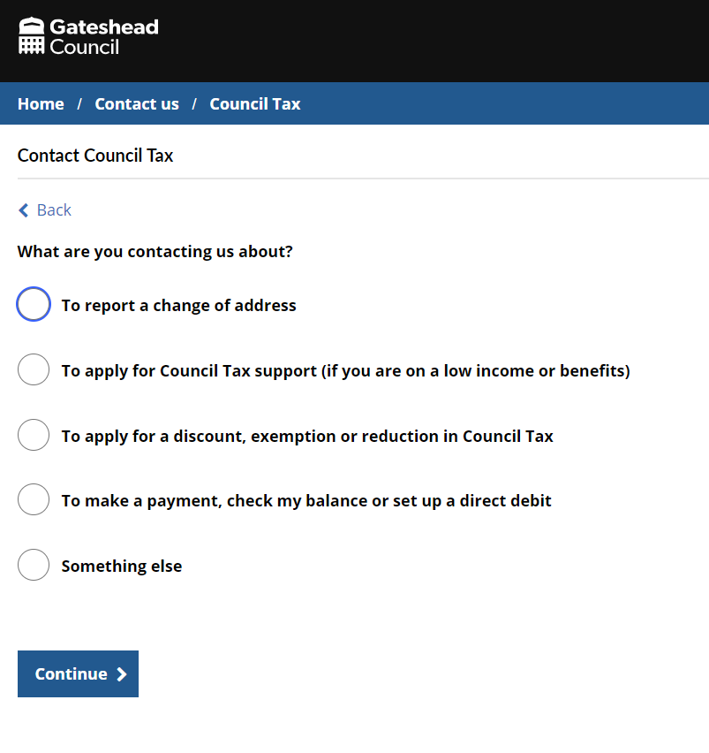
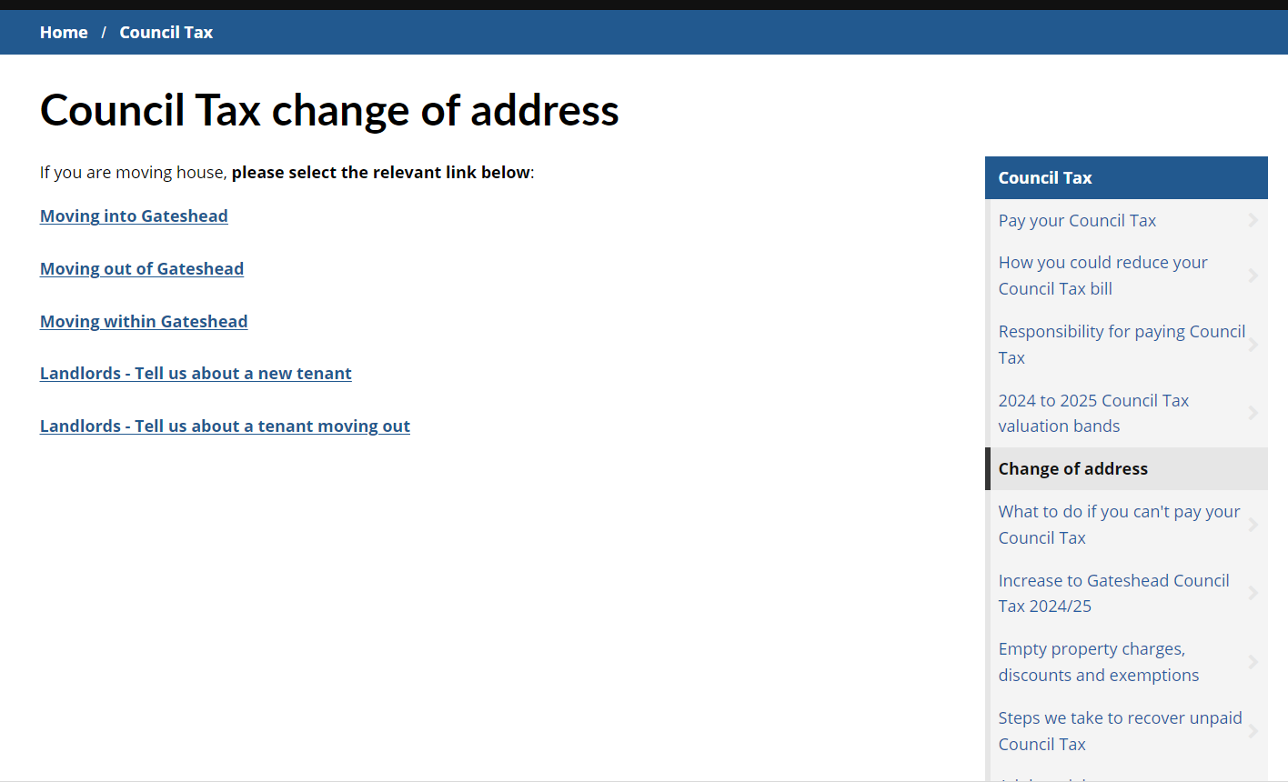
Sprint 47
Council Tax contact form

Slide 5
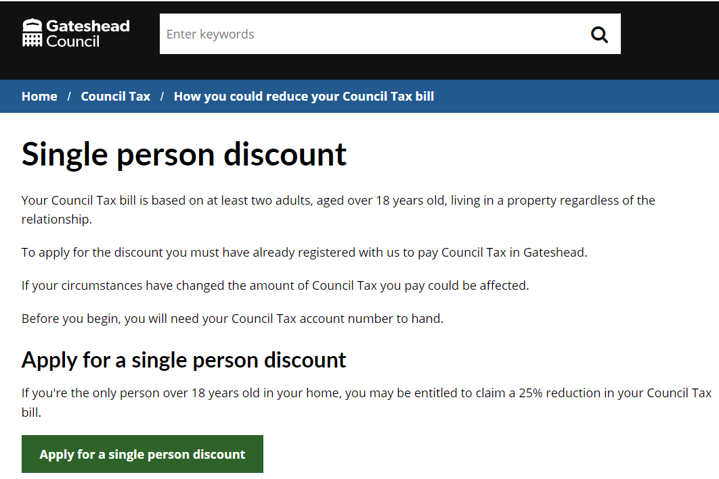
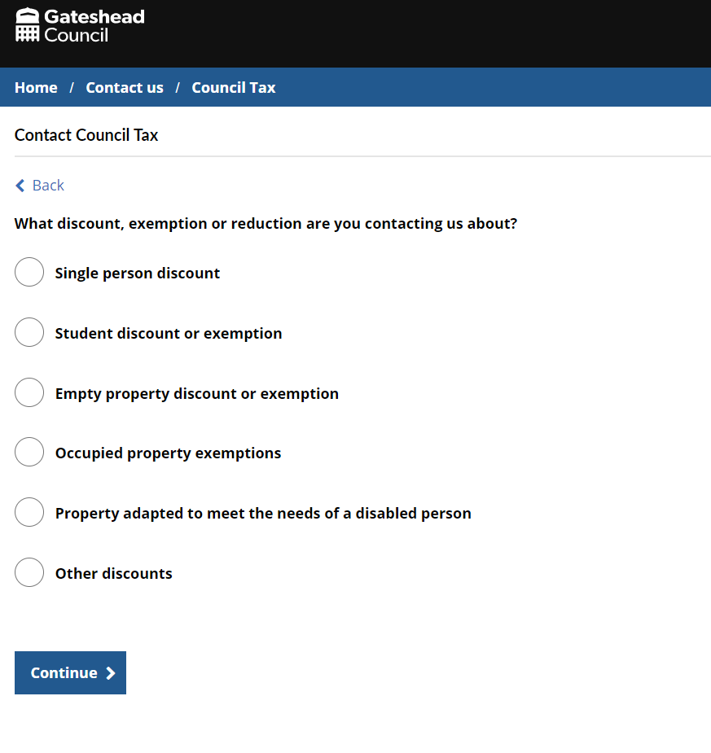
Sprint 47
Council Tax contact form

Slide 6
Sprint 47
Council Tax discounts and exemptions
Discovery into general Council Tax discount and exemption application process

Slide 7
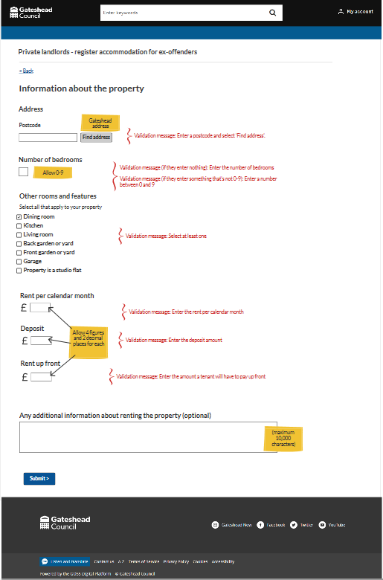
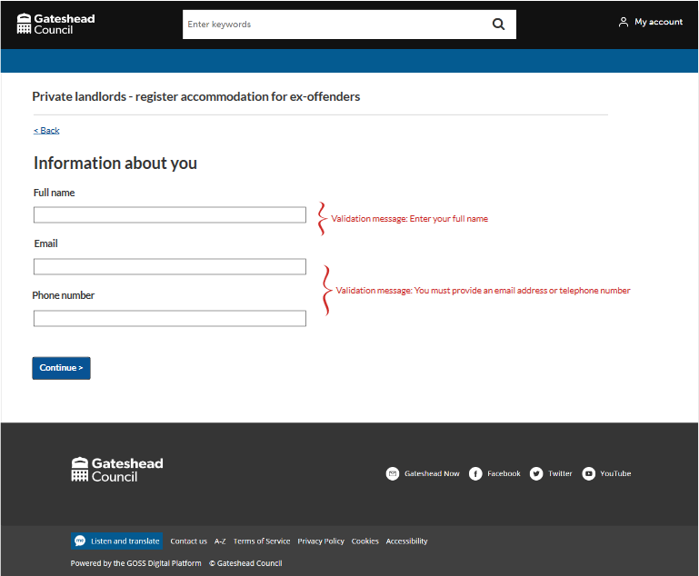
Sprint 47
Simple contact form for landlords offering housing to ex-offenders
Part of a comms campaign to attract more landlords
Ex-offenders housing - wireframe

Slide 8
Sprint 47
Tenant vetting
Demo of tenant vetting application form

Slide 9
Sprint 47
Development
Other
Change of Business Address – Fix for service email file attachments
Gateshead Energy Company – Contact form fixes and minor tweaks
TTRO – Preparing for go live and minor tweaks to case details
Council Tax contact us – Triage questions implemented, and evidence file upload added.

Slide 10
Sprint 47
What’s next?
Council Tax general discounts (smart snippets)
Council Tax content restructure
Complaints

