Slide 1
Sprint 48 Show and Tell 11 September 2024
C Squad
Digital Team

Slide 2
Sprint goal – Scope My Account priorities

Slide 3
My Account – mapping registration process
Recap
Duplicate accounts identified which are causing issues for CSU and customers
Started looking at data to identify scale of problem
Next task - map out the registration process for customers via gateshead.gov.uk and CSU advisers via Customer Contact to identify anything noteworthy

Slide 4
My Account – mapping registration process
What I did to inform the mapping
Tested the process from perspective of customer
Tested the process from perspective of CSU (and fell down rabbit holes in Customer Contact)
Attended meetings with CSU on search functions (both wider one and Assist search)
Got insight from Sam from her CSU shadowing
What I discovered…

Slide 5
Other services

Slide 6
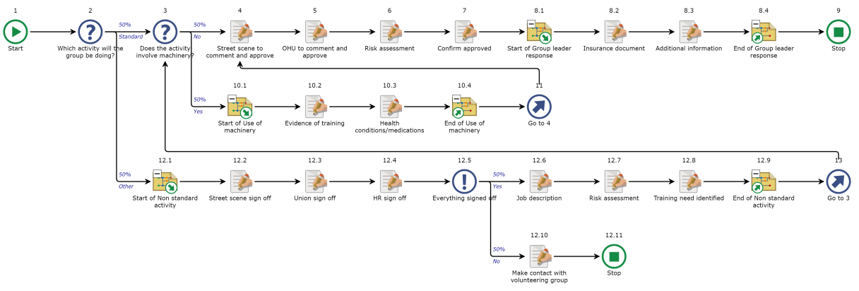
Group volunteering – case management

Slide 7
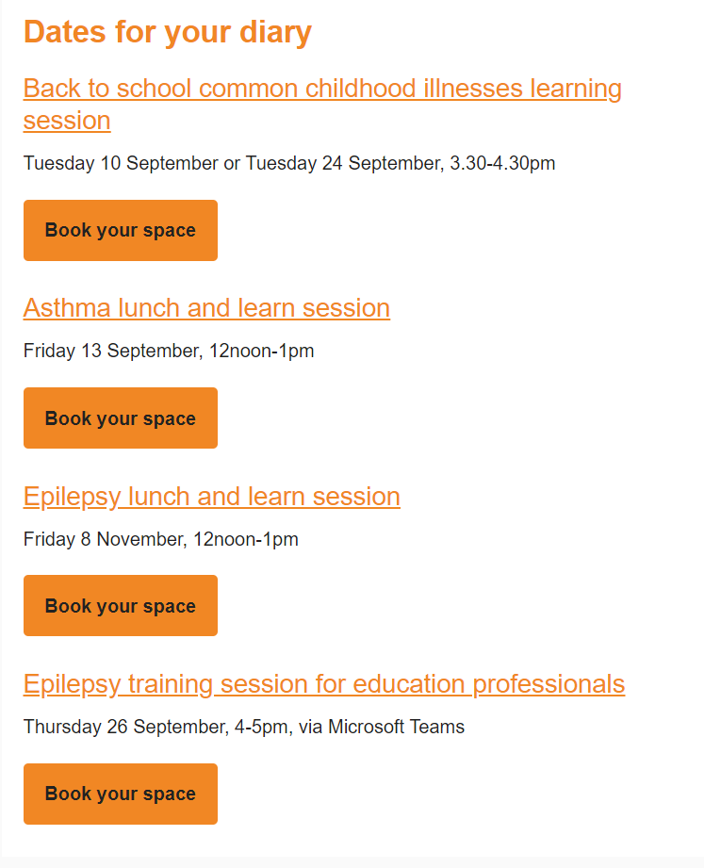
SENDCo newsletter
Creation of template for a new SENDCo newsletter
Content added
First newsletter sent to over 100 SENDCos in the borough

Slide 8
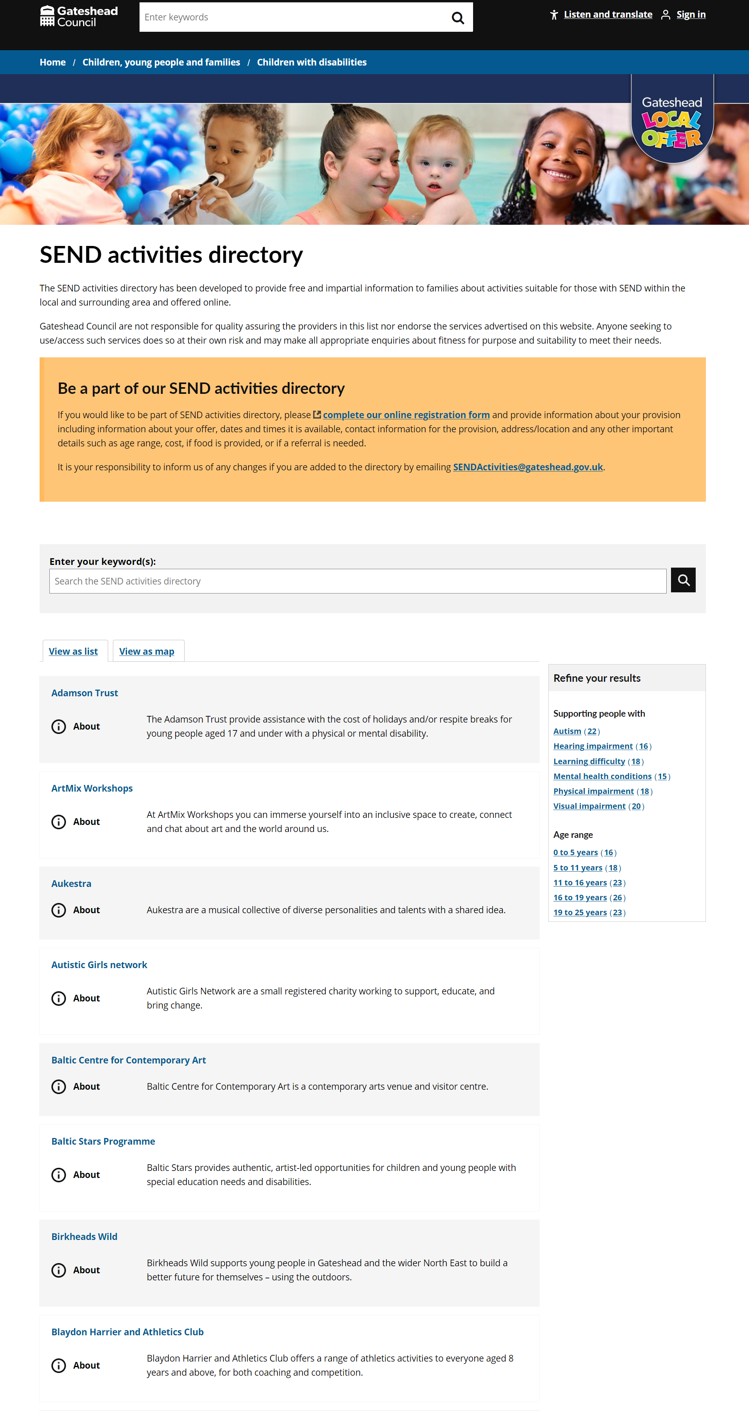
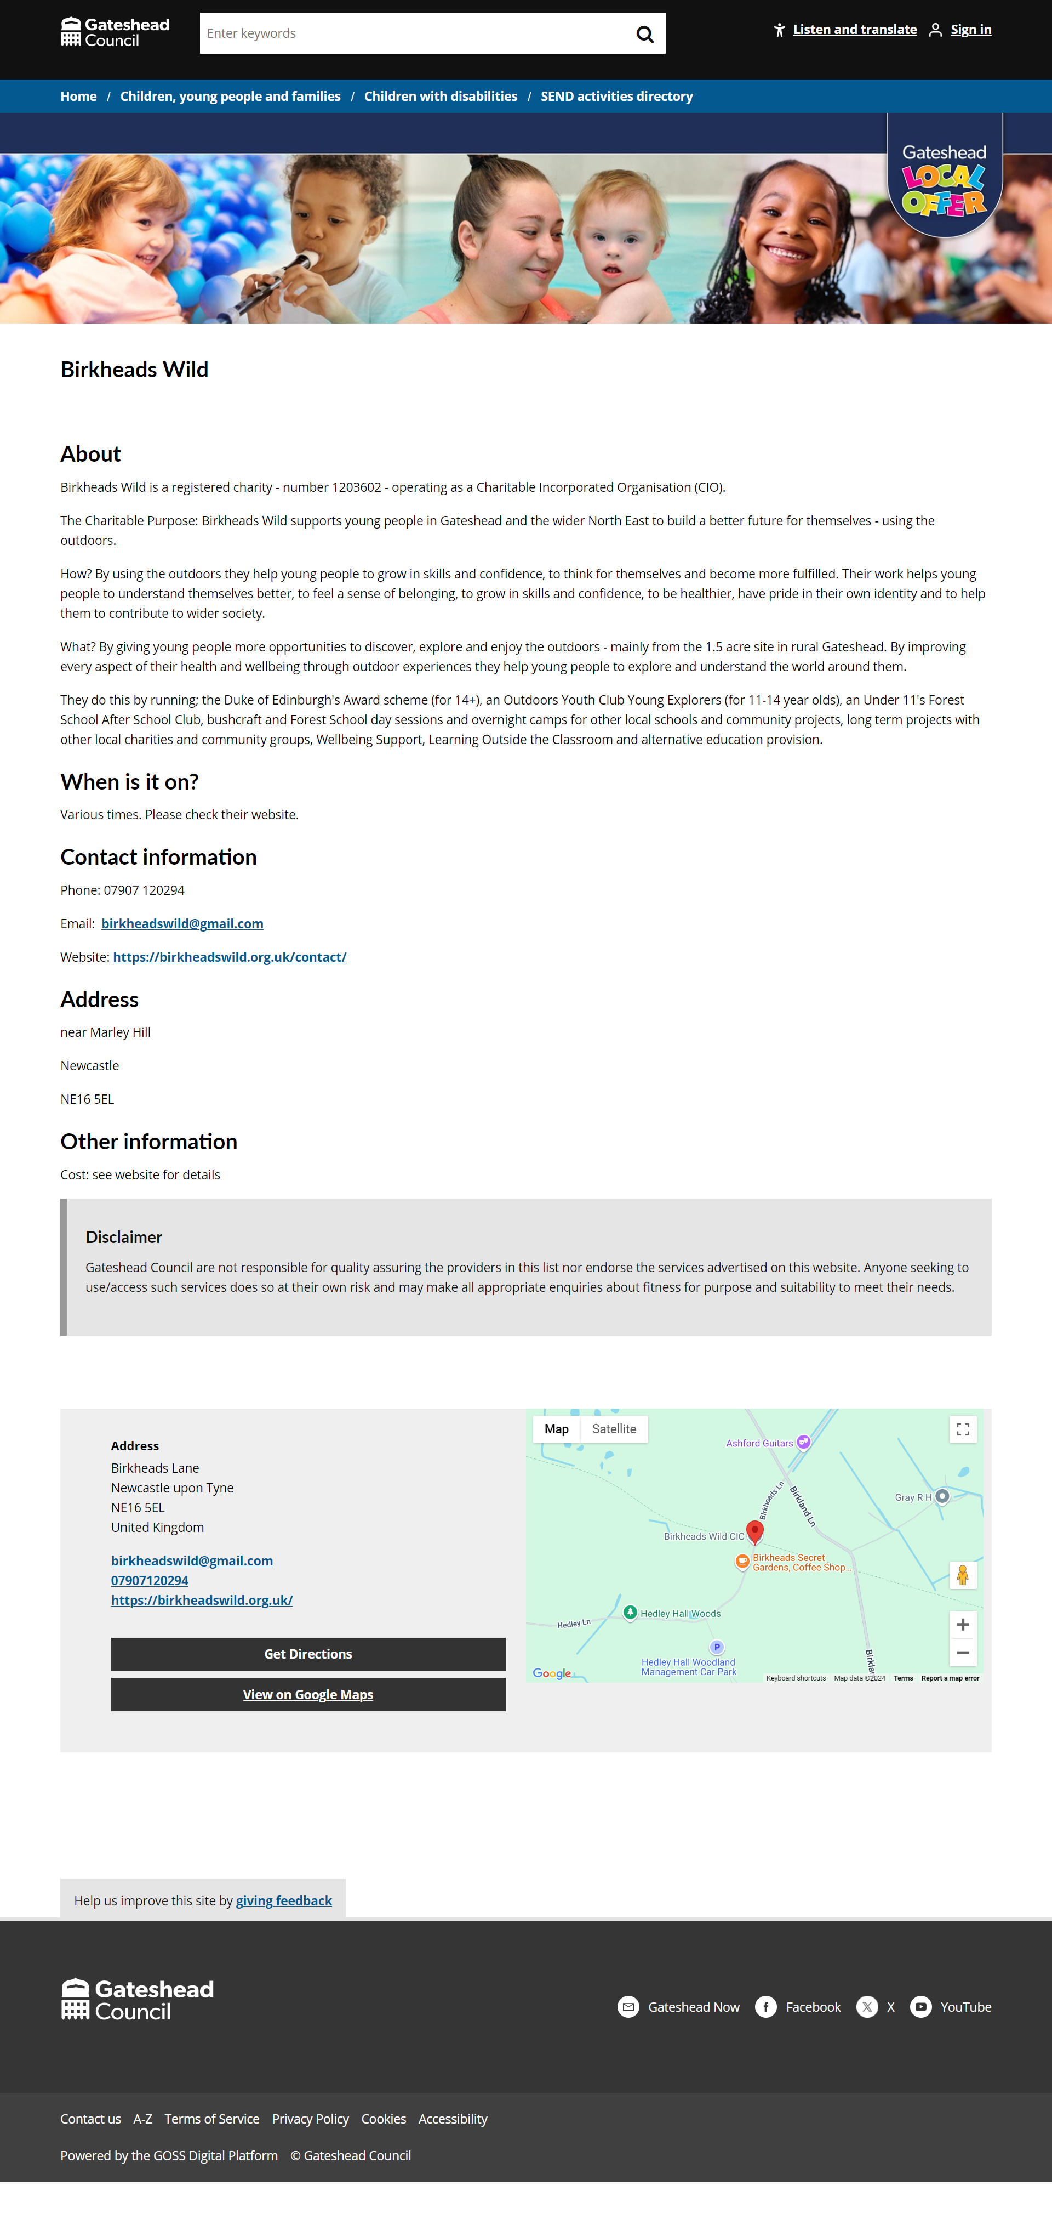
Go live
SEND activities directory

Slide 9
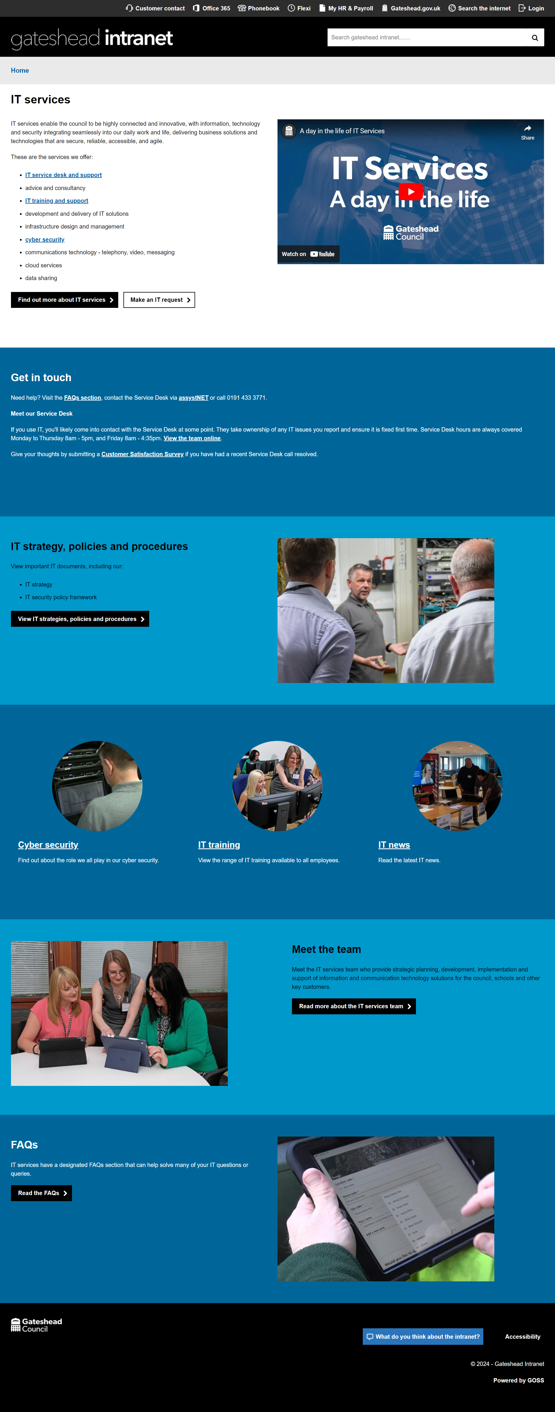
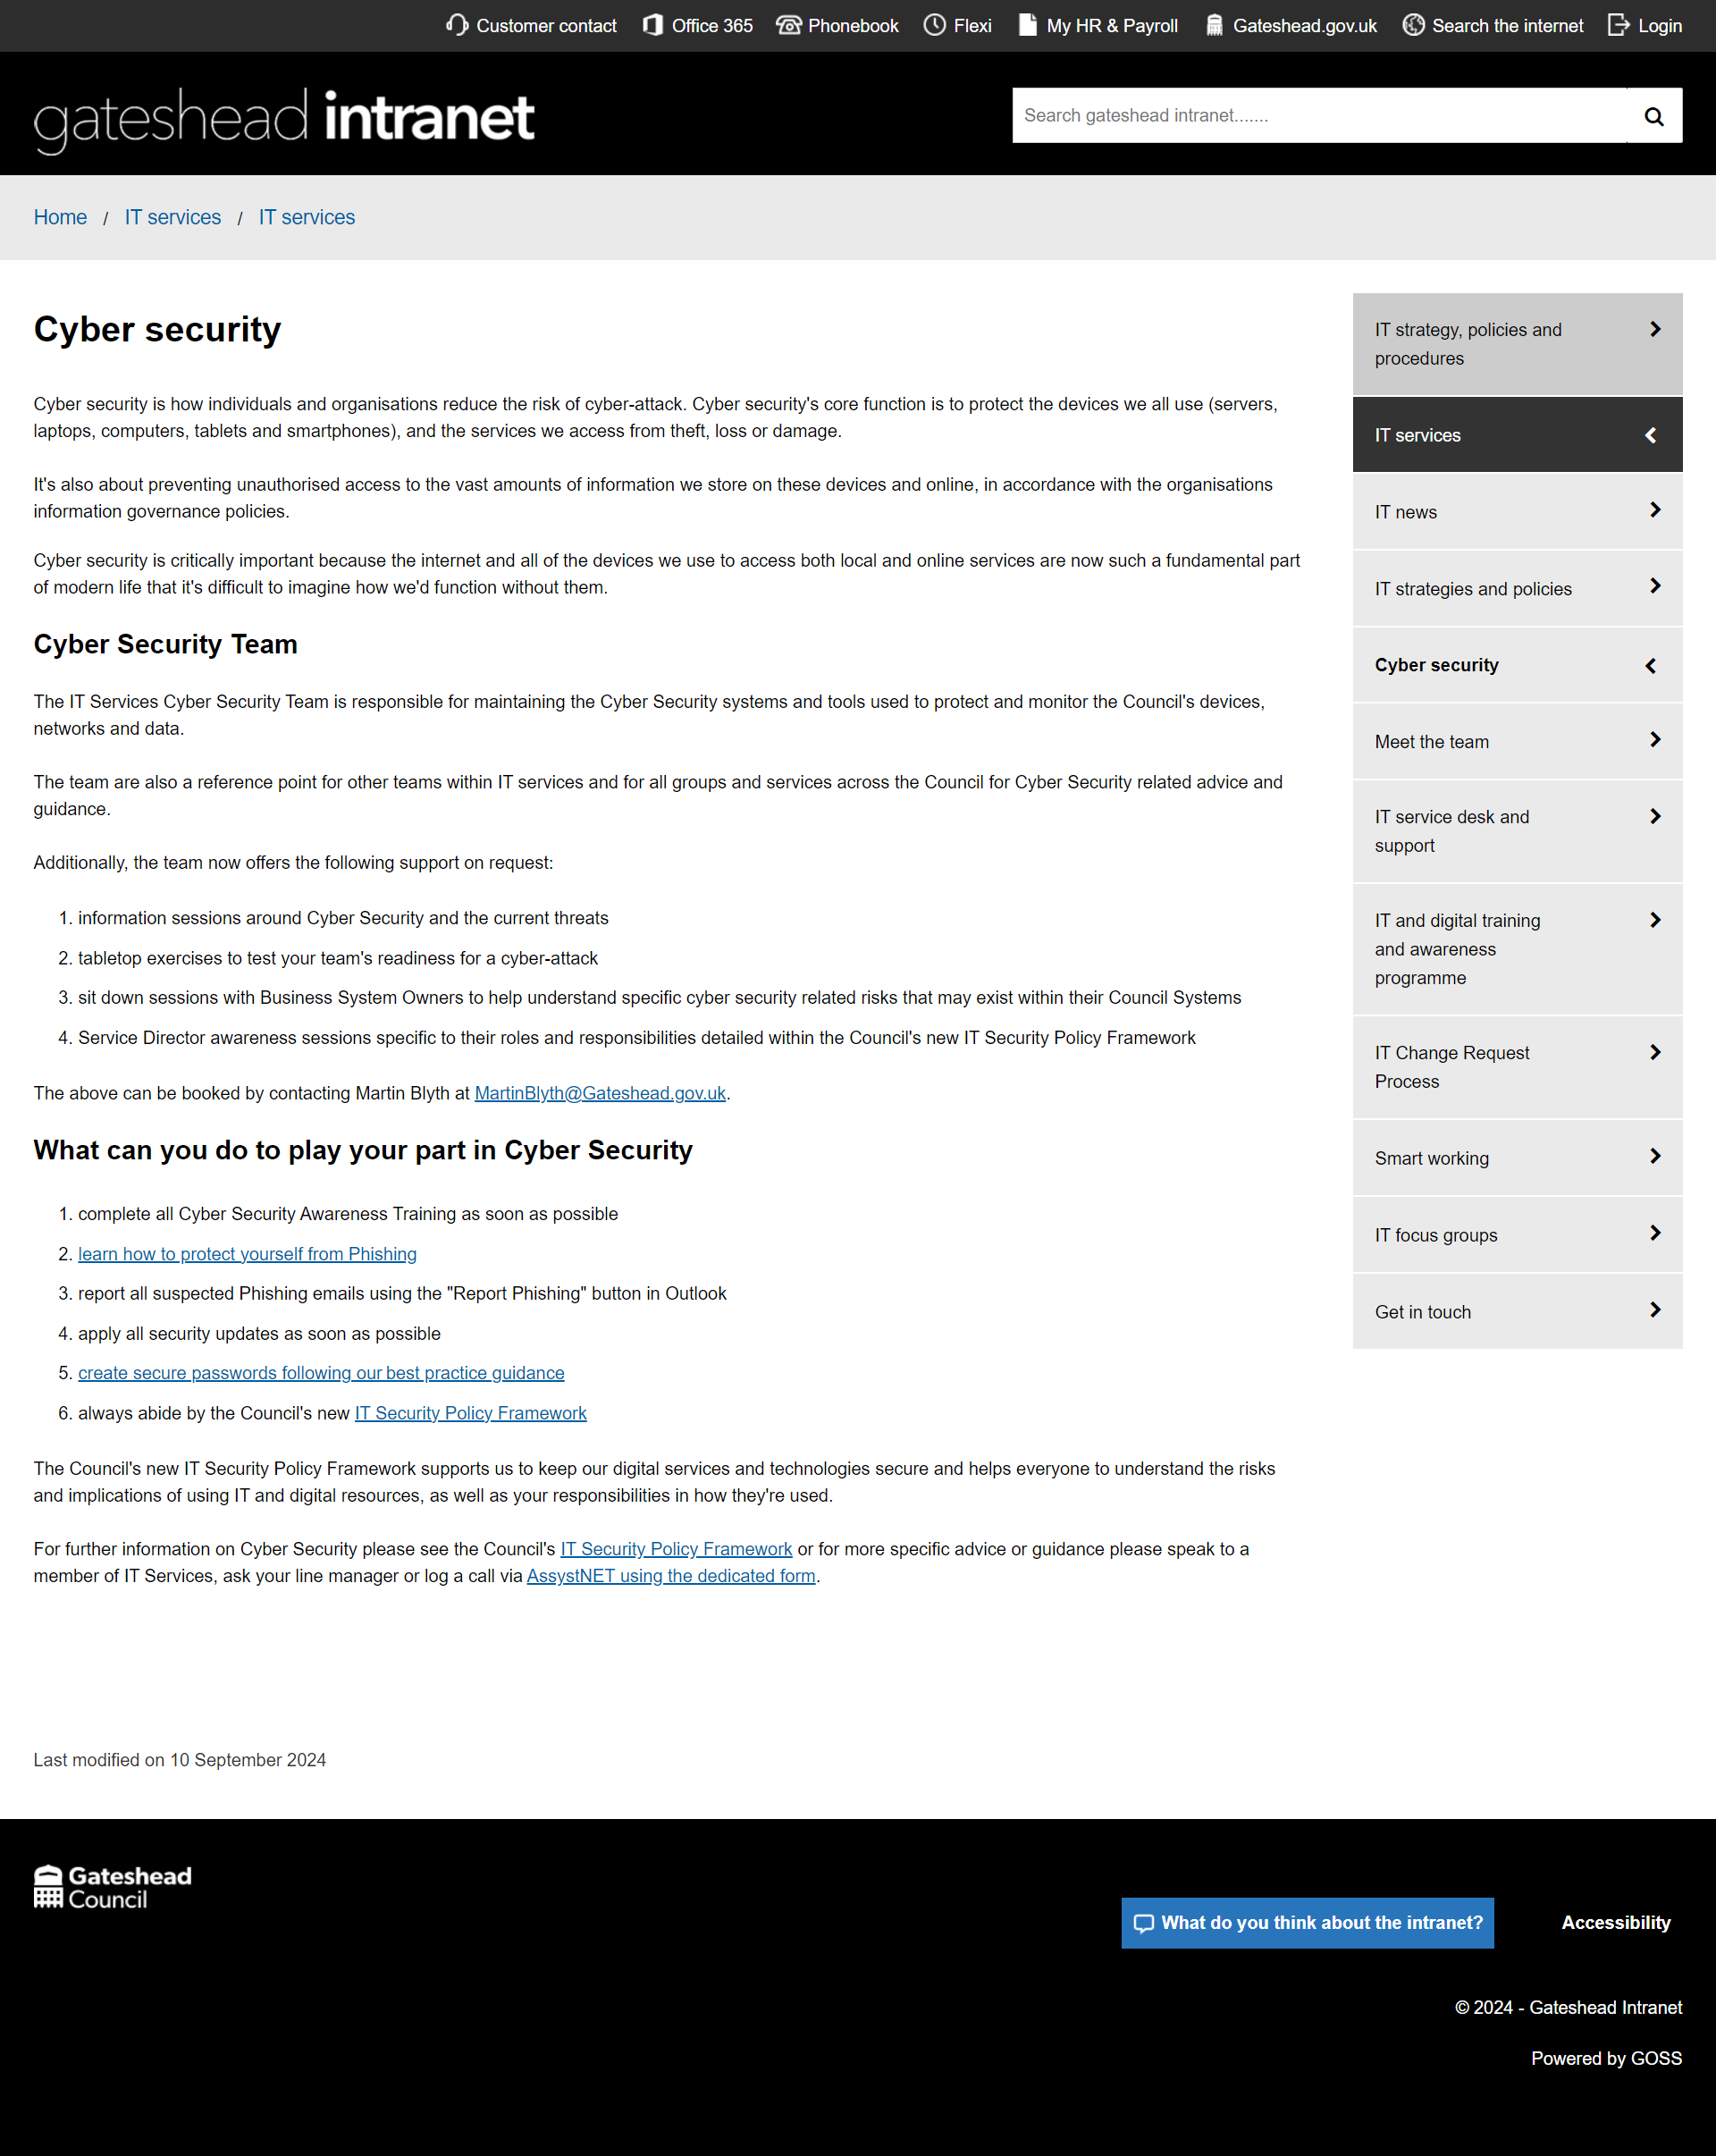
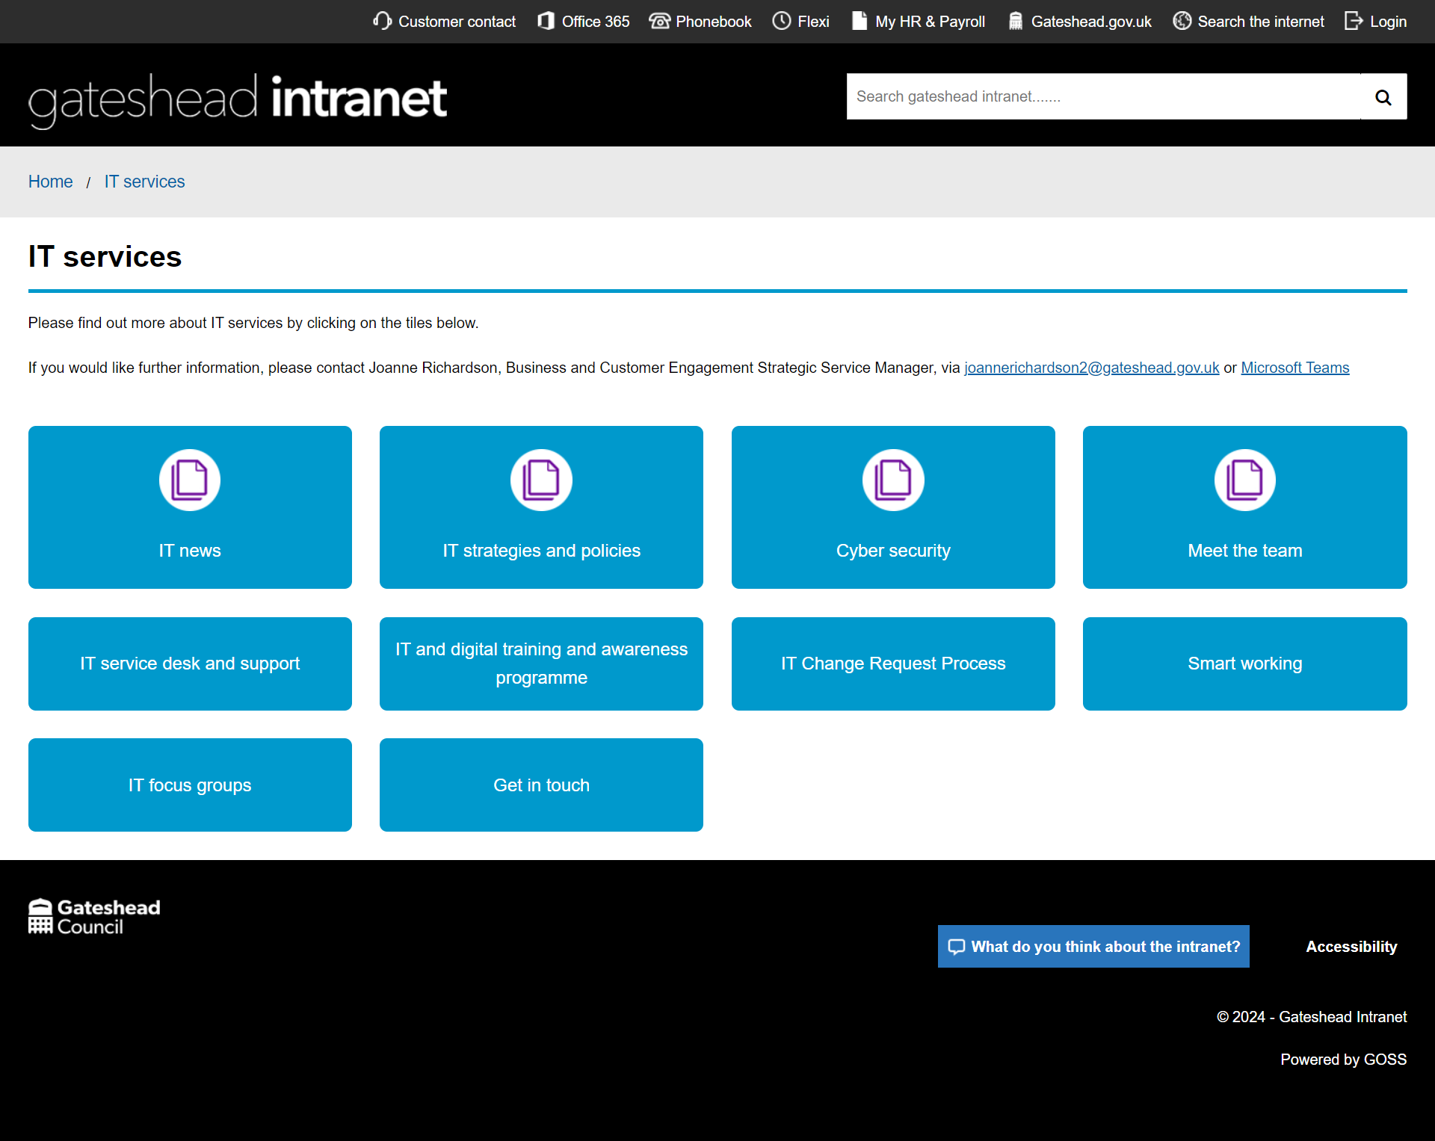
Go live
IT services intranet section

Slide 10
Design
Design tasks completed
Pay - remove the Help box from the Secure and Help section
SENDCo newsletter template for MailChimp
Metadata to hide images on search for SEND directory
Library waiting list - explore options
Business Gateshead – Removed Levelling UP logo
Tyne Derwent Way - Images sometimes not appearing
Design tasks in progress
Design standards - Blue badge customer journey
Create Gateshead Theme components for Figma wireframes

Slide 11
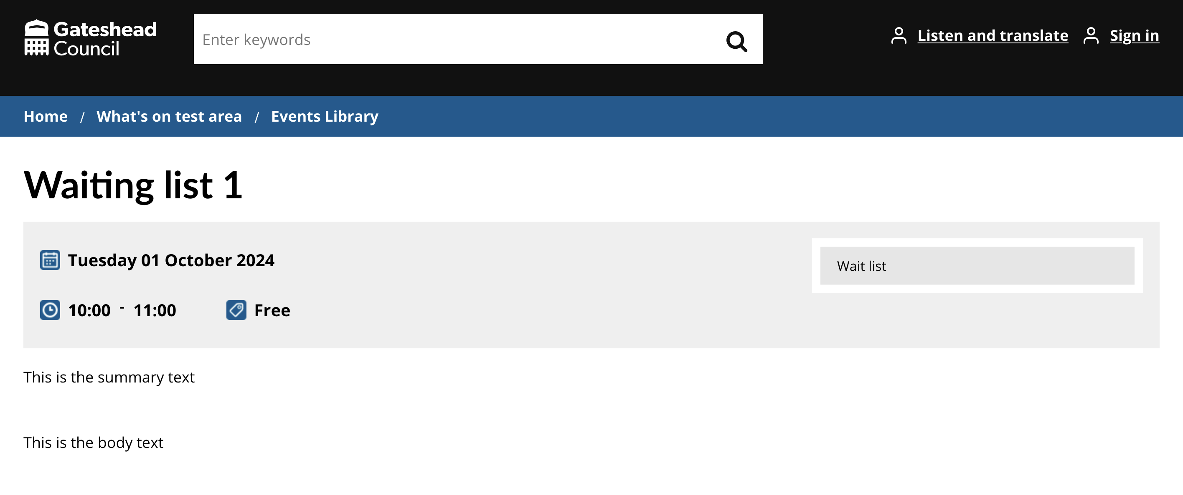
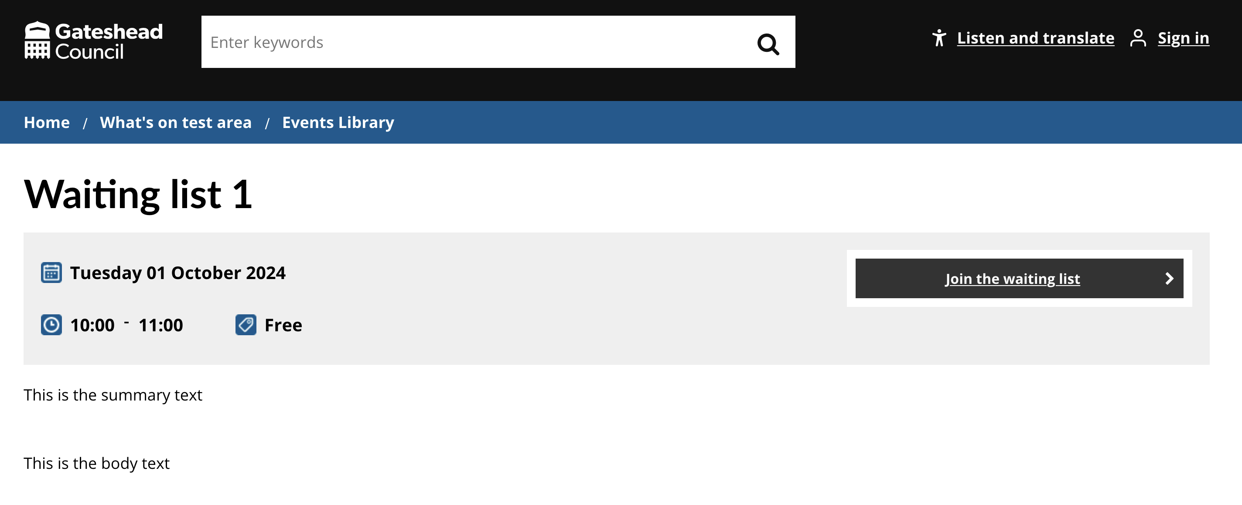
Library events waiting list
No JavaScript
Add JavaScript to change the text "Wait list" into a clickable link to a page the user can join a waiting list for tickets.
With JavaScript

Slide 12
Development
Development tasks completed
Creation of new group to deal with additional bin and assisted bin requests
Addition of ward to the case tile to assist case managers

Slide 13
Development
Development tasks completed
Removal of Registrars close case email when all tasks are completed
Forward case details by email task created for Waste Escalations
Update to Schools PN form to send the correct details to Capita
Correction of missing address link
Update to the Digital Service Request process to capture more user information
Digital service request - Gateshead Intranet (gosshosted.com)

Slide 14
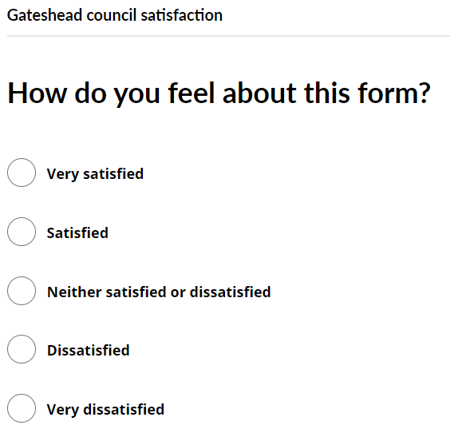
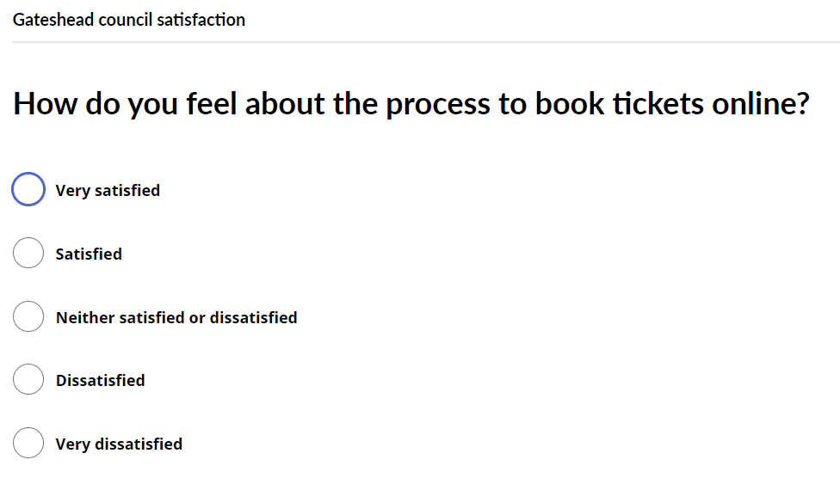
Development
Development tasks completed
Update of the feedback form to show different text when a libraries even has been booked.

Slide 15
What’s next?

Slide 16
Sprint 50
My Account research consolidation
Prepare Direct Payment user research
Discuss options of care cost contributions with service
Add features to Taxi testing process
Overpayment arrangement

Slide 17
Deployments

Slide 18
