Slide 1
Sprint 49 Show and Tell 18 September 2024
G Squad
Digital Team

Slide 2
Sprint 49
Introduction
Sprint Goals
Accommodation for ex-offenders contact form.
Universal Credit Council Tax Support application.
Council Tax content redesign.
Student and SMI discount and exemption final amends and handover.
Complaints form discovery

Slide 3
Sprint 49
[Worktype]
Intro Title
Intro description

Slide 4
Sprint 49
Data
Blue Badges data
An export of Blue Badge case to identify which cases could be closed.
180+ cases closed and removed from the backlog (rejected, not eligible, no evidence provided or failure to make the payment)
Analysing the cases highlighted some gaps in our knowledge around the process ('yes letters' or 'tick letters').
A meeting is scheduled with the service to bridge any knowledge gaps on our part and to discuss possible improvements or efficiencies that we could make to the process.

Slide 5
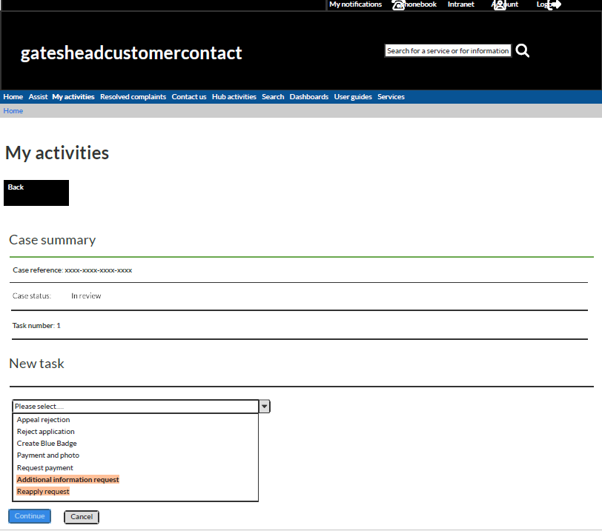
Sprint 49
Wireframe
Blue Badge additional task templates
New generic response tasks
Additional information request
Reapply request

Slide 6
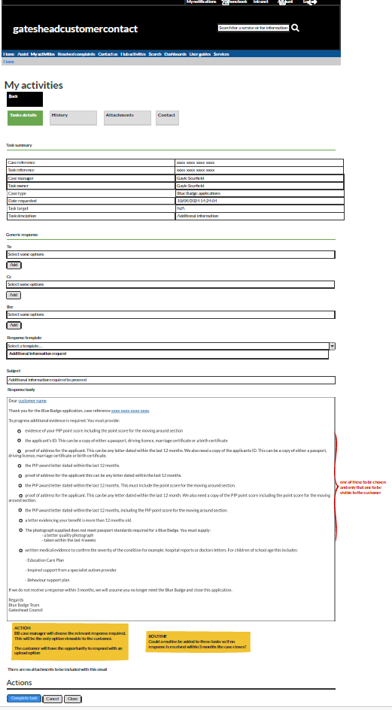
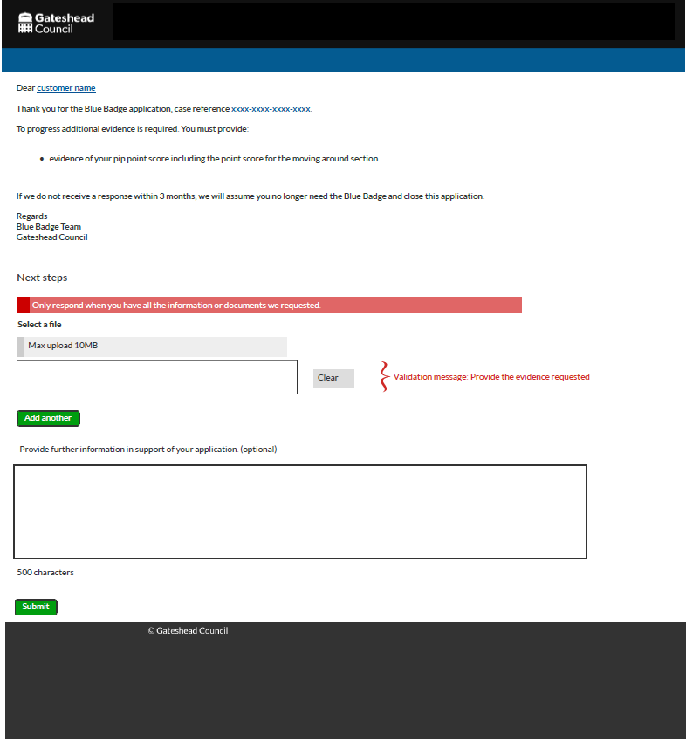
Sprint 49
Wireframe
Blue Badge additional task templates
Additional information request task

Slide 7
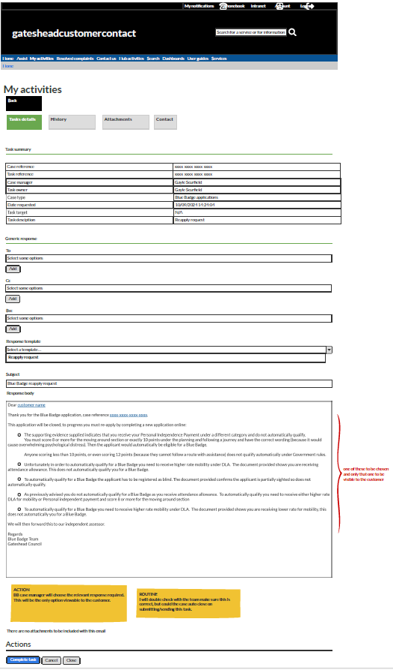
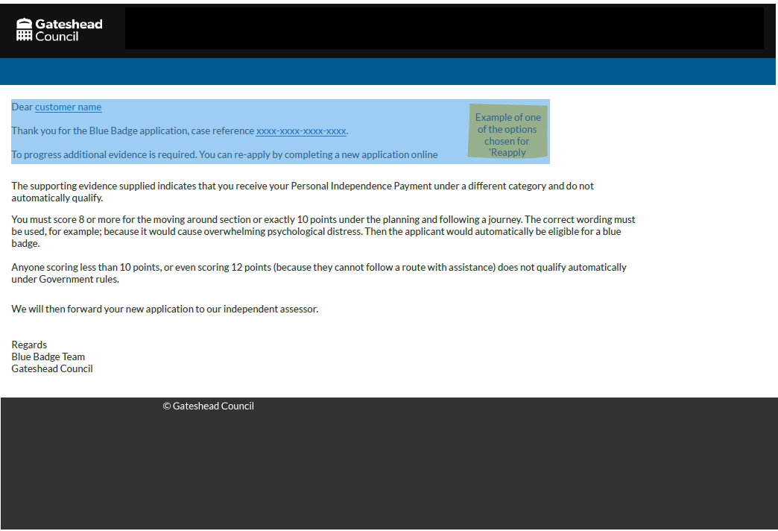
Sprint 49
Wireframe
Blue Badge additional task templates
Reapply request task

Slide 8
Sprint 49
Development
Council Tax
This sprint focused on building the "Council Tax exemptions - property left empty by a person receiving care" form. It helps people apply for a Council Tax exemption when a home is empty because the owner or tenant is receiving care. The form guides users through easy steps to ensure all their details are submitted correctly.
Demo

Slide 9
Sprint 49
Development
Council Tax
Demo of Council Tax Support application for Universal Credit applicants

Slide 10
Sprint 49
Data & Analysis
Account Deduplication
Working with model output

Slide 11
Sprint 49
Data and Analysis
Account Deduplication
Sprint 45: developed a prototype to check for deduplicate accounts using machine learning. So that:
We review all accounts for duplicates
Repeat the process as required

Slide 12
Sprint 49
Data and Analysis
Account Deduplication
Sometimes CSU have created more than one account for the person.
Sometimes CSU have created another account when the user may have created one.
Sometimes the user creates a new account with a new email for themselves.
Sometime there are accounts with multiple accounts created by the user and multiple accounts created by CSU.

Slide 13
Sprint 49
Data and Analysis
Account Deduplication
Focus of work for Sprint 49 is to monitor the performance of the machine-learning being used and reviewing the results being produced.
Need to be able to review results and feedback whether it is a good or bad match back into the model.
You cannot update data in Power BI.
Demo

Slide 14
Sprint 49
Development
Customer Contact
Updates to Assist search

Slide 15
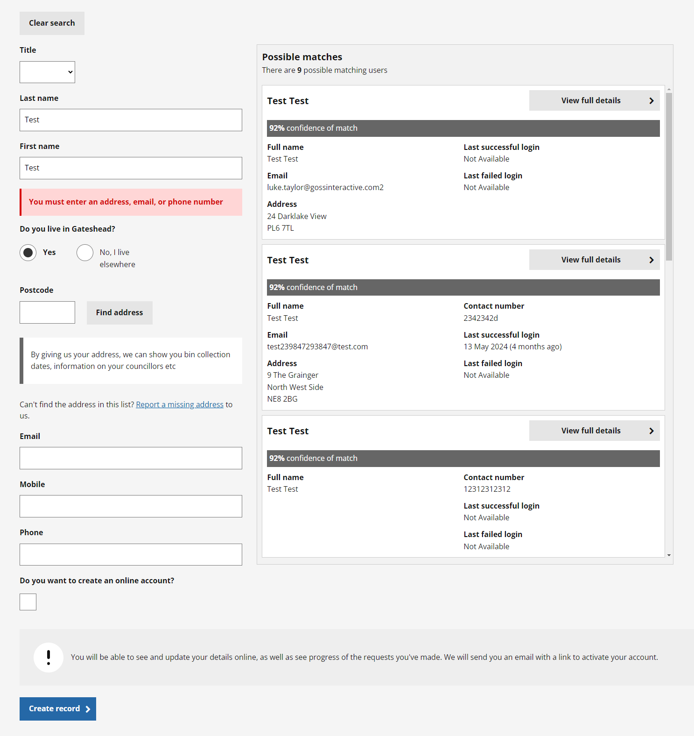
Sprint 49
Development
Through agent feedback and data analysis, we recognized opportunities to enhance the Customer Contact – Assist search. This sprint, I focused on refining the UI and functionality to better support agents in efficiently locating customer accounts.
Introduction

Slide 16
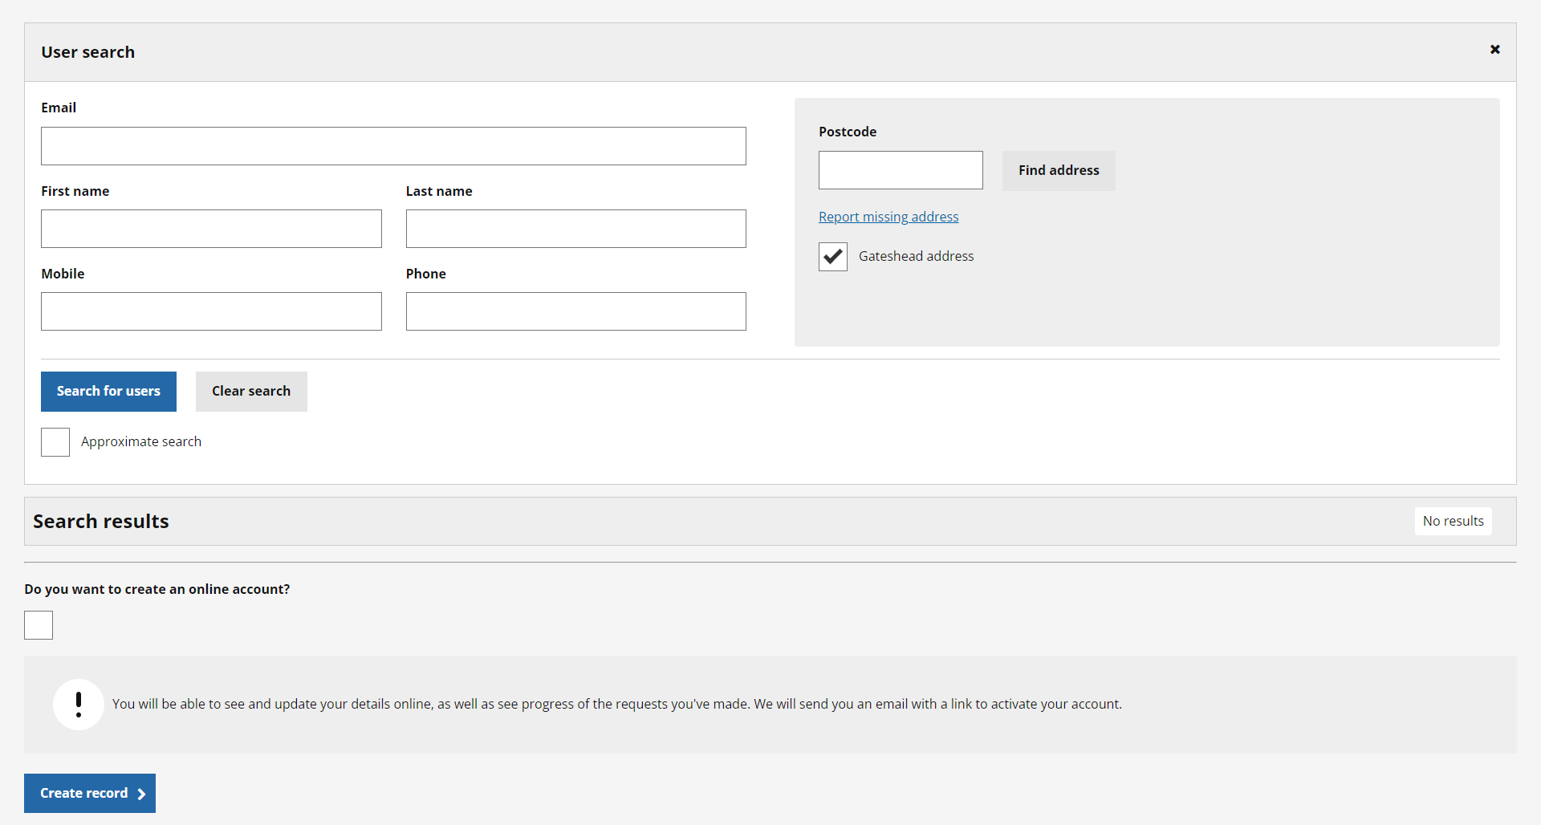
Sprint 49
Development
The updated UI brings search inputs together, making all details visible on a single page, with address lookups in a secondary column. Inputs have been streamlined and unnecessary fields removed.
UI improvements

Slide 17
Sprint 49
Development
UI improvements
Results are now displayed in a table format, ensuring that information remains in consistent positions for easy identification. This layout also allows for the optimal display of multiple records within the page view.

Slide 18
Sprint 49
Development
Results table
The results table now features advanced sorting options to help agents quickly locate the records they need.
Agents can sort by column headers (ascending/descending) or use additional options like 'Most Populated Rows' to prioritize accounts with the most complete data. The results table will automatically sort results based on last login.
Styling enhancements improve readability, with hover effects to highlight rows for easier navigation.

Slide 19
Sprint 49
Development
General improvements
Automated input focus and scroll functionality
Optimized screen space use
Enter key search functionality enabled
Disabled auto-search when shifting focus from fields
Address accuracy now determined solely by UPRN
Address clearing bug resolved
Search enabled across all fields
Approximate search functionality introduced
Row accuracy calculated on input value versus result value
Demo

Slide 20
Sprint 49
Development
Other development
Development of the 'register accommodation for ex-offenders' form.
Student discounts and exemptions form – tickets picked up from internal testing. Ready to hand over to the service for review.
Single person discount – tickets picked up from internal testing, ready to hand over to the service for review.

Slide 21
Sprint 49
Conclusion
What’s next?
Council Tax - change of address wireframe
Council Tax online content redesign (cont)
Offensive graffiti on council properties.
Complaint form discovery
Taxi vehicle test dashboard

