Slide 1
Sprint 50 Show and Tell 25 September 2024
C Squad
Digital Team

Slide 2
Sprint goal
Agree user research plan for Direct Payments

Slide 3
Agree user research plan for Direct Payments
Met with Rachel from equalities for advice on hosting focus groups with the Jewish community.
Drafted questions for focus groups and user interviews.
Drafted consent form and demographic survey questions.
Contacted interviewees to schedule interviews.
Contacted Jewish Community Council of Gateshead to plan next steps.
View documents here

Slide 4
Figma design system and walkthrough

Slide 5
Figma design system
Created a design system for the Gateshead Council website
Created components based on elements of the website
Components used to create standardised patterns
Components and patterns are published to a library
Library can be used to create wireframes
Updates to the library can pushed out to update the wireframes (for example, changes to the design of the header)
Work is ongoing
Created a walkthrough for the "Apply for a Blue Badge" form https://www.gateshead.gov.uk/article/29669/Apply-for-a-Blue-Badge
Figma design system file https://www.figma.com/design/rGnZYwPuJ37KSDKd2lRkL9/Gateshead-theme-template?node-id=0-1&t=rxvLHxRo4dlTdUCX-1
Design

Slide 6
Email marketing campaigns

Slide 7
Mailchimp audience review
Reviewed audiences held in Mailchimp to make sure that we're meeting requirements for GDPR.
Reviewed current audience lists.
Before the review we stored 750,000 email addresses in Mailchimp, many were duplicate emails stored on different lists uploaded multiple times.
Following the review over 400,000 email addresses have been deleted. Meeting with housing comms contact to reduce the number even further.
Guidance being drafted on good practice on creating and managing mailing lists so that only necessary data is stored in Mailchimp and lists are reviewed regularly.
Gateshead Now mailing list to be reviewed separately and an email to be sent to subscribers who haven't opened last 10 issues.
Content

Slide 8
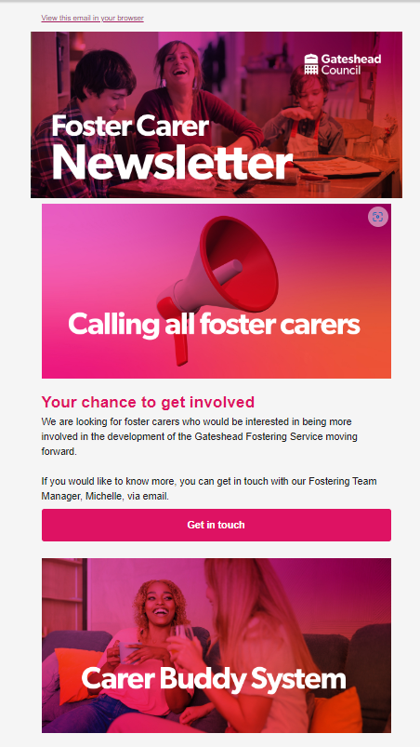
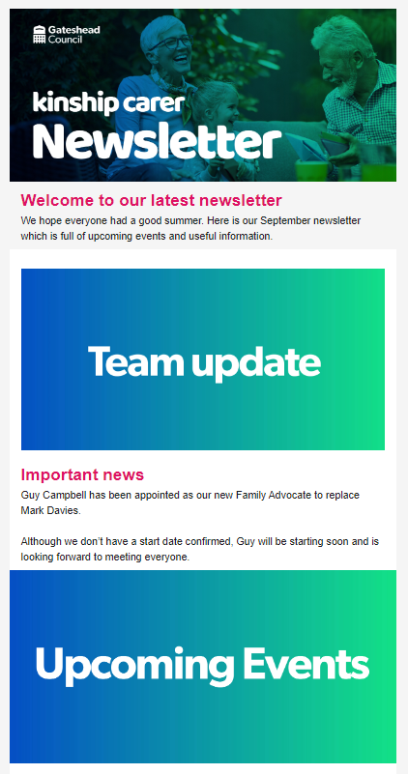
Mailchimp email campaigns
Email marketing campaigns sent out during this sprint
Gateshead Now – sent out 18 September
Foster carer newsletter – sent out 24 September
Kinship carer newsletter - sent out 19 September
Content

Slide 9
Other services

Slide 10
Development tasks completed
Creation of new group to deal with additional bin and assisted bin requests
Addition of ward to the case tile to assist case managers
Development

Slide 11
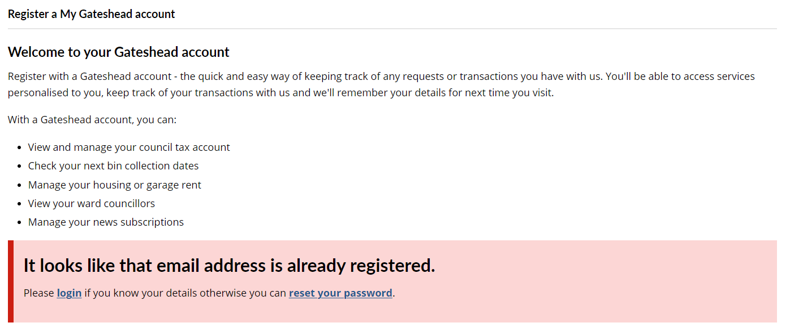
Update to account registration to remove the advice to sign up with another email address
Development

Slide 12
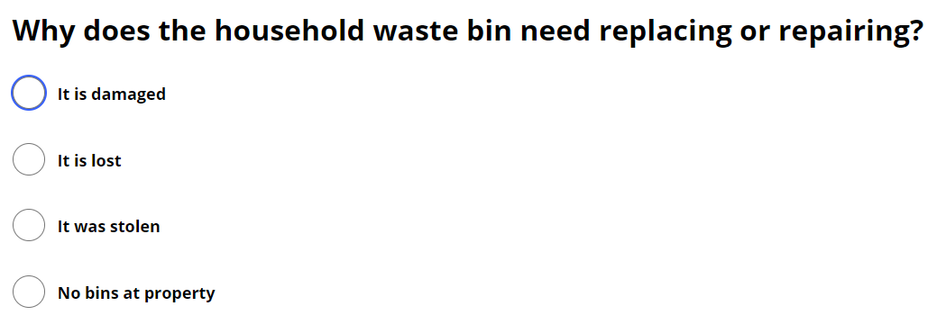
Improved text on new bins ordering form to account for advance updates of property information and addition of "No bins at property" option on replacement bin form
Development

Slide 13
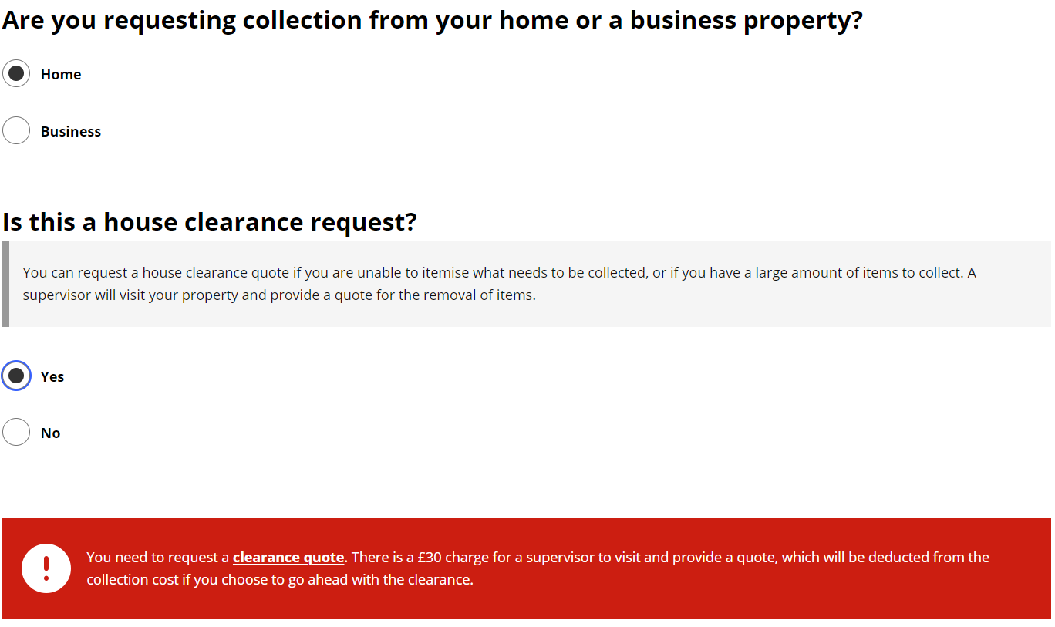
Addition of house clearance question for the bulky waste process. This will guide customers and CSU agents down the Supervisor Quote route
Development

Slide 14
Other development tasks completed
Volunteering forms - change who they go to, group expression of interest and individual expression of interest need to go to different officers.
Update of new case email for pest control cases – Update to HTML to allow email to be displayed correctly in case management.
Overhanging trees process – Add enforcement to the reassignment groups.
Dog fouling report form – Update to map text to make it clearer for customers.
Removal of coronavirus information from waste permit emails. Tickets to remove these questions from Pest Control and Bulky Waste forms will be worked on in sprint 52.
Development

Slide 15
Sprint 52

Slide 16
What's coming in the next sprint
Direct payments
Content review
User research
Customer contact
Discovery of Interaction log
Assist customer journey (new interface)
Agree a retention policy for my account records
Analysis of the creation and use of customer accounts by CS

Slide 17
Deployment

Slide 18
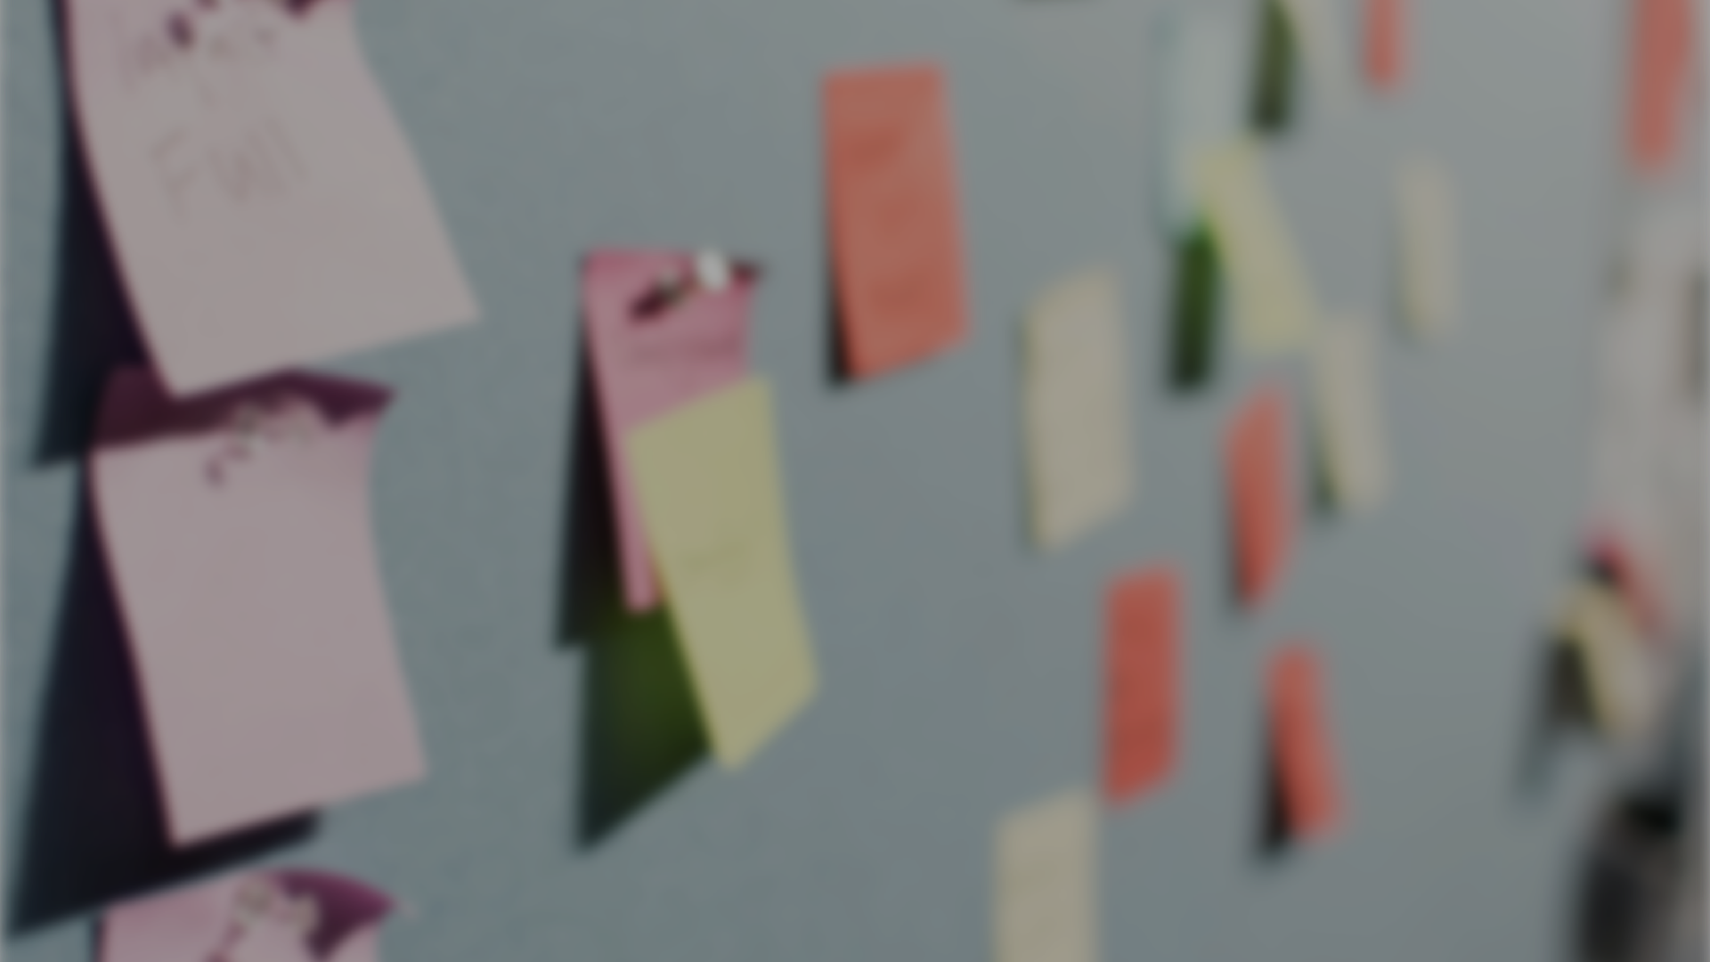
Thank you
That's all folks!

