Slide 1
Sprint 51 Show and Tell 2 October 2024
G Squad
Digital Team

Slide 2
Sprint 51
Introduction
Sprint Goals
Council Tax - change of address wireframe
Council Tax online content redesign (cont)
Offensive graffiti on council properties.
Complaint form discovery

Slide 3
Sprint 51
[Worktype]
Intro Title
Intro description

Slide 4
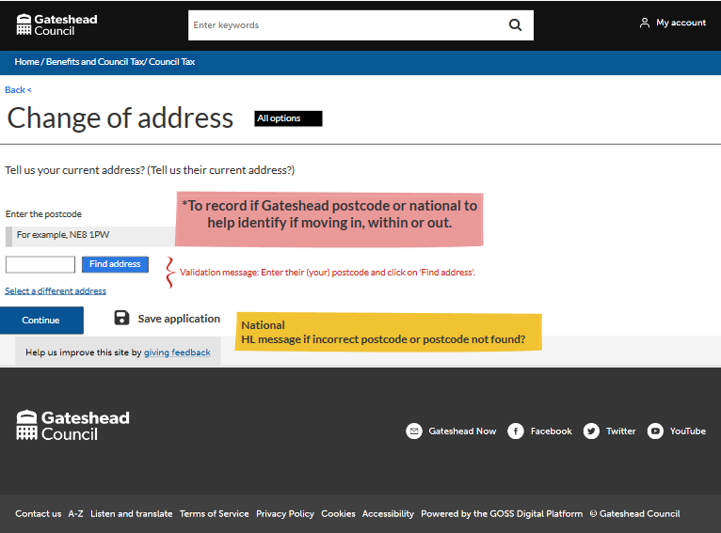
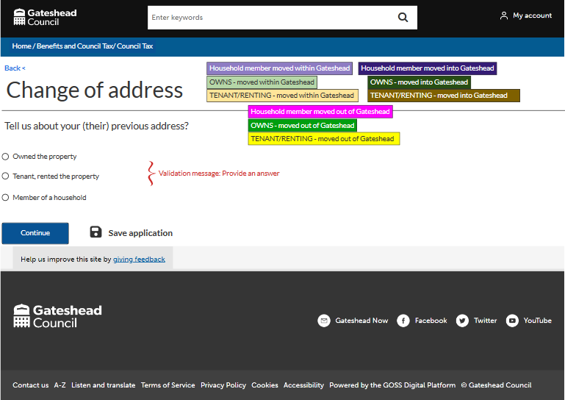
Sprint 51
Wireframe
Council Tax – Change of address
A few examples of the different options and routes through the form

Slide 5
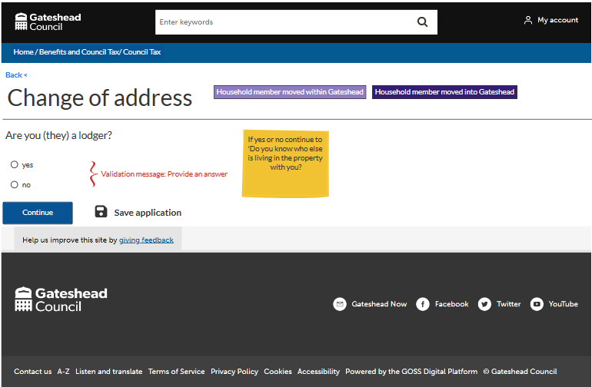
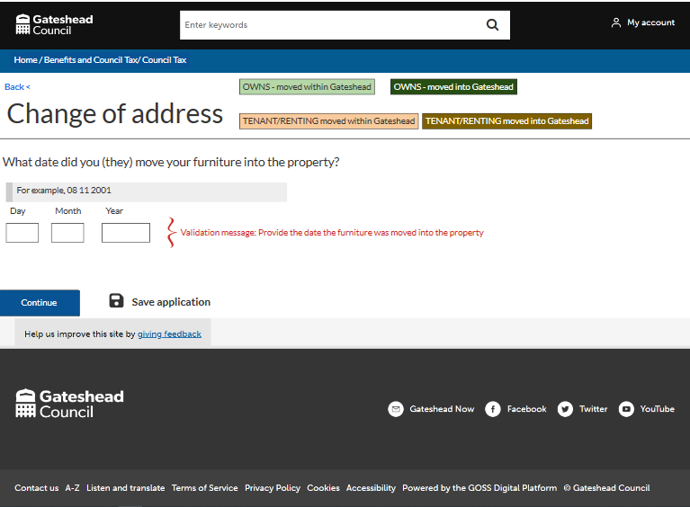
Sprint 51
Wireframe
Council Tax – Change of address
A few examples of the different options and routes through the form

Slide 6
Sprint 51
Content
Council Tax
Content redesign complete in PRP and sent to the service for UAT
Council Tax property left empty by a person receiving care [Development & Testing]

Slide 7
Sprint 51
Testing
Testing
Tenant vetting (main form) - back end stuff still to do
Council Tax property left empty by a person receiving care

Slide 8
Sprint 51
Wireframe
Alterations
Wireframe (including email responses) complete

Slide 9
Sprint 51
Development
Summary
Walk and Wheel updates
Council Tax property left empty by a person receiving care form feedback updates
MyAccount
Recent case dropdown
8x8 integration (With built in number formatting)
Account indicators
Form abandonment fixes
Triage bug fix

Slide 10
Sprint 51
Conclusion
What’s next?

