Slide 1
Sprint 52 Show and Tell 9 October 2024
C Squad
Digital Team

Slide 2
Sprint goal
Explore interaction logging and improvements to Customer Contact assist/My Account

Slide 3
Sprint goal: explore interaction logging
Context
Discovery to look at GOSS account registration in light of recent duplicates found
Mapped out the registration journey for advisers through Customer Contact
Identified assisting and interaction logging as another area for exploration - not working as it should
Links into corporate Customer Contact review - better data through reliable interaction logging should feed into this

Slide 4
Sprint goal: explore interaction logging
Process
Met with 2 CSU managers to discuss
Shadowed 2 advisers on North West Pavilion
Findings
8x8 pop ups should facilitate assisting…but this isn't always the case
Multiple tabs cause confusion
Interaction logging regarded as time-consuming
Culture of not getting customer details for anything other than service requests and My Gateshead account details

Slide 5
Sprint goal: explore interaction logging
Next steps and questions to answer
Mapping out interaction logging - are there a lot of steps/clicks?
What are the different routes that trigger interactions e.g. via assist search or via case search?
Explore the 8x8 pop ups - are advisers using these and are they working consistently?

Slide 6
Libraries newsletter

Slide 7
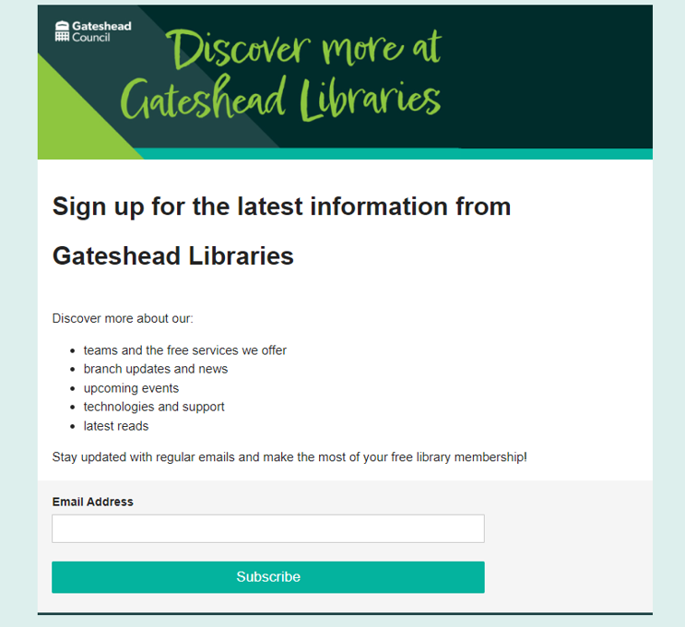
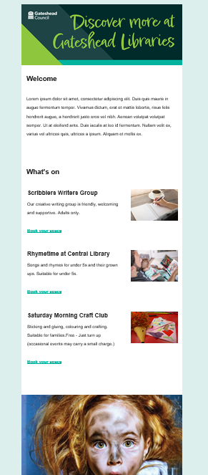
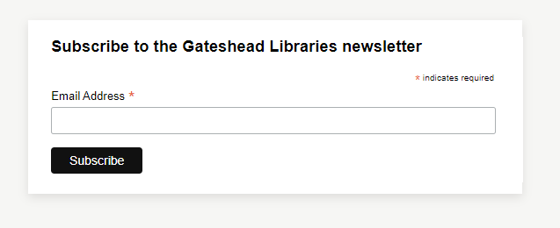
Libraries newsletter
Draft template created for new libraries newsletter. First issue to go out w/c 28 October.
Sign up landing page created
Embedded sign up form to add to library pages
Existing library membership form being amended to include sign up to newsletter
Content and design

Slide 8
Gateshead Now mailing list

Slide 9
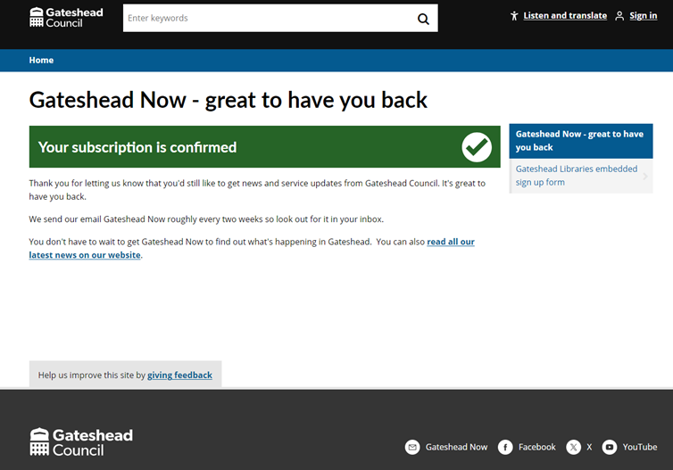
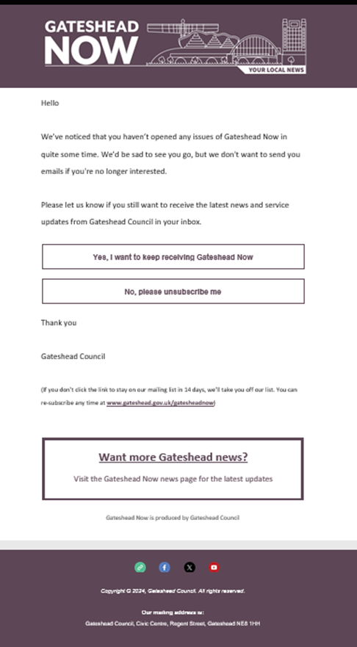
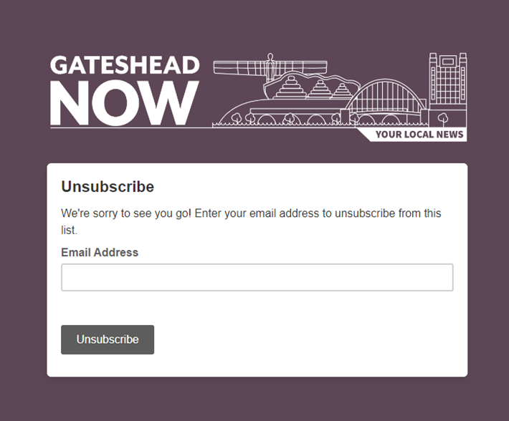
Gateshead Now
Email to go out to Gateshead Now subscribers who are disengaged on 9 October, (approx 10k).
Subscribers can indicate whether they want to still subscribe or be removed from the mailing list.
Anyone who doesn't open the email will be removed from the mailing list w/c 29 October
Content and design

Slide 10
Employee communication

Slide 11
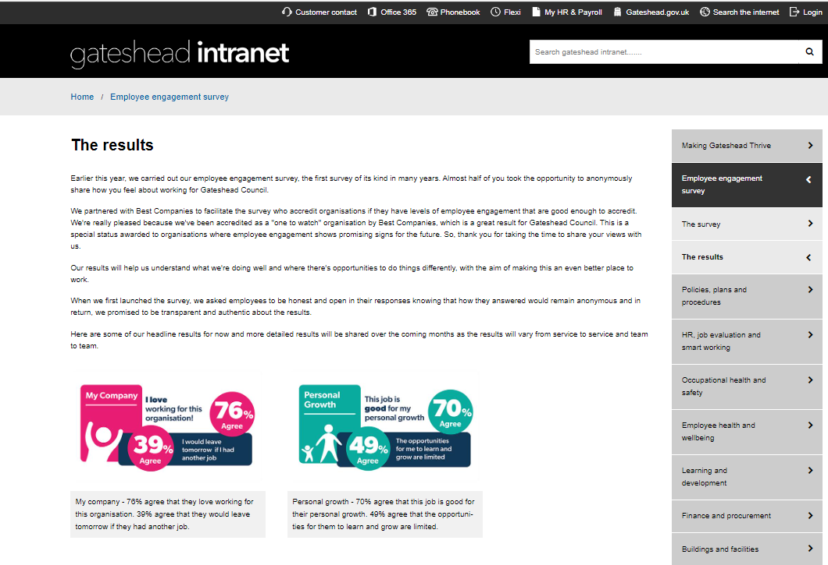
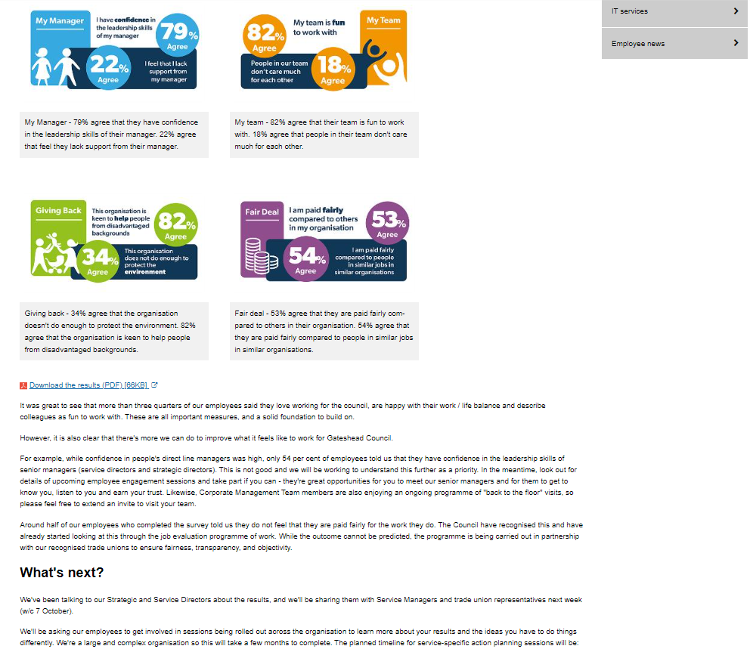
Employee survey results published
Employee survey results published on the intranet
The results - Gateshead Intranet
Content and design

Slide 12
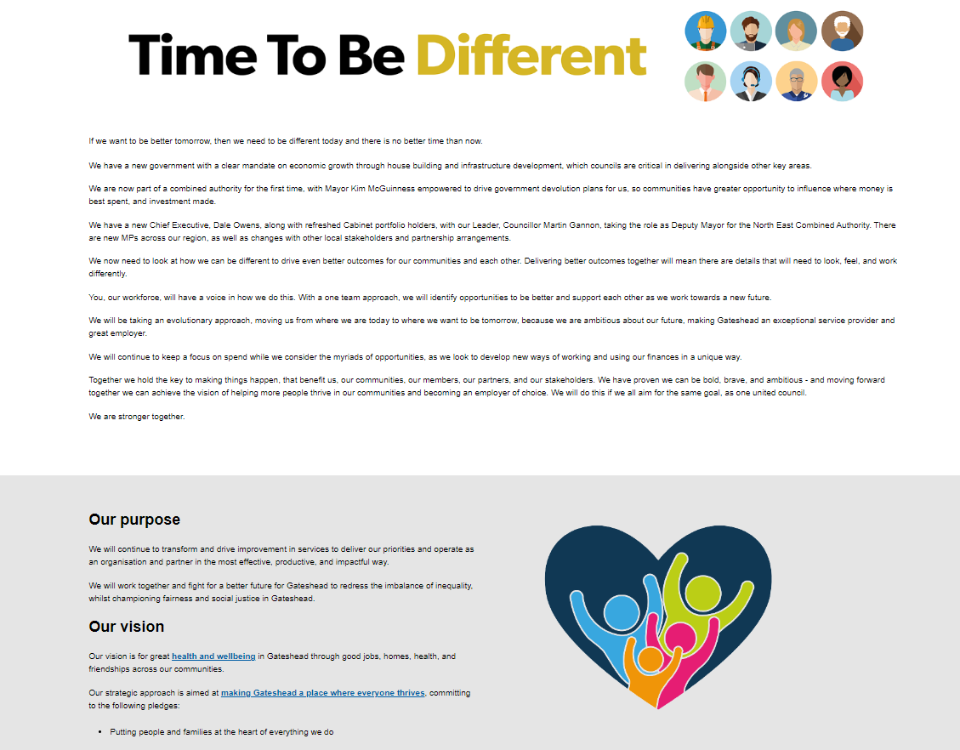
Time to be different
New HR section – Time to be different
Introducing golden thread, what we're doing to be different and how. New content around set up for success, values and behaviours
Updates to smarter working pages
Time to be different - Gateshead Intranet
Content and design

Slide 13
E-petitions

Slide 14
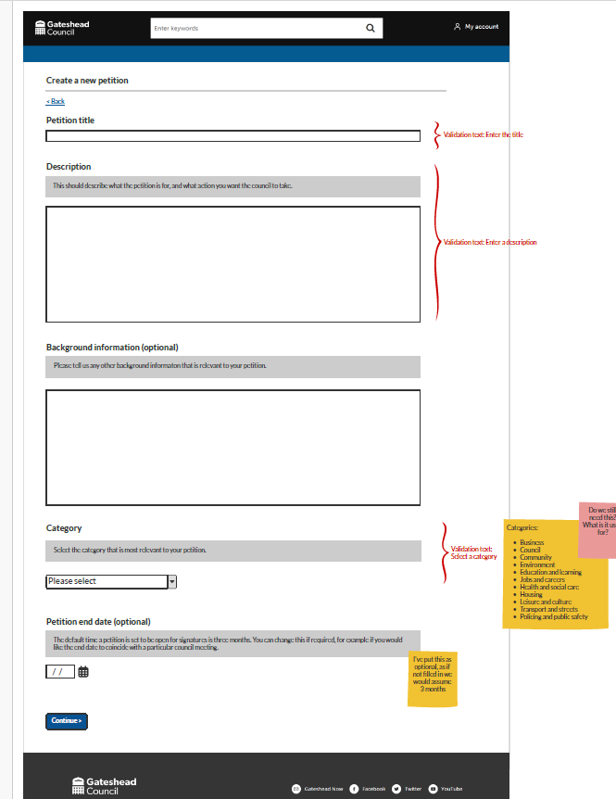
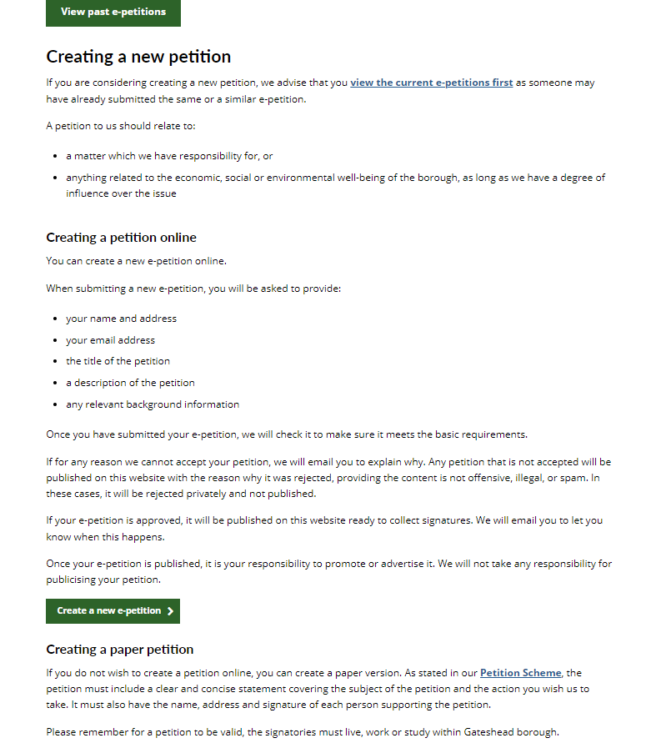
E-petitions
Wireframe for new e-petitions process
Web content update to reflect new process, and create pages instead of PDFs
Content and design

Slide 15
Other development tasks completed
Graphics request form – Initial development completed.
Removal of Covid questions from Pest Control and Bulky Waste processes.
Addition of an alert box to the Dangerous Structure process.
Renewal of ADFS keys – One click.
Update to read only page of the Digital Requests process.
Updated Civic room booking form and added case management.
Updated the late school application form for the upcoming application phase.
Development

Slide 16
Sprint 54

Slide 17
What's coming in the next sprint
Communications team graphics request
E-petitions development
Analysis of Direct Payment user research
Improvements to Policies and Strategies content
Senior recruitment content

Slide 18
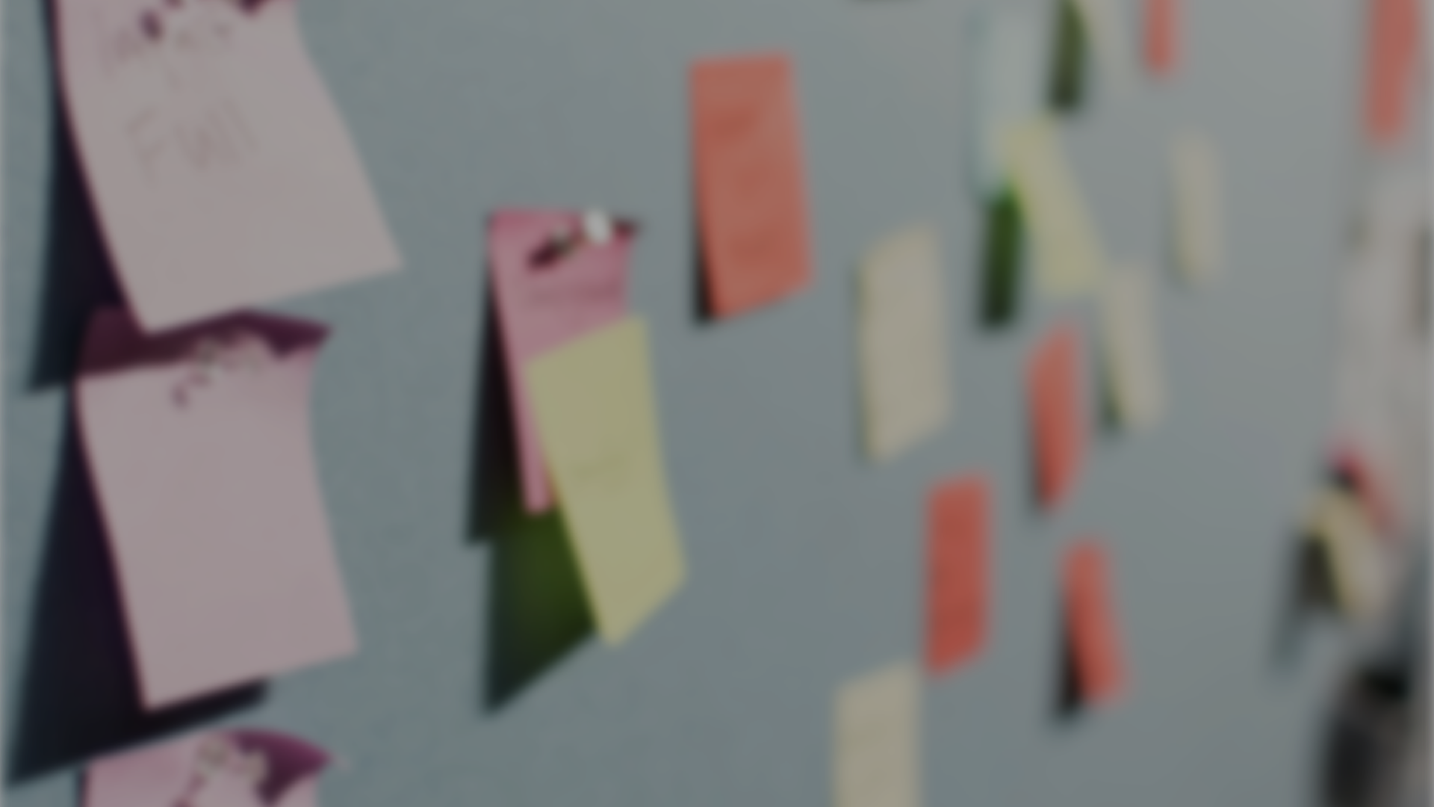
Thank you
That's all folks!

