Slide 1
Sprint 53 Show and Tell 16 October 2024
G Squad
Digital Team

Slide 2
Sprint 53
Introduction
Sprint Goals
Housing alterations development

Slide 3
Sprint 53
Content
Home ownership pages
Updated Right to Buy and Leaseholders content to comply with Regulator for Social Housing

Slide 4
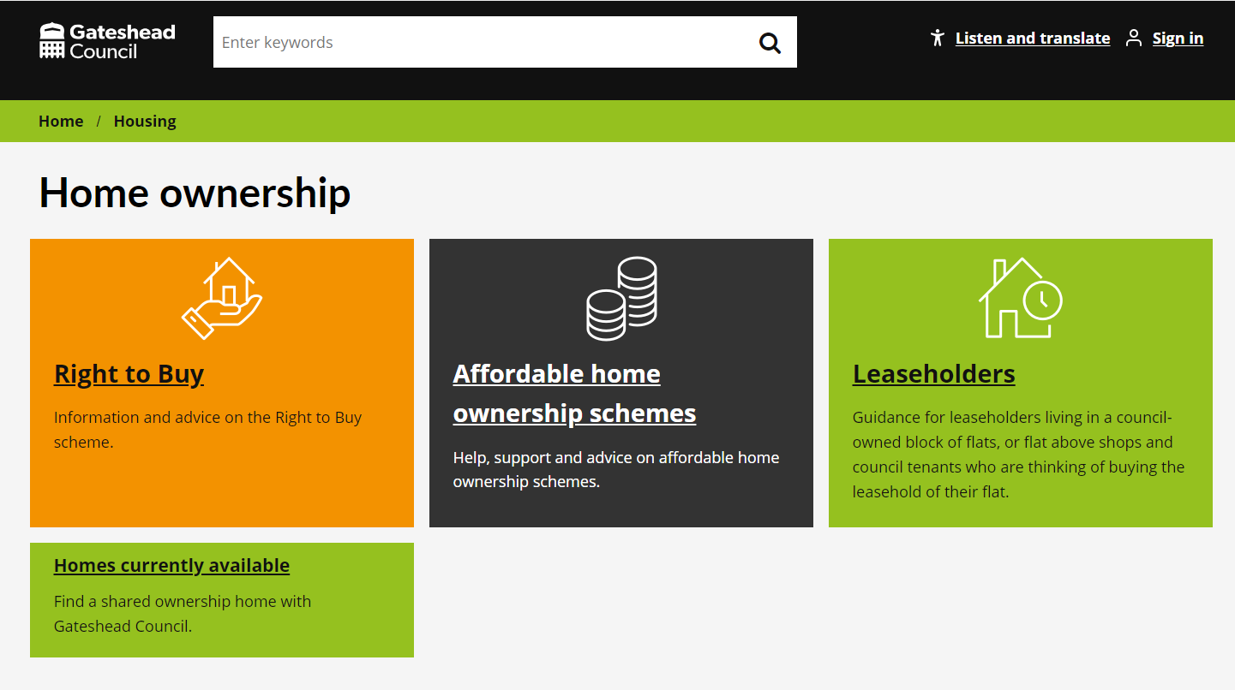
Sprint 53
Content
Plain English
Lower reading age
Up-to-date legislation
Help available (from us and independents)

Slide 5
Sprint 53
Content
Other content work
'Social housing in Gateshead' - in preprod
Sheltered schemes
HRA Business Plan

Slide 6
Sprint 53
Discovery
Complaints
Reviewing the proposed complaints form and case management

Slide 7
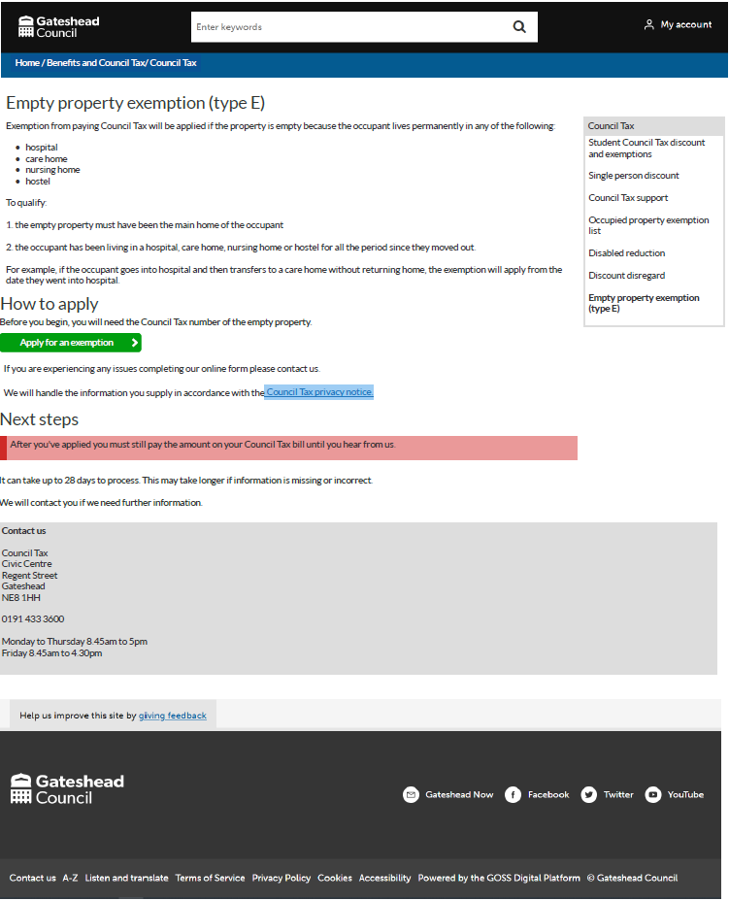
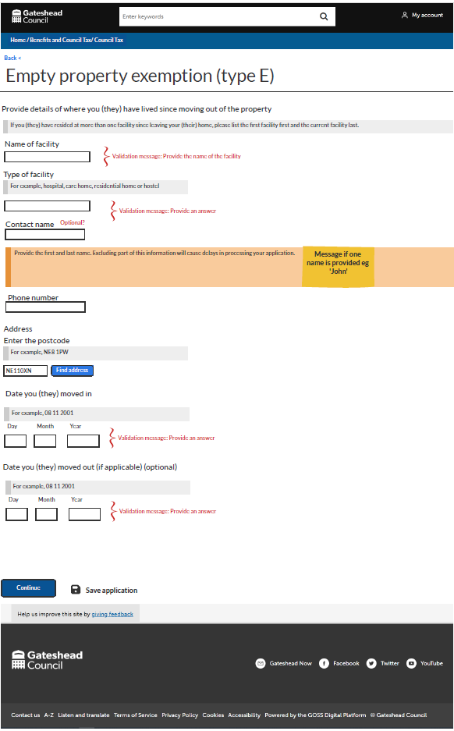
Sprint 53
Wireframes
Empty property exemption type E- occupant now lives permanently in a hospital, care home, nursing home or hostel

Slide 8
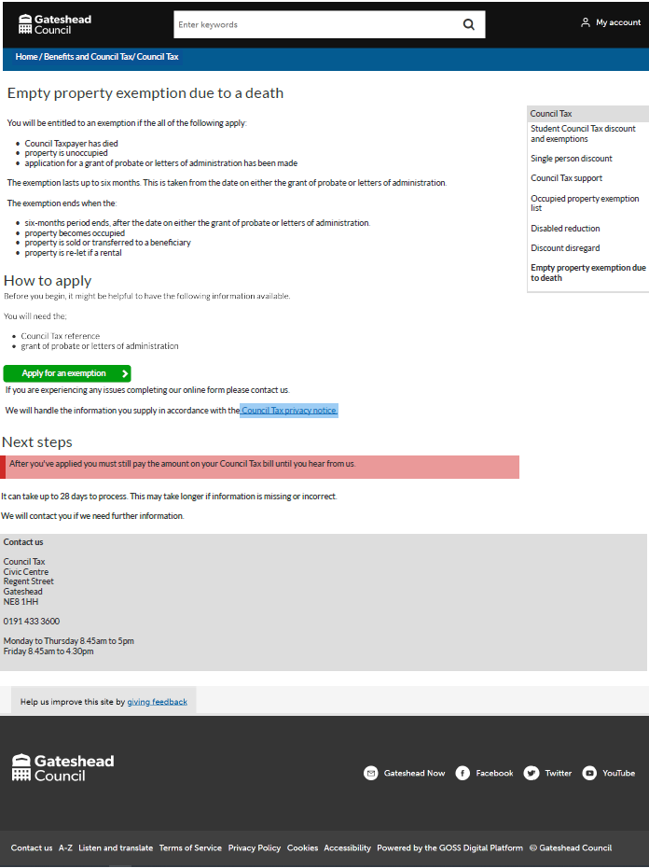
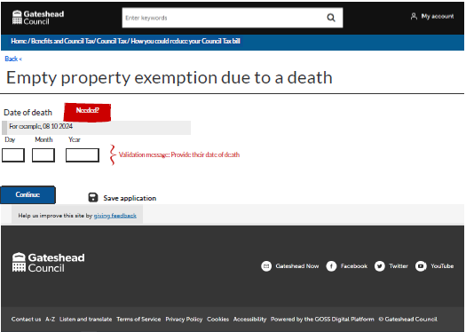
Sprint 53
Wireframes
Empty property exemption due to a death

Slide 9
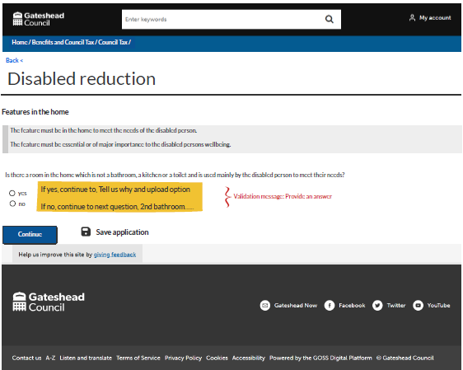
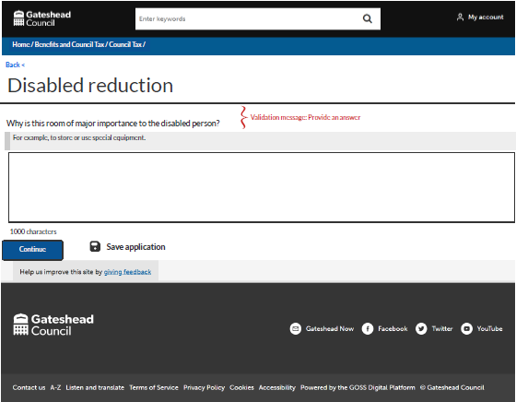
Sprint 53
Wireframes
Disabled reduction

Slide 10
Sprint 53
Development
Enhancing the User Experience for File Uploads
Utilising repeating pages to improve user experience

Slide 11
Sprint 53
Development
We’ve implemented the new Repeating page feature to streamline the process of uploading multiple files in our forms. Here are the key improvements:
Updated UI: A more intuitive design for easier navigation.
Clear information: Guidance to help users through the upload process.
Total file size limit: A cap of 10MB for all uploads combined.
Duplicate File Detection: Automatic identification of previously uploaded files.
Enhanced error messaging: More informative messages for a smoother experience.
Demo

Slide 12
Sprint 53
Development
Other development
Financial assessments: Implemented repeating pages to allow the service to collect three months' worth of financial statements for each account.
Council Tax student discount and exemptions: Final bug fixes and tweaks ready for go live.
Pavement licensing: Refactored to include payment reconciliation.

Slide 13
Sprint 53
Sprint 53
Conclusion
Conclusio
What’s next?
Continue with housing alterations development
Improvements to Bulky Waste process
Further Council Tax form developments

