Slide 1
Sprint 54 Show and Tell 23 October 2024
C Squad
Digital Team

Slide 2
Sprint goal
Prepare for LGA review
Transcribe Direct Payments user research interviews

Slide 3
Prepare for LGA review

Slide 4
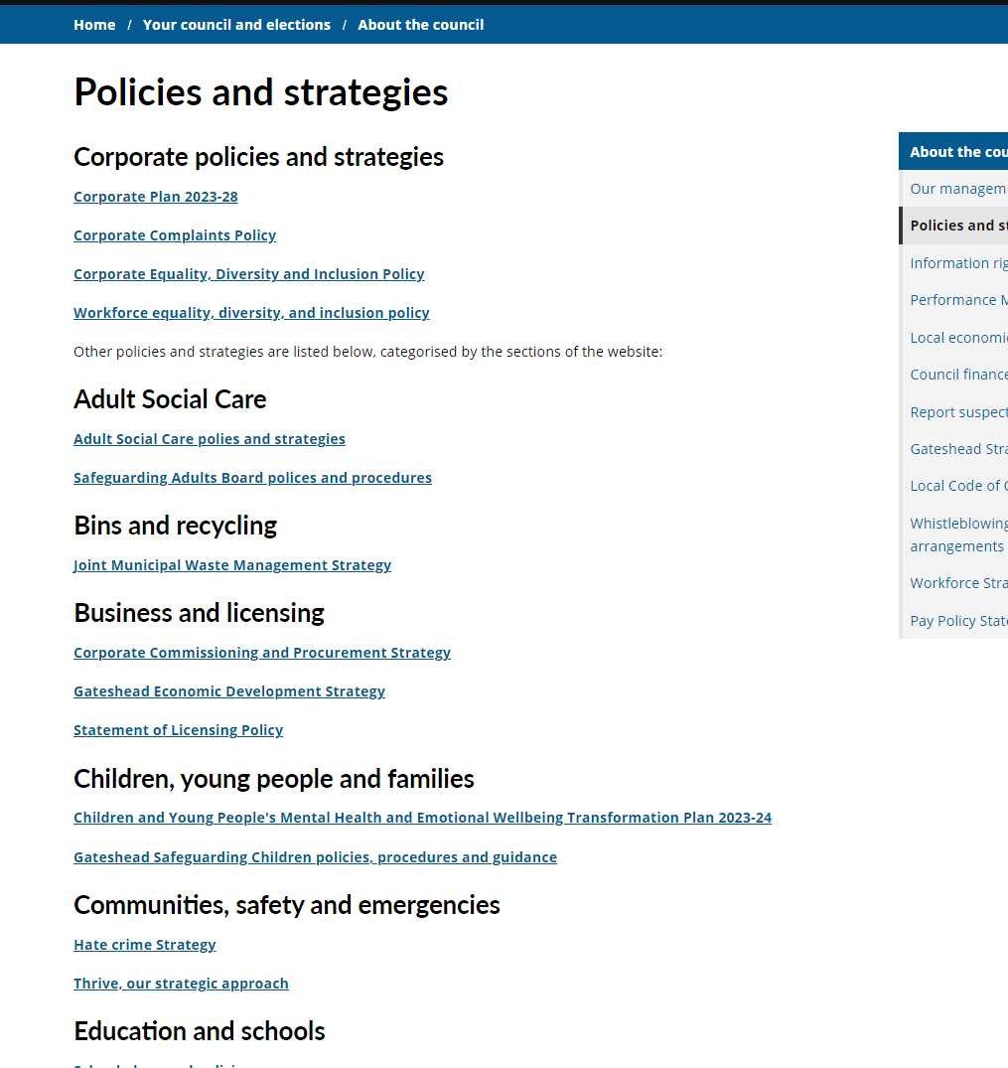
Policies and strategies content – phase 1
Review policies and strategies page: Policies and strategies - Gateshead Council
All policies and strategies moved into the relevant area of the website
Very old policies removed / hidden
Restructured page to follow new IA
Sprint goal

Slide 5
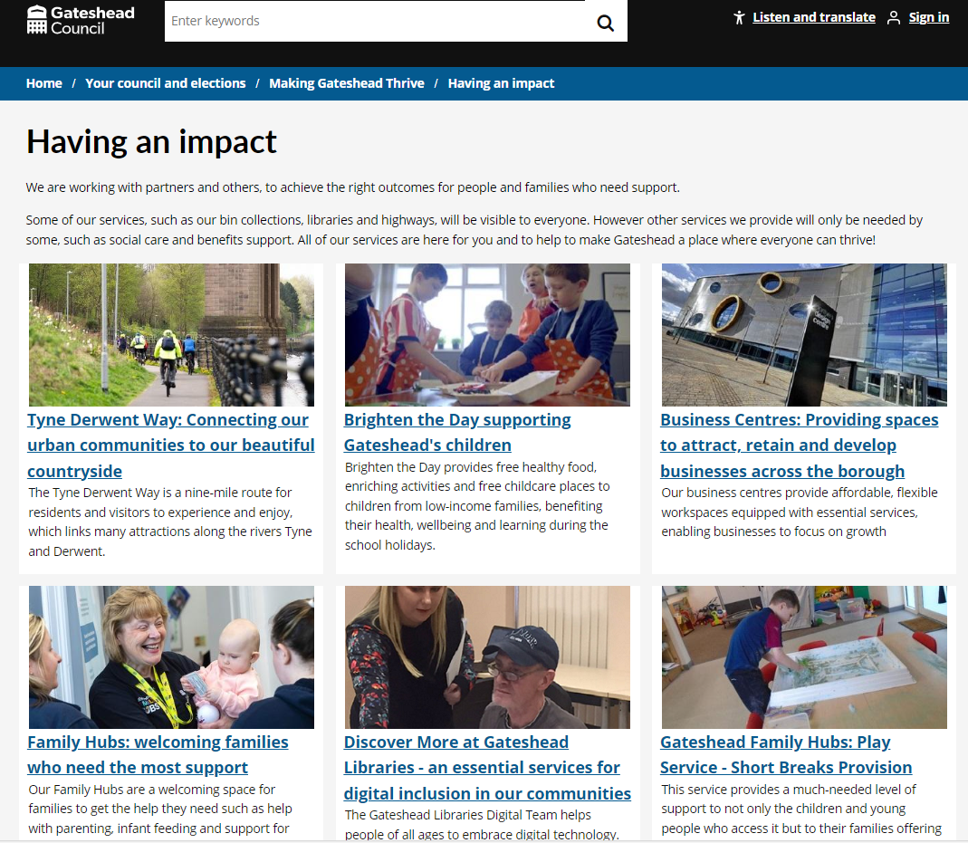
Preparation for LGA peer review - Making Gateshead Thrive
New Making Gateshead Thrive section being developed to bring together council pledges, corporate plan and engagement
New section featuring case studies of how our work in making an impact and helping to deliver thrive
Currently being developed in pre-prod to go live early November
Sprint goal

Slide 6
Direct Payments user research: lessons learnt

Slide 7
Context
Working on direct payments for a while to investigate the relatively poor uptake rate and build in improvements to the new Direct Payment Support Service (formally a smaller Direct Payments Team)
Discovery previously led by stakeholder conversations and mapping sessions
Wanted to do user research to find out more about the experience of those receiving direct payments and gather insights from this

Slide 8
Engagement
Put call out on website, through Gateshead Now and on the DP Team inbox autoreply
Also put in touch with Gateshead Parent Carer Forum through Children's Services
After call out, leaders from Jewish Community Council of Gateshead got in touch

Slide 9
Results
8 interviews so far
Rich and varied insights from interviews
Agreed on focus group(s) with JCCG who are working with us to find participants

Slide 10
Lessons learnt
Planning is everything.
Prepare...
Rooms
Incentives
Questions (with follow up questions as a back-up)
Refreshments
Recording device
Transcribing plan!
Your own answers to questions from volunteers about the research (especially around outcomes)

Slide 11
Lessons learnt
Participation
Promote your research – talk to colleagues for ideas of engagement
If participation is lacking, target existing organisations and groups
Quality of insights
Factor in representation – consider your users and try and find different experiences
Provide volunteers questions beforehand
Keep your questions open

Slide 12
Senior officer recruitment microsite

Slide 13
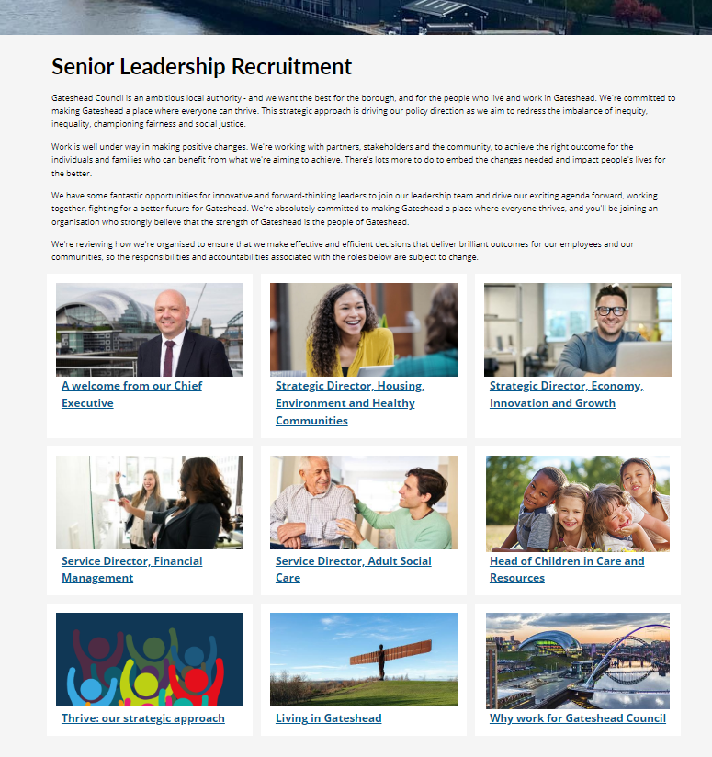
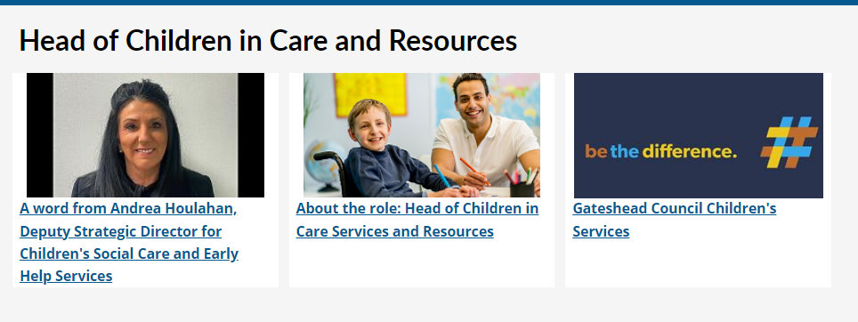
Senior officer recruitment
Developed new pages for 5 roles.
Worked with Penna to develop pages for:
Strategic Director - Housing, Environment and Healthy Communities
Strategic Director - Economy, Innovation and Growth
Service Director - Financial Management
Service Director - Adult Social Care
Worked with North Yorkshire Council to develop pages for:
Head of Children in Care and Resources
Senior Leadership Recruitment - Gateshead Council
Corporate

Slide 14
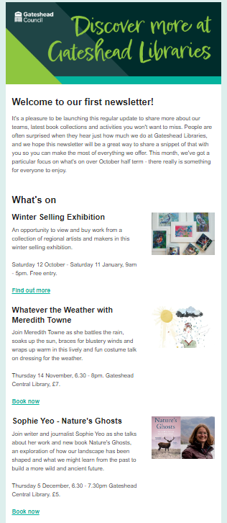
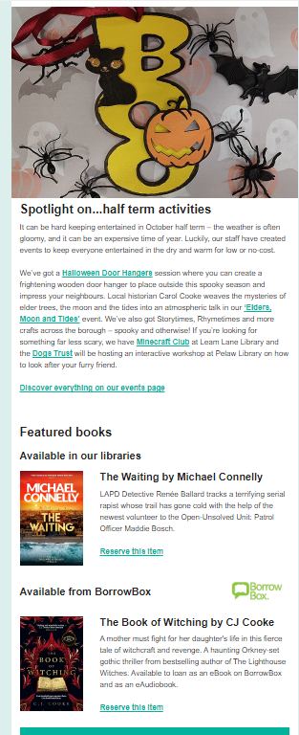
Libraries newsletter
First issue of Gateshead Libraries new monthly newsletter featuring what's on highlights, spotlight on events and new books to loan
Issue to be sent to subscribers on Friday 25 October ahead of half term
Libraries

Slide 15
Sprint 56

Slide 16
What's coming in the next sprint
Return a bin
Comms intranet pages
Changes to late school applications

Slide 17
Deployments

Slide 18
Thank you
That's all folks!

