Slide 1
Sprint 55 Show and Tell 30 October 2024
G Squad
Digital Team

Slide 2
Sprint 55
Introduction
Sprint Goals
Continue with housing alterations development
Improvements to Bulky Waste process
Further Council Tax form developments

Slide 3
Sprint 55
Content
Intro
Content

Slide 4
Sprint 55
Wireframes
Council Tax
Reviewed with the Council Tax team and revised:
Empty property exemption class E
Empty property class F
Disabled reduction

Slide 5
Sprint 55
Wireframes
Council Tax
Created
Apprentice discount
Empty property while tenant/owner moved out to provide personal care class J

Slide 6
Sprint 55
Testing
Testing
Forms tested this sprint:
Council Tax Support for UC claimants
Alterations (aka Improvements)
Tenant vetting

Slide 7
Sprint 55
Content
Sheltered housing
Previously no content
New photography
Advanced search/Location Gateshead bespoke (non bookings) templates

Slide 8
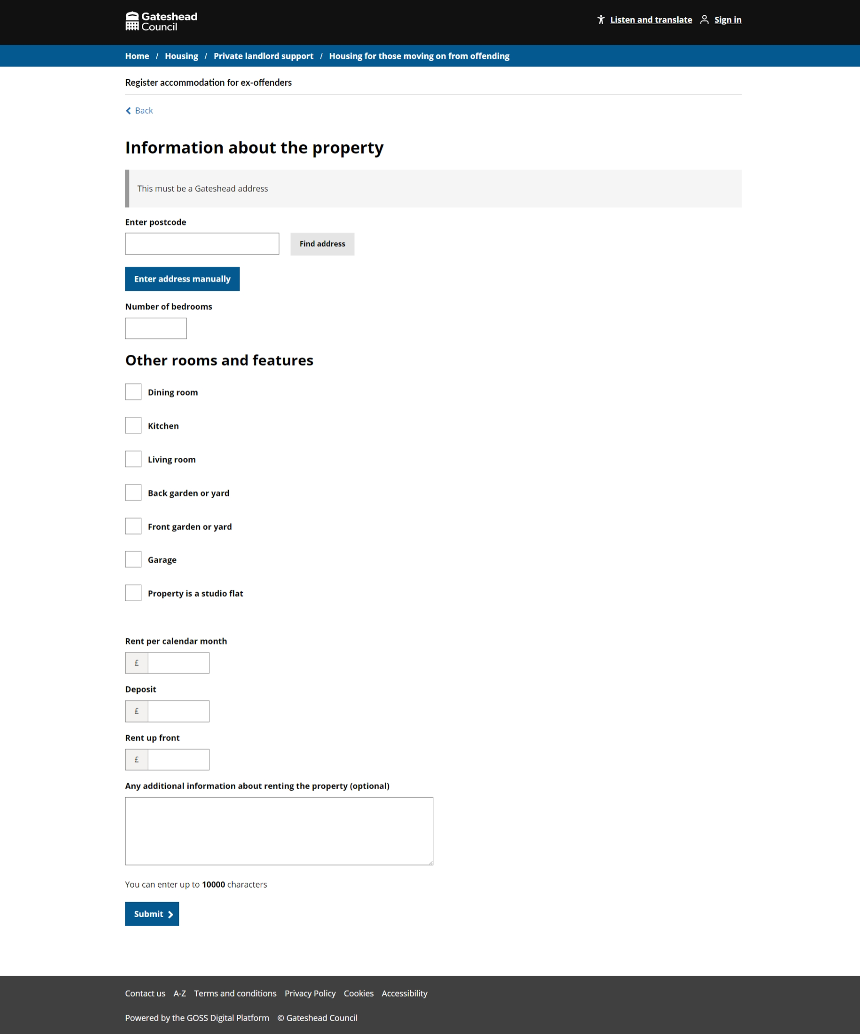
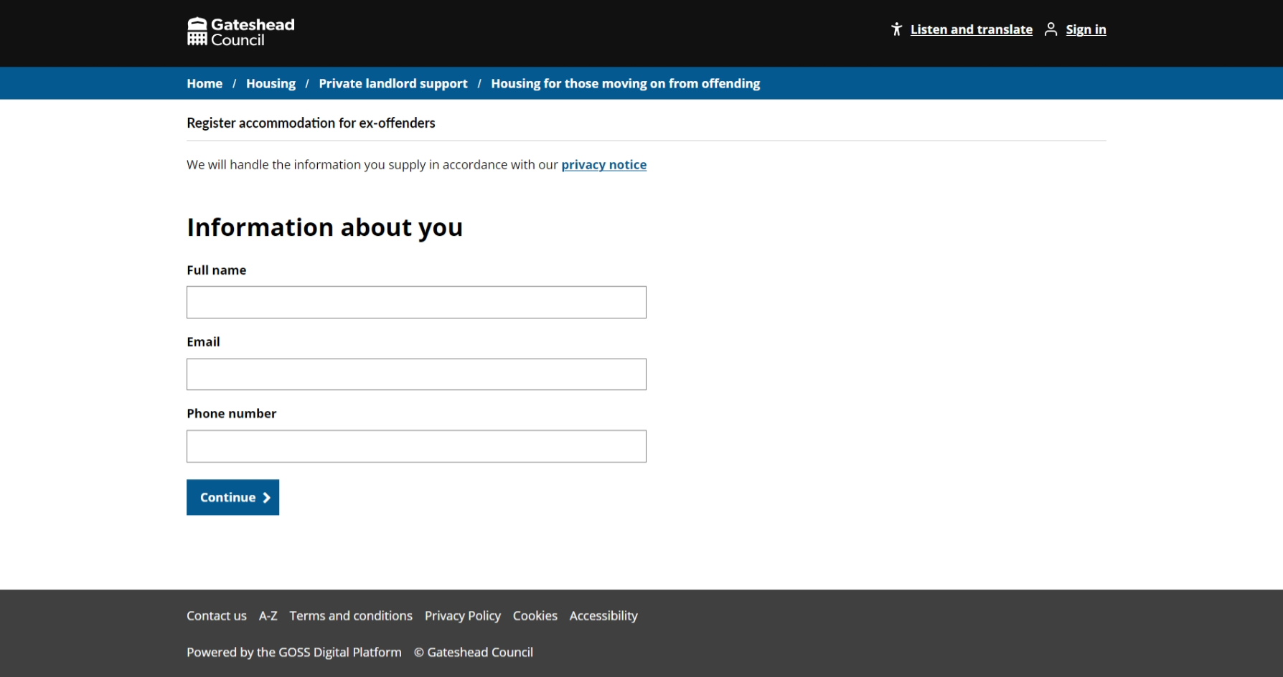
Sprint 55
Go-live
Housing for ex-offenders
Part of a campaign to encourage landlords
Simple contact form – goes to email

Slide 9
Sprint 55
Sprint 55
Conclusion
Conclusio
What’s next?

