Slide 1
Sprint 56 Show and Tell 6 November 2024
C Squad
Digital Team

Slide 2
Sprint goal
Launch garden waste
campaign for 2025

Slide 3
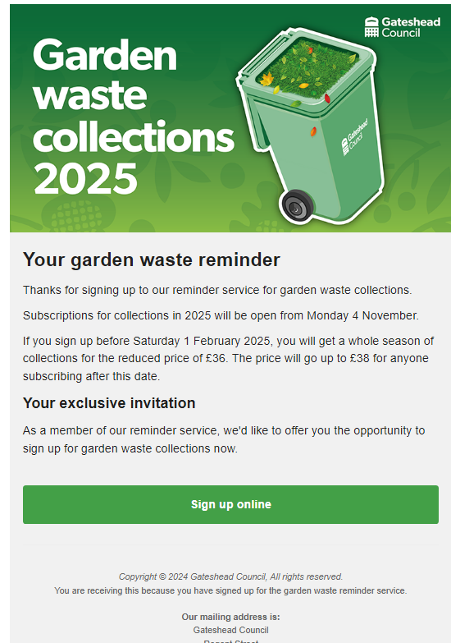
Send Garden Waste email to early adopters
Email sent to 358 residents who signed up to be reminded about Garden Waste subscriptions for 2025.
Email sent on Friday 1 November as an 'early adopters' offer before Garden Waste opened up to everyone on Monday 4 November
67 online sign ups from this email over the weekend
Garden Waste

Slide 4
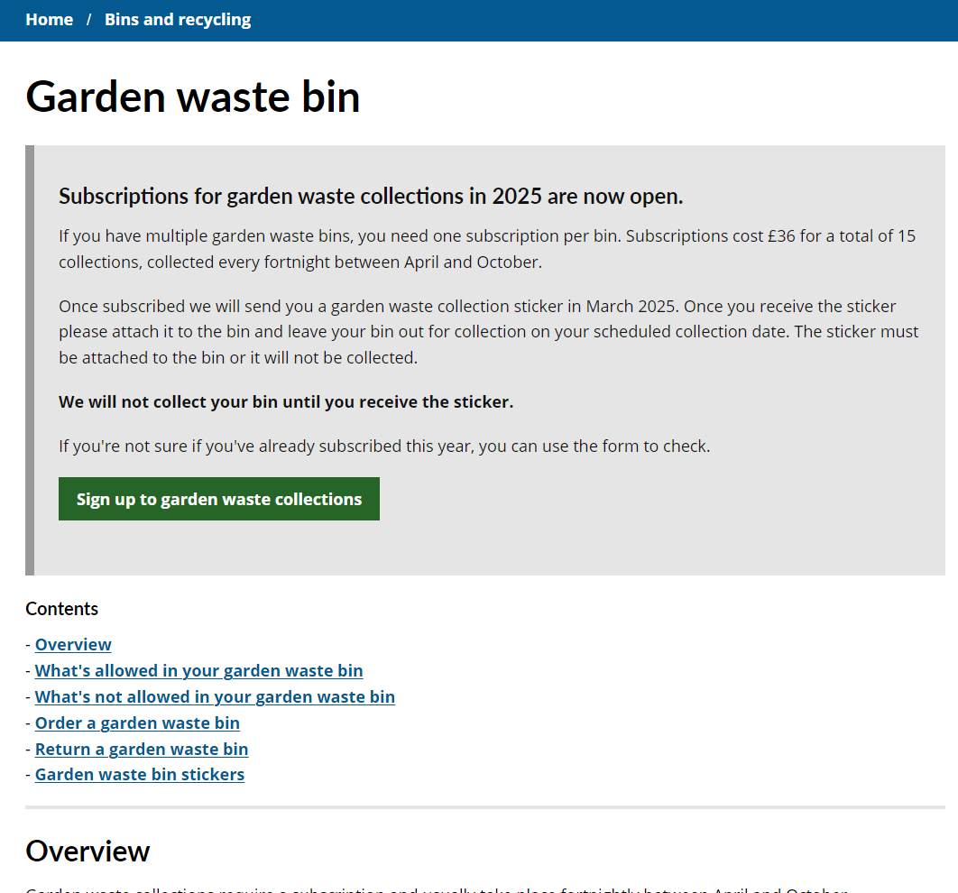
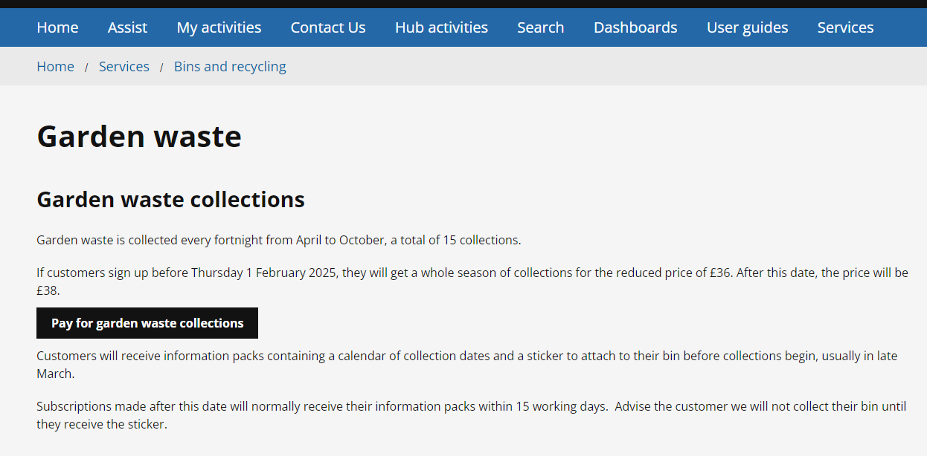
Garden Waste subscriptions reopened
www.gateshead.gov.uk/gardenwaste
Signups reopened on the website and Customer Contact on Monday 4 November
Garden Waste

Slide 5
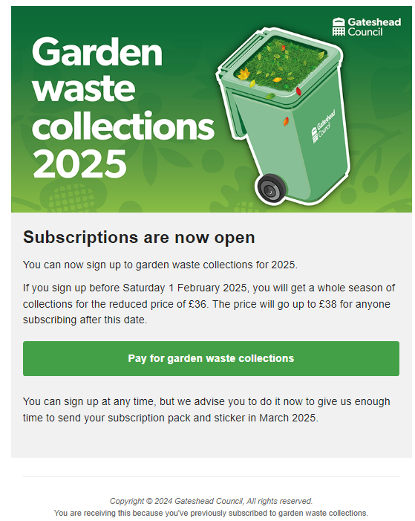
Send Garden Waste email to all past subscribers
Email sent to 20,731 residents who have signed up to Garden Waste in the past
Email sent at 2pm on Tuesday 6 November to coincide with letters arriving that had been sent to all eligible households
As of 9am on 6 November, we had 1463 online sign ups (95%) and a total of 1484 altogether.
Garden Waste

Slide 6
Direct payments - user research analysis

Slide 7
Context
Working on direct payments for a while to investigate the relatively poor uptake rate and build in improvements to the new Direct Payment Support Service
User research undertaken to find out more about the experience of those receiving direct payments and gather insights from this
9 interviews total
Focus group with Jewish Community Council of Gateshead hopefully pending
Have started analysis on interviews
Direct payments

Slide 8
Analysis process so far
Transcription highlighting key quotes affinity mapping spreadsheet
Spreadsheet now contains our key quotes categorised into themes and sub-themes
Have included more colleagues in analysis to improve the quality and reduce risk of bias –highlighting key quotes and points
Direct payments

Slide 9
Analysis next steps
Some more squad involvement with analysis
Draw out pain points and suggestions
Customer journey mapping to highlight the different experiences and needs of different users
Identifying user needs. Just as important as the user suggestions…
Direct payments

Slide 10
Deployments

Slide 11
Thank you
That's all folks!

