Slide 1
Sprint 57 Show and Tell 13 November 2024
G Squad
Digital Team

Slide 2
Sprint 57
Introduction
Sprint Goals
Report a breach in PlanX
Update to unlit bonfire
Continue with Council Tax developments

Slide 3
Sprint 57
Content
Intro
Content

Slide 4
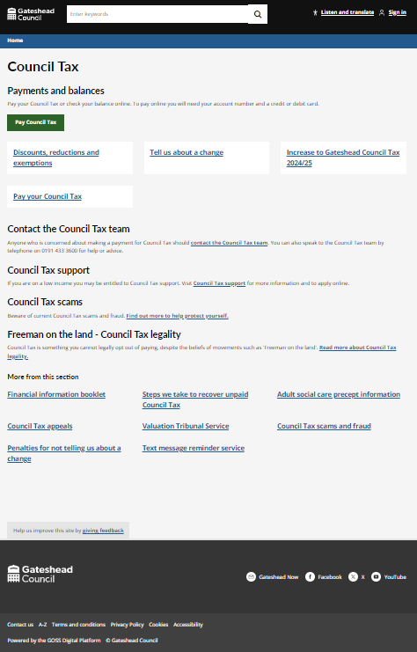
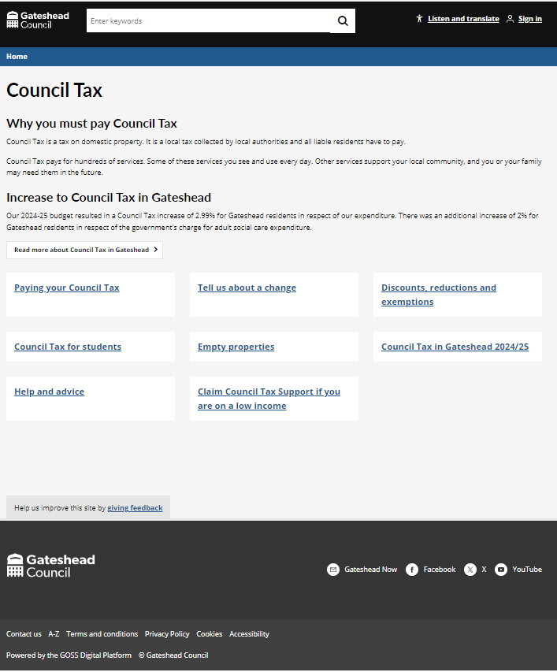
Sprint 57
Content
Council Tax
On left - old On right - new

Slide 5
Sprint 57
Content
Title

Slide 6
Sprint 57
Development
Household Support Fund (v6)
Gateshead Council has been allocated £1.8m in the 6th iteration of the Household Support Fund
The scheme will run until 31 March 2025
The service has new criteria around eligibility. This has been added to the form. More information is collected from each applicant​ to help the service more efficiently process each application
Demo of HSF application form

Slide 7
Sprint 57
Content
Housing improvement request
Demo

Slide 8
Sprint 57
Content
Minor Works Discovery

Slide 9
Sprint 57
Sprint 57
Conclusion
Conclusio
What’s next?
Housing improvements UAT
Bin delivery dashboard improvements
Council Tax discounts / exemptions
Person in detention
Unoccupied and owned by a charity

