Slide 1
Sprint 58 Show and Tell 20 November 2024
C Squad
Digital Team

Slide 2
Sprint goal
Complete affinity mapping for Direct Payments

Slide 3
Context
Working on direct payments for a while to investigate the relatively poor uptake rate and build in improvements to the new Direct Payment Support Service
User research undertaken to find out more about the experience of those receiving direct payments and gather insights from this
Transcription highlighting key quotes affinity mapping spreadsheet
dashboard
Direct Payments

Slide 4
Next steps – Customer journey mapping
Customer journey mapping is underway
Three maps – adults / carers / children’s
A useful way to present findings from user research as it shows the customer journey from start to finish
Shows pain points and emotions of the customer which helps to develop empathy
Gives us a better understanding of the customer and helps to identify user needs
We can identify improvement opportunities against each step of the journey
Direct Payments

Slide 5
Corporate

Slide 6
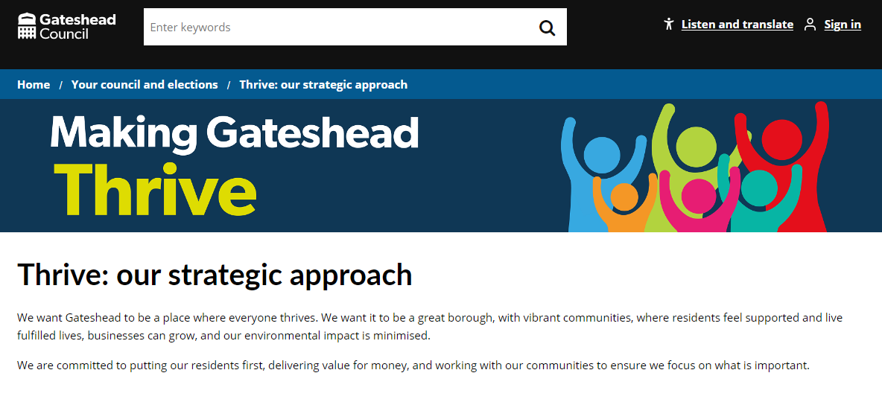
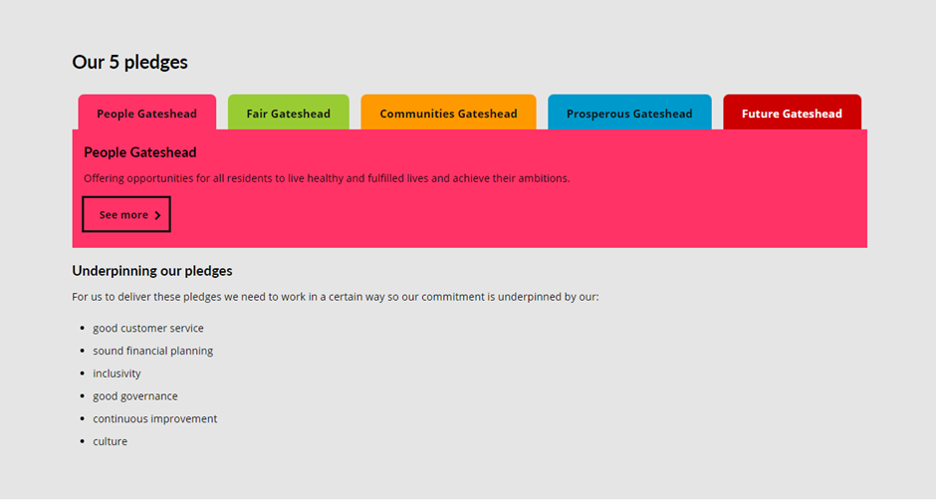
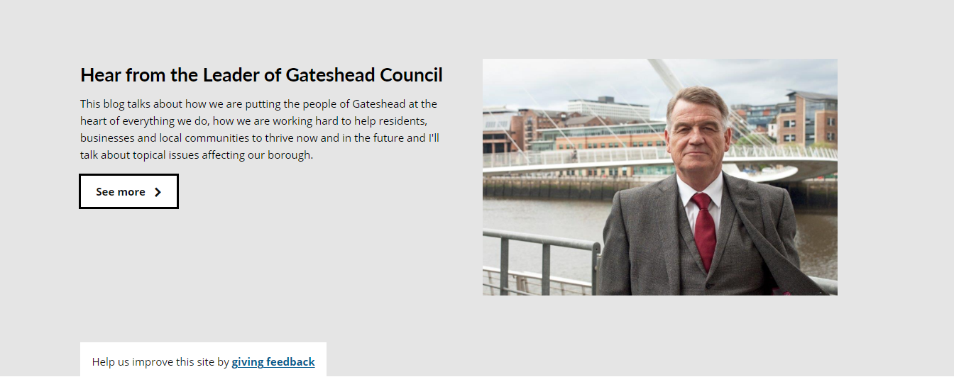
Thrive new content
New content added to demonstrate what we're doing to help Gateshead residents to thrive
Using panel template added tab feature show pledges and a news carousel for 'our stories'
Making Gateshead Thrive - Gateshead Council
Office of the Chief Executive

Slide 7
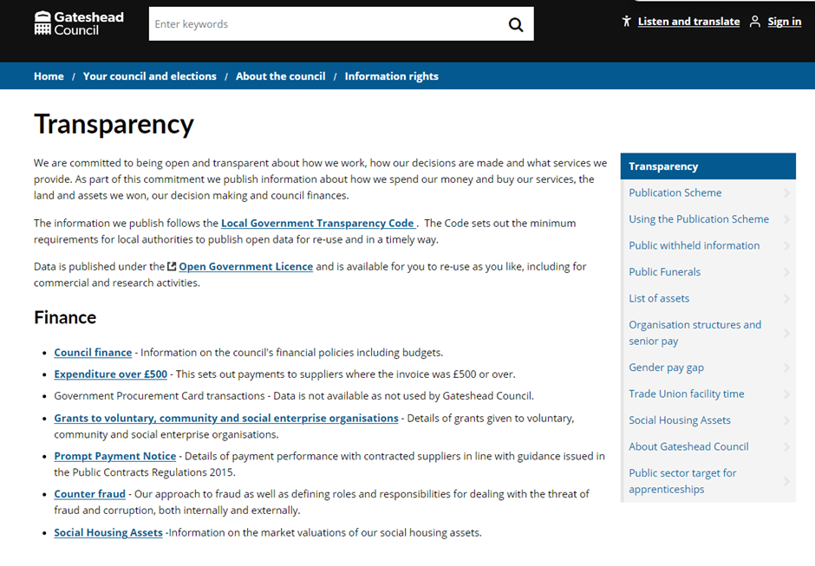
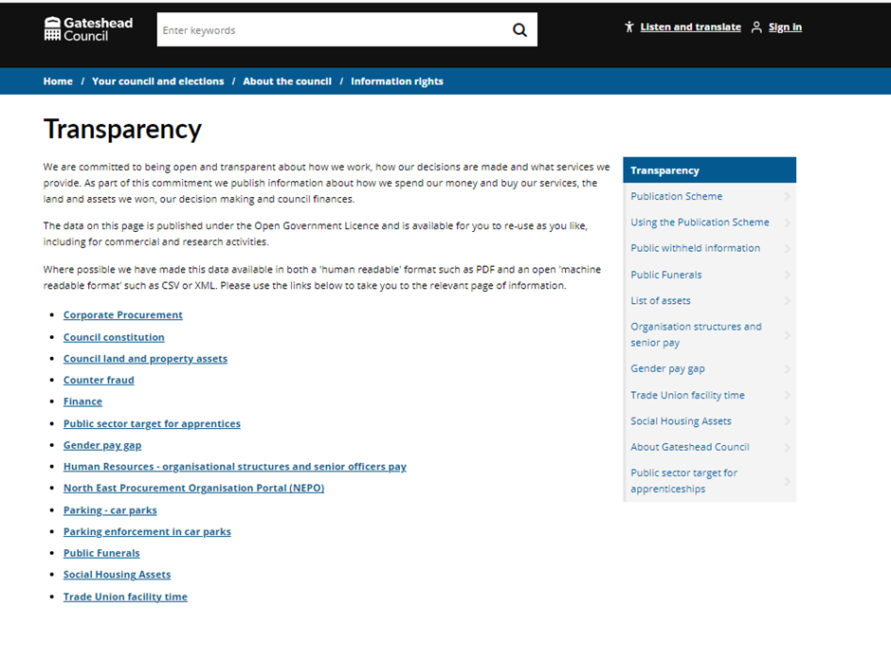
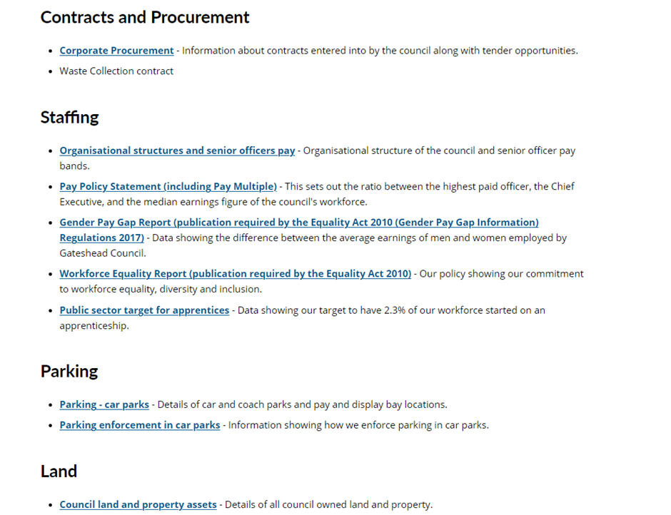
Transparency
Internal audit reviewed our transparency web pages and judged they were insufficient. Page lacked detail, missing links and not user friendly
Worked with service director to improve content
Will add more detailed content in the intranet in a future sprint
Legal and Democratic Service

Slide 8
What's next
Shadowing CSU to understand use of assist/search/interaction log
Appeal a school place decision
Learning skills contact
Pavement licence
Bulky waste POPs
Community volunteer newsletter
What's next

Slide 9
Deployments

Slide 10
Thank you
That's all folks!

