Slide 1
Sprint 59 Show and Tell 27 November 2024
G Squad
Digital Team

Slide 2
Sprint 59
Intro
Sprint Goals
Get tenant vetting process ready for service to test.
Get Housing Alterations ready for the service to test.
Digital Panel testing the Housing Chatbot

Slide 3
Sprint 59
User testing
Housing chatbot testing

Slide 4
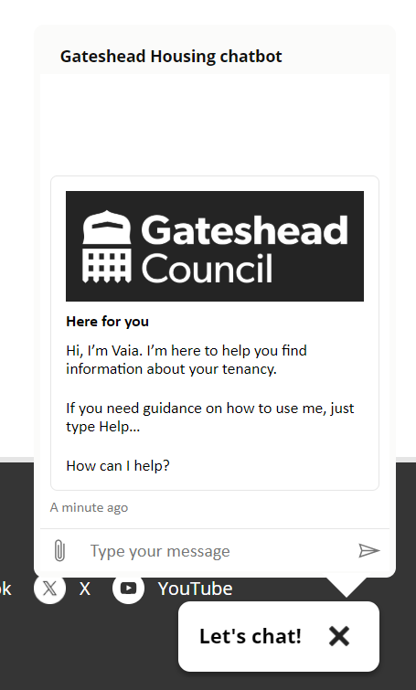
Sprint 59
User testing
Housing chatbot testing

Slide 5
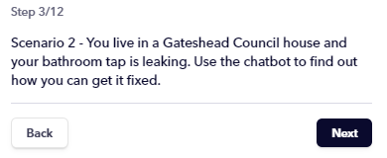
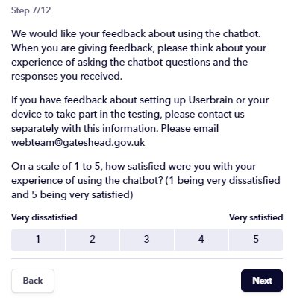
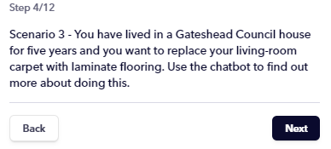
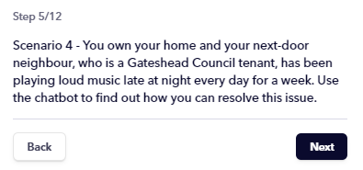
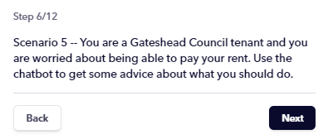
Sprint 59
User testing
Digital panel
Userbrain
Five scenarios
Short survey
Housing chatbot testing

Slide 6
Sprint 59
Demo
Tenant vetting demo

Slide 7
Sprint 59
Development
Bridging Systems
Seamlessly retrieving external files for use in GOSS

Slide 8
Sprint 59
Bridging Systems
The Challenge
When a tenant submits an alteration request for review, the required information is stored in housing's document management system.
To ensure the service has complete and accurate data, we need to retrieve asbestos survey information, which is stored as PDF files.
Notes:
What Was the Problem?
Title: Disconnected Systems
Important files were stored in a separate system, out of reach.
Case managers needed to jump between systems to gather information.
This caused delays and made managing cases less efficient.

Slide 9
Sprint 59
Bridging Systems
The Solution
Identifying the survey
Used established Northgate APIs to check for asbestos surveys on tenant properties.
Retrieving the survey
Accessed the document management system’s APIs to retrieve the survey, received in base64 format.
Processing the file
Developed a server-side script to convert the base64 file into binary for upload to GOSS.
Connecting to the case
The script automatically links the survey file to the tenant’s application using the case reference number.
1
3
2
4
Notes:
What Was the Problem?
Title: Disconnected Systems
Important files were stored in a separate system, out of reach.
Case managers needed to jump between systems to gather information.
This caused delays and made managing cases less efficient.

Slide 10
Sprint 59
Bridging Systems
The Benefits
Faster case resolution Immediate access to asbestos surveys speeds up case reviews.
Service efficiency Automated document retrieval minimises manual tasks, improving overall service efficiency and reducing risk of errors.
Better decision-making Case managers have all relevant information to hand, leading to more informed and timely decisions.
Improved tenant satisfaction: Case manager improvements contribute to a quicker and better tenant experience.

Slide 11
Sprint 59
Bridging Systems
What Next?
Leverage knowledge for future projects: We can apply what we've learned to expand and enhance other areas of the service.
Explore other external systems: This approach can be extended to integrate with other external systems that have similar file APIs.
Monitor API stability: We will continue to review and assess the stability of the current API to ensure ongoing accuracy and reliability.

Slide 12
Sprint 59
Development
Payment reconciliation dashboard

Slide 13
Sprint 59
Conclusion
What’s next?
Council Tax SMI go live
Further Council Tax discount and exemption forms
Alterations and Tenant Vetting user acceptance testing

