Slide 1
Sprint 60 Show and Tell 4 December 2024
C Squad
Digital Team

Slide 2
Sprint goal
Display POPs information to the right customer at the right time

Slide 3
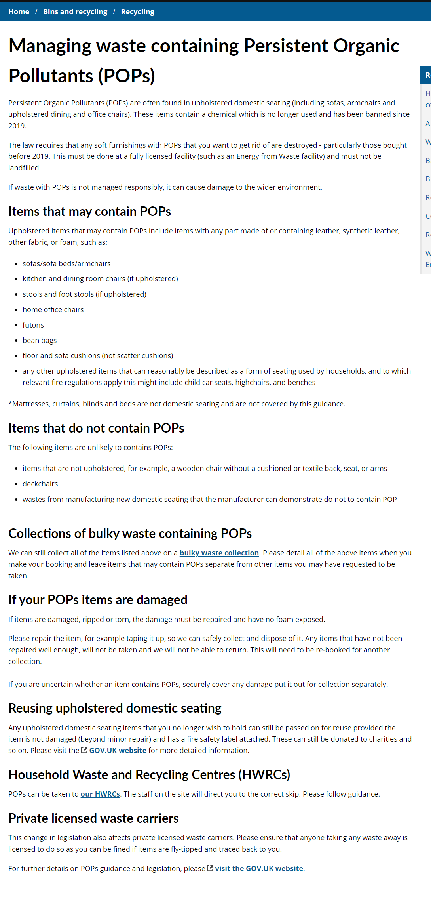
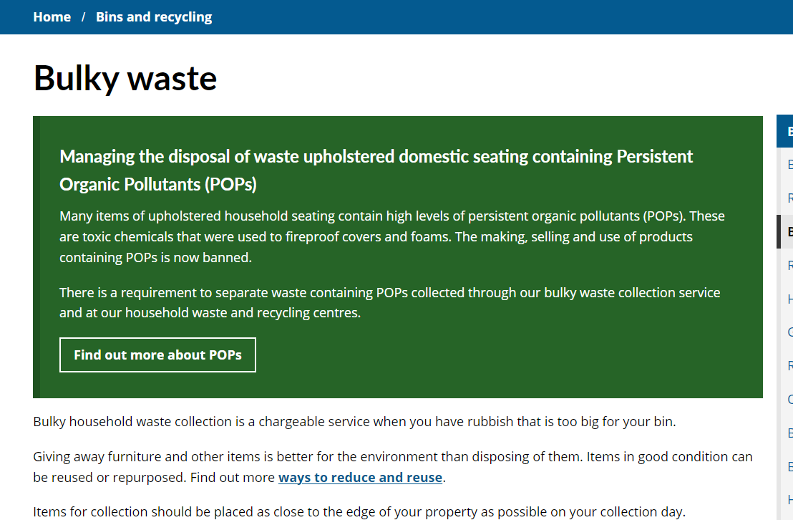
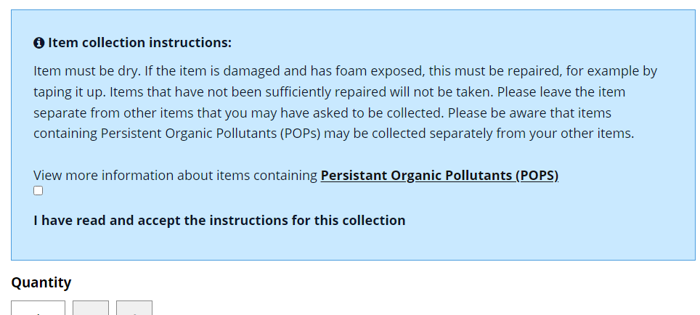
Content added to website about managing waste containing POPs (Persistent Organic Pollutants) Managing waste containing Persistent Organic Pollutants (POPs) - Gateshead Council
Highlight box added to bulky waste and HWRC pages
Instructions for items containing POPs in bulky waste collections added to the form
POPs

Slide 4
Direct Payments – Customer Journey Mapping

Slide 5
Context
Working on direct payments for a while to investigate the relatively poor uptake rate and look for opportunities to build the new Direct Payment Support Service
Nine interviews completed with direct payment recipients to find out more about the experience of those receiving direct payments and gather insights from this
Completed an affinity mapping exercise to pull out key quotes and categorise them into themes and sub-themes – compiled these into a dashboard
But still felt like there was more we had learned that we wanted to get across in a different way, with a different focus…
Direct payments

Slide 6
Customer journey mapping
Customer journey mapping completed
Three maps – adults / carers / children’s
A useful way to present findings from user research as it shows the customer journey from start to finish
Shows pain points and emotions of the customer which helps to develop empathy
Gives us a better understanding of the customer and helps to identify user needs
We can identify improvement opportunities against each step of the journey
Direct payments

Slide 7
Next steps
Content updating to meet user needs identified (take it away, Gemma)
Completing roadmap to plan for designing and developing digital outputs
Report to compile discovery exercise methodology, findings and recommendations
Direct payments

Slide 8
Children's services

Slide 9
Appeal a school place decision
Process map
Next
Develop an MVP
Explore case management
School place appeal

Slide 10
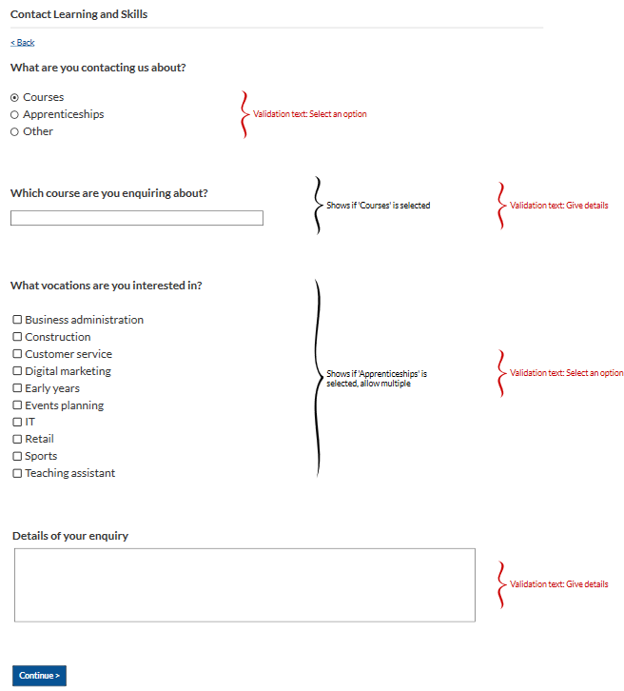
Learning skills migration
First draft of landing page and content designed and developed
Learning and Skills - Gateshead Council
Contact form wireframe developed
Learning skills

Slide 11
Licensing

Slide 12
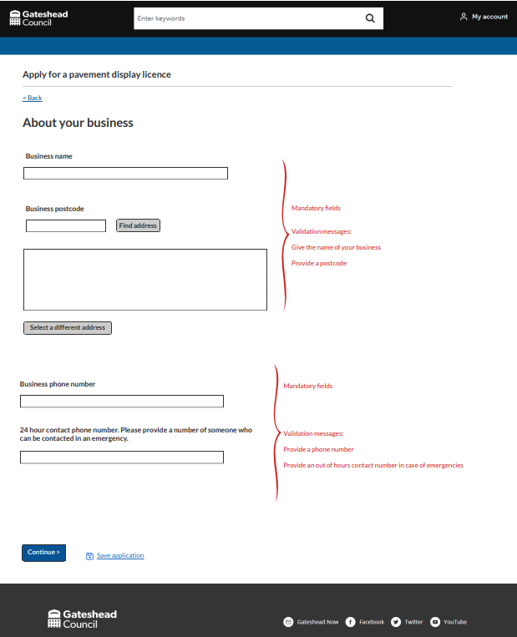
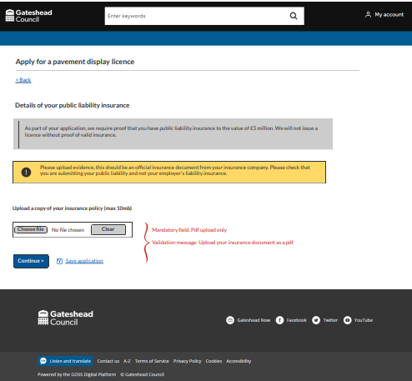
Pavement display licence wireframe
Developed wireframe for pavement display licence
New application form so businesses can be compliant with displaying goods on the highway and enforcement can take action against those who are unlicenced
For service review before development
Enforcement

Slide 13
Corporate

Slide 14
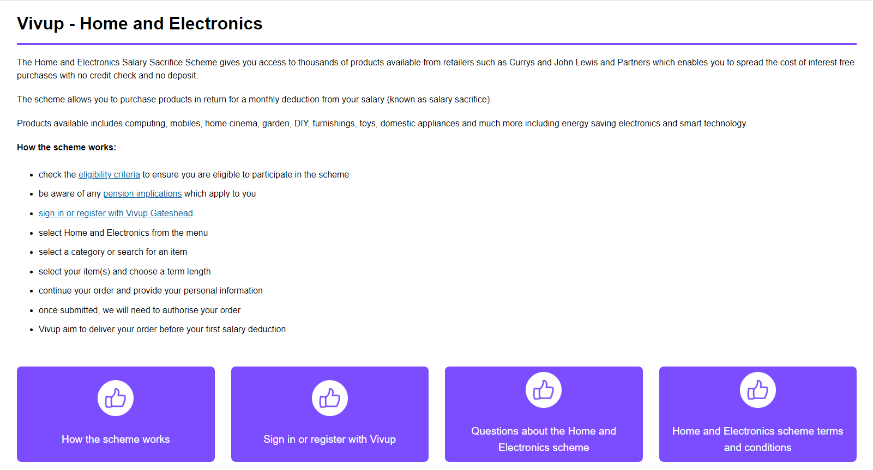
Employee benefits – new section for Home and Electronics scheme
We have a new Salary Sacrifice scheme for home and electronics purchases through Vivup
New area on the intranet created with details on how the scheme works
HR

Slide 15
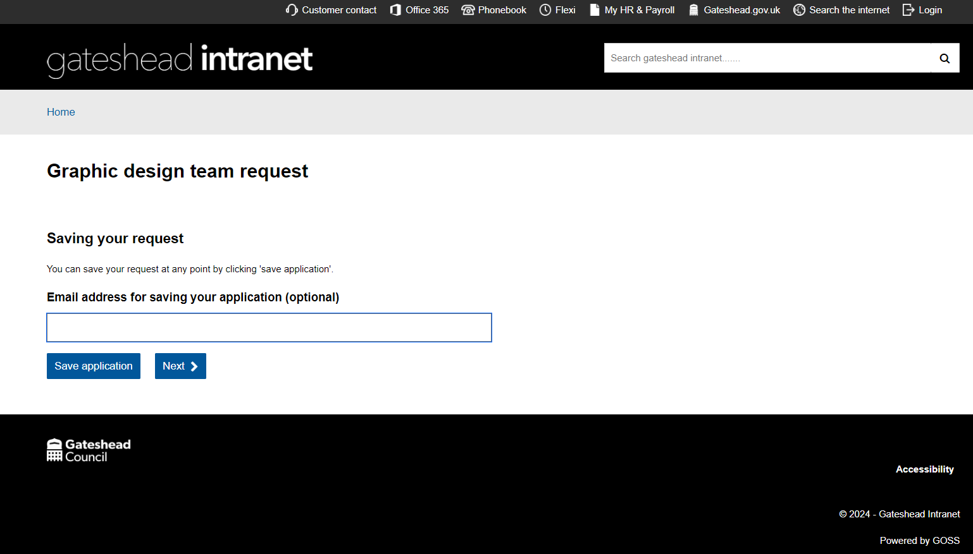
Graphics request form
Demo of graphic design team request form Graphic design request demo
Office of the chief executive

Slide 16
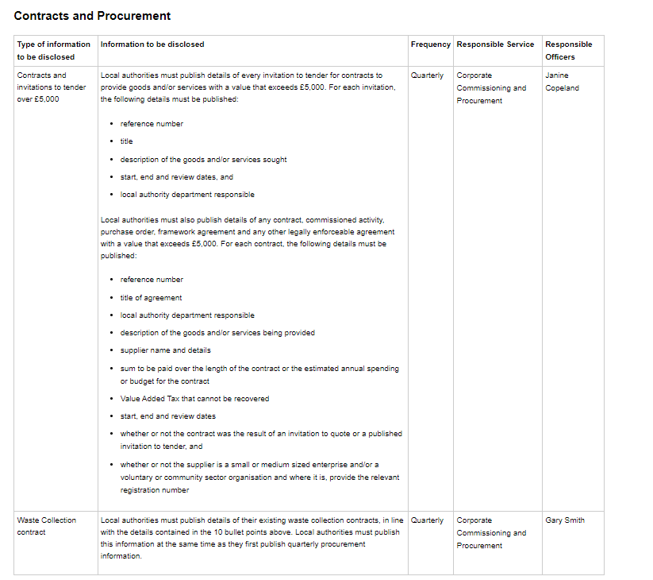
Transparency schedule of requirements
Transparency Code schedule of requirements added to intranet.
Following a review by audit that we needed to be compliant.
Full schedule now available with named officers for accountability.
Transparency Code - Schedule of requirements
Legal and democratic services

Slide 17
Create an e-petition
Demo of create an e-petition
Create an e-petition
Corporate Services and Governance

Slide 18
What's next
Change theme of safeguarding adults board website
Direct payment discovery report
Appeal a school place decision wireframe
Local offer card sort
Prep for newcastlegatesheadplan.org
Payments
What's next

Slide 19
Deployments

Slide 20
Thank you
That's all folks!

