Slide 1
Sprint 62 Show and Tell 18 December 2024
C Squad
Digital Team

Slide 2
Sprint goal
Go live with new theme for Safeguarding in Gateshead website

Slide 3
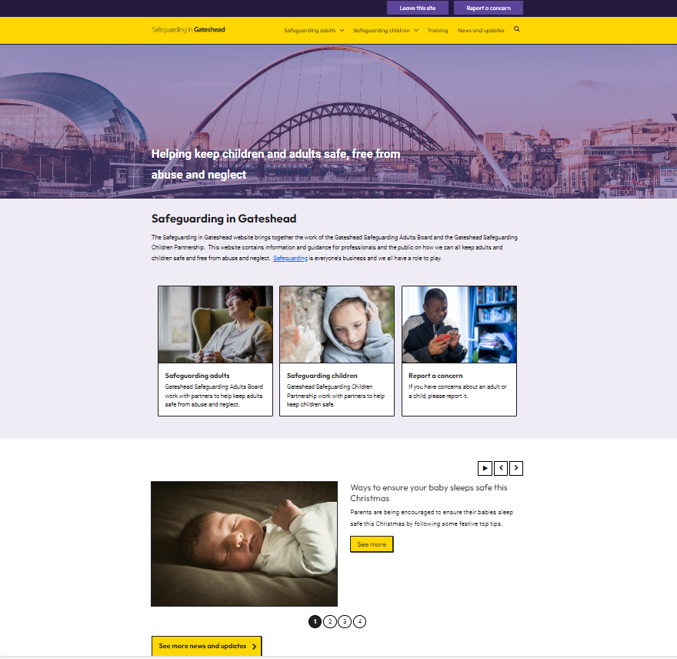
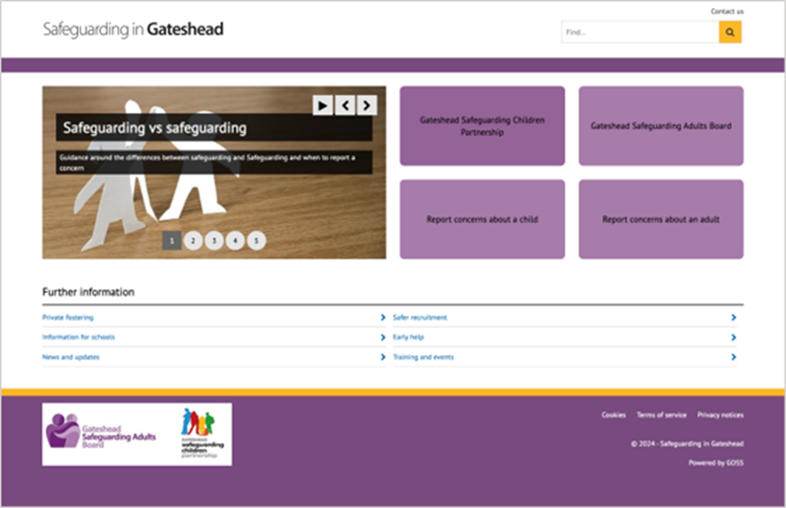
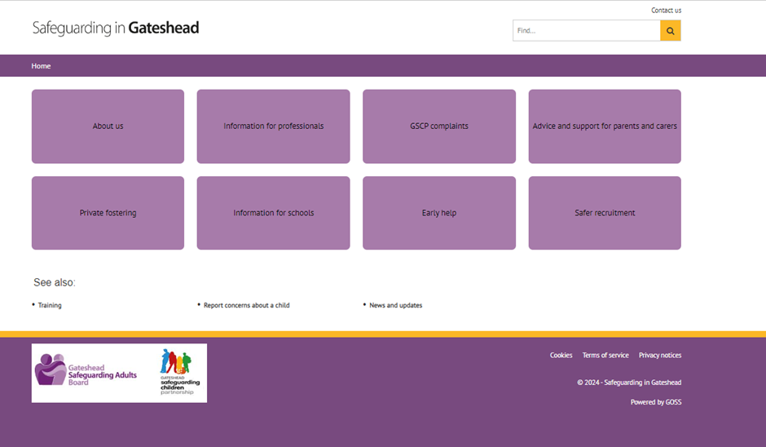
Safeguarding in Gateshead website theme change
Demo of new theme for website
Safeguarding

Slide 4
Financial assessments

Slide 5
Context – care cost calculator
Previously exploring idea of a care cost calculator
Now ready for design
However, the aim is for the calculator to link into the online financial assessment form – part of the same user journey
A higher uptake rate of online FA form is one of the metrics of success for calculator
Prompted a review of the financial assessment form
Financial assessments

Slide 6
Context – online financial assessment form
Online financial assessment form was launched in July 2023. We know previously uptake has been relatively poor and paper forms are still predominantly used.
Wanted to investigate to understand:
If digital uptake is still poor
If yes, why
If yes, what we could do about it
Financial assessments

Slide 7
Areas to explore
Data – what does the data tell us about the digital vs paper form ratio? Is there anything else the GOSS form data can tell us?
Usability – is the digital form itself a barrier? What is the user experience completing it?
Promotion – is this still seen as the biggest issue to uptake? If so, why isn’t it being promoted?
Financial assessments

Slide 8
Initial findings
Data - uptake rate still relatively poor - about 15% of all financial assessments forms have been digital
Usability - Hotjar presented some potential usability issues, alongside testing of the form ourselves
Promotion - still suggested as the main issue but crucially, we still don’t know why
Financial assessments

Slide 9
Next steps
Adult Social Care stakeholder engagement
Determine if there is user need for form improvements – e.g. hub and spoke
More data analysis:
Stakeholders might help us identify areas of interest
Form drop-off rate
Review impact of recent changes to process Financial Services have implemented
Financial assessments

Slide 10
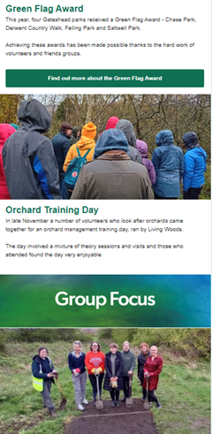
Request to develop a newsletter to help promote, inform and recognise work of countryside volunteers and friends groups. Template for first issue developed, communications supported with drafting and adding content on behalf of countryside team. Issued via Mailchimp to volunteers on 16 December. Next issue planned for spring 2025.
Countryside volunteers newsletter
Environment and Fleet Management

Slide 11
Development
Bulky waste
Removal of COVID questions and clarification around internal clearances
Update to bulky waste item list – removal of items
Change to allocation groups for bulky waste quote requests
Gambling licence payment form
Removal of validation on reference number
Update to Ref1 and Ref2 to ensure payments are processed correctly
Taxi licencing payments
Addition of Private Hire Operator – Annual fee
Schools PN payments
Addition of case detail to new case email
Development

Slide 12
Development
Standard payments
Update to form to show Phone number below Email address for consistency
Creation of four new enforcement payment types
Household duty of care - Household Duty of Care payment - Gateshead Council
Failure to produce waste documents
Failure to produce authority to transport waste
Miscellaneous enforcement payments
Variable payments
Five payments that have different payment amounts based on payment periods
Flytipping - Enforcement flytipping payment - Gateshead Council
Littering
Failure to comply with a waste receptacles notice
Failure to comply with a Community Protection Notice – Enforcement
Failure to comply with a Community Protection Notice – Private Sector Housing
Development

Slide 13
Coming next……
Christmas arrangements
Microsoft Clarity
Mobile Elevated Working Platforms (MEWPs)
Direct Payment report and content work
Coming next

Slide 14
No Deployments until 06/01/25

Slide 15
Thank you
That's all folks!

